Slide 1
Balanced diet
A balanced diet shall include a variety of foods providing appropriate calorie and nutrients. The energy intake required varies with age, height, body weight and physical activity.
The Food Pyramid is a useful practical guide for attaining a balanced diet.
Carbohydrates, proteins, fats, minerals, vitamins and dietary fibre are essential nutrients.

Slide 2
Recommended daily intake
World Health Organization (WHO) and Food and Agriculture Organization of the United Nations recommend that at least 55% of daily energy intake should come from carbohydrates, while 10% to 15% of daily energy intake should come from proteins. Daily fat intake should be limited to 15% to 30% of the total daily energy and saturated fats limited to less than 10%. Cholesterol intake should be limited to 300mg per day, and not more than 5g of salt should be consumed per day.
Nutrients | Daily recommendation
Carbohydrates | at least 55% of daily energy
Proteins | 10% to 15% of daily energy
Total fats | be limited to 15% to 30% of daily energy
Saturated fats | limited to less than 10% of daily energy
Cholesterol | limited to 300mg
Salt | not more than 5g
Source: World Health Organization

Slide 3
Recommended daily intake for fruits and vegetables
Adequate amounts of fruits and vegetables intake is an essential component of healthy eating.
WHO recommends a daily intake of at least 400 grams of fruits and vegetables (about 5 servings of fruits and vegetables) for the prevention of chronic diseases such as heart diseases, hypertension, cerebrovascular diseases, diabetes and certain cancers.

Slide 4
Average weight of common fruits
Fruits / vegetables | Average weight in gram
Apple with skin | 138
Banana without skin | 118
Orange without skin | 131
Pear without skin | 166
Kiwi fruit with skin | 77

Slide 5
Nutritional needs and dietary requirements
Various groups of people have different nutritional needs and dietary requirements which includes:
infants
toddlers
adolescents
adults
the elderly

Slide 6
Nutritional needs of infants
Concerns
During infancy through childhood, nutrition plays a critical role in promoting optimal growth and development, strengthening the immune system, and enhancing social and cognitive ability.

Slide 7
Nutritional needs of infants
Points to note
The primary food for infants during the first 12 months is either breast milk or iron-fortified formula. In addition to providing nutrients, breast milk also contains antibodies that offer immunological protection.
Exclusive breastfeeding is recommended by World Health Organization (WHO) that up to 6 months of age, with continued breastfeeding along with appropriate complementary solid foods such as rice cereal up to two years of age or beyond.

Slide 8
Nutritional needs of toddlers
Concern
Nutrition and healthy food play a very important role during the stages for growth and development and plenty of nutrients and energy are needed.

Slide 9
Nutritional needs of toddlers
Points to note
Toddlers are learning to feed themselves and try new foods one at a time and in small amounts. They should eat a variety of foods from all of the food groups.
The nutrients that are especially important to toddlers are iron, calcium and vitamin D.
Lack of iron in toddlers can cause fatigue and affect their behaviour, mood and attention span. A balanced diet with adequate consumption of iron-rich foods such as lean meat, enriched breads and cereal is important to toddlers.
Dairy products provide calcium and vitamin D to build strong bones and teeth. Two servings of dairy foods every day is recommended. Whole milk is recommended in toddlers unless body weight is an issue, as it provides the dietary fats needed for normal growth and brain development.

Slide 10
Nutritional needs of toddlers
Points to note
Sources of calcium include milk and dairy products, calcium-fortified soya beverages, calcium-fortified juices, fortified breads and cereals and dark green vegetables like broccoli, bok choy, and kale. Foods like eggs, butter and salmon are good sources of vitamin D.
About 50 grams (two ounces) equivalents of protein is required. Sources of high biological protein are meat, poultry, seafood, beans and peas, eggs, soya bean products, nuts and seeds.
Children at age 2 and up should adopt a healthy eating habit similar to adults.

Slide 11
Nutritional needs of adolescents
Concerns
Growth is very rapid during adolescence. During adolescent growth spur, both boys and girls have increased nutritional needs for carbohydrates and fats, protein, iron and calcium.
Inadequate calcium intake can set the stage for development of osteoporosis later in life.

Slide 12
Nutritional needs of adolescents
Points to note
High intake of fruits, vegetables, and calcium-rich, protein-rich and iron-rich foods. Iron is particularly important for teenage girls as they need additional iron to replace their monthly blood loss during menstruation.
Moderate intake of high-fat foods, especially snacks and junk foods. Preferable snacks include fresh fruits, raw vegetables and yoghurt.
Low consumption of soft-drinks.

Slide 13
Nutritional needs of adults
Concern
During adulthood the general energy expenditure decreases gradually and this leads to reduced caloric requirements. Failure to adjust levels of dietary intake and physical activity to compensate for this decline in energy expenditure has the potential to promote excess gains of body weight and fat.
Points to note
Balancing energy intake and physical activity to maintain healthy body weight.
Reduction in dietary fat and changes in the type of fat can reduce blood cholesterol.
Aim for 5 servings of fruits and vegetables a day.
Choose whole grains such as brown rice and oatmeal to increase fibre intake.

Slide 14
Nutritional needs of the elderly
Concerns
Although the energy needs of the elderly generally decline, requirements for most nutrients, except vitamin A, are equal to or greater than those of younger adults.
Nutrition is important in the prevention and treatment of chronic diseases including osteoporosis, coronary heart disease, and hypertension.
Multiple medications required by older adults may interfere with nutritional status and increase overall health risks.

Slide 15
Nutritional needs of the elderly
Points to note
Choose a variety of fibre-rich fruits, vegetables and whole grains to provide sufficient antioxidants, vitamins, minerals and fibre.
Adequate intake of water from food and beverages to prevent dehydration.
Regular consumption of proteins with high biological value such as lean meats, eggs and soya bean products to maintain lean body mass.
1-2 servings of low-fat dairy products per day to provide adequate calcium for prevention and delay of the progression of osteoporosis.
Pick foods that are low in cholesterol and fat. Reduce sodium intake to lower the risk of high blood pressure.

Slide 16
Eating disorder
Eating disorder is present when a person experiences severe disturbances in eating behaviour, such as extreme reduction of food intake or extreme overeating, or feelings of extreme distress or concern about body weight or shape.
Eating disorders are very complex, the biological, behavioural and social underpinnings of these illnesses remain elusive.
The two main types of eating disorders are anorexia nervosa and bulimia nervosa.

Slide 17
Case Categories of Eating disorder 2012-13
Source: Hong Kong Eating Disorders Association

Slide 18
Source: Hong Kong Eating Disorders Association

Slide 19
Anorexia Nervosa
Many people with anorexia see themselves as overweight, even when they are starved or are clearly malnourished. Eating, food and weight control become obsessions.

Slide 20
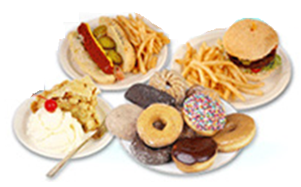
Bulimia Nervosa
Bulimia nervosa is characterised by binge-eating which means recurrent and frequent episodes of eating unusually large amounts of food, and feeling a lack of control over the eating.

Slide 21
Food and Drug Regulation Guidelines - Genetically Modified (GM) Food
In Hong Kong, there is no lawful regulation on the sales and labelling system of genetically modified food.
A set of guidelines for voluntary labelling has been issued in 2006 by the Centre for Food Safety for trade reference to enhance consumers’ knowledge and right to make an informed choice on GM food.
GM food refers to food or food ingredient that is, or is derived from, an organism in which genetic material has been modified using modern biotechnology.
Nowadays, scientists are able to identify and modify some genes controlling specific characteristics of organisms by means of modern biotechnology.
Source: Centre for Food Safety

Slide 22
Food and Drug Regulation Guidelines - Genetically Modified (GM) Food
The regulatory approaches on GM food labelling vary in different countries and areas, and can be broadly classified as voluntary or mandatory.
In Hong Kong GM food labelling is voluntary. The Centre for Food Safety (CFS) has issued a set of guidelines for labelling of GM food to facilitate the trade to provide truthful information on GM food.
Although the guidelines are advisory in nature and have no legal effect, the government encourages the trade to adopt these guidelines to standardise the information for the consumers.
Source: Centre for Food Safety

Slide 23
What types of GM food are recommended
to be labelled ?
Prepackaged food items with 5% or more GM materials in their respective food ingredient(s) are recommended to be labelled as “genetically modified”.
Additional declaration on the food label is recommended when significant modifications that have taken place under the following conditions:
(a) the composition or nutritional value is significantly different from that of its conventional counterpart;
(b) the level of anti-nutritional factors or natural toxicants is significantly different from those in its conventional counterpart;
(c) the presence of an allergen that is not found in its conventional counterpart;
(d) the intended use of the food is significantly different from that of its conventional counterpart; or
(e) an animal gene has been introduced into food of plant origin.
Source: Centre for Food Safety

Slide 24
How does the label of GM food look like?
Food items with 5% or more GM materials in their respective food ingredient(s) are recommended to be labelled as “genetically modified” in brackets following the name of the food/food ingredient in the “List of Ingredients” or in a prominently displayed footnote to the “List of Ingredients”.
Note:
If both the English and Chinese Languages are used in the labelling of prepackaged food, the name of the food and the list of ingredients shall appear in both languages.
Negative labelling such as “GM free” is not recommended for food without GM counterparts, as it would be misleading to consumers.
Source: Centre for Food Safety

Slide 25
Labelling of non-GM food products in the market

Slide 26
The Food and Drugs (Composition and Labelling) (Amendment) Regulation
The Food and Drugs (Composition and Labelling) (Amendment) Regulation 2004 (the Amendment Regulation) was enacted on 9 July 2004.
To assist the trade to adapt to the changes brought forward by the Amendment Regulation in particular on the following aspects -
(a) Labelling of allergenic substances;
(b) Labelling of food additives; and
(c) Labelling of date format.
Source: Centre for Food Safety

Slide 27
Labelling of allergenic substances
Allergies affect the lives of millions of people around the world. Food allergy is a reaction of the body’s immune system to some substances or ingredients in food. For this reason, the labelling of allergenic substances in food is important and essential for susceptible individuals. The presence of allergens in food can be potentially life-threatening.
Currently, there is no cure for food allergy. The only successful method to manage food allergy is avoidance of foods containing the allergen. In such cases, individuals must rely on accurate food labelling.
Source: Centre for Food Safety

Slide 28
Labelling of allergenic substances
Under this regulation, declaration is required if a food consists of or contains any of the following substances-
(i) cereals containing gluten (namely wheat, rye, barley, oats, spelt, their hybridized strains and their products);
(ii) crustacea and crustacean products;
(iii) eggs and egg products;
(iv) fish and fish products;
(v) peanuts, soyabeans and their products;
(vi) milk and milk products (including lactose);
(vii) tree nuts and nut products;
(viii) sulphite in a concentration of 10 parts per million or more, the functional class of the sulphite and its name shall be specified in the list of ingredients.
Source: Centre for Food Safety

Slide 29
Labelling of allergenic substances
The eight substances listed above have been identified to be responsible for 90% of the food allergic reactions.
Some of these items such as milk and eggs, are often used as food ingredients in formulated products. For food safety purpose, they are required to be indicated in the list of ingredients if present in the final food products under the Regulations.
The following examples are considered acceptable:
"Wheat"; "Rye"; "Flour (cereals containing gluten)"; "Egg";
"Shrimp (Crustacean)"; "Crab meat (Crustacean products)"; "Fish";
"Mackerel (fish)"; "Fish meat"; "Peanuts"; "soya sauce (contains soyabeans)"; "Flavour and flavouring (contains peanut)"; "Milk"; "Whey protein (milk product)"
Source: Centre for Food Safety

Slide 30
Labelling of allergenic substances containing food products in the market

Slide 31
Labelling of allergenic substances containing food products in the market

Slide 32
Labelling of food additives
This regulation requires that an additive constituting one of the ingredients of a prepackaged food shall be listed by both its functional class and its specific name or its identification number under the International Numbering System (INS) for Food Additives.

Slide 33
Labelling of food additives containing food products in the market

Slide 34
Labelling of date format
Indication of durability in Arabic numerals is not required to be expressed in the strict order of a day, a month and a year. Instead, the day, month and year can appear in any order.
The day shall be indicated by the words "DD", "dd", "D" or "d" in English lettering and "日" in Chinese character; the month shall be indicated by the words "MM", "mm", "M" or "m" in English lettering and "月" in Chinese character; and the year shall be indicated by the words "YY", "yy", "Y" or "y" in English lettering and "年" in Chinese character.

Slide 35
Labelling of date format
The following examples are considered acceptable:
(a) 年Y 月M 日D ;
(b) Y年 D日 M月 ;
(c) 日dd 月mm 年yy;
(d) y年 m月 d日；
(e) Y年 M月 D日；
(f) DD日 MM月 YY年.

Slide 36
Labelling of date format

Slide 37
Principles in food costing and budgeting
As food prices increase, the budget is needed to manage food expenditure and keep food costs down when making a purchase.
Eat at home more often as dining out is often more expensive.
Plan ahead for meals on the following days, week, month as meal planning can help save time and money and also avoid impulse buying.
Portion control and do not over-purchase and over-cook.
Skip the cake and snacks but replace with fresh fruits in between meals.
Compare prices and look for good deals and sales at local supermarket or grocery store.
Waste less with smaller servings.
Use leftover food by adding new fruits and vegetables to create new dish for the next day.

Slide 38
Keep meats and seafood costs down
The biggest expense in the food budget is meat. A money-saving and nutrition conscious step would be to reduce daily meat intake to no more than 190 - 230 grams (5 - 6 taels) per person.
The tougher cuts of meat are often less expensive but just as nutritious as tender cuts of meat and less fatty. In addition, it is generally more economical to buy the entire piece of meat and cut it up than buying the pre-cut or the marinated meat.
The non-meat protein substitutes provide inexpensive protein options. They include dried beans including soyabeans and bean curd (tofu), peas and lentils. These legumes are high in complex carbohydrates and fibre and are the alternative source of dietary protein from plants.

Slide 39
Keep meats and seafood costs down
Eggs are another nutritious and inexpensive protein source.
Frozen or canned fish is often less expensive than fresh fish. If fresh fish happens to be on sale, buy some and keep in the freezer.
Lobster, crabs and shrimp are usually more costly than other protein sources so they are best saved for special occasions.

Slide 40
Keep fruits and vegetables costs down
Buy seasonally: although most fresh vegetables and fruits are available year-round, seasonal produce is often less expensive and also often tastes better.
Buy locally: to reduce costs in transportation and get more fresh products.
Use frozen produce: frozen vegetables and fruits are usually less expensive than fresh one. They are pre-washed and usually flash frozen within hours of being picked, which reserves most of the nutrients.
Decrease waste: store fresh produce appropriately e.g. in the fridge to extend the shelf life and use up the vegetables left over to make soup.

Slide 41
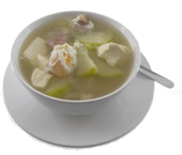
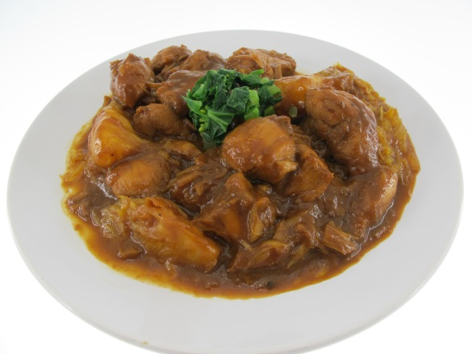
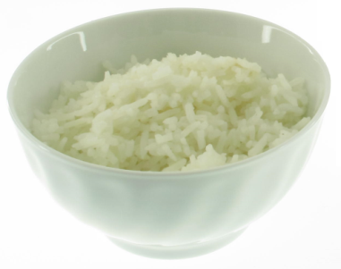
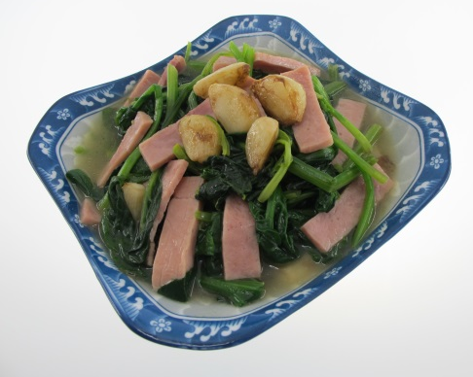
Meal pattern of a three-course Chinese meal (1)
Salty Egg Hairy Melon Soup
Stewed Beef with Potato
Starchy food, usually rice
Stir Fried Spinach with Ham
Soup + 2 main dishes + rice

Slide 42
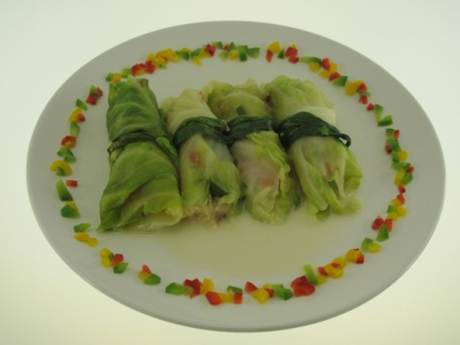
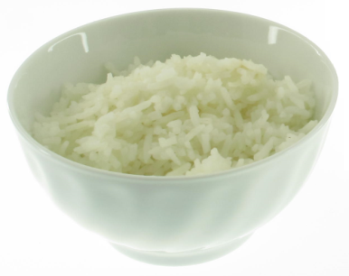
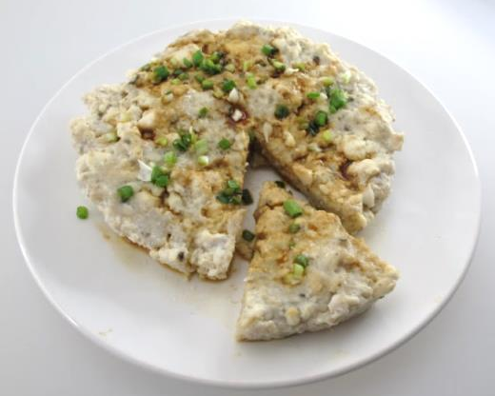
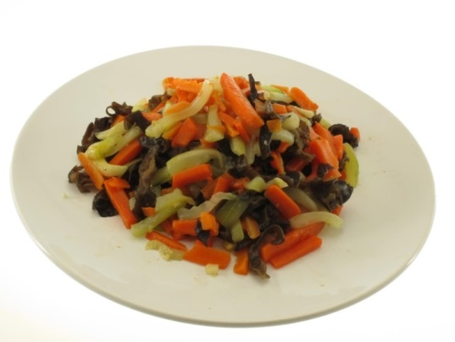
Meal pattern of a three-course Chinese meal (2)
Cabbage Roll with Pork
Starchy food, usually rice
Steamed Bean Curd with Minced Fish
Fried Assorted Vegetables
3 main dishes + rice

Slide 43
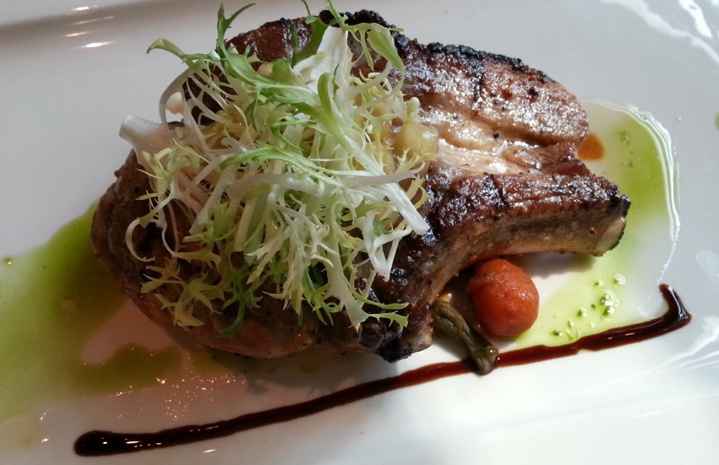
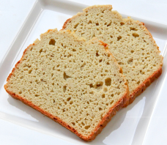
Meal pattern of a three-course Western meal
Cream of Pumpkin Soup
Fruit Jelly
Pork Chop served with Side Vegetables
Bread
Soup + Main Course (served with side vegetables) + dessert + starchy food as accompaniment

Slide 44
Reducing waste saves costs
Check the ingredients in the fridge and cupboards before writing a shopping list for just the extras needed.
Buy what you need. Take the shopping list during food purchasing to avoid impulse buying.
Store food in fridge at between 1 and 5 ºC for maximum freshness and longevity.
Use excess foods like over-ripe fruits for making smoothies and wilted vegetables for making soup.
Use up the leftovers instead of scraping them into the bin. Any leftovers can be cooled, stored in the fridge and used another day.
Portion control and serve small amounts of food in each meal.

Slide 45
Consideration when planning family meals (1)
Age of individual family members –
young children have very different dietary needs to those of older family members
during periods of rapid growth, children and teenagers need additional nutrients for growth including protein and calcium
Activity –
family members who are very active will have higher energy needs than those who are less active
Gender –
males utilise more energy and nutrients in general while females need higher levels of iron intake as iron is lost during menstruation

Slide 46
Consideration when planning family meals (2)
Individual likes and dislikes of family members
Budget available and time required to purchase and prepare foods and meals
Skills, knowledge and experience of the person preparing meals
Cooking facilities available to prepare the meal
Season of the year –
lighter foods are eaten in summer while winters foods are usually heavier and served hot
Variety in colour, texture, flavour and presentation of meals.

Slide 47
Planning meals for children
Offer simple foods to children so they can easily identify what they are eating.
Offer at least one colourful food in every meal, such as corn kernels.
Provide some soft or moist food that is easy to chew at each meal. A crisp or chewy food is also important to develop chewing skills.
Avoid strong-flavoured and highly salted foods as children have more taste buds than adults so these foods may taste too strong to them.
Provide good sources of nutrients including iron, vitamin E, potassium, fibre and calcium.

Slide 48
Planning meals for adolescents / teenagers
Emphasise complex carbohydrates containing fibre, such as brown rice, whole-grain breads and cereals, fruits and vegetables.
Dairy products should be included daily for sufficient calcium provision. Low fat varieties are preferred.
Nutritious snack choices in between main meals may include fresh fruits, quick breads, crackers, yoghurt or cereal bars.
Emphasise on nutritious breakfast such as cereal topped with fresh fruits, bread with cheese and tomato, noodles with lean meat and green vegetables in soup.
Teenage boys need more energy, protein, magnesium and zinc for muscle and bone development and girls need more iron due to the onset of menstruation.

Slide 49
Planning meals for the elderly
As the elderly have decreased energy needs and therefore eat less, their choices must be more nutrient-dense than those for other groups of people.
Offer moderately sized meals or even half portions.
Emphasise high-fibre foods such as fruits, vegetables and whole grains.
Dairy products such as milk and yoghurt are important sources of calcium, vitamin D, protein, potassium and vitamin B12.
Use herbs and spices to make foods more tasty and flavourful instead of salt.
Fluid intake to the elderly is crucial as they might have diminished sensitivity to dehydrate.
If chewing is a problem, softer foods can be chosen to provide a well-balanced diet.

Slide 50
Planning meals for people on weight management
Energy intake should not be overly restricted. Normal practice is to reduce 500 kcal each day and this amount to about 0.45kg (1 pound) lost in a week, in any case, energy intake should not be restricted to below 1200 kcal because it is difficult to get adequate nutrients at this level. A progressive weight loss of 0.45kg to 0.9kg (1 to 2 pounds) a week is considered safe.
Fat should be restricted to about 30% or less of total energy intake, protein to 15% and carbohydrates to 55%. During weight loss, attention should be given to maintaining an adequate intake of vitamins and minerals.
Variety, balance and moderation are crucial to satisfying all nutritional needs.

Slide 51
Planning meals for people on weight management
Food group | Instead of | Replace with
Meat group | Fatty beef like ribs and brisket | Lean beef like loin with fat trimmed
 | Fatty pork like spareribs | Pork tenderloin with fat trimmed
 | Whole eggs | Egg whites
 | Oil-packed canned fish | Water-packed canned fish
Cereal and grains | Pasta with white sauce | Pasta with tomato sauce
 | White rice | Brown or red rice
Dairy products | Whole milk | Low fat (1%) or fat free milk
 | Evaporated milk | Skimmed evaporated milk or low fat milk
 | Ice cream | Low fat yoghurt
 | Regular cottage cheese | Low-fat cottage cheese

Slide 52
Planning meals for celebration
Food is not only eaten to satisfy the hunger, but also to satisfy the social and emotional needs. When sharing food with others, love, pride, friendship and a sense of belonging are also developed.
People celebrate special events by feasting on special foods and dishes.
When planning meals for celebration, consider the age group of the guests, number of guests and the reason for celebration. Special arrangements may be needed for food preparation and table setting.

Slide 53
Principles in food preparation
Balance in colours, shapes, textures and flavours
Match overall portion size with the plate size
Balance the portion sizes of various items on the plate
Keep food off the rim of the plate
Make the garnish count
Keep it simple
Serve hot foods hot and on hot plates
Serve cold foods cold and on cold plates

Slide 54
Food presentation in buffet
A buffet should look lavish and plentiful. The appearance of an abundance of food beautifully laid out is exciting and stimulating to the appetite.
Points to consider:
A variety of colours
Height of foods on tray
Proper spacing between the trays

Slide 55
Development of creative recipes
A recipe is a formula with weighed/measured ingredients with specific cooking procedures.
Recipe development requires specific information such as:
Name of food item
Portion size and number of portions
Cooking time and preparation time
List of ingredients in order of use
Amount of each ingredient by weight, measure, or count
Cooking procedures
Serving and garnishing suggestions
Alternative ingredients
Optional ingredients

Slide 56
Development of creative recipes for meeting different needs
We can create our own recipes by modifying the cooking methods, ingredients used and even the meal presentation for meeting different needs such as:
Softer texture for the elderly
More colours for the children
Adding dietary fibre for general wellness
Reducing the amount of salt, sugar and fat
Using local ingredients for cuisine of other places
Baking or grilling instead of deep frying

Slide 57
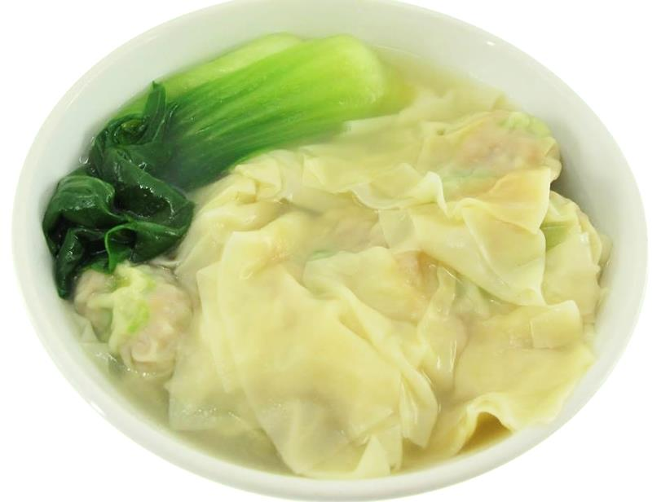
Examples of creative recipe
Oatmeal Wonton
This dish is easy to prepare and high in dietary fibre. It gives sense of fullness and also can serve as a side dish for noodles and as a snack.

Slide 58
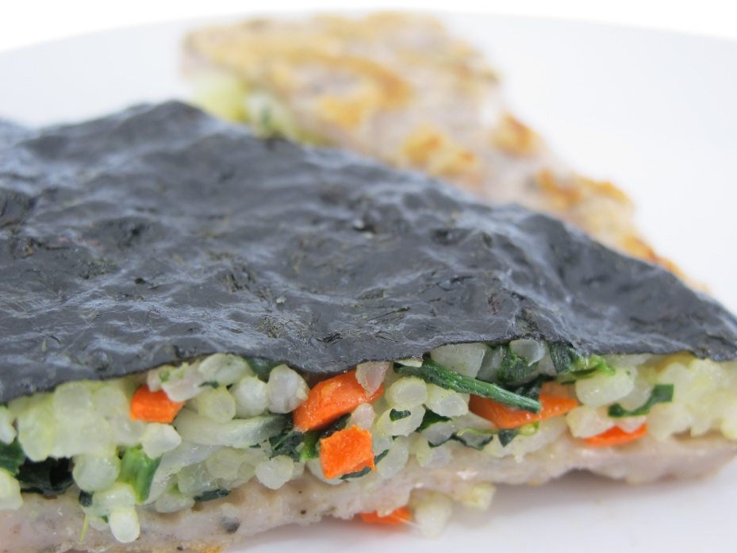
Examples of creative recipe
Rice Pizza
This dish is colourful and a good source of iodine from seaweed. It is suitable for children and the elderly as it is easy to chew.

Slide 59
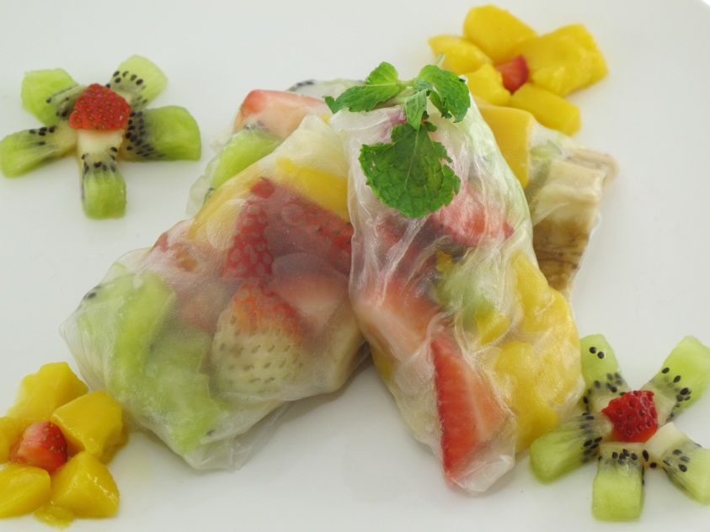
Examples of creative recipe
Tropical Fruits Rice Paper Rolls
This dish is colourful and includes a variety of fruits. It is high in vitamin C which is an antioxidant and improves iron absorption. It can be served as a snack.

Slide 60
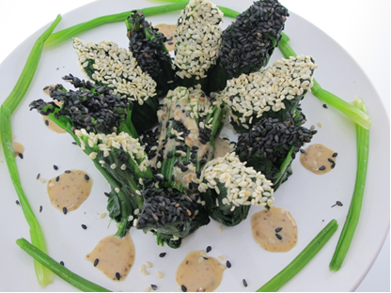
Examples of creative recipe
Sesame Spinach Rolls
This dish is high in folate and provides a good source of calcium and iron. It looks attractive and can be eaten as a cold dish.

Slide 61
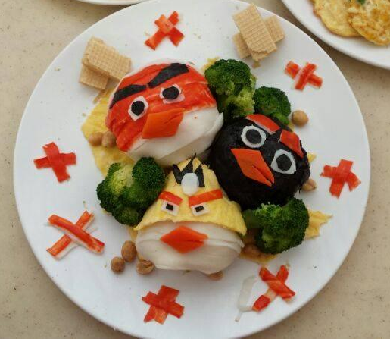
Examples of creative recipe
Angry Birds Rice Ball
This dish looks attractive to children. It has a lot of vegetables and provides excellent source of dietary fibre.

Slide 62
1) Suggested activity for fruits intake:
Some people think fruits are expensive. Try to do a market survey to see their costs. You may also compare the price with your favourite snacks.
Fruit | Servings/unit | cost | Cost per gram
e.g. apples | 3 medium (410 gram) | $12 | $0.03
Snacks | Servings/unit | cost | Cost per gram
e.g. CALBEE POTATO CHIPS-BBQ | 25 gram (1 small pack) | $4.3 | $0.17

Slide 63
2) Celebrations and foods
List two occasions in your family when special food is served.
Complete the following table
Type of celebration/occasion | Guests invited | Special foods eaten
e.g. Chinese New Year | 10 relatives | New year cake, wax-cured duck and Chinese sausage, Buddha's delight (羅漢齋)

Slide 64
3) Understanding food descriptions
Write down three favourite foods of yours. And for each food write down as many words as you can to describe its taste, texture, aroma and appearance.
Suggestions for the descriptive words
Taste | Texture | Aroma | Appearance
Bland/plain | Doughy | Strong | Golden
Sweet | Soft | Mild | Colourful
Sour | Hard | Fruity | Puffed
Bitter | Crisp | Yeasty | Dull
Salty | Crunchy | Spicy | Even-shaped
Spicy | Creamy | Delicious | Well-risen
Hot | Firm |  | Over-cooked
Strong | Lumpy |  | Clear
Rich | Sticky |  | Contrasting
Tangy | Smooth |  | Speckled

Slide 65
Suggested assessment 1:
Using the metric measuring tools, calculate equivalent or equal measures for the followings:
From | To
1 tablespoon | ________ millilitres
1 teaspoon | ________ millilitres
½ teaspoon | ________ millilitres
¼ teaspoon | ________ millilitres
1 tablespoon | ________ teaspoon
1 cup | ________ millilitres
1 litre | ________ cups
1 kilogram | ________ grams
1 ounce | ________ grams
1 pound | ________ grams

Slide 66
Answer for suggested assessment 1:
Using the metric measuring tools, calculate equivalent or equal measures for the followings:
From | To
1 tablespoon | 15 millilitres
1 teaspoon | 5 millilitres
½ teaspoon | 2.5 millilitres
¼ teaspoon | 1.25 millilitres
1 tablespoon | 3 teaspoon
1 cup | 237 millilitres
1 litre | 4.2 cups
1 kilogram | 1000 grams
1 ounce | 28 grams
1 pound | 454 grams

Slide 67
Suggested assessment 2:
Planning family meals
Use a range of recipe books, magazines or the internet to research recipes suitable for family meals.
Write down the name and a brief description of each recipe. Each student should collect about 10 different recipes.
Make up a class list of all of the recipes.
Group these recipes under the headings of ‘main dish’, ‘side dish’ and ‘dessert’.

Slide 68
Glossary:
Adequate diet: a diet that provides enough energy, essential nutrients and dietary fibre to keep a person healthy
Anorexia Nervosa: an eating disorder identified by an obsession for thinness
Binge Eating: eating a large amount of food in a short period of time together with a loss of self-control
Bulimia Nervosa: an eating disorder identified by cycles of binge eating and purging. Binging (eating large amounts of food) is followed by purging (vomiting, laxative use) to get rid of the unwanted food.
Complementary Feeding: the process starting when breast milk alone is no longer sufficient to meet the nutritional requirements of infants and therefore other foods and liquids are needed along with breast milk.

Slide 69
Glossary:
Food allergens: substances (such as proteins) in food that cause food allergies.
Food Allergies: food allergy is an immune system reaction to a substance in food, usually a protein.
High quality protein: also known as ‘complete proteins’. These proteins supply all of the essential amino acids the body needs. Essential amino acids are those that the body cannot produce by itself so it needs to get them from food.
Purging: attempt to get rid of unwanted food in the body by vomiting, excessive exercise, fasting or by abusing diet pills or laxatives.
Sulphites: food additives commonly found in dried fruit, canned vegetables, jam, wine and beer.

