Slide 1


If our diet only contains one kind of food, how much of it should be eaten to meet the daily requirement?

Slide 2
Dietary fibre

Slide 3
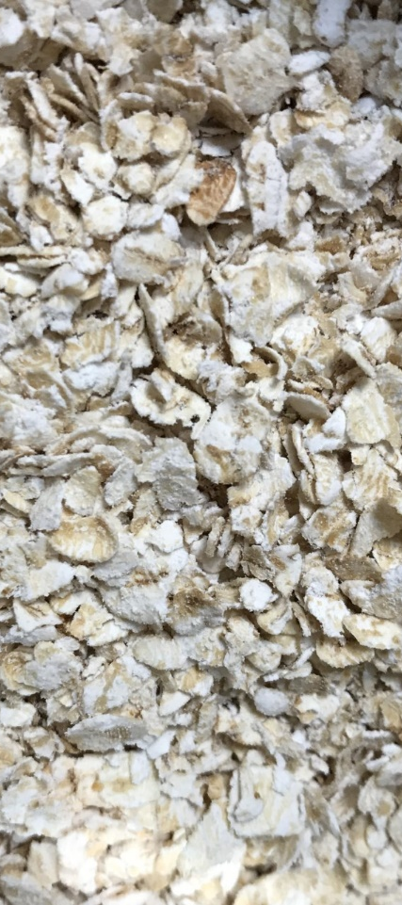
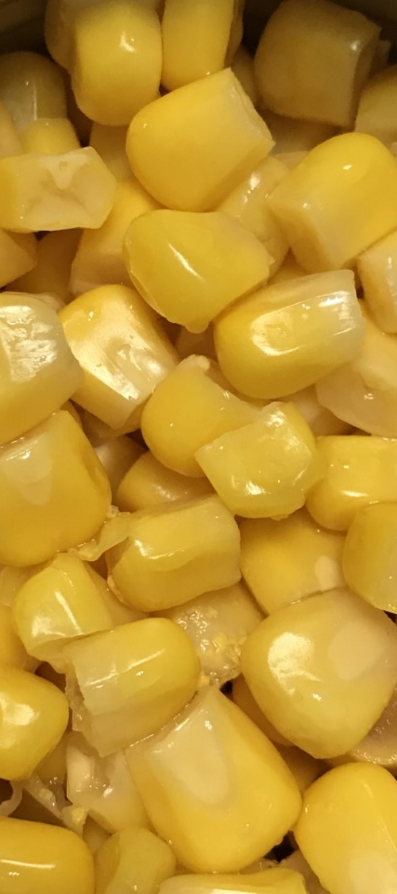
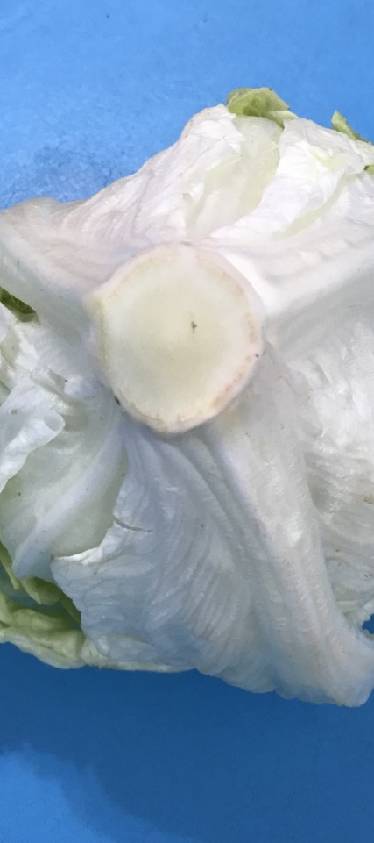
How much of these should be eaten? oatmeal, corn kernels, lettuce

Slide 4
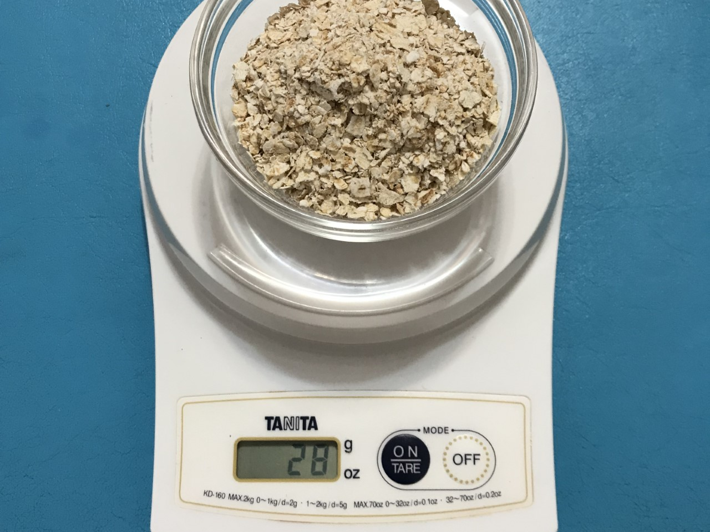
One serving of oatmeal = 28 grams (approximately ¼ cup), provides 2.8 g of dietary fibre
100 grams of instant, dry, oatmeal contain 10 grams of dietary fibre

Slide 5
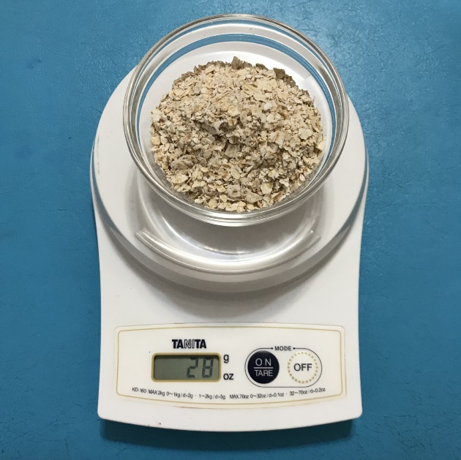
Reference value of dietary fibre is not less than 25g per day*
1 serving 2.8 grams dietary fibre | 2 servings 5.6 grams dietary fibre | 3 servings 8.4 grams dietary fibre | 4 servings 11.2 grams dietary fibre | 5 servings 14 grams dietary fibre
6 servings 16.8 grams dietary fibre | 7 servings 19.6 grams dietary fibre | 8 servings 22.4 grams dietary fibre | 8.9 serving 25 grams dietary fibre
250 g oatmeal
= 8.9 servings
= 2¼ cups
= 25 grams dietary fibre
*Source: Centre for Health Protection, Department of Health

Slide 6
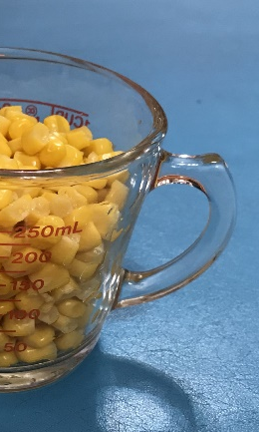
One serving of corn kernels = approximately ½ cup (82 grams), provides 1.64 g of dietary fibre
100 grams of corn kernels contain 2 grams of dietary fibre

Slide 7

Reference value of dietary fibre is not less than 25g per day*
1,250 g corn kernel
= 15.2 servings
= 7.6 cups
= 25 grams dietary fibre
*Source: Centre for Health Protection, Department of Health

Slide 8
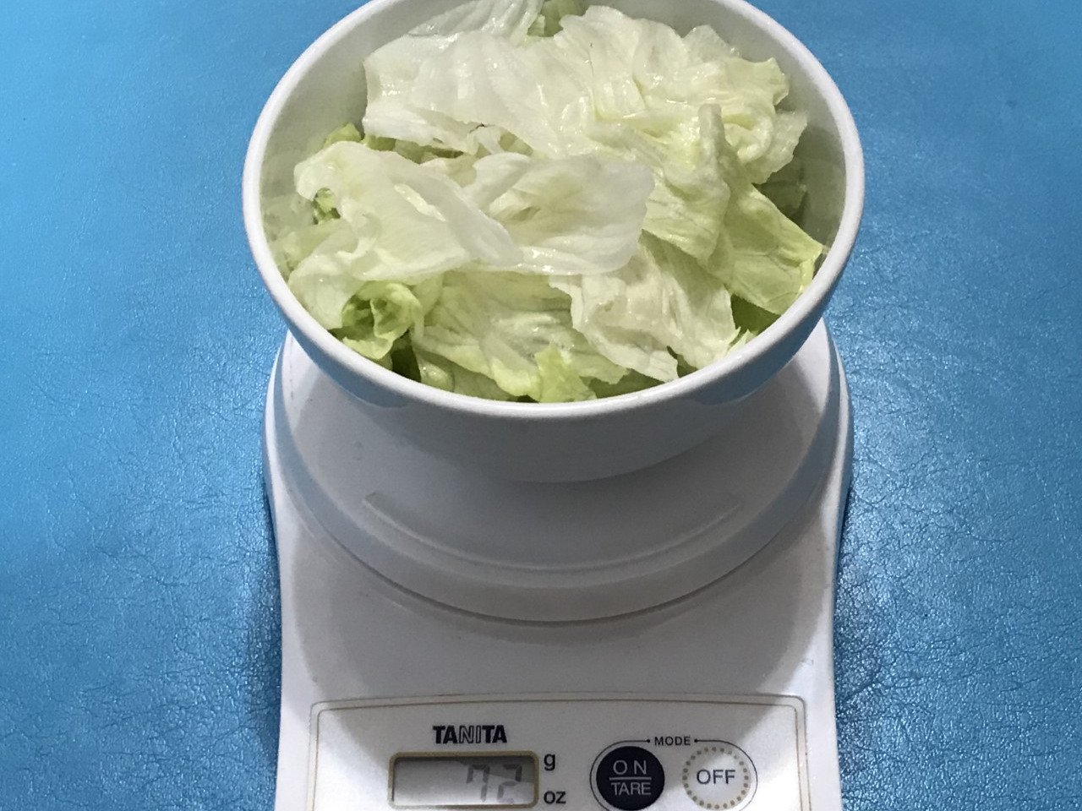
One serving of lettuce = 1 bowl (approximately 72 grams), provides 0.86 g of dietary fibre
100 grams of lettuce contain 1.2 grams of dietary fibre

Slide 9
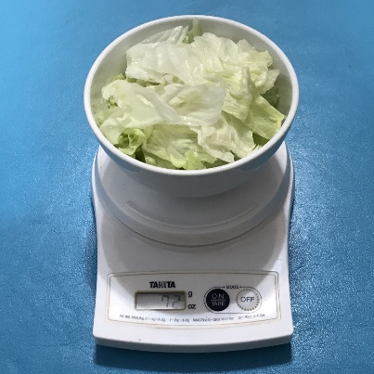
Reference value of dietary fibre is not less than 25g per day*
2,083 g lettuce
= 28.9 servings
= 28.9 bowls
= 25 grams dietary fibre
*Source: Centre for Health Protection, Department of Health

Slide 10

Reference value of dietary fibre is not less than 25g per day
Also equals to
3.86 heads of lettuce
(1 head = 539 grams)

Slide 11
Vitamin C

Slide 12
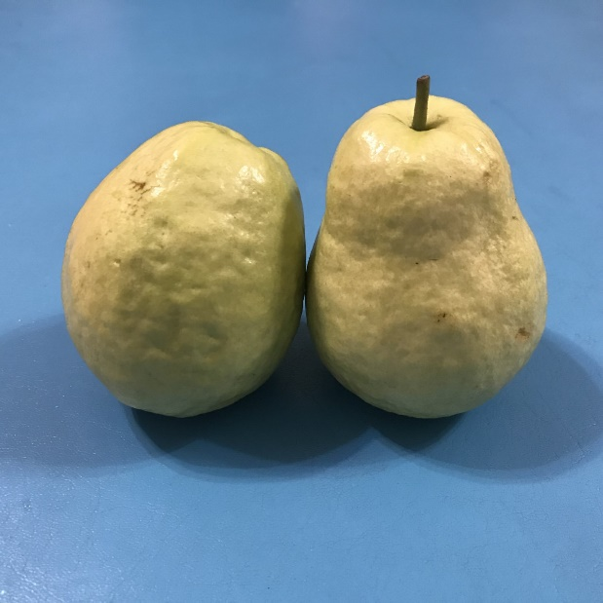
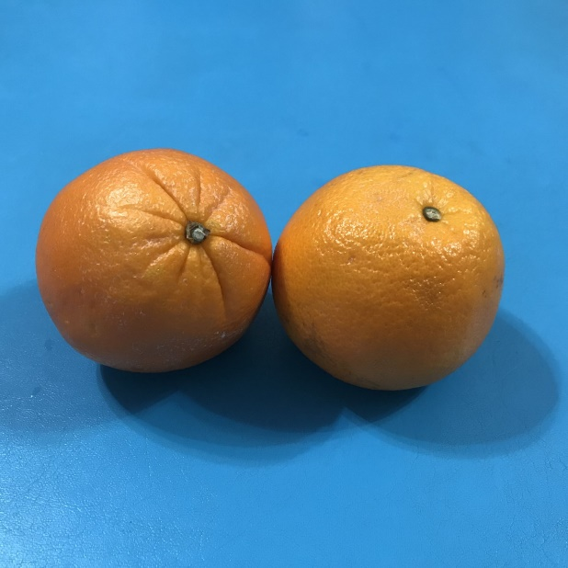
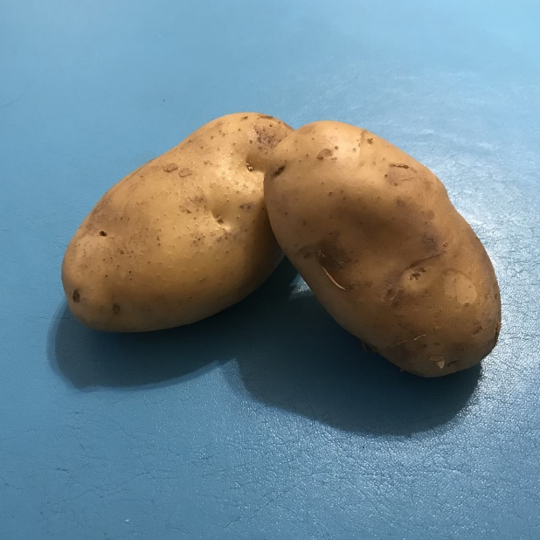
How much of these should be eaten? guava, orange, potato

Slide 13
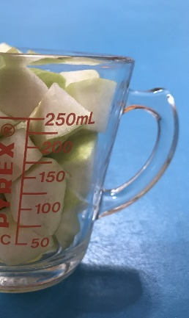
One serving of guava = ½ cup (approximately 82 grams), provides 187 mg of vitamin C
100 grams of guava contain 228 mg of vitamin C

Slide 14
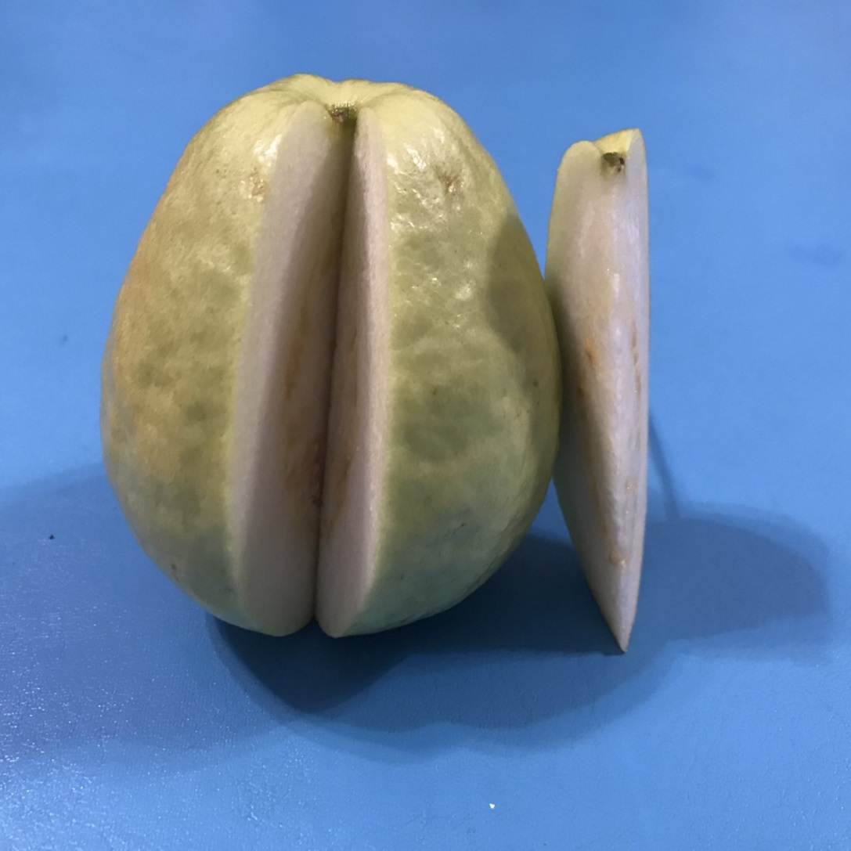
Reference Nutrient Intakes (RNI)** of vitamin C for adults per day is 40 mg
17.5 grams of guava
= 0.2 serving
= 1/13 guava
(1 guava = 230 grams)
= 40 milligrams vitamin C
** Source: British Nutrition Foundation

Slide 15
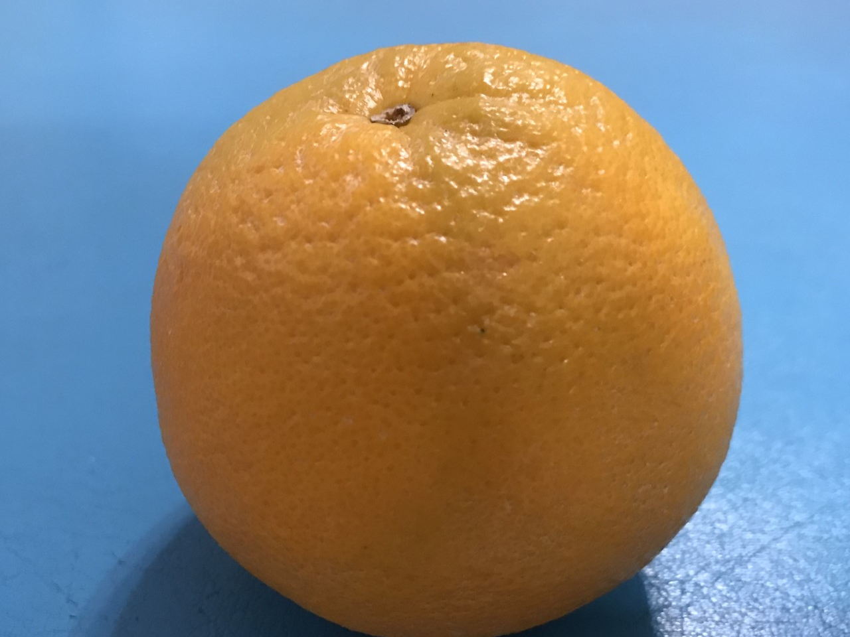
One serving of orange = 1 orange (approximately 151 grams), provides 68 mg of vitamin C
100 grams of orange contain 45 mg of vitamin C

Slide 16

Reference Nutrient Intakes (RNI)** of vitamin C for adults per day is 40 mg
88.9 grams of orange
= 0.6 serving
= 0.6 orange
(1 orange = 151 grams)
= 40 milligrams vitamin C
** Source: British Nutrition Foundation

Slide 17
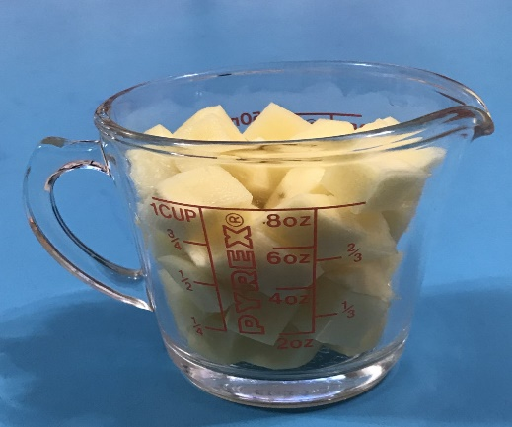
One serving of potato
= ½ cup (approximately 75 grams), provides 6.7 mg of vitamin C
100 grams of potato contains 11 mg of vitamin C

Slide 18
Reference Nutrient Intakes (RNI)** of vitamin C for adults per day is 40 mg
363.6 grams potatoes
= 4.8 servings
= 40 mg vitamin C
** Source: British Nutrition Foundation

Slide 19
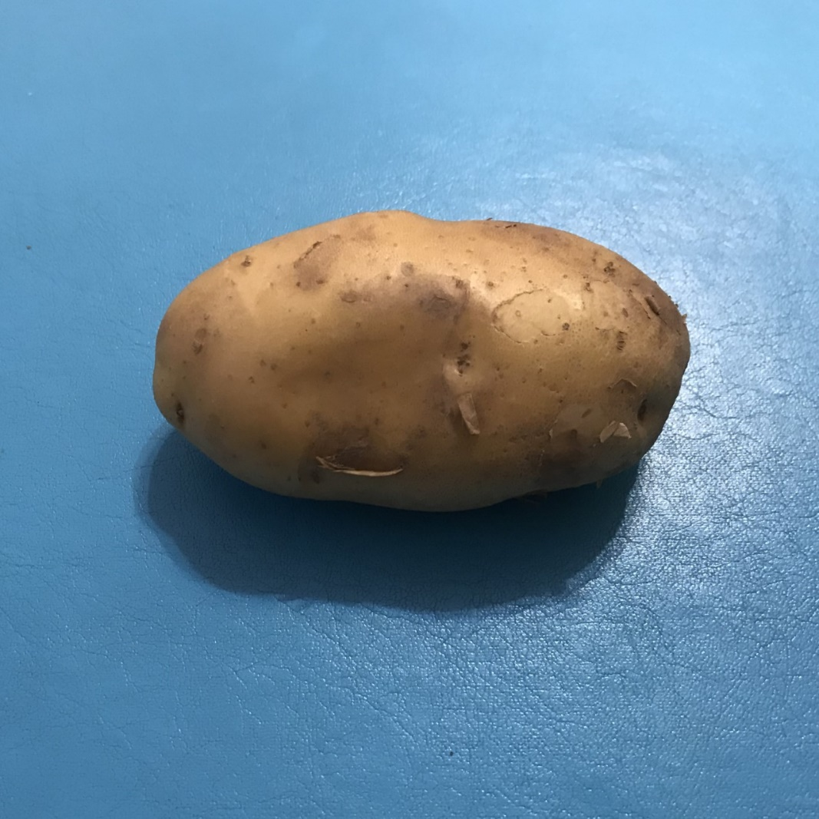
Reference Nutrient Intakes (RNI) of vitamin C for adults per day is 40 mg
Also equals to
1.8 potatoes (1 potato = 200 gram)

Slide 20

Calcium

Slide 21
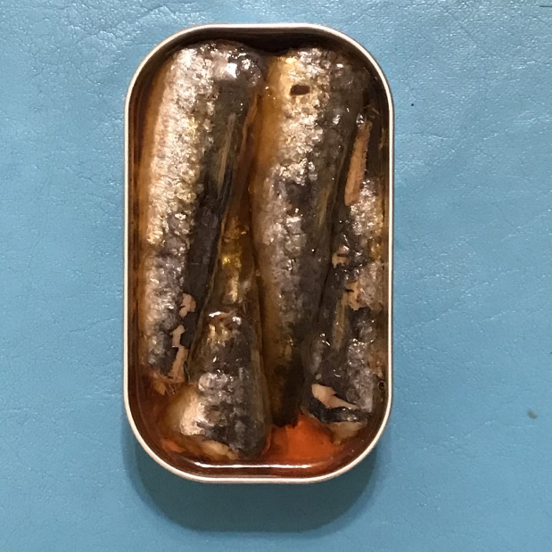
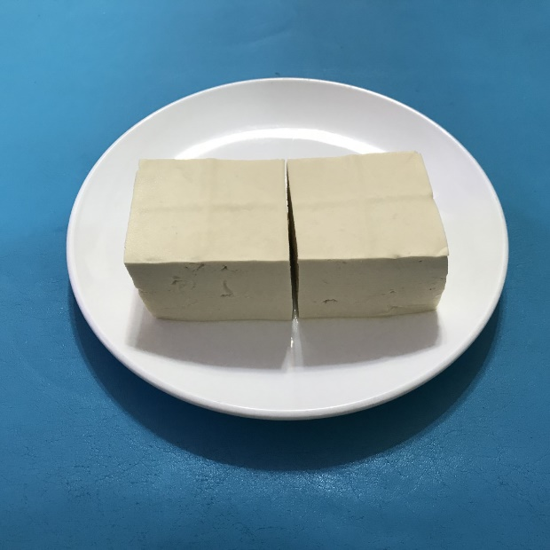
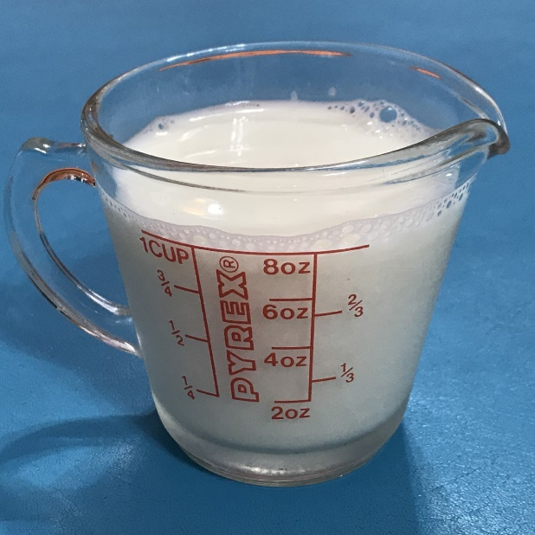
How much of these should be eaten? sardine (with bones), firm tofu, high calcium milk

Slide 22
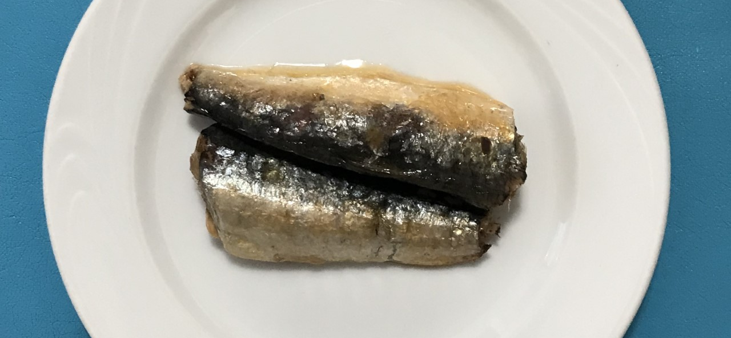
One serving of sardines (with bones) = 2 sardines (approximately 24 grams), provides 91.7 mg of calcium
100 grams of sardines (with bones) contain 382 mg of calcium

Slide 23

Reference Nutrient Intakes (RNI)** of calcium for adults per day is not less than 1,000 mg
261.8 grams sardines
= 10.9 servings
= 21.8 sardines (1 sardine = 12 grams)
= 1,000 mg calcium
** Source: British Nutrition Foundation

Slide 24
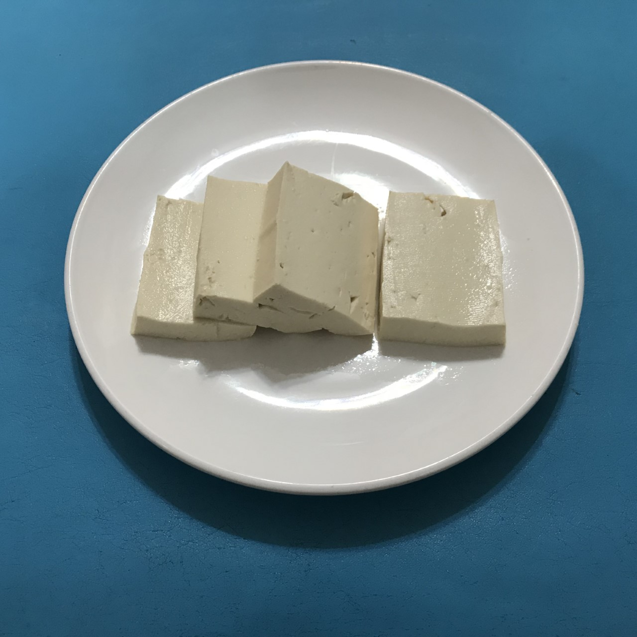
One serving of firm tofu = ¼ block (approximately 75 grams), provides 240 mg of calcium
100 grams of firm tofu contain 320 mg of calcium

Slide 25
Reference Nutrient Intakes (RNI)** of calcium for adults per day is not less than 1,000 mg
312.5 grams firm tofu
= 4.2 servings
= 1 block
(1 block, 7cm x 8cm x 8cm = 300 grams)
= 1,000 mg calcium
** Source: British Nutrition Foundation

Slide 26

One serving of high calcium milk = 1 cup (approximately 244 grams), provides 366 mg of calcium
100 grams of high calcium milk contain 150 mg of calcium

Slide 27


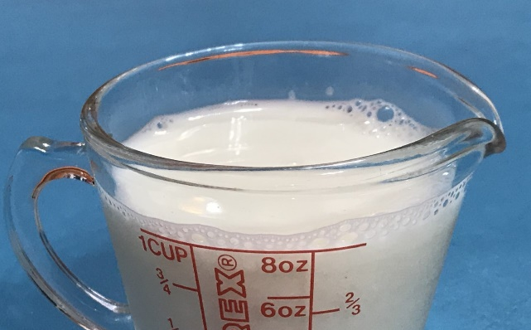
Reference Nutrient Intakes (RNI)** of calcium for adults per day is not less than 1,000 mg
666.7 grams high calcium milk
= 2.7 servings
= 2.7 cups (1 cup = 244 grams)
= 1,000 mg calcium
** Source: British Nutrition Foundation

Slide 28
References
Centre for Health Protection, Department of Health - Two Plus Three Every Day.
British Nutrition Foundation (2016). Nutrition Requirements.
Food Nutrient Finder.
Get Ready for FoodData Central, a New USDA Food and Nutrient Data System.

