Slide 1
Traffic Light Labels for Meals

Slide 2

Evaluate the Dishes
For each of the dishes shown in the subsequent slides, name the major ingredients and state the food group each ingredient belongs to.
Discuss and evaluate if the dishes are appropriate to be part of a healthy meal
  if it is a healthy dish, colour the traffic light in green.
  if it is a conditionally healthy dish, colour the traffic light in yellow.
  if it is an unhealthy dish, colour the traffic light in red.
Support with reasons.

Slide 3
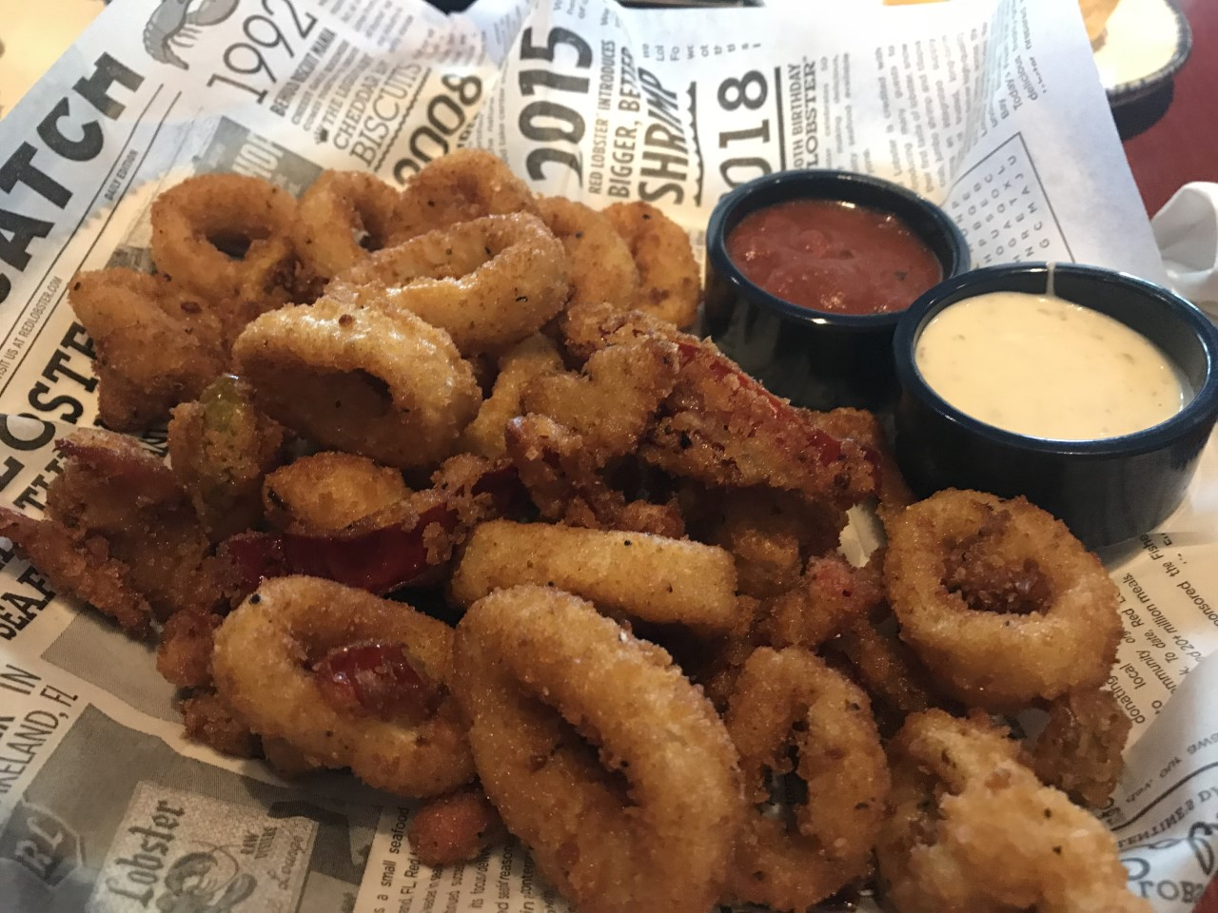

Deep-fried Calamari

Slide 4


Suggested Points for Discussion for
Deep-fried Calamari
Squid is a kind of mollusk shellfish that is high in cholesterol
Deep fried foods contain excessive oil
Mayonnaise is high in fat/oil
Ketchup is high in salt and sugar
Major ingredient | Food group
Squid | Meat, Fish, Egg and Alternatives
Mayonnaise | Fat/Oil, Salt and Sugar
Ketchup | Fat/Oil, Salt and Sugar

Slide 5
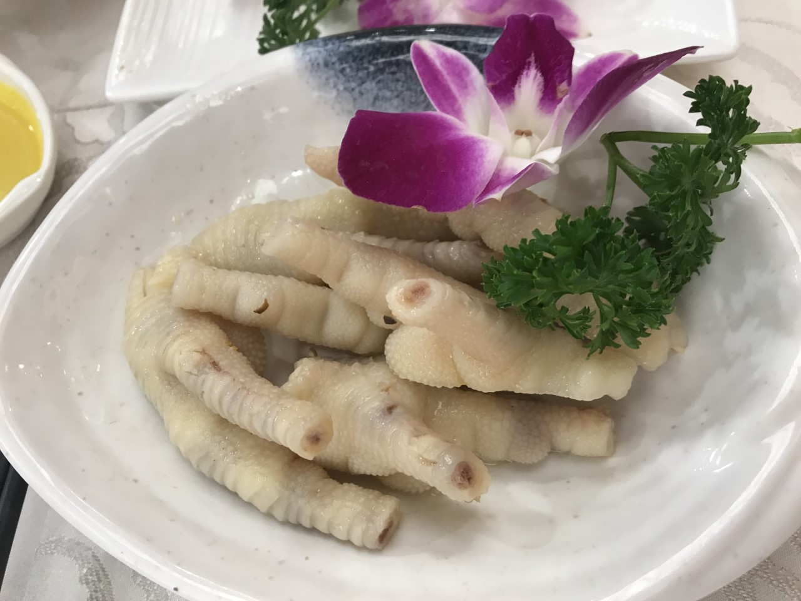
Baiyun Chicken Feet (Pickled Chicken Feet)

Slide 6

Suggested Points for Discussion for
Baiyun Chicken Feet (Pickled Chicken Feet)
Chicken feet contain a lot of fat
Chicken fat is high in saturated fat
Major ingredient | Food group
Chicken feet | Meat, Fish, Egg and Alternatives

Slide 7
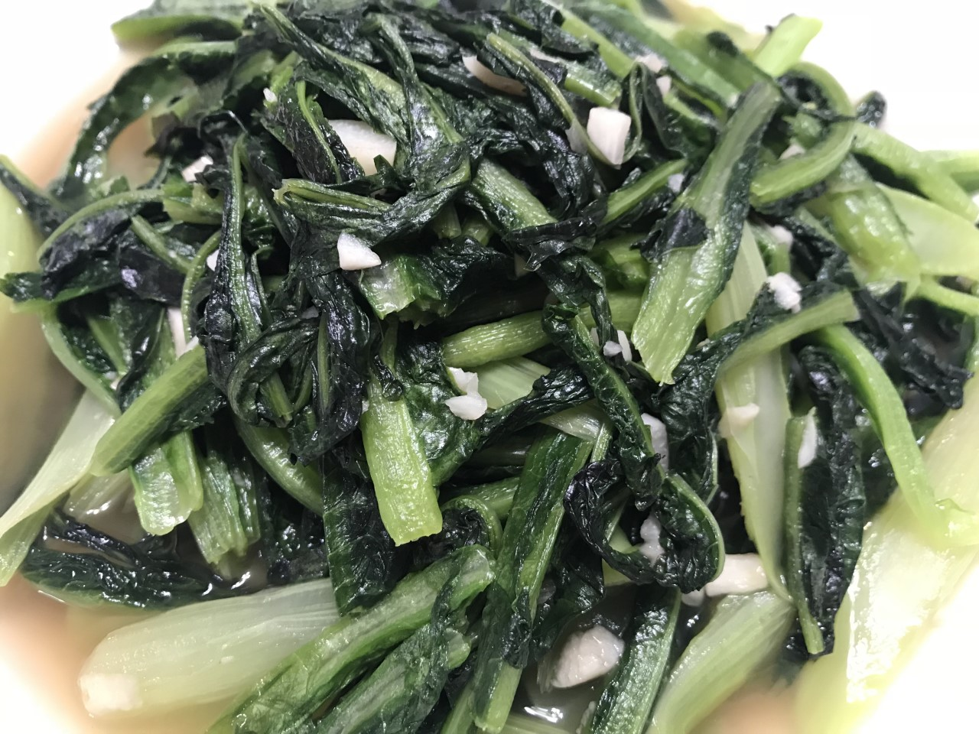
Stir-fried Indian Lettuce with Garlic

Slide 8

Suggested Points for Discussion for
Stir-fried Indian Lettuce with Garlic
Leafy vegetable is a source of fibre*, calcium, iron, and vitamin A, C, E, and K
Garlic can enhance the aroma and taste of the dish without excess use of salt
Note:
small amount of oil should be used in stir-frying the vegetables, as oil is high in fat
*Except for lettuce which is low in fibre
Major ingredient | Food group
Indian lettuce | Vegetables
Garlic | Vegetables
Oil | Fat/Oil, Salt and Sugar

Slide 9
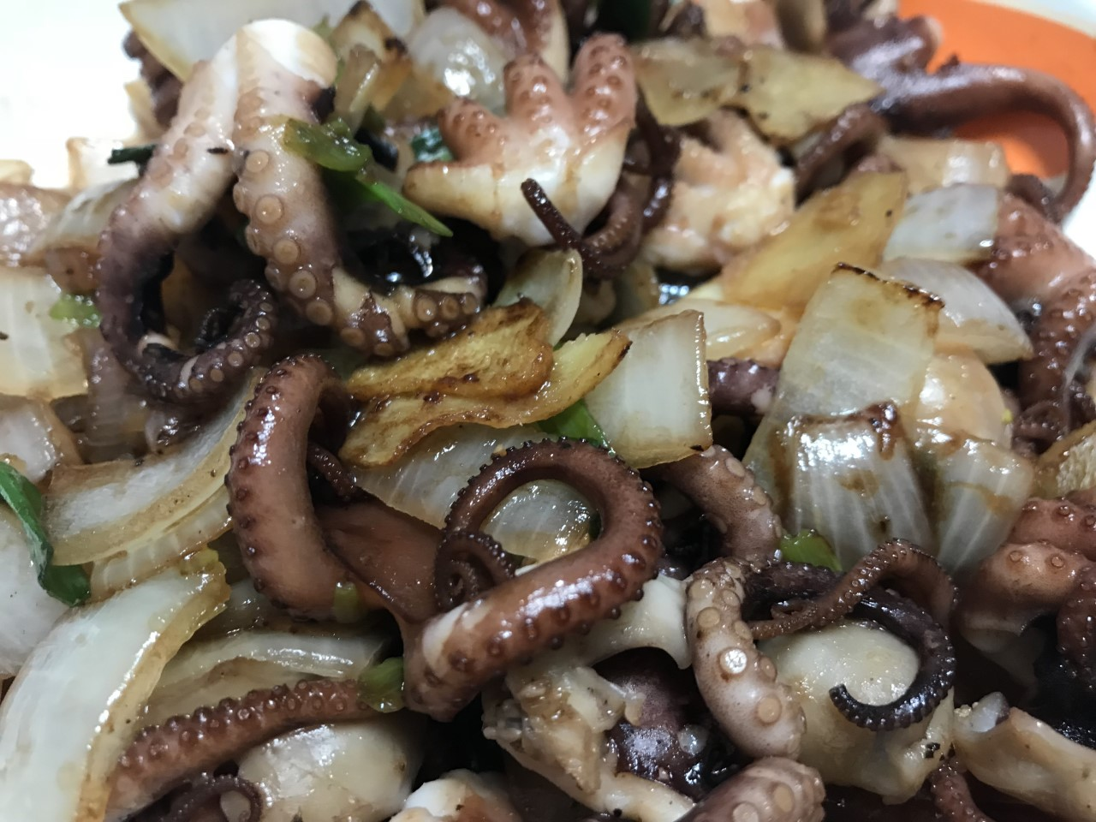
Stir-fried Baby Octopus with Onions

Slide 10

Suggested Points for Discussion for
Stir-fried Baby Octopus with Onions
Octopus is a kind of mollusk shellfish that contains low level of cholesterol
Onion can enhance the aroma and taste of the dish without excess use of salt
A large amount of oil is used for this dish
Major ingredient | Food group
Baby Octopus | Meat, Fish, Egg and Alternatives
Onions | Vegetables
Oil | Fat/Oil, Salt and Sugar

Slide 11
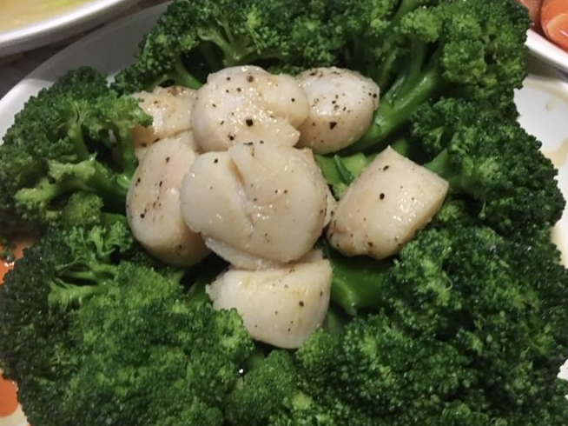
Stir-fried Broccoli with Scallops

Slide 12

Suggested Points for Discussion for
Stir-fried Broccoli with Scallops
Broccoli is a source of fibre, calcium, iron, and vitamin A, C, E, and K
Scallop is a kind of mollusk shellfish that contains low level of fat and cholesterol
Note:
small amount of oil should be used in making the dish, as oil is high in fat
Major ingredient | Food group
Broccoli | Vegetables
Scallops | Meat, Fish, Egg and Alternatives
Oil | Fat/Oil, Salt and Sugar

Slide 13
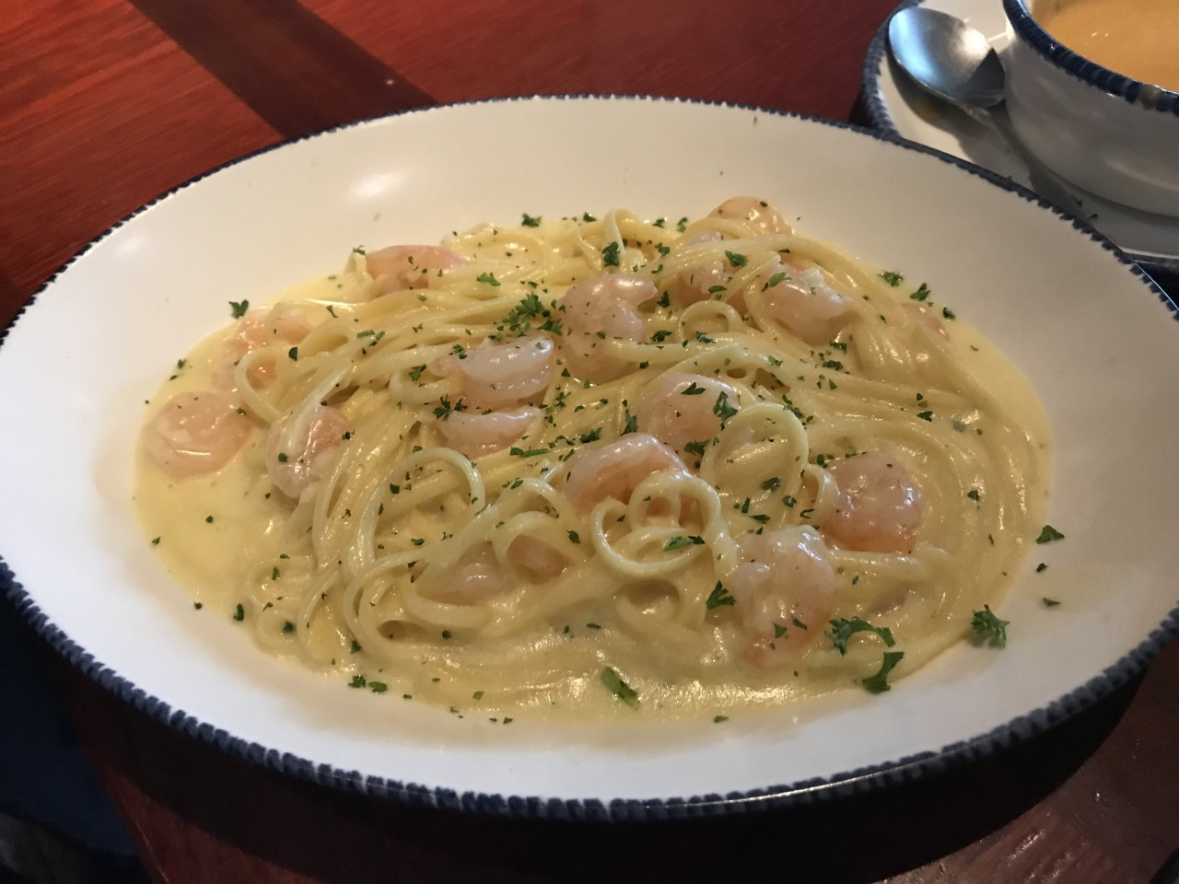
Linguine Carbonara with Shrimps

Slide 14

Suggested Points for Discussion for
Linguine Carbonara with Shrimps
Linguine is a carbohydrate rich food, which provides us with energy
Shrimp is a kind of crustacean that contains high level of cholesterol
Cream is one of the ingredients for Carbonara sauce which is high in fat
Major ingredient | Food group
Linguine | Grains
Shrimp | Meat, Fish, Egg and Alternatives
Cream | Milk and Alternatives

Slide 15
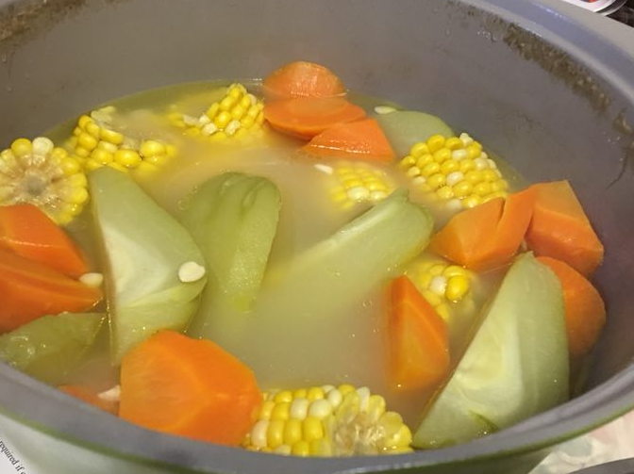
Chayote, Carrot and Corn Soup

Slide 16
Suggested Points for Discussion for
Chayote, Carrot and Corn Soup
Chayote, carrot, and corn are vegetables and are sources of vitamins, minerals and fibre
Soup contains water which is essential in a balanced diet
Note:
small amount of oil should be used in the soup base, as oil is high in fat
Major ingredient | Food group
Chayote | Vegetables
Carrot | Vegetables
Corn | Vegetables

Slide 17
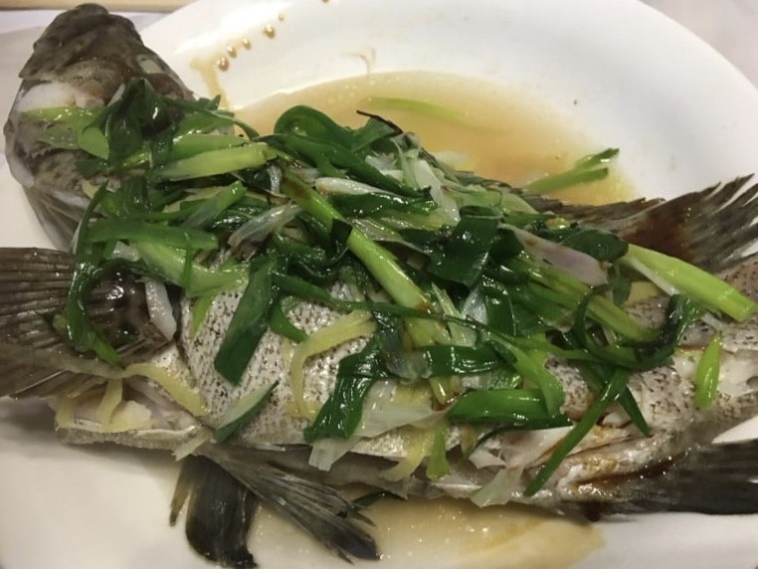
Steamed Fish with Ginger and Spring Onion

Slide 18

Suggested Points for Discussion for
Steamed Fish with Ginger and Spring Onion
Fish provides high biological value proteins
Fish contains unsaturated fatty acids that is healthy to our body
Ginger and spring onion can enhance the aroma and taste of the dish without excess use of salt
Note:
small amount of oil should be used in steaming the fish, as oil is high in fat
Major ingredient | Food group
Fish | Meat, Fish, Egg and Alternatives
Ginger | Vegetables
Spring onion | Vegetables
Oil | Fat/Oil, Salt and Sugar

Slide 19
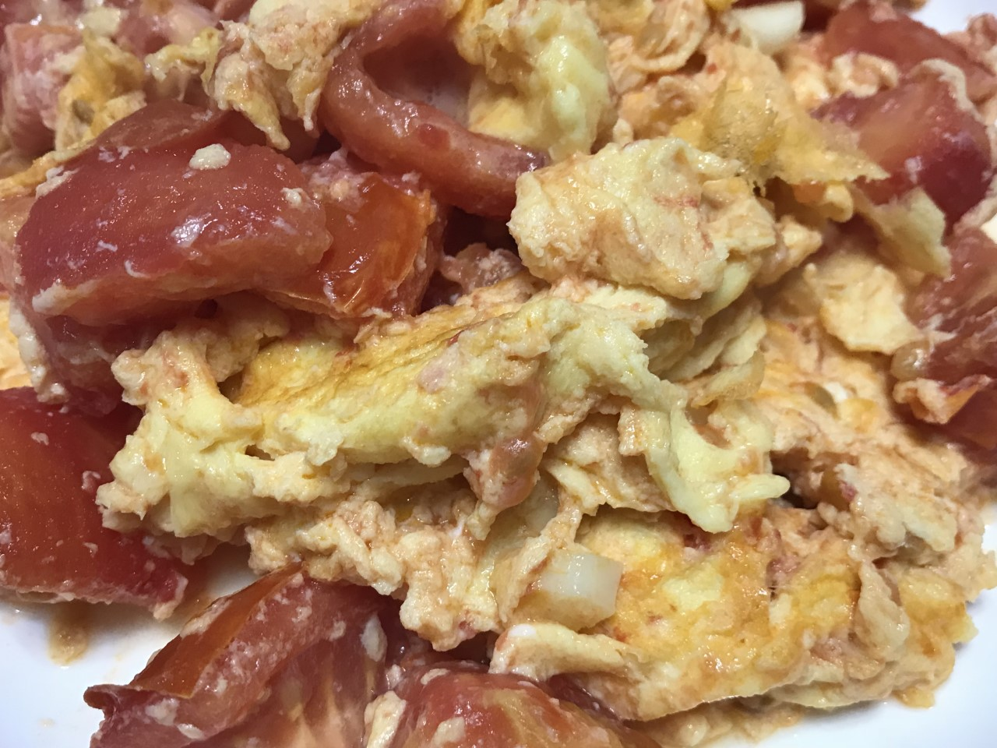
Stir-fried Tomato and Egg

Slide 20

Suggested Points for Discussion for Stir-fried Tomato and Egg
Tomato is a source of fibre, vitamin A and C
Egg provides high biological value proteins
Note:
small amount of oil should be used in frying the egg and tomato, as oil is high in fat
Major ingredient | Food group
Tomato | Vegetables
Egg | Meat, Fish, Egg and Alternatives
Oil | Fat/Oil, Salt and Sugar

Slide 21
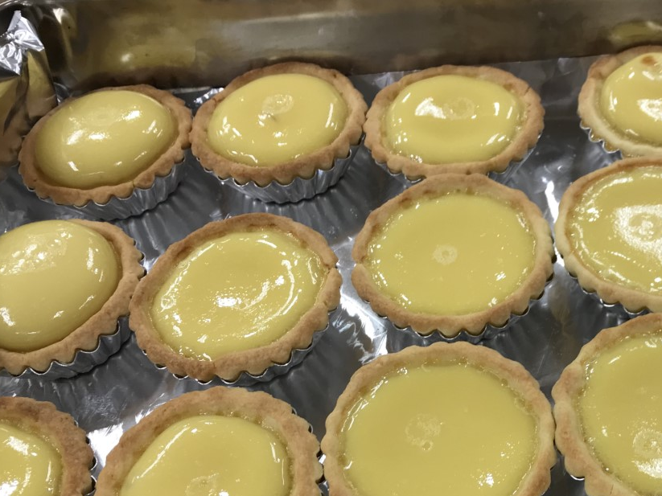
Egg Custard Tart

Slide 22

Suggested Points for Discussion for
Egg Custard Tart
The shell of egg custard tart is rich in fat and sugar
Sugar is also added in the filling to contribute to its sweet taste
Egg and milk provide high biological value proteins, however, they are in a small amount
Major ingredient | Food group
Flour | Grains
Butter | Fat/Oil, Salt and Sugar
Sugar | Fat/Oil, Salt and Sugar
Egg | Meat, Fish, Egg and Alternatives
Milk | Milk and Alternatives

Slide 23

Caffè Latte (Milk Coffee)

Slide 24

Suggested Points for Discussion for Caffè Latte (Milk Coffee)
Milk provides high biological value proteins and it is a rich source of calcium
Even though coffee is the fruit of a plant, it does not belong to the fruits or vegetables group. It is because it does not have the nutritional value like a vegetable or fruit. It should rather be used like oil – in a small amount.
Note:
to reduce fat intake, whole milk can be replaced with low fat milk or skimmed milk
to lower sugar intake, use less sugar or artificial sweetener
Major ingredient | Food group
Milk | Milk and Alternatives
Coffee | Fat/Oil, Salt and Sugar
Sugar (optional) | Fat/Oil, Salt and Sugar

