Slide 1
Nutrient Level of Foods

Slide 2
Dietary fibre

Slide 3
Where is Dietary Fibre from?
Do these foods contain dietary fibre?
Which food provides the highest level of dietary fibre? Rank them in descending order.
Look up the amount of dietary fibre provided by these foods in the food composition database, what are the differences in the dietary fibre content?
If our diet only contains one kind of these foods, how much of it should be eaten to meet the daily requirement of dietary fibre?
Corn kernels
Lettuce
Oatmeal

Slide 4
Vitamin C

Slide 5
Where is Vitamin C from?
Do these foods contain vitamin C?
Which food provides the highest level of vitamin C? Rank them in descending order.
Look up the amount of vitamin C provided by these foods in the food composition database, what are the differences in the vitamin C content?
If our diet only contains one kind of these foods, how much of it should be eaten to meet the daily requirement of vitamin C?
Guava
Orange
Potato

Slide 6
Calcium

Slide 7
Where is Calcium from?
Do these foods contain calcium?
Which food provides the highest level of calcium? Rank them in descending order.
Look up the amount of calcium provided by these foods in the food composition database, , what are the differences in the calcium content?
If our diet only contains one kind of these foods, how much of it should be eaten to meet the daily requirement of calcium?
Sardine (with bones)
Firm tofu
High calcium milk

Slide 8
Sources of food composition database
Food Nutrient Finder.
Get Ready for FoodData Central, a New USDA Food and Nutrient Data System.

Slide 9
Answers

Slide 10
Dietary Fibre
All three foods contain dietary fibre
Oatmeal > Corn kernels > Lettuce
Food (based on 100 grams of food) | Dietary fibre (g)
Oatmeal, dry, instant | 10
Corn kernels | 2
Lettuce | 1.2

Slide 11
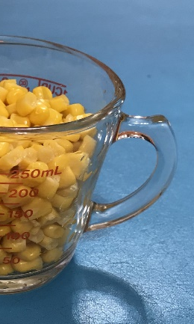
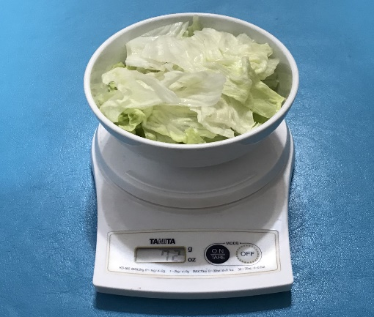
Dietary Fibre
One serving of oatmeal
One serving of lettuce
One serving of corn kernels
28 gram (approximately ¼ cup)^{A}
Provides 2.8 g of dietary fibre
Approximately ½ cup (82 gram)^{A}
Provides 1.64 g of dietary fibre
1 bowl (approximately 72 gram)^{B}
Provides 0.86 g of dietary fibre
Source:
A: United States Department of Agriculture
B: Centre for Health Protection, Department of Health

Slide 12
Dietary Fibre
Given that the reference value of dietary fibre is not less than 25g per day*
25 g/day of dietary fibre is equivalent to:
Oatmeal | Corn kernel | Lettuce
250 grams | 1,250 grams | 2,083 grams
8.9 servings | 15.2 servings | 28.9 servings
2.25 cups | 7.6 cups | 28.9 bowls
 |  | 3.86 heads (1 head = 539 grams)
Source: Centre of Food Safety, Food and Environmental Hygiene Department

Slide 13
Vitamin C
All three foods contain vitamin C
Guava > Orange > Potato
Food (based on 100 grams of food) | Vitamin C (mg)
Guava | 228
Orange | 45
Potato | 11

Slide 14
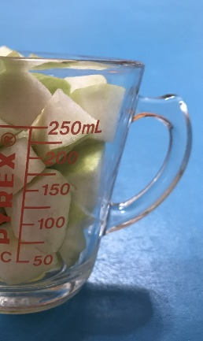
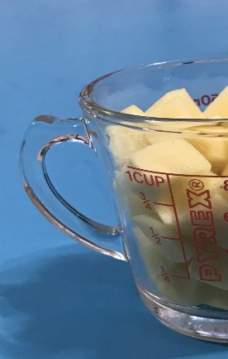
Vitamin C
One serving of guava
½ cup (approximately 82 grams)^{A}
Provides 187 mg of vitamin C
One serving of orange
1 orange (approximately 151 grams)^{B}
Provides 68 mg of vitamin C
One serving of potato
½ cup (approximately 75 grams)^{A}
Provides 6.7 mg of vitamin C
Source:
A: United States Department of Agriculture
B: Centre for Health Protection, Department of Health

Slide 15
Vitamin C
Given that the Reference Nutrient Intakes (RNI)** of vitamin C for adults per day is 40 mg
40 mg/day of vitamin C is equivalent to:
Guava | Orange | Potato
17.5 grams | 88.9 grams | 363.6 grams
0.2 servings | 0.6 servings | 4.8 servings
1/13 guava (1 guava = 230 grams) | 0.6 orange (1 orange = 151 grams) | 1.8 potatoes (1 potato = 200 grams)
Source: Nutrition Requirements, British Nutrition Foundation

Slide 16
Calcium
All three foods contain calcium
Sardines (with bones) > Firm bean curd / tofu > High calcium milk
Food (based on 100 grams of food) | Calcium (mg)
Sardines (with bones) | 382
Firm bean curd / tofu | 320
High calcium milk | 150

Slide 17
Calcium
One serving of sardines (with bones)
2 sardines (approximately 24 grams)^{A}
Provides 91.7 mg of calcium
One serving of firm bean curd / tofu
¼ block (approximately 75 grams)^{A}
Provides 240 mg of calcium
One serving of high calcium milk
1 cup (approximately 244 grams)^{A}
Provides 360 mg of calcium
Source: United States Department of Agriculture

Slide 18
Calcium
Given that the Reference Nutrient Intakes (RNI)** of calcium for adults per day is not less than 1,000 mg
1,000 mg/day of calcium is equivalent to:
Sardines (with bones) | Firm bean curd / tofu | High calcium milk
261.8 grams | 312.5 grams | 666.7 grams
10.9 servings | 4.2 servings | 2.7 servings
21.8 sardines (1 sardine = 12 grams) | 1 block (1 block, 7cm x 8cm x 8cm = 300 grams) | 2.7 cups (1 cup = 244 grams)
Source: Centre for Food Safety, Food and Environment Hygiene Department - Nutrients Definition and Function.

