Slide 1
Nutrition and Health
Nutritional Requirements

Slide 2
Introduction
Different countries take different approaches to set nutritional requirements for their population with slightly different terminology, e.g.
  Dietary Reference Values (DRVs) in United Kingdom
  Recommended Daily Allowance (RDA) in the United States of America
  Population Reference Intake (PRI) in the European Union
  Dietary Reference Intakes (DRIs) in China

Slide 3
United Kingdom
Dietary Reference Values

Slide 4
Dietary Reference Values
Dietary Reference Values (DRVs) are a series of data to estimate the amount of energy and nutrients needed by different groups of healthy people in the United Kingdom population.

Slide 5
Dietary Reference Values - Types
There are four types of Dietary Reference Values:
  Estimated Average Requirements (EARs)
  Reference Nutrient Intakes (RNIs)
  Lower Reference Nutrient Intakes (LRNIs)
  Safe Intake
These estimated amounts are based on the needs of a group, not individuals.

Slide 6
Dietary Reference Values –
Estimated Average Requirement
The Estimated Average Requirement (EARs) is an estimate of the median requirement for energy or a nutrient for a particular group of people.
Approximately 50% of the group will need less energy or the nutrient and 50% of the group will need more.

Slide 7
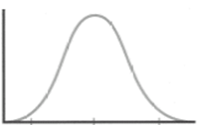
Dietary Reference Values –
Estimated Average Requirement
The distribution of nutrient requirements within a group.
Number of people
EAR
Requirements
Source: British Nutrition Foundation

Slide 8
Dietary Reference Values –
Reference Nutrient Intake
The Reference Nutrient Intake (RNI) is the amount of a nutrient that is enough to ensure that the needs of nearly all the people of a particular group (97.5%) are being met.
RNI values vary by age and gender.

Slide 9
Dietary Reference Values –
Reference Nutrient Intake
The distribution of nutrient requirements within a group.
Number of people
RNI
Requirements
Source: British Nutrition Foundation

Slide 10
Dietary Reference Values –
Lower Reference Nutrient Intake
The Lower Reference Nutrient Intake (LRNI) is the amount of a nutrient that is enough for only a small number of people in a particular group who have low requirements (2.5%).
The majority of the group will need more.

Slide 11
Dietary Reference Values –
Lower Reference Nutrient Intake
The distribution of nutrient requirements within a group.
Number of people
LRNI
Requirements
Source: British Nutrition Foundation

Slide 12
Dietary Reference Values - Safe Intake
The Safe Intake is used where there is insufficient evidence to set an EAR, RNI or LRNI.
The safe intake is the amount judged to be enough for almost everyone in a particular group, but below a level that could have undesirable effects.

Slide 13
China
Dietary Reference Intake

Slide 14
Dietary Reference Intakes
The Chinese Dietary Reference Intakes (DRIs) were established by the Chinese Nutrition Society in 2000.
DRIs are used as benchmarks to evaluate the nutritional status a the individual and population levels.

Slide 15
Dietary Reference Intakes - Types
There are four sets of reference values:
Estimated Average Requirement (EAR)
Recommended Nutrient Intake (RNI)
Tolerable Upper Intake Level (UL)
Adequate Intake (AI)

Slide 16
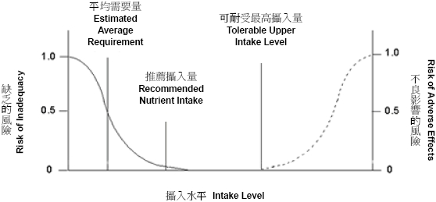
Relationship of Dietary Reference Intakes to Risk of Nutrient Inadequacy and Risk of Adverse Health Effects
Source: Centre of Food Safety, Food and Environmental Hygiene Department

Slide 17
Dietary Reference Intakes –
Estimated Average Requirement
The Estimated Average Requirement (EAR) is the average daily nutrient intake value that is estimated to meet the needs of half the healthy individuals in a given age and gender group.

Slide 18
Dietary Reference Intakes –
Recommended Nutrient Intake
The Recommended Nutrient Intake (RNI) is a daily nutrient intake value that is estimated to meet the needs of 97 to 98% healthy individuals in a given age and gender group.

Slide 19
Dietary Reference Intakes –
Tolerable Upper Intake Level
The Tolerable Upper Intake level (UL) is the highest nutrient intake value that is likely to pose no risk of adverse health effects for individuals in a given age and gender group.
It is not intended to be a recommended level of intake.
The UL is established when strong evidence supporting the relationship between the over dosage of a nutrient and the adverse effects on health is available.

Slide 20
Dietary Reference Intakes –
Adequate Intake
The Adequate Intake (AI) is provided when sufficient scientific evidence is lacking, the EAR cannot be determined and the RNI cannot be calculated.
The AI is based on experimental data or observed nutrient intake by a group of healthy people, with an assumption that the intake is adequate to promote health.

Slide 21
References
British Nutrition Foundation (2016). Nutrition Requirements.
Combet, E., & Buckton, C. (2015). Micronutrient deficiencies, vitamin pills and nutritional supplements. Medicine,43(2), 66-72. doi:10.1016/j.mpmed.2014.11.002
Fung, J. (2008). Nutrient and Health - Maintain Optimal Nutrient Intake(Vol. 28, Food Safety Focus) (Hong Kong, Centre for Food Safety, Risk Communication Section).

