Slide 1
Understanding Ingredients
Meat

Slide 2
Topics
Introduction
Types of Meat and Poultry
Structures of Meat and Poultry
Nutritive Value of Meat and Poultry
Choice and Storage of Meat and Poultry
Uses of Meat and Poultry in Cooking / Diet

Slide 3
Introduction

Slide 4
Introduction
“Meat” may include the edible portion of mammals such as beef and pork, as well as the non-mammals poultry and fish.
Meat is the edible portion—the flesh of animals—used for food
Poultry are domesticated birds kept by humans for their eggs and their meat
There is a variety of meat available in our shops and markets
Red meat is the meat from mammals including beef and veal, lamb, mutton, and pork
White meat refers to meat from poultry and seafood

Slide 5
Introduction
Various animal flesh may be used as food throughout the world
Game is meat from non-domesticated animals
Examples of game are: rabbit, venison, pigeon, quail
Meat are being sold fresh, chilled or frozen
Meat is also processed or manufactured into meat products

Slide 6
Types of Meat and Poultry

Slide 7
Types of Meat and Poultry
Fresh, chilled, or frozen meat available in Hong Kong
Fresh, chilled, or frozen poultry available in Hong Kong
Beef from cattle
Lamb, mutton from sheep
Pork from pig
Veal from calf
Chicken
Duck
Goose
Pigeon
Quail
Turkey

Slide 8
Types of Meat and Poultry
Processed meat and poultry products available in the market:
Canned meat
Corned beef
Luncheon meat
Canned sausages
Smoked meat
bacon
Dried meat
Chinese sausage
Chinese preserved meat
Jerky
Cured meat
Ham
Frankfurters

Slide 9
Structures of Meat and Poultry

Slide 10
Structures of Meat and Poultry
Meat is composed of three tissues: muscle tissue, connective tissue, and adipose or fatty tissue
Muscle Tissue
Muscle tissue is referred to as the lean tissue of meat
It is made up of bundles of muscle fibres
The muscle fibres are protein, they are hollow tubes which are filled with minerals such as iron and B vitamins

Slide 11
Structures of Meat and Poultry
Connective tissue
Connective tissue is made up of protein and mucopolysaccharides
It is located throughout the muscle
It determines the degree of meat tenderness, cuts that contains less connective tissue are more tender
Connective tissue also extends beyond the muscle fibers to form tendons, which attach the muscle to bones
Connective tissue also forms ligaments, attaching one bone to another

Slide 12
Structures of Meat and Poultry
Connective tissue (cont’d)
Two important protein that forms the basic structure of connective tissue
Collagen
found in meat and poultry, the white connective tissue
the structure is broken down by the application of heat, especially moist heat
the greater the breakdown, the more tender the final product
Elastin
found in concentrated deposits appearing as a yellow, rubbery mass
changed very little by cooking

Slide 13
Structures of Meat and Poultry
The carcass is cut up and sold in smaller portions called joints or cuts
Tenderness of meat cuts after cooking has a direct relationship to the amount and quality of connective tissue in the product
Tender meat comes from young animals and birds, and the muscles which are not often used, e.g. along the back
Tough meat comes from older animals and birds, and the well-used muscles such as the leg and neck
Flesh from the breast and wing is easier to digest than that of the legs (drumstick) which is coarser and darker because of greater muscular activity

Slide 14
Cuts of Pork
Tender cuts
For frying, grilling, barbecuing, and roasting
Loin
Tough cuts
For stewing, boiling, slow cooking
Shin
Belly
Fillet or tenderloin
Neck
Spare rib
Foreleg
Head

Slide 15
Cuts of Beef
Tender cuts
For grilling, frying, and barbecuing
Rump
Sirloin
Tough cuts
For casserole, stewing, and slow cooking
Topside of leg
Flank
Tenderloin
T-bone steaks
Tender cuts
For roasting
Shoulder
Brisket
Shin
Rump
Sirloin
Ribs

Slide 16
Cuts of Lamb
Tender cuts
For grilling, frying, and barbecuing
Neck
Loin chops
Tough cuts
For casserole and stewing
Breast
Shoulder
Leg
Tender cuts
For roasting
Scrag-end of neck
Leg
Shoulder

Slide 17
Cuts of Chicken, Turkey, and Duck
Tender cuts
For frying, grilling, barbecuing, and roasting
Tough cuts
For stewing
Wing
Foot
Breast
Fillet (boneless breast)
Whole leg
Thigh

Slide 18
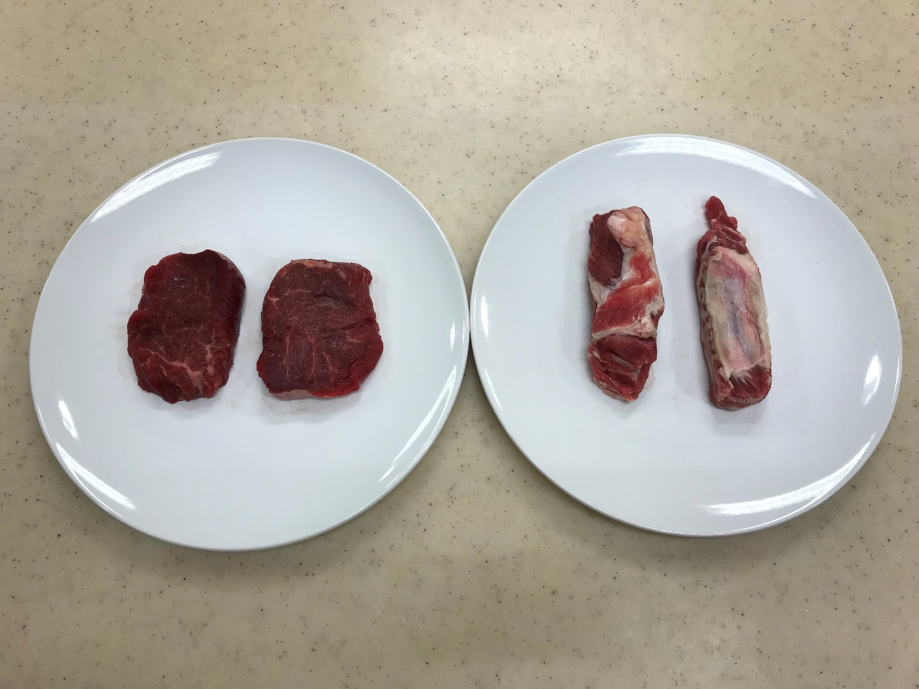
Structures of Meat and Poultry
Tender cut (beef tenderloin) (left) and tough cut (beef brisket) (right)

Slide 19
Structures of Meat and Poultry
Adipose or fatty tissue
Adipose tissue: fat that is stored around the heart, kidney organs, and in the pelvic canal areas
Subcutaneous fat: fat that is visible after the skin is removed, this layer of fat can be trimmed before cooking to reduce the fat content in a dish
Intermuscular fat: fat between muscles
Intramuscular fat: fat within muscles (marbling)

Slide 20
Structures of Meat and Poultry
Adipose or fatty tissue (cont’d)
When cooked, the melted fat contributes to juiciness, the sensation of tenderness, and flavour
Thus, well-marbled meat with intramuscular fat may be desirable (despite the high level of fatty tissues)

Slide 21
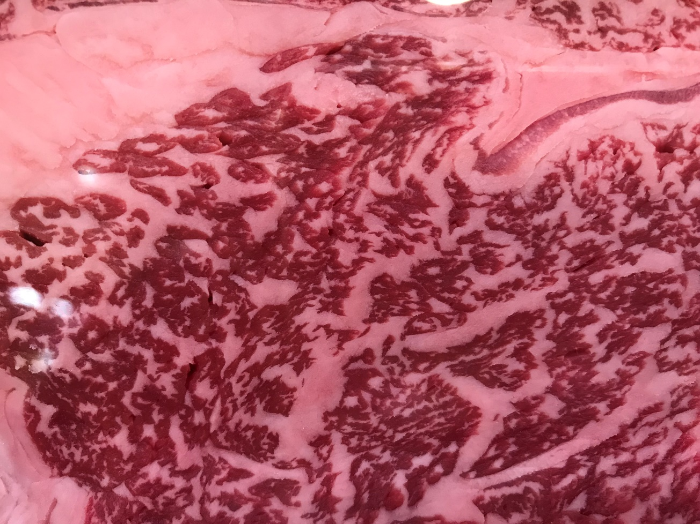
Structures of Meat and Poultry
Intermuscular fat
Intramuscular fat
Well-marbled beef

Slide 22
Nutritive Value of Meat and Poultry

Slide 23
Nutritive Value of Meat and Poultry
Meat and poultry are major sources of essential nutrients:
Protein
Meat provides high quality protein
Fat
Fat from meat contains a high proportion of saturated fatty acids, which can increase the cholesterol level in the blood and can increase the risk of coronary heart disease in some people
Fat content can be affected by several factors:
Type of meat – pork has more fat than liver (liver has more cholesterol than pork)
Parts eaten – chicken with skin contains more fat than skinless chicken
Method of cooking – frying or deep-frying calls for more fat than roasting or grilling

Slide 24
Nutritive Value of Meat and Poultry
Cholesterol
Present in the cell membranes of all animal tissue
Typically, lean meats have a lower cholesterol content than fatty meats, except for veal, which is low in fat, yet high in cholesterol
Carbohydrates
Negligible in animal tissue
Small percentage of carbohydrates in animals is stored in the liver as glycogen

Slide 25
Nutritive Value of Meat and Poultry
Vitamin A
Vitamin A is only found in liver and kidneys, not in other parts meats
Liver products such as pâté are a useful source of Vitamin A
Vitamin B
Meat and poultry contain water-soluble B-complex vitamins that function as cofactors in many energy-yielding metabolic reactions

Slide 26
Nutritive Value of Meat and Poultry
Iron
Iron is found mainly in red meats and liver
It is in soluble form which is easily absorbed and used in the body for the haemoglobin in red blood cells
Chicken provides mainly white meat, therefore it contains little iron
Zinc and phosphorus are present in meat, poultry contains little phosphorous

Slide 27
Choice and Storage of Meat and Poultry

Slide 28
Choosing Fresh/Chilled Meat and Poultry
Fresh/chilled meat and poultry
Fresh meat and poultry should be bright in colour
Fresh pork is pale pink in colour and fresh beef is bright red
Pork and beef should be firm, moist and springy to touch and with no unpleasant smell
Poultry should be plump, with pliable breastbone

Slide 29
Choosing Frozen Meat and Poultry
Frozen meat and poultry
Should be in frozen state
Should be no sign of thawing and re-freezing
Check the expiry date
Poultry should not have white patches on the skin

Slide 30
Storing Fresh/Chilled Meat and Poultry
Raw meat and poultry should be stored in a sealed container or wrapped securely to prevent meat juices from contaminating other foods
Storage Times for Refrigerated Foods
Ground meat and poultry | Ground beef, turkey, veal, pork, lamb | 1-2 days
Fresh meat (beef, veal, lamb, and pork) | Steaks, chops, roasts | 3-5 days
 | Variety meats (Tongue, kidneys, liver, heart, chitterlings) | 1-2 days
Fresh poultry | Chicken or turkey, whole | 1-2 days
 | Chicken or turkey, parts | 1-2 days
 | Giblets | 1-2 days
Source: Food Safety and Inspection Service, United States Department of Agriculture

Slide 31
Storing Frozen Meat and Poultry
Keep frozen and store in a deep-freezer
Before using, allow to thaw slowly overnight in the refrigerator
Thaw completely before cooking
Never refreeze thawed meat, harmful bacteria may have started to increase
Never store cooked meat or ready-to-eat food together with raw meat. (The raw meat that carries bacteria may contaminate the cooked meat or ready-to-eat food)

Slide 32
Uses of Meat and Poultry in Cooking / Diet

Slide 33
Uses of Meat and Poultry in Cooking / Diet
Appetiser/salad
Roasted suckling pig
Roast beef salad
Shredded chicken with vermicelli （雞絲粉皮）
Main dish
Sweet and Sour Pork
Beef Steak
Chicken Curry
Snack
Ham and egg sandwich
Beef curry samosa
Chicken nuggets

Slide 34
References
“FSIS.” Refrigeration and Food Safety, United States Department of Agriculture, 23 Mar. 2015.
Provost, J., Kelly, B., Bodwin, J., & Wallert, M. (2016). The Science of Cooking. John Wiley & Sons.
Vickie A. Vaclavik, Elizabeth W. Christian. Essentials of food science. New York, NY: Springer, c2008.

