Slide 1

Personal Financial Planning in a life-cycle Context
7 July 2015

Slide 2
Disclaimer
This presentation is intended to provide a general overview for information and educational purposes only and is not a comprehensive treatment of the subject matter. The information is provided generally without considering specific circumstances and should not be regarded as a substitute for professional advice. The Investor Education Centre (“IEC”) has not advised on, passed on the merit of, endorsed or recommended any of the products/services or types of products/services referred to in this presentation. Readers/Audiences should seek professional advice if they consider necessary.
The IEC endeavours to ensure that the information contained in this presentation is accurate as of the date of its presentation, but the information is provided on an "as is" basis and the IEC does not warrant its accuracy, timeliness, or completeness. The IEC has no obligation to update this presentation as law and practices change. In no event shall the IEC accept or assume any liability (including third party liability) nor entertain any claim for any loss or damage of any kind howsoever caused arising from or in connection with the use of or reliance upon this presentation (including whether caused by the IEC’s negligence or any error or omission in information or otherwise).
Examples and case studies provided in this presentation are for educational purposes only. All background information, characters and situations created for the examples and the case studies are fictitious.
Copyright for presentations
The Investor Education Centre (“IEC”) is the owner of the copyright and other intellectual property rights in this presentation. This presentation (in whole or in part) may not be reproduced or distributed, or used for commercial purposes, without the prior written permission of the IEC.
Copyright © 2014 Investor Education Centre. All rights reserved.

Slide 3

Contents
What is financial planning?
The financial planning process
Financial planning at different life stages
Case studies
Q&A

Slide 4

Are these statements correct?
One only needs to start financial planning when approaching retirement.
Financial planning = Investing
Once you finish your financial plan, you do not have to think about it again.
You need a lot of money to do financial planning.

Slide 5

What is financial planning?
Financial planning is the process of setting, planning, achieving and reviewing your life goals through the proper management of your finances.

Slide 6
The financial planning process
1
Assess your financial status
2
Create a budget
3
Set your financial goals
4
5
6
Know your risk tolerance
Work out and implement a basic financial plan
Review and adjust your financial plan regularly

Slide 7
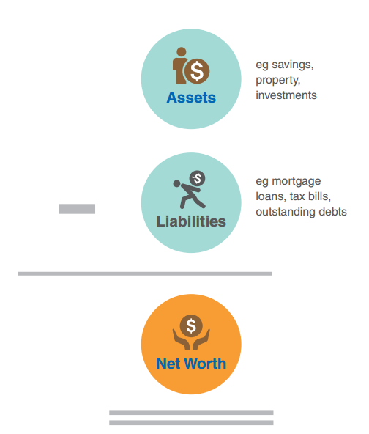
Step 1: Assess your financial status
Assets: what you own
eg savings, investments, property
Liabilities: what you owe
eg tax bills, debt and loan
Net worth: Assets - Liabilities

Slide 8
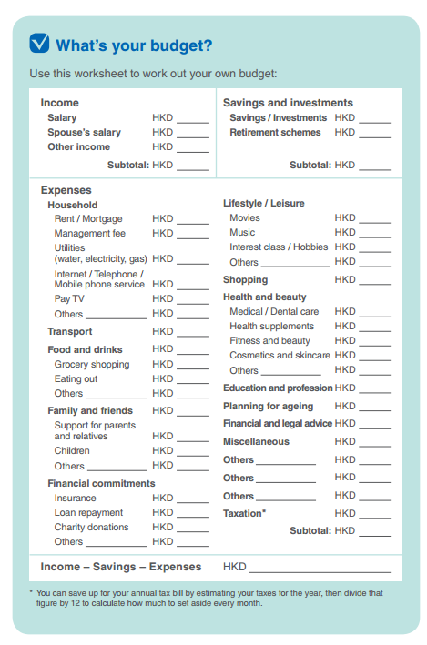
Step 2: Create a budget
Track your spending
  Expenses diary
Understand the nature of your expenses
  Fixed vs Variable
  Regular vs Occasional
Plan ahead with a budget planner

Slide 9
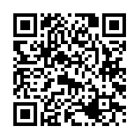
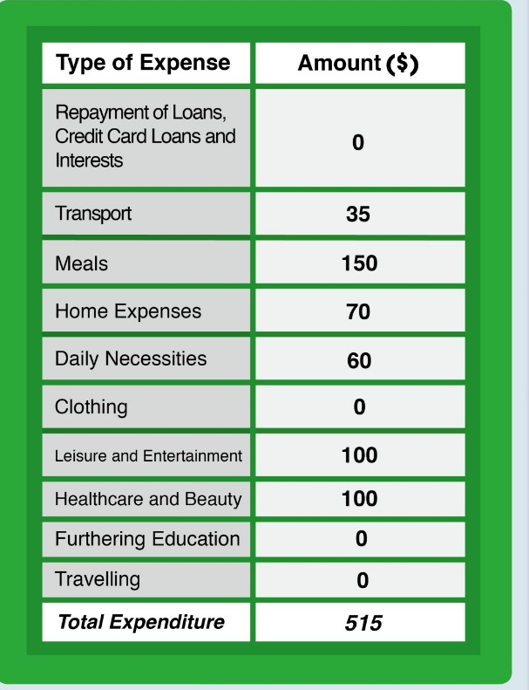
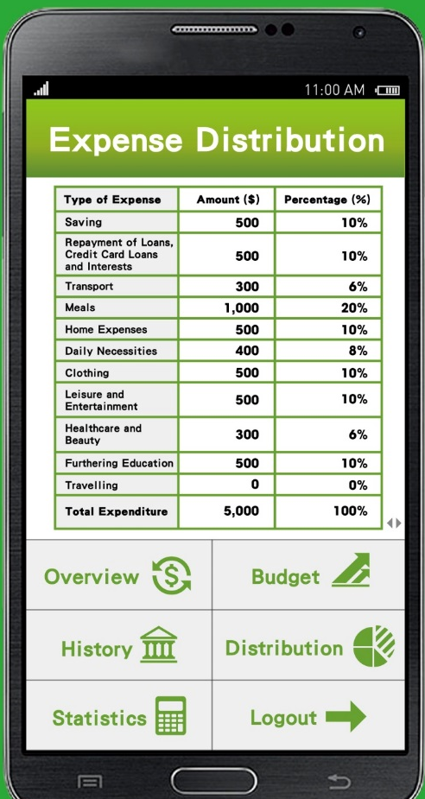
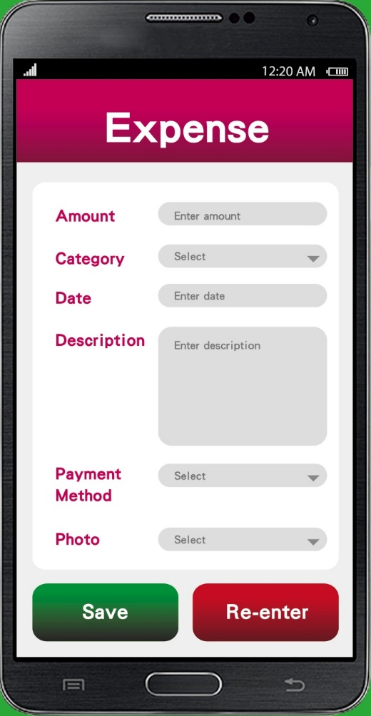
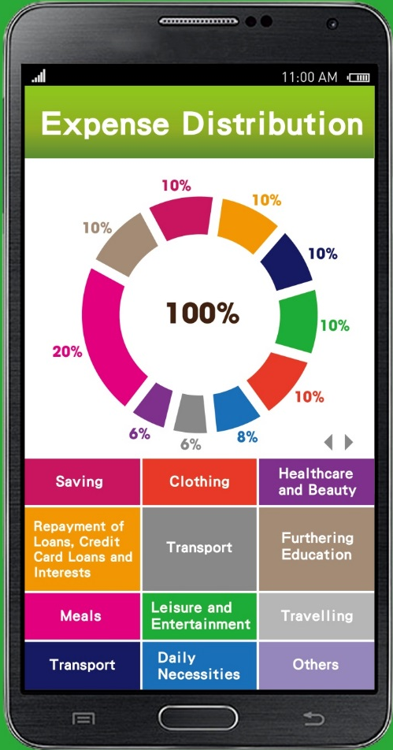
Step 2: Create a budget
Examples of common tools
http://www.hkiec.hk/web/en/tools-and-resources/tools/index.html

Slide 10
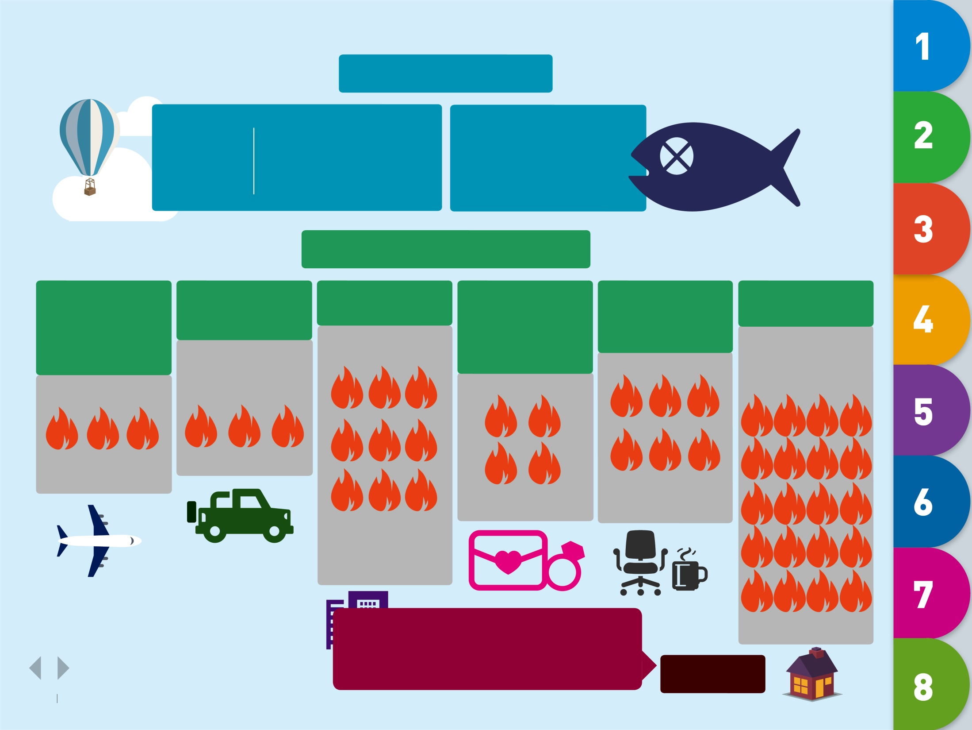
Step 3: Set your financial goals
Do you have any goals?
Yes.
Is there any difference between a person without goals and a salted fish?
No.
So what is your goal?
Travel around the world / one-year working holiday
Buy your
dream car
Buy an apartment
Get your dream girl / boy, get married and have children
Be your own boss/ start your own business
Retirement
Index of saving:
Index of saving:
Index of saving:
Index of saving:
Index of saving:
Index of saving:
(Depending on how luxurious your trip is)
(Well, a business is easy to start up but hard to maintain)
(At least……)
(Down payment only…... have to repay the mortgage for X years)
No matter what goals you have, saving is a must.
(or moreeeeeee)
CONCLUSION

Slide 11
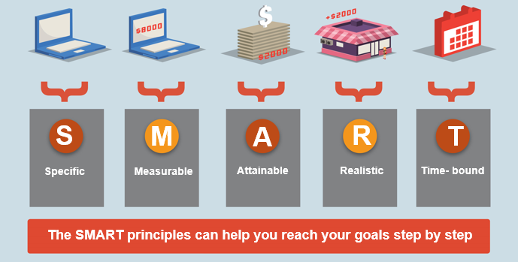
Step 3: Set your financial goals
S
M
A
R
T
Specific
Measurable
Attainable
Realistic
Time- bound
The SMART principles can help you reach your goals step by step
3.5

Slide 12
Step 3: Set your financial goals
Different needs and goals at different life stages
  Make a list of all needs and goals
  Set SMART goals
  Example: My laptop is out of order.
  Specific - I need a new laptop.
  Measurable - I need $7,500 to buy the laptop.
  Attainable - I will put aside $1,500 a month to purchase the laptop.
  Realistic - I can save $1,500 a month by working part-time.
  Time-bound - I will save $ 7,500 in 5 months.
  Map out the cost of each financial goal

Slide 13

Step 3: Set your financial goals
Young single
Possible goals: Pay off student loan Pay salaries tax on time Travel once a year Get married in 5 years

Slide 14

Step 3: Set your financial goals
Just married
Possible goals: Prepare emergency fund Prepare down payment for a flat in 4 years Have a baby in 5 years Prepare for retirement

Slide 15

Step 3: Set your financial goals
Married with children
Possible goals: Repay mortgage on time Hire a maid Take out an insurance plan Save for children’s education Prepare for retirement

Slide 16

Step 3: Set your financial goals
Retiree
Possible goals: Preserve retirement fund Reserve for medical expenses Carry out estate planning

Slide 17
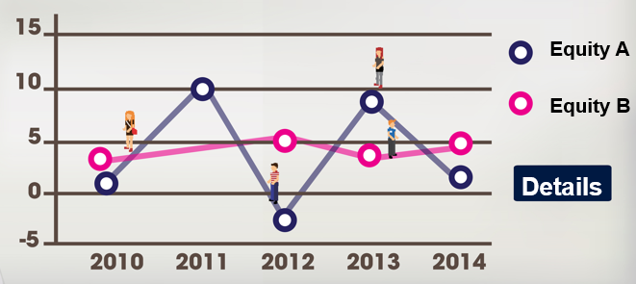
Step 4: Know your risk tolerance

Slide 18

Step 4: Know your risk tolerance
Risk tolerance
Subjective
Risk capacity
Factors
  Financial goals
  Time horizon (age)
  Liquidity needs
  Financial resources
  Number of dependents
Your risk capacity will change over time and along different life stages
Reference:
  http://www.hkifa.org.hk/chi/RiskAssessmentTools.aspx

Slide 19

Step 4: Know your risk tolerance
Balanced
Moderately cautious
Moderately aggressive
Aggressive
Conservative

Slide 20
Step 5: Work out and implement a basic financial plan
Prioritise your needs and goals
Identify action steps to reach your goals
Choose financial products according to your risk tolerance and capacity
Understand your rights and responsibilities in purchasing financial products
Maintain a diversified investment portfolio

Slide 21

Step 6: Review and adjust your financial plan regularly
Be disciplined to follow the plan
Review your plan regularly
Adjust your plan if needed

Slide 22
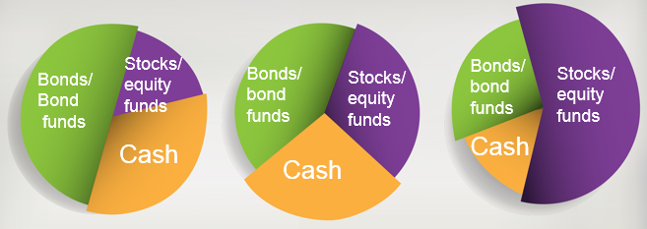
Financial planning at different life stages

Slide 23
Typical life cycle of personal income
Wealth Consolidation
Income
Wealth Accumulation
Wealth Consumption
Age
10 20 30 40 50 60 70 80 90
(Assumption: Retiring at 60)

Slide 24
Financial planning at different life stages
Different life events affect what financial goals you will set
Financial goals are not static once set or achieved
They will need to be redeveloped and may even change over time
Starting work
Repaying student loan
Starting a family
Getting married
Middle aged
Expanding retirement fund
Retirement
Moving out
Further education
Saving for flat deposit
Building retirement fund
Having a child
Preparing for children education fund
Building retirement fund
Buying a flat
Changing to a larger flat
Asset protection
Health care
Age care
Health care
Estate planning
Long holidays

Slide 25
Financial planning at different life stages
Plan according to your situation:
  Age
  Income and expenses
  Assets and liabilities
  Marital status
  Family conditions
  No. of dependents
  Specific needs
  Other constraints
http://www.hkiec.hk/web/en/tools-and-resources/tools/index.html

Slide 26
Case studies

Slide 27
Case 1: Young single – Jason
Age: 26
Occupation: Sales
Problems:
  Impulse buying
  Rely on tax loan to pay salaries tax
Goals:
  Save for salaries tax payment
  Take out a life insurance plan
  Learn how to drive in 2015

Slide 28
Jason’s monthly expenses in May
Monthly income | $20,000
Monthly expenses
Support for parents | $0
Rent | $10,000
Household and utilities | $1,000
Food and drink | $3,500
Transport (mostly taxi) | $800
Shopping | $5,000
Mobile phone plan | $400
MPF | $900
Total | $21,600
Cash flow | - $1,600
Share the flat with friends
Avoid taking taxi
Avoid impulse buying
Select a cheaper plan

Slide 29
Jason’s budget planning in Jun
Monthly income | $20,000
Monthly expenses
Support for parents | $2,000
Rent | $5,000
Household and utilities | $1,000
Food and drink | $3,500
Transport | $400
Shopping | $3,500
Mobile phone plan | $200
MPF | $900
Total | $14,500
Cash flow | $5,500

Slide 30
The pyramid of wealth management
Distribution
Protection
Accumulation
Estate planning
Donation
Saving
Investment
Emergency fund
Debt management
Insurance

Slide 31
Case 1: Young single – Jason
Prioritise goals
Higher priority:
  Reserve emergency fund
  Save for tax payment
  Take out insurance plan
Lower priority:
  Learn how to drive in 2015

Slide 32
How much does each of the goals cost?
  Goal 1: Save for salaries tax payment
  2014/15 tax payment: $6,960
  Set aside $600/month
    Possible action: purchase Tax Reserve Certificates (TRCs) monthly through bank autopay

Slide 33
How much does each of the goals cost?
Goal 2: Take out a life insurance plan
Review insurance need
  Whom or which asset do you want to protect?
  What risks do you want to insure against?
  How likely will the risk occur and can you mitigate against it?
  What would happen to you and your family or how much would you suffer financially if it occurs?
  How much does the insurance policy cost?
  How much can you afford to pay the premiums on certain insurance policies with longer term?

Slide 34
How much does each of the goals cost?
Goal 3: Learn how to drive in 2015
Cost of a driving course in 2014: $8,000
How much will it cost in 2015?
How likely will you pass all parts of the driving test on your first attempt?

Slide 35
Case 2: Married with younger children
– Mrs. Lee
Age: 35
Occupation: Housewife
Family members:
  Husband: Truck driver (Age: 38)
  Son: Primary 1 (Age: 6)
Family income: $18,000/month
Family savings: $3,000/month
Goal: Prepare $400,000 for her son as education fund in 12 years

Slide 36
Case 2: Married with younger children
– Mrs. Lee
Years of savings: 12 years
Rate of return | Monthly saving amount
 | $1,000 | $1,500 | $2,000
0% | $144,000 | $216,000 | $288,000
2% | $162,597 | $243,896 | $325,194
5% | $196,764 | $295,146 | $393,528
7% | $224,698 | $337,043 | $449,390
9% | $257,712 | $386,567 | $515,423
(Correct to the nearest dollar)
Build portfolio according to risk tolerance level!

Slide 37
Case 3: Pre-retiree – Uncle Wong
Age: 58
Occupation: Bus driver
Family members:
  Wife: Housewife (Age: 56)
  Daughter: Civil servant (Age: 24)

Slide 38
Case 3: Pre-retiree – Uncle Wong
Risk profiles at different stages of life
  Age: 26
  Marital status: Single
  Occupation: Factory worker
  Lived with parents
  Could afford to take on more risks

Slide 39
Case 3: Pre-retiree – Uncle Wong
Risk profiles at different stages of life
  Age: 36
  Marital status: Married
  Occupation: Bus driver
  Rent a flat and lived with
  his wife and two-year-old daughter
  More conservative in his risk profile

Slide 40
Case 3: Pre-retiree – Uncle Wong
Risk profiles at different stages of life
  Age: 56
  Marital status: Married
  Occupation: Bus driver
  Lived in a flat purchased 10 years
  ago under the Home Ownership
  Scheme (HOS)
  Adopted a conservative portfolio

Slide 41

Case 3: Pre-retiree – Uncle Wong
As Uncle Wong is preparing to retire at the age of 65, he is reviewing his investment portfolio again to manage risks.
Uncle Wong’s current portfolio:
  Equities:
  5% - Stock A (China Banking industry)
  5% - Stock B (China Banking industry)
  Bonds:
  30% - RMB bonds
  10% - iBond
  Cash:
  20% - RMB
  30% - HKD
https://www.hkiec.hk/tools/fhc/tc/main/index.jsp

Slide 42
Diversification
Risks are unavoidable
Diversification
  Investment vehicles perform differently under different market conditions in general (eg stock vs bond)
  Invest in different assets (eg stock, currency, bond)
  Invest in different markets (eg regional or global investment through funds, foreign currency deposits, etc)
  Investment distribution affected by risk profile
  (aggressive vs conservative)
Don’t put all the eggs in one basket

Slide 43
Summary
Financial planning ≠ Investing
Financial planning has to take into account the different stage of lives – birth, working period, retirement period, etc.
A comprehensive and holistic personal financial planning process covers a number of areas:
  Cash flow management
  Tax planning
  Risk Management and insurance planning
  Investment planning
  Retirement planning
  Estate planning

Slide 44
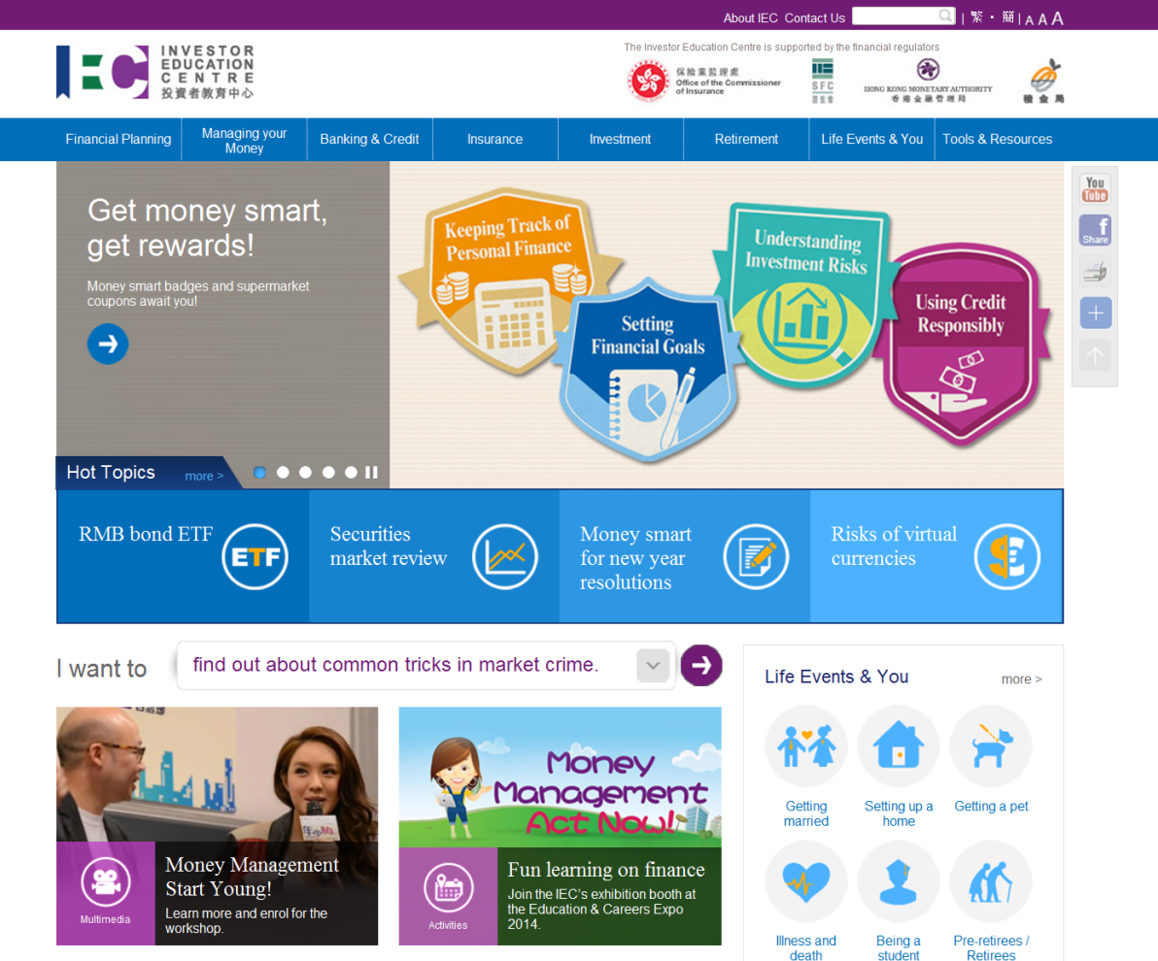
Visit the IEC website www.hkiec.hk

Slide 45
Thank you
45

