Slide 1
CHAPTER 10
Consumer choice for value II

Slide 2
FAIR TRADE & EthICS in FASHION
Royalty-free photo sourced from Pexels

Slide 3
WHAT IS FAIR TRADE?
WHY we pay more for IT?
Royalty-free photo sourced from Pexels.

Slide 4
Fair Trade is a concept that mixes both ethics and business; it requires that producers of commodities such as cotton, wool, coffee, and apples be paid ”fair” prices for their goods rather than minimuM prices allowed in the market place
(Hillery, 2009)
Reference: Paulins, V. A., & Hillery, J. L. (2009). Ethics in the fashion industry. Fairchild Publications.
Royalty-free photo sourced from Pexels.

Slide 5
Fashion & Fair Trade
Fashion Company
Society
A balance between a fashion company and society
Social and environmental responsibility
In particular the needs and concerns of small-scale farmers/producers
Core issues, such as fair price, decent working conditions and support for the local community
Fair commercial terms for farmers and workers in developing economies or countries
(Rinaldi & Testa, 2015)
Rinaldi, F. R., & Testa, S. (2015). The responsible fashion company: integrating ethics and aesthetics in the value chain. Greenleaf Publishing.

Slide 6
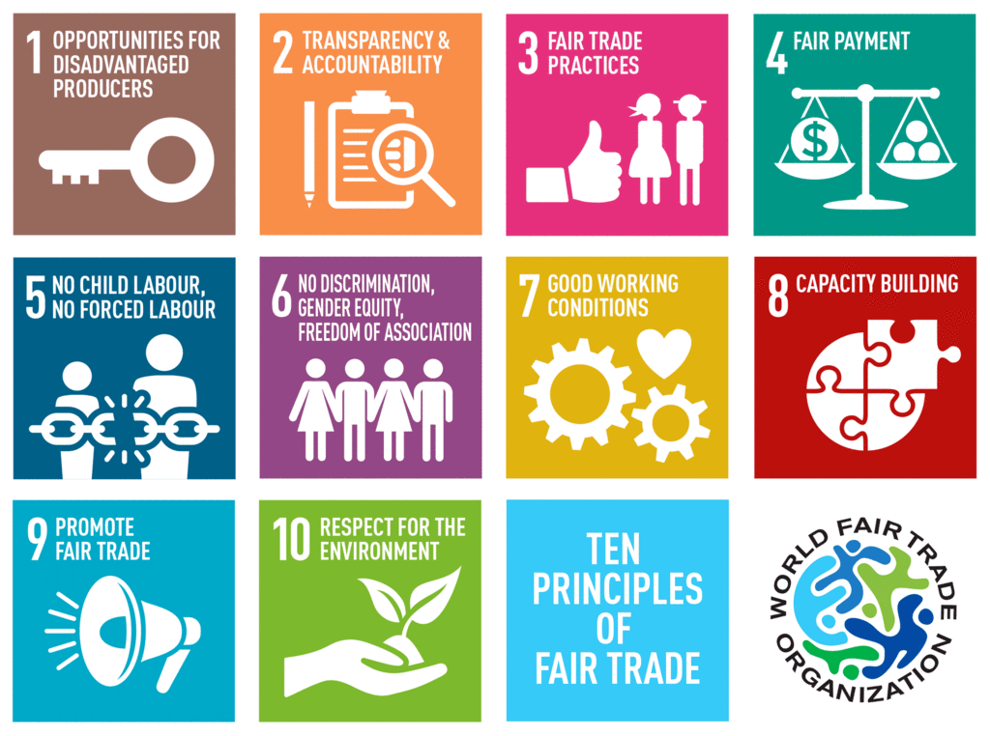
10 Principles of Fair Trade by World Fair Trade Organization (WFTO)
Creating opportunities for economically disadvantaged producers
Transparency and accountability
Fair trading practices
Payment of a fair price
Ensuring no child labour and forced labour
Commitment to non-discrimination, gender equity and women’s economic empowerment and freedom of association
Ensuring good working conditions
Providing capacity building
Promoting fair trade
Respect for the environment
WFTO: World Fair Trade Organisation
Reference: Fair Trade Association of Australia and New Zealand
Notes:
1: Creating Opportunities for Economically Disadvantaged Producers
Poverty reduction by making producers economically independent.
2: Transparency and Accountability
Involving producers in important decision making.
3: Fair Trading Practices
Trading fairly with concern for the social, economic and environmental well-being of producers.
4: Payment of a Fair Price
Paying producers a fixed price by mutual agreement, ensuring socially acceptable wages depending on the location.
5: Ensuring no Child Labor and Forced Labor
Adhering to the United Nations (UN) Convention on children’s rights.
6: Commitment to Non Discrimination, Gender Equity and Women’s Economic Empowerment and Freedom of Association
Respecting the trade union rights and rejecting discrimination based on gender, religion or ethnicity.
7: Ensuring Good Working Conditions
Providing a safe and healthy working environment for producers and wrokers in line with the International Labour Organization (ILO) conventions.
8: Providing Capacity Building
Seeking to develop the skills of producers and workers so they can continue to grow and prosper.
9: Promoting Fair Trade
Raising awareness for the need of greater justice in world trade by trading fairly with poor communities.
10: Respect for the Environment
Caring for the environment by maximising use of sustainable energy and raw materials while minimising waste and pollution

