Slide 1
Introduction to Fashion Design
CHAPTER 1

Slide 2
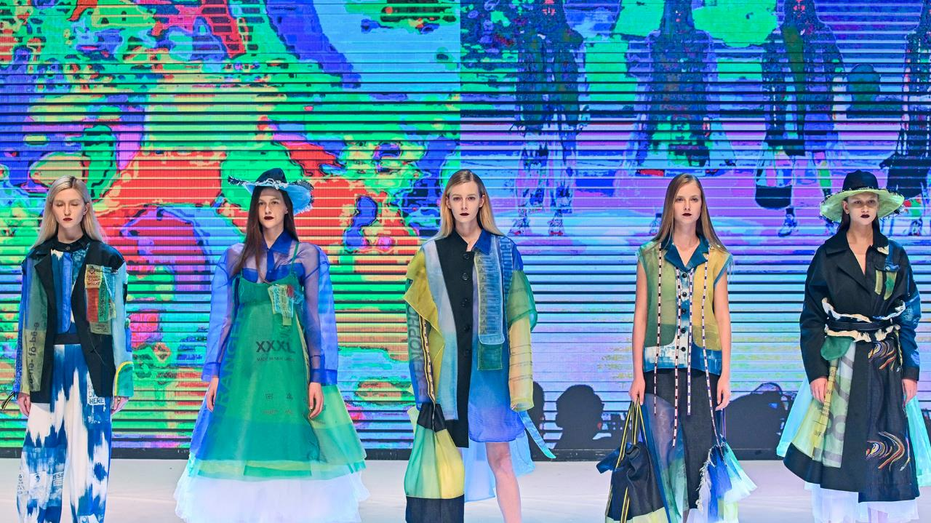
WHAT IS Fashion?
Collection Presentation (Collection by Kau Kar Man, Alumni of HD in Fashion Design, Hong Kong Design Institute)
Photo/s is/are owned and provided by HKDI

Slide 3
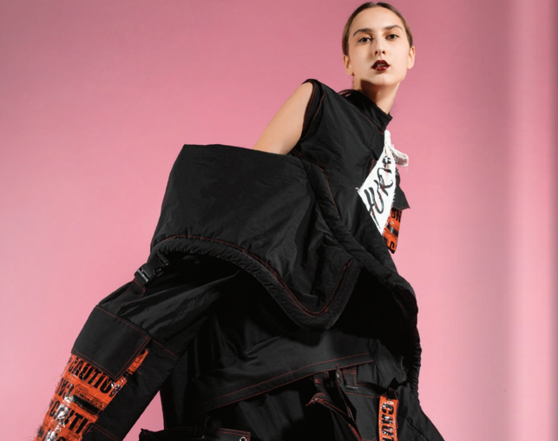
Definition of Fashion
Designer, Bloomy Tse hoped to arouse people’s attention to and concern for friends and family who suffered from mental illness, through collection presentation, as a means of creative expression
‘a popular or the latest style of clothing, hair, decoration or behaviour’, in Oxford Dictionary
Fashion is not only as a means to individually express ourselves through the way in which we choose to dress, but also as a means of creative expression through design.
Collection by Bloomy Tse, year 2 student of HD in Fashion Design in Hong Kong Design Institute ^{(x)}
Photo(s) is/are owned and provided by HKDI

Slide 4
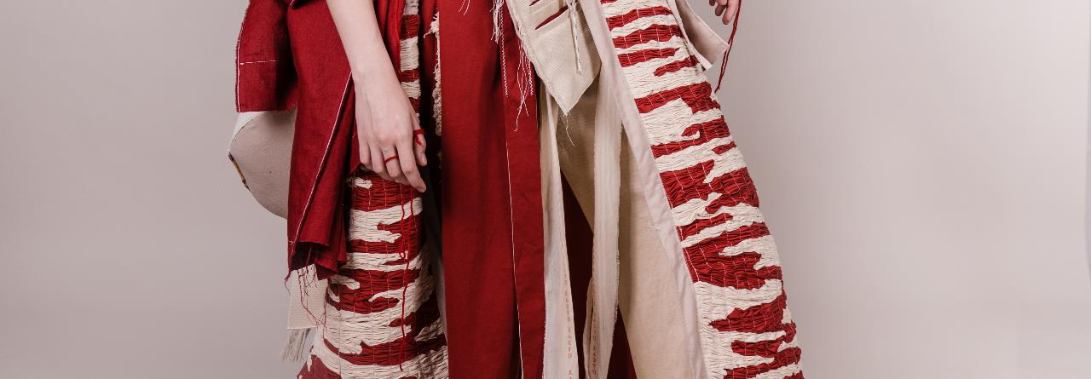

AND Fashion Design is
Collection by Chan Pui Yi, year 2 student of HD in Fashion Design in Hong Kong Design Institute
Photo(s) is/are owned and provided by HKDI
Scan to Check:
Fashion Show Booklet
a constant search for new concepts and idea

Slide 5
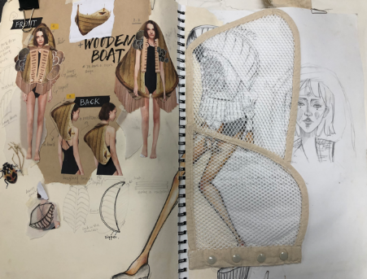
What do fashion designers do?
  Keeping up with emerging design trends
  Creating and visualising design ideas
  Selecting colours, fabrics and trims
  Planning and developing seasonal ranges of clothing items
  Following up sample development
  Presenting new collections
  Reviewing sales figures and market information
Collage Sketchbook by Chan Pui Yi, year 1 student of HD in Fashion Design in Hong Kong Design Institute
Photo(s) is/are owned and provided by HKDI

Slide 6
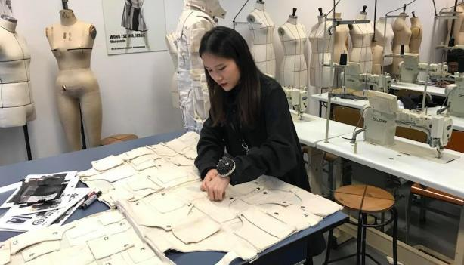
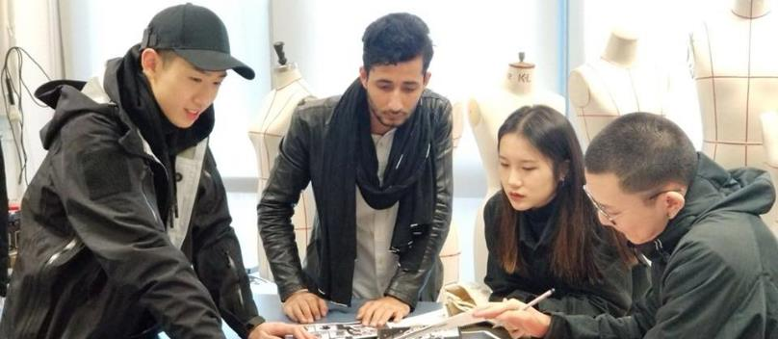
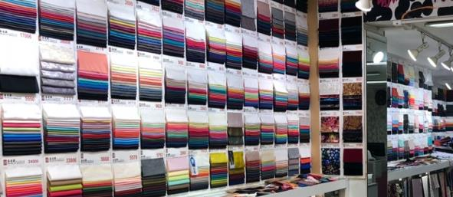
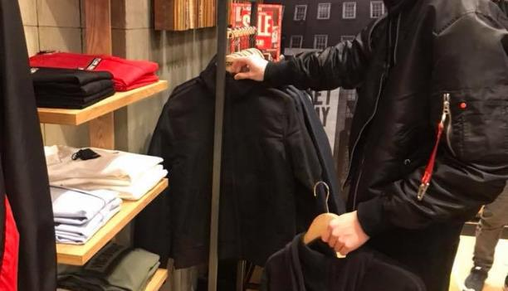
Sample development in fashion studio
The daily work of fashion designers
  Selecting fabrics and trims at fabric market
  Go to boutique to observe market trends and get inspirations
Photo(s) is/are owned and provided by HKDI

Slide 7
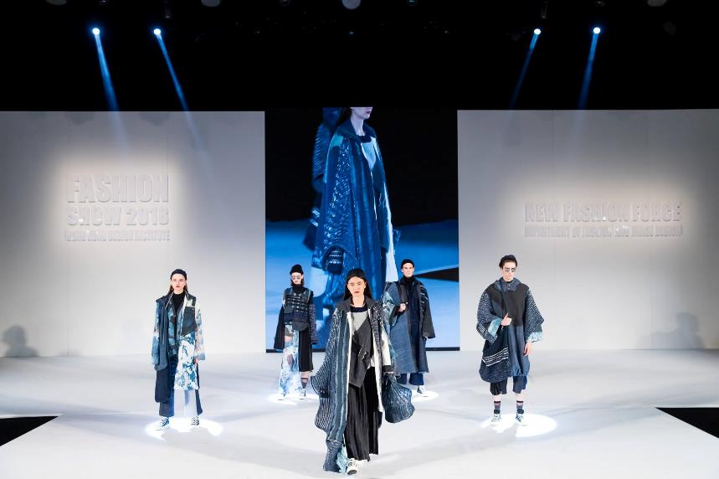
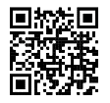
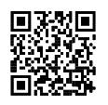

What is a Fashion Show
Scan to Check:
FASHION SHOW
HKDI Fashion Show
2019
HKDI Fashion Show
2018
Graduation collection by knitwear designer, Carmen Li (Alumni, HD in Fashion Design of Hong Kong Design Institute)
Photo/s is/are owned and provided by HKDI

Slide 8
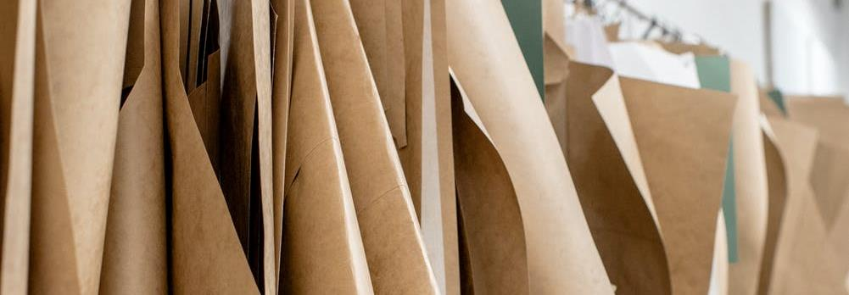
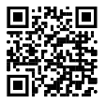
Royalty-free photo sourced from www.pexels.com
Scan to check:
Voguerunway.com
Chapter Activity
WHO IS YOUR FIRST FAVOURITE FASHION DESIGNER?
1. Start your first research to check on different fashion websites (QR CODE).
2. Choose your favourite collection in the latest fashion week.
3. Check the background information of the designer.

