Slide 1
Basic design elements
Chapter 2

Slide 2
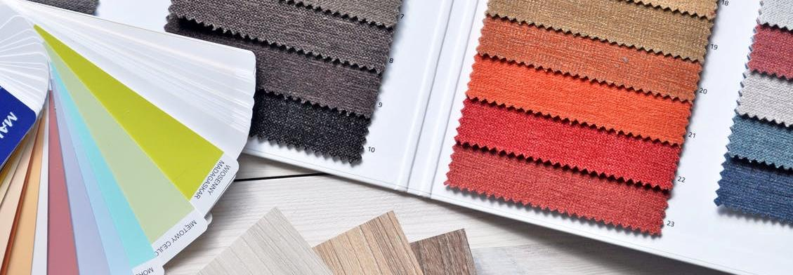
Introduction
Source from royalty free photo from Pexels
Basic elements of design in fashion include lines, shapes, form, texture and colour.

Slide 3
01. lines
Lines generally include straight lines, diagonal lines and curved lines and is one of the basic elements of design.
Fashion designers incorporate lines into a garment using two different methods.
Source from royalty free photo from Pexels

Slide 4
Lines: Structural method
Lines are created by garment construction techniques
(e.g. seams, darts or pleats).
⁽¹⁾
⁽²⁾
⁽³⁾

Slide 5
LINEs: Decorative method
Lines are presented as details on the surface of the garment
(e.g. buttons, piping or bindings).
⁽⁴⁾
⁽⁵⁾
⁽⁶⁾

Slide 6
02.
SHAPE
A shape is a two-dimensional area that stands out from the space around it due to variations in contour, colour or material.
Shapes can be geometric or organic.
Source from royalty free photo from Pexels

Slide 7
shape
Garment silhouettes are often subdivided into smaller shapes
(e.g. patchworks).
⁽⁷⁾
⁽⁸⁾
⁽⁹⁾

Slide 8
03. form
Form is the three-dimensional element of design and consists of length, width and height.
Form can be organic or inorganic and is enhanced by colour, shade, tone and texture.
Silhouette is the term designer used in fashion, which is the first element to be seen from a distance.
Source from royalty free photo from Pexels

Slide 9
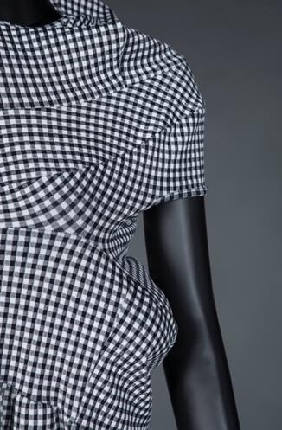
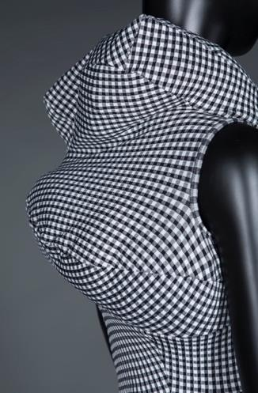

Scan to check:
Runway Photos
Comme des Garçons Spring 1997 collection titled “Body Meets Dress, Dress Meets Body”. Often referred to as the “lumps and bumps” show, it featured tube-like gingham dresses stuffed with lumpen filler that sculpted.
Source from HKDI Fashion Archive

Slide 10
04. texture
Texture refers to the surface quality of objects and can be both visual and tactile.
Textures are widely used in fashion in the form of prints, weaves, and other surface embellishments.
Source from royalty free photo from Pexels

Slide 11
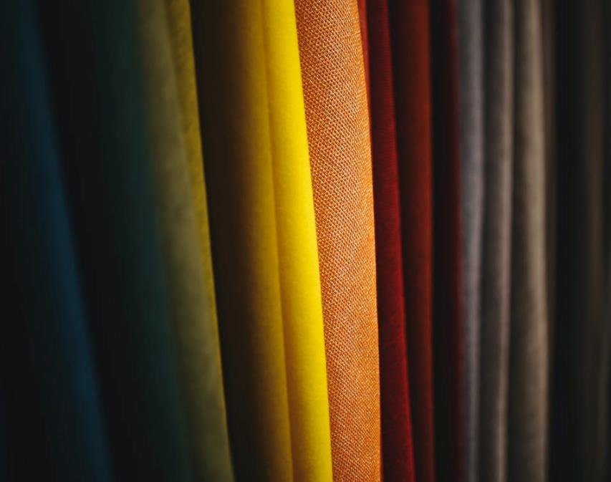
05.
Colour
Colour plays an important role in a design by reflecting the season’s mood, and fashion designers often use colour to achieve a harmonious garment design.
Source from royalty free photo from Pexels

Slide 12

Warm colour palette
Source from royalty free photo from Pexels
Warm colours consist of shades obtained from red, yellow and orange, that appear to be hot like the sun or fire.

Slide 13

cool colour palette
Source from royalty free photo from Pexels
Cool colours include those obtained from blue, green and purple, that serve as reminders of water or sky.

Slide 14

neutral colour palette
Source from royalty free photo from Pexels
Tints and shades of black and white form the neutral colour range.

Slide 15
System for Communicating colour globally

Slide 16

Scan to check:
Company Web
The Pantone Colour Matching System is la standardised colour reproduction system. By standardising the colours, different manufacturers in different locations can all refer to the Pantone system to make sure colours match without direct contact with one another.
Source from royalty free photo from Pexels

Slide 17
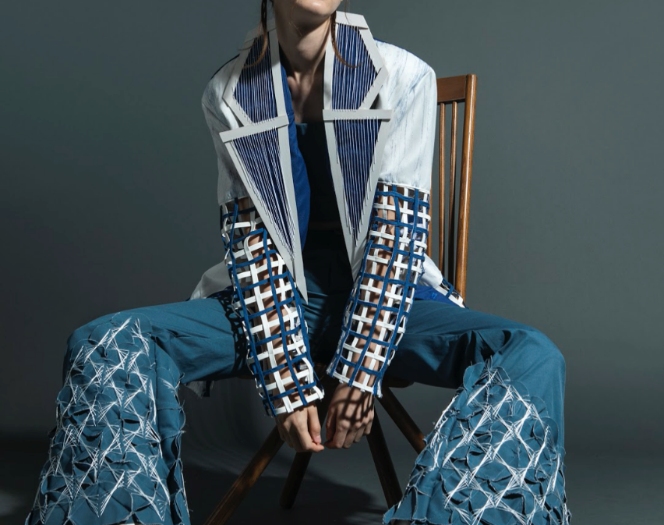
chapter activity
ELEMENT:
SHAPES
Discuss in small group of 5 students, can you identify all the different shapes within this design?
Collection by LEE Oi Ying, year 2 student of HD in Fashion Design in Hong Kong Design Institute

