Slide 1
Basic design principles
Chapter 2

Slide 2
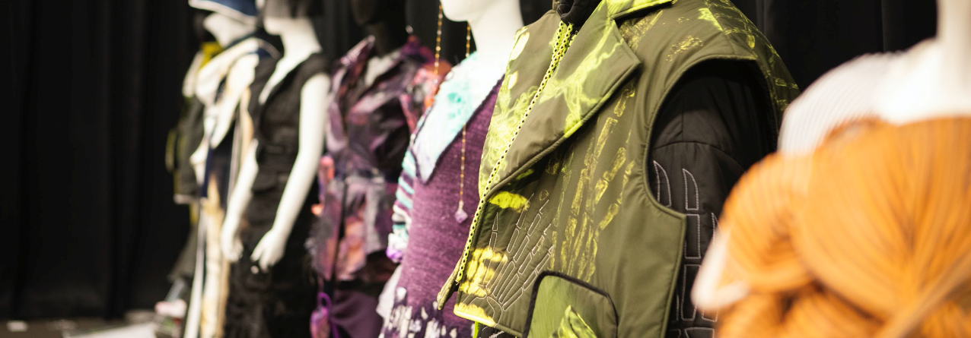
Introduction
Photo(s) is/are owned and provided by HKDI
Every garment is uniquely designed keeping the wearer in mind.
The principles of fashion design include unity, balance, proportion, emphasis, and rhythm.

Slide 3
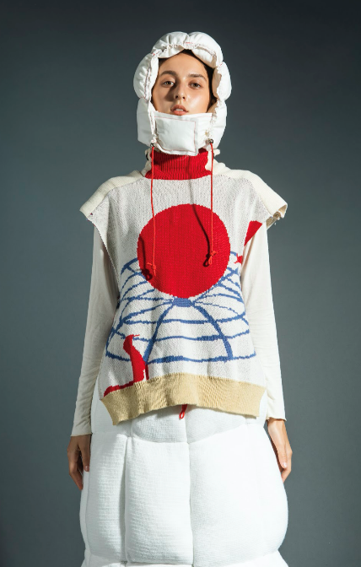
01. balance
Sense of evenly distributed weight, resulting in the overall feeling of stability.
Weight is perceived visually:
  Darkness of a value
  Depth of a texture
  Size & placement of a shape
  Orientation or width of a line
  Brightness of a colour
Collection by LEUNG Mei Wa, year 2 student of HD in Fashion Design in Hong Kong Design Institute

Slide 4
Horizontal
Balance
Formal balance: when each element on one side of the line has a counterpart on the other.
Informal balance: when the elements on either side achieve equality in weight but with variety in line, shape, texture and colours.
Formal balance
Informal balance

Slide 5
Vertical
Balance
Vertical balance: the top of the garment balance the bottom.

Slide 6
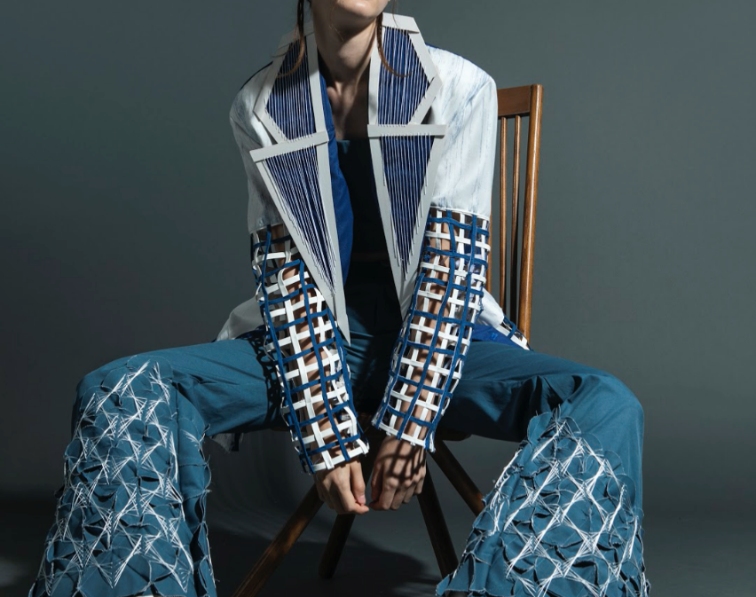
Symmetry
Aa strict adherence to the elements on either side of the median line such as shape, size, line, value, texture, colour and arrangement.
Collection by LEE Oi Ying, year 2 student of HD in Fashion Design in Hong Kong Design Institute

Slide 7

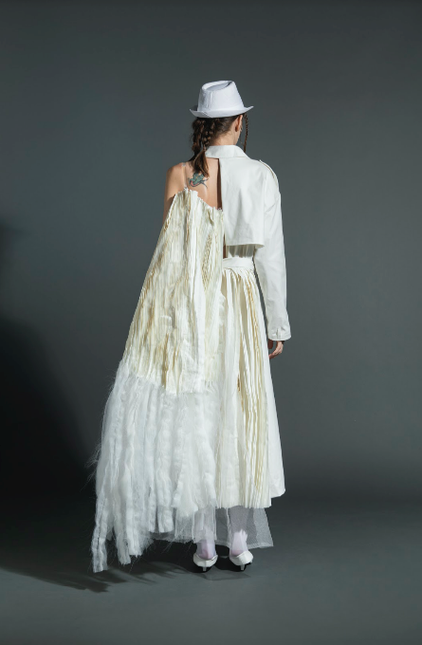
Asymmetry
Different on either side of the median.
The result offers the potential for real surprise, more lively, dramatic, casual or complex effects.
Collection by TSANG Pui Yan, year 2 student of HD in Fashion Design in Hong Kong Design Institute

Slide 8
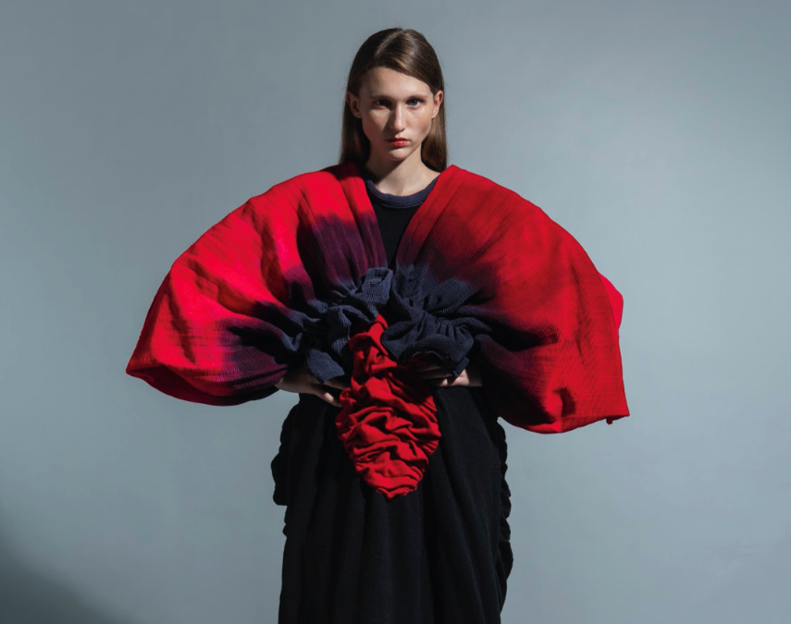
02.
Emphasis
o direct the viewer’s eye to the focus of the garment and then throughout the entire design.
Collection by YIP Chun Wa, year 2 student of HD in Fashion Design in Hong Kong Design Institute

Slide 9
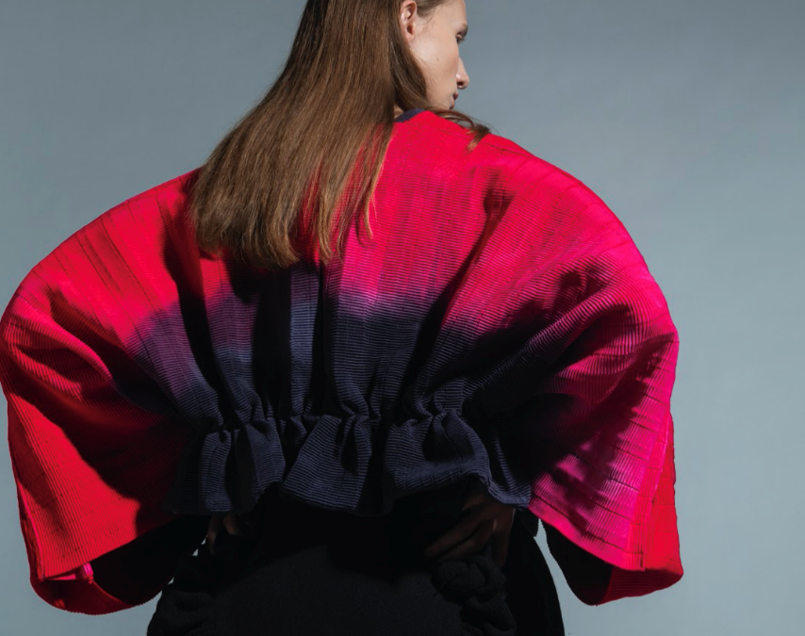
Emphasis is what the designer wants the viewer to see
It’s the centre of attention or the area of great visual importance.
Point of initial contact on the design.
Collection by YIP Chun Wa, year 2 student of HD in Fashion Design in Hong Kong Design Institute

Slide 10
Applying Emphasis
There are several approaches to apply emphasis on a design:
Isolation
Contrast
Repetition
Radiation

