Slide 1
Basic design principles
Chapter 2

Slide 2
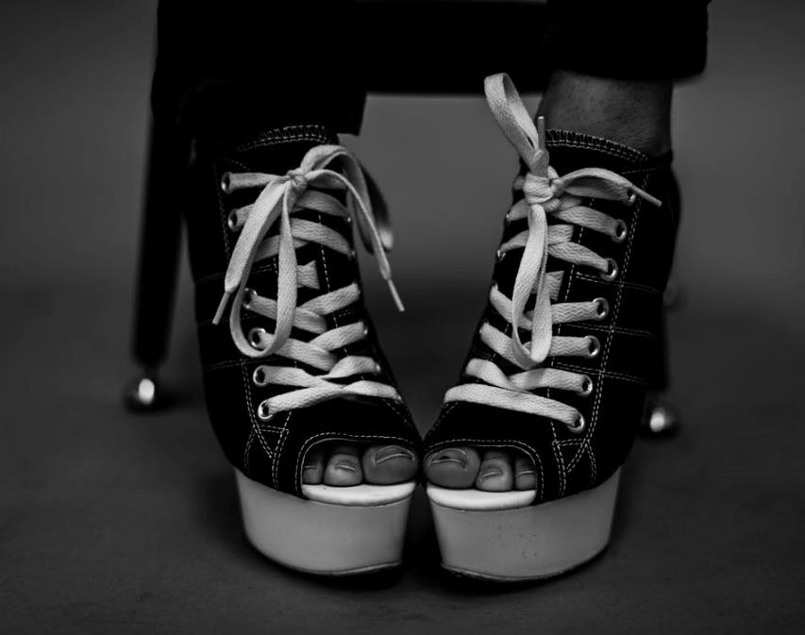
Emphasis: Isolation
A shape that stands out by itself.
Anomaly – a deviation from the norm.
Source from royalty free photo from Pexels

Slide 3
Emphasis: Contrast
Contrast is when two forces operate in opposition, causing a significant difference.
In fashion design, the forces may involve any of the following design elements:
  Shape
  Line
  Texture
  Colour

Slide 4
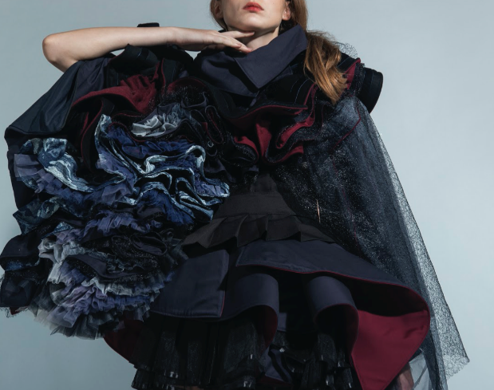
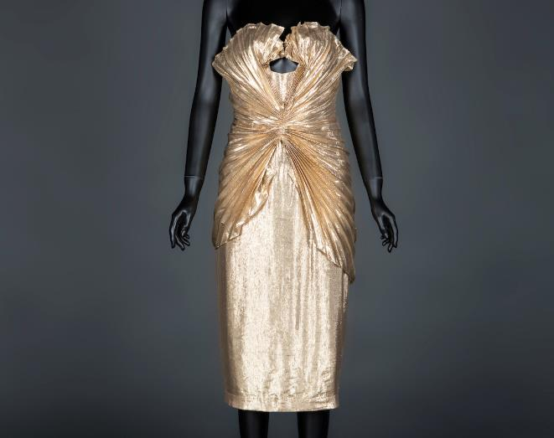
Emphasis: Repetition
Emphasis: Radiation
Collection by CHEUNG Tsz Ying, year 2 student of HD in Fashion Design in Hong Kong Design Institute
Thiery Mugler golden dress from HKDI Fashion Archive

Slide 5
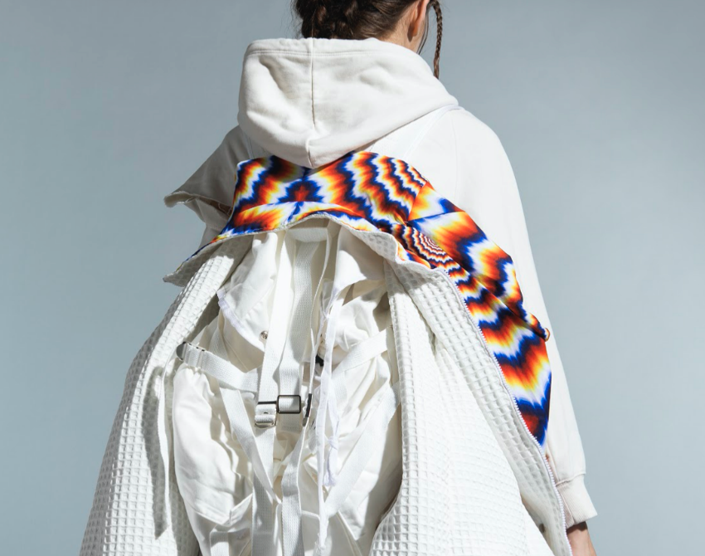
03.
Rhythm
Collection by CHOI Yee Nok, year 2 student of HD in Fashion Design in Hong Kong Design Institute

Slide 6
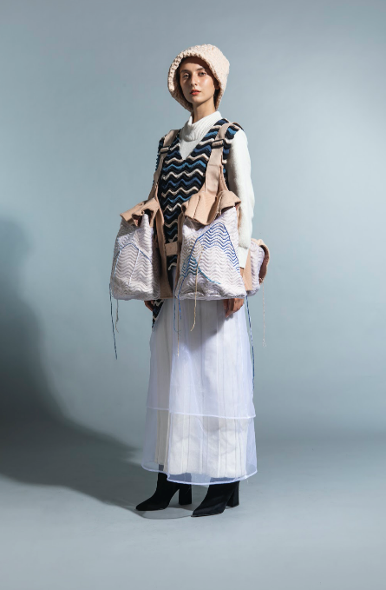
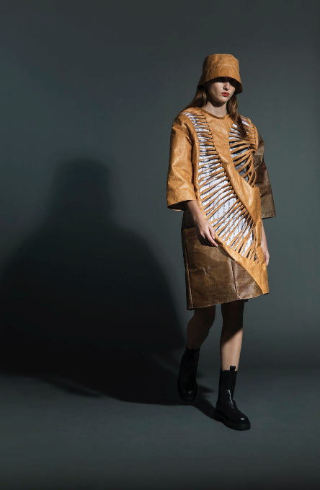
Visual Pathways
Fashion designers use line, shape, form, space, colour, pattern etc.
Line leads the eye as a consequence of its visual path.
The eyes move speedily along straight line and undulate according to curve or wave.
Collection by MA Wan Mei (Left), LUK Kam Ting (Right), year 2 students of HD in Fashion Design in Hong Kong Design Institute

Slide 7
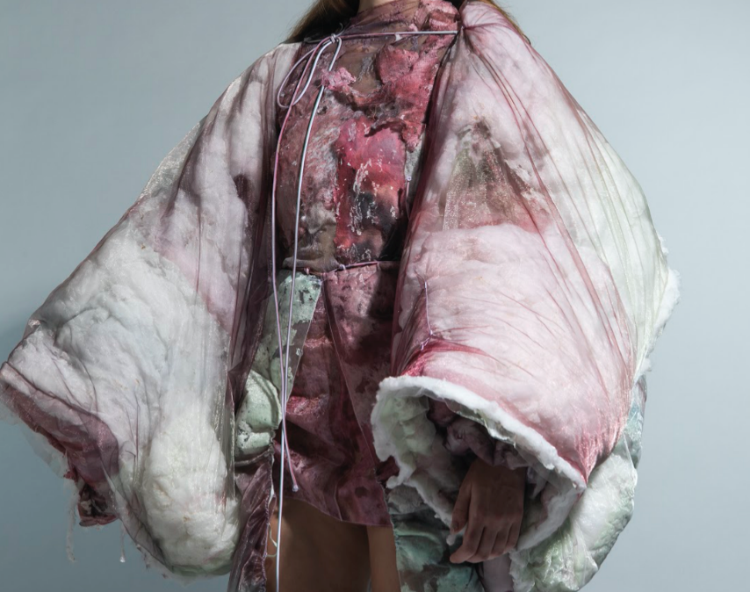
04. proportion
Result of the comparative relationships of distances, sizes, amounts, or parts to the whole.
Collection by WONG Cheuk Ying, year 2 student of HD in Fashion Design in Hong Kong Design Institute

Slide 8
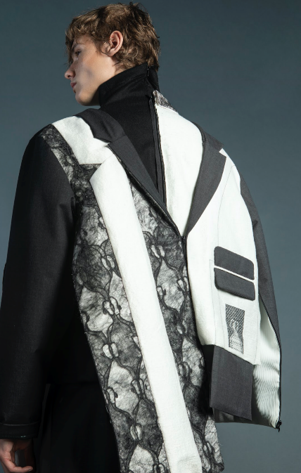
Proportion and the Figure
In fashion design, most proportion relates to the human figure.
Scale
The term used when proportion size is compared with human size.
Exaggerated proportions attract attention because they are different from the norm.
Collection by LI Yiu Kwan Yumiko, year 2 student of HD in Fashion Design Menswear in Hong Kong Design Institute

Slide 9
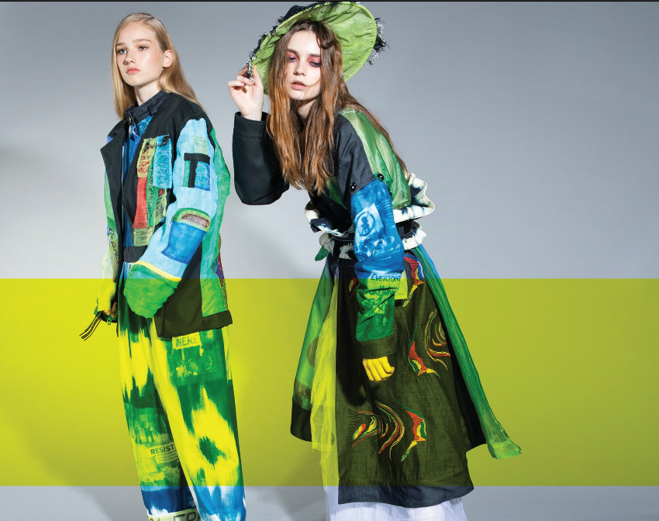
05. unity
Pulls all parts of the design together and ensures that all parts work together.
Collection by KAU Ka Man, 2019 graduated student of HD in Fashion Design in Hong Kong Design Institute

Slide 10
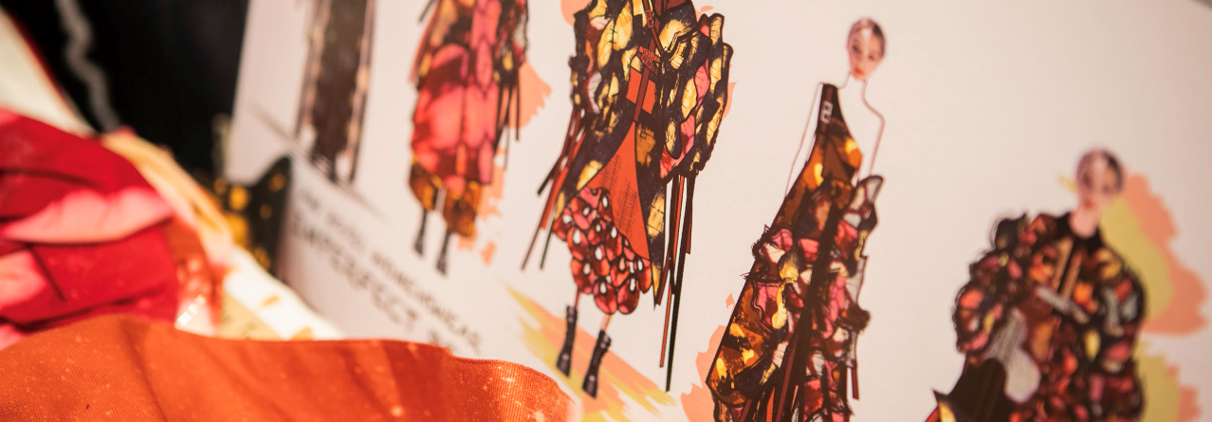
Variety and Harmony
Photo(s) is/are owned and provided by HKDI
It is necessary to maintain a balance between sameness and variety.
Too much variety brings confusion.
Collection line-up sketch board by YEUNG Hoi Yi, year 2 student of HD in Fashion Design in Hong Kong Design Institute

Slide 11
Unity and Harmony in Fashion
As the ultimate synthesising principle, it has a distinctive interpretation in fashion:
The structural, functional, and decorative levels of the design work towards a unified result.
Selection and use of materials.
Back of the garment works with the front.
Garment parts work with each other.
The design avoids conflict and competition by organising attention around a central theme.
There is a sense of completion to the design.

