Slide 1
fashion design applications
Chapter 2

Slide 2
ADHD
Collection by LAU Sin Yi

Slide 3
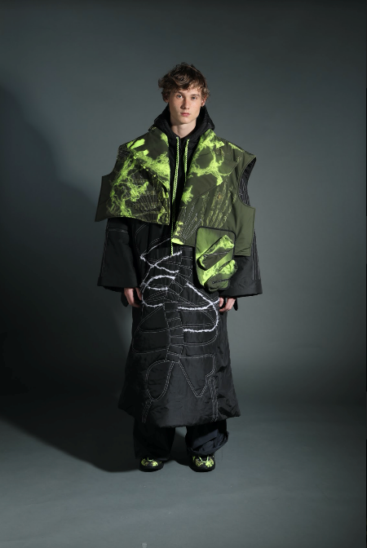
Design rationale:
ADHD is one kind of psychological disorder. This collection shows the beauty sides of the imperfect thing. Hand drawing of distorted backbone, skull and raw DNA pattern executed by transfer printing technique aims to present the abnormal and imperfect human body. Magnets are used for opening and joints which allow garment to be detachable easily for changing styles and achieve a functional streetwear look.
Design elements | Line | Solid diagonal lines
 | Shape | Sporty and functional panels
 | Form | Super boxy
 | Texture | Quilted fabrication
 | Colour | Neutral colour palette with accent colour
Design principles | Balance | Symmetrical design (visually balanced)
 | Emphasis | Contrasted colour prints & stitching
 | Rhythm | Repetition
 | Proportion | Oversized
 | Unity | Contrasted accent colours and prints
Collection by LAU Sin Yi, year 2 student of HD in Fashion Design Menswear in Hong Kong Design Institute

Slide 4
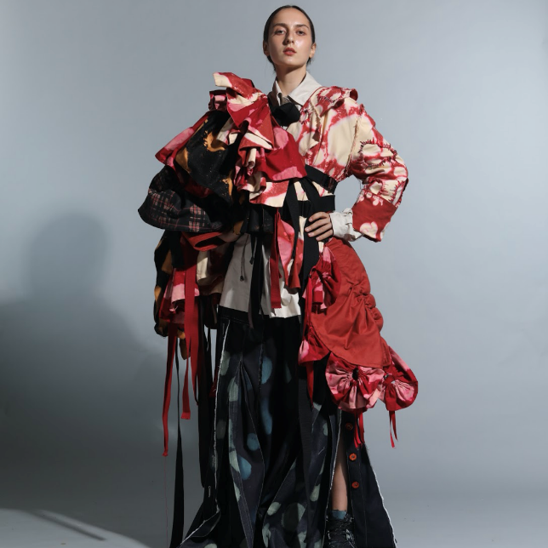
IMPERFECT BEAUTY
Collection by YEUNG Hoi Yi

Slide 5
Design rationale:
This collection aims to say no to racism and celebrate the uniqueness of individuality. There is no defined beauty in human, nothing to do with race, skin colour, body figure and appearance. Instead of applying ready-to-made material without soul, creating specialised and unique surface appearance could add organic value on ordinary cotton material, such as canvas and denim. With an exaggerated form and silhouette created, this collection expresses the essence of imperfect beauty, which reminds people on how to appreciate the beauty of fashion, and create beauty of human.
Design elements | Line | Mixed
 | Shape | Mixed
 | Form | Exaggerated forms
 | Texture | Tie dyed finishing and gathering effect
 | Colour | Warm colour palette
Design principles | Balance | Asymmetrical design
 | Emphasis | Contrasted textures and surface finishing
 | Rhythm | Progression (ruffles)
 | Proportion | Oversized
 | Unity | Contrasted forms & structures
Collection by YEUNG Hoi Yi, year 2 student of HD in Fashion Design in Hong Kong Design Institute

Slide 6
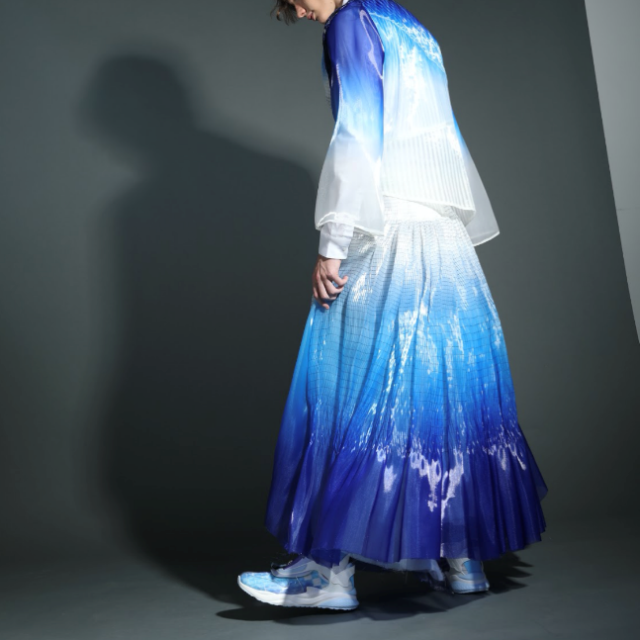
Variety - optics
Collection by YIU Ka Po

Slide 7
Design rationale:
In optics, there are different natural phenomena and effects such as gradient, refraction, reflection and perspective. This collection is inspired by these natural effects. The designer manipulates a piece of fabric to present interesting surface design details. Simultaneously use shibori, pleating, printing and draping techniques to achieve different dynamic forms and silhouette.
Design elements | Line | Streamlines
 | Shape | Geometric
 | Form | Structured
 | Texture | Tie dyed finishing with pleated effect
 | Colour | Cool colour palette
Design principles | Balance | Asymmetrical design
 | Emphasis | Contrasted textures and surface finishing
 | Rhythm | Repetition (lines), Radiation (colour)
 | Proportion | Fitted
 | Unity | Unified materials and finishes
Collection by YIU Ka Po, year 2 student of HD in Fashion Design Menswear in Hong Kong Design Institute

Slide 8
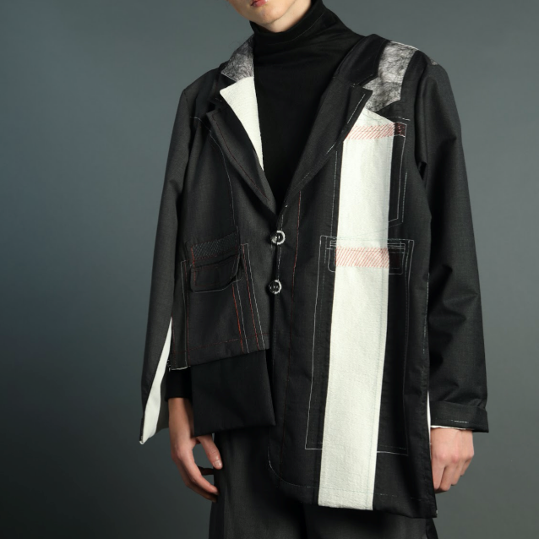
Devouring: two in one
Collection by LI Yiu Kwan

Slide 9
Design rationale:
Collection inspired by the mystery story of ‘The Silent Twins - June and Jennifer Gibbons’ and several pairs of twin's friends existing in the designer’s life. The design aims to show the struggles of twins because of different characters and how they accept each other by merging process which are executed through embroidery and interesting cutting on the outfit.
Design elements | Line | Straight & clean
 | Shape | Geometrical
 | Form | Boxy
 | Texture | Semi-finished
 | Colour | Neutral colour palette with accent colours
Design principles | Balance | Asymmetrical design
 | Emphasis | Contrasted front & back design
 | Rhythm | Isolation (duplicated back & front)
 | Proportion | Oversized
 | Unity | Duplicated design details
Collection by LI Yiu Kwan, year 2 student of HD in Fashion Design Menswear in Hong Kong Design Institute

Slide 10
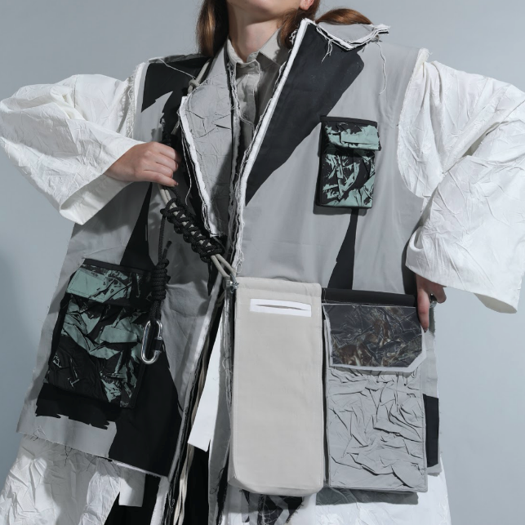
Preserve sth
Collection by TO Wing In

Slide 11
Design rationale:
PRESERVE STH is about fashion sustainability. Hong Kong is an overcrowded city, and people often use vacuum bag to store their clothing. The design inspiration come from: “shrinking theme” = more for less. The designer compresses the fabric scraps with biodegradable plastic (eco-friendly) and re-creates a new type of material. The design direction is stylish and unisex using the concept of Zero wastage.
Design elements | Line | Mixed
 | Shape | Geometrical
 | Form | Boxy
 | Texture | Semi-finished
 | Colour | Neutral colour palette
Design principles | Balance | Asymmetrical design
 | Emphasis | Contrasted textures
 | Rhythm | Repetition (texture)
 | Proportion | Loose fitted
 | Unity | Textile effect
Collection by TO Wing In, year 2 student of HD in Fashion Design in Hong Kong Design Institute

