Slide 1
Concept Development Process
Chapter 3

Slide 2
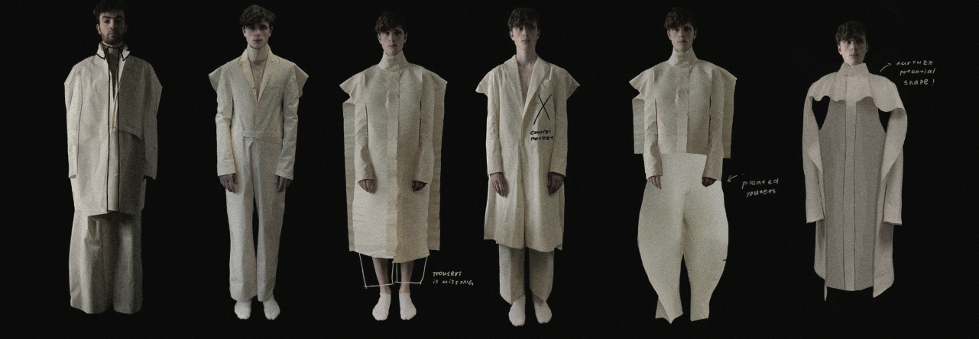
From concept to
Fashion Collection
Choosing a theme
Start your research book
Collaging idea
Juxtaposing (generating idea by mixing images, drawing and fabric)
Making theme/mood boards
Developments in fabric
Sketching
Constructing prototypes
Completing full collection
Fashion show
Photo(s) is/are provided by the copyright holder, Mr. Lam Kin Yan

Slide 3
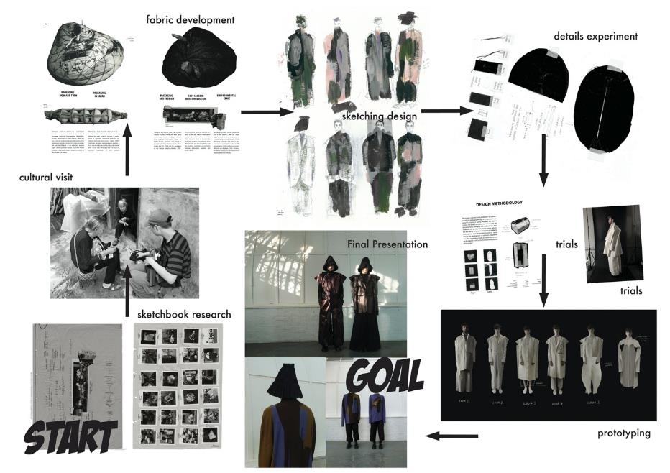
Case studies of collection development
Mr. LAM Kin Yan
(Alumni, HD in Fashion Design of Hong Kong Design Institute and London College of Fashion)
Case study of collection development by Mr. Lam Kin Yan (Alumni, HD in Fashion Design of Hong Kong Design Institute and London College of Fashion)

Slide 4
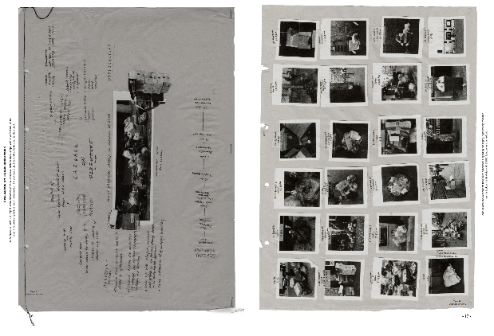
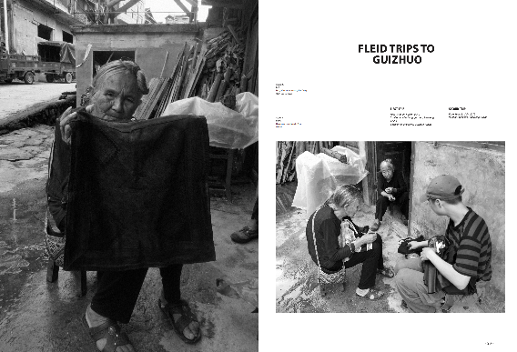
Sketchbook Research
Photo provided by the copyright holder, Mr. Lam Kin Yan
Cultural
Visit
Case study of collection development by Mr. LAM Kin Yan
(Alumni, HD in Fashion Design of Hong Kong Design Institute and London College of Fashion)

Slide 5
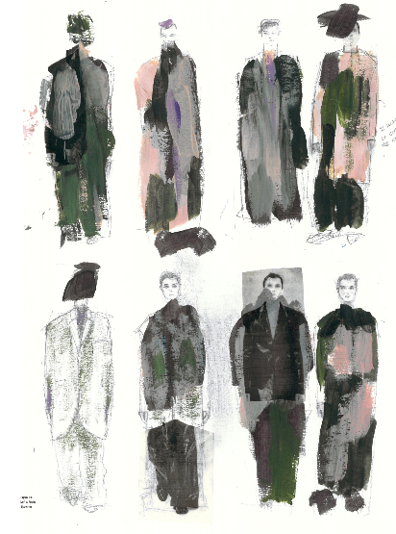
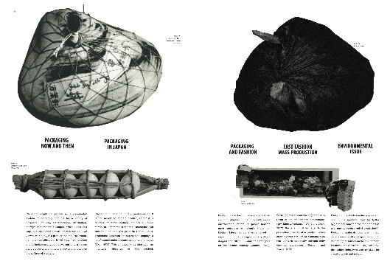
Fabric
Development
Sketching
Case study of collection development by Mr. LAM Kin Yan
(Alumni, HD in Fashion Design of Hong Kong Design Institute and London College of Fashion)

Slide 6
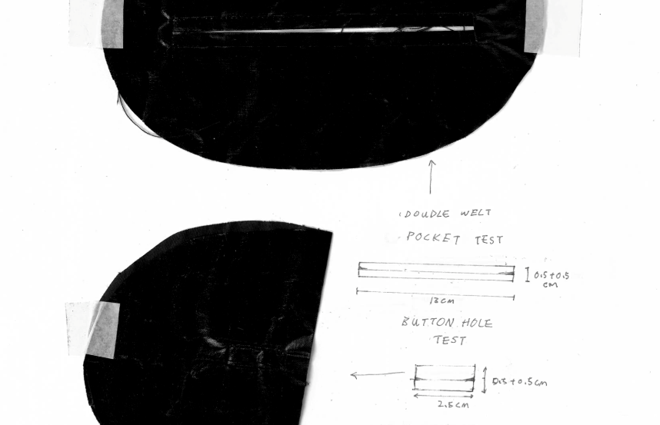
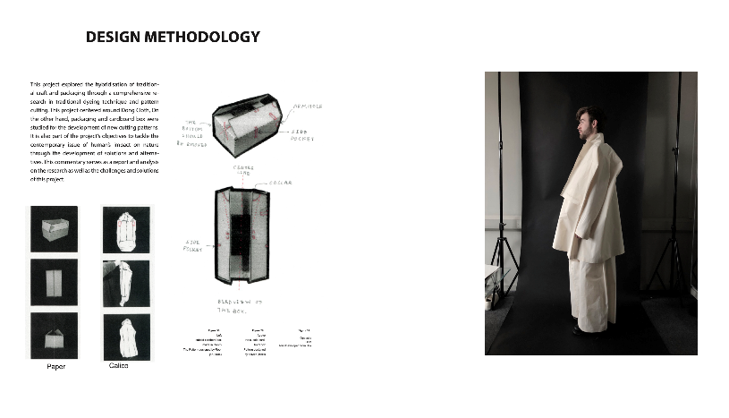
Details Development
Case study of collection development by Mr. LAM Kin Yan (Alumni, HD in Fashion Design of Hong Kong Design Institute and London College of Fashion)
TRIALS

Slide 7
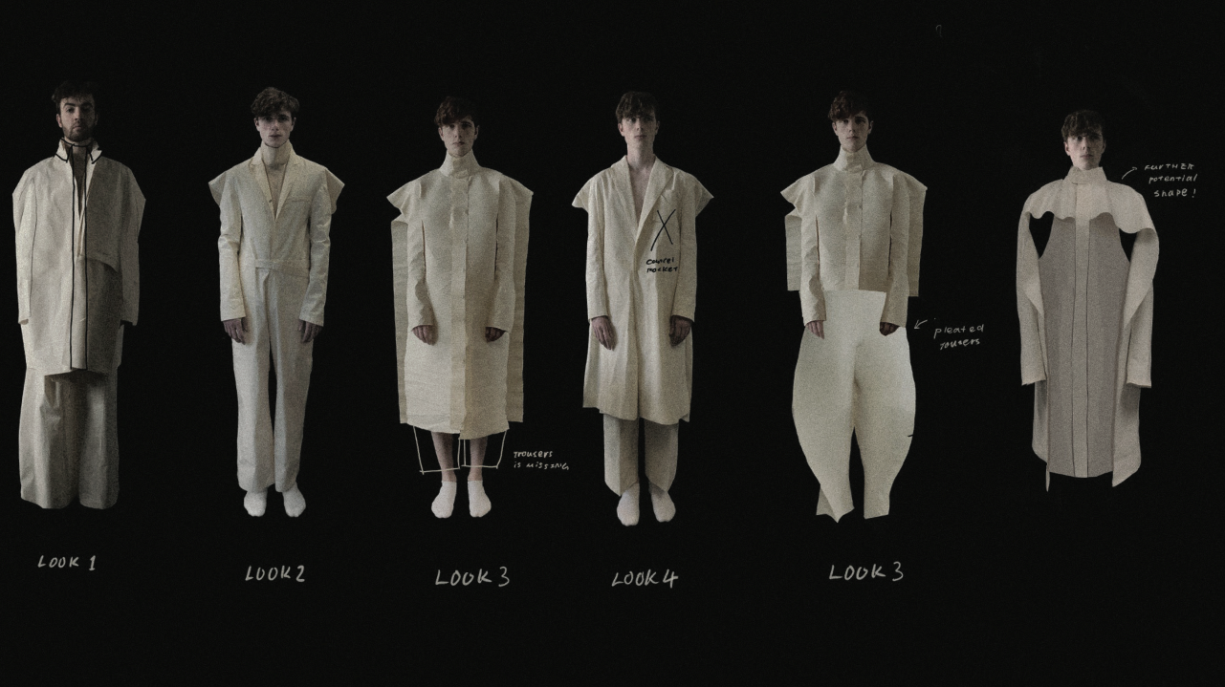
PROTOTYPING
Case study of collection development by Mr. LAM Kin Yan
(Alumni, HD in Fashion Design of Hong Kong Design Institute and London College of Fashion)

Slide 8
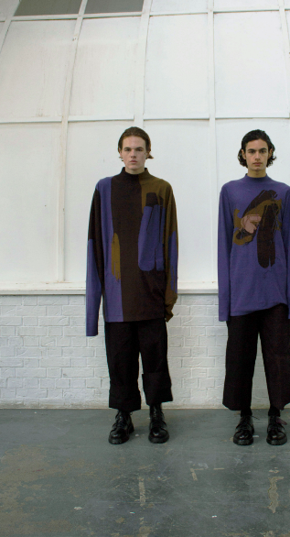
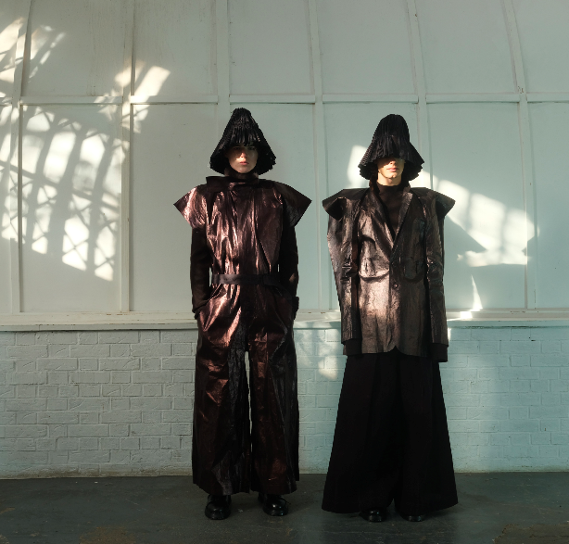
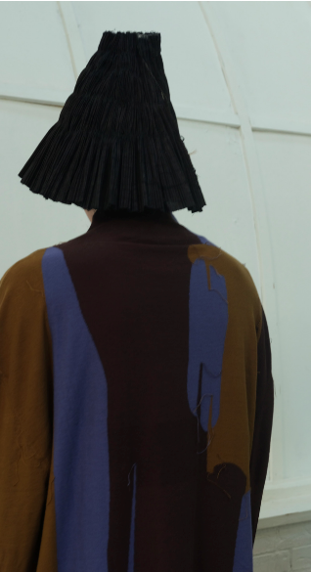
Collection showcase
Case study of collection development by Mr. LAM Kin Yan (Alumni, HD in Fashion Design of Hong Kong Design Institute and London College of Fashion)

