Slide 1
Design presentation: Presentation techniques
CHAPTER 4

Slide 2
A Portfolio communicates design ideas and outcomes in A range of visual formats
It indicates the designers’ creativity, personal strengths and interests (e.g. womenswear or menswear)
Physical portfolio or in a digital format
Fashion designers are increasingly embracing the use of new media technologies due to the advances in communication technology and the rise of social media

Slide 3
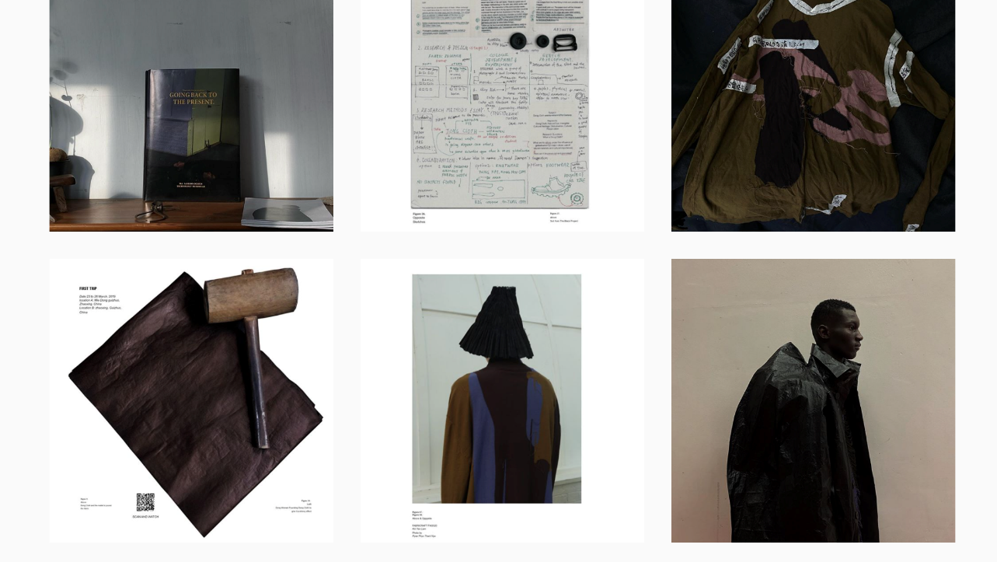
Latest trends and technologies in portfolio design:
ONLINE presentation
Instagram presentation of collection by Mr. Lam Kin Yan (Alumni of Vocational Training Council)

Slide 4
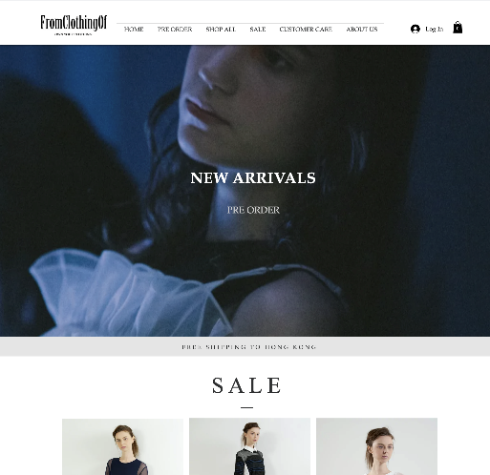
ONLINE PRESENTATION PLATFORMs
Designer website & webstore
A website gives a designer/ brand a crucial and common presence in the market.
It will present seasonal portfolio, information of brand, profile of designers and video of collection.
Usually, a webstore will also be setup as a selling point that customers are able to purchase goods right after they are impressed by the presentation.
Website presentation of collection, fromclothingof by Mr. Shirley Wong (Alumni of Vocational Training Council)

Slide 5
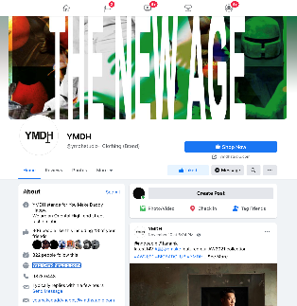
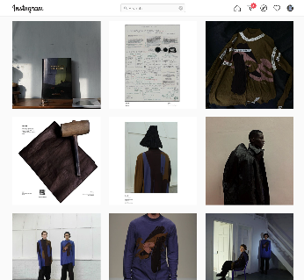
ONLINE PRESENTATION PLATFORMs
Fanpage
Presents seasonal portfolio, information of brand, profile of designers and video of collection.
Offers opportunity to create designers’ or brands’ profiles and to extend network
Helps marketing and attracts customers
Could be updated instantly and regularly
Facebook
Instagram
Online presentation of collection by YMDH of Mr. Jason Lee (left) and Mr. Lam Kin Yan (right) (Alumni of Vocational Training Council)

Slide 6
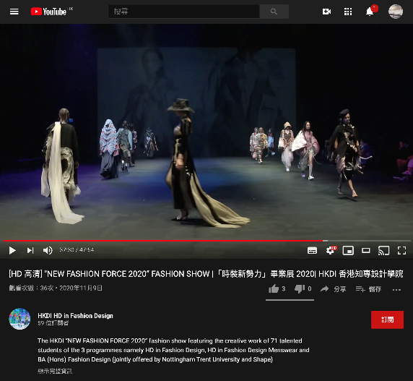
ONLINE PRESENTATION PLATFORMs
Online fashion show
It is getting popular in recent decade, due to the growing significance of social media platform such as Instagram, facebook, tiktok, and online video streaming platform e.g. youtube
Due to the Covid-19, all major fashion weeks are held in virtual format in 2020. This opens up a new future of runway presentation.

