Slide 1
Design presentation: Visual presentation skills
CHAPTER 4

Slide 2
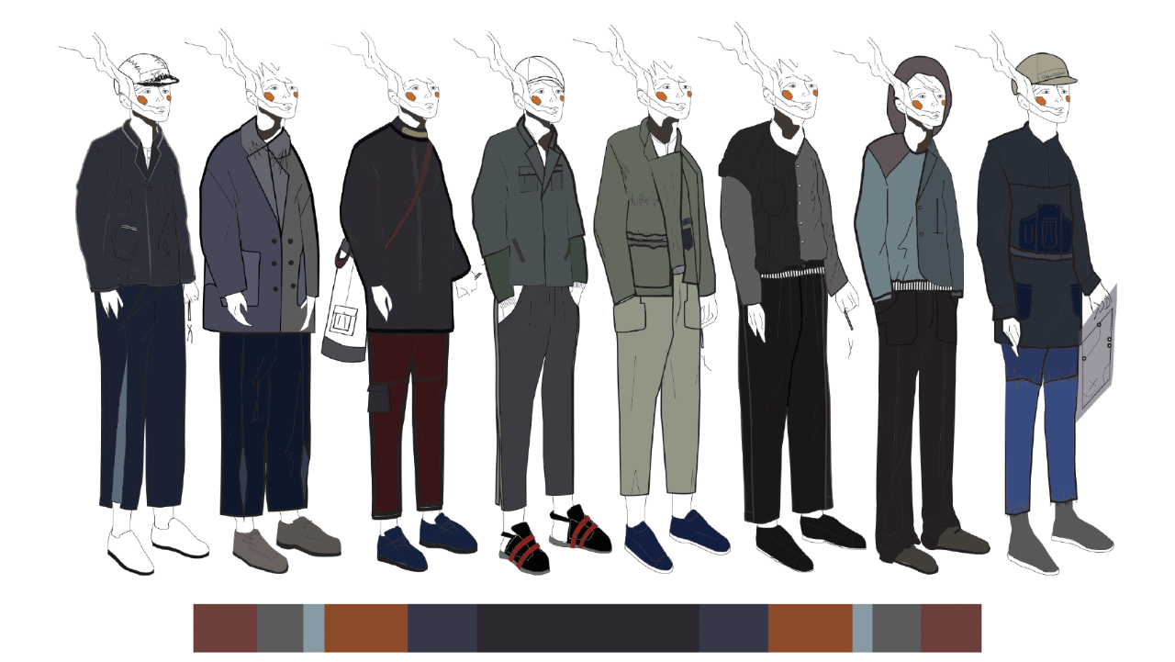
FAShion visualiSation
Illustration Lineup by Haylee Wong, 2016 (Alumni of Vocational Training Council)

Slide 3
MOOD/ THEME &
COLOUR BOARDS
Are made up as collages (physical or digital)
Essentially a distillation of designers’ research
‘Presentation’ version of the research book
Show clearly the themes, concepts, colours and fabrics
With keywords to communicate design idea

Slide 4
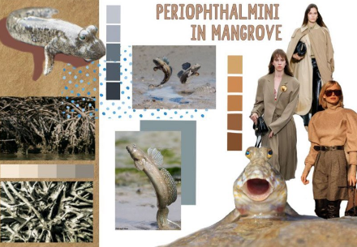
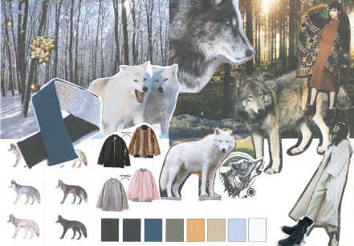
A MOOD BOARD
Present key mood of the collection, usually composed of pictures showing expressive colours, lines, textures and vibes. Keywords are provided to convey key features of inspirations.
Wool4School Hong Kong Student Design Competition 2020
Winner of the Senior Category: Liang Yuk-ying (St Catharine’s School for Girls)
Wool4School Hong Kong Student Design Competition 2020
Winner of the Junior Category: Ng Kei-yin (St Catharine’s School for Girls)
Photos provided by the Woolmark Company

Slide 5
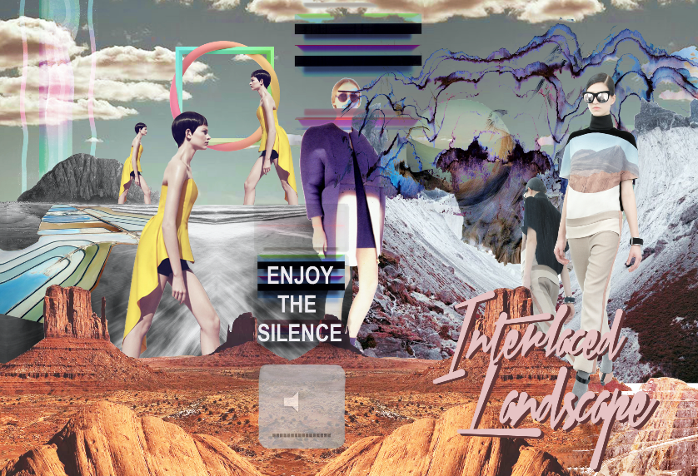
Digital collage THEME BOARD by Mickey Yeung (VTC Alumni) in 2015
A THEME BOARD
Shows the main title and
sub-titles or keywords that outline the key story of collection with the aids of photographs and artistic images. It sets as the major story board to present the collection’s story.

Slide 6
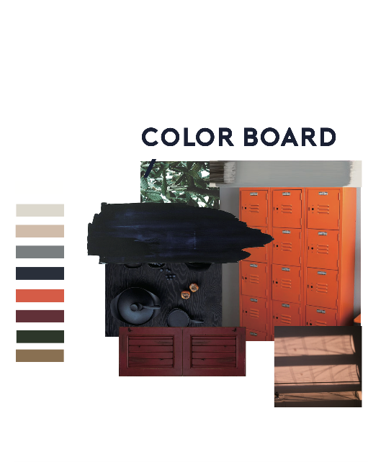
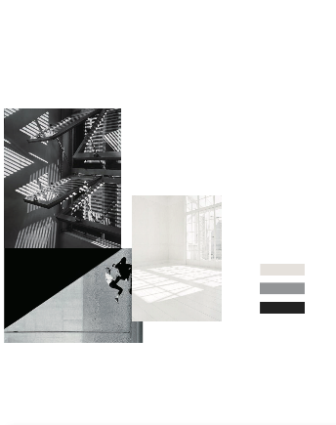
COLOUR BOARD
MAIN COLOUR
A COLOUR BOARD
Composed of images showing a range of colours to be used in the collection.
A set of colour palette is
designed for every single collection, with suggestions on how colours coordinate.
NEW NAVY
PLAYGROUND ORANGE
ACCENT COLOUR
WINE RED
Digital collage COLOUR BOARD by Tong Wan Ki, 2016 (Alumni of Vocational Training Council)

Slide 7
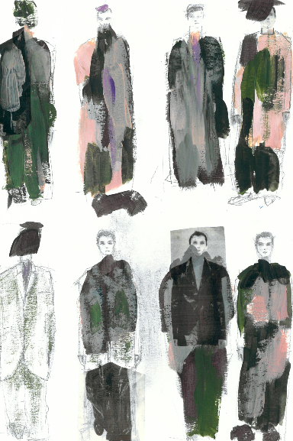
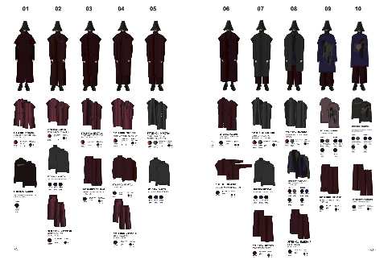
WHAT ARE
DESIGN BOARDS?
DESIGN BOARDS by Mr. Lam Kin Yan (Alumni of Vocational Training Council)
Photo provided by the copyright holder, Mr. Lam Kin Yan

Slide 8
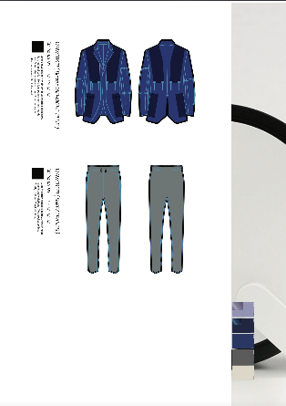
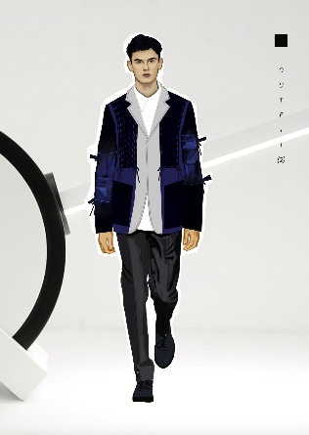
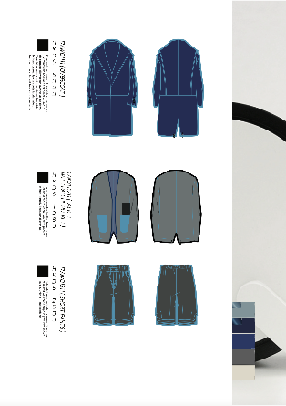
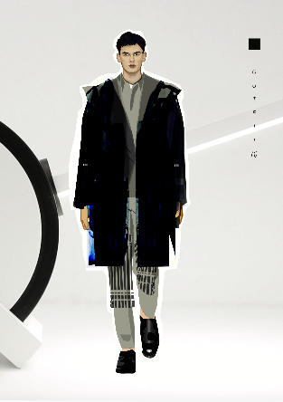
DESIGN BOARDS by LAU Kat Chun in 2016 (Alumni of Vocational Training Council)
MATERIALS
DESIGN BOARDS
Design board presents the outfit design (tops and bottoms).
With the support of flat drawings, illustration, written description, and materials used.
One outfit per design board i.e. a collection of 12 outfits, 12 design boards are required.
Photo provided by the copyright holder, Ms. Lau Kat Chun

