Slide 1
Fashion development in late 20th century
Chapter 5

Slide 2
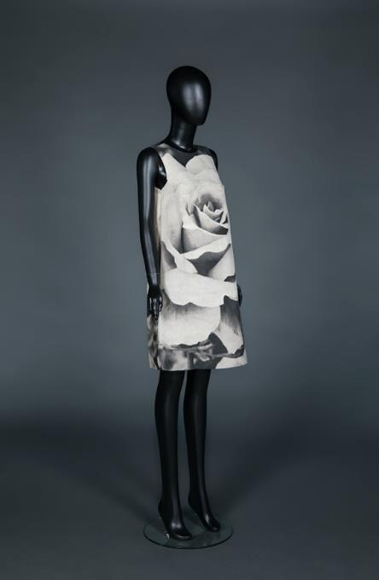
1960s
The Amazing Space Age
Art meets Fashion: Poster dress from 1960s
The 1960s was the age of turmoil and openness. After the world wars, people started to pursue freedom, liberation of thought and individualism.
With the impacts of social change, films and music on the younger generation, they began to criticise traditional culture and aesthetics, gradually created new patterns of life and values. Some described this as another "Belle Époque" due to the liberation of thought.
Fashion became more youthful, democratic and internationalised in the 1960s.
Paco Rabanne’s iconic rhodoid disc dress
Poster dress and Paco Rabanne dress from HKDI Fashion Archive

Slide 3
1970s
Fusion.
Variety. Freedom
The psychedelic dress is a symbol of the pursuit of freedom.
1970s is a period of rebellion. From music and fashion to films, people challenged traditional values with creativity.
Feminism, albeit inchoate, was leading a revolution in fashion.
Crochet cotton tunic and flare pants from 1970s
Psychedelic printed dress and crochet tunic and pants from HKDI Fashion Archive

Slide 4
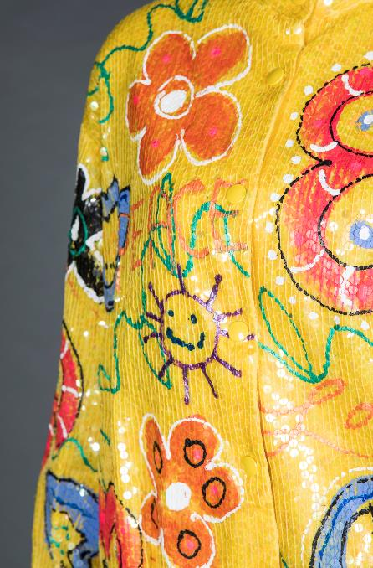
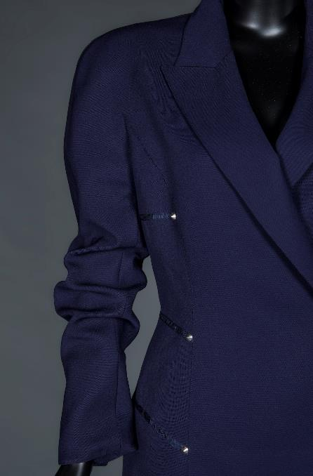
1980s Flourishing and Diverse Fashion
Prosperous economy, stable society, flourishing music development and disco culture in the 1980s all paved the way for the golden age of fashion.
The 1980s fashion was all about the gorgeousness with a wide range of styles, reflecting a specific attitude to life.
1980’s fashion is characterised by oversized cut and extravagant designs.
Printed silk jacket and Claude Montana power suit from HKDI Fashion Archive

Slide 5
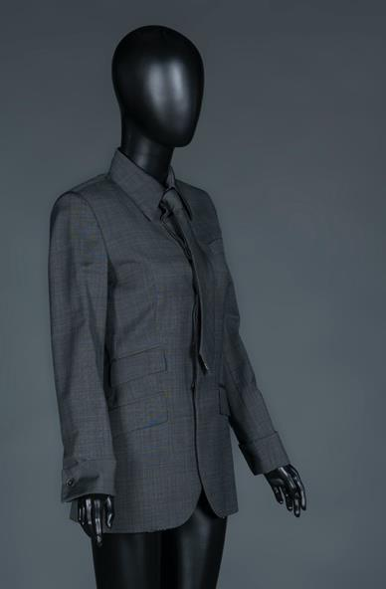
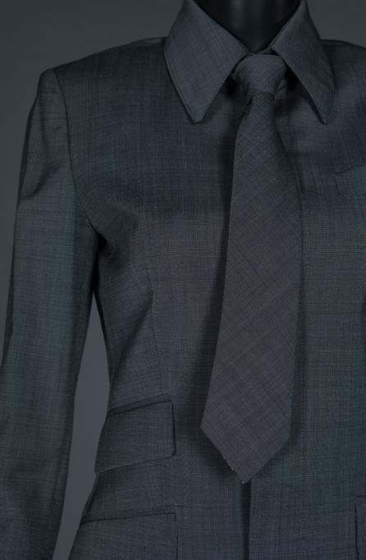
1990s
The Age of Individualism
1990s Jean Paul Gaultier tied suit
During the 1990s, aesthetics was stripped down of the last decade's excess and opulence. To present the beauty of "less is more", simplest garment cutting and basic colour palette ranging from black to white were applied.
Androgyny was another keyword of the decade, reflecting the gender blurring and emphasising the pursuit of individuality. Some described such design as "the lesbian chic".
Jean Paul Gaultier suit jacket from HKDI Fashion Archive

