Slide 1
CHAPTER 7
Colour theories for wardrobe planning

Slide 2
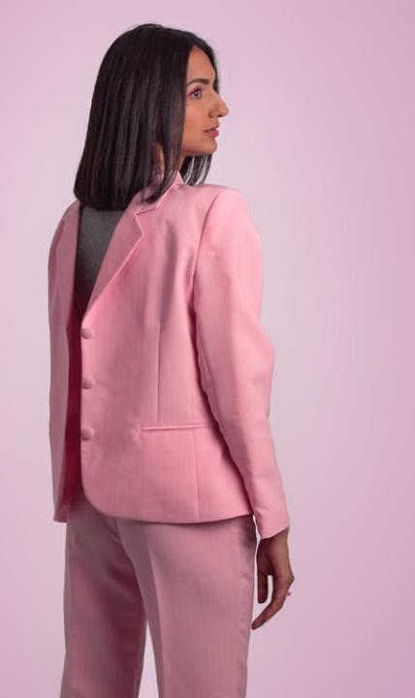
The use of colours in relation to outfits coordination
Royalty-free photo sourced from Pexels.

Slide 3
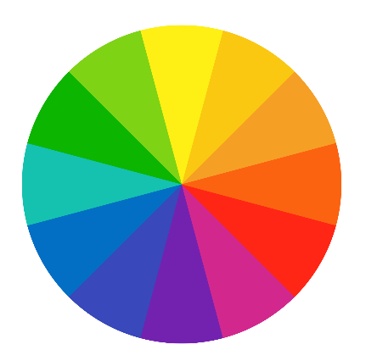
About COLOUR & FASHION
Colours draw our first attention when shopping for a garment
Psychological as a visual selection factor
Black reminds death, funeral; whereas white is pure and heavenly
Dark colours make a form slender, while light colours add additional volume
An important way to add visual presence to personal style
THE

Slide 4
WARM HUES VS COOL HUES
Warm hues such as yellow and orange are intense and bright colours
They make wearers appear larger and increase in body size
Make wearers appear shorter and heavier
Cool hues refer to sky and ocean blue
Decrease body size and make wearers look taller and slimmer
Royalty-free photo sourced from Pexels.

Slide 5
Monochromatic
All one colour, using one hue
e.g. all black, all grey, all beige
COLOUR
HARMONIES
CONTRASTING
Colour harmony
No hue in common hue
e.g. red & blue, yellow and purple
Royalty-free photo sourced from Pexels.

Slide 6
Analogous
Colours that appear next to each other on the colour wheel
e.g. yellow-orange, yellow-green
COLOUR
HARMONIES
Complementary
Colours that appear opposite to each other on the colour wheel
e.g. blue & orange
Royalty-free photo sourced from Pexels

Slide 7
COLOUR HARMONIES & Clothing
Clothing Choice | Hue | Value | Chroma | Harmony | Fashion Personality
Appear larger, increase size | Warm hues | Light | Pure | Contrasting Complementary | Dramatic Romantic Elegant
Appear smaller, decrease size | Cool hues | Dark | Weak | Monochromatic Analogous | Classic Sporty Elegant
Plummer (2009)
Reference: Plummer, N., 2009. Your personal style. Fairchild books.

Slide 8
SEASONAL COLOUR THEORY
The colour seasons – autumn, spring, winter and summer are related to the colours on the colour wheel
Autumn and spring are warm hues
Winter and summer are cool hues
Plummer (2009)
Royalty-free photo sourced from Pexels.

Slide 9
Colour | Suggestion
Black | Wealth, power, confidence, sophistication
Purple | Royalty, creativity, dignity, mystery
Green | Growth, stability, wealth, calming
Red | Hot, intense, strength, exciting
Yellow | Optimism, vitality, happy, new
Blue | Intellectual, tradition, trust, conservative
White | Clean, pure, innocent, truth
Orange | Active, motion, energy
Pink | Romance, passive, stress reducer, complaint
PSYCHOLOGY OF COLOUR
Knowing what people perceive the colour you are wearing helps you choose the right colour for certain occasions
Plummer (2009)
Reference: Plummer, N., 2009. Your personal style. Fairchild books.

Slide 10
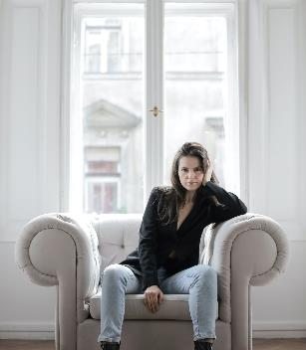
BLUE
Colour of Tops MAKES A DIFFERENCE
RED
BLACK
PINK
Romance, passive, stress reducer
Intellectual, tradition, trust, conservative
Hot, intense, strength, exciting
Wealth, power, confidence, sophistication
Royalty-free photo sourced from Pexels.

