Slide 1
CHAPTER 9
Wardrobe planning for social gathering

Slide 2
LET’s PLAN Your Wardrobe
Royalty-free photo sourced from Pexels

Slide 3
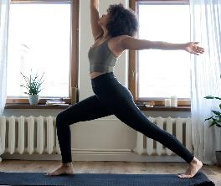
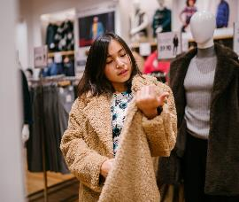
Lifestyle Chart
A lifestyle chart helps us realise our daily life pattern.
By completing the chart which records our weekly activities, it allows us to understand our wardrobe needs.
Royalty-free photo sourced from Pexels

Slide 4
Lifestyle Chart
Based on the lifestyle chart suggested by Marshall, et al., 2012, we could understand our needs of clothing and determine our wardrobe.
List the activities in the time chart using the following code:
A= Athletics (sports & exercise)
U = At school *
E= Extra-curricular activities*
F= Formal/ semiformal events
S= Social events (gathering with friends, hangout)
T= Travel (short trip)
O= Others (specify:___)
*“U = At school” and “E=Extra-curricular activities” replaced the option of “executive office work” and “casual office work” to optimise the effectiveness of lifestyle chart for teenagers.
Planning for daily activities

Slide 5
Planning for daily activities
Lifestyle Chart
Analyse the percentage of time spent on each type of activity.
Suggest clothing appropriate for each activity.
Apportion the clothing budget.

Slide 6
Lifestyle Chart
Planning for daily activities
Chapter Activity
WHAT IS YOUR LIFESTYLE CHART?
The result will determine which types of clothing you need more.

Slide 7

Lifestyle Chart
If you spend more time on athletics and social events”,
more athleisure style of clothing should be a great choice for the wardrobe;
If you spend more time on social events and extra-curricular activities,
casualwear style should be a great choice for you.
Royalty-free photo sourced from Pexels

Slide 8
KEY LOOKS
Royalty-free photo sourced from Pexels

Slide 9
CASUAL SHIRT X
JEANS X
SNEAKERS
KEY LOOK SCENARIO 1
If a boy who participates in a music performance during weekends, “smart casual” style is a cool choice for him.
Royalty-free photo sourced from Pexels

Slide 10
JERSEY TOPS X
JOGGER PANTS X
SNEAKERS
KEY LOOK SCENARIO 2
If a girl loves playing leisure sport activities during weekends, “athleisure” style is a beautiful choice for her.
Royalty-free photo sourced from Pexels

