Slide 1
Technology & living
Textile Technology
S3.2.1 Advanced Fabric Construction

Slide 2
Fabric Forming Technologies
Woven Fabric Technology
The technology used to form the fabric by interlacing two or more sets of yarns at the right angles to each others.
Knitted Fabric Technology
The technology used to form the fabric by intermeshing the yarn into loops.
Non-woven Fabric Technology
The technology used to form the fabrics by fibre or filament webs.
Photo(s) is/are owned and provided by HKDI.

Slide 3
Fabric Forming Technologies
Braided Fabric Technology
Braid consists of three or more yarns twisted around one another.
Tufted Fabric Technology
Tufted fabric has piles of fibres / loops of yarns that stand up from the base fabric. For example velvet, terry towel and carpets,
Photo(s) is/are owned and provided by HKDI.

Slide 4
Comparison
Fabric | General Structural Features | Main Applications for Apparel | Productivity
Woven | High dimensional stability | Outwear, suits, shirt, jeans, etc. | High
Knitted | High extensibility and elasticity | Underwear, intimate wear, sportswear, casual wear, etc. | Higher than woven fabric
Non-woven | Low mechanical properties | Liners, paddings, disposal clothing | Highest

Slide 5
Non-woven – Web Forming
All nonwoven fabrics are based on a fibrous web.
Characteristics of the web determine the physical properties of the final product.
These characteristics depend on the methods of web formation.

Slide 6
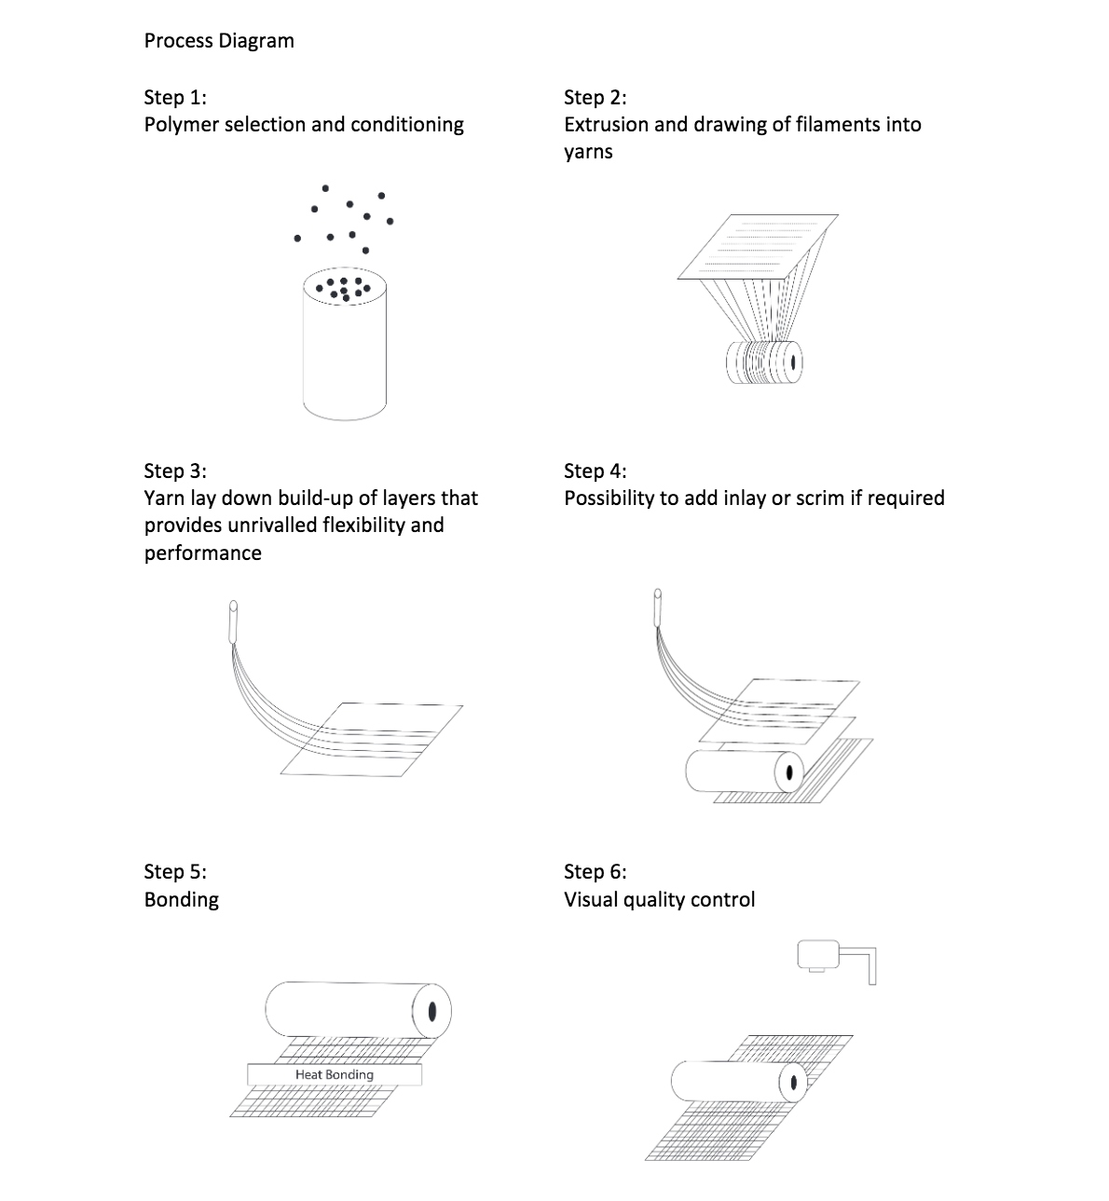
Process Diagram
Step 1:
Polymer selection and conditioning
Step 2:
Extrusion and drawing of filaments into yarns
Step 3;
Yarn lay down to form layers
Step 4;
Add inlay or scrim if required
Step 5:
Bonding
Step 6:
Quality control
Photo(s) is/are owned and provided by HKDI.

Slide 7
Forming Webs Methods
Determined by fibre length
Initially the methods for the forming of webs from staple-length fibres were based on the textile carding process
Whereas web formation from short fibres was based on papermaking technology
Determined by fibre diameter
Fibre diameter is a very important parameter for choosing a web forming method such as
Spun-bonded (normal diameter)
Melt blown (Microfibre
Electrospun (nano-fibre)

Slide 8
Properties of Spun-bonded Web
Chemical and physical stability
High strength
Unique and highly controllable structure which can be engineered to provide desired properties
Very light and flexible structure to heavy and stiff structure

Slide 9
Application of Spun-bonded Web
Automotive, e.g. trunckliner, floor carpets
Civil engineering, e.g. railroad beds stabilisation, highway cracking prevention, protection
Sanitary, e.g. napkins, diapers
Medical, e.g. disposable operating room gowns, shoe cover
Packaging, e.g. medical sterile packaging, high performance envelops

Slide 10
Properties of Melt Blown Web
Random fibre orientation
Lower to moderate web strength
Good insulation and filtration
Smooth surface texture
Most melt blown webs are layered or shingled in structure, the numbers of layers is based on the required weight of the fabric

Slide 11
Application of Melt Blown Web
Melt-blown is unique production method for very fine fibre
Melt-blown system can be applied to micro-denier fibre
Filtration media, e.g. cartridge filters, clean room filters
Medical
Sanitary, e.g. diaper top sheet
Oil adsorbents, e.g. sorbents to pick up oil from surface of water
Apparel, e.g. thermal insulation, substrate for synthetic leather

