Slide 1
Circular Product Development
Apparel Industry - Market research and developments

Slide 2
Fashion Product Development process and cycle

Slide 3
Fashion Product Development process and cycle
Formulate Buying Plan by Buyers
Trend Scouting by Designers and Buyers
Collection Design by Designers
Costing by Merchandisers and Factories
Buyers Select Styles and Place Orders
Pre-production Resampling and Approval by Buyers
Production Started
Goods to be Shipped to Retail
Sample Making

Slide 4
What is Fashion circular product development?
Material Sourcing
Renewable Materials
Designed and Produced to Last
Repair and Re-design
Wear
Rent or Resell
Garment Production
Circular fashion is a concept that aims to design, produce, and consume clothing in a way that minimizes waste, maximizes resources, and extends the lifespan of garments
It is also a design and manufacturing approach that brings out the concept of “Design Out Waste”.
It is a closed-loop system making new materials out of old materials. Materials can be re-used and re-cycled continuously
”Old clothes are becoming new”
A closed-loop system

Slide 5
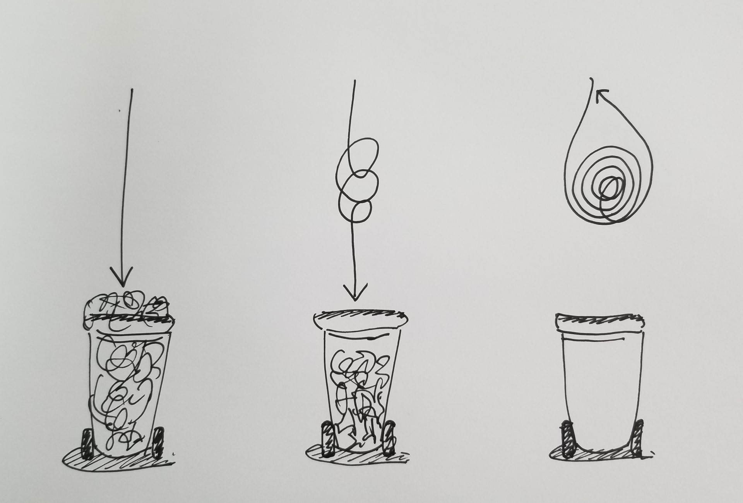
Sustainability of the Textiles and Garment Industry
Linear Fashion Development
The process goes straight from one stage to another, from material extraction to consumer usage and to final disposal
Recycling and Upcycling Fashion Development
Recycling fashion is to recover existing fabrics or materials of worn garments to create new products
Upcycling fashion is to re-design old garments to create new outfits that are more on trends and with new values to the customers
Circular Fashion Development
It is a holistic design approach to avoid textile and garment wastes to go to landfills - a closed-loop system
Linear Fashion
Development
Recycling and
Upcycling Fashion
Development
Circular Fashion
Development
Image(s) is/are provided by Hong Kong Design Institute

Slide 6
Linear Fashion Development
Recycling and Upcycling Fashion Development
Raw Materials
Design
Garment Production
Wear
Trash
Landfill
Raw Materials
Design
Garment Production
Wear
Trash
Landfill
Recycle old garments into fibres or fabrics for restarting the whole development process again
Redesign old garments into new products to give them a new product life cycle

Slide 7
Circular Fashion is A more holistic approach combining the concept of recycling and upcycling
Bring in the concept of sustainability to avoid any resources thrown into landfills :-
Materials Sourcing and Production
Choose manufacturers that are using sustainable management approach
Use of recycling/renewable materials
Garment Design
Design garments that are durable, adapt to daily life and able to wear long
Garment Production
Choose manufacturers that are using sustainable management approach, e.g. “Zero Waste” pattern making and cutting method
Personal Usage
Upcycle the garments instead of throwing them away
Repair garments for minor worn out
New Fashion Culture/Businesses
Advocate new cultures such as vintage fashion, mix n match fashion
Advocate new businesses such as fashion renting services, fashion exchange or resell

Slide 8
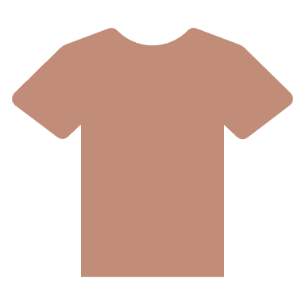
Textiles and apparel industry and global warming

Slide 9
The World 3rd largest pulluter
Fashion Industry
Responsible to
8 - 10%
Global Annual
Carbon Emission
!!

Slide 10
What can the textiles and apparel industry do to save the world!!

Slide 11
Eco-innovative solutions on Textiles
Organic silk
Organic & re-cycled cotton
Re-cycled wool
Chrome-free leather
Synthetic materials with environmentally-friendly certification
Use sustainable dyestuff
Use of botanic dyes, made of extracts from raw materials such as flowers, shells, fruits and leaves

Slide 12
Green Manufacturing
Efficient energy consumption
Use solar water heating system and generate energy from waste heat
Upgrade cooling system
Use energy-efficient sewing machines, load shifting machines and lighting systems
Less water to be used and more cautious about waste water treatment
Use green suppliers
Use organic and re-cycled materials

Slide 13
Eco-innovation solutions on Fashion design and retailing
Made to be re-made
Avoid over-consumption, especially re-think the business model of fast fashion
Buy second-hand clothes and advocate the culture of vintage clothing
Encourage up-cycling, ie. Encourage people to repair, re-vamp and re-design their old clothes
Encourage clothes renting culture
Donate clothes to the needy
Advocate less is more concept to promote ”Buy Less” habit. However, it will have a financial implication to fashion brands
All packaging and retail store materials to be re-usable and re-cyclable or compostable

Slide 14
Green Marketing
Educate consumer and get their support on eco-friendly product “ethical consumption attitudes”
Internal Control - product style, product design, product colour, product care, and product quality
External Control - pricing, packaging, place of origin and product brand

Slide 15
Reference (Retrieved on 23 Aug, 2023)
In the textiles industry, old is increasingly becoming new (https://www.unep.org/ )
What is Circular Fashion?
(https://www.thesustainablefashionforum.com/ )
Climate+ Acceleration Webinar
(https://textileexchange.org/)
Akter, S., Ji, X., Sarker, M. M., Cai, L., Shao, Y., Hasan, M. K., Abir, S. A., & Quan, V. (2020). Clean manufacturing and green practices in the apparel supply chain. Open Journal of Business and Management, 8(1), 104–113.

