Slide 1
The Evolution of the Apparel Supply Chain and Fashion Retail Landscape
Apparel Industry -
Business Environment

Slide 2
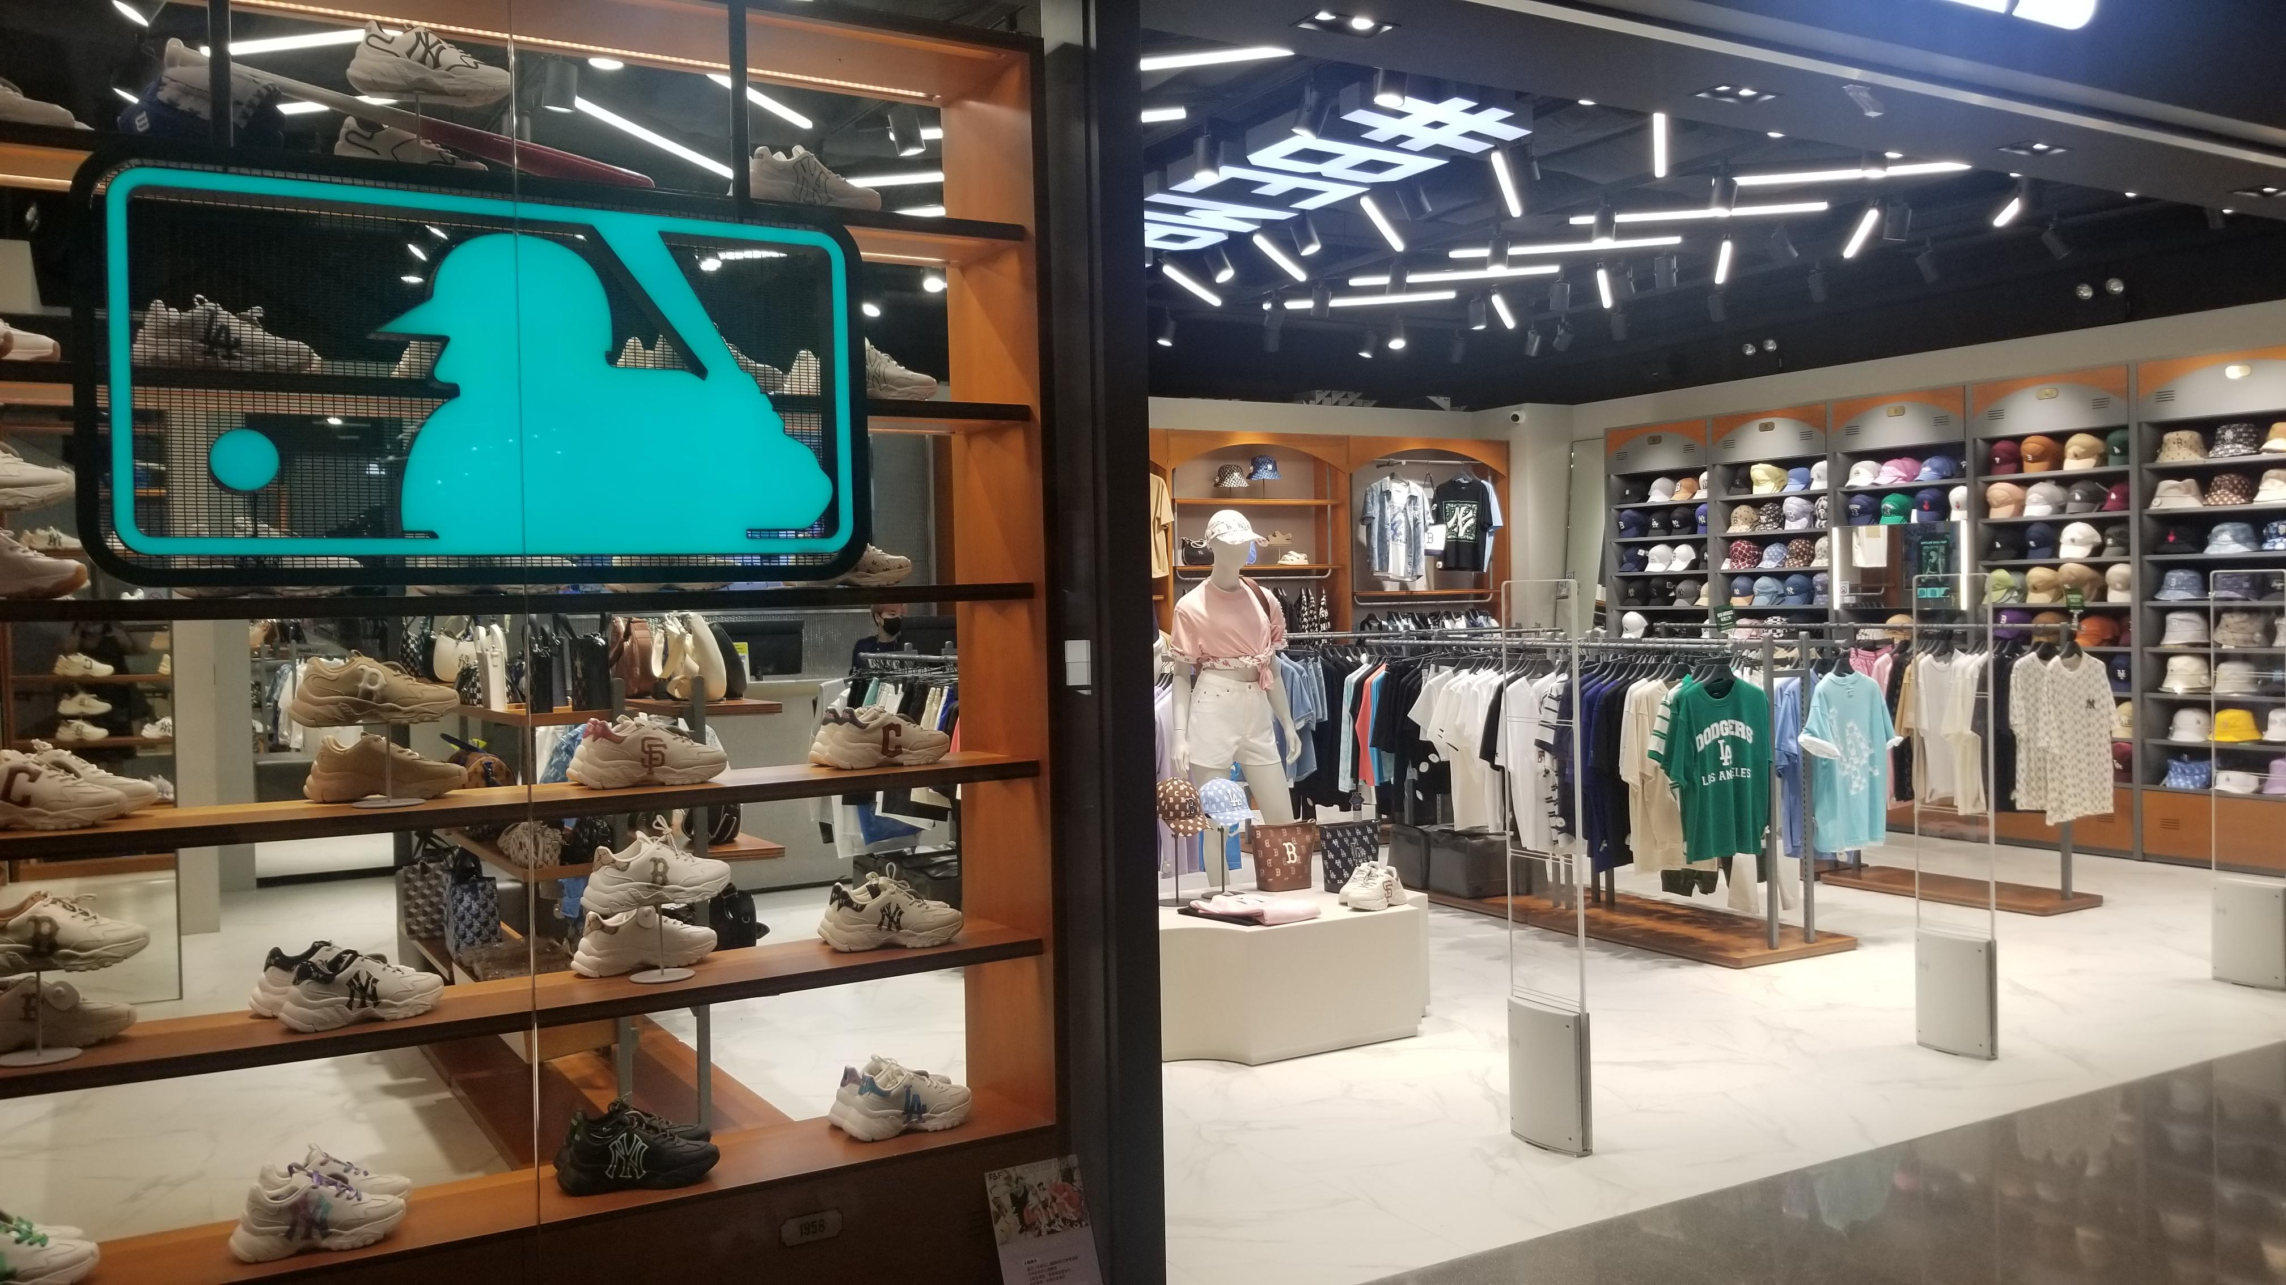
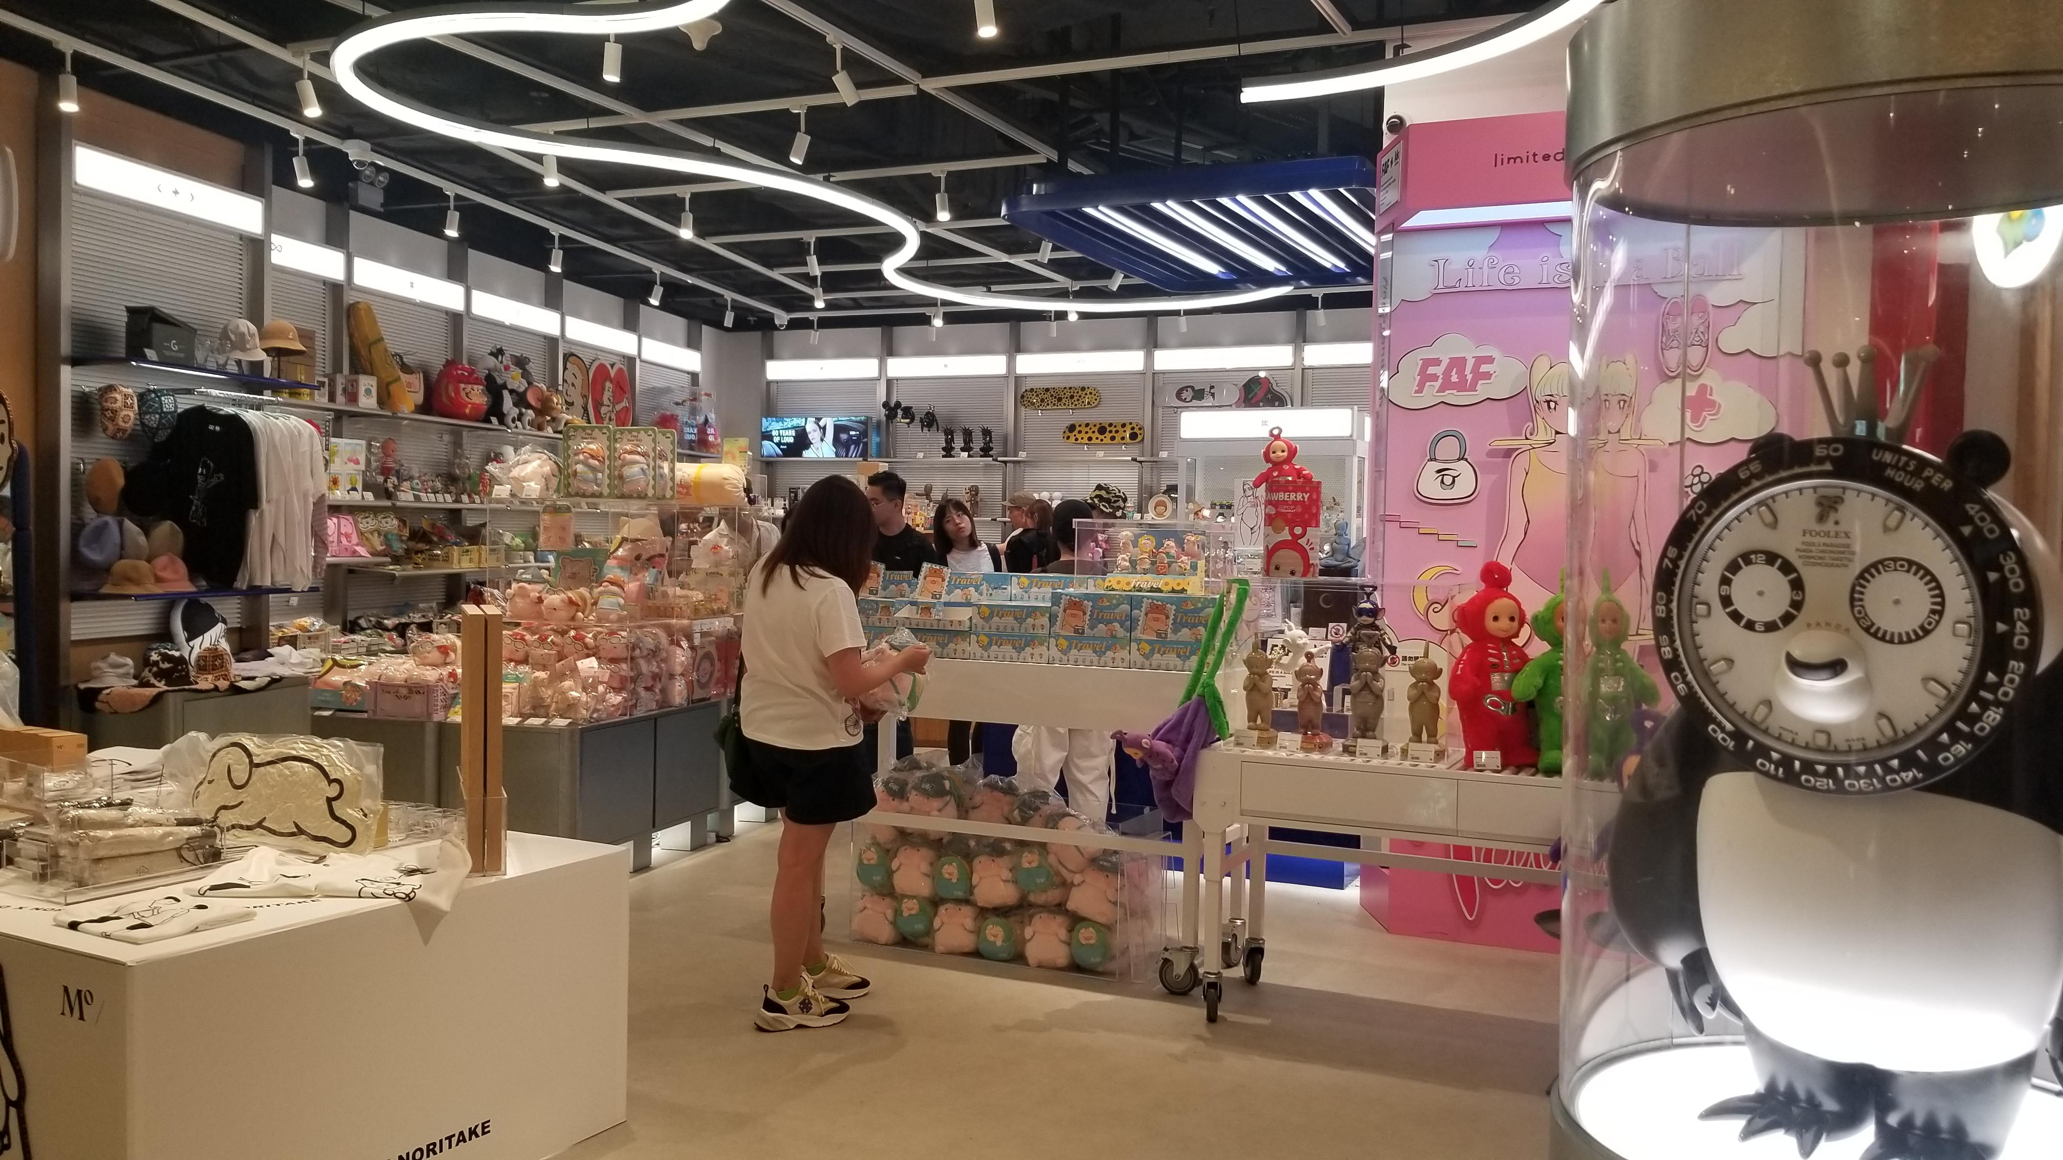
Brick n Mortar Retail Store Development
Brick n Mortar stores refers to physical retail store locations
It is a traditional operation on retailing
Photo(s) is/are provided by Hong Kong Design Institute

Slide 3
Types and Trends of Retail Store
Single-branded Stores
Local or international brands with products from a single trademark
Multi-branded “Select Shop”
Department Stores
Designers’ branded “Select Shops”
Consignment Shops
The consignee (usually a retailer), agrees to pay the consignor (seller) for merchandise after it is sold.
A consignment arrangement is made, the typical split ranges from 50/50 to 40/60.
The consignees do not need to pay for the merchandise until it is sold. They have to depend on consignors to provide a steady supply of merchandise.
The consignors can reduce upfront cost and risks. There may be delay payment from the consignees.
Discount Stores/Outlets
Notes:
Consignment Shops e.g. Sogo. The store landlord rents out the space to different brands to run the business individually, but they will have central cashier control and the brands need to give an agreed rental and commission to the landlord.

Slide 4
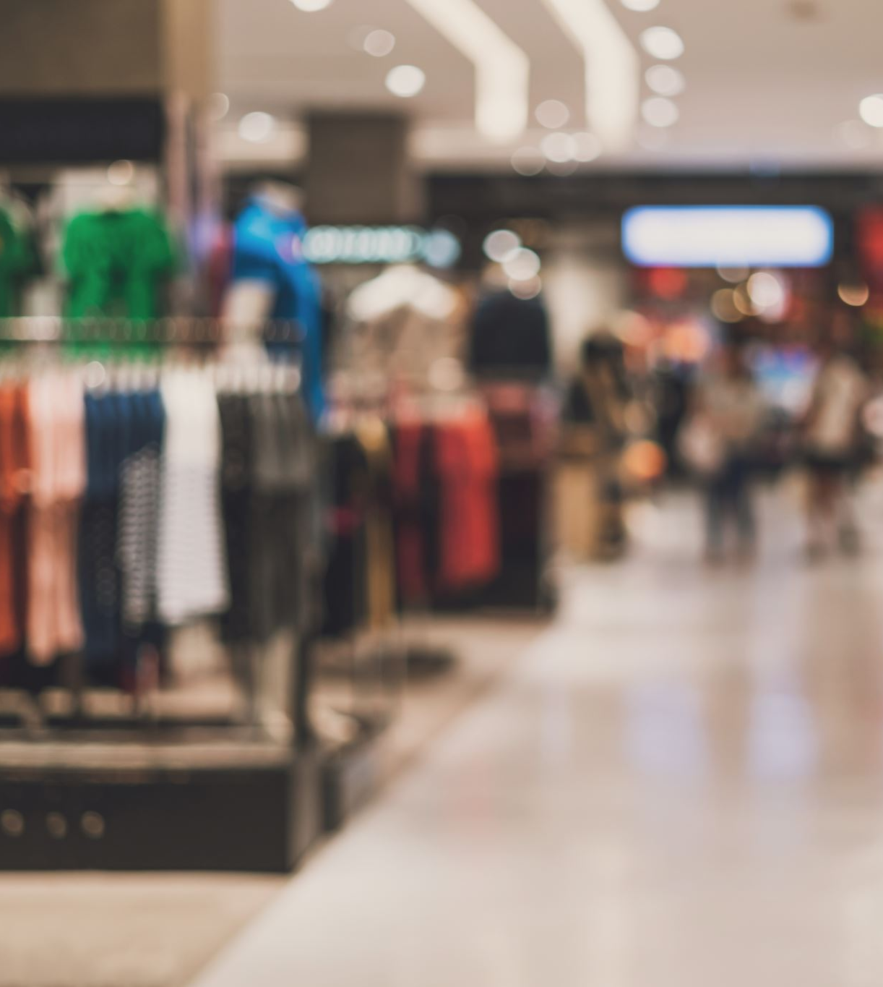
Types of Popular Retail Store Locations in Hong Kong
Stand-alone stores in the street
Stand-alone stores in shopping mall
Department Stores
Pop-up Stores
Upstairs Stores

Slide 5
Fashion Select Shops
A select shop is a retail format where a retailer selects and sells fashion and lifestyle products from various brands
Buyers source around the world with unique design aesthetic standard
The shop’s design and product displays are considered to be more artistic and with acute fashion and design sense
It provides a very pleasant shopping experience to the customers like enjoying in a museum

Slide 6
Upstairs Fashion Shops
Upstairs fashion shop is a unique type of retail operation in Hong Kong due to high rental
Customers visit these upstairs fashion shops usually through referrals or advertisements
These shops are mainly selling multi-branded products in low to mid-price range

Slide 7
Pop-up Fashion Stores
It is a very prominent trend in fashion retailing
A pop-up fashion store is a temporary and experimental retail space to introduce new product campaigns, generate surprising shopping experience or test a market / location
In Hong Kong, pop-up fashion stores sometimes are alternatives of insufficient retail space and to minimise investment on long term rental

Slide 8
Outlets
Fashion outlet is also a prominent trend in retailing
Fashion brands sell their off-season merchandises in a discounted price to clear up the stock
The competitive retail price attracts many customers to fashion outlets to spend and it becomes another revenue generator for fashion brands
Examples of famous Fashion Outlets :-
Hong Kong – Tung Chung Citygate Outlet
UK – Bicester Village, Oxfordshire
USA – Niagara Falls Fashion Outlet

Slide 9
E-commerce Development
“Electronic Commerce” is the buying and selling of goods or services on the Internet
Payment is completed online too

Slide 10
E-Commerce Business Models
B2B – Business-to-Business
It refers to the business trade platforms between businesses in exchange of products, services or information
This business model usually involves a manufacturer and a wholesaler or retailer, or a manufacturer to a manufacturer
B2C – Business-to-Consumer
It involves sales between online businesses and individual consumers/end-users
C2C – Consumer-to-Consumer
It is a business model that individuals sell directly to individuals online
Usually do not sell through a middleman except using the e-commerce platform to introduce their products or services
C2B – Consumer-to-Business
In this business model, consumers become a fee-based service or product provider to a company or an organisation
Examples : freelancers such as photographers, social media content writers or information technology (IT) specialists
Notes:
B2B e.g. Alibaba
B2C e.g. Taobao, Zalora, mydress, HBX
C2B e.g. Upwork
C2C e.g. Carousell, ebay
C2B e.g.

Slide 11
4 Types of Internet Platforms for E-commerce
Social Media Storefront
-Facebook Business Page
- Instagram for Business
- Carousell
Marketplace
- Amazon
- HKTVMall
- Zalora
E-Commerce Platform
- Shopify
-Shopline
-Boutir
Build Own Website

Slide 12
Social Media Storefront
They are the business pages that brands build on the social media platforms to communicate with their customers or to look for potential customers for sales.
It is simple to start up and can easily reach target customers. The brands can promote their services/products in a relatively low cost as the social media platforms already have a good system to support the brands.
However, the brand identity in the store front is limited by the design and operation policies of the social media platforms.

Slide 13
Marketplace
Brands’ presence on this kind of platforms is like putting their products in a supermarket.
The platforms have good storefront and infrastructure to facilitate the brands to do business. They only need to decide what kind of products to be sold.
The platforms are also taken the role of product delivery, handling technical problems and co-promotion execution .
The start up cost and commission is high but the brands can benefit from the customer database and traffic of the platforms.

Slide 14
E-Commerce Platforms
These platforms provide good infrastructures and supports for the brands to run their online businesses.
However, the brands will have to design, build and maintain their own storefront and operations. They will run the business as if they are tenants in a shopping mall.

Slide 15
Build Own Website
Many brands, especially established and well-known ones, build their own stand-alone website.
It is very good for brand building and creating brand identity.
However, it is very costly to build, operate and maintain.

