Slide 1
Current Trends in Fashion Marketing communications and Merchandising
Apparel industry - Business Environment

Slide 2
Areas and careers in fashion Business
Fashion Marketing and Branding
Fashion Marketing Communications
Fashion Branding
Digitisation
E-commerce Operation
Digital Customer Relationship Management (CRM)
Brand Communication
Visual Merchandising
Advertising
Public Relations
Event Planning
Omnichannel Buyer

Slide 3
What is Marketing?

Slide 4
Definition by Chartered Institute of Marketing
“ Marketing is the management process responsible for identifying, anticipating and satisfying customer requirements profitably.”
- Chartered Institute of Marketing 2015

Slide 5
What is Branding?

Slide 6
Branding Is Who You Are
Branding is the creation of the identity, positioning and reputation of the company, service, or product.
Branding captures the emotions, beliefs, values, and desires the service or product evokes. It is the personality of the product or service, and, ultimately, branding is what keeps the customers loyal year after year.

Slide 7
Branding
Identity
Personality and uniqueness of a brand.
Such as the brand name, the mission, expectations and promises of a brand.
Along with a selected tone and language, forming tagline and personality, leading to reputation.
Visual Elements
The visual style and representation of the brand’s identity.
Includes, logo, fonts, colours and design elements such as graphics, photography and illustrations.

Slide 8
The Identity of a Fashion Brand
01
02
03
MISSION
VOICE & TONE
PHOTOGRAPHY
What the brand is about and why the brand exists?
The brand’s vision and statement.
Words and phrases that should/shouldn’t be used when speaking on behalf of the brand, and the brand voice and tone (ie. compassionate, professional, fun).
The style of photos in marketing materials.

Slide 9
The Visual elements of Fashion Branding
What needs to be define for a brand?
01
02
03
LOGO
COLOUR
TYPOGRAPHY
Logo usage, including colours and sizes, as well as logo variations.
The brand colours that represent the brand, both the primary and accent colours.
The brand fonts, along with size guides and how they can be used.

Slide 10
Logo and Brand Image
Typography and Brand Image
Colour and Brand Image

Slide 11
Fashion Branding Design by CHIU YI Ching Christy, CHAN Ho Yee & FENG Xiao Shan,
High Diploma in Fashion Branding and Buying, Hong Kong Design Institute

Slide 12
Fashion Branding Design by
LUI Ka Wing, AO Kin Iao,
LI Yao Zu, FU Cheng-en, Anne
High Diploma in Fashion Branding and Buying,
Hong Kong Design Institute

Slide 13
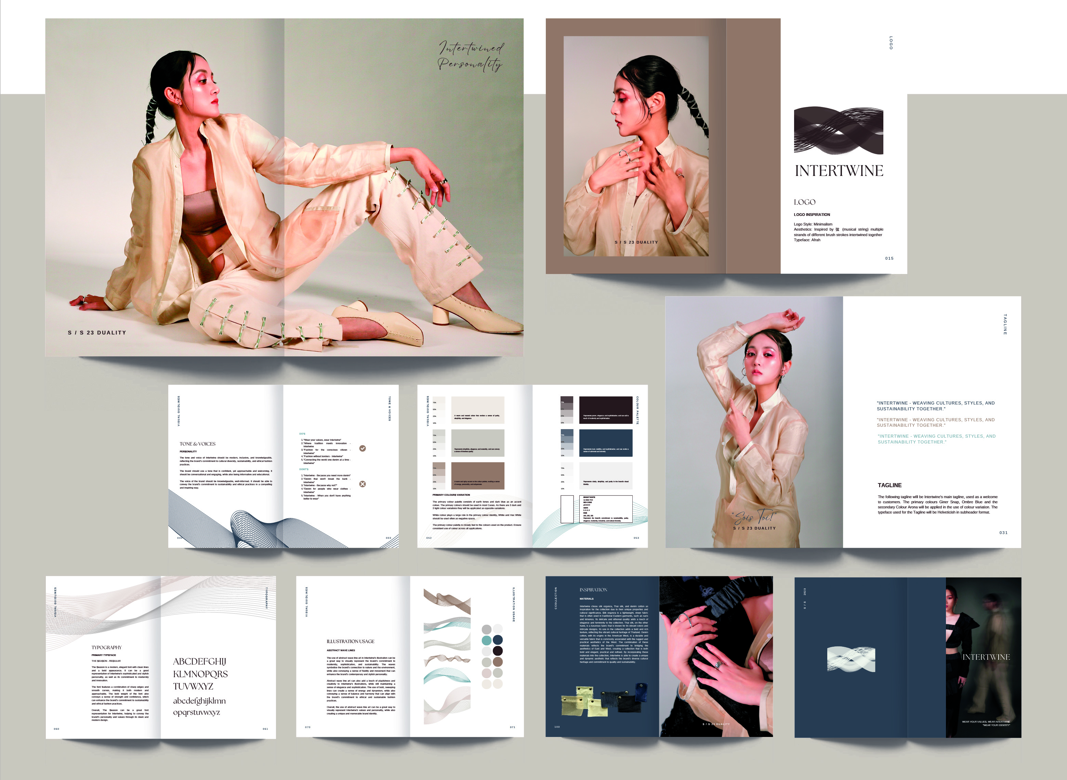
Fashion Branding Design by
LUI Teresa Oi Yan, TANG Tsz Yan, Bella
TUNG Man Cheong
High Diploma in Fashion Branding and Buying,
Hong Kong Design Institute

Slide 14
What is Marketing Communications?

Slide 15
Marketing Communications
“Marketing Communication” is a part of the process of ”Marketing”. The objectives are to create and sustain demand and preferences of products or services from the consumers using different modes of communications.​
A successful marketing communication campaign involves a good analysis on the market. ​
Identifying Target Audience
Understanding Fashion Preferences
Where and How to Reach the Target Audience

Slide 16
Different popular Modes of fashion Marketing Communications
Fashion Marketing Communications
Advertising
Direct Marketing
Sales Promotion
Gamification
Word of Mouth
Digital Marketing
Events, Experiences and Public Relations

Slide 17
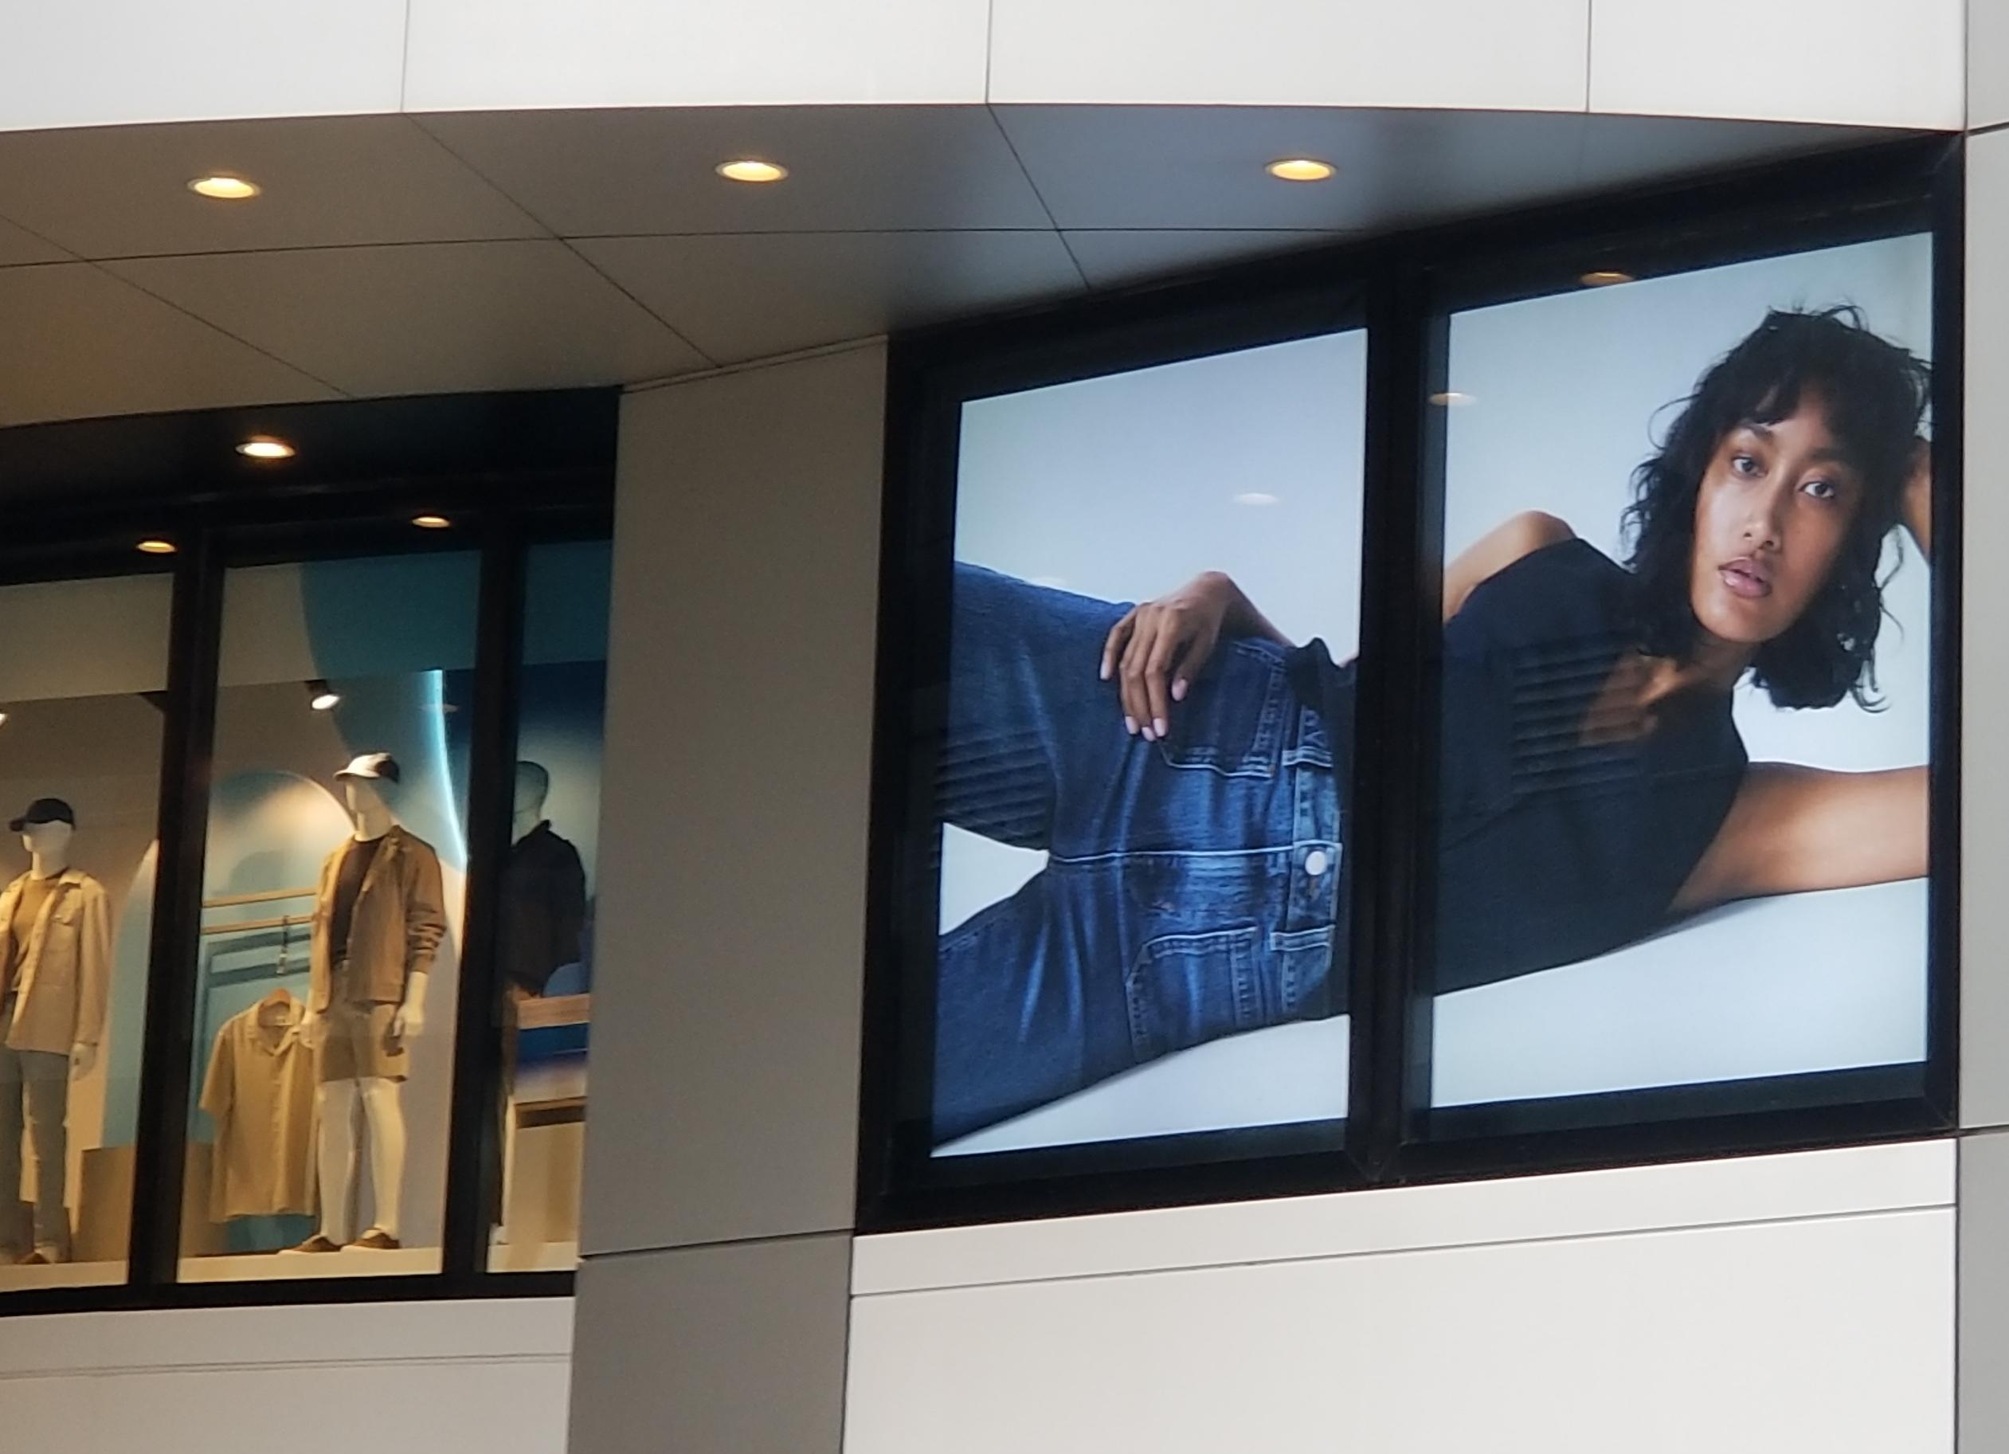
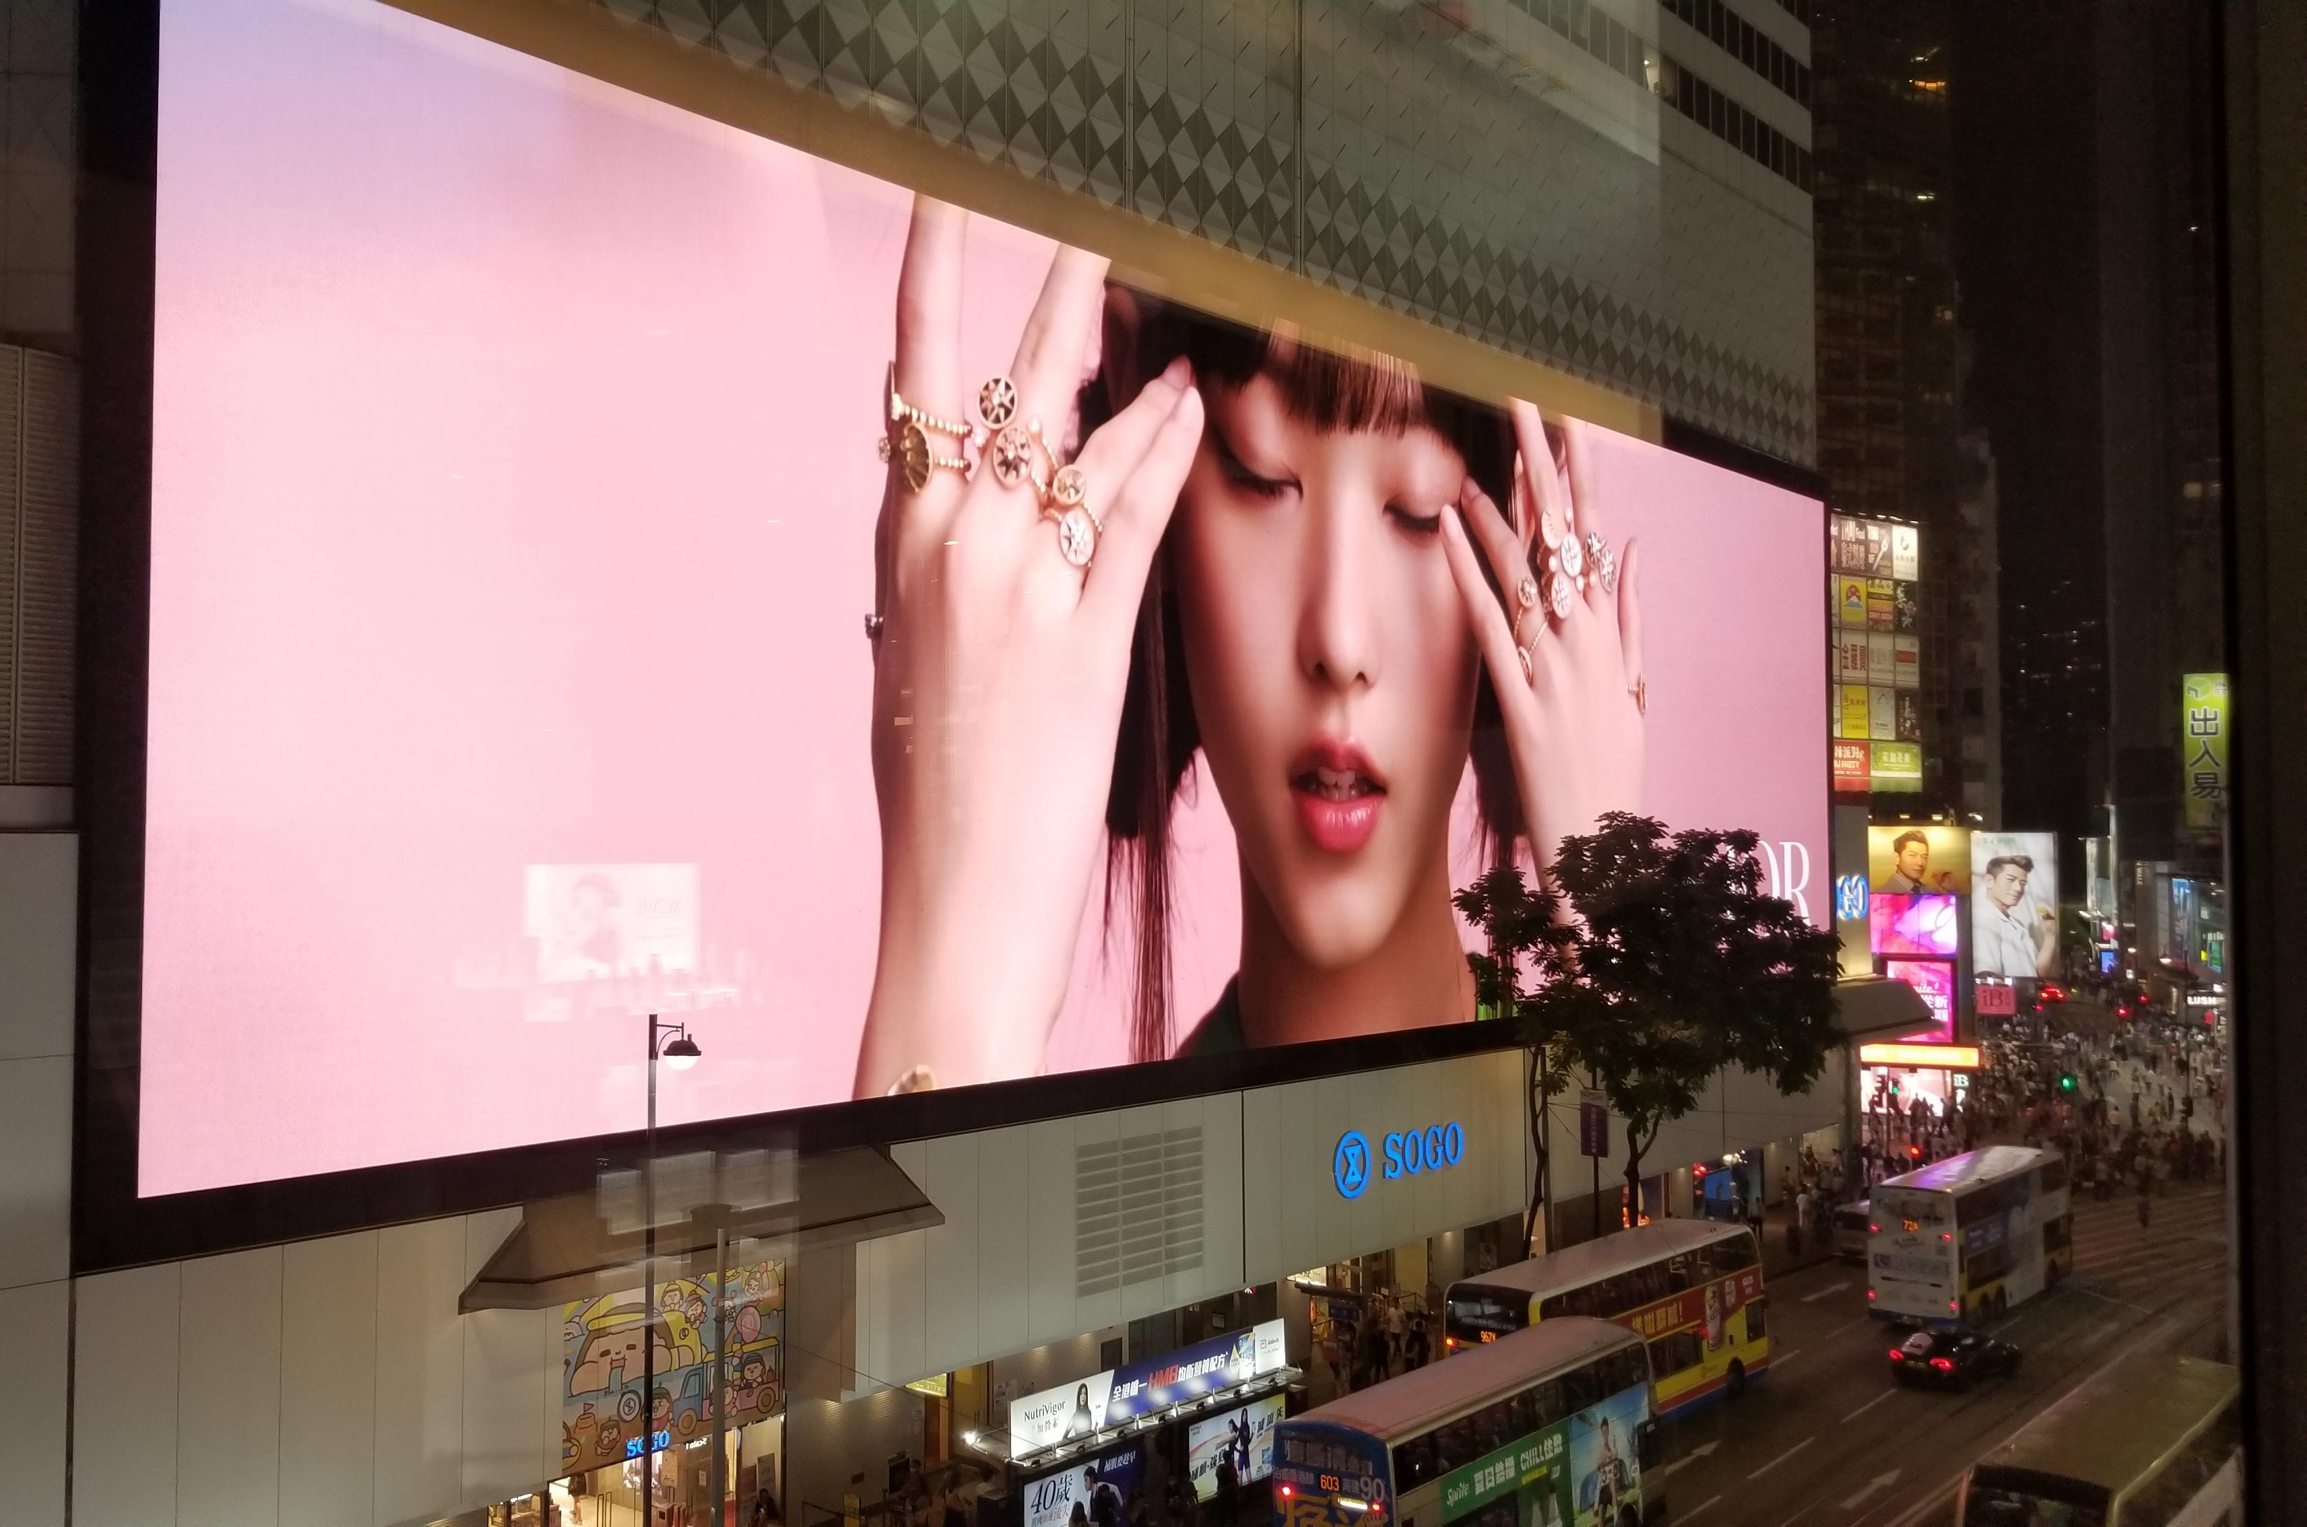
Fashion Advertising
Fashion advertising is a process to promote and sell the products or services of a fashion brand through print or digital medium
Media of print advertisements are :
Magazines, brochures & booklets, instore posters & leaflets, packaging outer, display signs, outdoor billboards, bus-stop & MTR lightboxes, body of trams & buses
Media of digital advertisements are :​
Social media platforms
Photo(s) is/are provided by Hong Kong Design Institute

Slide 18
Fashion video/film Ads
Fashion videos/films are the new trend that many fashion brands are using to convey their brand messages and new products trends
Different from traditional television advertisements, fashion brands can broadcast their video advertisements on many social media platforms. The length of each video/film can be more flexible.
The content of fashion advertisements becomes very artistic and always projects the lifestyles of the target customers
Storytelling is also a trend on fashion video advertisements to highlight the brands’ history and heritage

Slide 19
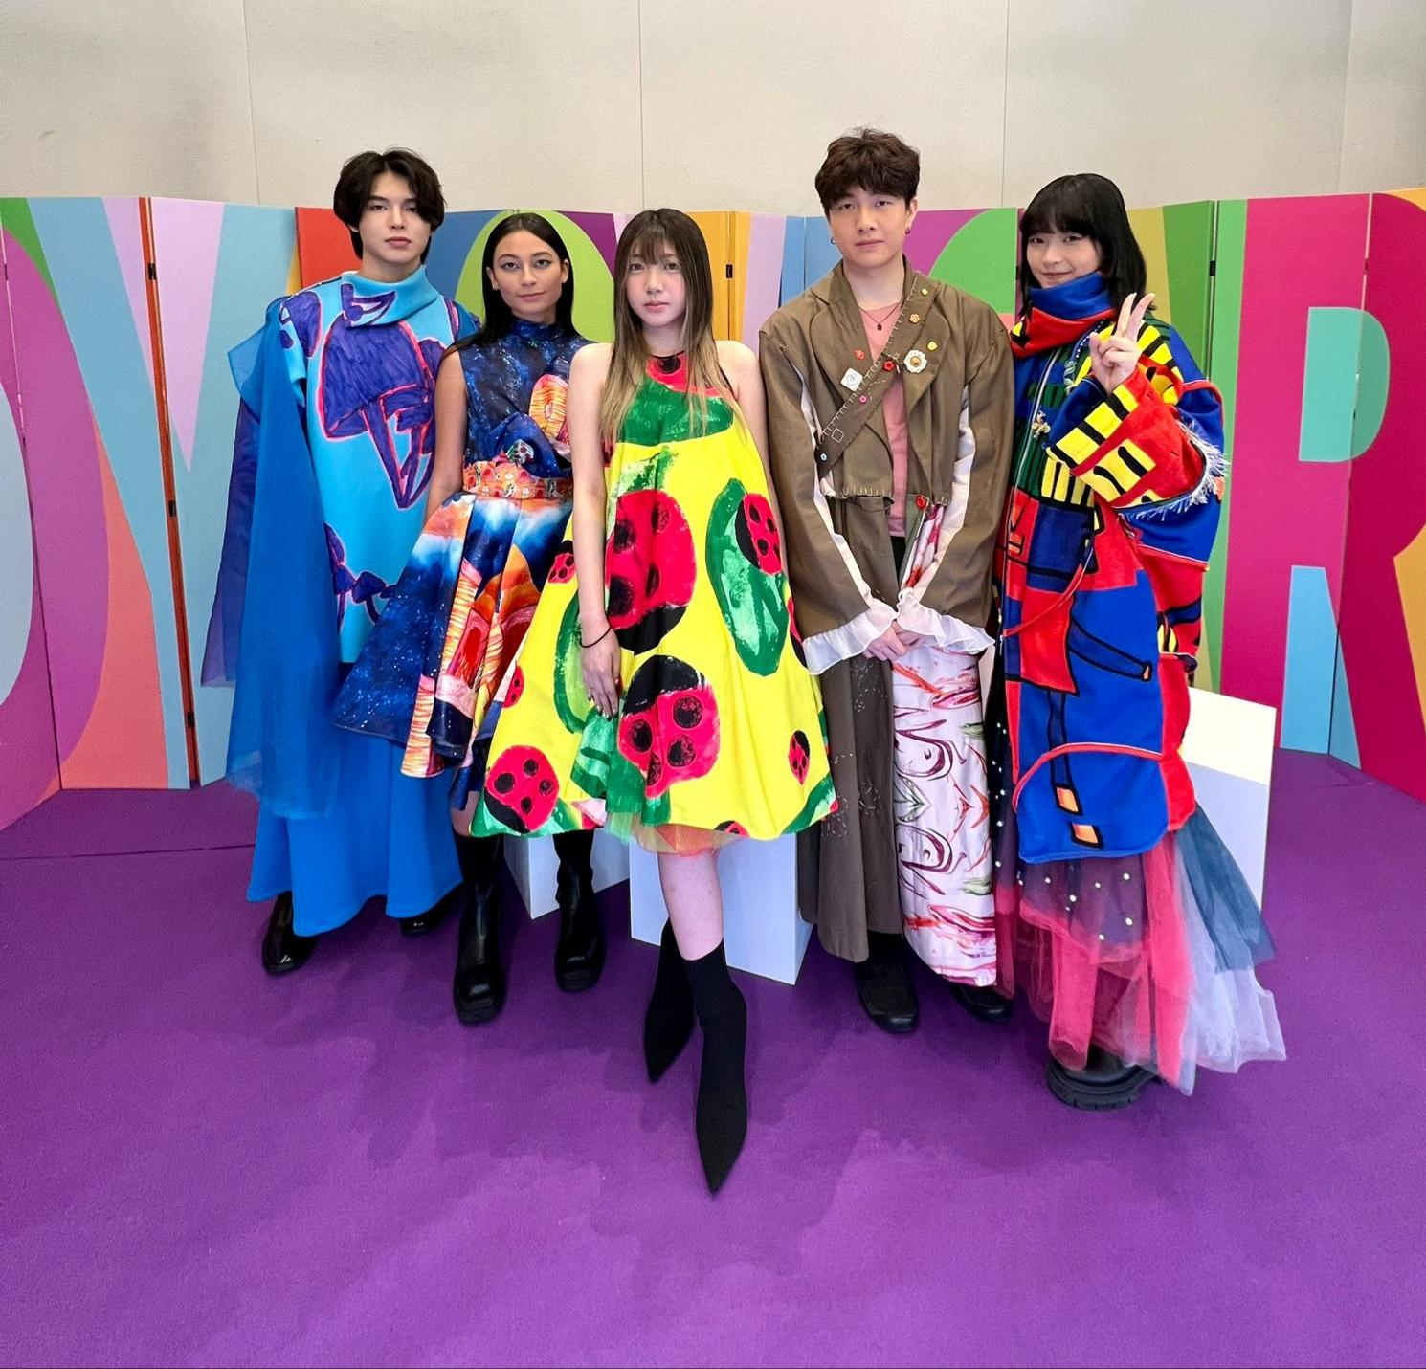
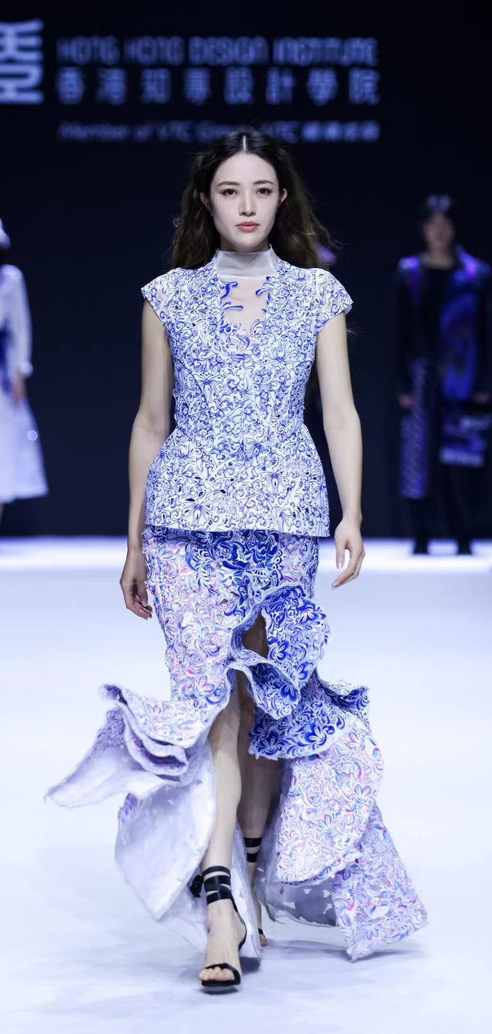
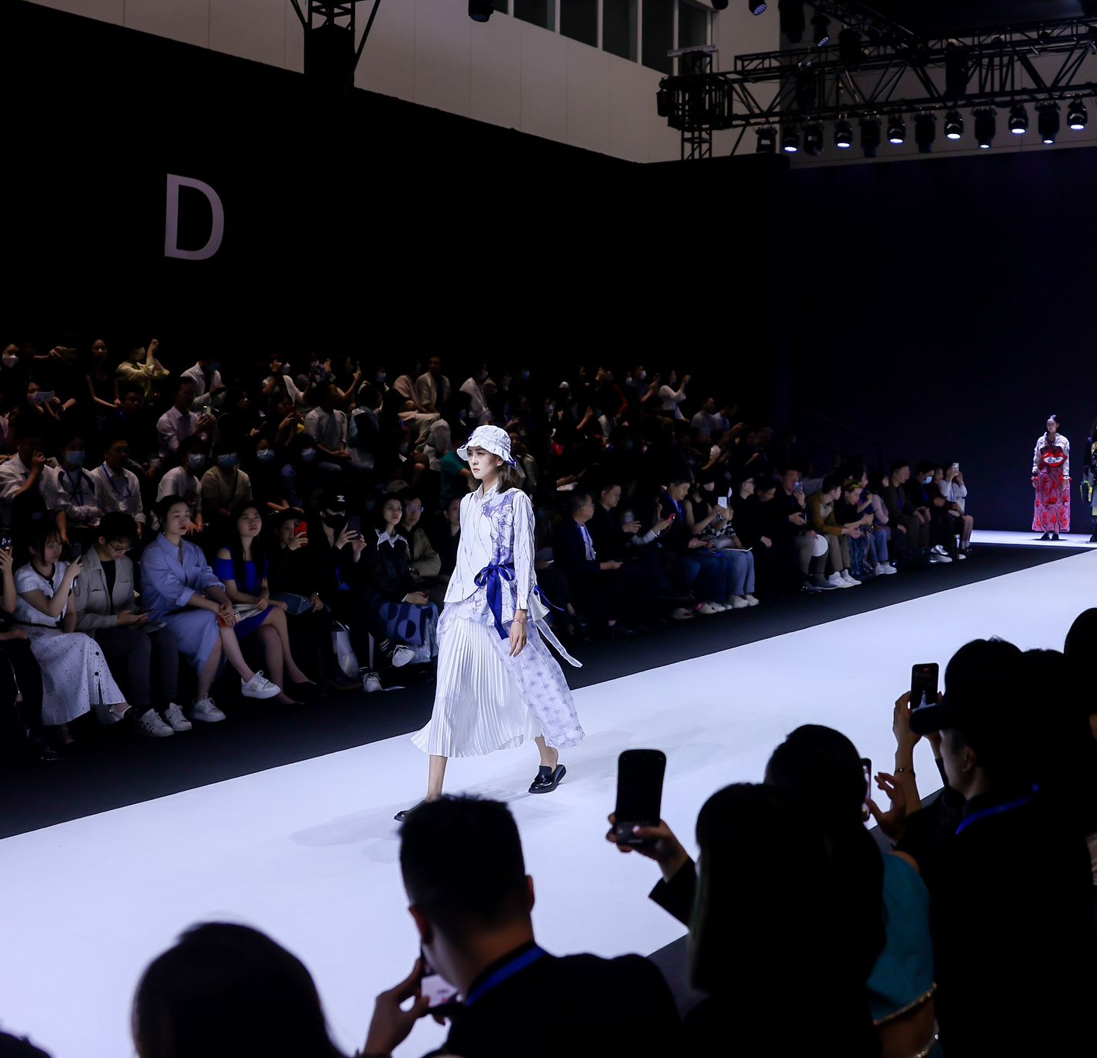
Fashion Shows
Seasonal fashion shows are an important sales and public relations (PR) events to communicate with the customers
Seasonal fashion shows are organised twice a year :
Spring/Summer - during February and March
Autumn/Winter – during September
Many famous fashion brands choose to release their seasonal collections during the fashion weeks in the 4 global fashion centres :
New York
London
Milan
Paris
Recent trend - many traditional luxury brands put a lot of efforts to target younger customers and rejuvenate their fashion shows
Photo(s) is/are provided by Hong Kong Design Institute

Slide 20
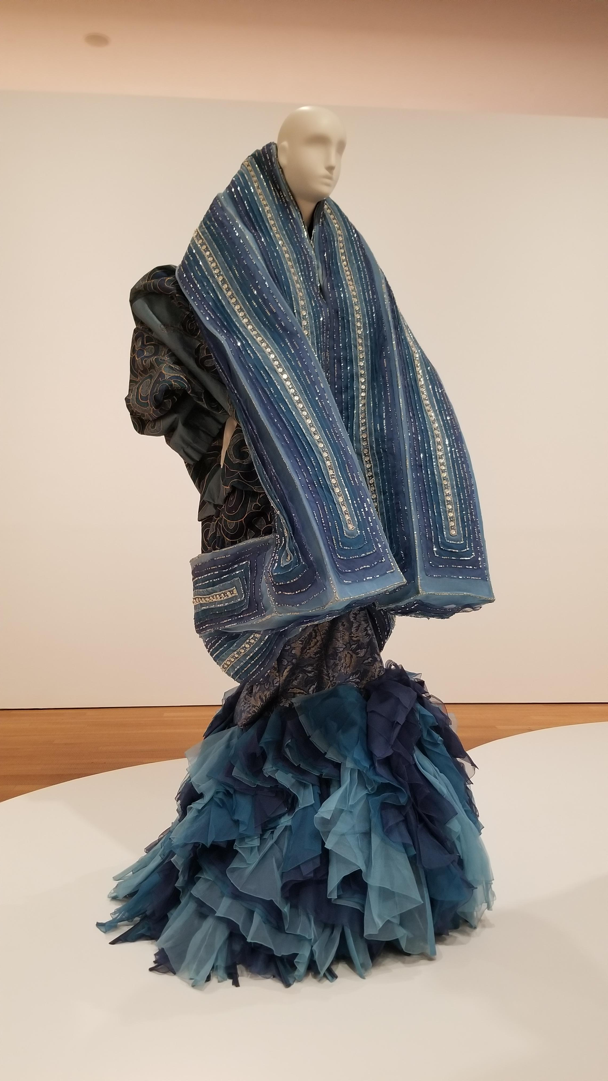
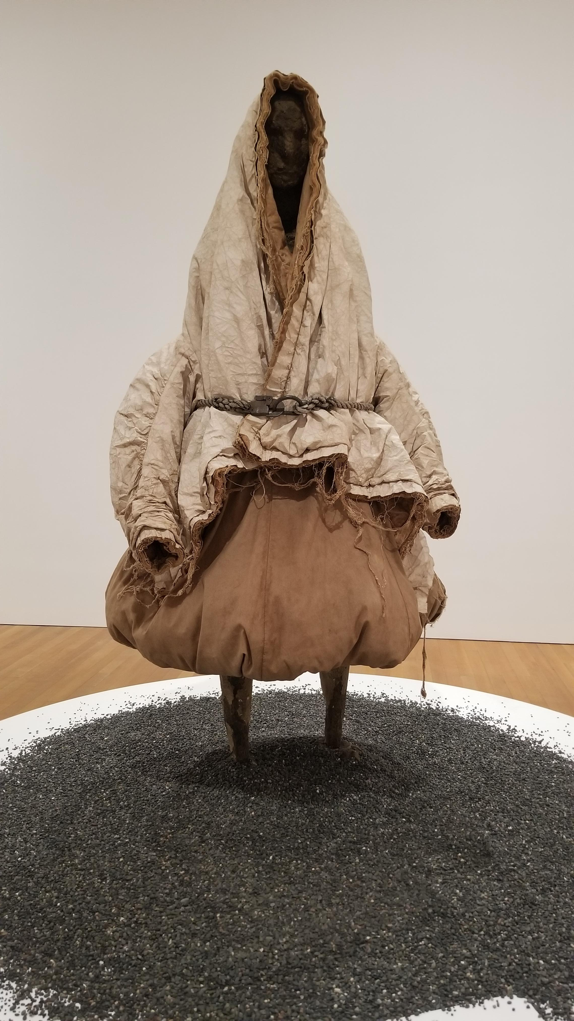
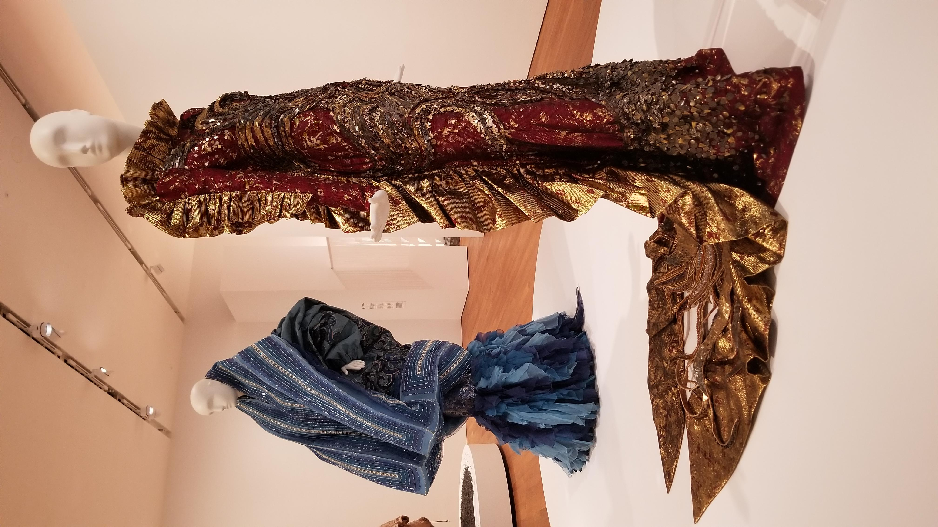
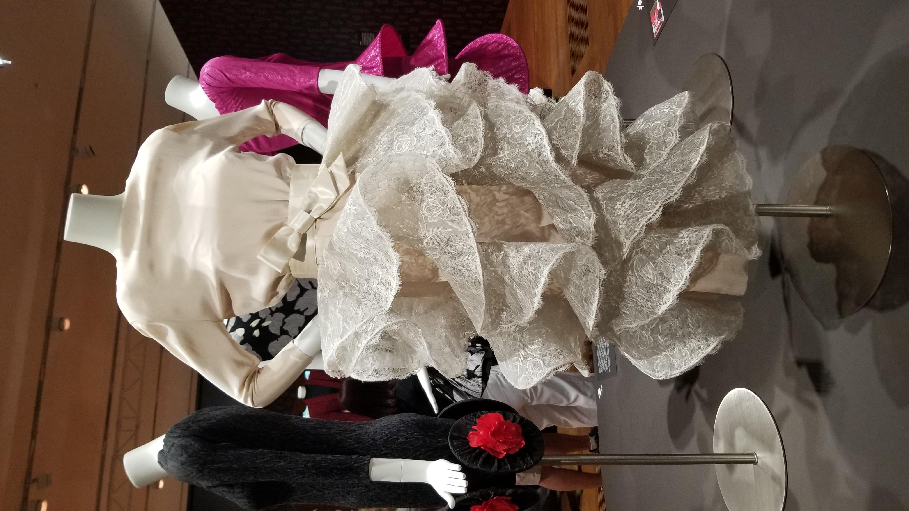
Events, Experiences and Public Relations
Fashion not only takes place on catwalks, but can also be seen in museums, community and shopping malls
E.g. “Madame Song : Pioneering Art and Fashion in China” in M+ Museum
Photo(s) is/are provided by Hong Kong Design Institute

Slide 21
Fashion Gamification
Interactive content is the next big move in fashion communication
Gamification is a marketing technique using video gaming to engage customers with amusing experiences. It uses elements like point scoring and competition to encourage user engagement of a product or service

Slide 22
Word of Mouth
Paid Media
i.e. Advertising
Fashion brands have to pay for the media before the messages can be delivered to the consumers
Earned Media - Word of Mouth
Brand messages to be spread by word of mouth, social media or other means
Owned Media
Fashion brands own and able to control the messages that are showed in the media
Brands' website, social media pages, in-store space...etc

Slide 23
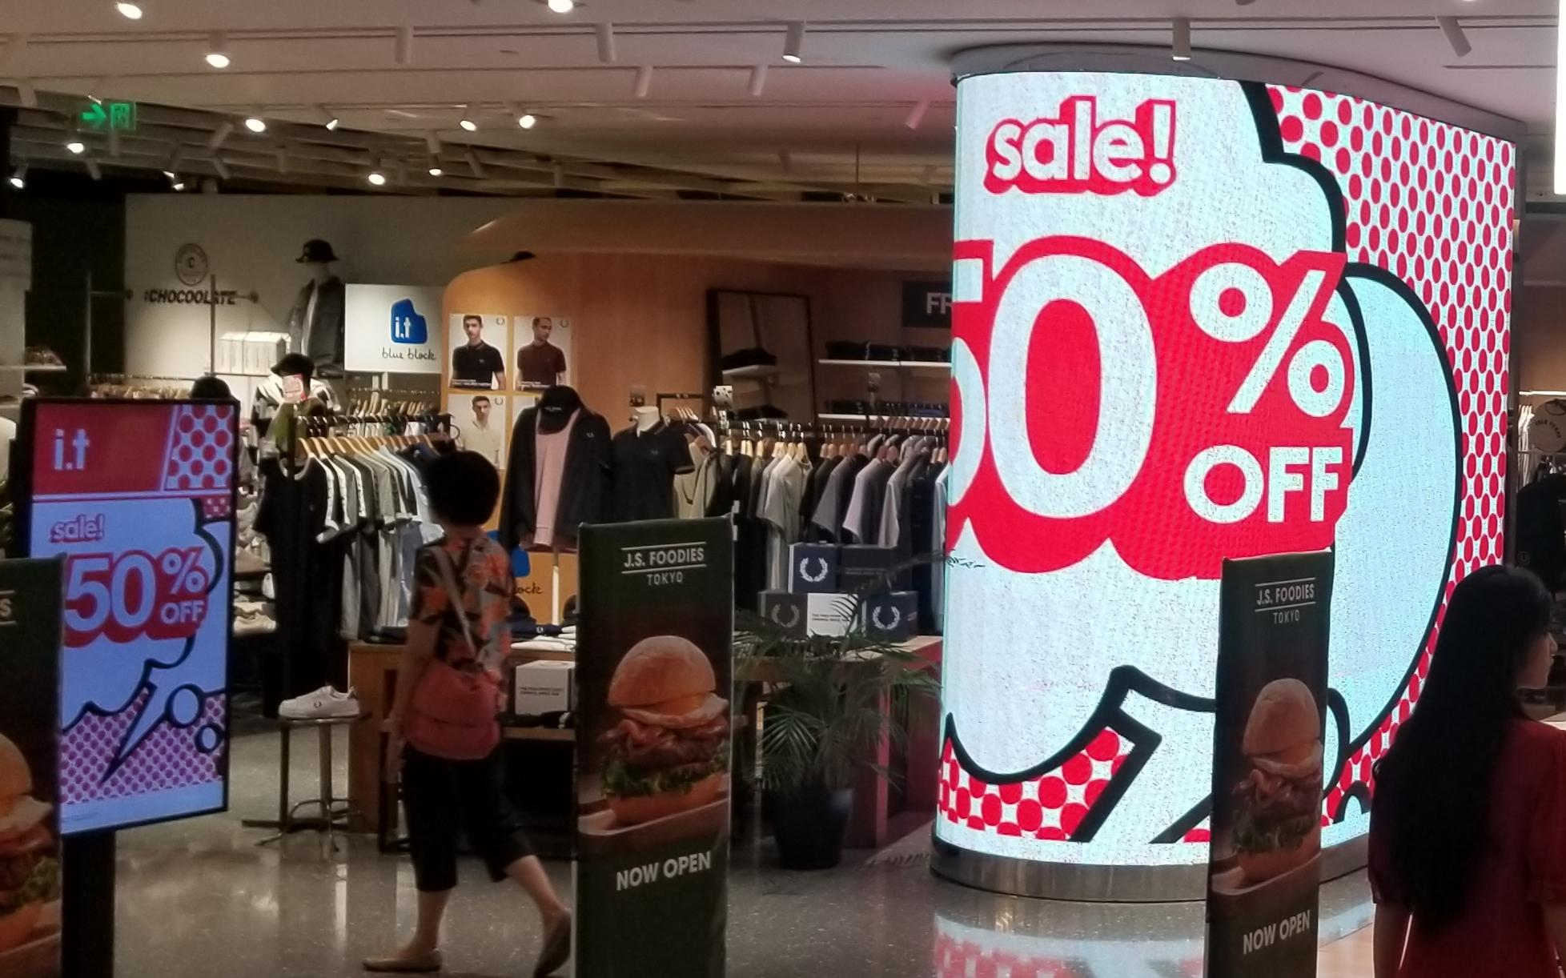
Sales Promotion
More proactive strategies to attract customers to purchase
Strategies include :
discount
gifts
personal selling e.g. personal styling services
Photo(s) is/are provided by Hong Kong Design Institute

Slide 24
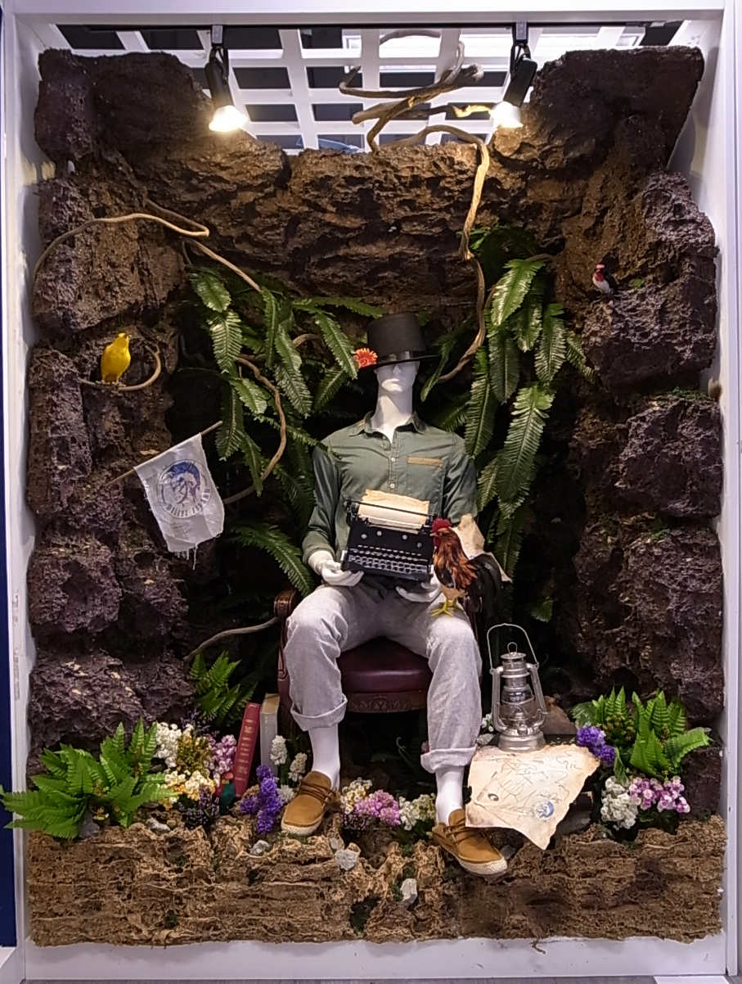
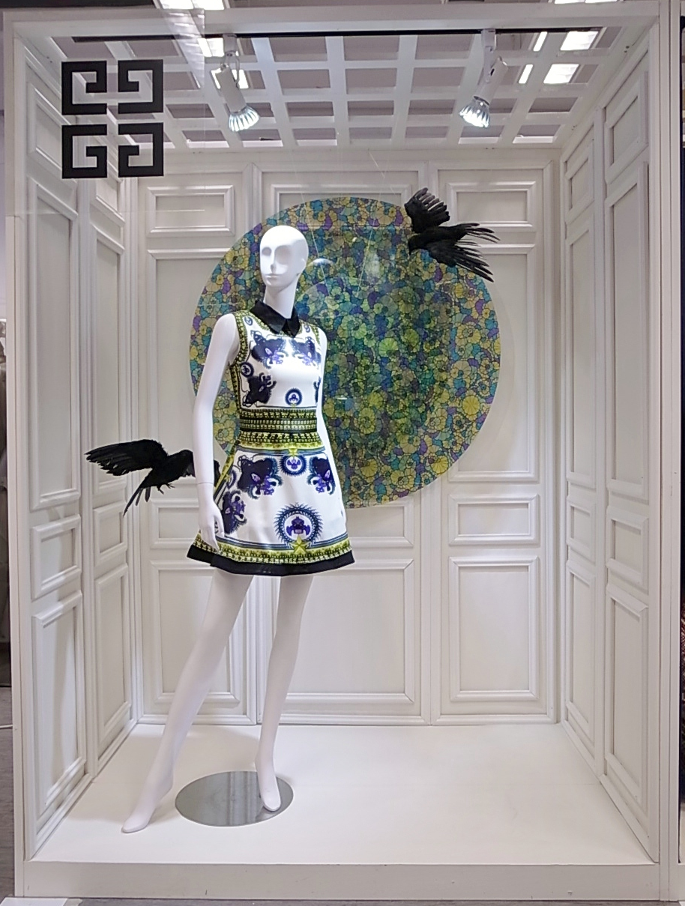
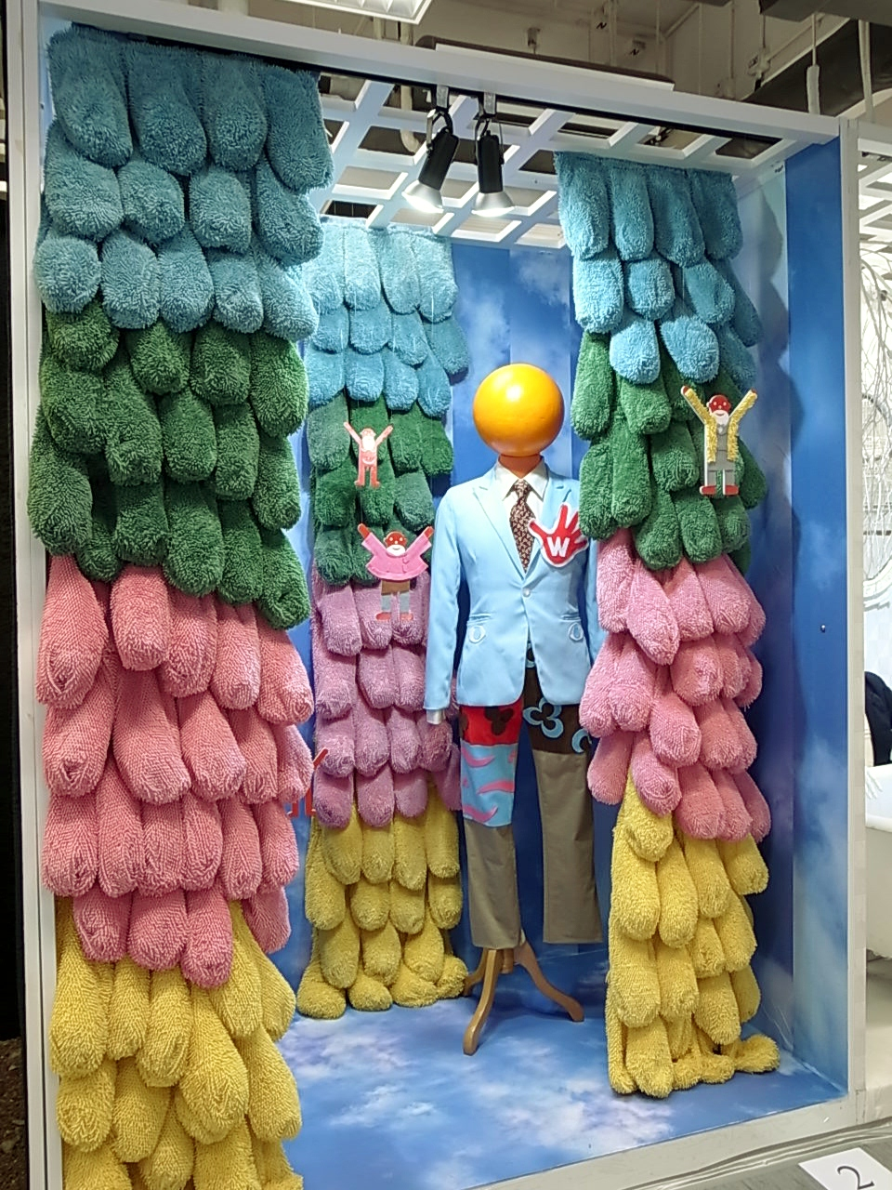
Visual Merchandising
Visual Merchandising Designs by students in High Diploma in Fashion Branding and Buying, Hong Kong Design Institute

Slide 25
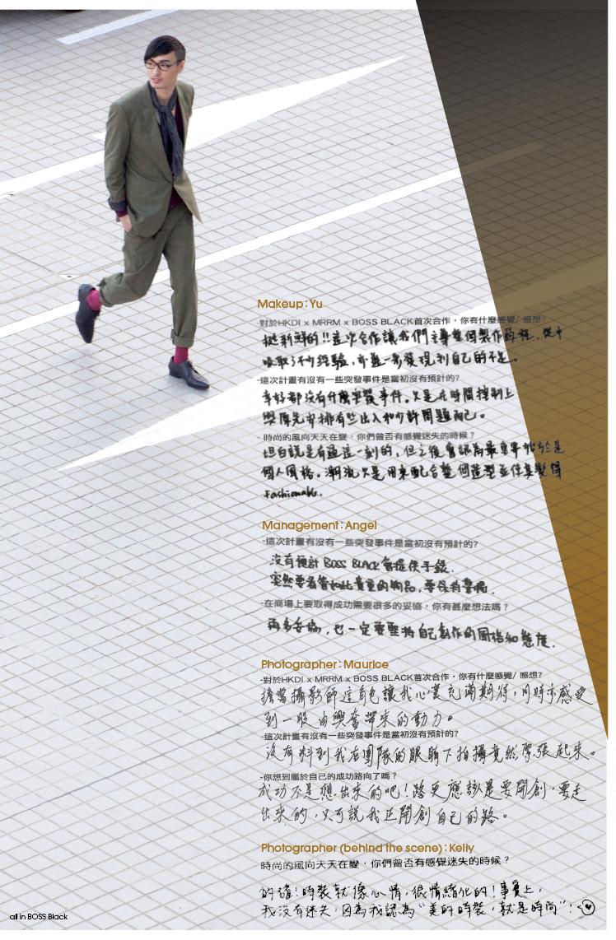
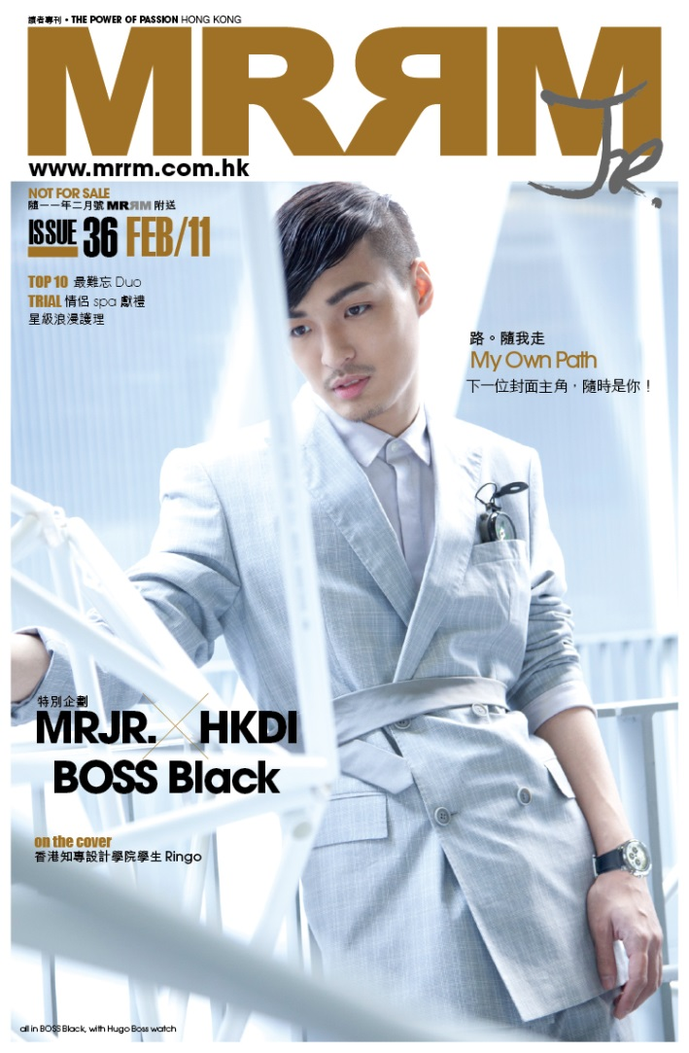
Fashion journalism – Public Relations
Visuals from Hong Kong Design Institute – “MR Magazine x HKDI Project”, visuals, styling, modeling, photography and text by Hong Kong Design Institute students

Slide 26
Direct Marketing in Fashion
E-mail marketing
Text marketing (SMS)
Dropping promotional cards or leaflets to letterbox
Sales Associate’s personal relationship building with the customer

Slide 27
Trends in Fashion Apparel Retailing and Wholesaling

Slide 28
Types
Retailing
Offline – Physical Stores
Online – Virtual Stores
Franchising
Licensing
Wholesaling

Slide 29
Fashion retailing and wholesaling
Retailing
A company designs the fashion collections by in-house designers and produces the products by own selected manufacturers
Wholesaling
A company buys products in bulk from a fashion wholesaler and sells the products in their own retail stores
Buy wholesaling products from :
Asia : China, Korea, Japan
Europe : Paris, Italy, London

Slide 30
Franchising vs licensing

Slide 31
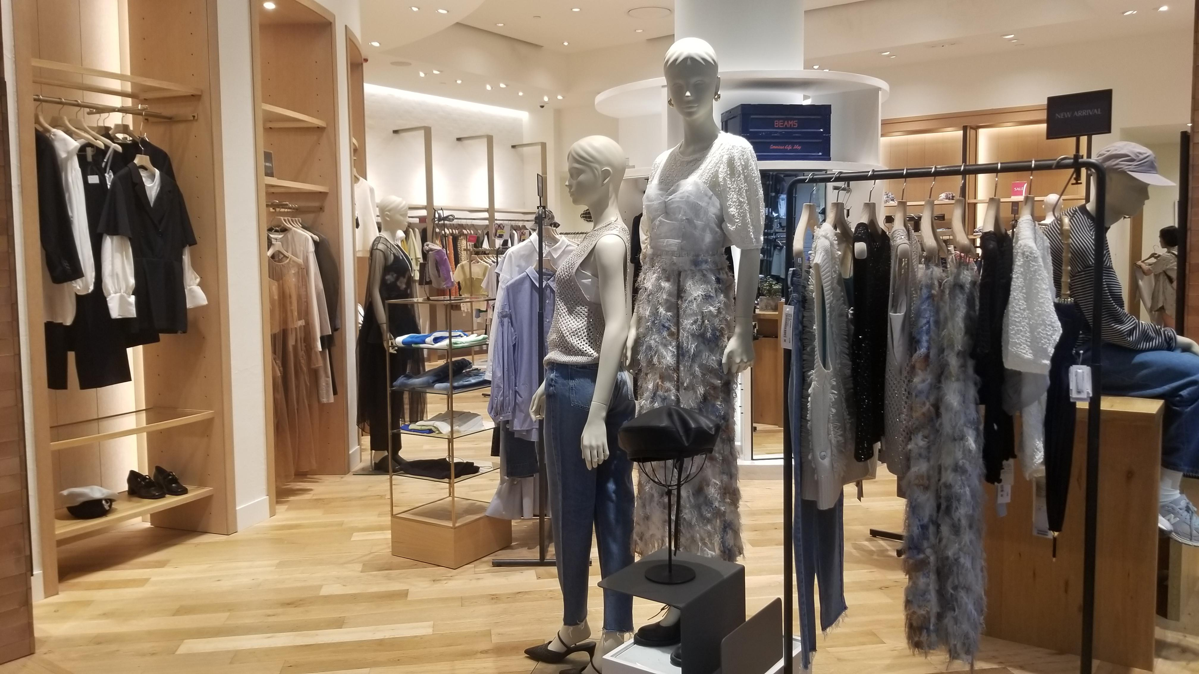
Retail Franchising
Franchising is a retail operation method
Franchising is a contractual relationship between a brand and an investor who wants to operate the business using the brand’s famous name
The investor cannot make their own designs
The investor will pay the brand a royalty (a lump sum of money paid annually) to use the reputation, technical know-how, expertise and products of the brand
Franchising is a system for expanding a business and distributing goods or services with more cost-effective investment.
Photo(s) is/are provided by Hong Kong Design Institute

Slide 32
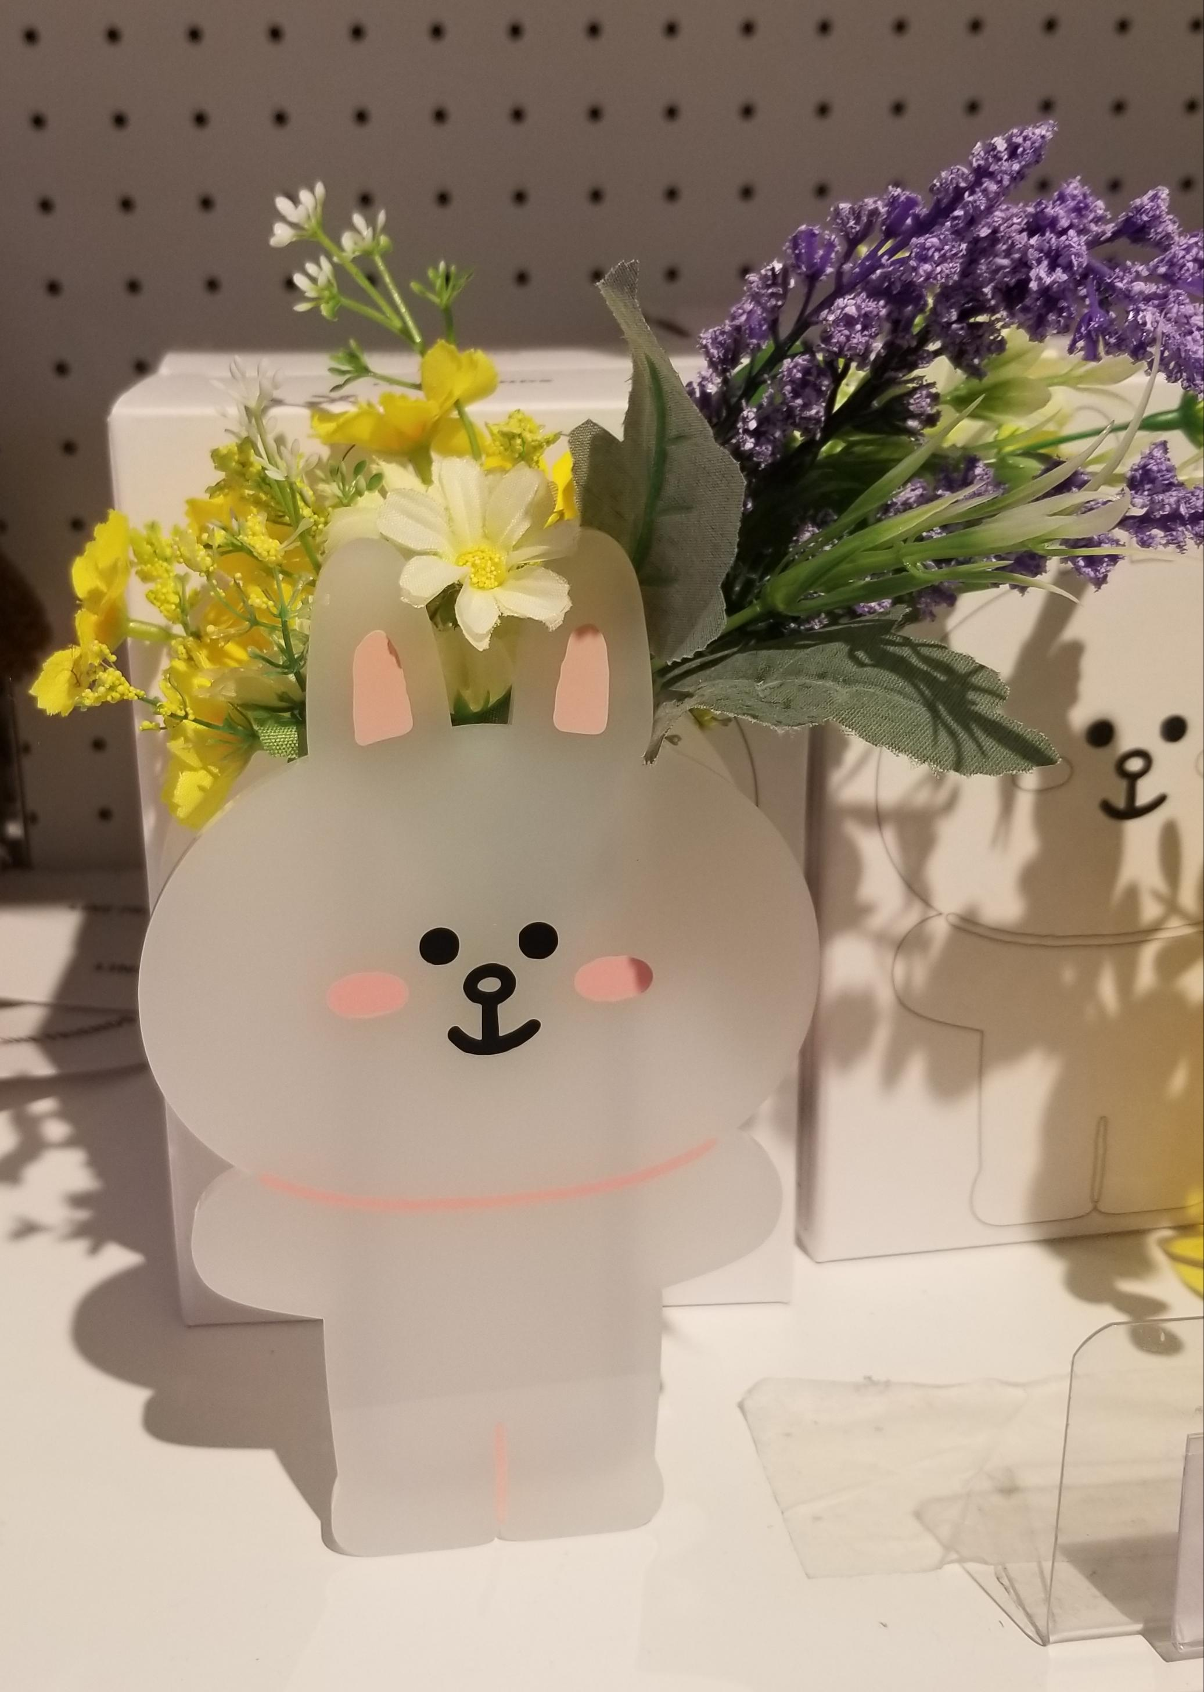
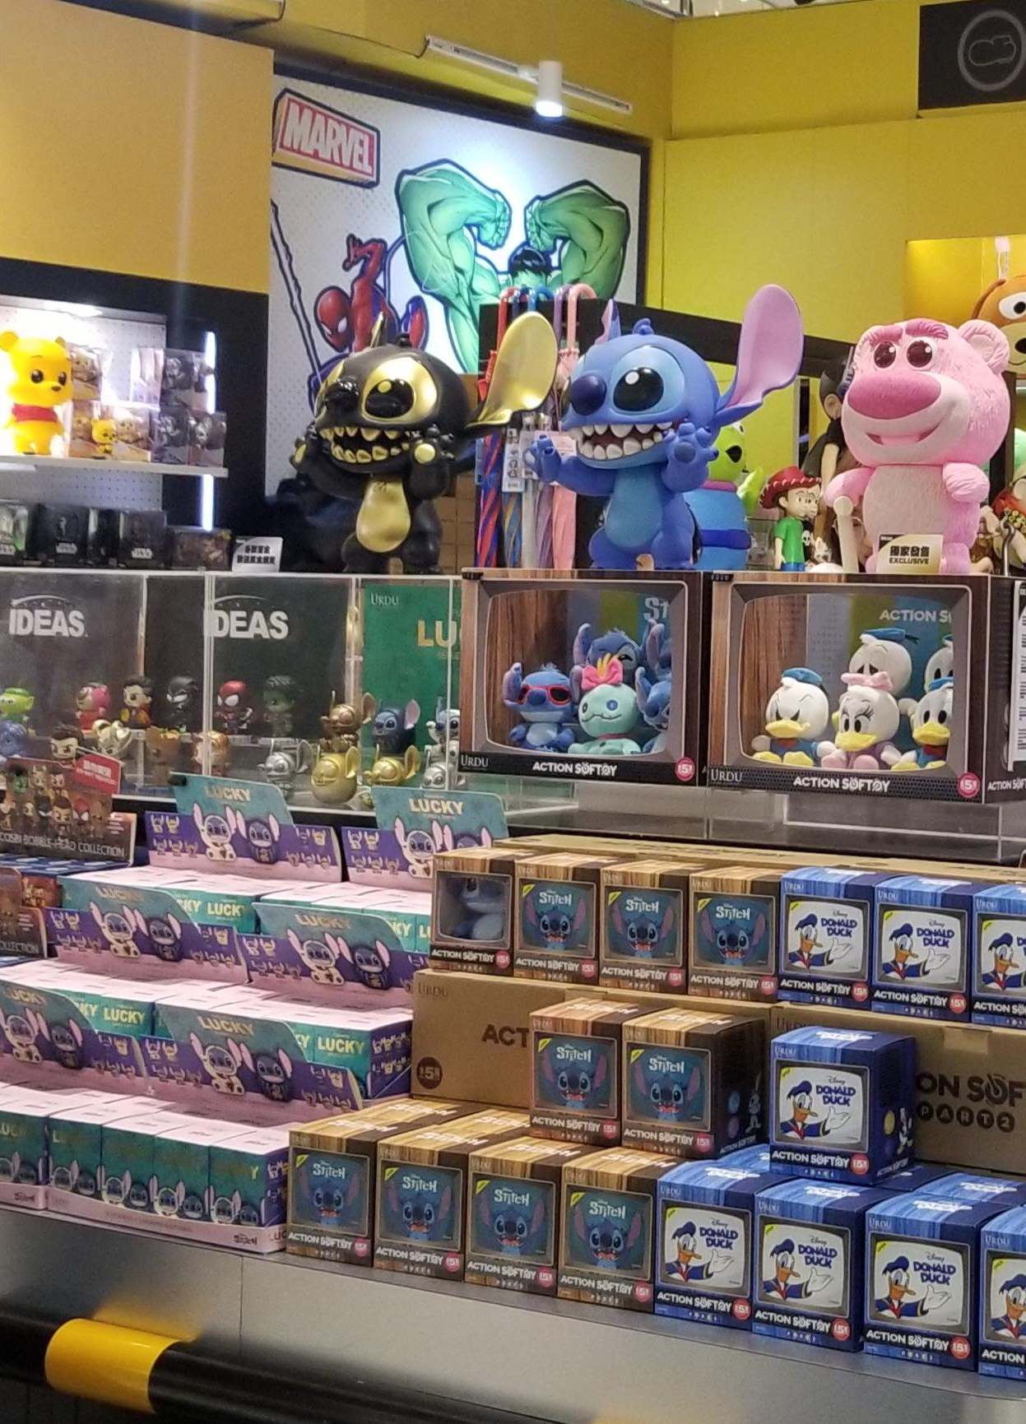
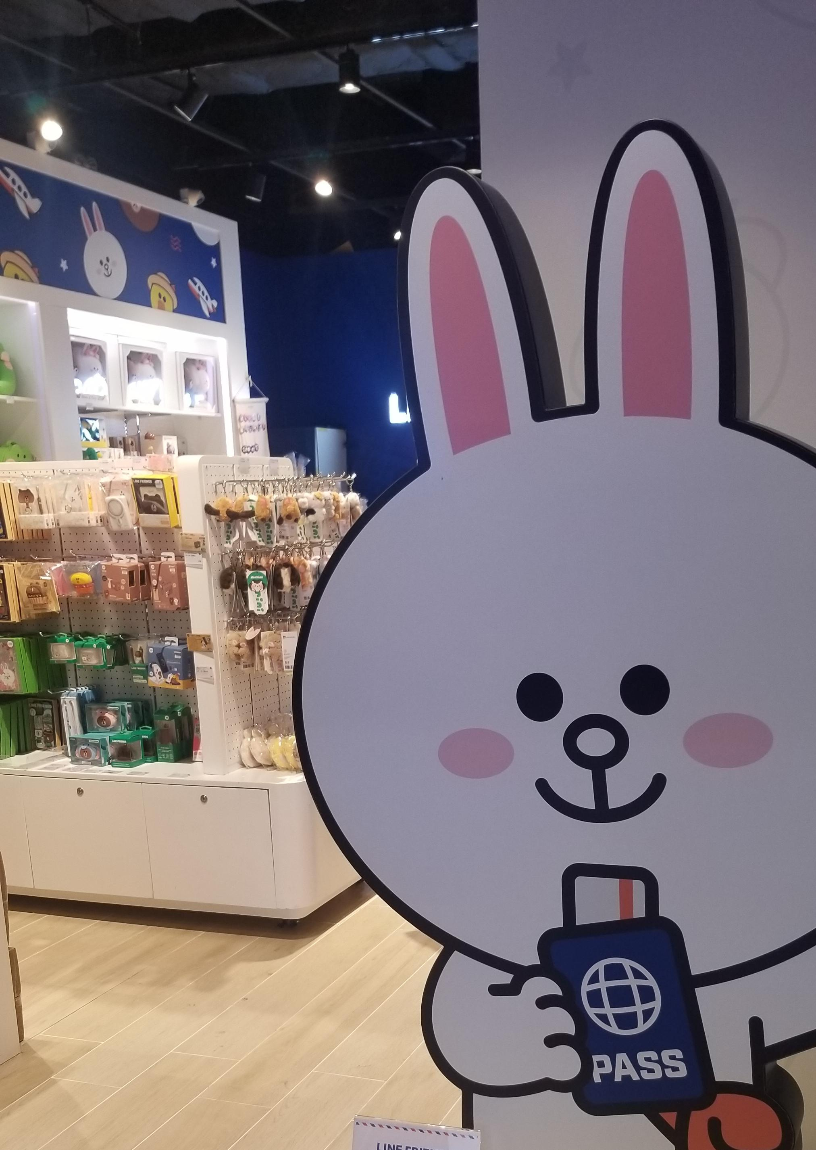
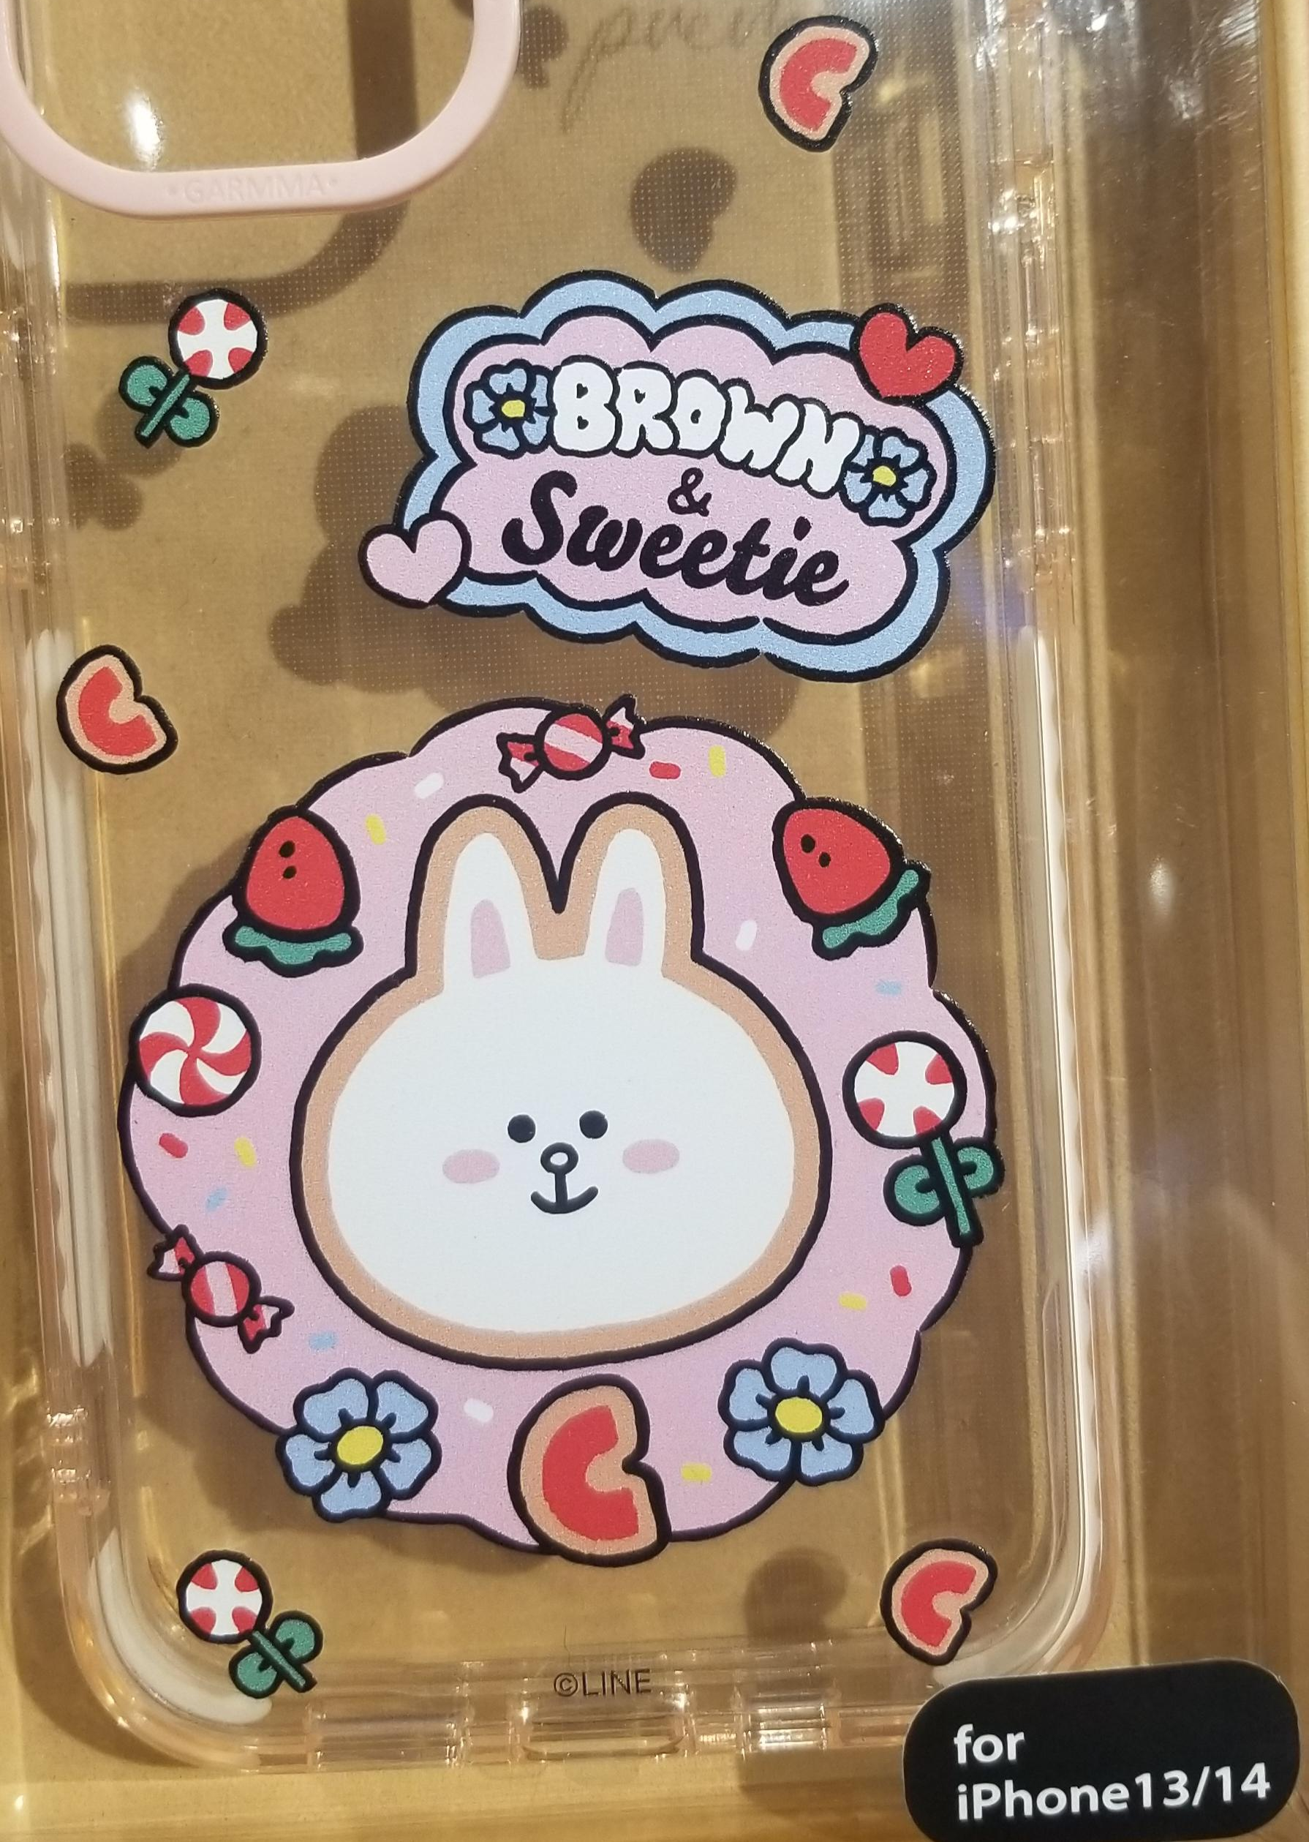
Retail Licensing
Licensing is also a retail operation method
It is when a brand gives permission to a company (an investor) to use their names and logos or images on their merchandises
The investor can design their products which are different from the original collection of the famous brand; while in franchising,.
The investor will also pay a licensing fee to the famous brand
Photo(s) is/are provided by Hong Kong Design Institute

Slide 33
What is Franchising and Licensing business model in Fashion in HK?
A mix mode !
Franchising + Licensing
The store looks like the mother brand in the retail store but the local company (investor) will add on their own designs with the brand’s trademark on top of the brand’s original collection

Slide 34
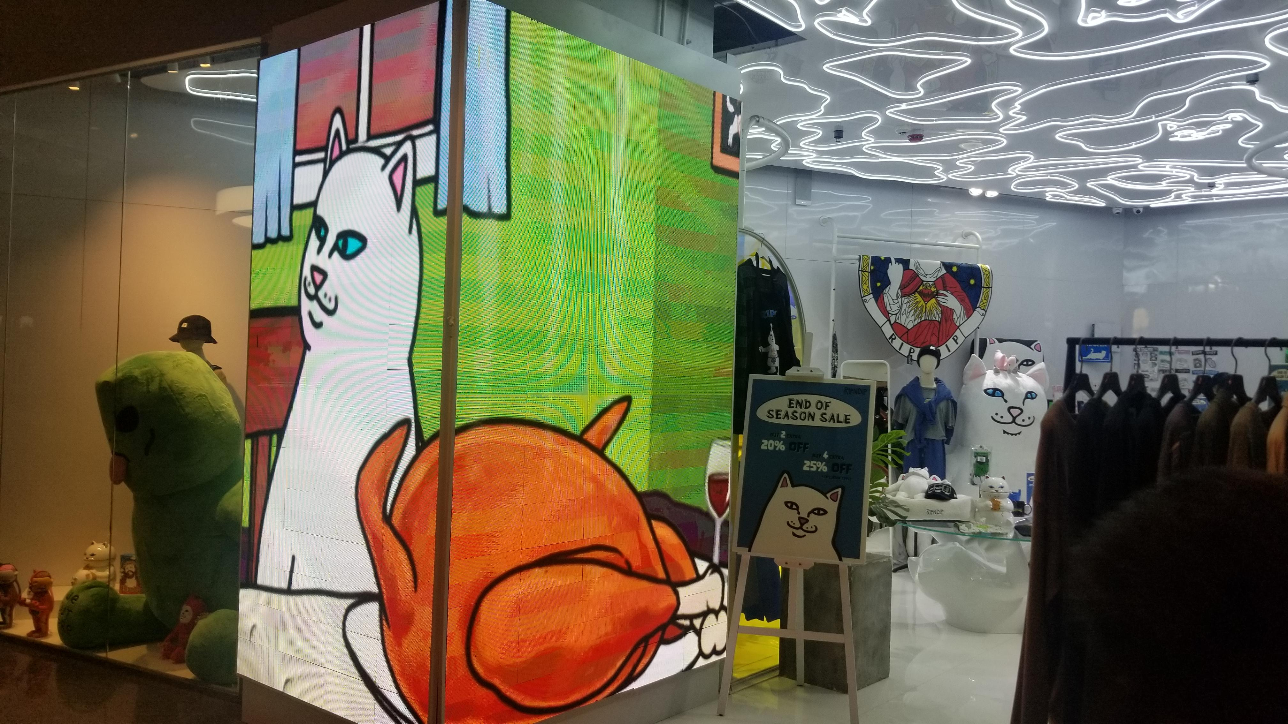
Franchising + Licensing
Hong Kong retailers introducing international brands to Hong Kong market through a franchising business operation. The shop designs follow the instructions and styles of the mother brand
Some of the products are from the original collection of the mother brand
Some of the products in the store are designed and produced by the Hong Kong investor through a licensing agreement
Photo(s) is/are provided by Hong Kong Design Institute

Slide 35
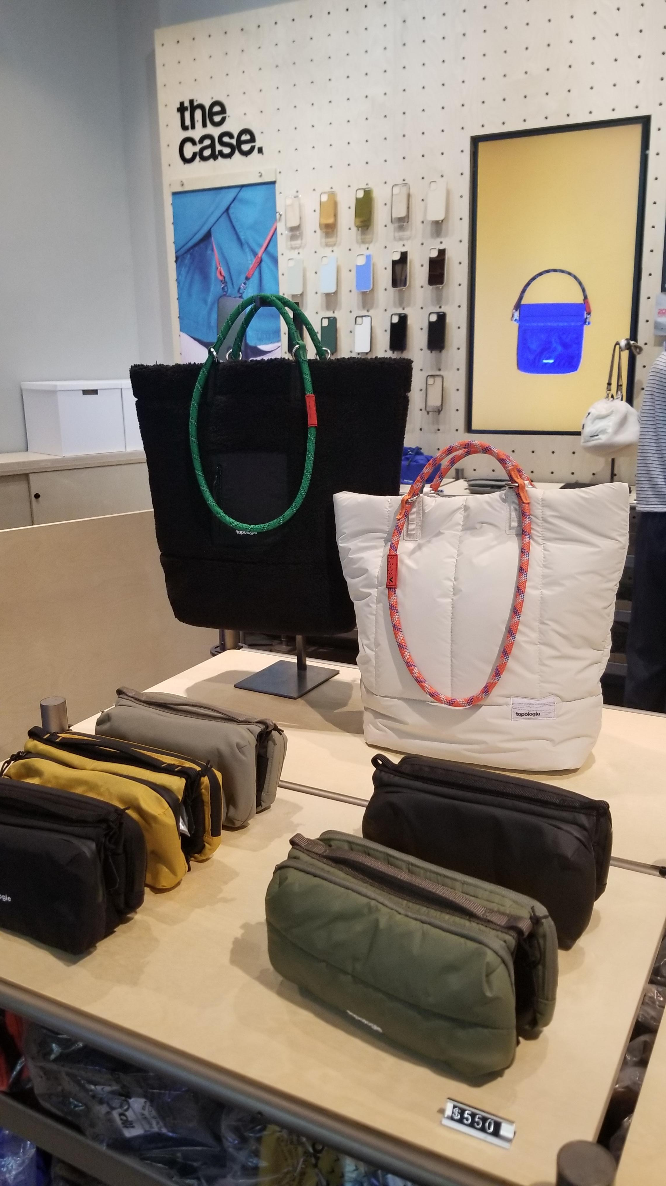
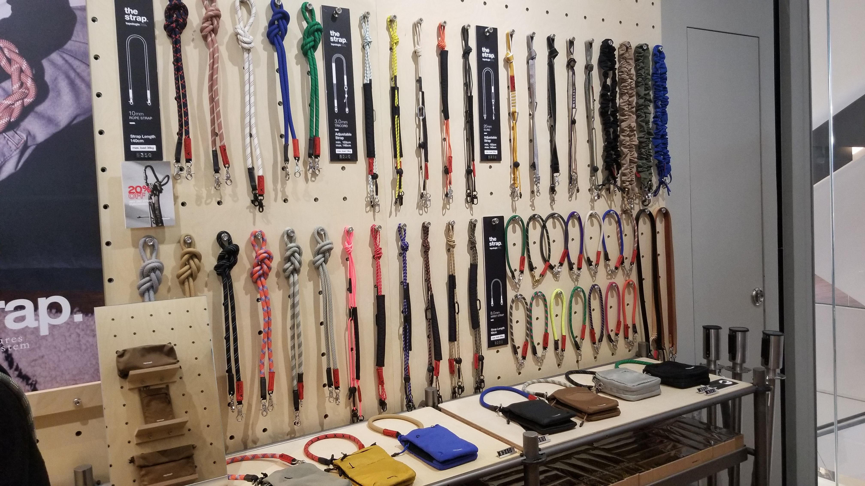
Customisation products
There is a growing trend of customisation products in retailing
It provides a flexibility for customers to personalise their products
Photo(s) is/are provided by Hong Kong Design Institute

Slide 36
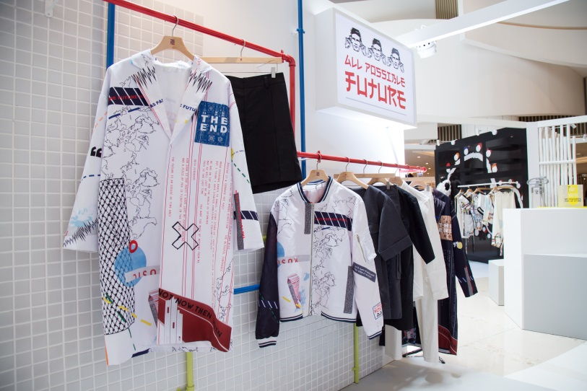
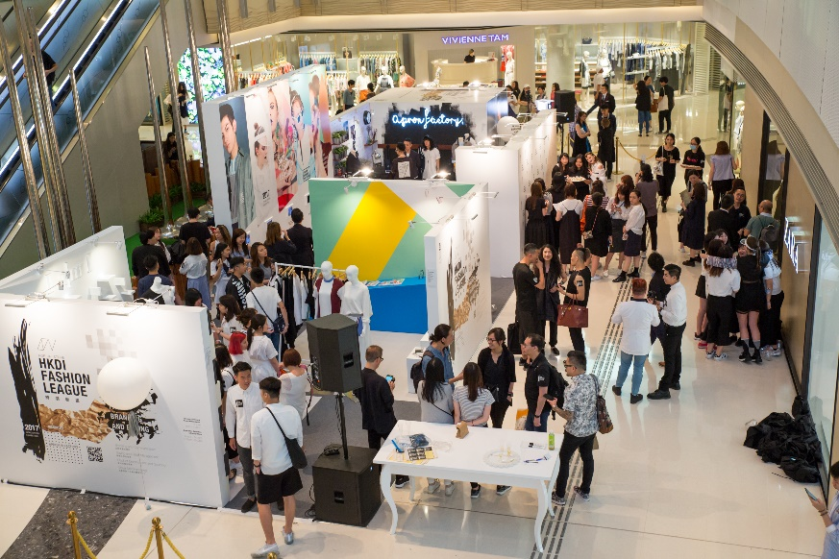
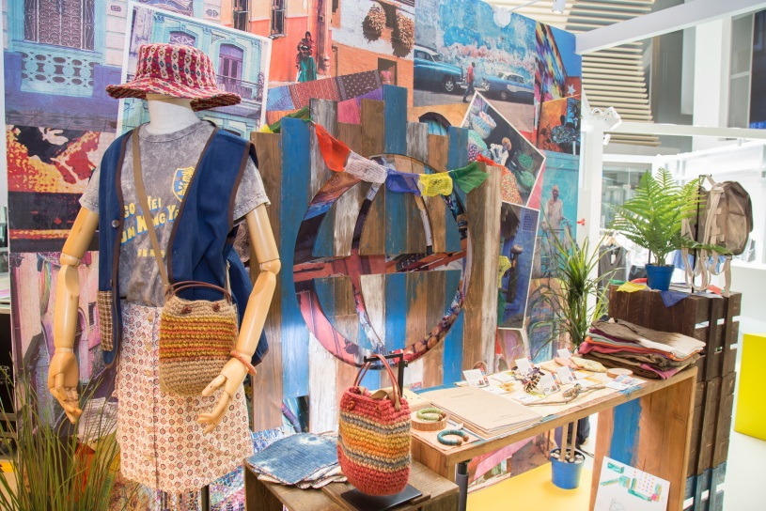
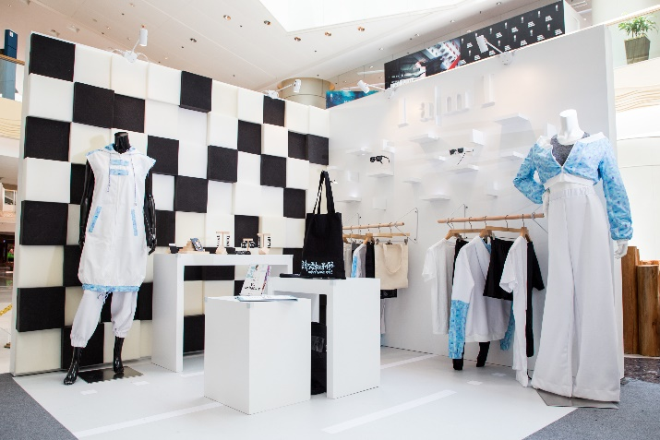
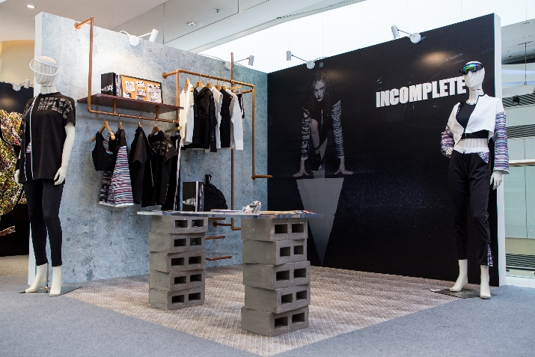
Building Own Fashion Brands
Build your own brand! – Graduation Exhibition of students in High Diploma in Fashion Branding and Buying, Hong Kong Design Institute

