Slide 1

Global Apparel Manufacturing Trends
Apparel Industry -
Types, Size and Operation of Companies in the Apparel Industry

Slide 2
Overview of the Textiles-Clothing Supply Chain

Slide 3
Types of Textiles Manufacturers
Fibre Manufacturers
  Natural Fibres – e.g. Cotton, Wool, Silk, Down, Cashmere, Linen
  Synthetic Fibres – e.g. Polyester
Yarn Spinners
  Manufacturers who spin fibres into yarns
Fabric Manufacturers
  Weavers – for Woven Fabrics
  Knitters – for Knitted Fabrics
Garment Manufacturers

Slide 4
Textile Fibres
Natural Fibres
Man-made (Synthetic) Fibres
Plant Fibres
Animal Fibres

Slide 5
Natural Fibres
Plant Fibres
Cotton
Linen
Animal Fibres
Wool
Silk
Cashmere
Down
Alpaca

Slide 6



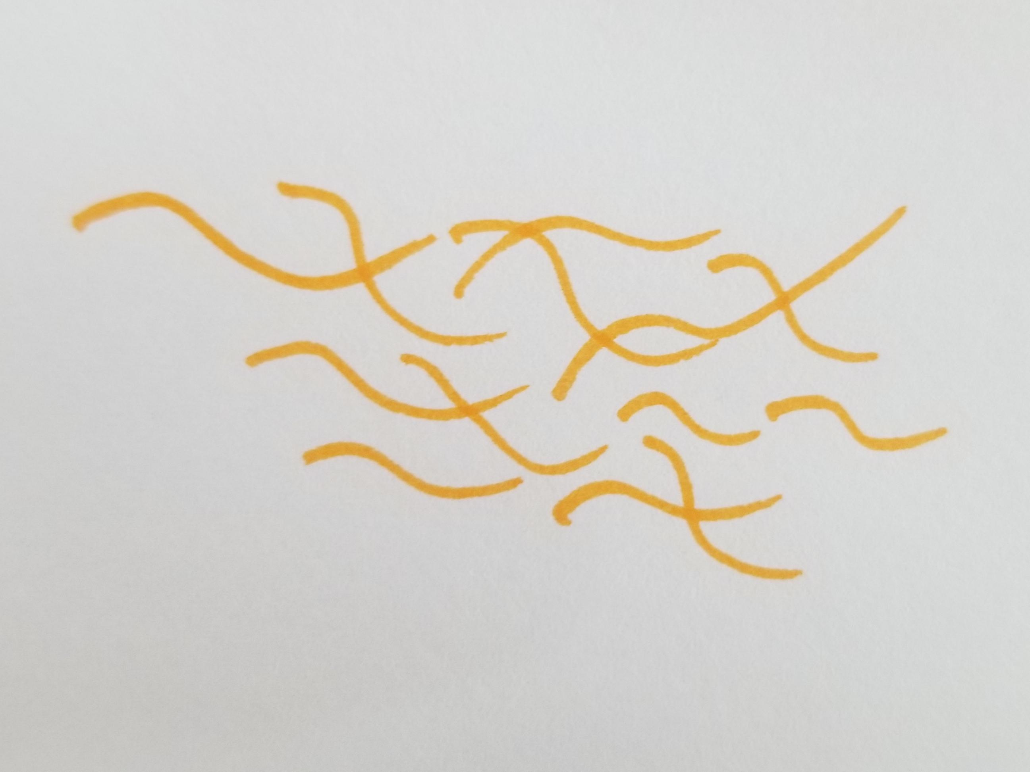
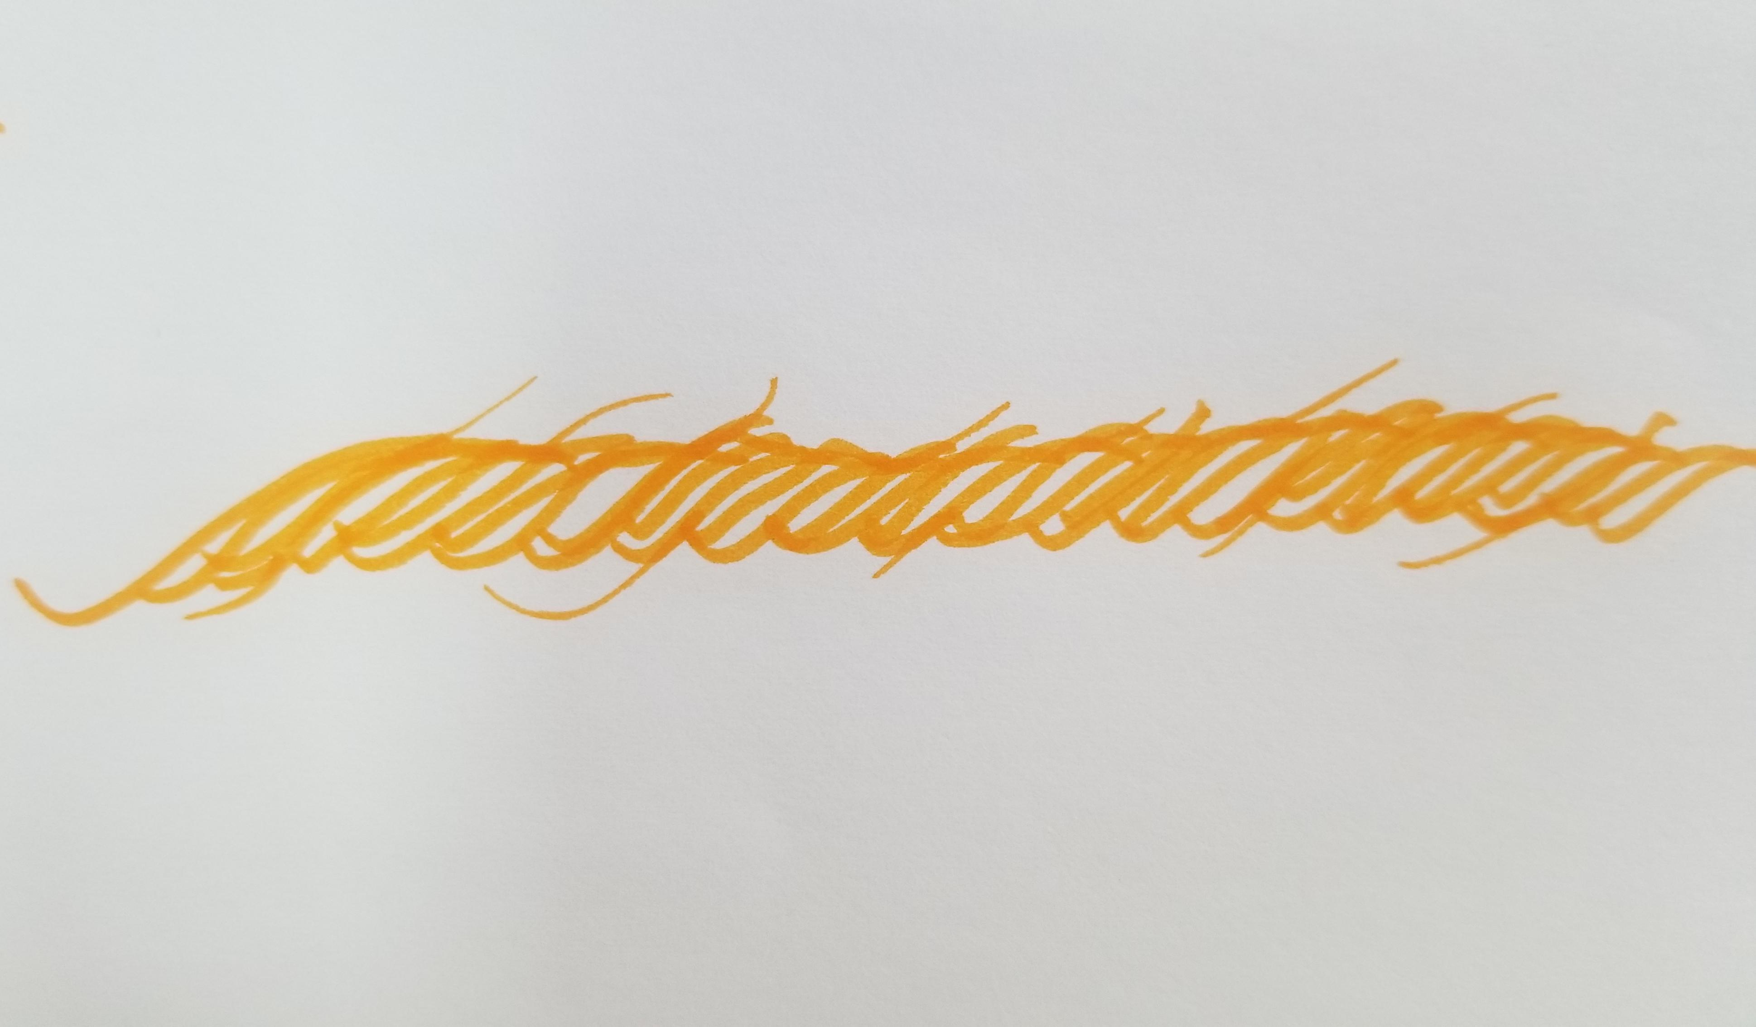
Yarn Spinning
Natural fibres are in staple form and will be spinned into yarns.
Synthetic fibres are sometimes in filament form, but if want to imitate the hand feel of natural fibres, yarn spinners will cut the synthetic filament yarns into staples, then go through the spinning process to make yarns.
Yarns are used for making fabric, both knitted and woven fabrics.
Natural Staple Fibres
Spin Staple Fibres into Yarns
Cut into
Staple Synthetic Fibres
Synthetic Filament Yarns
Spin Staple Fibres into Yarns
Photo(s) is/are provided by Hong Kong Design Institute
Background image from PowerPoint Designer
Notes:
Notes :
Natural fibres are in stapled form and will be spinned into yarns.
Synthetic fibres are sometimes in filament form, but if want to imitate the hand feel or natural fibres, manufacturers will cut the synthetic filament yarns into staples, then do the spinning process to make yarns.
Yarns will be the form for making fabric, both knitted and woven fabrics.

Slide 7

Global Fibre Production Trends
Background image from PowerPoint Designer
The global fibre production has almost doubled in the last 20 years from 58 million tonnes in 2000 to 109 million tonnes in 2020. Although hit by the COVID-19 pandemic in 2020, the trend is still on the upward side. In 2030, the estimation of fibre production will have 34% increase.
However, less than 0.5 percent of the global fibre market was from pre- and post-consumer recycled textiles in 2020.
Reference: Preferred Fiber & Materials – Market Report 2021, Textiles Exchange

Slide 8
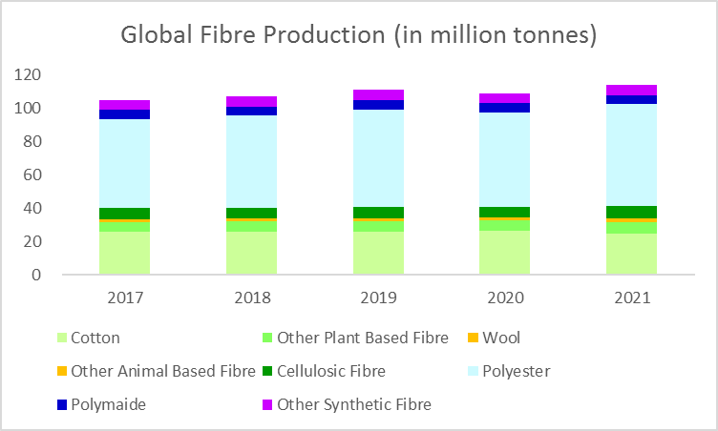
Global Fibre Production in the past 5 years
Reference: Preferred Fiber & Materials Market Report 2018, 2019, 2020, 2021, 2022, Textile Exchange

Slide 9
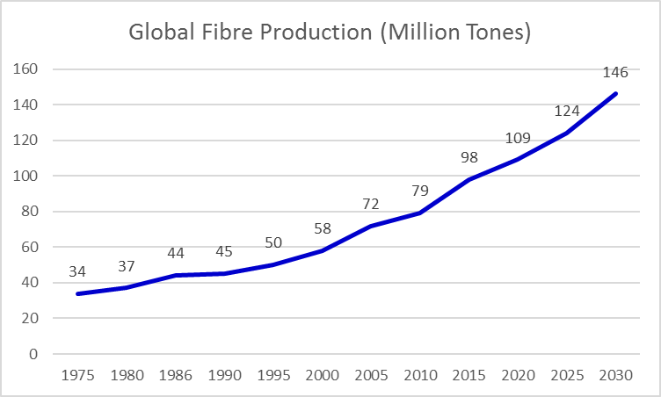
Global Fibre Production Trends
Reference: Preferred Fiber & Materials – Market Report 2021, Textiles Exchange

Slide 10
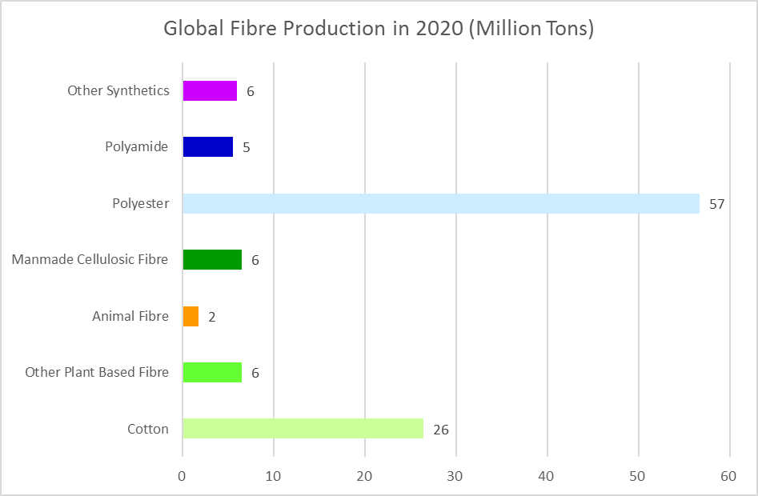
Reference: Preferred Fiber & Materials – Market Report 2021, Textiles Exchange

Slide 11
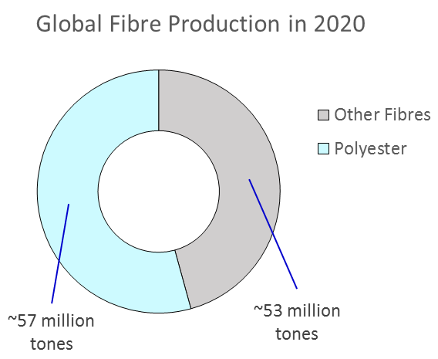
The largest Synthetic Fibre Production - Polyester
Many countries and regions produce polyester, namely China, Japan, Korea, India, USA, S.E. Asia (Pakistan, Thailand, Indonesia, Sri Lanka), Europe (Germany, Switzerland, UK, France, Italy, Spain, the Netherlands), Canada and Kenya in Africa.
Polyester had a market share of approximately 52 percent of the global fibre production in 2020.
~109 million tones
Reference: Preferred Fiber & Materials – Market Report 2021, Textiles Exchange

Slide 12
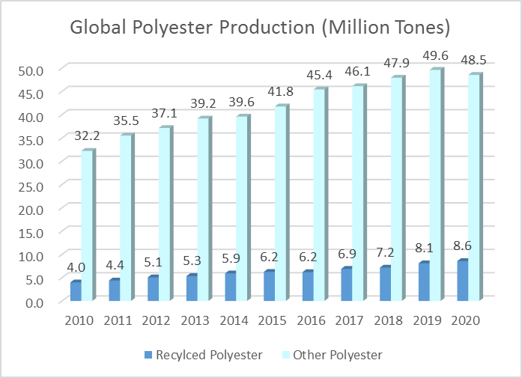
Polyester
Only 15% polyester are recycled in 2020
Most recycled polyester is currently mechanically recycled from polyethylene terephthalate (PET) bottles
Reference: Preferred Fiber & Materials – Market Report 2021, Textiles Exchange

Slide 13
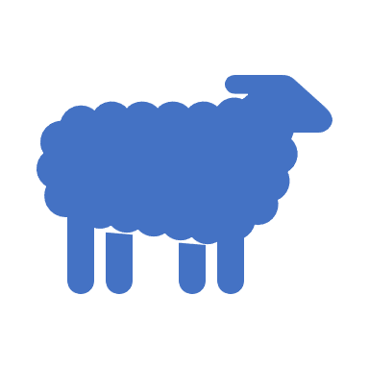
Wool Production
Australia is the largest Wool producing and exporting country
  Australia: 22%
  China: 14%
  New Zealand: 10%
  Turkey: 3%
  Sudan: 3%
  Others (South Africa, Uruguay, Argentina, USA) : 48%
Reference: Preferred Fiber & Materials – Market Report 2021, Textiles Exchange

Slide 14
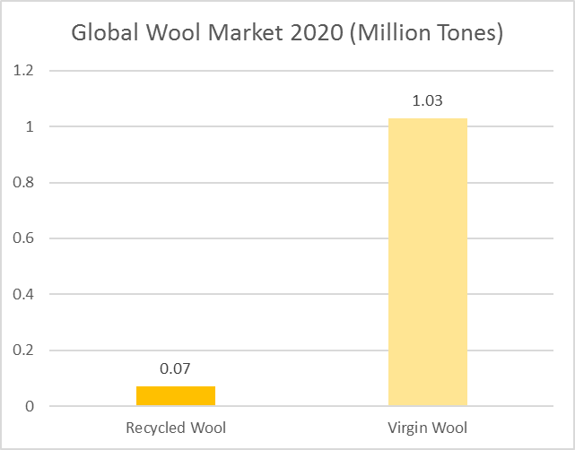
Virgin Wool vs Recycled Wool
Reference: Preferred Fiber & Materials – Market Report 2021, Textiles Exchange
Notes:
Virgin Wool is the wool fibre shed directly from sheep and have not been used for any purposes.

Slide 15
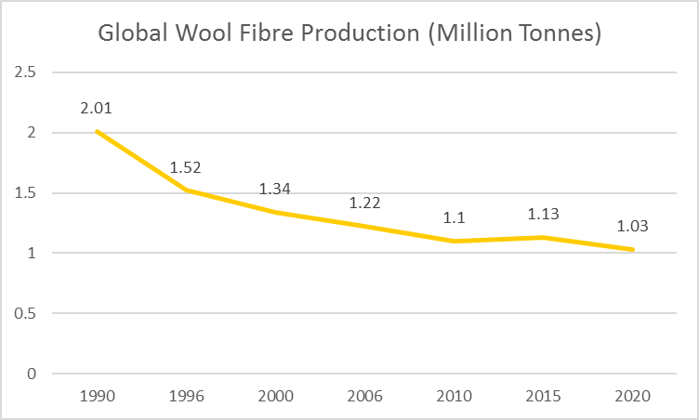
Due to the use of mass-produced synthetic fibres, the use of wool in clothing has been dropping in the past 20 years
Reference: Preferred Fiber & Materials – Market Report 2021, Textiles Exchange

Slide 16
The Woolmark Company
– Australian Merino Wool
It is a global organisation representing Australian woolgrowers to promote and conduct innovative Research and Development (R&D) on Merino Wool
It owns the “Woolmark” logo, a quality assurance symbol applied to products made by Australian Merino Wool
Merino Wool is the finest wool fibre for fashion
China is the largest importing country of Australian Merino Wool to produce wool products, both woven and knitted apparel

Slide 17
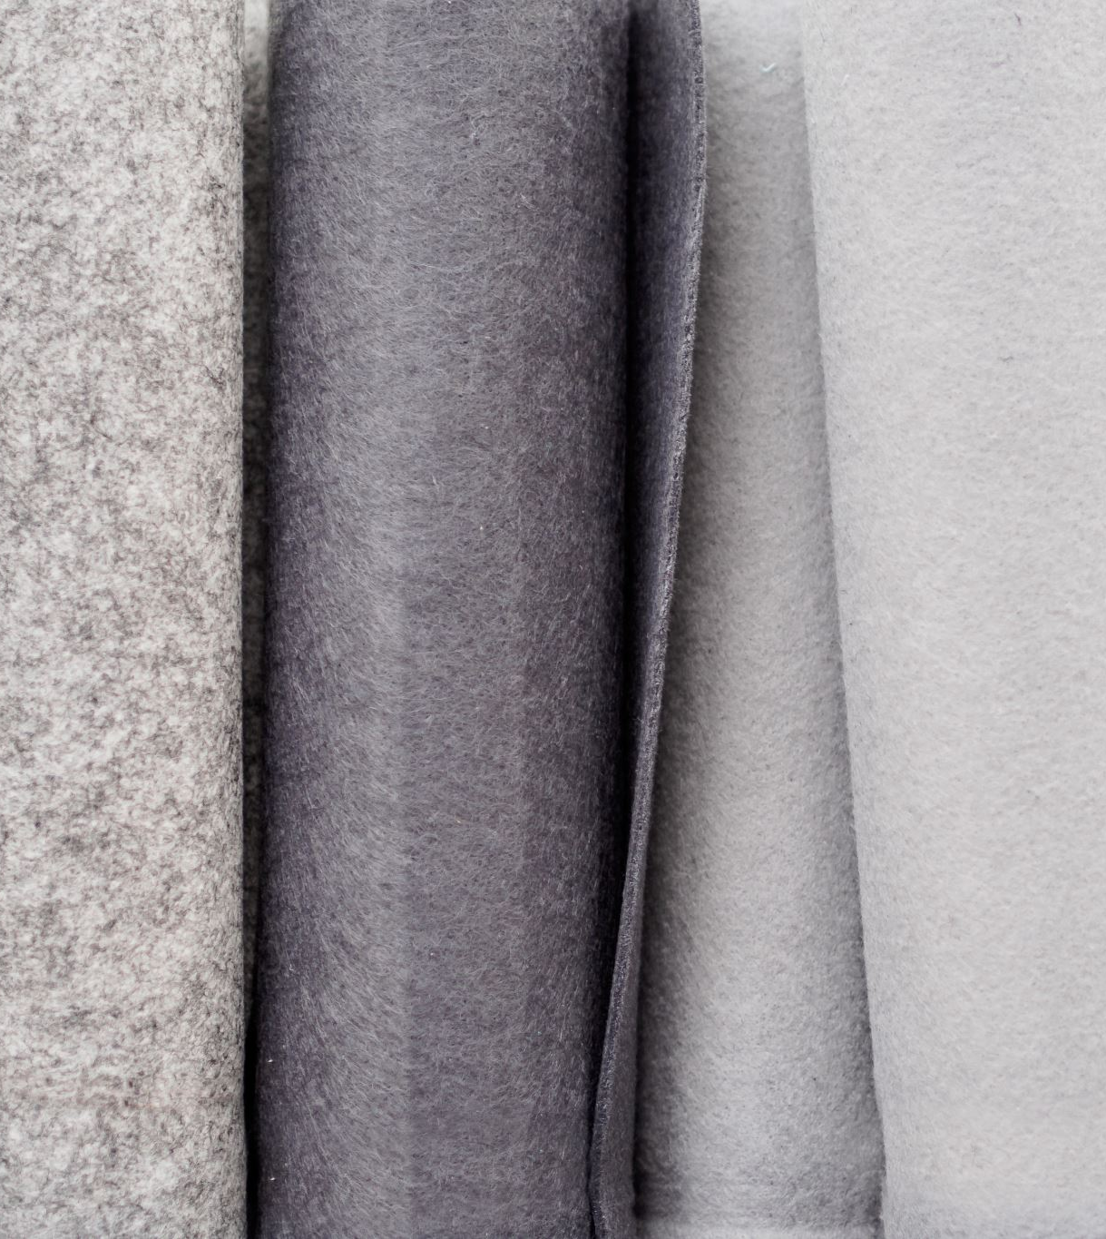
Cashmere
  60 percent of cashmere is produced in China
  20 percent in Mongolia
  20 percent in other countries
  Preferred (Sustainable) Cashmere is only 7% of the total production
Reference: Preferred Fiber & Materials – Market Report 2021, Textiles Exchange
Notes:
Preferred cashmere means the production process of the fibres is more environmentally friendly.

Slide 18

  Down
  Major production regions for preferred down are China and Eastern Europe, including Poland and Ukraine
  94% are from China
Background image from PowerPoint Designer
Reference: Preferred Fiber & Materials – Market Report 2021, Textiles Exchange

Slide 19
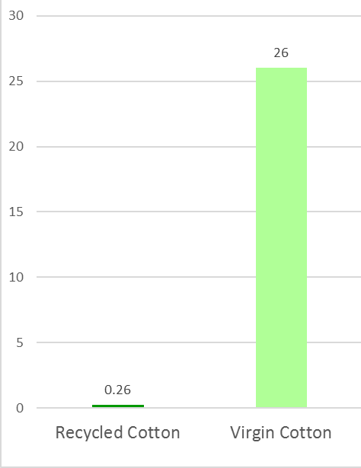
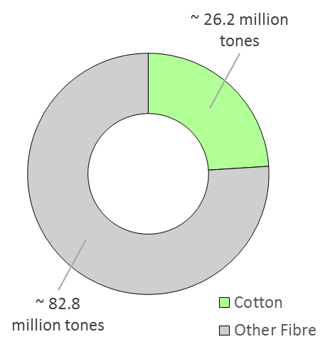
Cotton is accounted for 24% of the total world fibre production, but only around 1% are recycled cotton
Global Cotton Market 2020 (Million Tons)
Reference: Preferred Fiber & Materials – Market Report 2021, Textiles Exchange

Slide 20
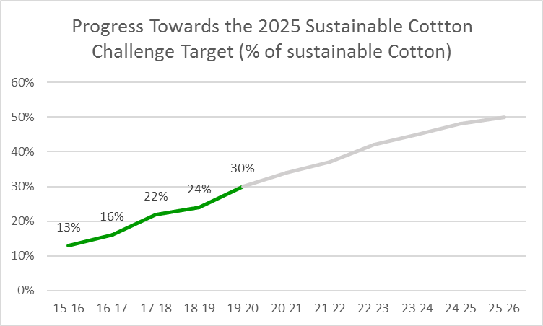
Since Cotton is a major fibre in the garment industry, there is a target to reach 50% of the cotton production to meet sustainable standards by 25/26. The industry also encourage more recycled cotton to be used.
Reference: Preferred Fiber & Materials – Market Report 2021, Textiles Exchange

Slide 21

Cotton Incorporated (Cotton Inc.)
It is a global organisation funded by the United States growers of upland cotton and importers of cotton and cotton textile products
It is also a research and marketing company. The Program is designed and operated to improve the demand for and profitability of cotton
The introduction of the Seal of Cotton in 1973

Slide 22
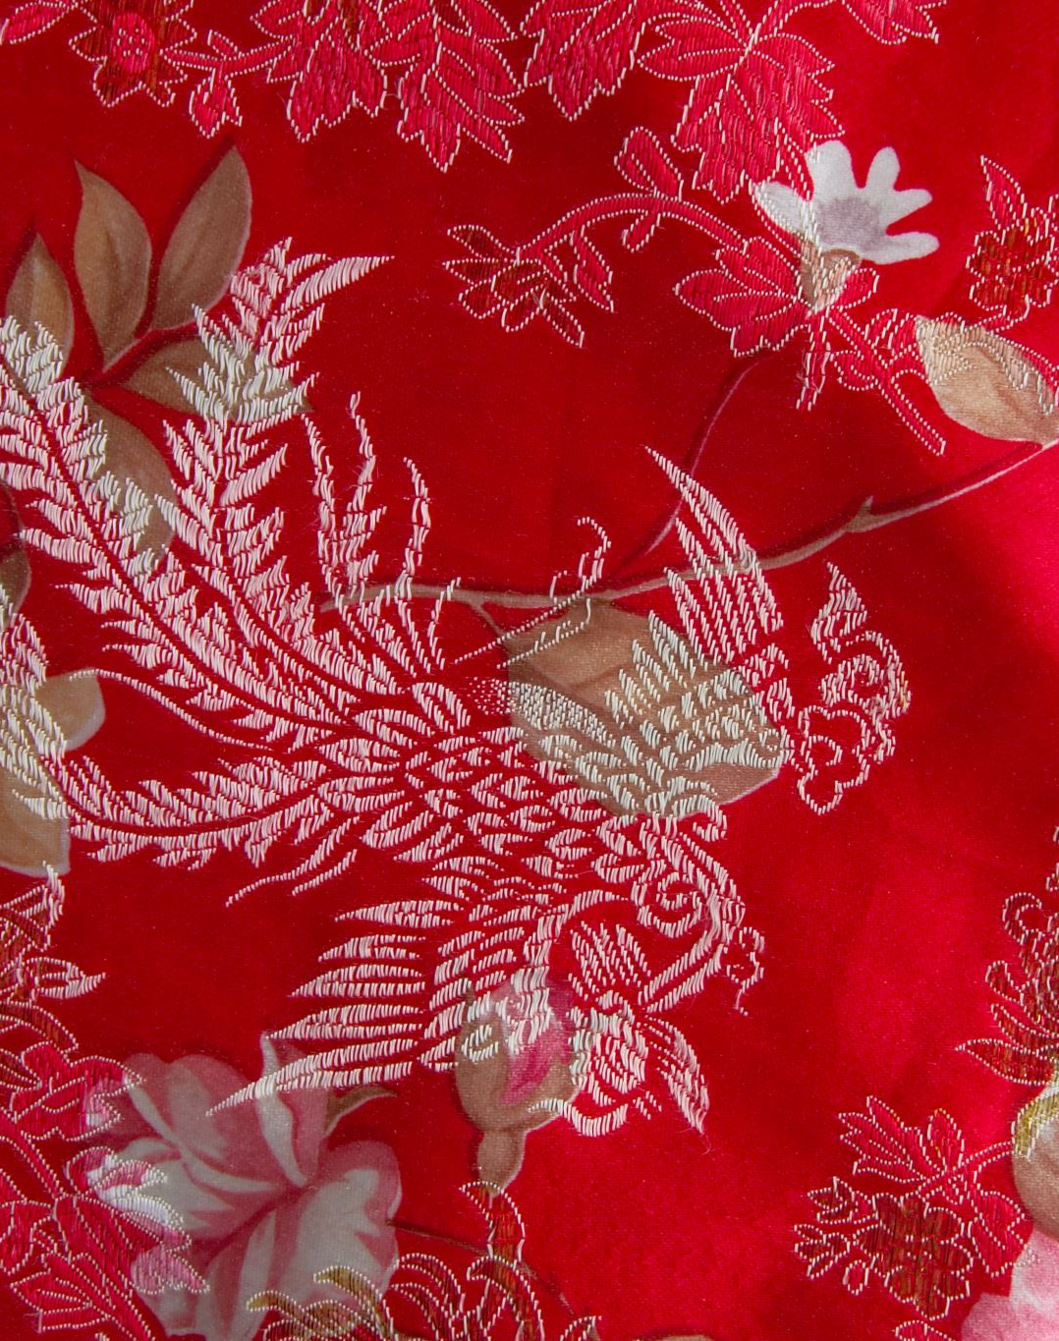
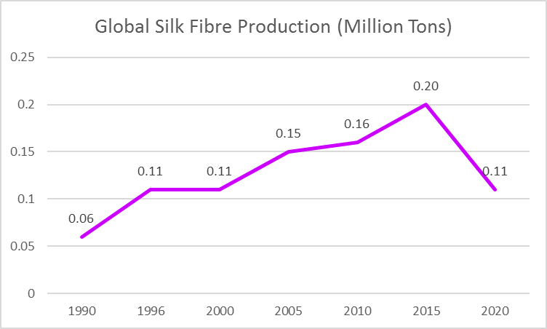
Silk
Overall global silk production had dropped by almost half as compared to 2015
China is the largest silk production country
  China 63%
  India 33%
  Uzbekistan 2%
  Others 2%
Reference: Preferred Fiber & Materials – Market Report 2021, Textiles Exchange

Slide 23
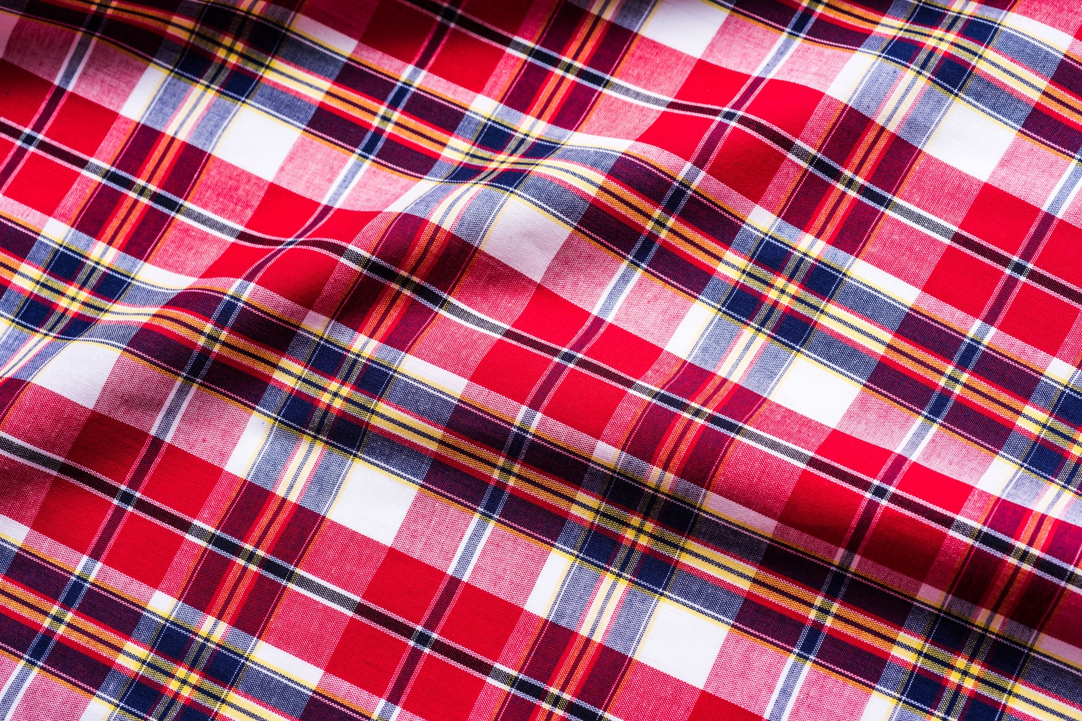
Woven Fabric
- Fabrics are made by interlacing the warp and weft yarns
- Woven fabrics can be made of natural fibers, synthetic fibers, or a mixture of both
Fabrics – Woven
Notes:
Warp is the vertical yarn.
Weft is the horizontal yarn.

Slide 24
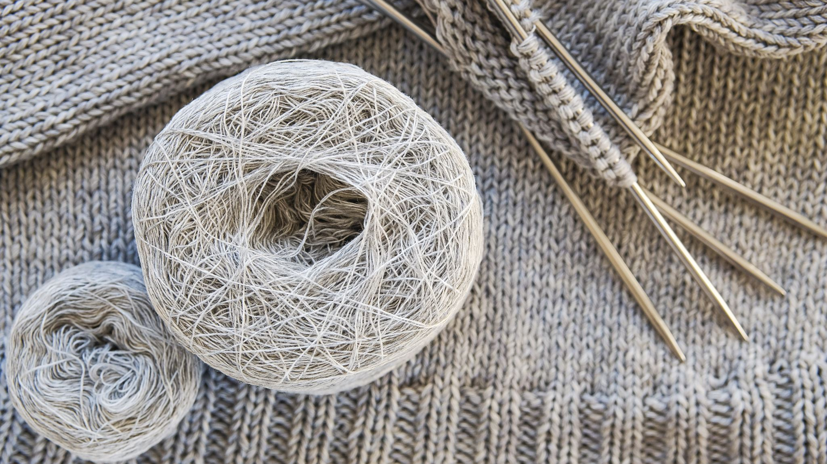
Knitwear
Sweaters
- Sweaters are made by using knitting equipment to form loops of yarns and then string them over each other to form the shape of individual parts of the garment. The parts will be sewn together to form a garment.
- Materials for producing sweaters are usually wool, cashmere, synthetic or wool blended yarns.
Knitted Fabric is made under a knitting process. Garments are made through a “Cut & Sewn” process. Usually, the knitted fabrics are in cotton or synthetic materials. Mostly for making T-shirts.
Photo(s) is/are provided by Hong Kong Design Institute

Slide 25
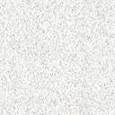
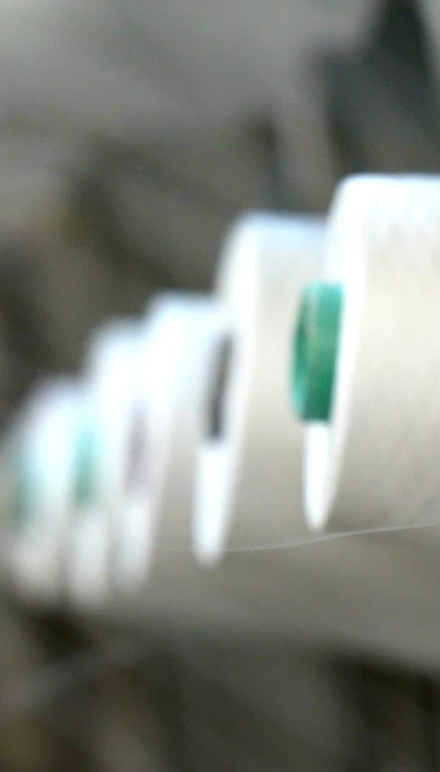
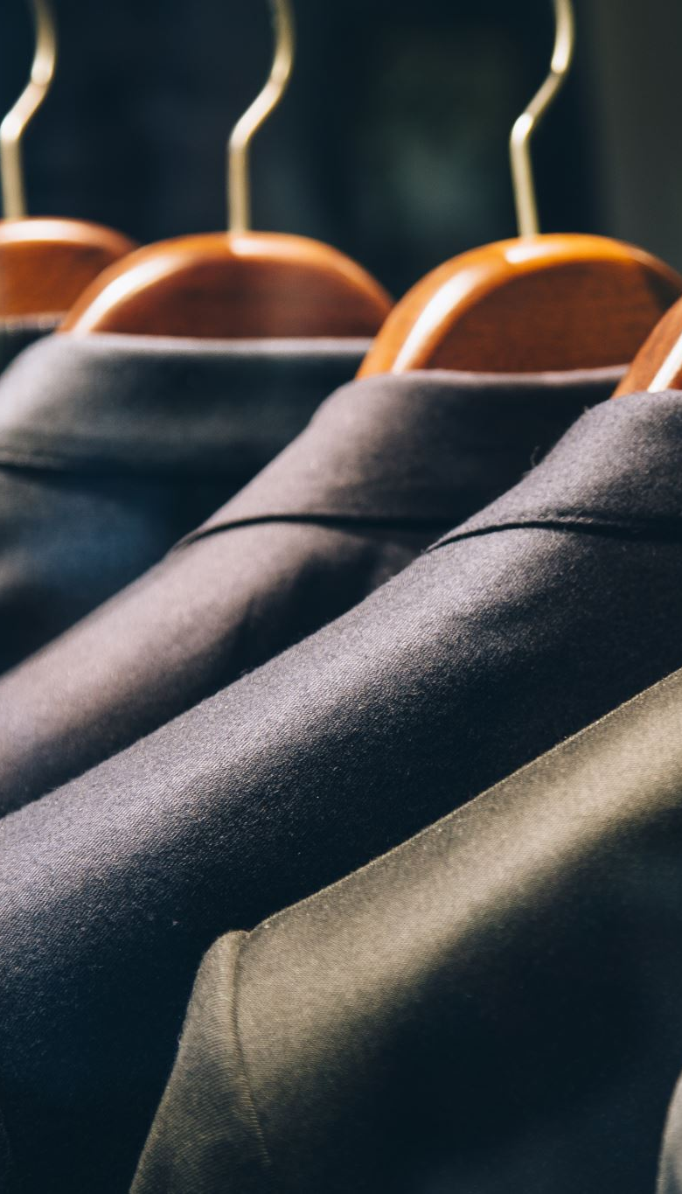
Manufacturing Trends in the Textiles and Apparel Industry

Slide 26
E S G
=
Environmental, Social and Governance

Slide 27

ESG is a very popular term in many industries including textiles and fashion. It is a framework used to assess an organisation's business practices and performance on various sustainability and ethical issues.
Environmental
How the industry helps lessens the impact of climate change and protects the environment
e.g. waste reduction, carbon footprint reduction and energy efficiency
Social
How the companies manage the relationships with employees, suppliers and customers
e.g. equal employment opportunities, workplace health and safety, fair pay and community engagement
Governance
It is about the companies’ leadership, internal control, audit and shareholders’ rights
e.g. risk management, avoid conflict of interests. ethical business practices and accounting transparency

Slide 28
What are textiles and apparel industry’s works on ESG sustainability?
Environmental
Use of recycled fibres
Social
Pay more attention on staff’s work life balance, avoid the norm of long working hours in the industry
Respecting human rights
Accept diversity in race and sexual orientation
Care for local community
Governance
Choose manufacturer with good business ethics e.g. no child labours, no prisoner labours
No corruption
Comply with law
No tax avoidance
Use less water and avoid polluting water when processing fabric or garments
Decarbonisation and save energy in factory
Try best to produce goods nearer to the market to avoid long haul transportation
Use less toxic dyestuffs

Slide 29
Design for Circularity
To be used for a long term
Made to be re-made
Made from safe and recycled or renewable materials

Slide 30
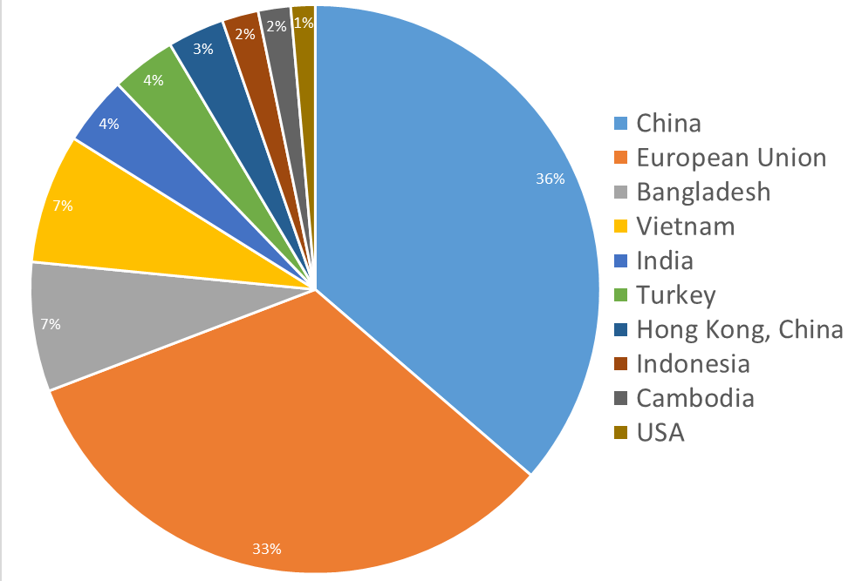
Manufacturing Territory - The top 10 production base of apparel products before Covid-19
2018
China is the largest manufacturing country. However, South and South East Asian countries namely Vietnam, Bangledash and India are becoming more and more important
China
South East Asia
Reference: World Trade Statistical Review 2019, World Trade Organization

Slide 31
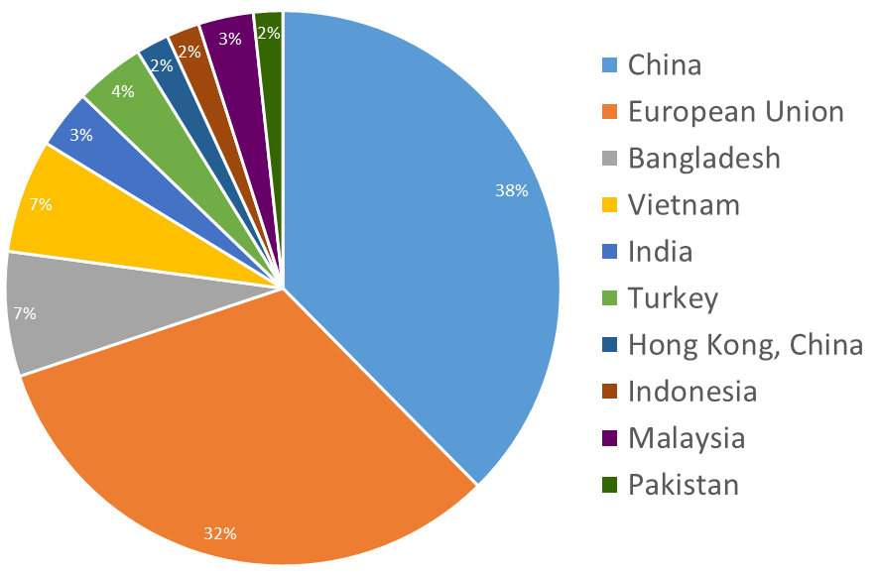
Apparel Production Countries during Covid-19
2021
Comparing with the figures in 2018, China is still the largest exporter of clothes in 2021 during Covid-19. It is observed that the trend of shifting apparel production to South-East Asian countries is getting more prominent.
Reference: World Trade Statistical Review 2022, World Trade Organization

Slide 32
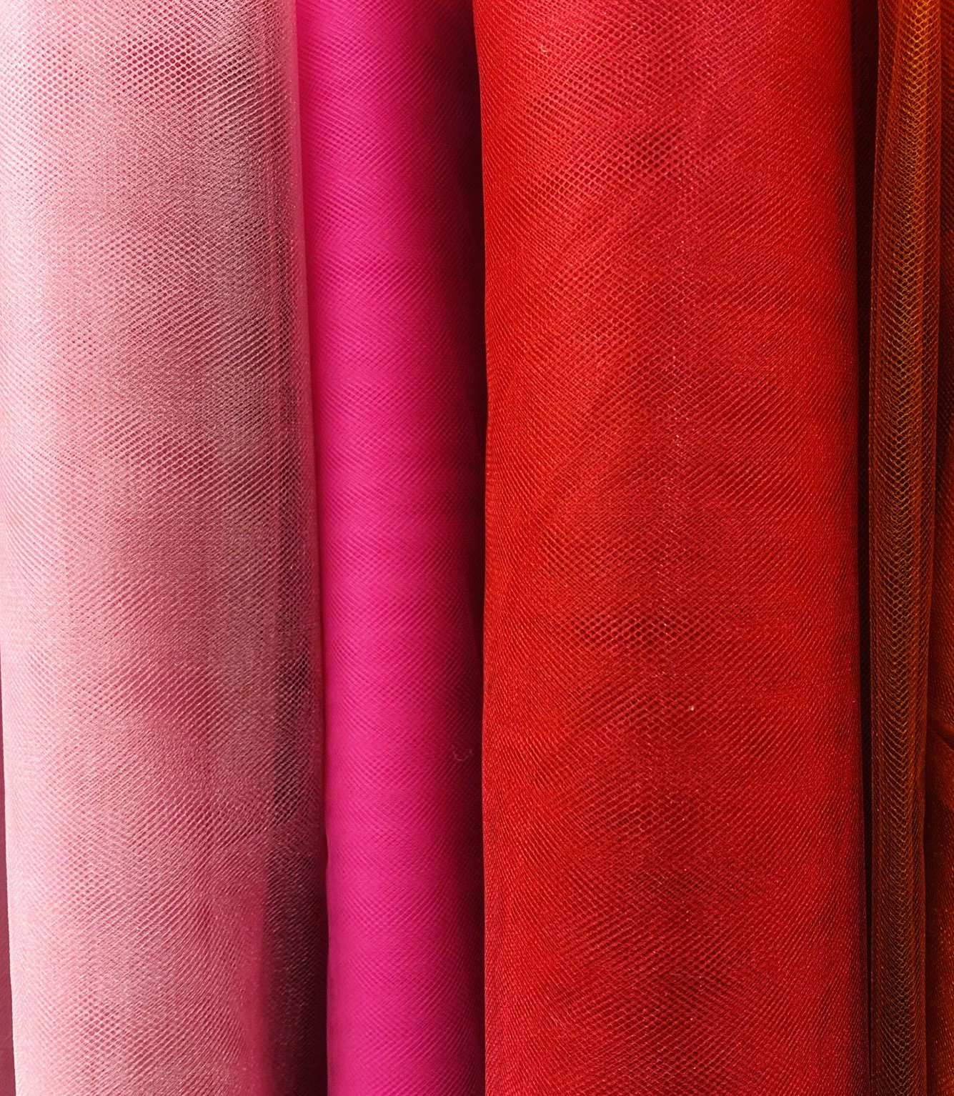
Manufacturing Territory of Fabric
China
  China is the largest textile country in the world accounting for over 50% of the global production
  Types of fabric are diversified including cotton, wool and synthetic
  China is the world's largest producer and with the finest quality of cashmere, about 60% of the global supply
  China is also the top leader of silk production, about 60% of the global supply

Slide 33
Other Territories of Fabric Production
India
  India is the second largest producer of textiles in the world. Cotton and silk rank world second in production. It is also the largest producer of jute in the world
Pakistan
  Important production source of cotton in the world, especially denim fabric
  It also produces other types of textiles
Italy
  It is well known for the advanced dyeing and finishing process done with high end technology
  Italy is also very famous in producing finest textile designs and product development in the world with top design aesthetics and quality
South Korea
  It is well known for a variety of synthetic fibres and fabric
Turkey
  Good at cotton materials using the finest Egyptian Cotton

Slide 34
Reference (Retrieved on Aug 23, 2023)
KPMG & InvestHK (2020), Future of Sourcing: 2021 and beyond Hong Kong’s vital role in the global supply chain
The Woolmark Company
(https://www.woolmark/)
Cotton Incorporated
(https://www.cottoninc.com/)
What Is Environmental, Social, and Governance (ESG) Investing?
(https://www.investopedia.com/)
DIGITAL 2023: HONG KONG
(https://datareportal.com/)
Preferred Fiber & Materials Market Report, Textile Exchange
(https://textileexchange.org/)
World Trade Statistical Review, World Trade Organization
(https://www.wto.org)

