Slide 1
Assessment 1

Slide 2
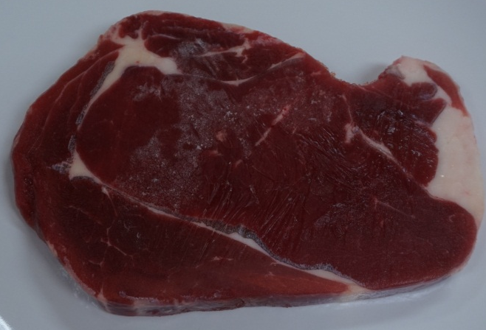
How will you cook sirloin steak?
Dry heat preparation
Moist heat preparation

Slide 3
Correct!!
Sirloin is cut of tender meat with less connective tissue and collagen when compared to brisket
High temperature with short cooking time keep meat tender
NEXT STEP : COOKING

Slide 4
Think again!!
HINTS
Is there a lot of collagen in this part of meat?
If no, what happens if we cook it for long time?
Go BACK and choose the right answer

Slide 5
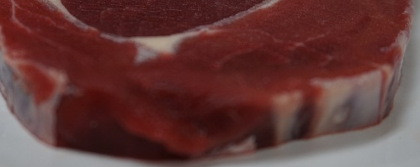
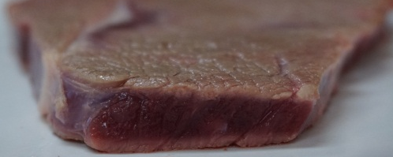
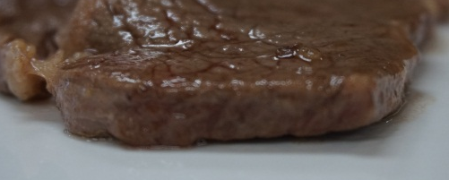
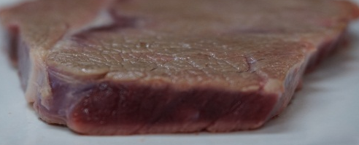
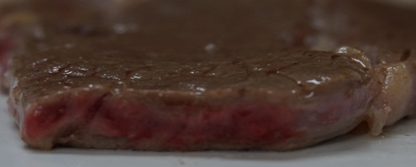
SHallow Frying ……
Statement: High temperature causes the denaturation of myoglobin so the colour of meat changes from bright red to greyish brown.
True
False

Slide 6
Correct!
Myoglobin is a pigment containing protein which is red in colour
  It denatures under heating and then hemichrome pigment (denatured globin and oxidized heme iron) is formed
  Hemichrome is greyish brown in colour
NEXT QUESTION

Slide 7
Think again!!
The answer should be TRUE
Myoglobin is a pigment containing protein which is red in colour
  It denatures under heating and then hemichrome pigment (denatured globin and oxidized heme iron) is formed
  Hemichrome is greyish brown in colour
Go BACK and choose the right answer

Slide 8
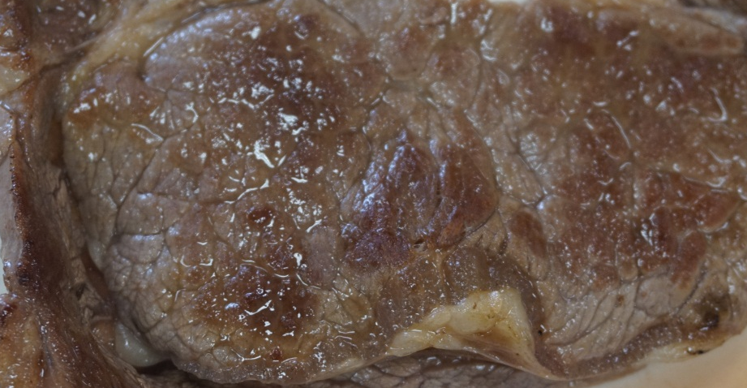
Why IS there browning on the SURFACE of meat After cooking?
Protein Coagulation
Maillard Reaction
Dextrinisation

Slide 9
Think again!!
HINTS:
Heating will cause meat protein to coagulate
However, protein coagulation affects the texture of meat, it is not the reason for browning on the surface of meat
Go BACK and choose the right answer

Slide 10
Think again!!
HINTS:
Dextrinisation takes place when starch is under heating, starch molecules are broken down into dextrins which are brown in colour
It is not the explanation for browning on the surface of meat
Go BACK and choose the right answer

Slide 11
Correct!!
Trace amount of carbohydrates in meat can react with amino groups of protein to form brown pigments on the surface of meat through Maillard Reaction during heating.

Slide 12
THE END

