Slide 1
TECHNOLOGY & LIVING
Textile Technology
S1.2.2 Classification of Fibres - Cellulosic (Plant) Fibres

Slide 2
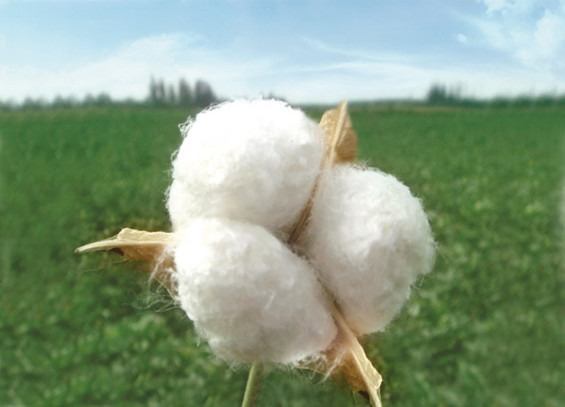
Natural Fibres –
Cellulosic (Plant) Fibres
Cotton
Different kinds and types of cotton are grown in various parts of the world. Variations occur among cotton fibres because of growth conditions, including such factors as soil, climate, fertilisers and pests.
The quality of cotton fibre is based on its colour, length, fineness, and strength.
Usually, longer fibres are finer and stronger.
Photo(s) is/are owned and provided by Esquel Group & HKDI.

Slide 3
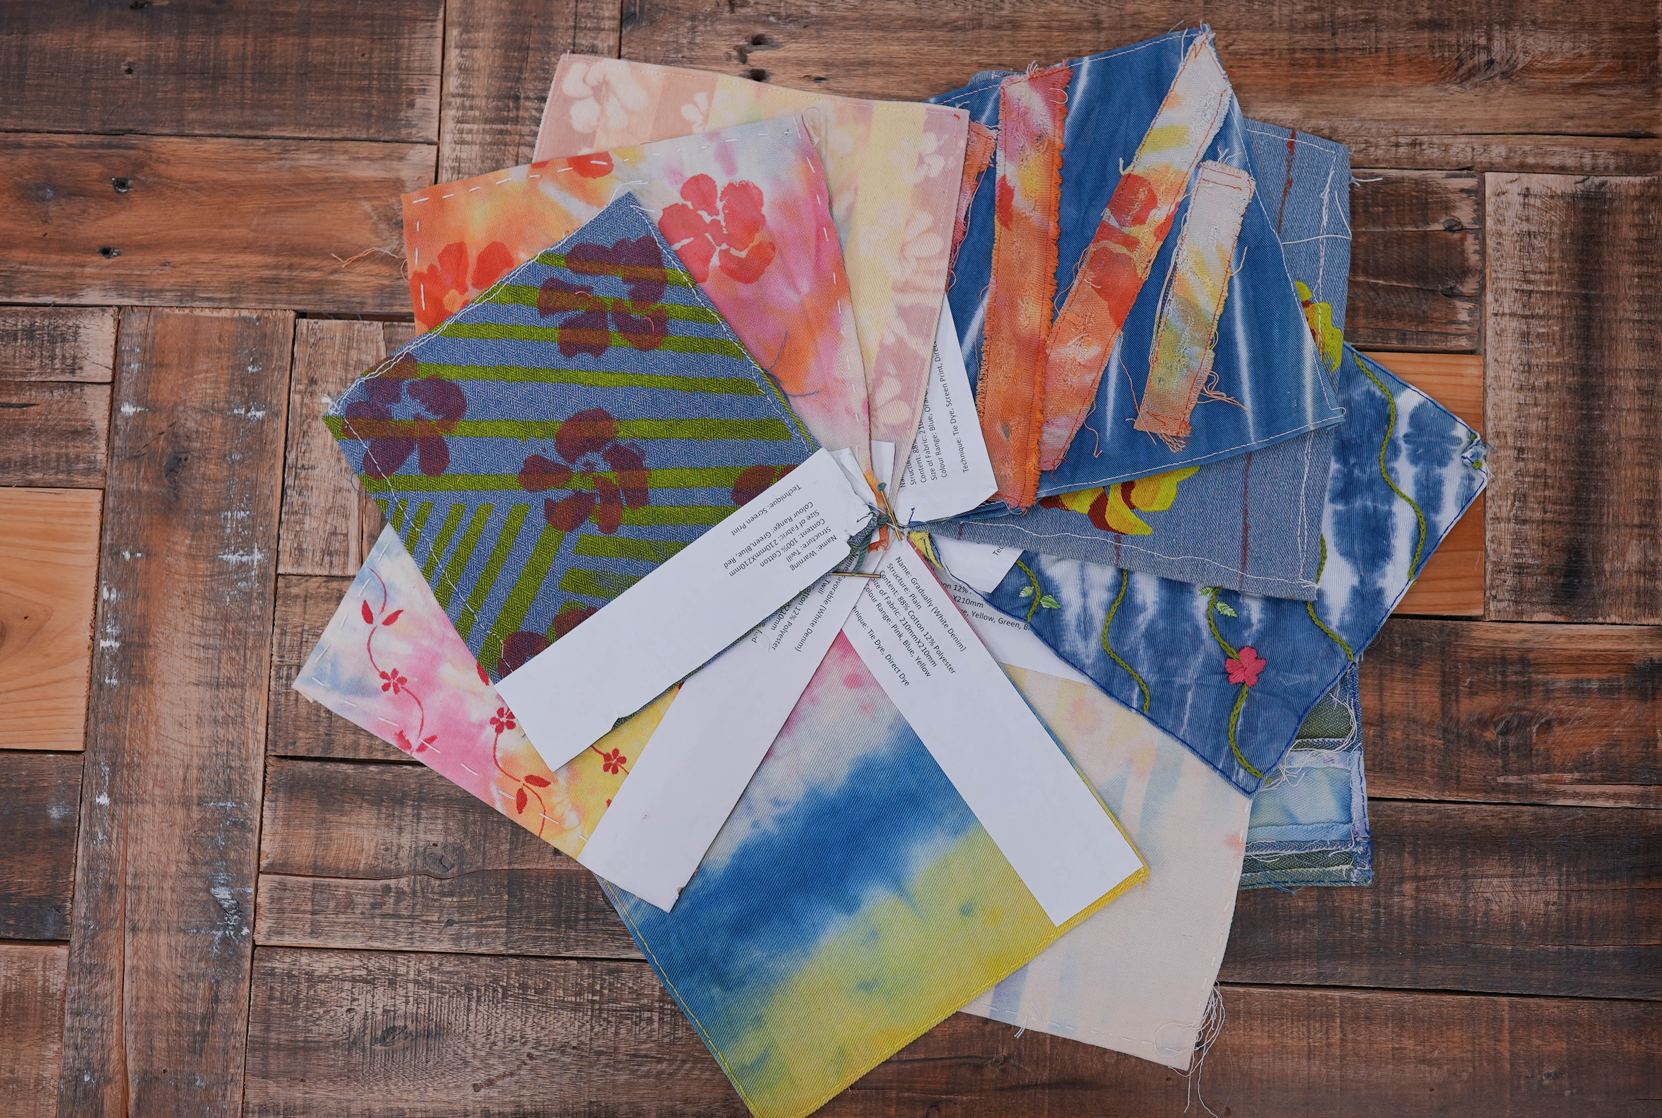
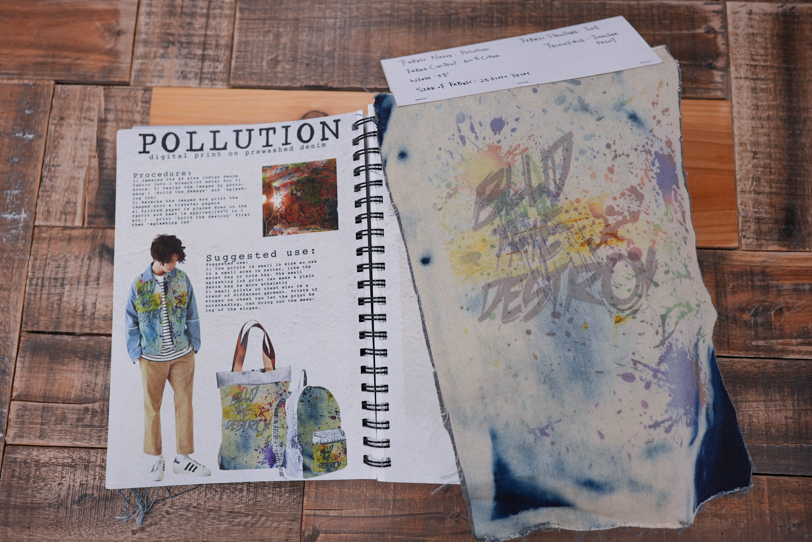

Natural Fibres –
Cellulosic (Plant) Fibres
Cotton
Properties:
  Comfortable
  Good absorbency
  Good colour retention
  Prints well
  Machine-washable
  Dry-cleanable
  Good strength
  Drapes well
  Antistatic
Watch to learn more!
Video(s) is/are owned and provided by Esquel Group & HKDI.
Photo (s) is/are owned by HKDI( (related works are provided by students of HD in Fashion Branding and Buying

Slide 4
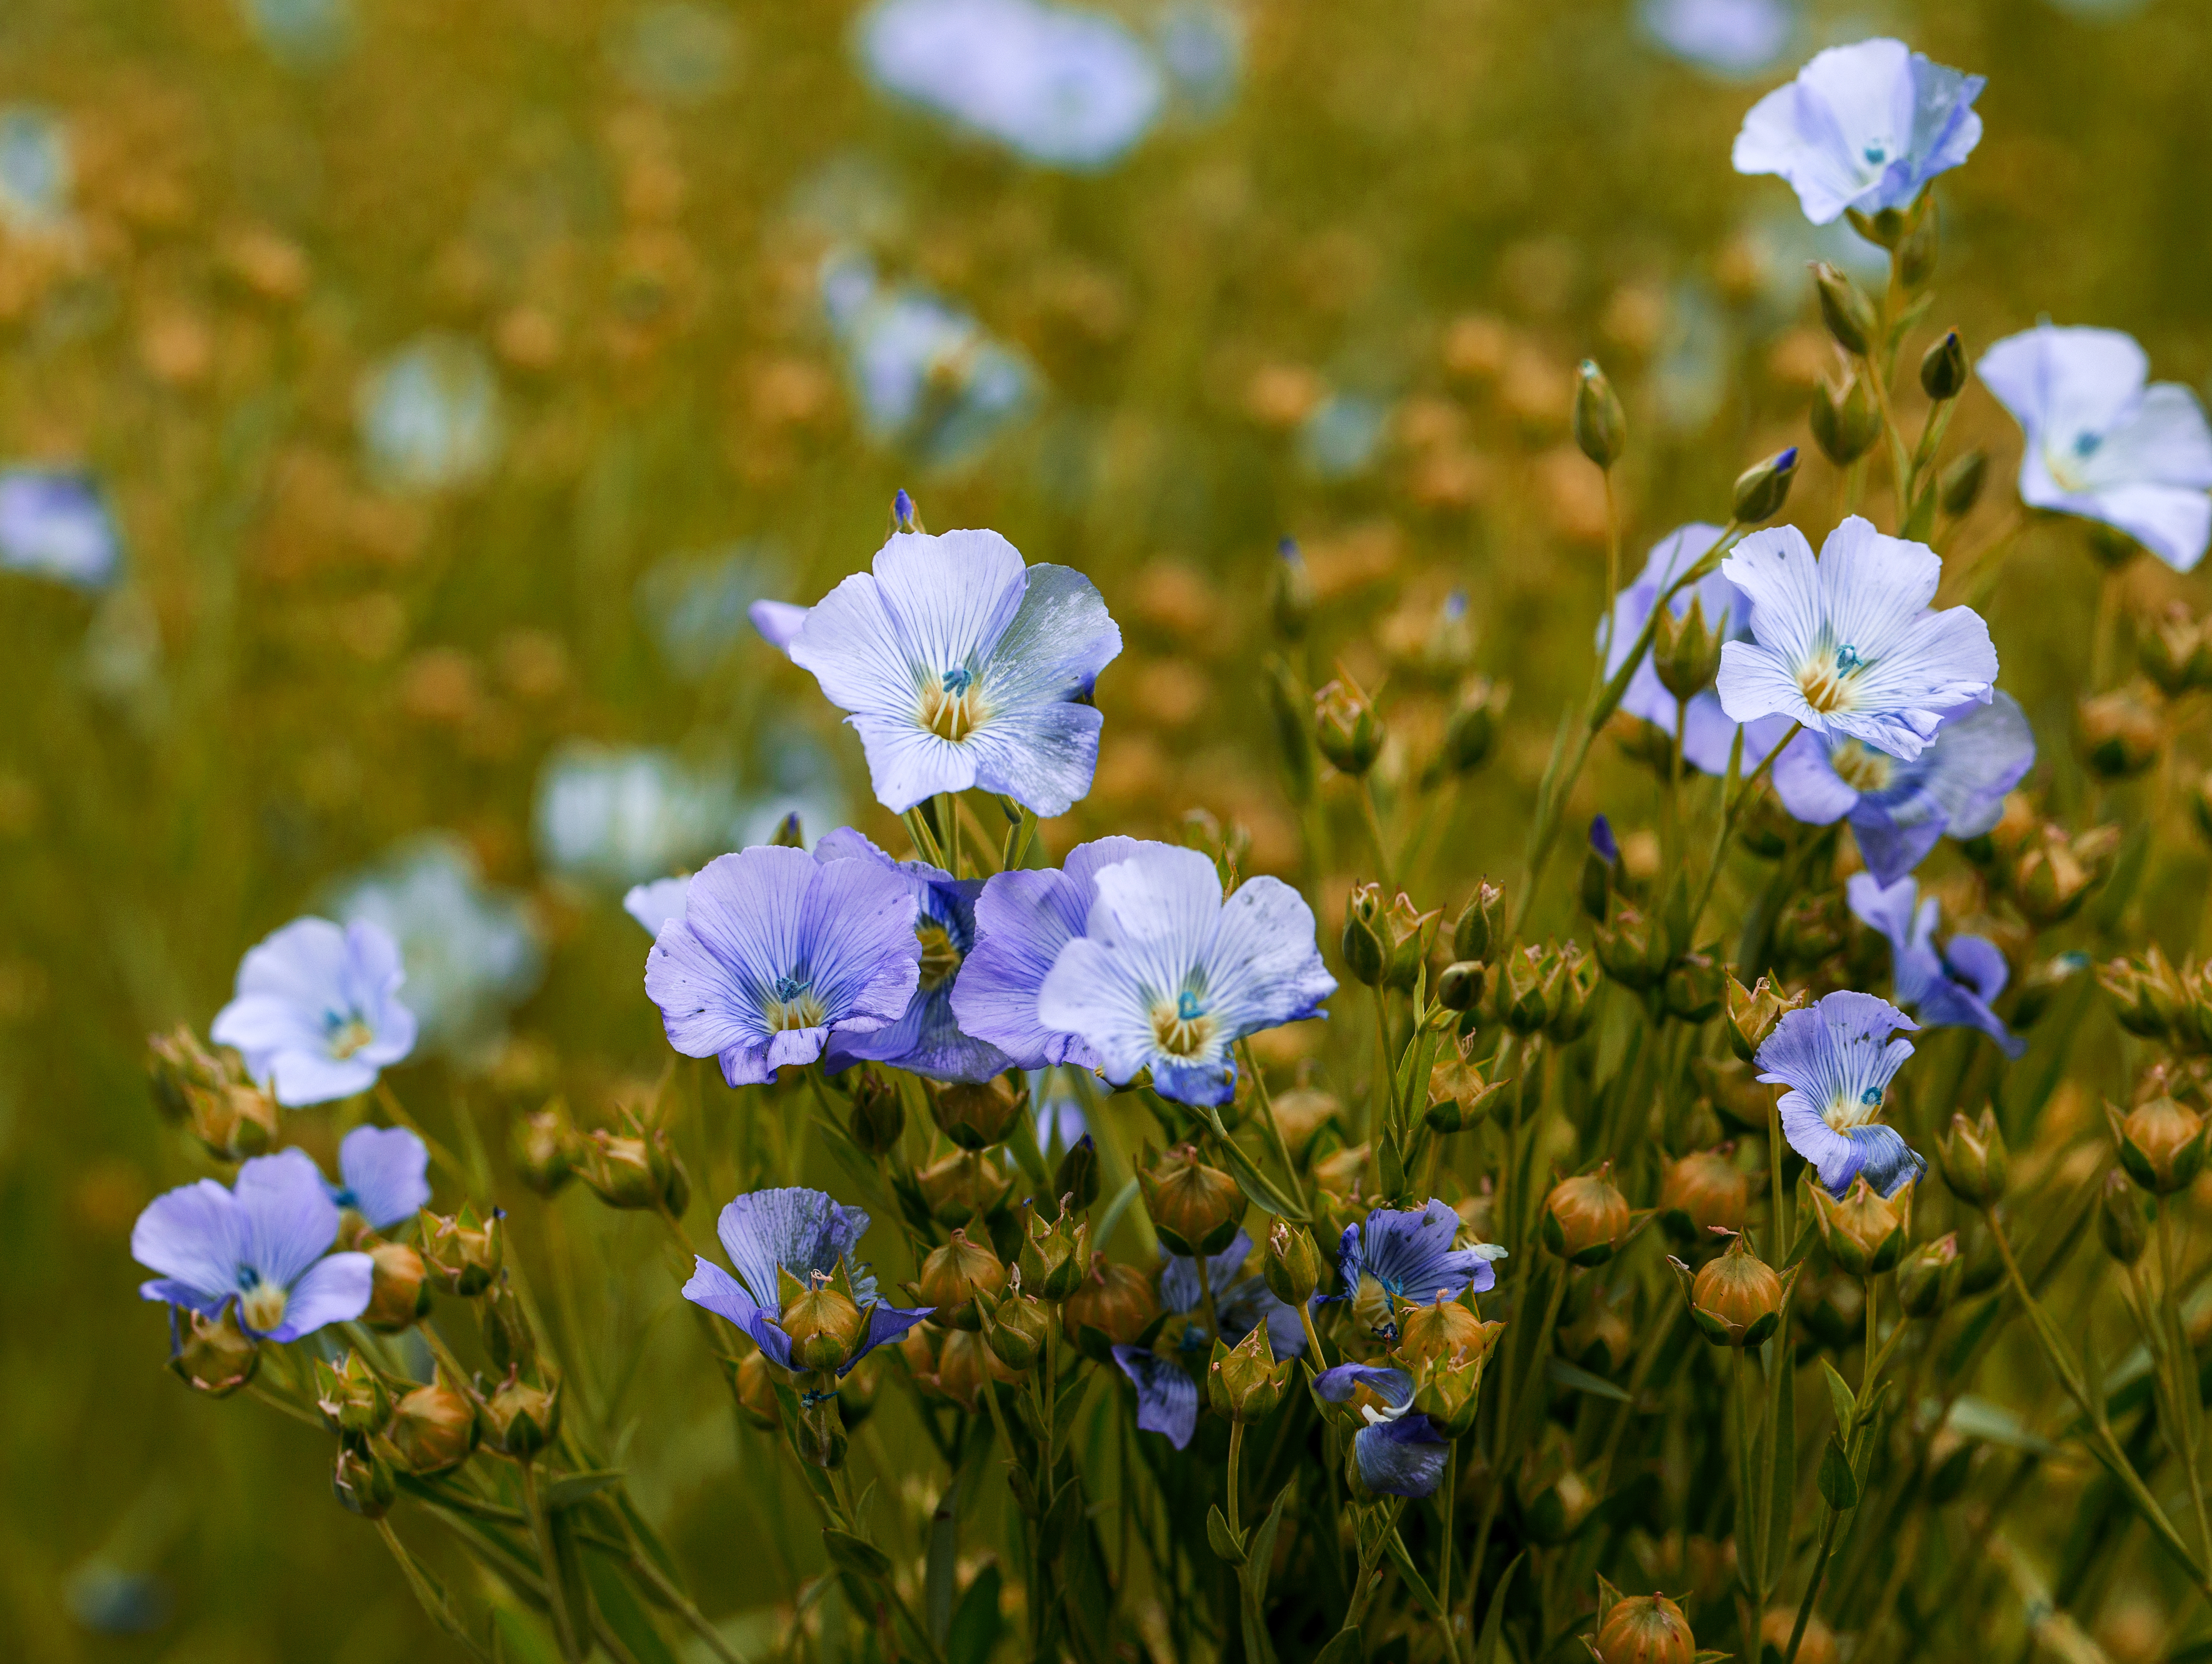
Natural Fibres –
Cellulosic (Plant) Fibres
Flax
  It comes from the stem of the flax plant.
  When the fibre is processed into fabric, it is called linen.
Properties:
  Very low elasticity
  Non-allergenic
  Antistatic
  Antibacterial
  Feel cool and dry to the touch
Source: stock.adobe.com

Slide 5

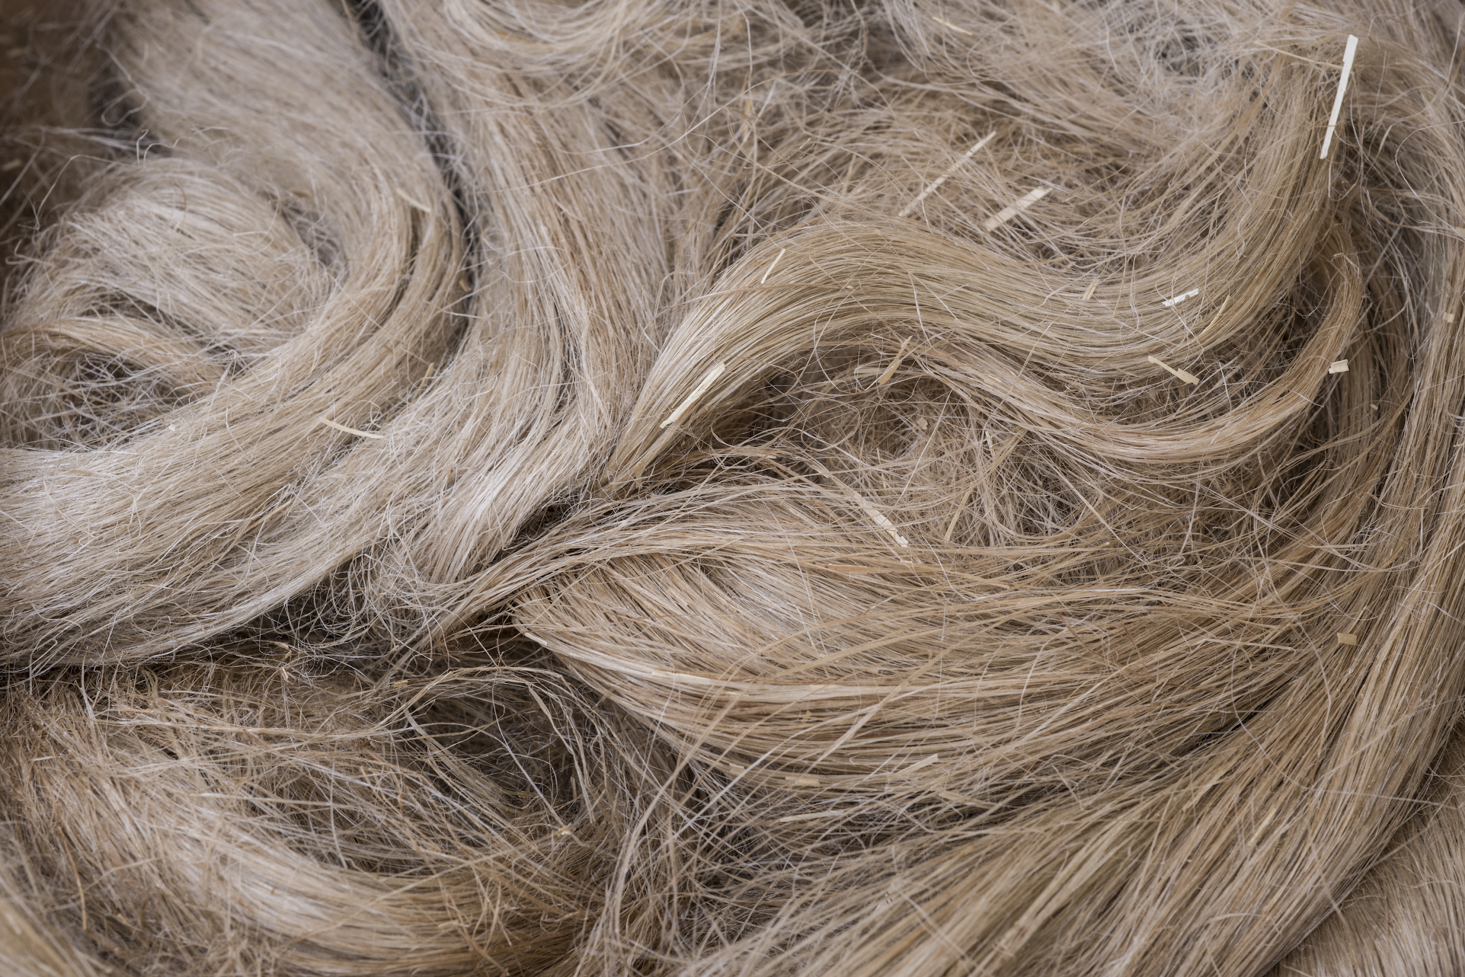
Natural Fibres –
Cellulosic (Plant) Fibres
Ramie
Ramie is a bast fibre from a plant known as reha and China grass. It is obtained from a tall shrub grown in Southeast Asia, China, Japan, and Southern Europe. The fibre is stiff, more brittle than linen, and highly lustrous. It can be bleached to extreme whiteness.
Click to Watch
Traditional Ramie Fabric Weaving Process!
Source: stock.adobe.com

Slide 6
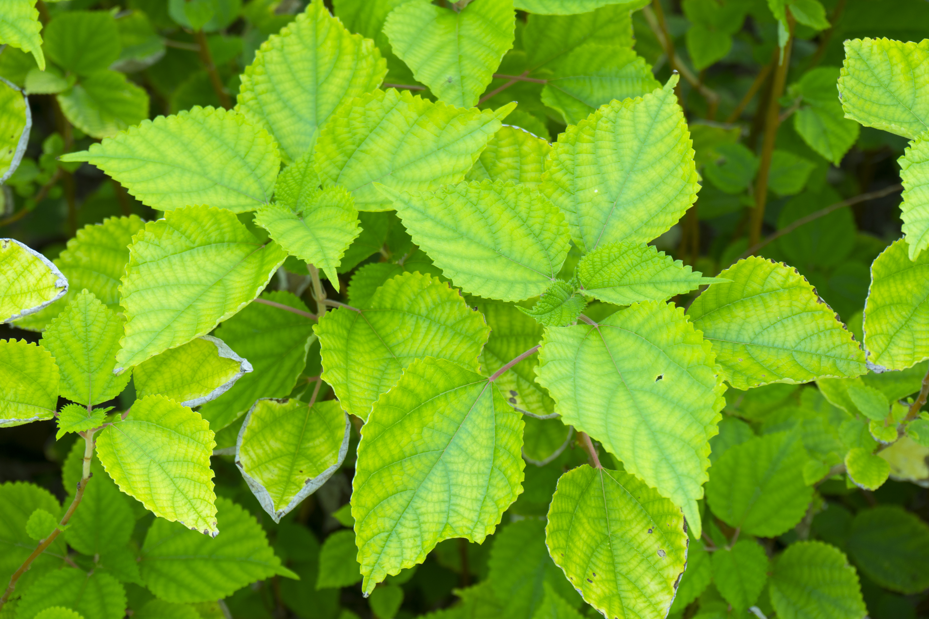
Natural Fibres –
Cellulosic (Plant) Fibres
Ramie
Ramie fibres are whiter and softer than flax and are ten to fifteen centimetres (four to six inches) long. Ramie fabric is gaining popularity in the fashion industry as a sustainable eco fibre. It can be grown without using chemical pesticides and sterilizers as it can naturally resist various pests and diseases, making it a typical environmentally green crop.
Properties:
  Resistant to bacteria
  Extremely absorbent / comfortable to wear
  Dyes easily
  Keeps its shape and does not shrink
  Can be bleached
Source: stock.adobe.com

