Slide 1
Technology & living
Textile Technology
S2.2.3 Choice and Care of Fabrics

Slide 2
Choice of Woven Fabrics
Plain Weave | Twill Weave | Satin Weave
Firmest Fabric | Compared with the plain weave heavier fabric can be produced | Soft and lustrous surface
Most durable | Great extendibility | Reflects the light better
Inexpensive production cost | Suitable for outdoor | Has a great sheen
Easy cleaning

Slide 3
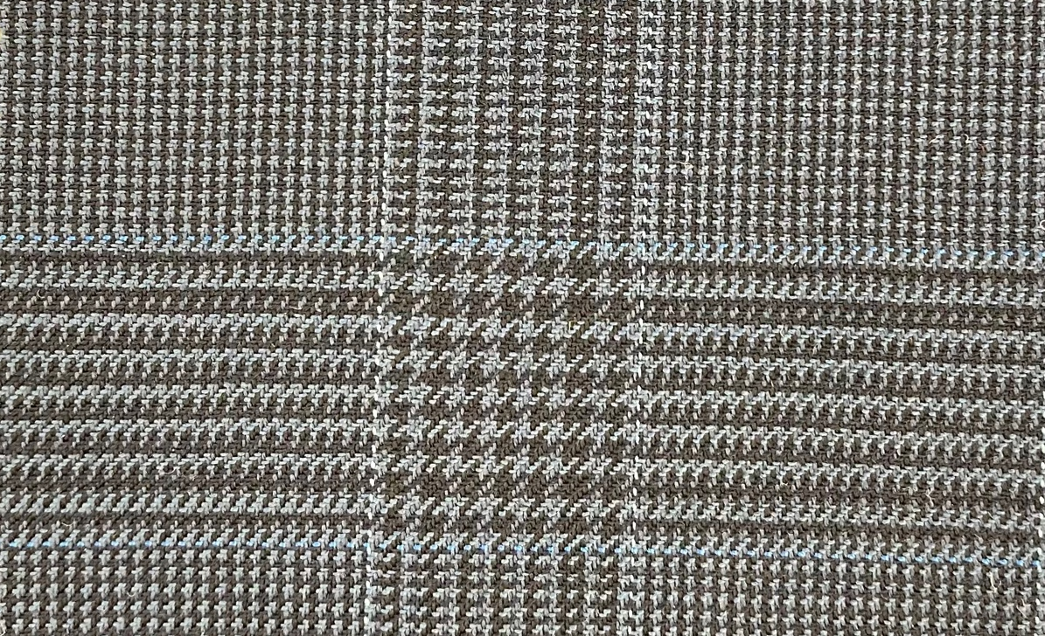
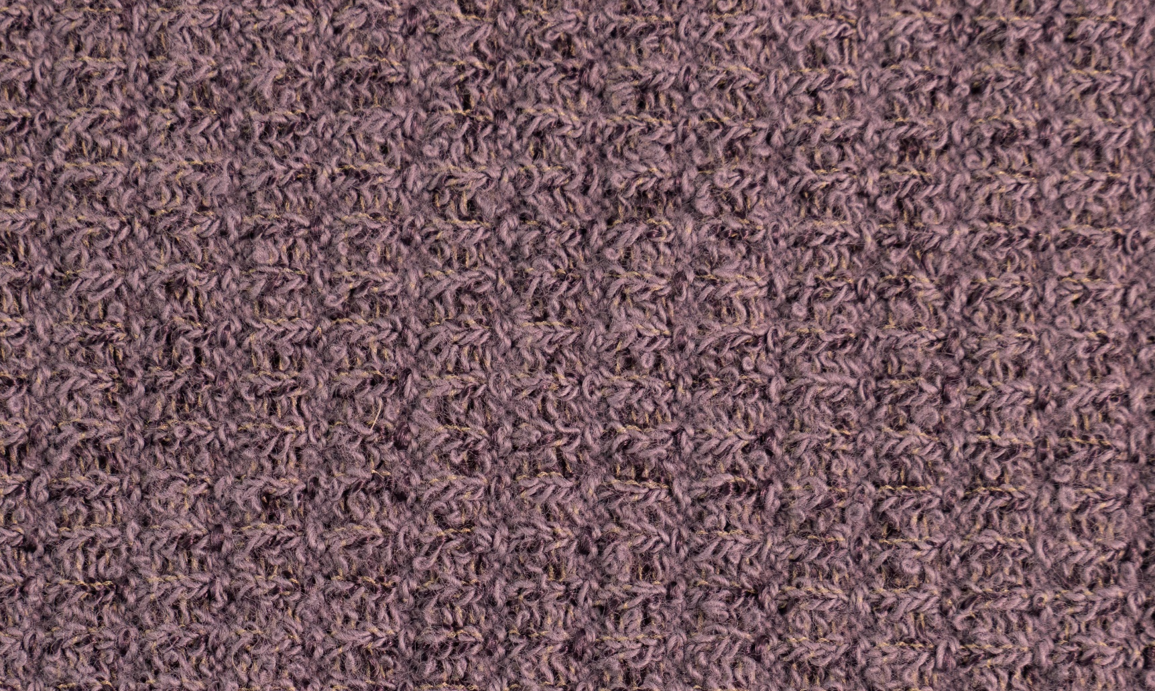
Choice of Woollen Fabrics
Woven Woollen Fabric
Formal clothing
Winter clothing, trousers, waistcoats, coats and suits
Knitted Woollen Fabric
Socks, mittens, underwear and sweaters

Slide 4



Care of Woollen Garments (1)
Washing
Drying
Ironing
Dark and light colour garment should be washed separately.
Dry the woollen garment at room temperature and away from direct sunlight or heat.
Use steam when pressing woollen garment. Avoid ironing the garment when it is totally dry.

Slide 5

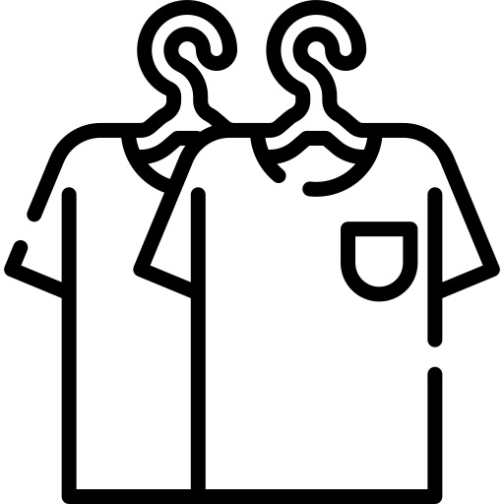

Care of Woollen Garments (2)
Brushing
Airing
Storing
Brush woven woollen garments lengthwise to remove surface dust and dirt.
Hang woollen garments out to air or give them a gentle steam to remove odour.
Hang woven garments on shaped or padded coat hangers. Fold knitted garments and store in drawers.

Slide 6
Care of Silk Garments
Washing
Drying
Ironing
Use a mild detergent and never use chlorine bleach.
Do not expose silk to direct sunlight, sun rays can cause discoloration or even damage the fabric.
Iron silk when dry. Never spray when ironing.

