Slide 1
Technology & living
Textile Technology
S2.2.2 Basic Fabric Construction

Slide 2
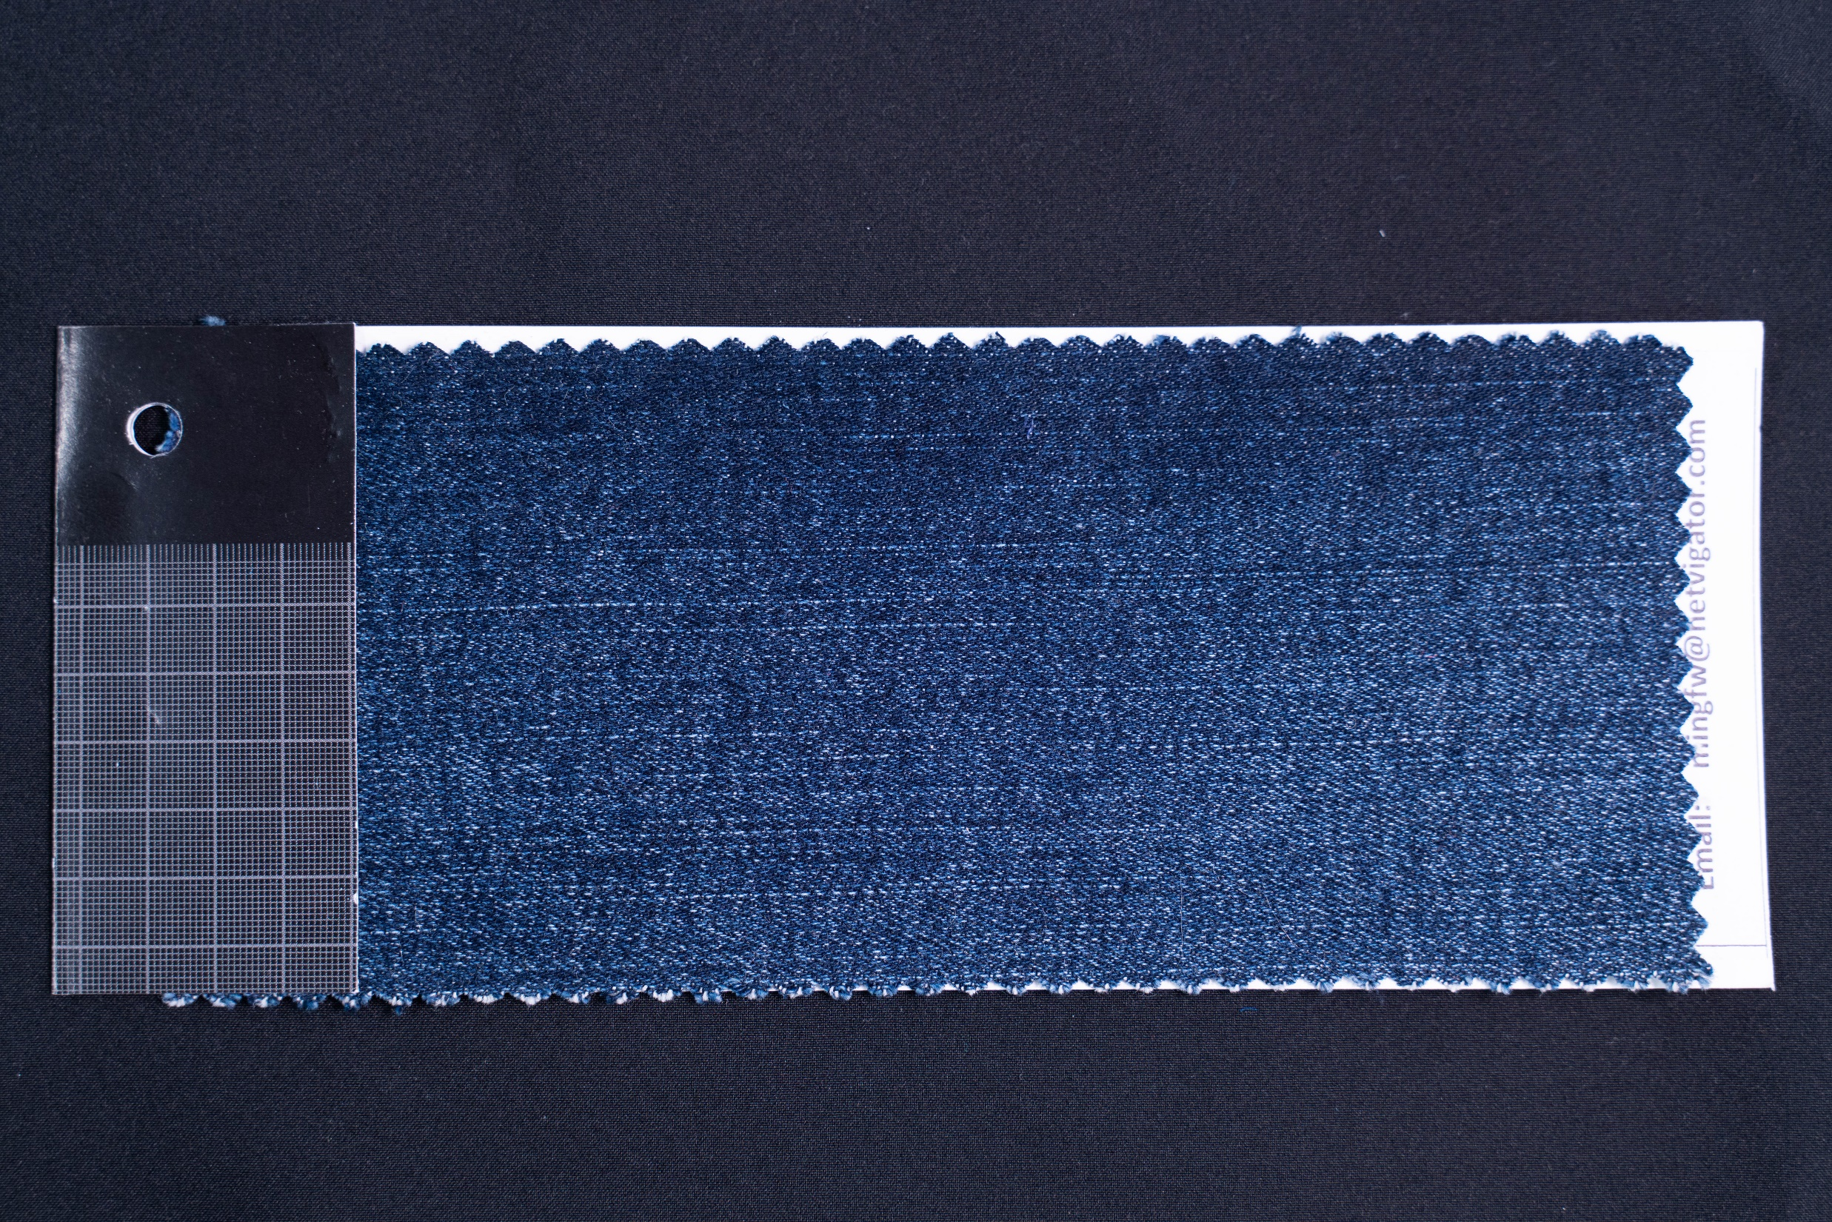
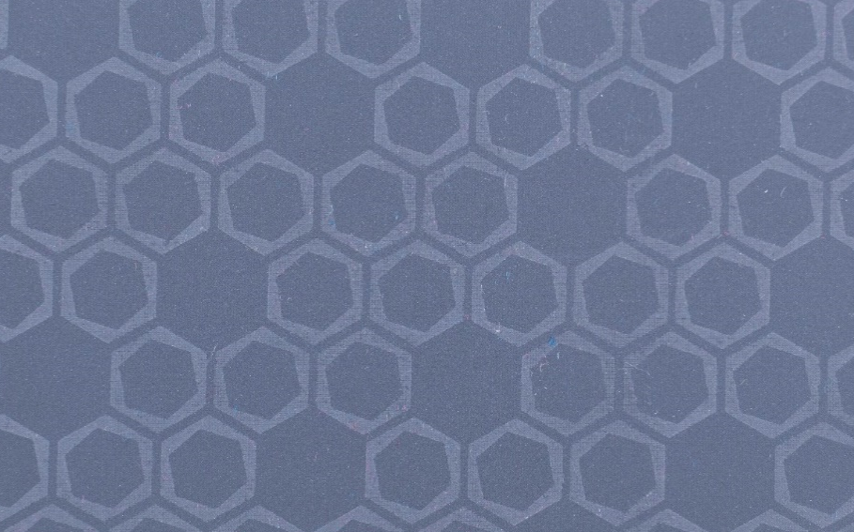
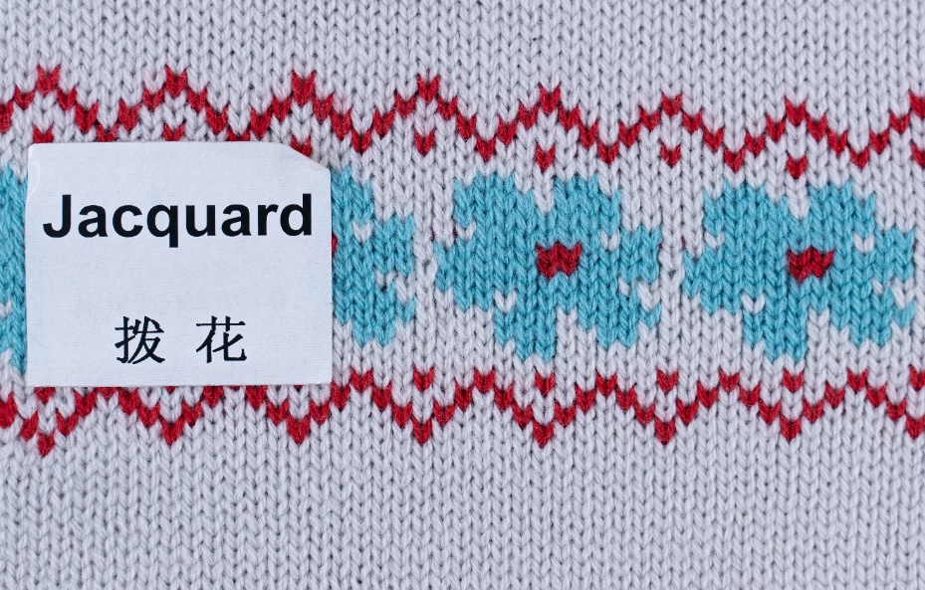
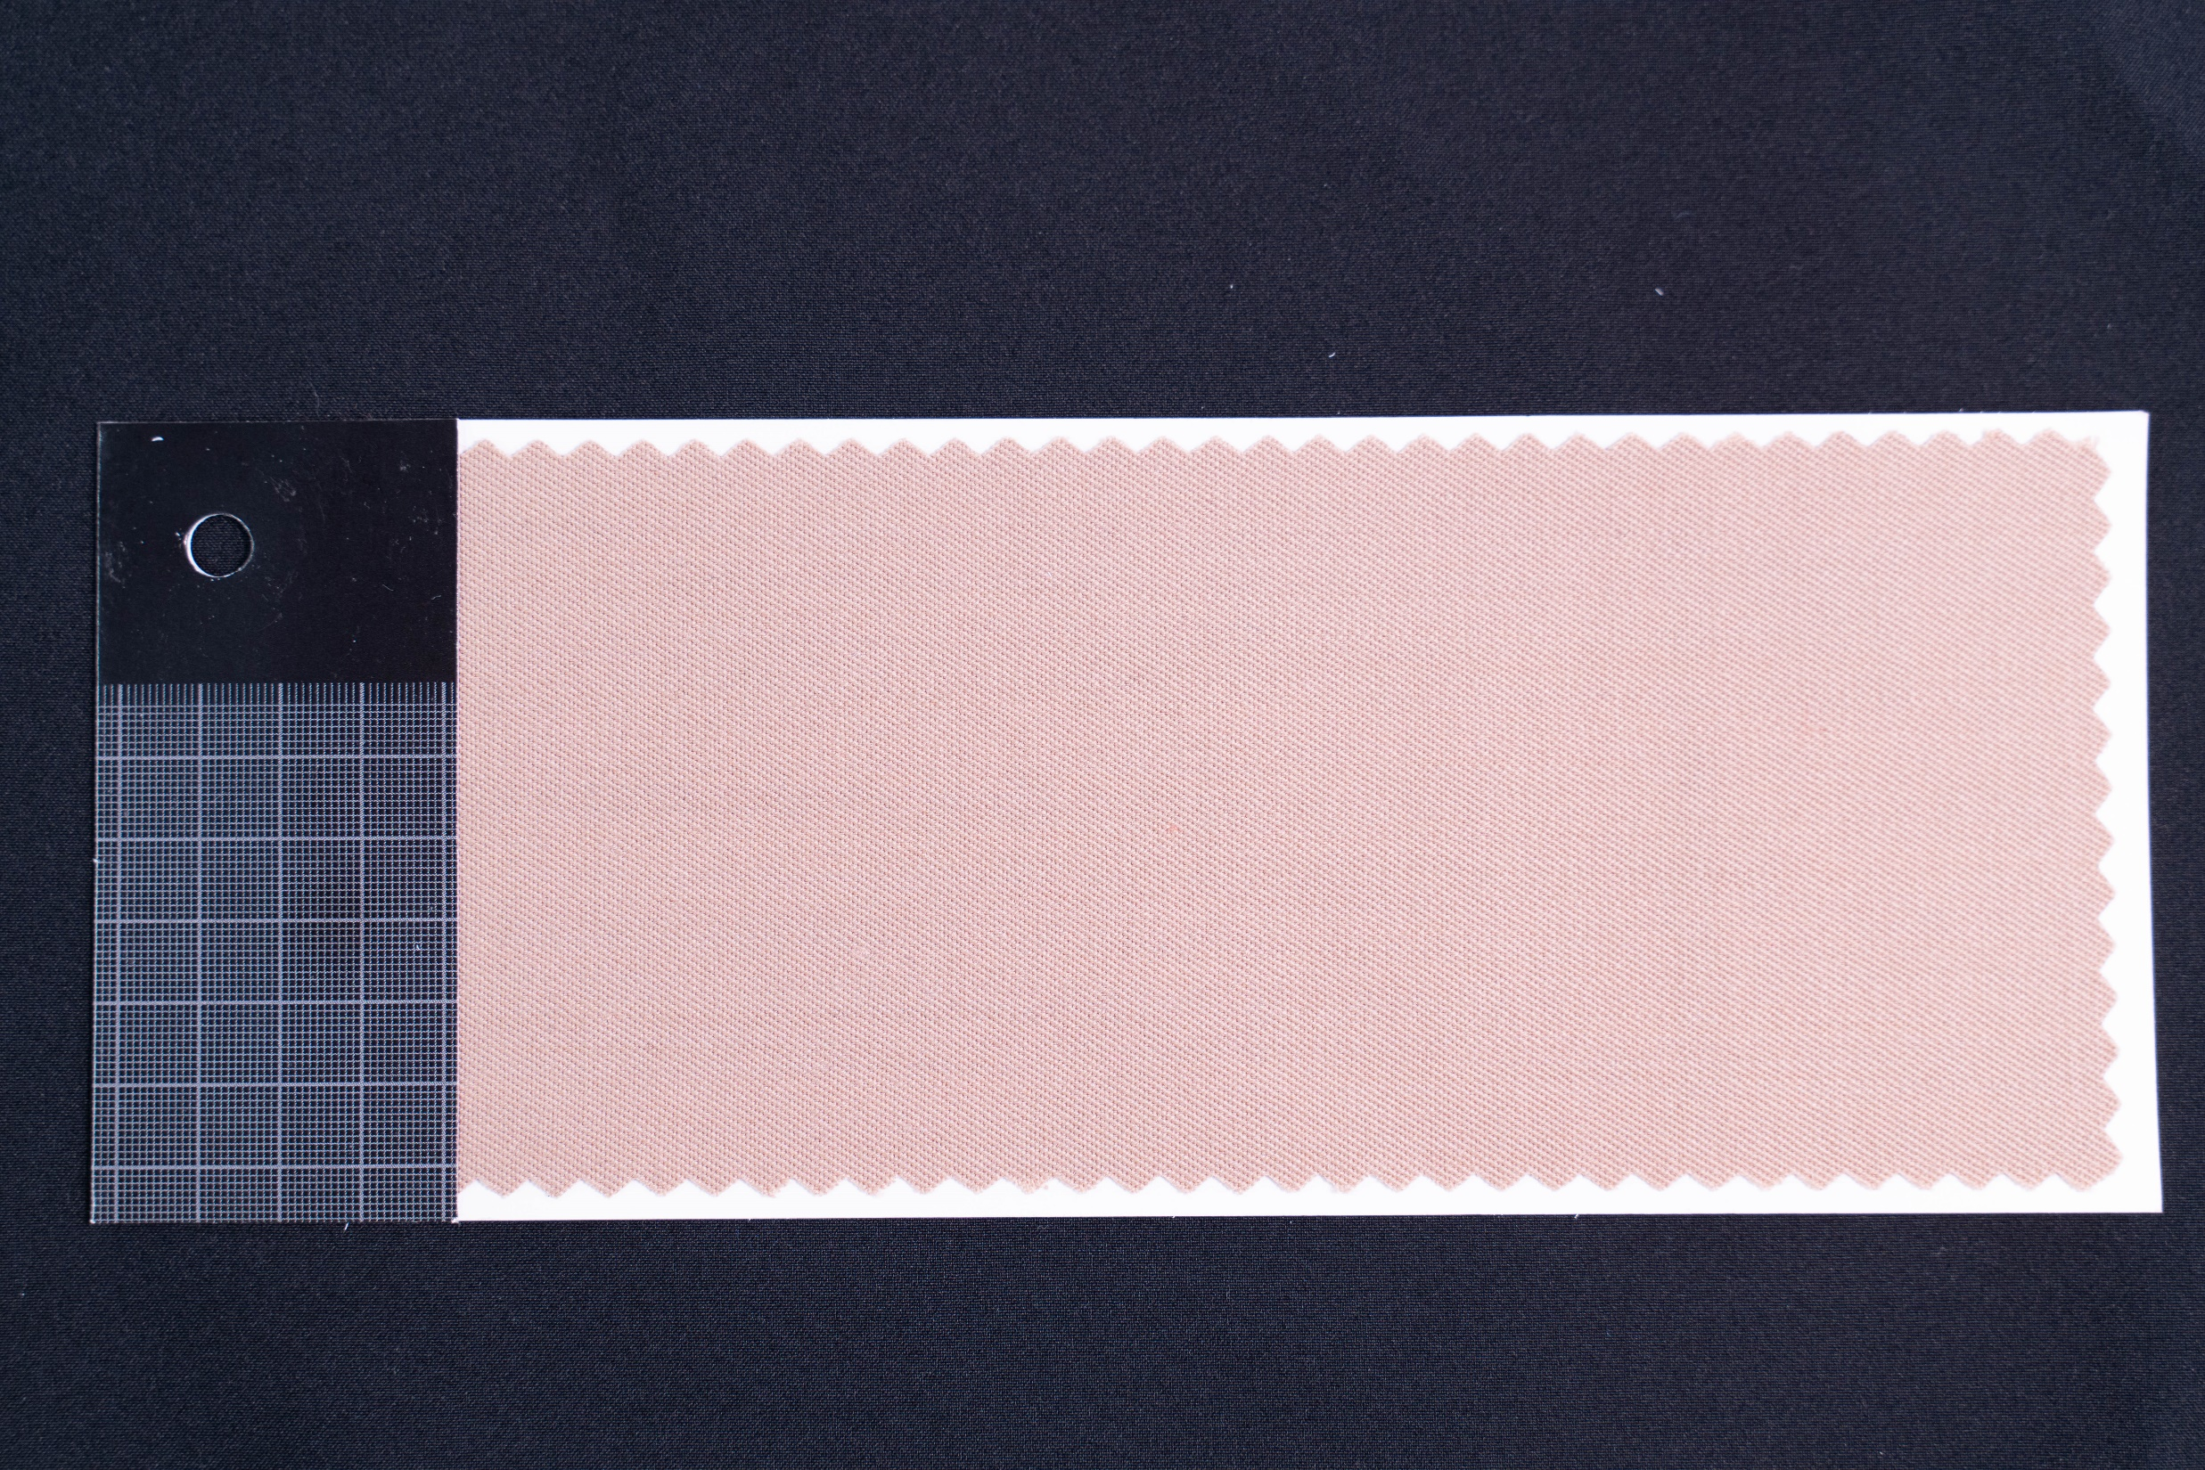
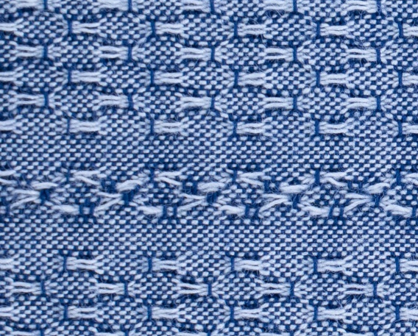
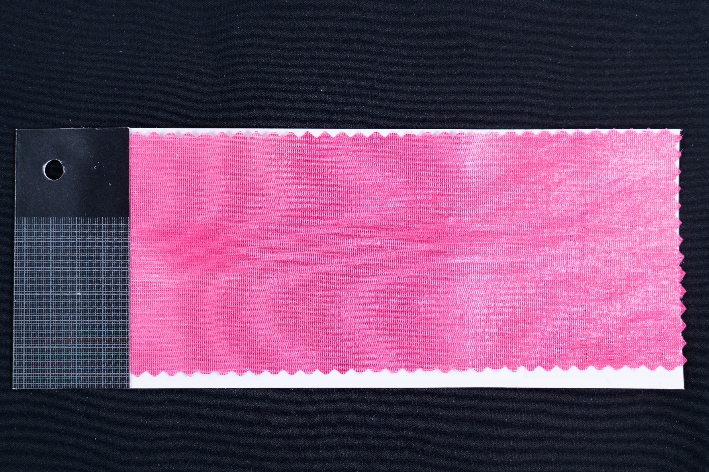
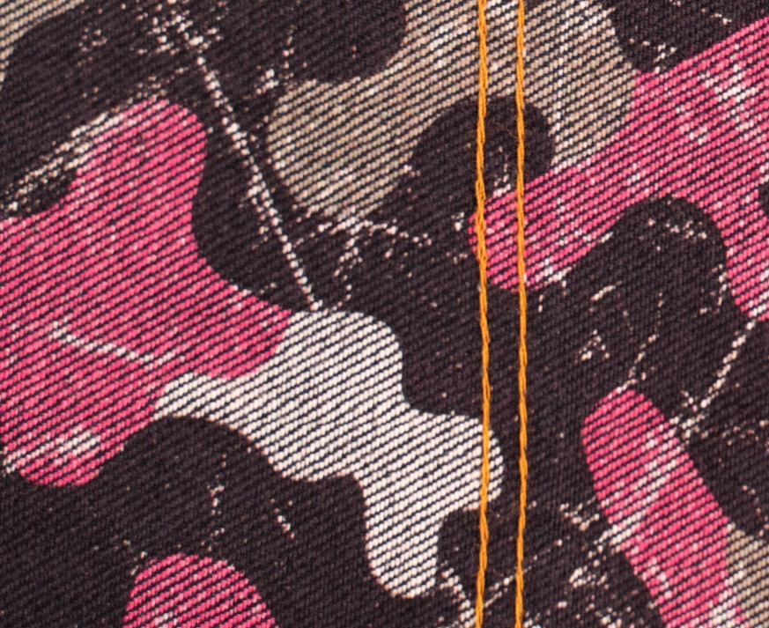
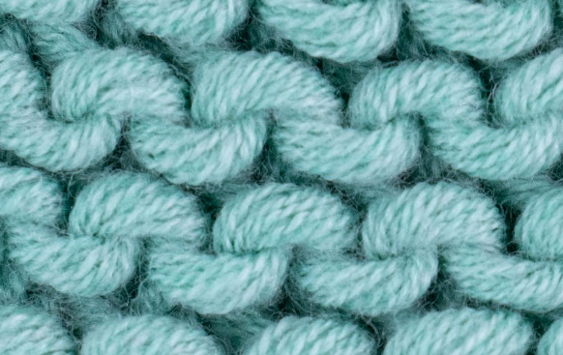
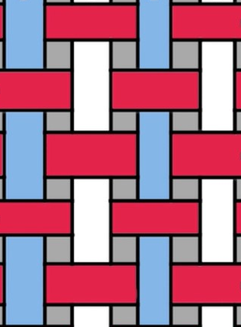
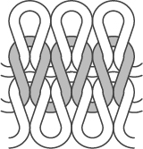
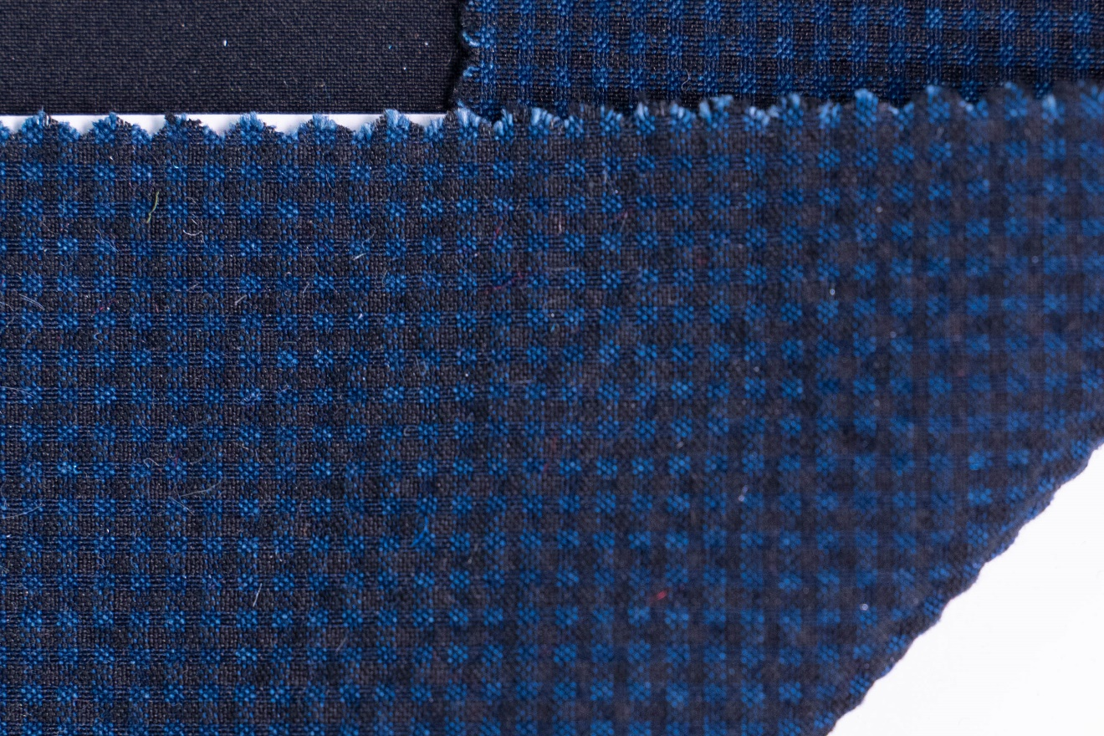
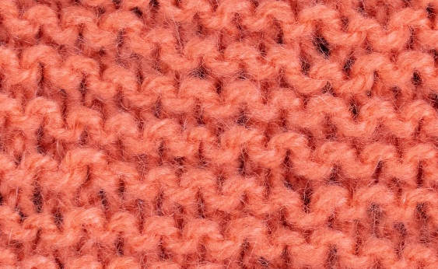
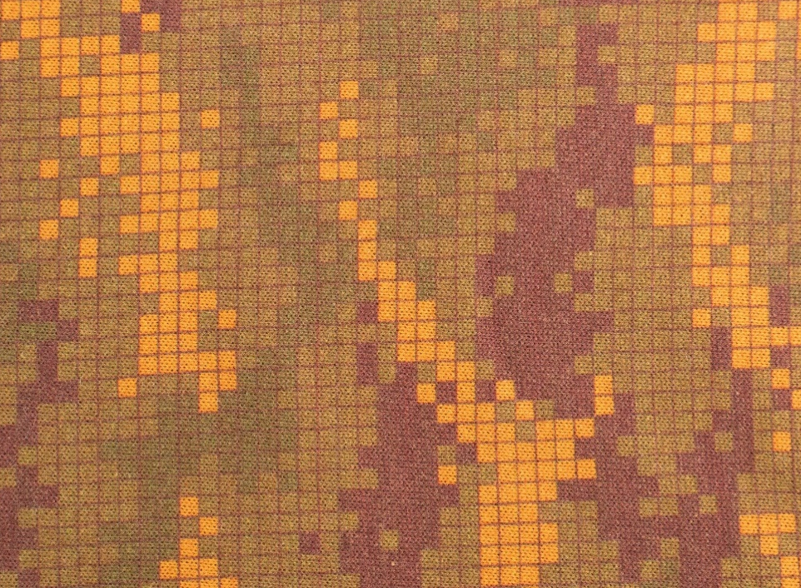
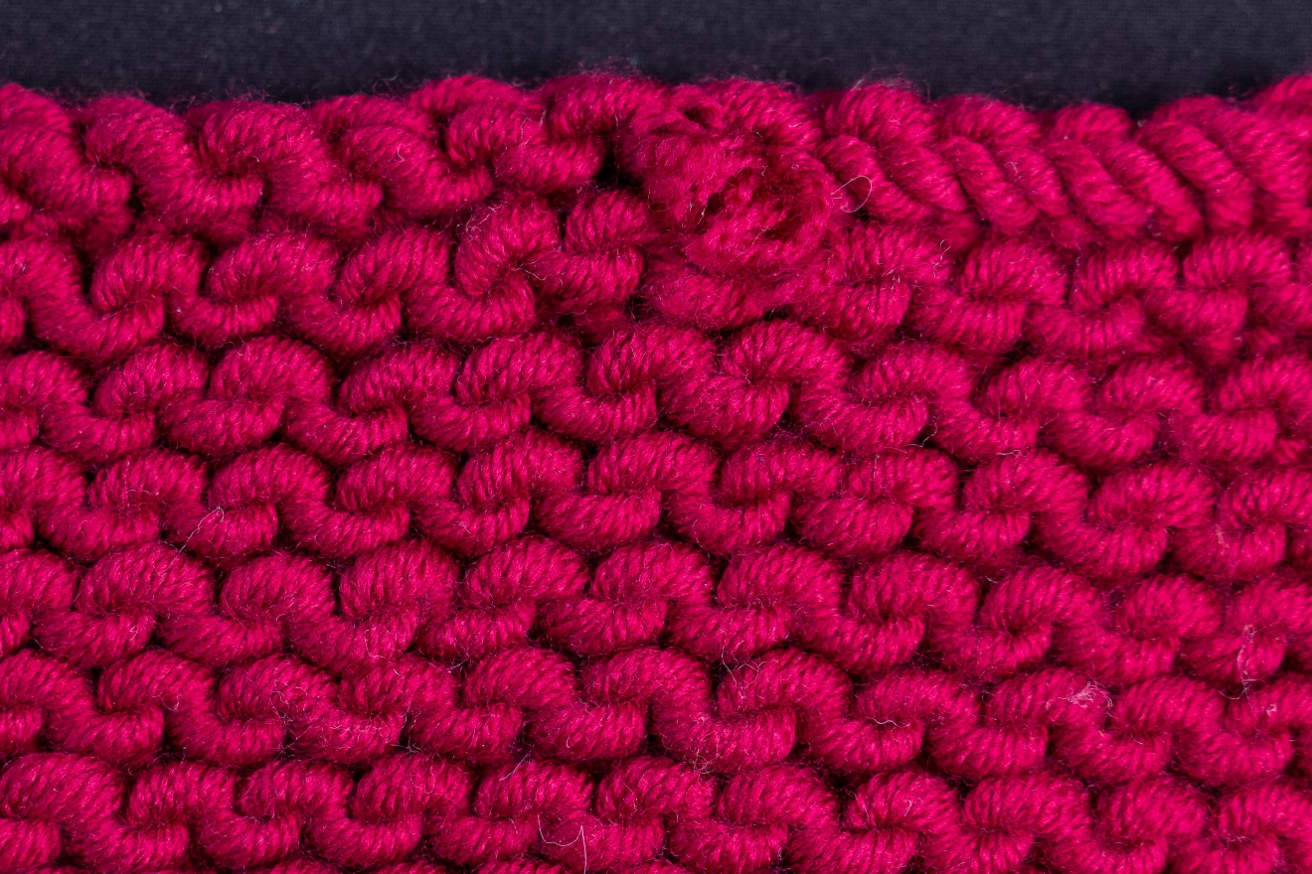
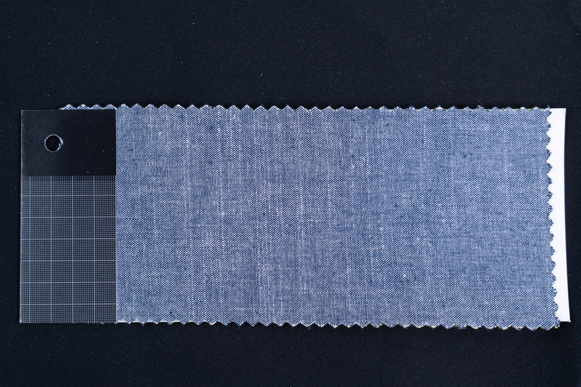
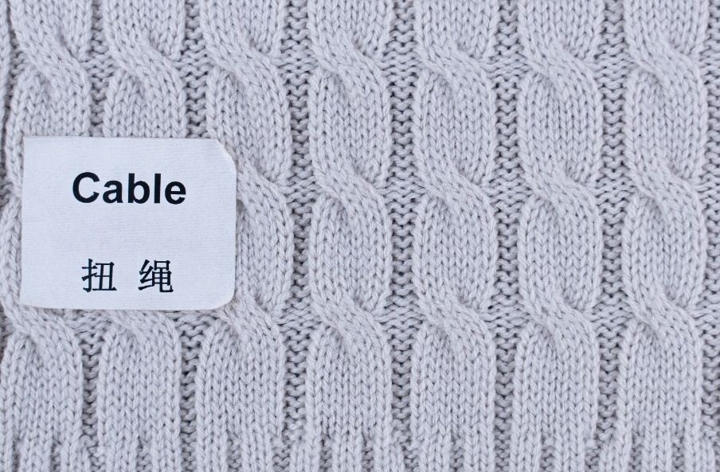
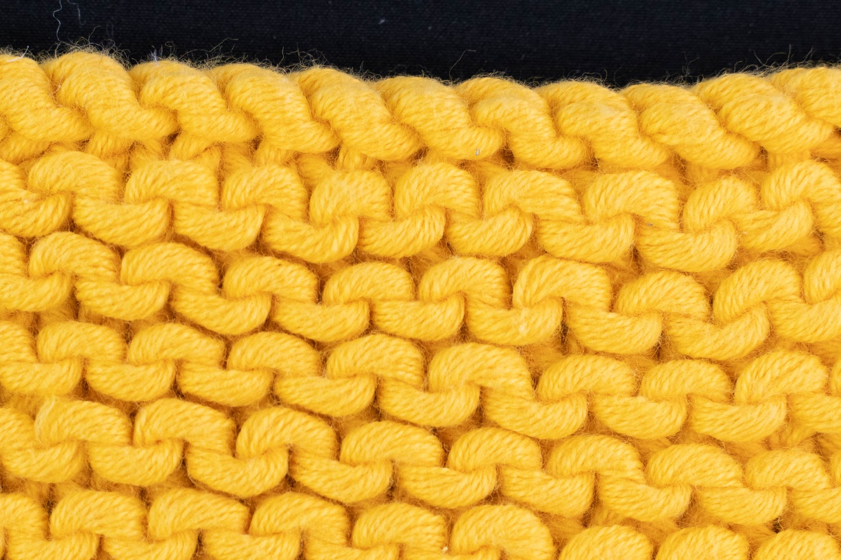
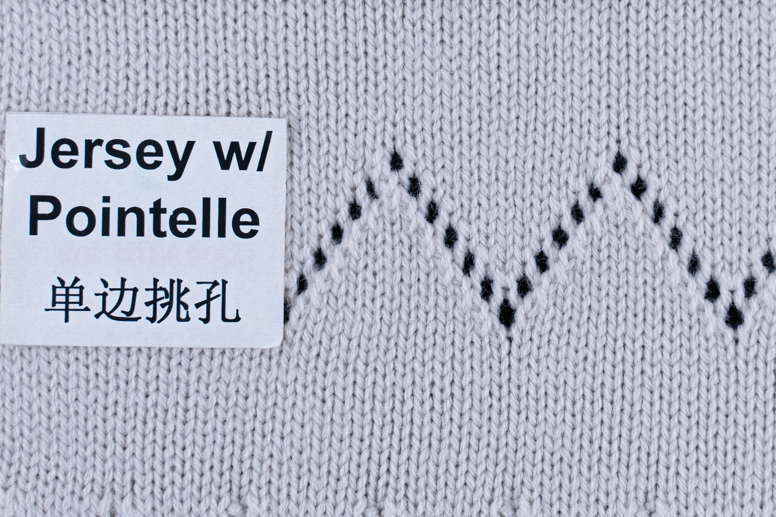
Basic Woven Structure Basic Knitted Structure
Photo(s) is/are owned and provided by HKDI.
Source: stock.adobe.com
Photo(s) is/are owned and provided by HKDI.

Slide 3
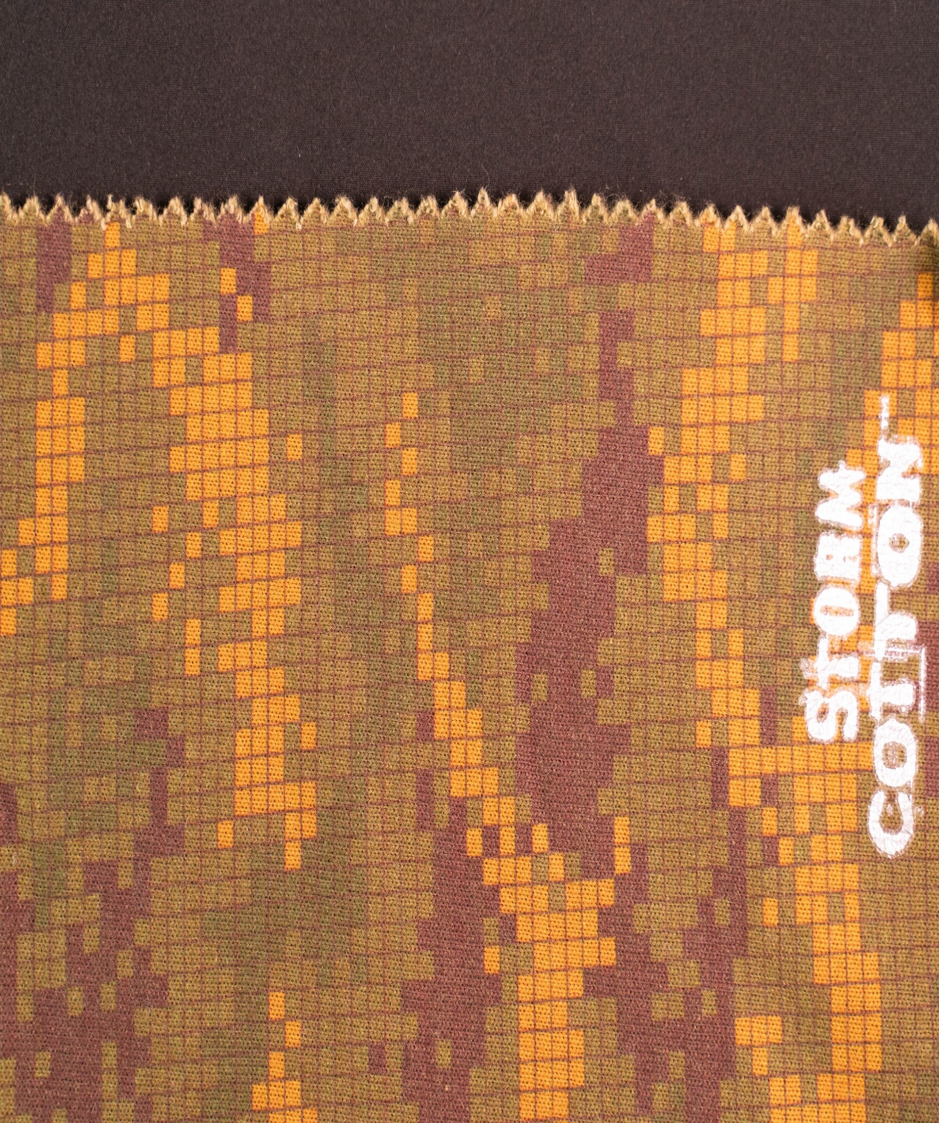

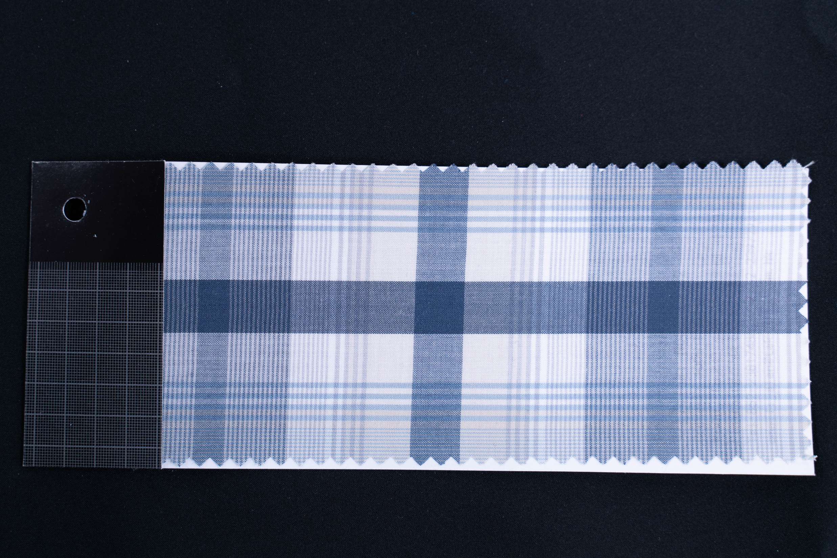


Basic Woven Structure
    There are three basic fabric weaves commonly used in woven fabrics.
    Plain weave
    Twill weave
    Satin weave
Scan to Watch More!
Photo(s) is/are owned and provided by HKDI.

Slide 4
Plain Weave
The simplest and the most used weave structure.
Plain weave is reversible, unless one side is chosen as the face by finishing or printing.
Normally has firm constructions.
Common types of plain weave fabric: chiffon, chambray, organza, poplin, taffeta, georgette.
Photo(s) is/are owned and provided by HKDI.

Slide 5
Twill Weave
Z twill
- diagonals run upward to the right
S twill
- diagonals run upward to the left
Photo(s) is/are owned and provided by HKDI.

Slide 6

Twill Weave
Denim, gabardine and chino are some well-known twill weave fabrics.
Twill weaves are named according to the number of yarn sets, for example:
  2/1 twill (three sets of yarn)
  3/1 twill and 1/3 twill (four sets of yarn)
Diagram of 2/1 Z Twill
Diagram of 3/1 Z Twill

Slide 7
Satin Weave
Similar to the twill weave.
The diagonal line of the satin weave is not visible.
Flat, smooth, lustrous surface.
Relatively long floats.
Diagram of 5 shaft warp face Satin Weave

Slide 8
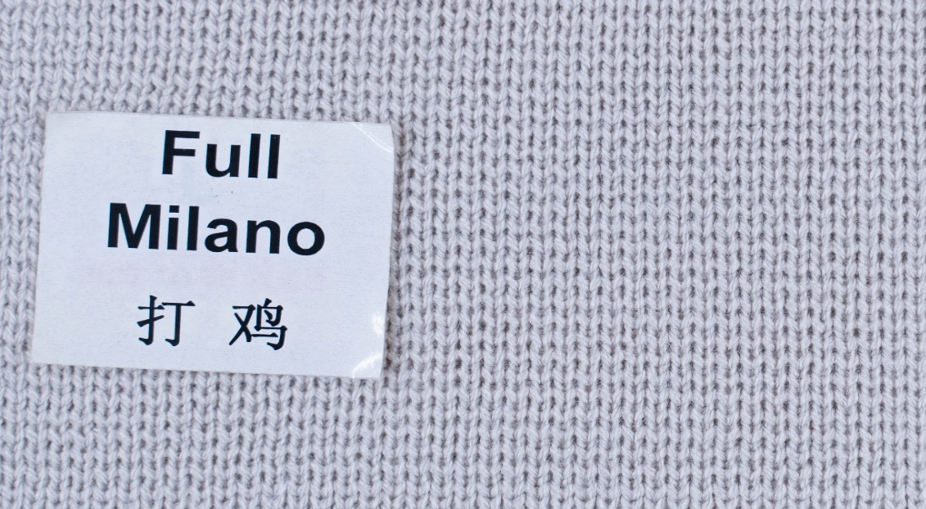
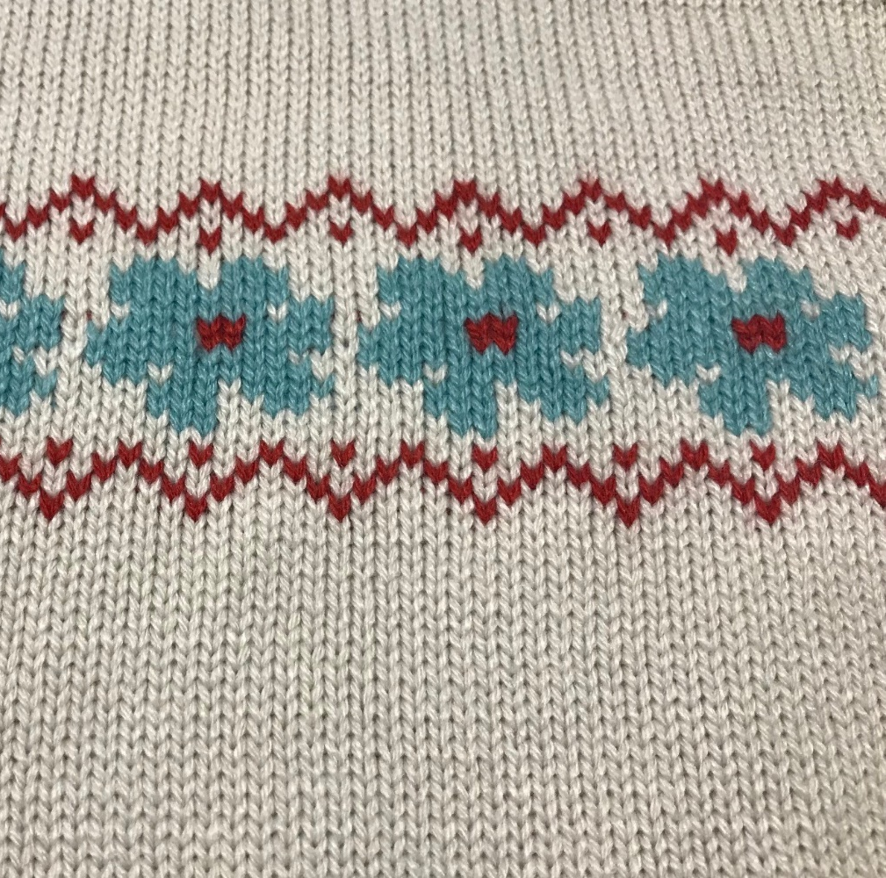

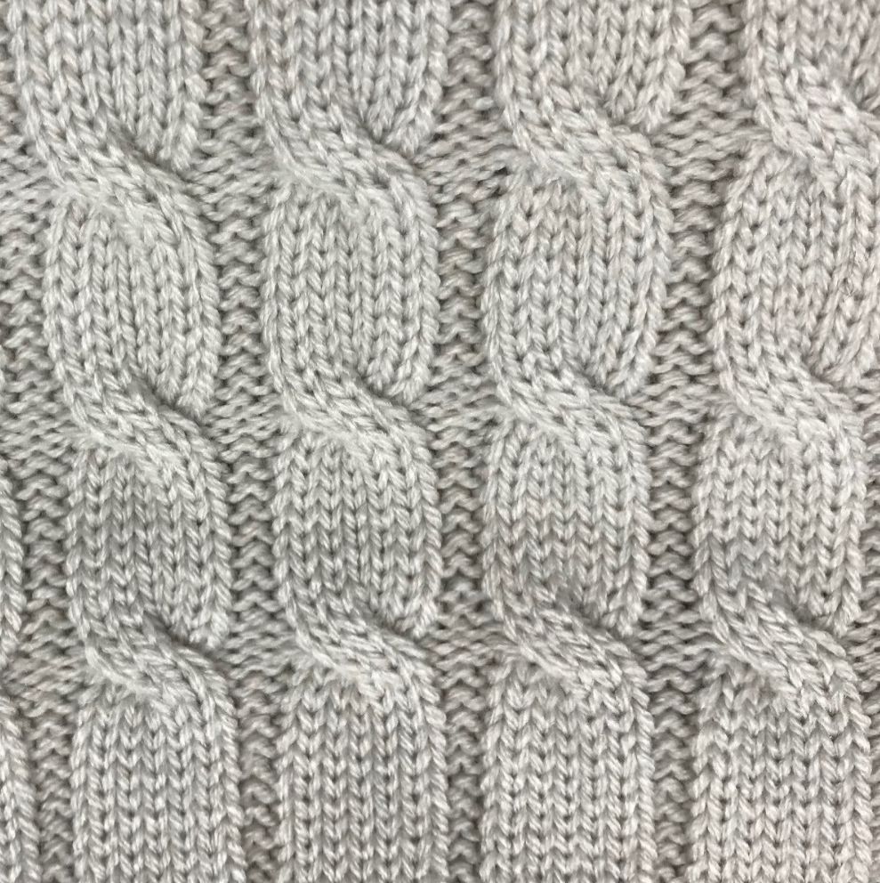

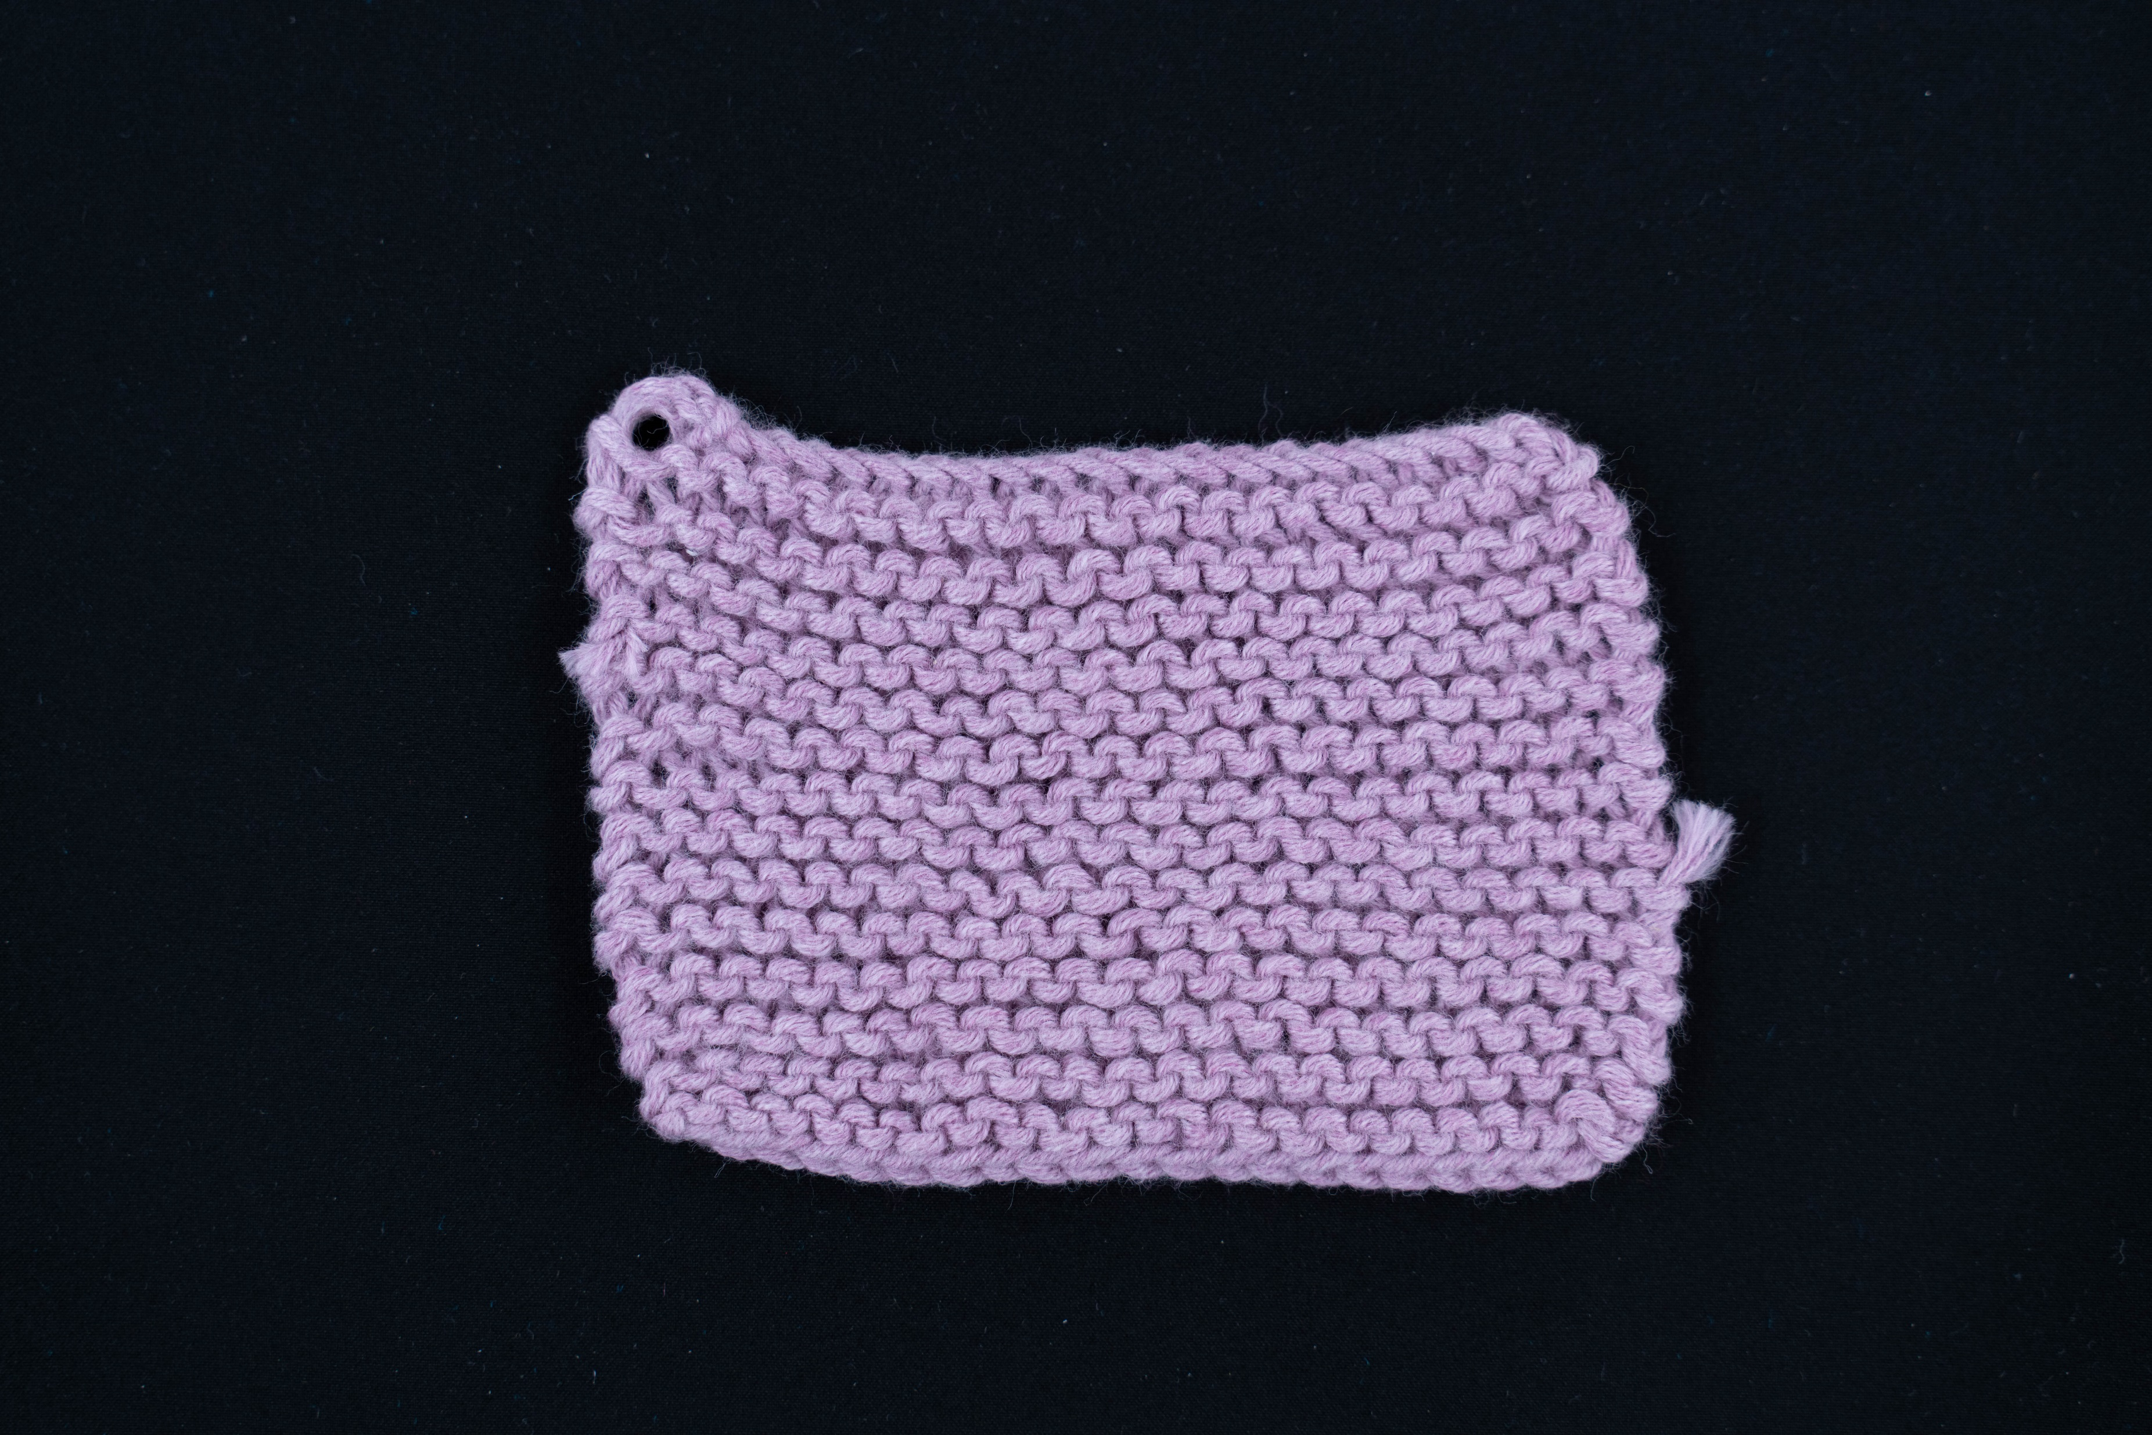
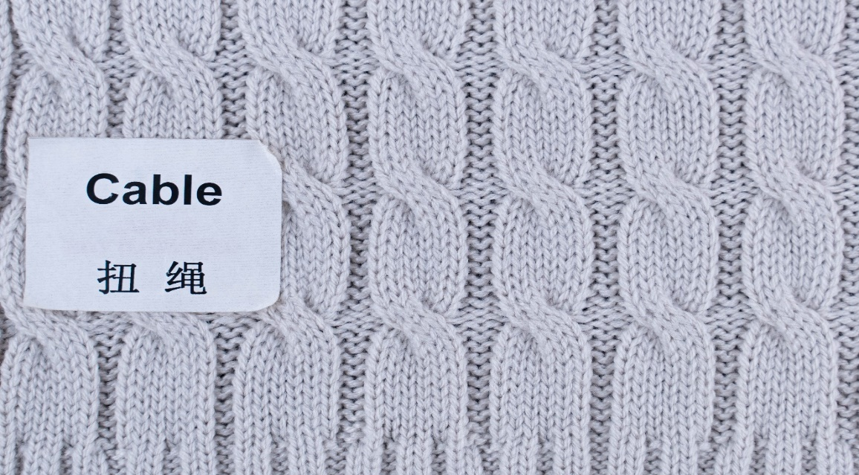
Basic Knitted Structure
    The commonly used basic knitted structure in weft knitted fabrics are:
    plain knit or single jersey
    purl knit
Scan to Watch More!
Photo(s) is/are owned and provided by HKDI.

Slide 9
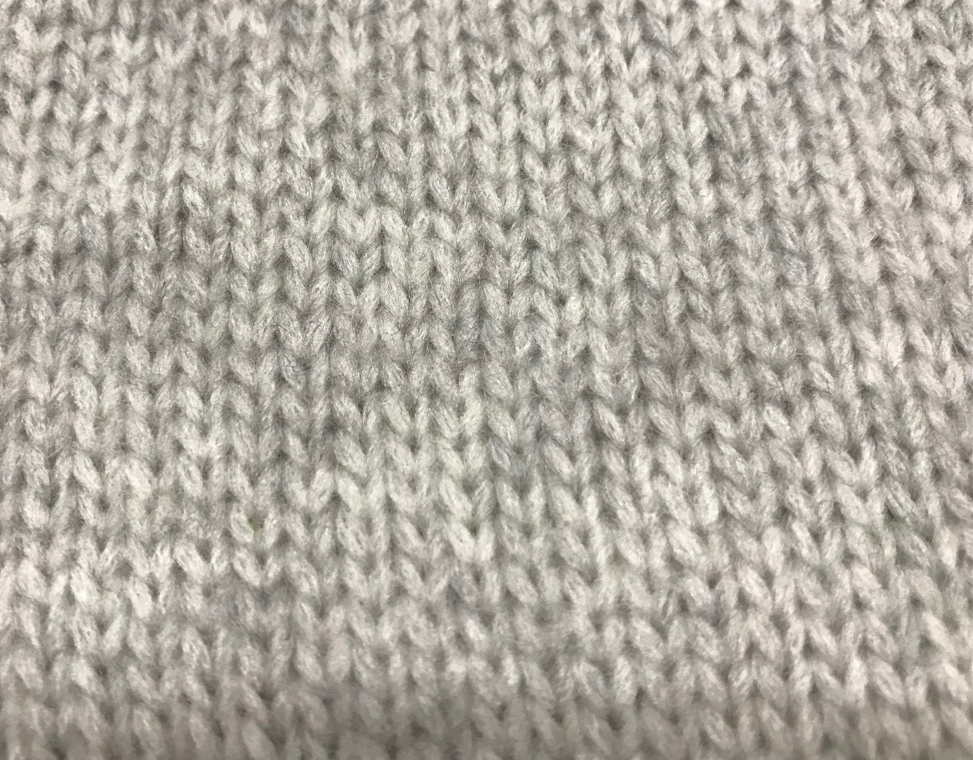
Plain Knit
Plain knit is also known as single jersey.
This is the simplest and most basic structure of knitted fabrics.
If one yarn breaks, it causes an unravelling of adjoining stitches.
The smooth side is the right side, while the wrong side has a textured appearance.
Photo(s) is/are owned and provided by HKDI.

Slide 10
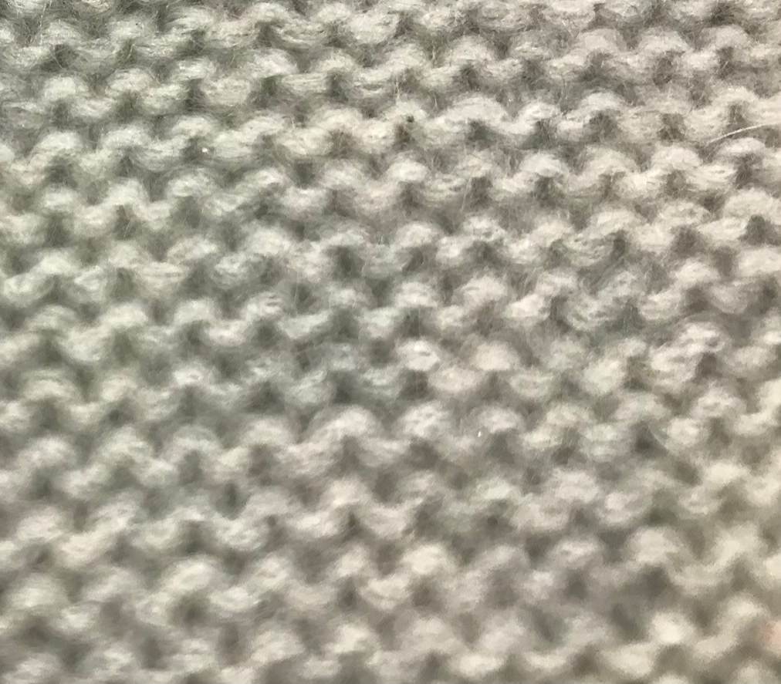
Purl Knit
Simple purl knit fabric looks the same on both sides of the fabric, and they both appear somewhat like the back of jersey.
Photo(s) is/are owned and provided by HKDI.

