Slide 1
Food Product Development
Design Process for the Development of Food Products

Slide 2
Topics
Introduction
Design brief
Market research
Design specification
Idea generation
Feasibility study
Development of prototype
Evaluation of a food product / design idea

Slide 3
Introduction

Slide 4
Introduction
Product Development:
The overall process of strategy, organisation, concept generation, product and marketing plan creation and evaluation, and commercialisation of a new product.
The Product Development and Management Association
The PDMA Hand Book 1st Edition.

Slide 5
Phases in Product Development
New food product development can be divided into several phases
There is no common agreement on the number, order, or names of the phases
Practically, the phases overlap and are concurrent

Slide 6
Phases in Product Development
Earle (2009) describes the development process with four main stages:
Stage 1 Development of a business strategy that describes the project
Stage 2 A research and development phase of the project including the design for manufacturing process
Stage 3 Development of programmes for marketing, production, and quality assurance
Stage 4 Organisation of production and distribution for
the launch and an analysis of the launch sales data

Slide 7
Design Process
Design brief
Market research
Design specification
Idea generation
Development of prototype
Evaluation of a food product / design idea
Feasibility study
Identify design problems
Identify user group
Collect and analyse information of customers’ needs
Devise the intended purpose of a product
Study the internal and external factors
Generating design proposals
Evaluation or analysis of the possible potentials of the proposed food product idea
Make the first real product as a specimen for trial and market research
sensory evaluation
Modifying food products
Evaluation of a prototype
Issues affecting the development of a new product

Slide 8
Design brief

Slide 9
Identifying Design Problems
Identify a gap in the current market to see if there is a need of a new product that will satisfy customers’ need
Identify a user group or target market

Slide 10
Ways to Identify the Gap in the Market
Identifying the gap
Looking at what competitors are producing
Consulting government research
Reading recipe books
Looking at what products already exist and thinking how a new range could be developed
Carrying out supermarket surveys
Carrying out interviews and questionnaires
Looking at trends in the media
Reading newspaper and magazine articles

Slide 11
Examples of Gaps in the Market
From a manufacturer’s research, it is seen that snacks are mainly youthful and fun or mature and healthy. A need of youthful and healthy snacks is lacking.
After looking at what is available in other supermarkets, a food retailer has decided that their range of single portion cook-chill meals needs developing.
Summer desserts are selling well, a food retailer wants to develop their range.
A food retailer has decided to reflect the “2 plus 3 a Day” campaign by introducing a new range of fruit desserts.

Slide 12
Identifying the User Group or
Intended Target Market
The purpose is to match the product to customers’ need, hence satisfying customer by producing a successful marketable product
The user group or intended target market is the group of people whom a product is aimed at

Slide 13
Identifying the User Group or
Intended Target Market
Examples of user group or intended target market
Vegetarians
Teenagers
Toddlers
Elderly
Single-person household
Couples
Parents

Slide 14
Identifying the User Group or
Intended Target Market
Reasons for identifying the customers
Views of the group are considered
Dietary needs can be taken into account
Eating habits are considered
Preferred cooking method, e.g. microwavable dinners for college students
Appropriate portion size
Packaging and marketing of the product is focused towards the user group
Cost is appropriate for the targeted customers

Slide 15
Developing a Design Brief
A design brief is a short statement that outlines the problem to be solved.
The design brief may state:
  the product must be marketable
  the type of product to be developed
  the user group or intended target
  market
  the occasion or place which the product is used / consumed
  the cost
A design brief is a short statement that outlines the problem to be solved.

Slide 16
Developing a Design Brief
Example of a design brief:
Design and make a marketable hand-held savoury snack for vegetarian adults at a cost of HK$10.

Slide 17
Market research

Slide 18
Purpose of Conducting Research
Why carry out research?
To find out the opinions of the intended target market
To ensure time and money are not wasted on a product no one will want
To find out which products are marketable using sales figures
To find out market trends e.g. shopping/eating habits
To find out about types of products which are already in the market

Slide 19
Market Research
A process of collecting and analysing information of customers’ needs
Helps a company to create its business plan and to find out if the new product is marketable
Can be done by research companies
Two types of market research: primary research and secondary research

Slide 20
Two Types of Market Research
Primary research sources
Information that is obtained directly from interviews, questionnaires and observations or from sensory testing
Secondary research sources
Information that has been collected by other people, for instance, from books or newspapers

Slide 21
Two Types of Market Research
 | Primary research | Secondary research
Source of information | Focus groups, surveys, field tests, interviews or observation | Local libraries, web sites, books, business publications, magazines and newspapers
Purpose | Gain information from a company’s target group of customers for a particular new products | Find out market information for extending business into new markets, adding new services or product lines
Accuracy and specificity | Tailor-made for the company’s particular needs More accurate and specific for the target market of the company | Second-hand information, less accurate, useful and specific, which may not suit the particular need of the company
Expense | More expensive | Less expensive
Source: Food Science and Technology Strand (n.d.). Learning and Teaching References, Technology and Living (Secondary 4-6), 13 Food Product Development. Hong Kong Education Bureau.

Slide 22
Methods of Research
1. Questionnaires
A set of questions carefully designed to obtain the opinions of people
Can be done by research companies
Can be carried out in a variety of ways, e.g.:
    over the telephone
    in supermarket
    sent through the post
    on the street

Slide 23
Methods of Research
2. Evaluating existing products
A food manufacturer may evaluate their own
existing products or those of their competitors
Can be done by carrying out sensory evaluation
Reasons for evaluating
existing products:
    to get ideas for new products
    to improve existing products
sensory evaluation: looking at, smelling and tasting a food for product development.

Slide 24
Methods of Research
3. Supermarket surveys
Visits to supermarkets are useful to find out:
    what products competitors are producing and selling
    the costs of similar products
    how well a product is selling
    information about the market trends, e.g. eating and shopping habits of people

Slide 25
Questionnaires
A questionnaire should be designed for extracting specific information from people about the qualities they would like to see in a new product
Properly introduce the questionnaire, so that it allows the public to:
  focus clearly on the theme of the questionnaire
  feel involved from the start, so a more satisfactory response is given
  understand the purpose of the questionnaire
Fehners, V., Simpson, M., & Monks, B. (2011). Food technology. London: Hodder Education.

Slide 26
Questionnaires
General rules of designing questionnaires:
Questions are clear and easy to understand and answer
Easy to collate the results using graphs, tables, tally charts, pie charts, etc.
Data are easy to analyse and draw conclusion from
Questionnaire should not be too long that may cause irritation
Make sure that all questions will lead to useful answers
Information and Communication Technology (ICT) is often used to design and analyse the questionnaire
After obtaining results, summarise the findings
Fehners, V., Simpson, M., & Monks, B. (2011). Food technology. London: Hodder Education.

Slide 27
Questionnaires
Different types of questions can be used:
1. Closed questions
can be a very quick way of finding out specific information
provide a yes/no type response or offer limited choice of answers, e.g.
Do you like the flavour of the chocolate?
□ Yes □ No
Fehners, V., Simpson, M., & Monks, B. (2011). Food technology. London: Hodder Education.

Slide 28
Questionnaires
2. Multiple choice
offers a range of responses for the respondents to choose from, e.g.
Which flavour do you prefer?
□ Chocolate □ Lemon □ Coffee □ Ginger
Fehners, V., Simpson, M., & Monks, B. (2011). Food technology. London: Hodder Education.

Slide 29
Questionnaires
3. Ordered choice
sometimes it is useful for the respondents to rank a set of options by numbering them in order, e.g.
Place in order of preference the following flavourings. Indicate by numbering from 1 to 4 in order, where 1 is the most preferred.
□ Chocolate □ Lemon □ Coffee □ Ginger
Fehners, V., Simpson, M., & Monks, B. (2011). Food technology. London: Hodder Education.

Slide 30
Questionnaires
4. Open-ended questions
can produce a wide variety of responses that take a long time to interpret and put into categories
useful for finding out about attitudes and opinions, e.g.
1. What do you like about biscuits?
2. What flavour would you like the biscuit to be and why?
Fehners, V., Simpson, M., & Monks, B. (2011). Food technology. London: Hodder Education.

Slide 31
Design specification

Slide 32
The Intended Purpose of a Product
The product development team is a group of people who are responsible for creating new food products.
The product development team
should have a clear understanding
of the product’s intended purpose
Examples:
  The intended purpose of a cereal bar is to provide a quick, hand-held and easy to eat snack.
  The intended purpose of a single frozen meal is to provide a quick and convenient meal for one person.

Slide 33
Issues Affecting the Development of a New Product
Consider the issues that might affect product development, e.g.:
Method of production
Environmental issues
Cost issues
Ethical issues
Social issues
Cultural issues

Slide 34
Issues Affecting the Development of a New Product
Method of production
Ethical issues
Do the products include any genetically modified foods?
Social issues
Is there demographic differences in different areas? E.g. retailers in a wealthy district make more profits on expensive items.
Cultural issues
Are the ingredients in the products suitable for all cultures, including different religions?
Environmental issues
Cost issues
Can be manufactured with existing machinery?
Budget for buying and installing new machinery?
Packaging materials include recycled or recyclable materials?
Budget available to produce the new product?
Consider food cost, production cost, distribution cost, and profit

Slide 35
Writing a Design Specification
A design specification is usually written as a series of bullet points or a numbered list.
It clearly states the general details
of the product to be developed.
It is a checklist for evaluation
throughout the development of
a product and when testing the
final product.
Design specification:
the qualities a product should have.

Slide 36
Writing a Design Specification
A design specification may include the following:
Type and purpose of product
Requirements of target group
Nutritional information
Types of ingredients to be used
Portion size
Shape / Flavour / Colour
Price range of the product
Packaging
Storage and shelf life considerations
Environmental / Ethical / Social / Cultural issues

Slide 37
Writing a Design Specification
Example of a design specification:
Design specification
Low-fat, less than 3g per 100g portion
Savoury
Use existing packaging materials
Tasty
Suitable for manufacture in quantity
Snack size
Priced between HK$10 and HK$15
Hand-held

Slide 38
Idea generation

Slide 39
Idea Generation
A process of creating ideas or concepts for developing new products; also called “concept generation”
By studying external and internal factors as well as the trends of the marketplace, find out ways of either improving or modifying the current products
Source: Food Science and Technology Strand (n.d.). Learning and Teaching References, Technology and Living (Secondary 4-6), 13 Food Product Development. Hong Kong Education Bureau.

Slide 40
Idea Generation
Recipe books
Web sites
Existing products
Where do ideas come from?
Analysis of research information
Ideas from chefs on the television

Slide 41
Idea Generation
Can be done by brainstorming or mind map
Brainstorming
A useful tool for generating ideas
A problem solving activity by a group of people trying to find out a solution to a specific problem
Source: Food Science and Technology Strand (n.d.). Learning and Teaching References, Technology and Living (Secondary 4-6), 13 Food Product Development. Hong Kong Education Bureau.

Slide 42
Idea Generation
Mind map
A diagram used to note down words, ideas, tasks or other items linked to and arranged radially around a central key word or idea
A useful tool in the process of brainstorming
The schematic structure of information may aid the recall of existing memories
Source: Food Science and Technology Strand (n.d.). Learning and Teaching References, Technology and Living (Secondary 4-6), 13 Food Product Development. Hong Kong Education Bureau.

Slide 43
Idea Generation
Example of a mind map:
Rose flavour
Chrysanthemum flavour
Use sweeteners available in
food law to replace sugar
Suitable, not easy to
block the esophagus
⇦⇨
Floral flavours
Candy
Different flavours
Low sugar
Safe to eat
Healthy for elderly
Source: Food Science and Technology Strand (n.d.). Learning and Teaching References, Technology and Living (Secondary 4-6), 13 Food Product Development. Hong Kong Education Bureau.

Slide 44
Generating Design Proposals
A product development team communicates their ideas to other people by:
- annotated sketches
mood boards
photographs
making up samples

Slide 45
Annotated sketches
What could an annotated sketch include?
Size/Weight
Shape
Ingredients to be used
Finishes
Colours
Method of production
Nutritional information
Packaging (optional)

Slide 46
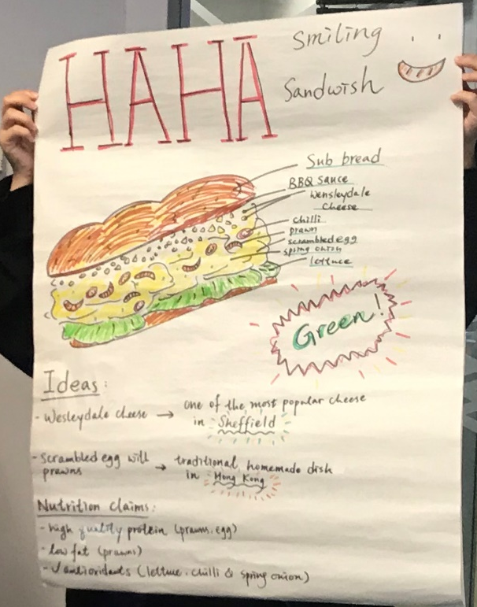
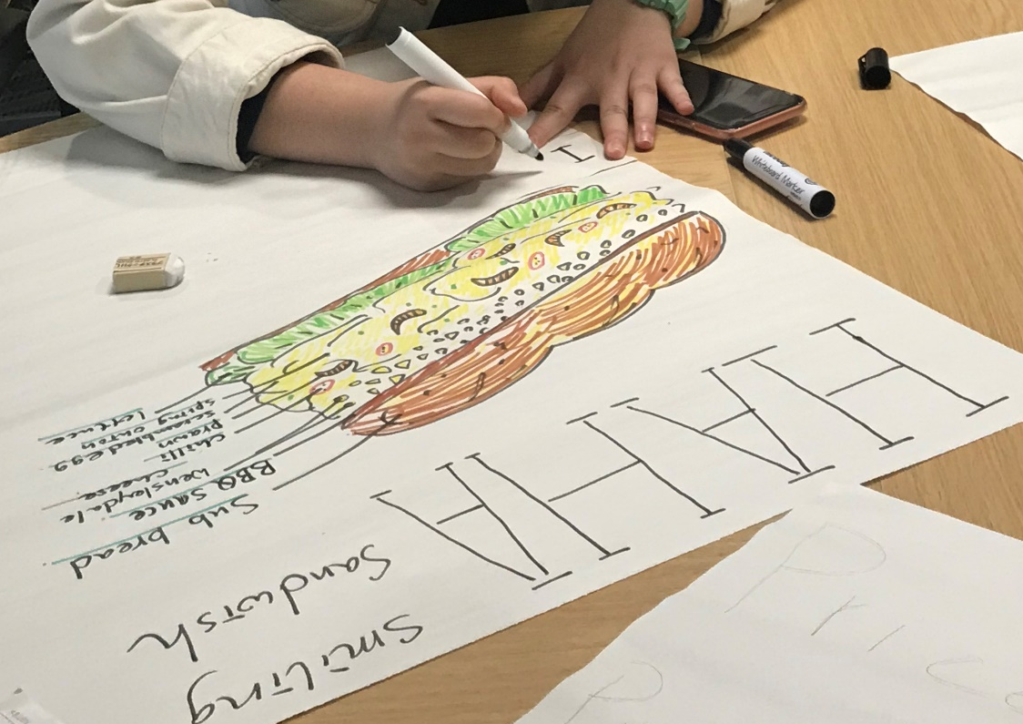
Annotated sketches

Slide 47
Feasibility Study

Slide 48
Feasibility Study
An evaluation or analysis of the possible potentials of the proposed food product idea
Provides information to assist decision-makers to determine whether the idea is feasible or the development process has to be stopped at this stage
Based on an extensive research and analysis on financial and operational impact

Slide 49
Feasibility Study
Questions to be Answered During a Feasibility Study
Can the product be produced by existing facilities?
Are new facilities needed?
Does the manufacturing process have to be invented for the new product? If yes, consider extra resources.
Are the required raw and packaging materials available?
Are there any other operational considerations particular to the project?
What is the capital of the project?
Is the price acceptable by the customers?
Is the selling price of the product competitive enough?

Slide 50
Development of prototype

Slide 51
Development of Prototype
After justifying the idea, the product can be made on a small scale
The first real product is the prototype or sample
A prototype is an example or specimen for trail and market research
Recipes are adapted and modified
so that the product meets the
requirements stated in the
product specifications
A prototype
is the first of its kind produced.

Slide 52
Development of Prototype
When making the product, keep accurate records of:
a list of ingredients and quantities
costing of the ingredients used
preparation and processing procedures
preparation and processing time used, e.g. cooking time shape / size / weight of the finished product
cooking temperature (for baked products)
Special equipment needed

Slide 53
Evaluation of a food product / design idea

Slide 54
Evaluation of a Prototype
Evaluation is ongoing throughout the development of a food product
Once the product development team is satisfied with a prototype, they can begin to ask others to evaluate it
The evaluation involves:
  looking at the product
  smelling the product
  tasting the product

Slide 55
Evaluation of a Prototype
Concept
Develop samples
Accept
Sensory evaluation (sensory testing)
Simple flow chart
of sensory
evaluation stage
Reject

Slide 56
Sensory Evaluation
Who carries out the sensory evaluation?
People who work in the food factory
  can provide quick feedback
General public
  more detailed feedback
  often the same group of people who have been trained and can represent the user group or intended target market

Slide 57
Sensory Evaluation
Why carry out sensory evaluation?
To test and develop new products
To improve existing products
To reduce costs, e.g. by changing the cost of a product without changing the taste, texture or appearance
To allow changes to be made to products before they go into production
To enable the target market to try the product
To check the quality of the product during production
To promote a product, e.g. tasting at supermarkets

Slide 58
Modifying Food Products
After sensory evaluation has taken place, product development team can consolidate results and if necessary, modify the products
Modification that can be made to a product:
  the ingredients used
  proportions of ingredients used
  the cooking method used
  presentation of the product, e.g. shape
  assembling of the product, e.g. layering differently

Slide 59
Modifying Food Products
Reasons to modify food products
To improve the nutritional content
To change the flavour
To alter the colour
To alter the texture
To reduce costs
To alter the shape
To improve the final appearance of a product
To make the product suitable for different dietary and cultural needs
To fit packaging design requirements

Slide 60
References
Earle, M. D. (2009). Food product development. Boca Raton, FL: CRC Press.
Fehners, V., Simpson, M., & Monks, B. (2011). Food technology. London: Hodder Education.
Food Science and Technology Strand (n.d.). Learning and Teaching References, Technology and Living (Secondary 4-6), 13 Food Product Development. Hong Kong Education Bureau.
Hong Kong Examinations and Assessment Authority (2017) .Technology and Living School-based Assessment Food Science and Technology Strand Guidelines on Project for Food Product Development (2017). Hong Kong: Hong Kong Examinations and Assessment authority
Winson, A. (2003). Revise for OCR GCSE food technology. Oxford: Heinemann.

