Slide 1
Effects of heat on food commodities

Slide 2
Topics
Meat, poultry and fish
Eggs and dairy products
Cereals, cereal products and sugar
Fats and oils
Fruits and vegetables

Slide 3
Meat, Poultry and Fish

Slide 4
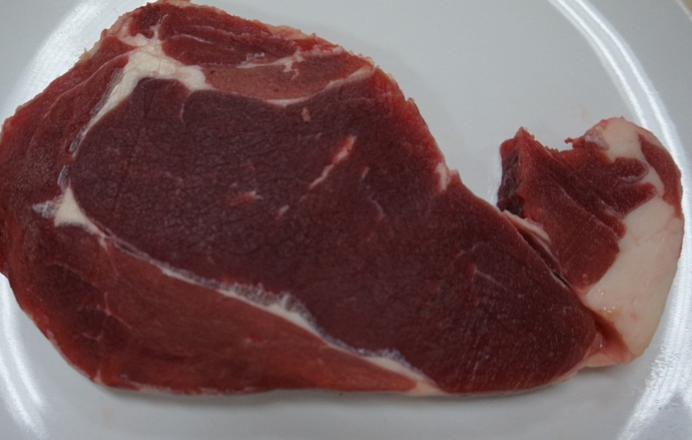
Meat and poultry - structure
Muscle fibres
Meat and poultry are made up of muscles, connective tissues, adipose tissues and bones
Connective tissue is a glue that holds muscle fibres together
Most abundant protein in connective tissue is collagen
  Tough and fibrous,
  Can convert to gelatine when exposed to moist heat
Adipose tissue

Slide 5
Meat and poultry
Texture changes during heating
Meat becomes tender when cooked, however it becomes tough and dry, resulting in some shrinkage and moisture loss if cooked for a prolonged time or at a high temperature
  at 38ºC : proteins start to unfold (red in colour)
  at 49ºC: proteins start to coagulate(clump together) and lose water →firm(pink in colour)
  at 60ºC: connective tissues shrink and more moisture is lost (pinkish brown in colour)
  at 66ºC: connective tissues begin dissolving into gelatine-like substance while proteins are densely packed and become tough (brown in colour)
  at 77ºC: proteins are entirely coagulated, most of the moisture is lost and become hard

Slide 6
Meat and poultry
Connective tissues vs. protein
Proteins denature, coagulate and become tough when temperature increases
When temperature is higher than 60ºC, hydrogen bonds in collagen are broken, some collagen are converted to gelatine, then connective tissues begin dissolving into gelatine-like substance
  Meats become soft and tender
There is tension between softening connective tissues and toughening of muscle proteins
Meat with more collagen should use cooking method which can soften the collagen (moist heat, solubilise collagen)

Slide 7
Meat and poultry - fat in meat and poultry during heating
Fats in meat and poultry melt which enhance the tenderness, juiciness and flavour of meat and poultry
Fats should be added to lean meats to improve texture and flavour

Slide 8
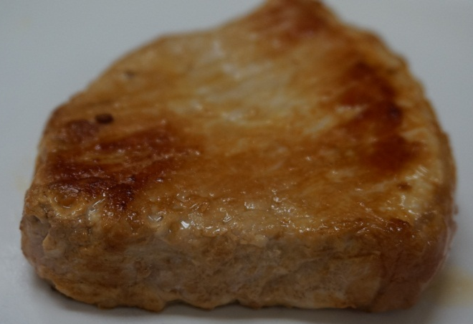
Meat : flavour changes during heating
Coagulation of protein, melting and breaking down of fat → contribute to flavour
Trace amount of carbohydrates in meat can contribute to special flavour of browned meat through Maillard Reaction during heating

Slide 9
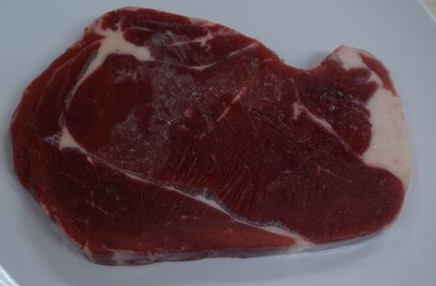
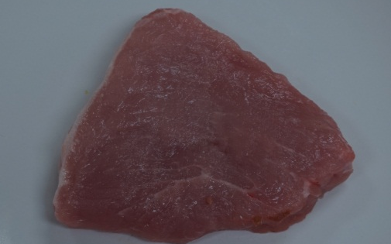
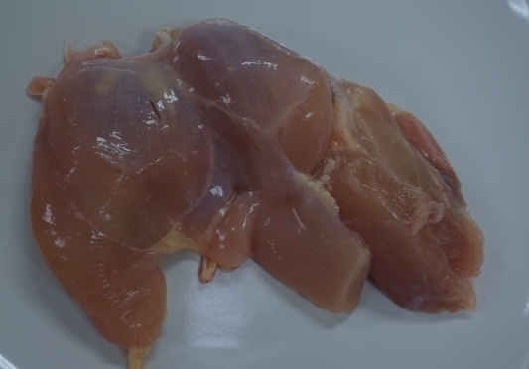
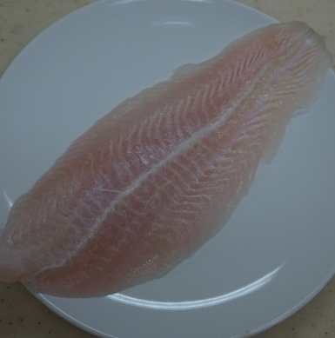
Meat and poultry - colour pigments
Beef
Pork
Colour of meat is derived from pigment-containing protein
  Myoglobin (mainly)
  Haemoglobin (lesser extend)
The higher concentration of myoglobin in raw status, the more intense its colour (bright red)
Number of myoglobin and haemoglobin in beef and pork are more than poultry and fish
Chicken
Fish

Slide 10
Meat and poultry - colour changes during heating
High temperature causes the denaturation of pigment containing proteins , meat changes its colour to greyish brown
  Hemichrome pigment (denatured globin and oxidised heme iron) is formed

Slide 11
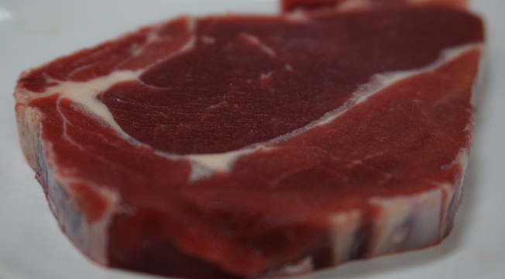
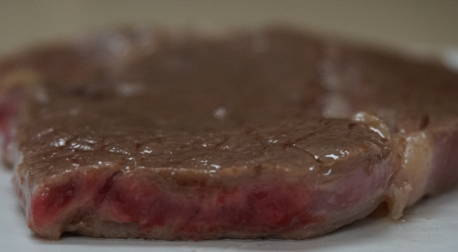
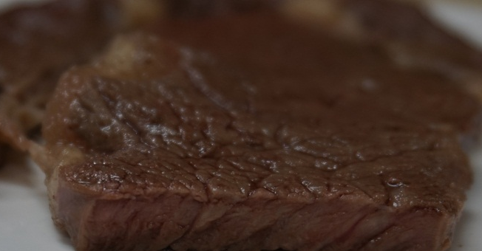
Beef : colour changes during heating
Raw : Strong red interior
Medium : Rosy pink interior
Well done : Brown interior

Slide 12
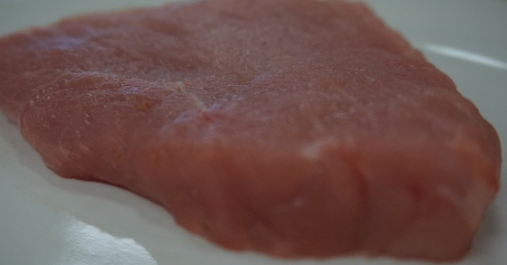
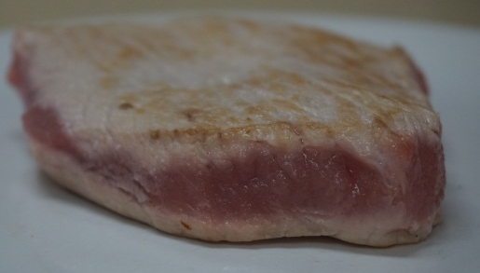
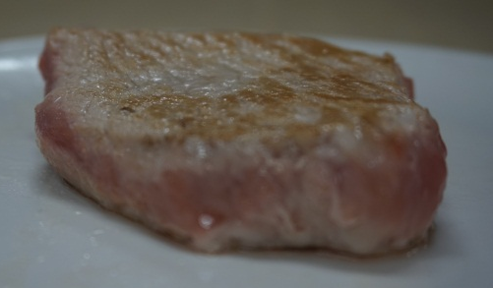
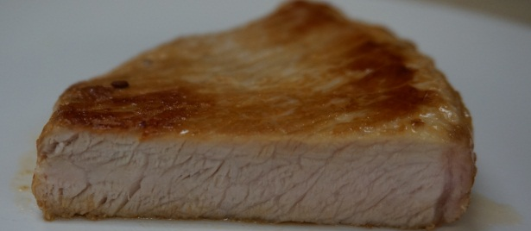
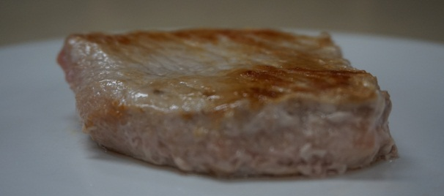
Pork : colour changes during heating
From pinkish to whiter colour as they are heated to well done stage

Slide 13
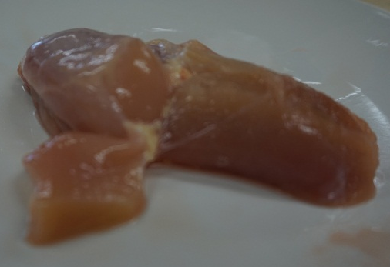
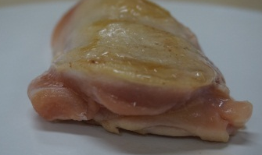
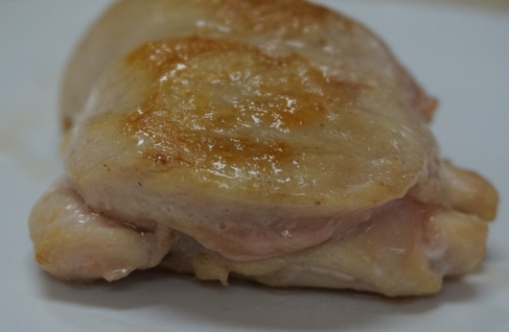
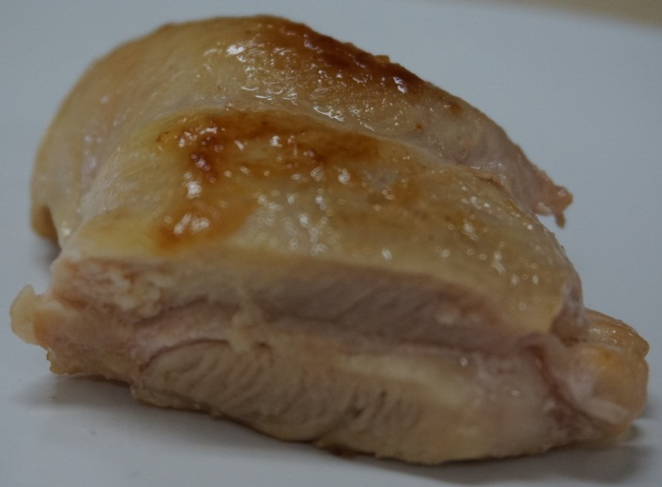
Chicken: colour changes during heating

Slide 14
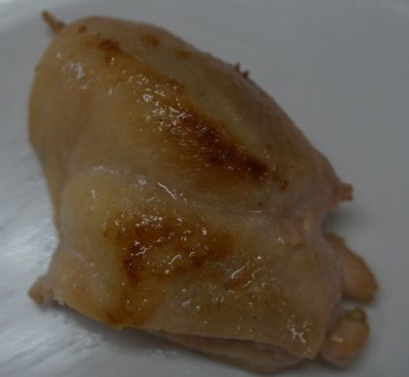
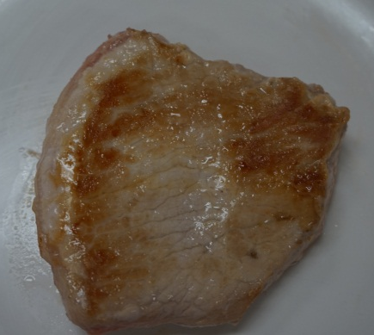
Meat - browning on the surface
Trace amount of carbohydrates (reducing sugars) in meat can react with amino groups of protein to form brown pigments and flavour compounds
This reaction is Maillard reaction and it will be speeded up by heating

Slide 15
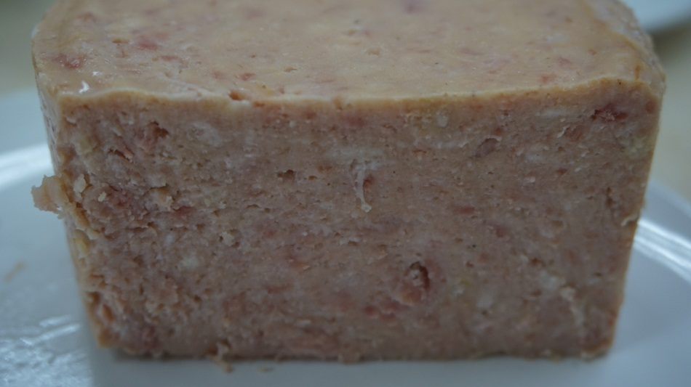
Processed meat
Myoglobin + nitrite will form nitrosyl hemochrome after heating which is pink in colour

Slide 16
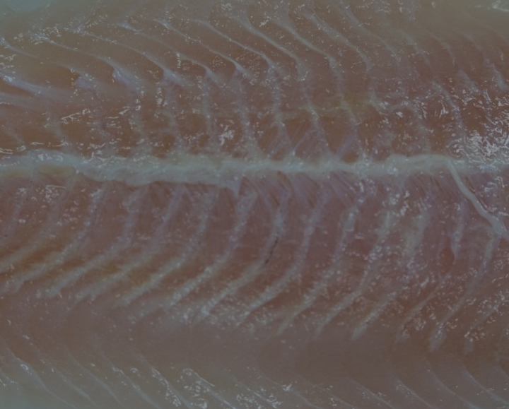
Fish - structure
Connective tissues
Short fibres
Unlike meat and poultry (long bundle of fibres), fish has short fibres and are separated by very thin layers of connectives tissues → flaky texture
Three structural factors contribute to the tenderness of fish : collagen, amino acid content and muscle structure
  When compared to meat and poultry (15%), lower amount of collagen : 3% only
  With less hydroxyl proline in its connective tissues so collagen can be converted to gelatine easily at lower temperature

Slide 17
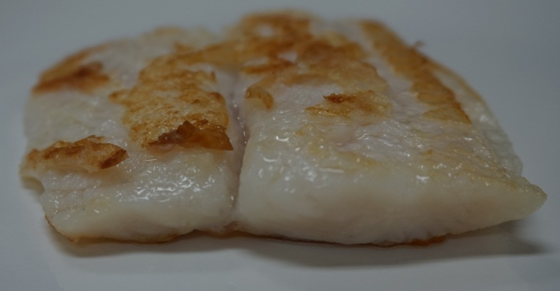
Fish : texture changes during heating
Prolonged heating will tighten protein bonds, shrink the protein mesh and cause the loss of moisture, resulting in tough and dry flesh
Fish is done when it flakes easily with gentle pressure of a fork
Do not cook for too long or with too high temperature → excessive flakiness, dryness and toughness

Slide 18

Fish – colour of flesh
Colour of flesh depends on whether fish relied on slow or fast movements predominantly
  Long distance swimming → with slow twitch fibre → red or darker colour in flesh
  Quick bursts of speed and brief duration → with fast twitch fibre →white flesh
  With both slow twitch and fast twitch fibre → dark, red and white flesh

Slide 19
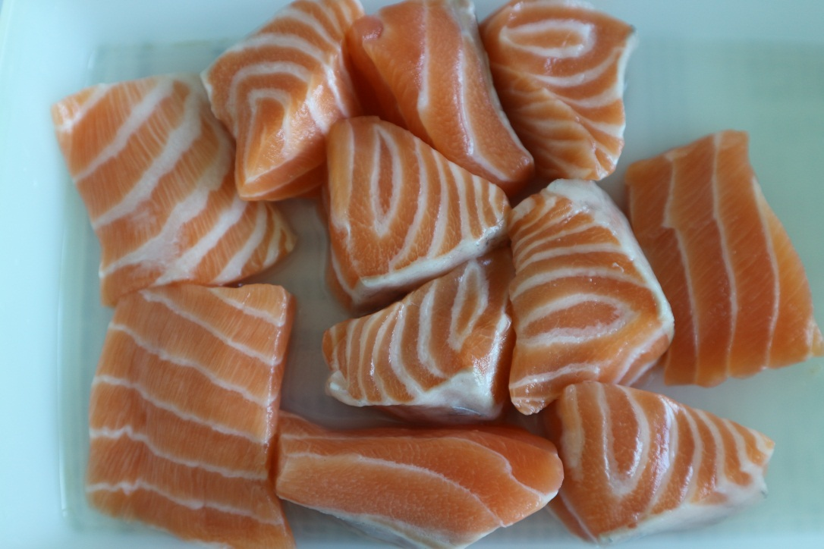
Fish with orange flesh
Carotenoid pigment and astaxanthin → orange pink in colour e.g. salmon

Slide 20
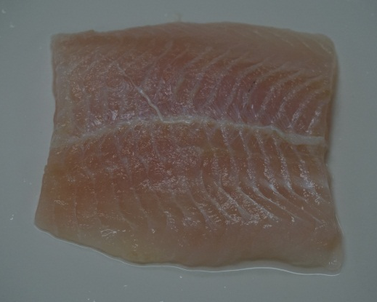
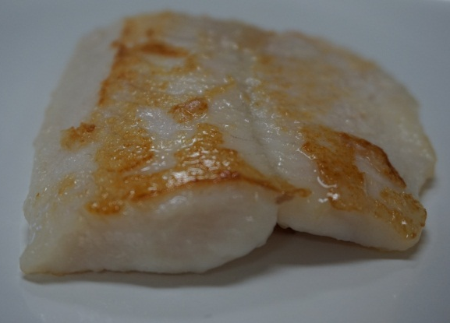
Fish : colour changes during heating
Flesh of fish turns opaque during heating
Heat causes the denaturation of proteins
Proteins unfold and clump together with one another so that water can attach to them resulting in a whitish hue

Slide 21
Eggs and dairy products

Slide 22
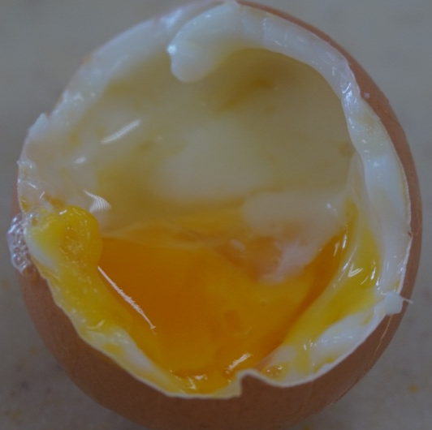
Egg : texture changes during heating
Heat causes→ egg whites and yolks become hard and firm
Egg white : starts coagulation at ~ 60ºC and is completely coagulated at 65-70ºC
Egg yolk : coagulates within 62ºC – 70ºC
Egg can be cooked at 61ºC for an hour and still has a soft yolk
Beaten egg coagulates at slightly higher temperature (69ºC)
Egg white coagulates first

Slide 23
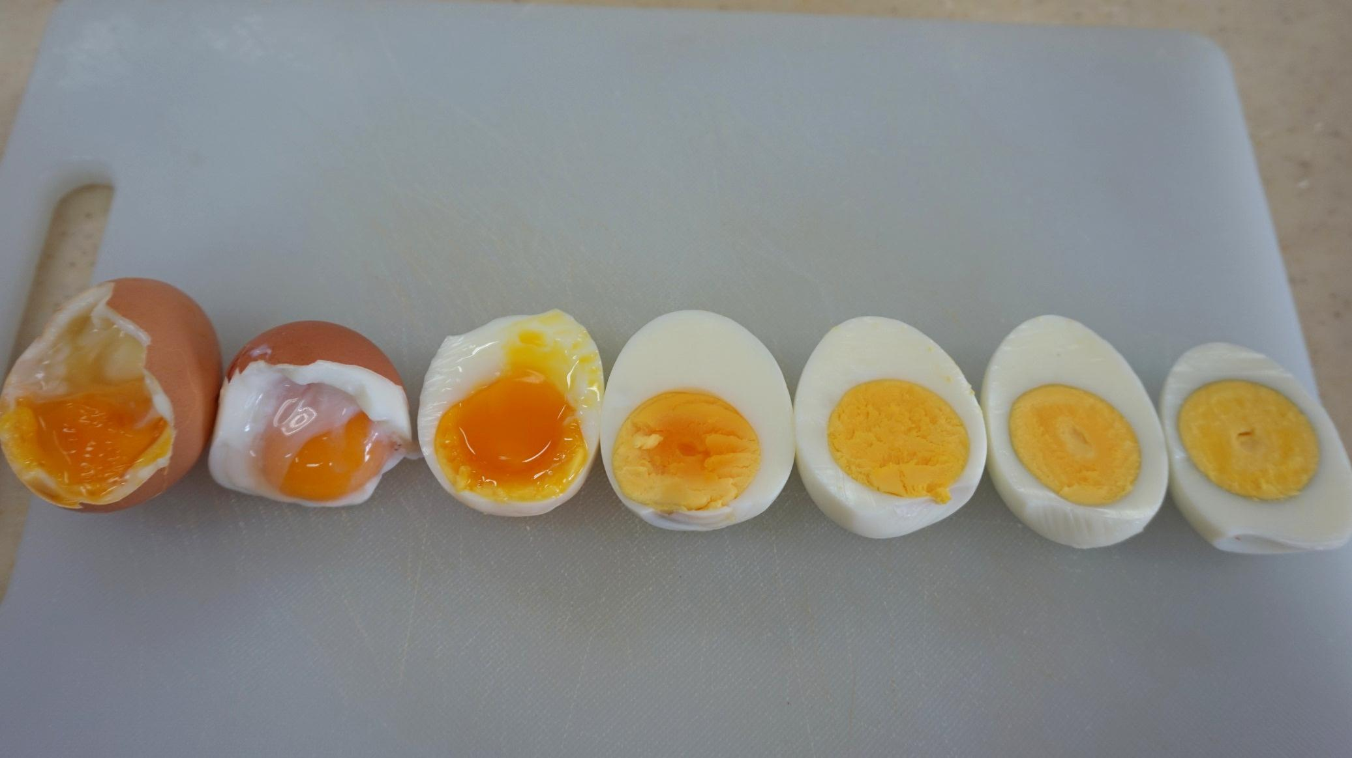
Boiling of eggs across time
Temp of water from 25ºC reaching ~80ºC
Temp of water from 25ºC reaching ~90ºC
~ 100ºC water for 2 mins
~ 100ºC water for 5 mins
~ 100ºC water for 6 mins
~ 100ºC water for 7 mins
~ 100ºC water for 15 mins

Slide 24
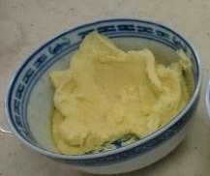
Egg : texture changes during heating
Heating eggs at high temperature for a long period can diminish their texture, flavour and colour
Overcooked egg becomes tough, rubbery and shrink because of dehydration
The key factors in cooking eggs are temperature or cooking time

Slide 25
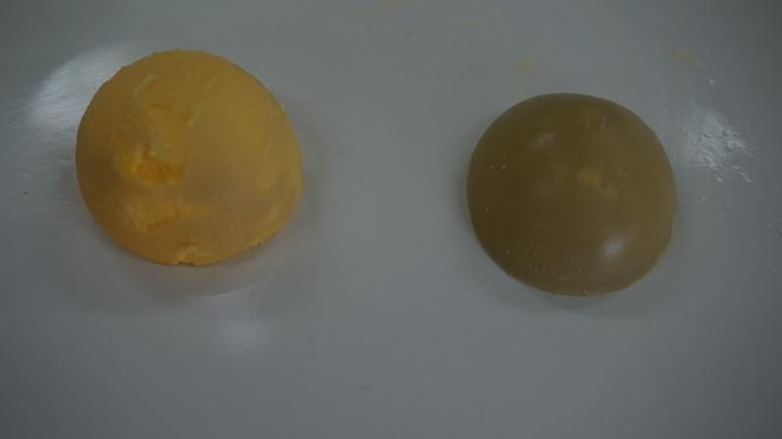
Egg : colour changes during heating
Green ring
Eggs become opaque due to coagulation of protein
Sometimes, slight browning in eggs because of Maillard reaction
Undesirable colour changes is found when eggs are overcooked
  Sulphur in egg white may combine with iron in yolk to form ferrous sulphide, a green coloured compound with strong odour and flavour of a “green yolk”
  Cool hard boiled eggs quickly in cold water or cooked in stainless steel equipment with low cooking temperature can prevent changes in colour
Normal egg yolk
Green egg yolk

Slide 26
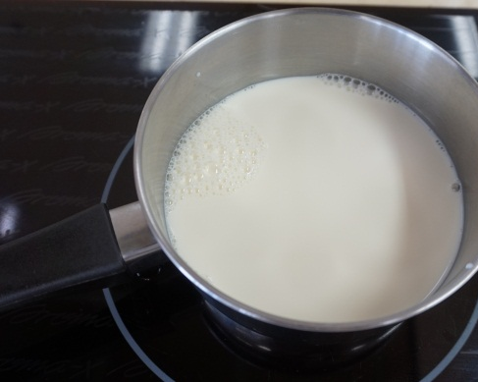
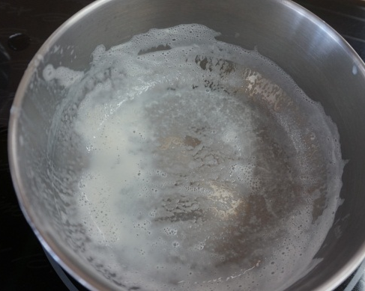
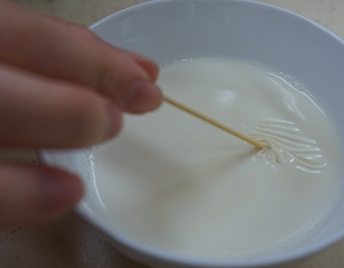
Milk : texture changes during heating
Heat causes proteins in milk to precipitate
  When heating milk to almost the boiling point, whey protein become insoluble mesh with calcium phosphate and precipitate
  A film will be formed on the bottom and sides of pan
A skin will also be formed on the surface of heated milk
  The skin is formed by the evaporation of water which is accompanied by an increased concentration of casein, fat and mineral salt
  Constant stirring can help to prevent the forming of film
Heating
Film on bottom and sides of pan
Film on surface of milk

Slide 27
Milk : flavour changes during heating
Slightly sweet flavour of milk comes from lactose, salts, sulphur compound and short chain fatty acid
“Cooked” flavour develops during heating
  Heating denatures whey proteins and releases volatile sulphur compounds contributing to the off flavour

Slide 28
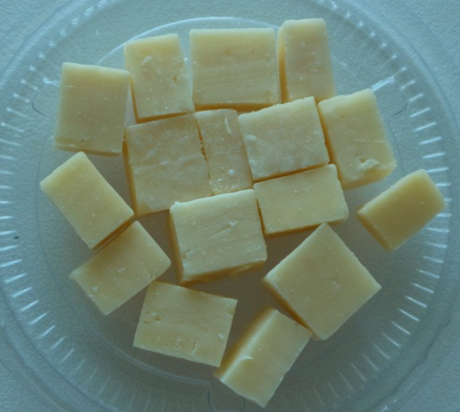
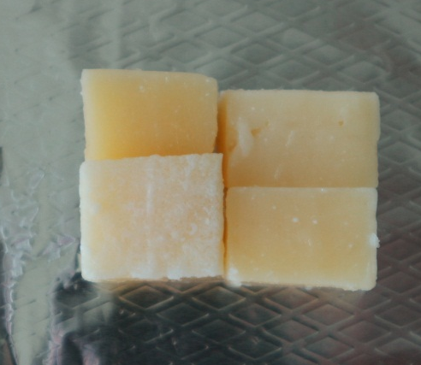
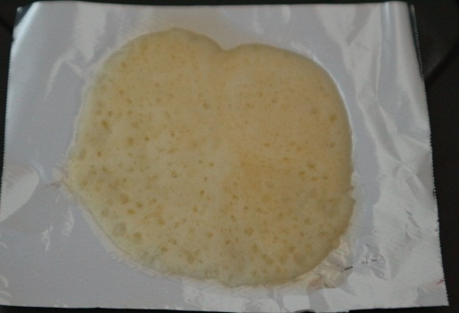
Cheese : Meltability
Cheese is often used as an ingredient to add flavour, colour and texture to a dish
Heating can melt the cheese
Meltability depends on the fat and moisture content of cheese
  The higher fat and moisture content, the greater its meltability is

Slide 29
Cheese : texture changes during heating
High temperature or prolonged cooking :
  Toughens cheese protein
  Causes fat separating out create an oily stringy and inferior product
Normally cheese is added during the last stages of preparation to prevent separating
Low fat cheese :
  Separates more easily when exposed to high heat
  Higher protein content makes it toughen easily when heating
  Not good for cooking
Processed cheeses which contain added water emulsifier can be heated without fat separating and melted more easily than unprocessed cheese

Slide 30

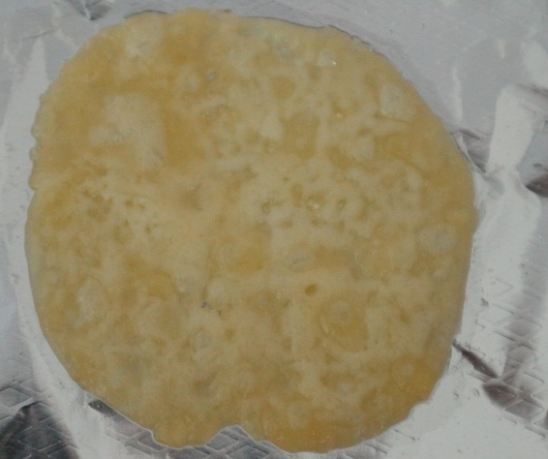
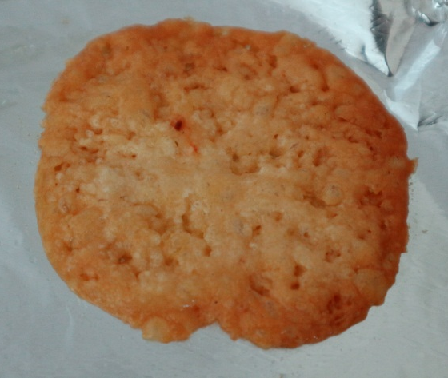
Cheese : browning during heating
Heating will cause browning of cheese because of Maillard reaction

Slide 31
Cereals, cereal products and sugar

Slide 32
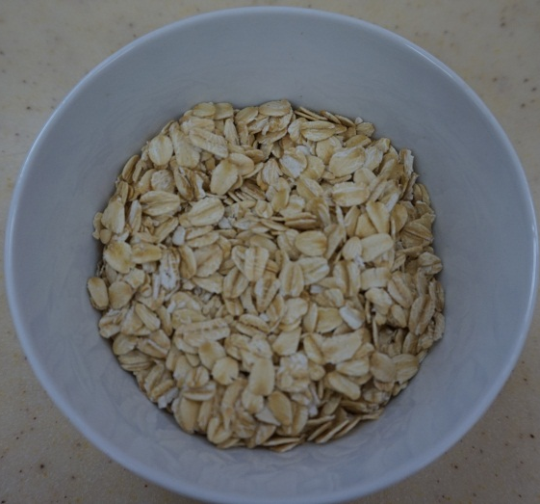
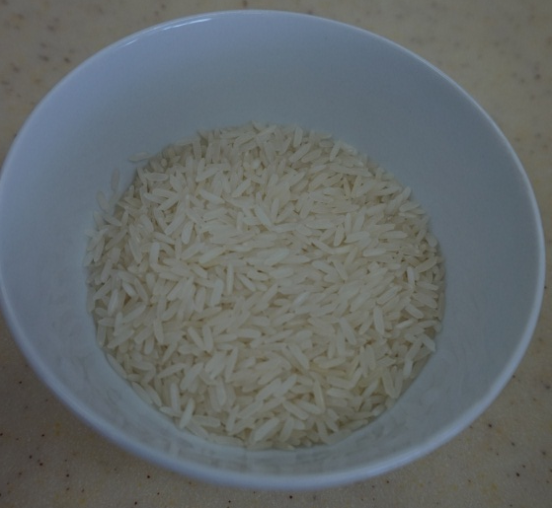
Cereals
Nearly indigestible in natural form
  Hard hull covering to prevent seeds from immediate consumption
Oatmeal
Rice

Slide 33
Cereal : texture changes during heating
Heating grains in water can soften the outer covering and make the starchy endosperm digestible
Cooking can gelatinise the starch improving the flavour and texture since the grains expand and are softened
Grain’s size expands to 2-3 times when cooked

Slide 34
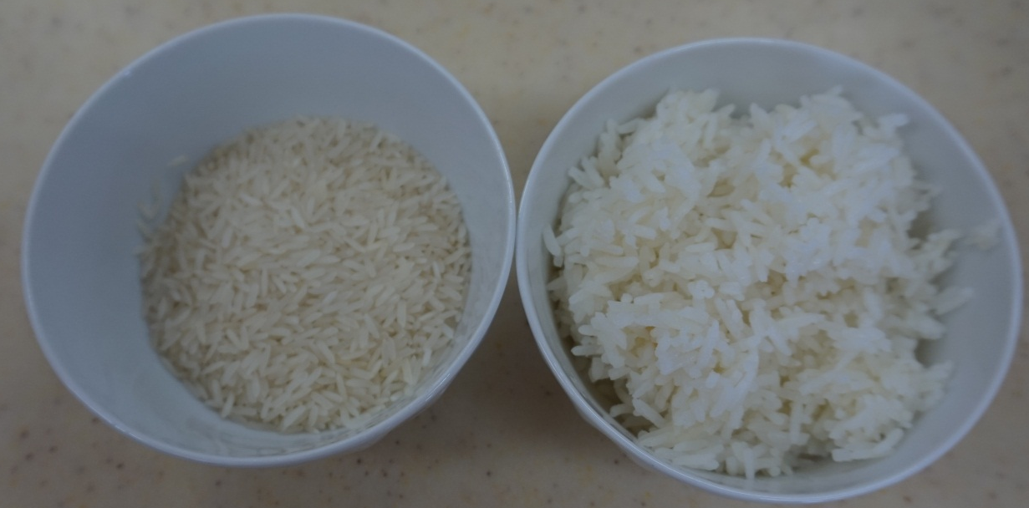
Rice
Size expands to 2-3 times when cooked
Raw
Cooked

Slide 35
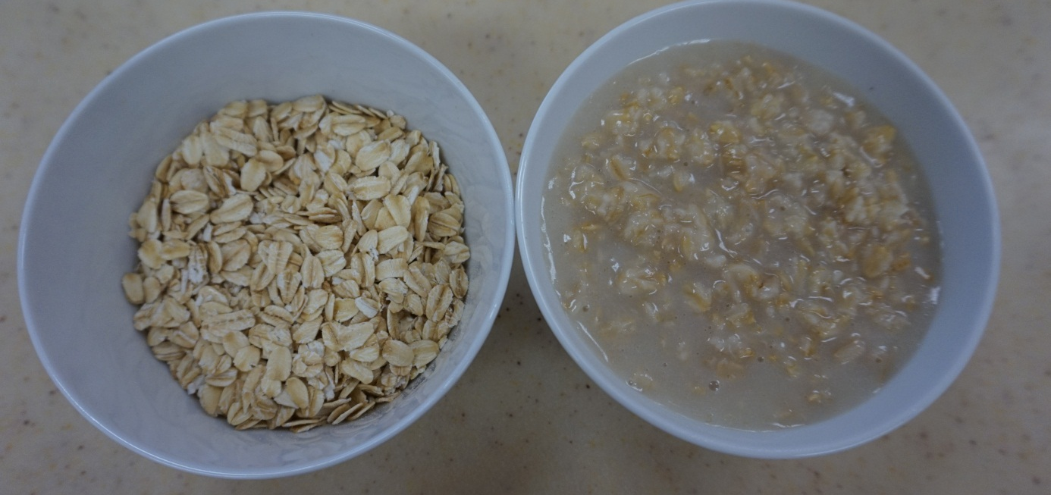
Hot breakfast cereal : oatmeal
Raw
Cooked

Slide 36
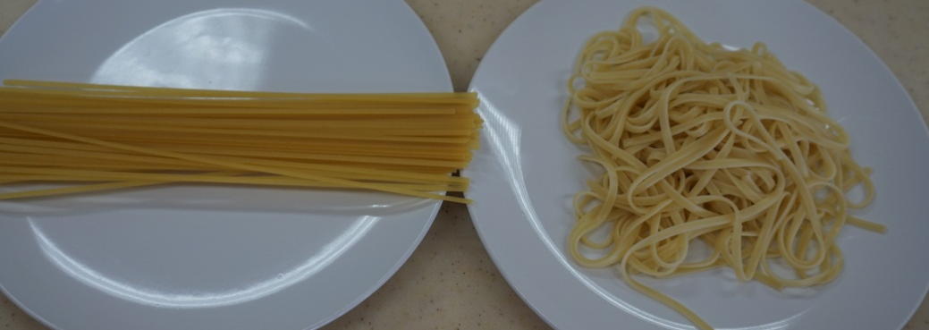
Cooking of Pasta
Pasta is a mixture of primarily flour starch and water
A type of flour derived from durum wheat, protein in durum wheat flour gives pasta its elasticity and helps it maintain its shape during cooking
Raw
Cooked

Slide 37
Baking of bakery products
Flour mixture : flour mixed with fats, sugars and leavening agents
When heat is applied, gases such as steam, CO2 and air immediately expand, creating pressure that stretches the elastic network of gluten
  Bakery products rise
Heat melts the fats, gelatinises the starches and coagulates the protein in flour, egg and milk
Browning the outer surfaces is the result of caramelisation of sugar, Maillard reaction and dextrinisation of starch during baking

Slide 38
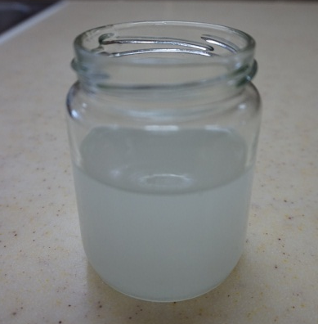
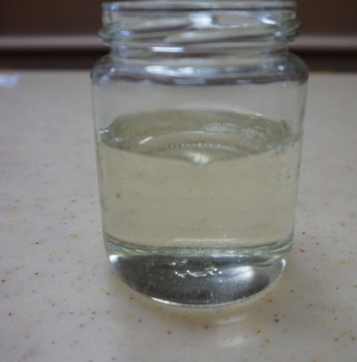
Solubility of sugar
Different types of sugars have different solubility
Degree of solubility of sugars influence the perceived mouthfeel and texture of food
Increasing temperature of a sugar solution allows more sugar to dissolve
60ºC sugar solution
120ºC sugar solution

Slide 39
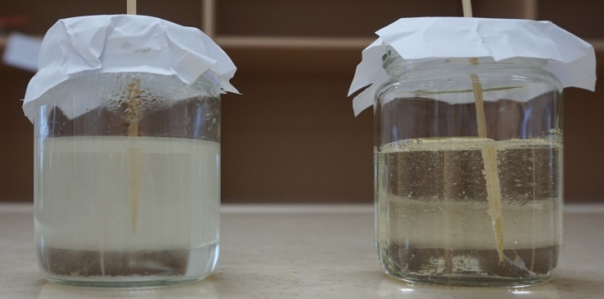
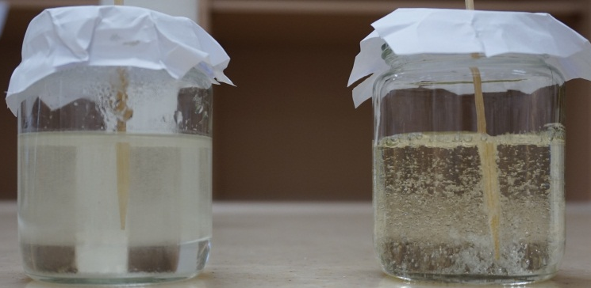
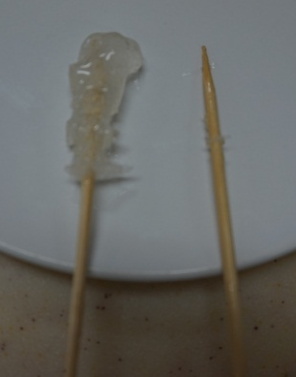
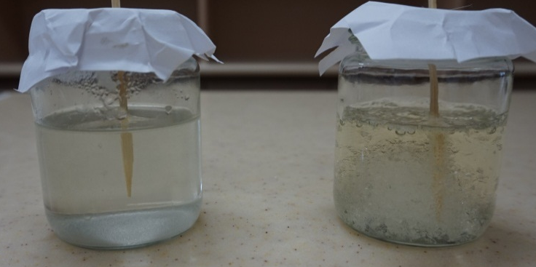
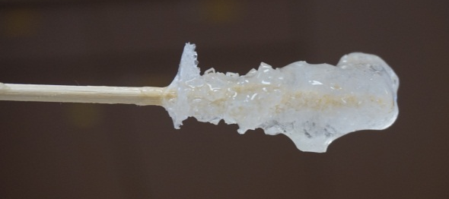
Learning activity
Crystallisation : Effects of temperature on sugar solubility
Turbid solution
Clear solution
Cooling for 30 mins
60ºC sugar solution
120ºC sugar solution
60ºC sugar solution
120ºC sugar solution
Cooling for another 60 mins
120ºC sugar solution
60ºC sugar solution
60ºC sugar solution
120ºC sugar solution
Sugar crystal formed from 120ºC sugar solution

Slide 40

Browning of sugar
Caramelisation : heating of sugars
  Sugars start to melt when heated
  If heating continues and the caramelisation temperature is reached, the melted sugars will become smooth glossy then start to caramelise
Fructose starts caramelise at slightly lower temperature 110ºC when compared to sucrose at 160ºC

Slide 41







Learning activity
Caramelisation of different sugars
Heating of Fructose
Heating of Sucrose
~110ºC
~110ºC
~130ºC
~130ºC
~155ºC
~160ºC
~180ºC

Slide 42
Fats and oils

Slide 43
Function of fats and oils in food
Contribute to the flavour, colour, texture and mouthfeel of food
Fat is a medium of heat transfer, it can help transfer heat to food without burning them
Not all fat is suitable for high temperature processing
Fats and oils for deep frying must be heat stable
  High smoke point
  Do not develop rancid off flavour

Slide 44
Smoke point
Temperature at which fat or oil begins to smoke
  Release of free glycerol followed by breakdown of glycerol to Acrolein
  Acrolein has offensive odour and harmful to mucous membrane of mouth and nasal passage

Slide 45
Smoke point of different fats and oils
Butter : 121 - 148ºC
Lard : 183 - 205ºC
Most olive oil : ~ 199ºC
Most vegetable oil : 227 - 232ºC
  Refined peanut oil : ~ 232ºC
  Refined canola oil : ~204ºC

Slide 46
Flash point and fire point
When keep on heating fats:
  Reaching flash point(~316ºC)
    Temperature at tiny wisps of fire streak to the surface of heated substance
    Reaching fire point (~370ºC)
    Temperature at which heated substance bursts into flames and burns for at least 5 seconds

Slide 47
Overheating of deep frying fats
Rapid deterioration of fat through polymerisation
Increase the viscosity of overheated fat
  Higher absorption of fat in the fried food making them greasy
Optimal frying temperatures :
  191- 199ºC for small piece of food
  177-185ºC for large piece of food

Slide 48
Changes in reused deep frying fats
More viscous
Darker colour
  Pick up protein and carbohydrate from food → browning
Having smoke easily
  Smoke point gets lower
  Each heating hydrolyses some of the triglycerides into smaller molecules
Higher chance of rancidity
  Trigger by high temperature process
  Fat is broken down into smaller units such as acids, alcohols aldehydes and ketones results in rancid of odour and flavour

Slide 49






Learning activity
Deep frying of French fries with different fats
Changes in fats
Butter :
Canola oil :
Peanut oil :
Before After
Before After
Before After
French Fries

Slide 50
Fruits and vegetables

Slide 51

Vegetables : texture changes during heating
High temperature:
  Gelatinises starch
  Decreases bulk by softening the cellulose
  Causes a reduction in turgor due to water loss
Long cooking time is suitable for potatoes or legumes but not for most vegetables
Raw vegetable
Cooked vegetable

Slide 52

Vegetables : texture changes during heating
Adding alkaline ingredients can speed up the breakdown of cellulose and produce a mushy texture
Baking soda in water
Water only
Vinegar in water

Slide 53
Vegetables : flavour changes during heating
Vegetables obtain their flavour from volatile oils, organic acids, sulphur compounds , mineral salts, carbohydrates and polyphenolic compounds
Cooking with water will lose the flavour of vegetables

Slide 54
Odour released during heating
When onion and cabbage are cooked, pungent odour is released especially when overheating
In cabbage, heat triggers the enzyme to release excess hydrogen sulphide

Slide 55


Fruits : texture changes during heating
Fruits will become soft when cooked and mushy if cooked for a long time
  Conversion of fruit protopectin to pectin
  Degradation of cellulose and hemicellulose
  Denaturation of cell membrane protein → cell membrane loses its function to maintain turgor
Raw Cooked
Raw Cooked

Slide 56
Fruits : flavour changes during heating
Sugars and acids contribute to the sweet and sour taste in fruits
Phenolic, aromatic compounds and essential oils contribute to the flavour
Some flavour substances and volatile compound can be lost during heating so aroma will be lost

Slide 57
Fruits and vegetables : colour pigments
Chlorophyll, carotenoids and anthocyanins are three common pigments in fruits and vegetables
There will be loss of pigmentation during heating

Slide 58

Chlorophyll changes during heating
Chlorophyll is rich in broccoli , choi sum and kiwi
  Chlorophyll (blue green) → bright green when start heating (deficient of air)
  Application of heat continues→ acid in cells released form pheophytin (dull olive brown )

Slide 59


Chlorophyll changes during heating
Fat soluble
  Chlorophyll leaching out to the medium when boiling with fat

Slide 60
Keeping vegetables green
If alkaline such as baking soda is added in the water, acid from vegetables will be neutralised and the chlorophyll in vegetables can keep its colour
Drawback : loss of vitamins is much faster

Slide 61

Learning activity
Heating green vegetables under different pH conditions
Baking soda in water
Water only
Vinegar in water

Slide 62
Carotenoid changes during heating
Carotenoid is rich in carrots, sweet potatoes ,lemon and oranges
Carotenoid is fat soluble → leaching out when cooking with fat
Lead to degradation of the pigment when undergo oxidation → lighter orange colour
  Boiling for a long time (contact with oxygen) → pale food colour

Slide 63

Carrots boiled in water for long
Carotenoid leach out to boiling water
Cooked carrots became pale in colour when compared to the raw ones

Slide 64

Anthocyanin changes during heating
Anthocyanin is rich in red cabbage, blueberry and red cherry
Anthocyanin will be red in colour in an acidic environment, while blue in colour in alkaline situation
Anthocyanin is water soluble → leaching out during boiling → becomes dull reddish brown
With baking soda
With vinegar
Control

Slide 65
Anthocyanin, pH and heating
Baked goods with baking soda or powder in the flour mixture will discolour anthocyanin to blue
Use sour cream instead of milk can maintain its colour
Red cabbage can be prevented from turning blue when vinegar is added during cooking

Slide 66

Blanching of vegetables
Polyphenol oxidase can be destroyed during heating
Enzymatic browning is prevented
Raw potato exposed to air
Blanched potato exposed to air

Slide 67
Nutrient lost during cooking
Leaching is the greatest reason of vitamins and minerals loss in fruits and vegetables
Minimise the loss through
  Avoid peeling of skin when possible
  Cutting vegetables into fewer and larger chunks
  Cooking to the point of just doneness

Slide 68
THE END

