Slide 1
Technology & living
Textile Technology
S1.3.1 Fundamental Knowledge of Fabrics

Slide 2
Types of Fabrics
Woven
Knitted
Non-woven

Slide 3
Weaving
The technology used to form the fabric by interlacing two or more sets of yarns at the right angles to each other.
Properties of woven fabrics:
Firm, durable, easy to clean, inexpensive production cost.
Different weaving construction can be applied for different effects.

Slide 4
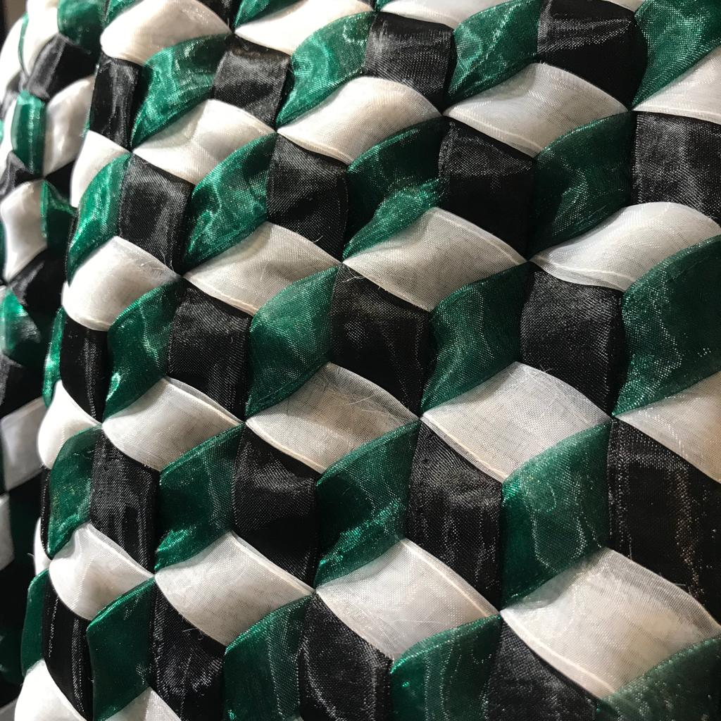
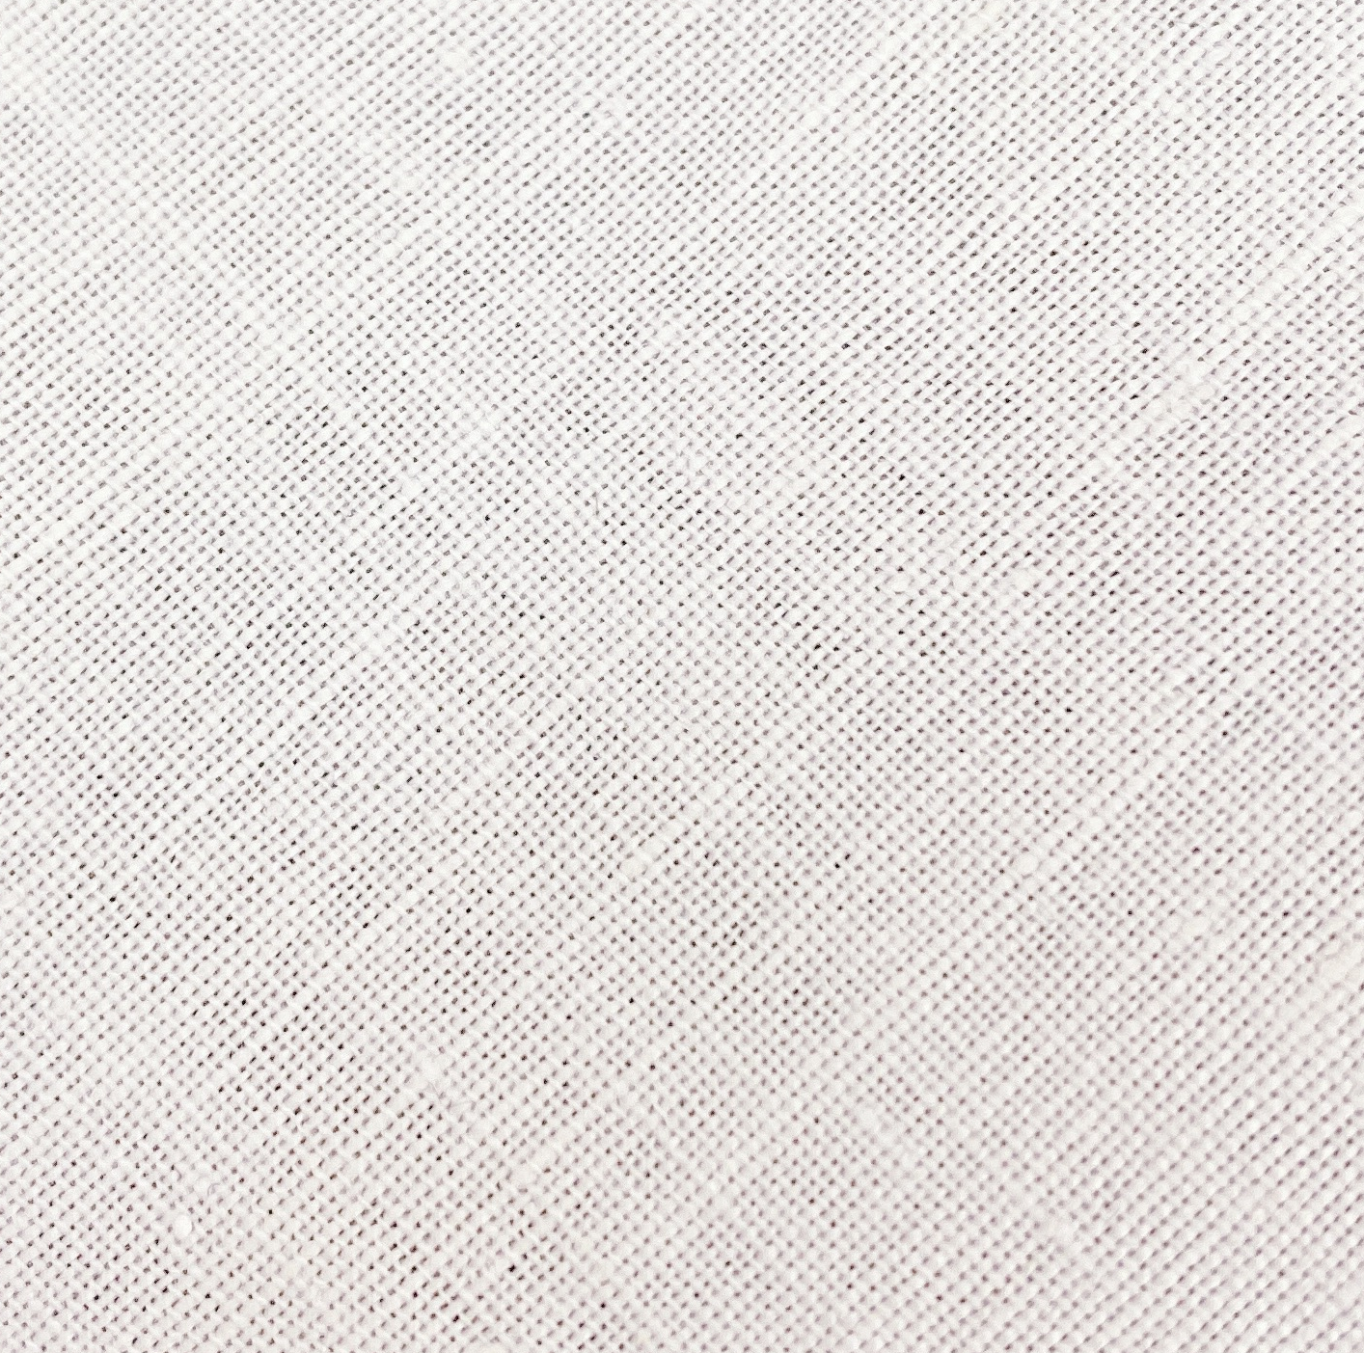
Woven Fabric
Closed structure
Interlacing structure
Photo(s) is / are owned and provided by HKDI

Slide 5
Knitting
The technology used to form the fabric by intermeshing the yarn into loops.
Properties of knitted fabrics:
Soft, extensible, some has reversible structure.
Different knitting construction can be applied for different effects, e.g. thickness, extensibility.

Slide 6
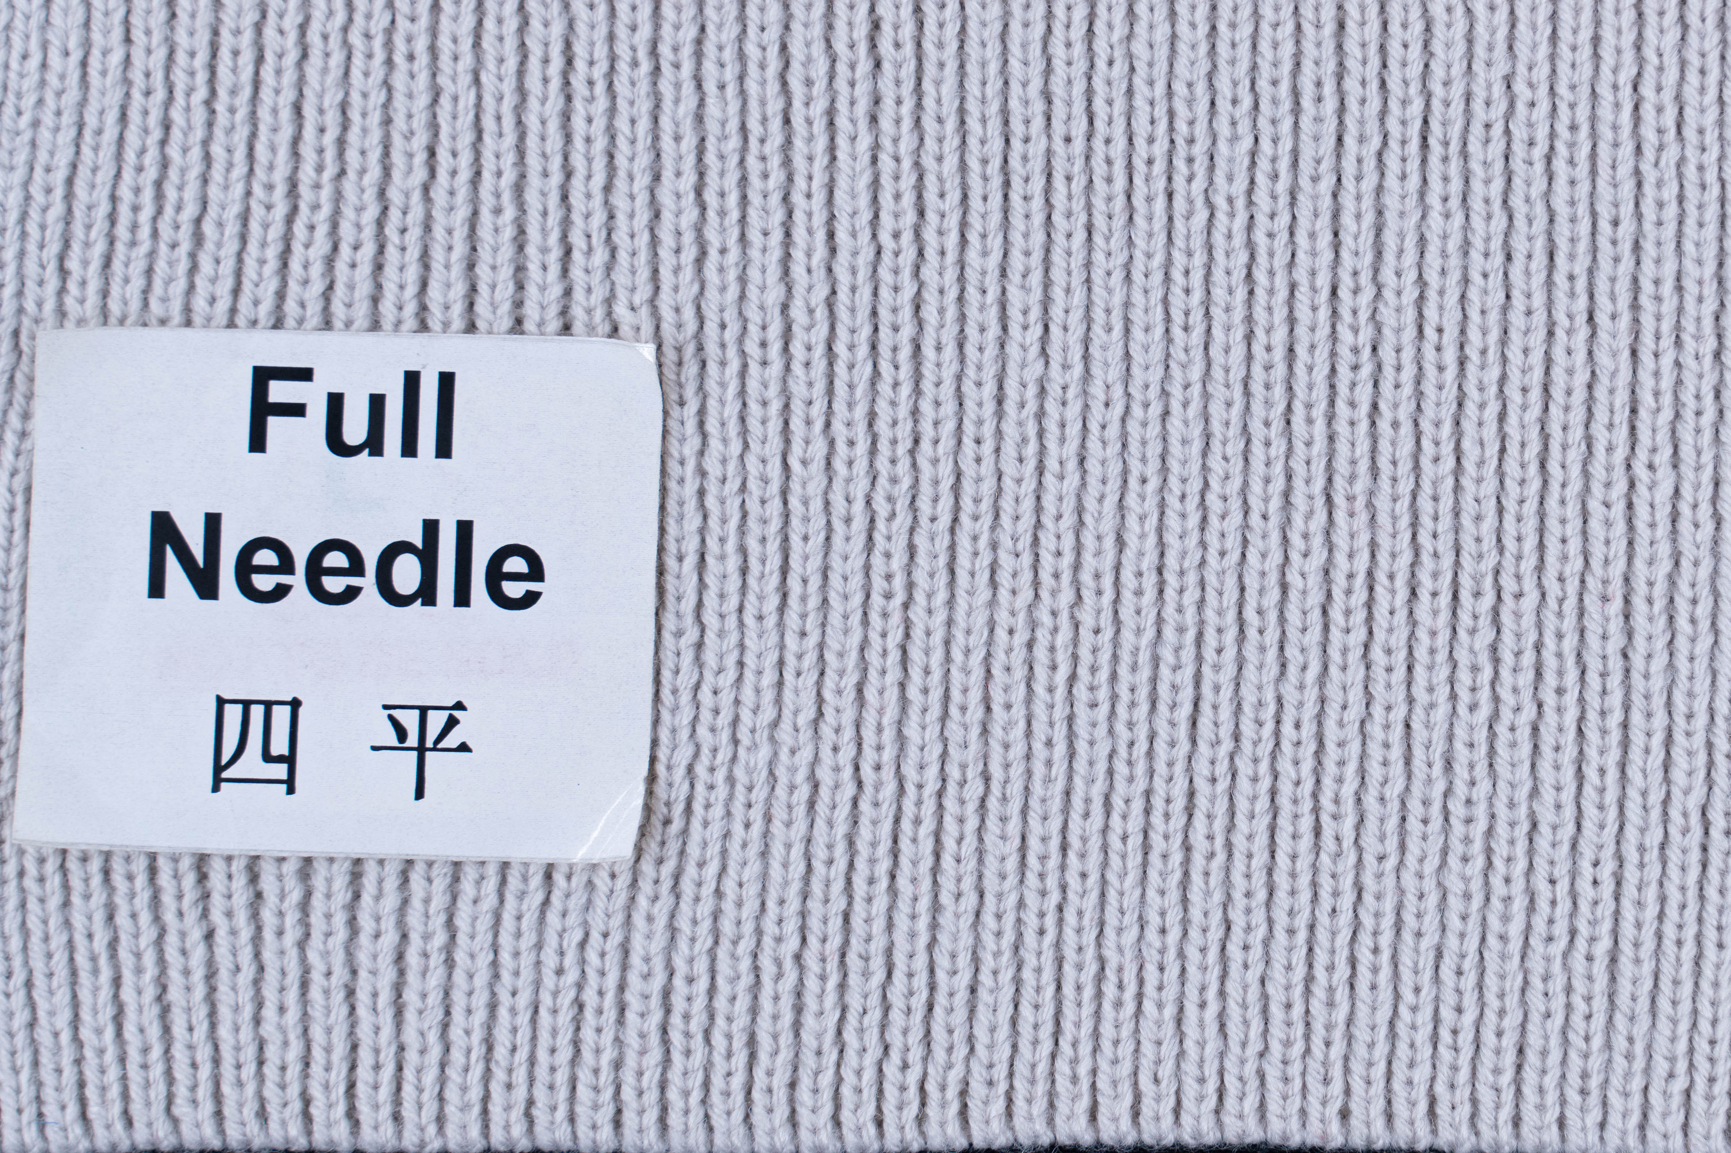
Knitted Fabric
Reversible structure
Loop structure
Photo(s) is / are owned and provided by HKDI

Slide 7
Non-woven
The technology used to form the fabrics by fibre or filament webs.
Non-woven properties:
Low mechanical properties

Slide 8
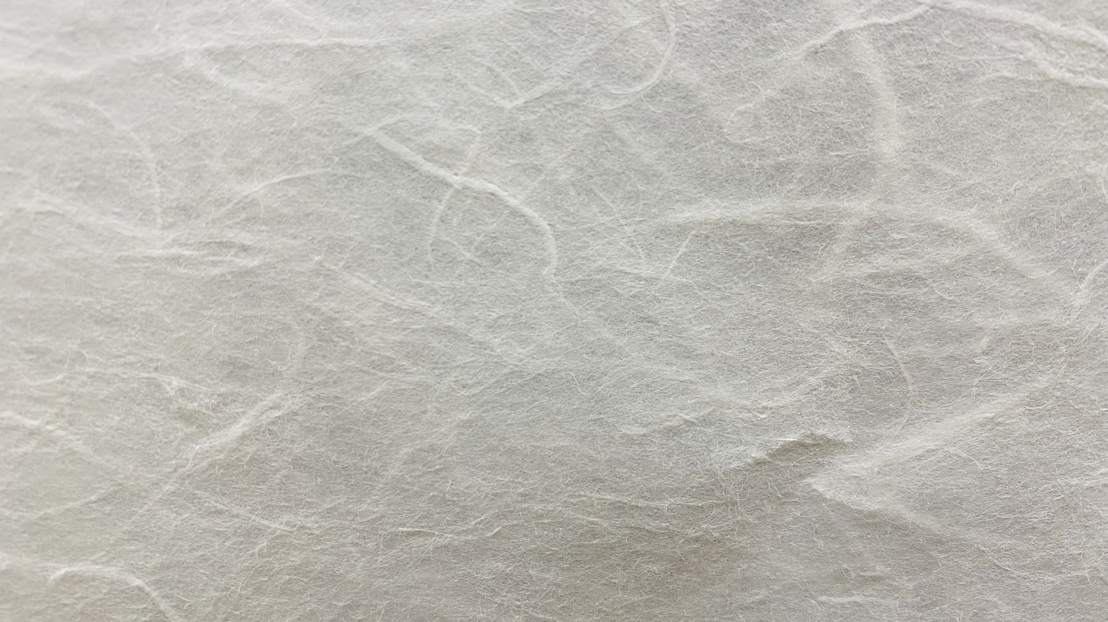
Non-woven Fabric
Web structure
Photo(s) is / are owned and provided by HKDI

