Slide 1
Food test:
Fats and oils emulsions

Slide 2
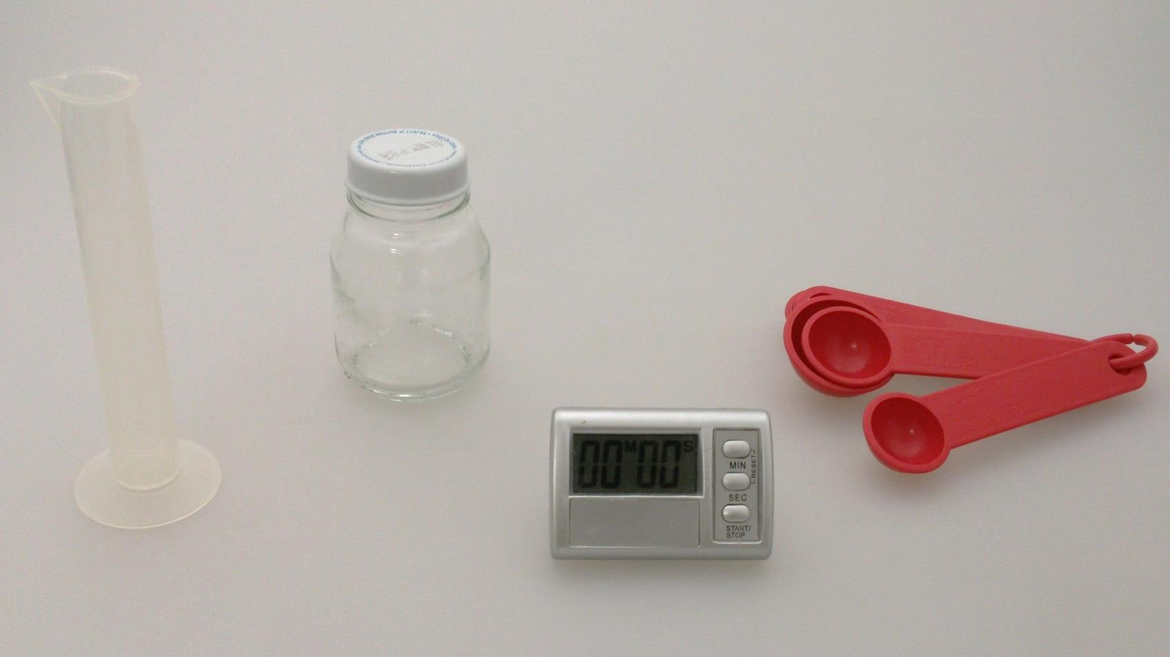
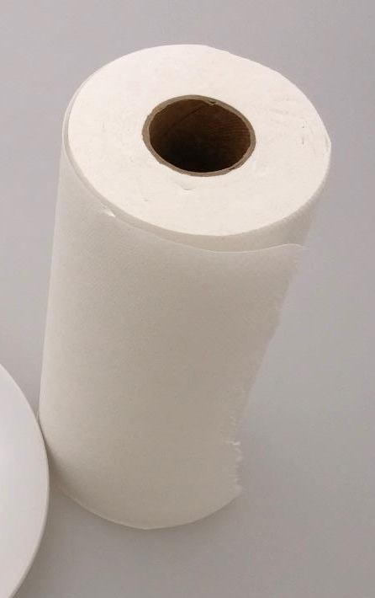
Equipment
Glass bottle
Measuring spoons
Measuring cylinder
Timer
Paper towel

Slide 3
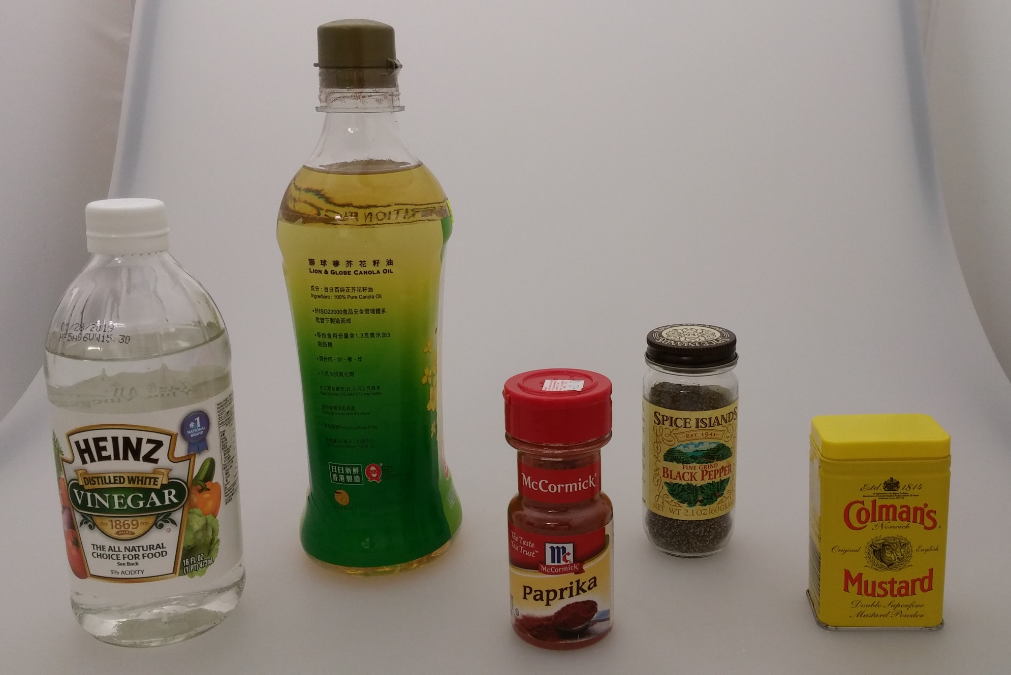
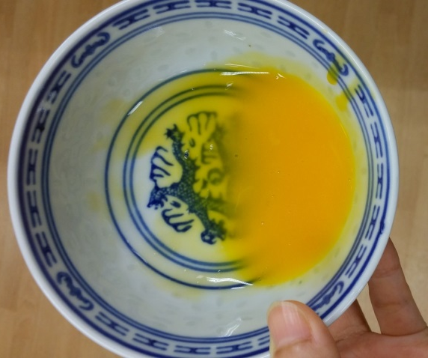
Materials
Beaten egg yolk
Oil
Pepper
Dry mustard
Vinegar
Paprika

Slide 4
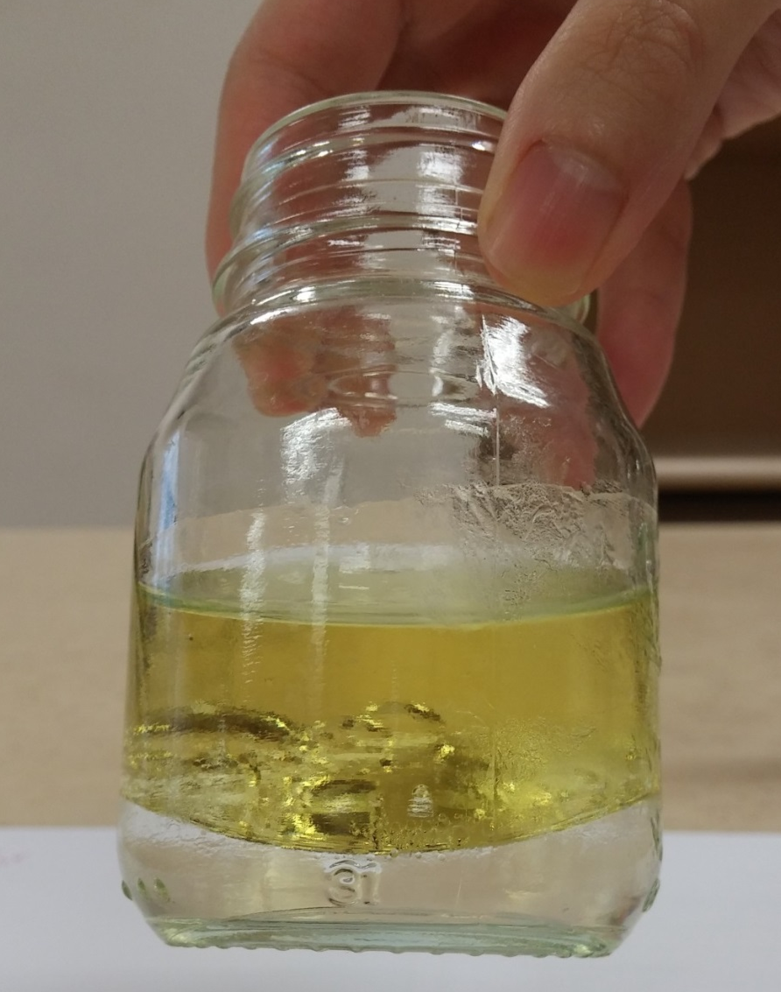
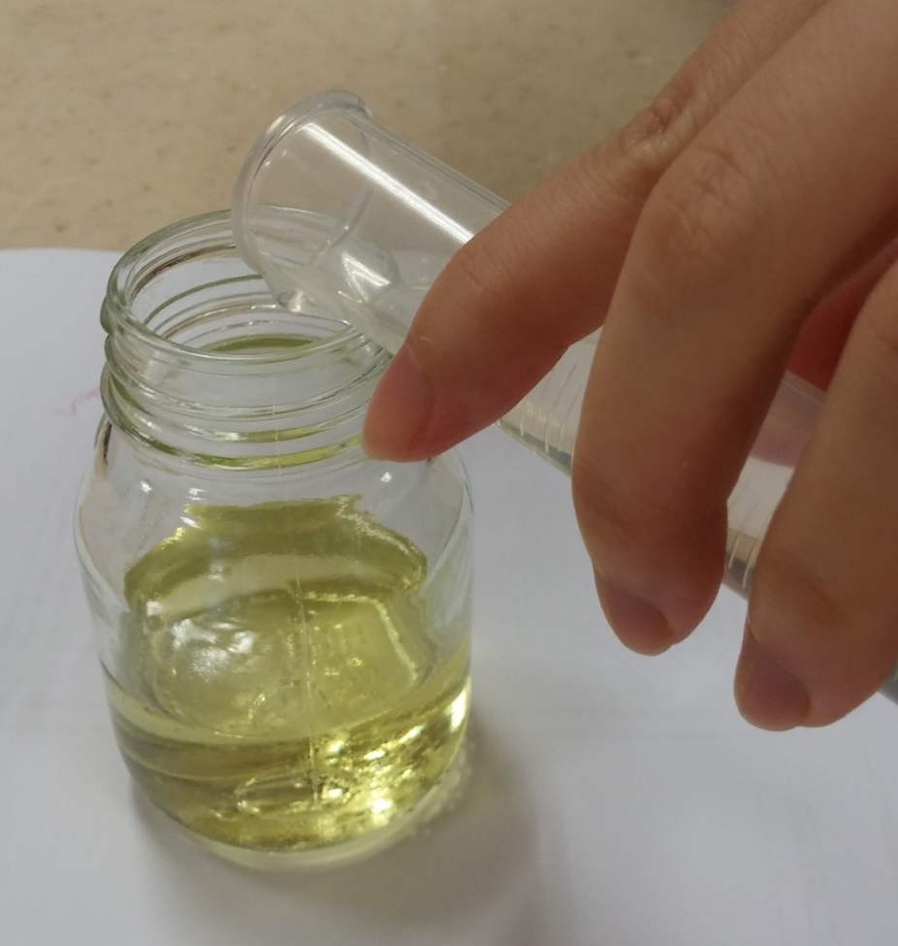
Procedures
Mix vinegar and oil
Oil and vinegar are immiscible
Oil forms a layer on top of vinegar

Slide 5

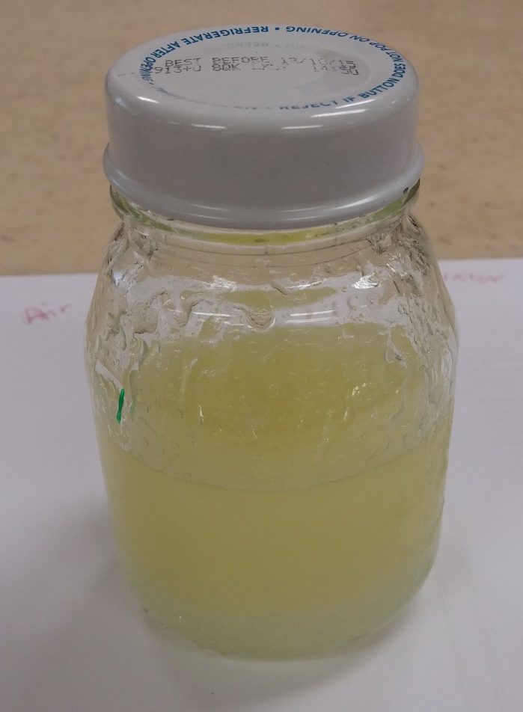
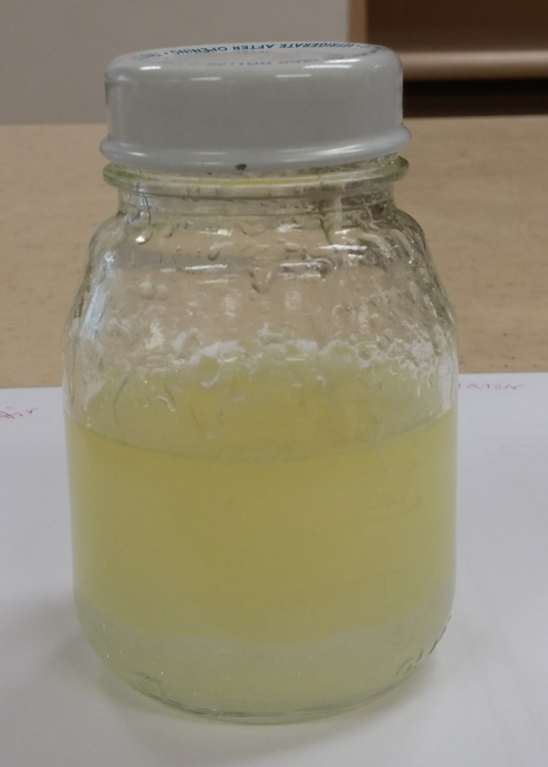
Sample 1:
Vigorous shaking of 25ml vinegar and 50ml oil for 30seconds
Before shaking
Immediately after shaking
1min after shaking

Slide 6
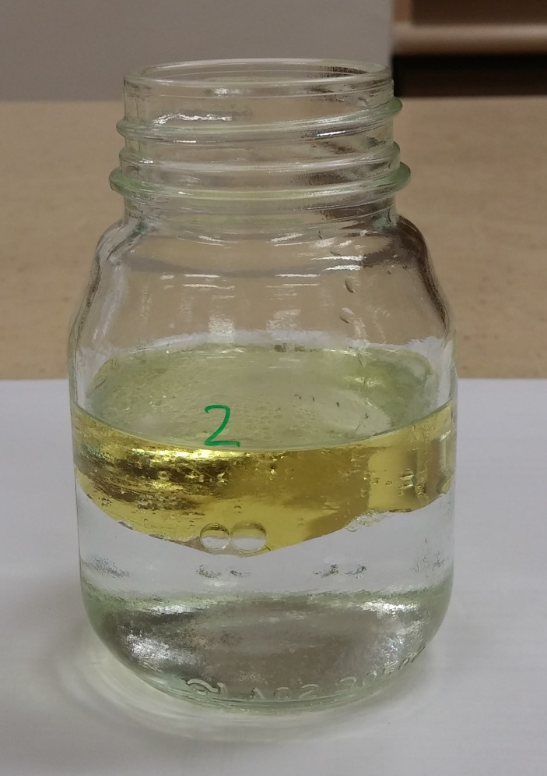
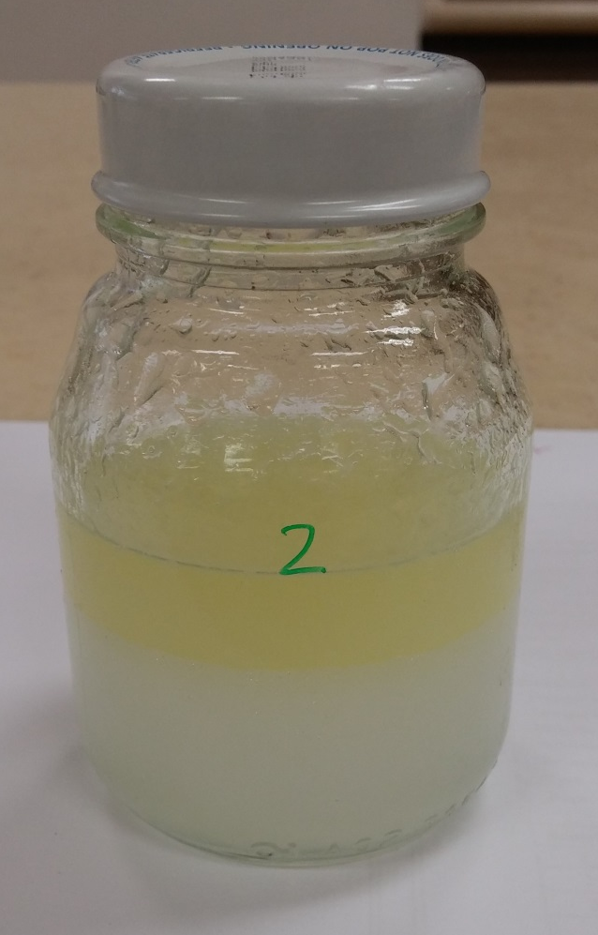
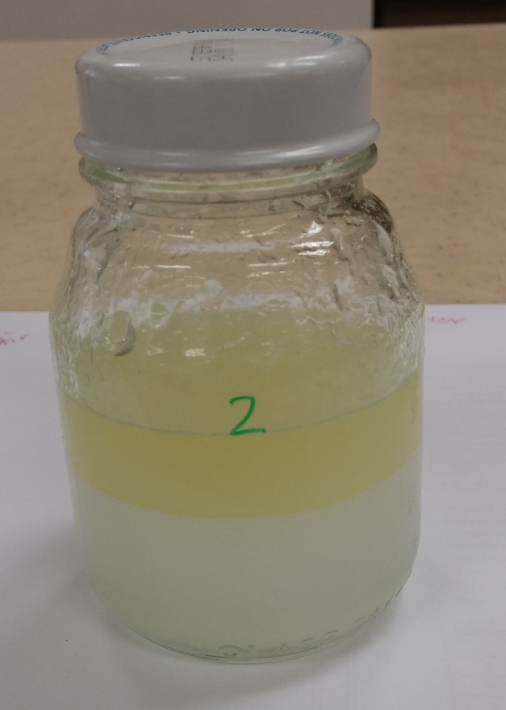
Sample 2:
Vigorous shaking of 50ml vinegar and 25ml oil for 30seconds
Before shaking
Immediately after shaking
1min after shaking

Slide 7
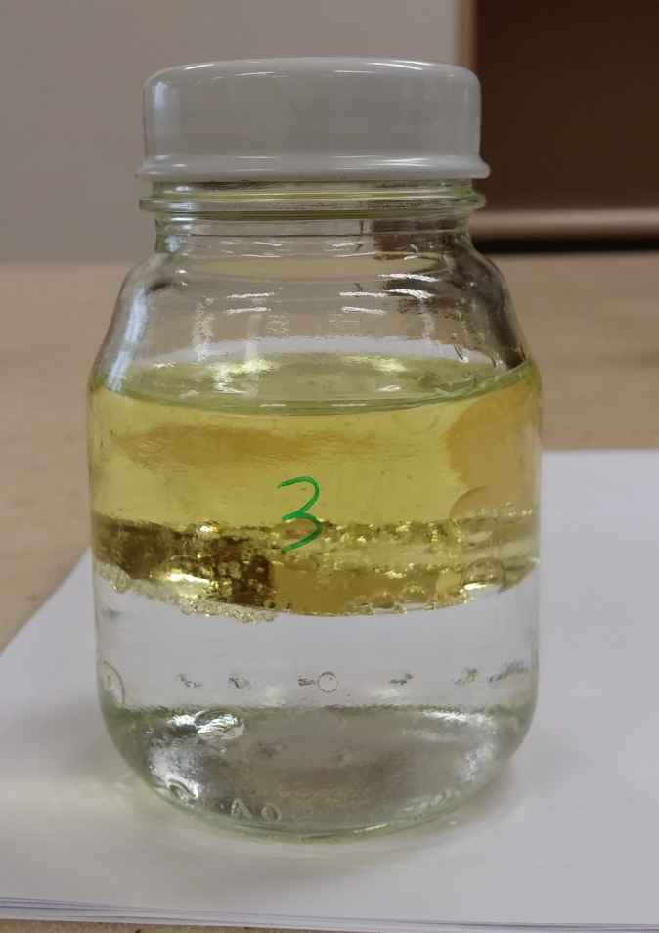
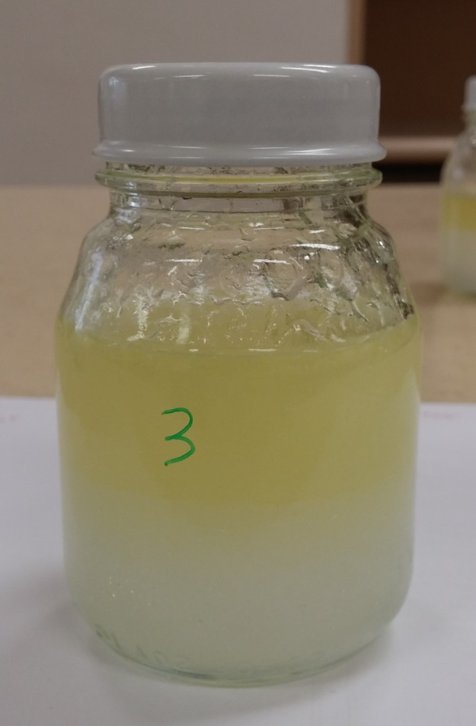
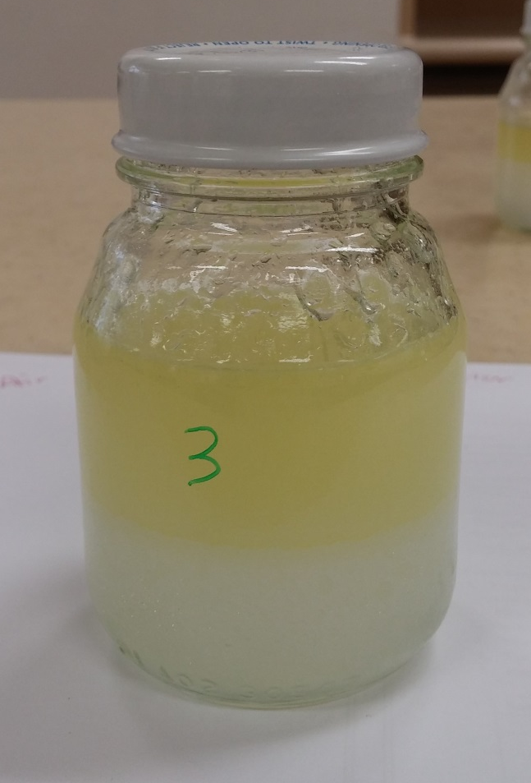
Sample 3:
Vigorous shaking of 50ml vinegar and 50ml oil for 30seconds
Before shaking
Immediately after shaking
1min after shaking

Slide 8
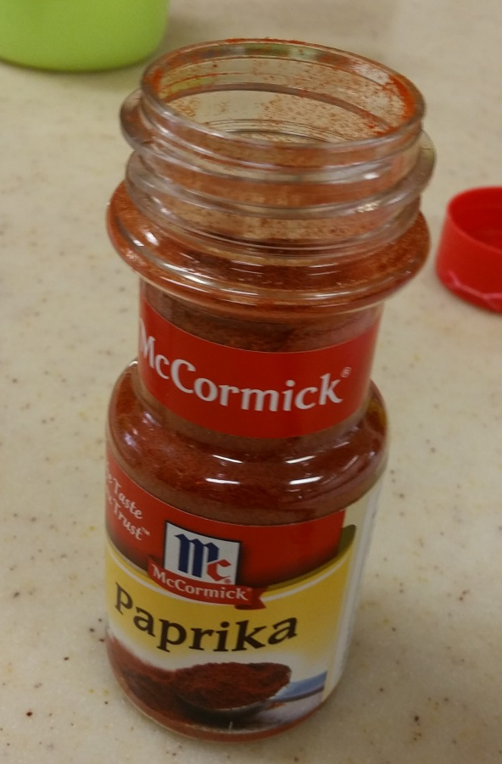
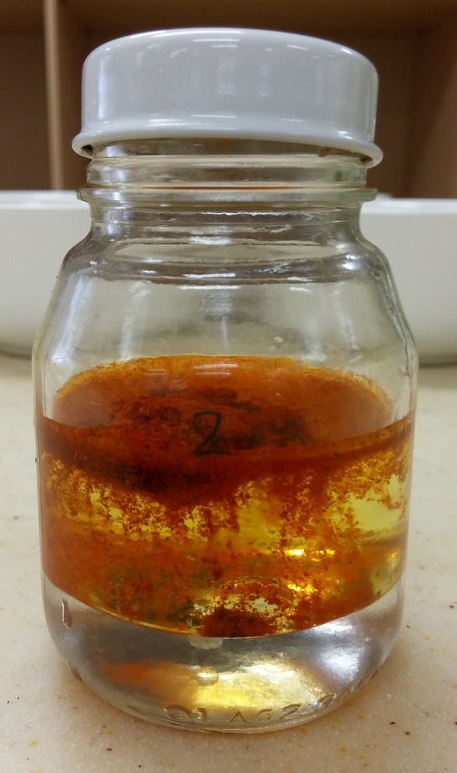

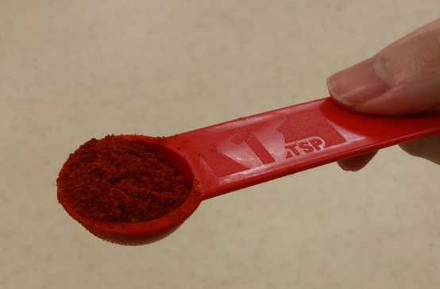
Sample 4:
Add 1tsp of paprika to 25ml vinegar and 50ml oil
Paprika added to oil-vinegar mixture
1 tsp of paprika

Slide 9
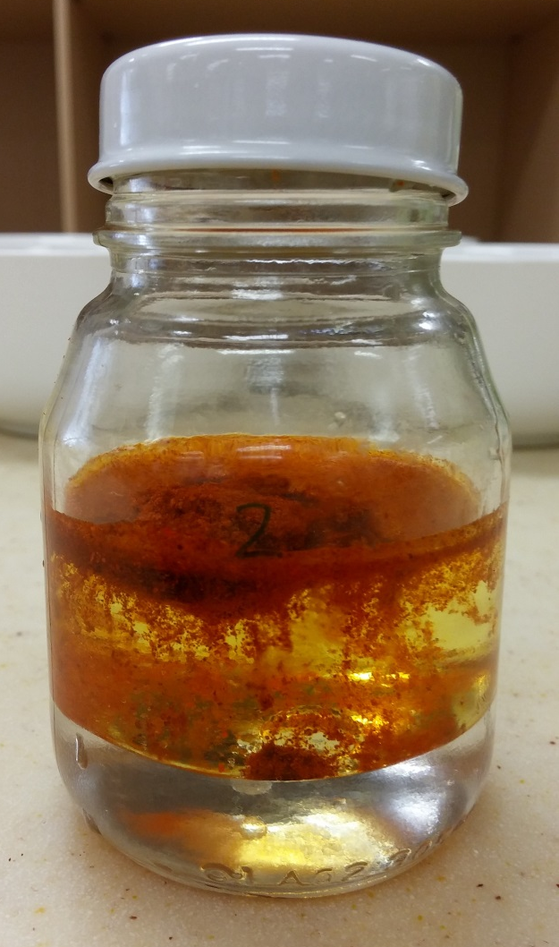
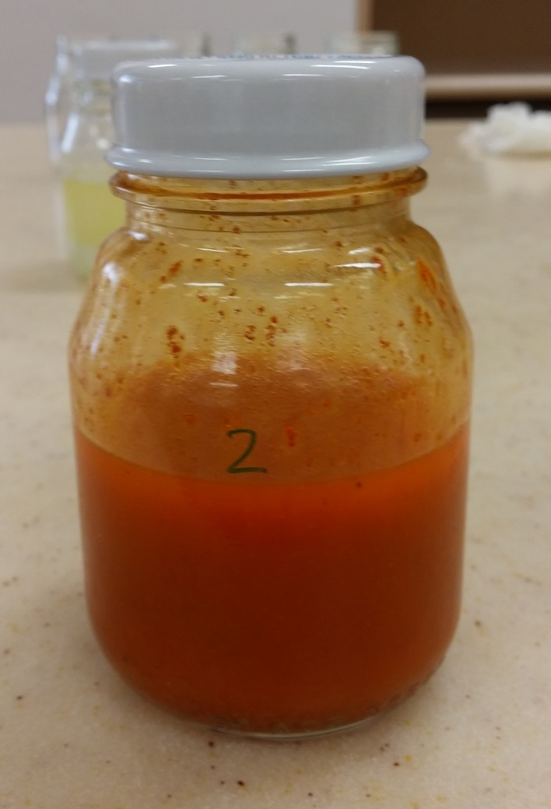
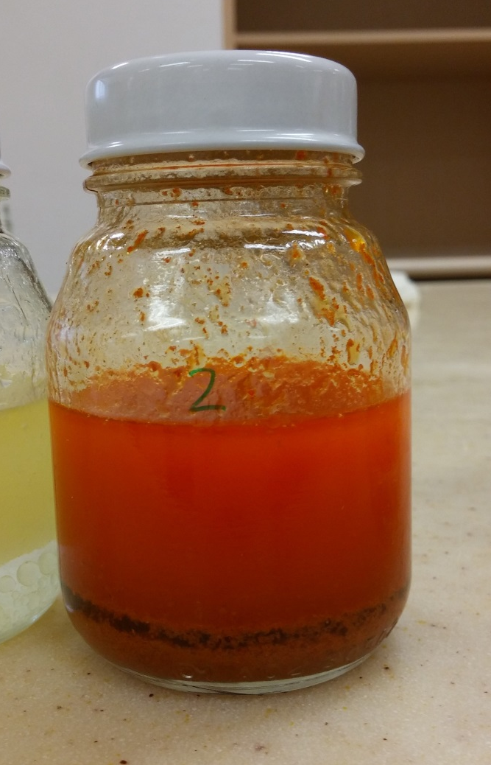
Sample 4:
2. Vigorous shaking for 30seconds
Before shaking
Immediately after shaking
1min after shaking

Slide 10
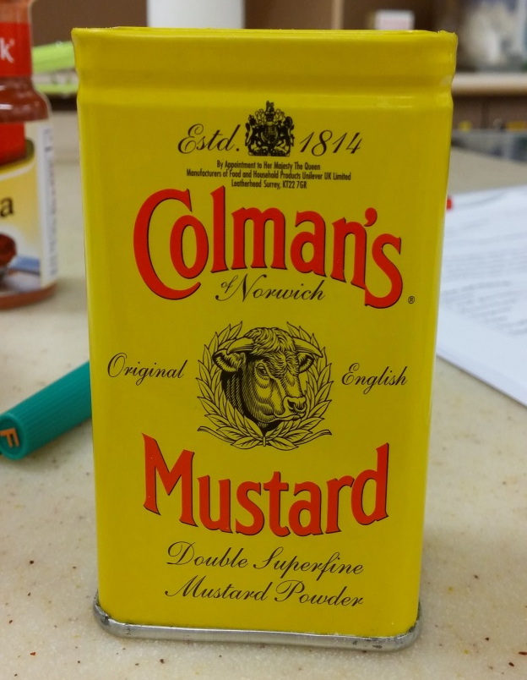
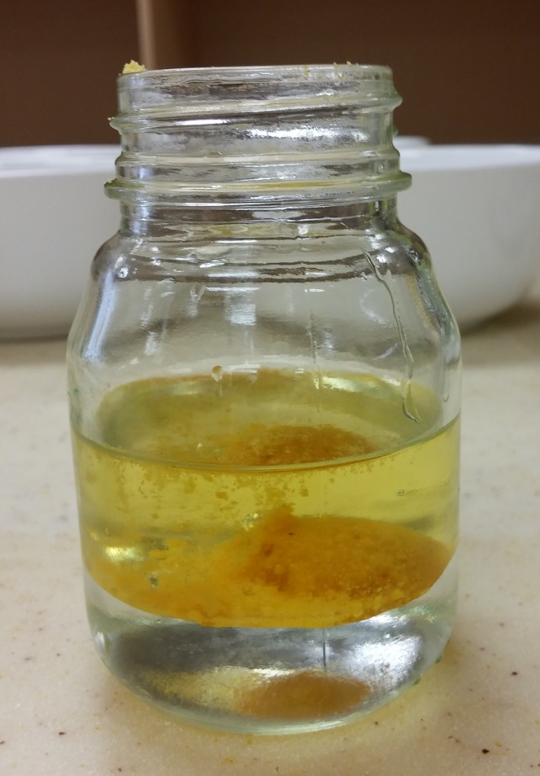
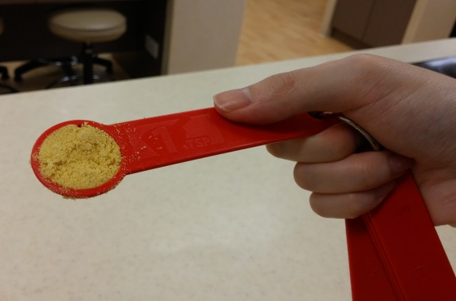
Sample 5:
Add 1tsp of dry mustard to 25ml vinegar and 50ml oil
Dry mustard added to oil-vinegar mixture
1 tsp of dry mustard

Slide 11
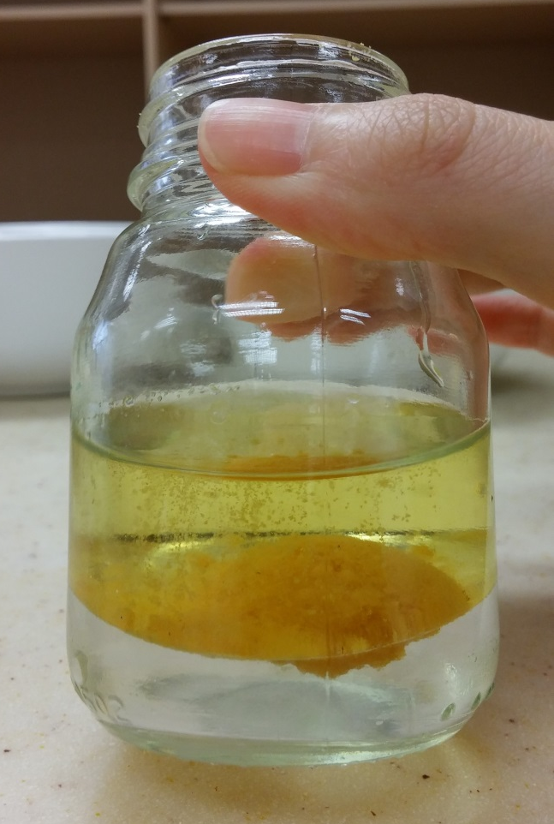
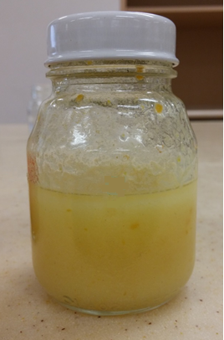
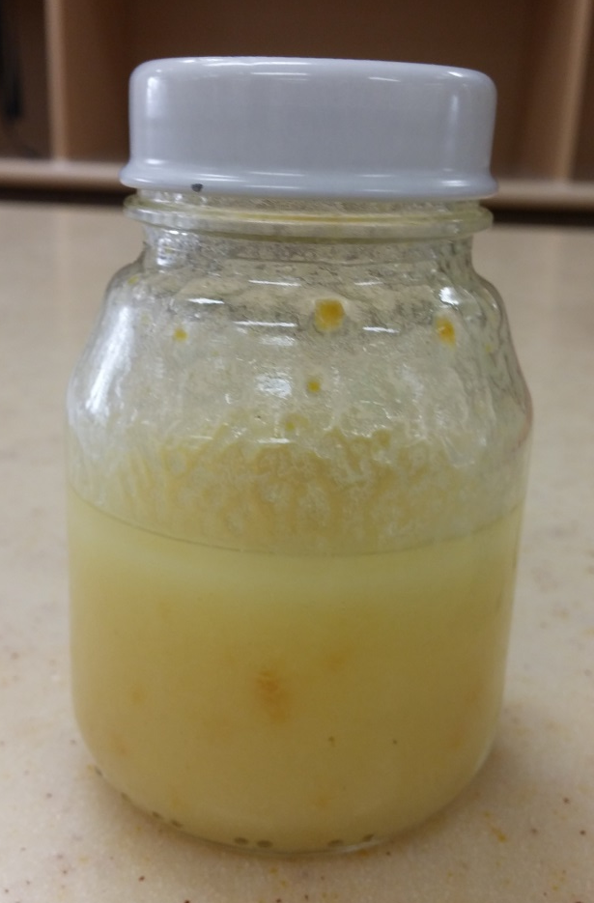
Sample 5:
2. Vigorous shaking for 30seconds
Before shaking
Immediately after shaking
1min after shaking

Slide 12
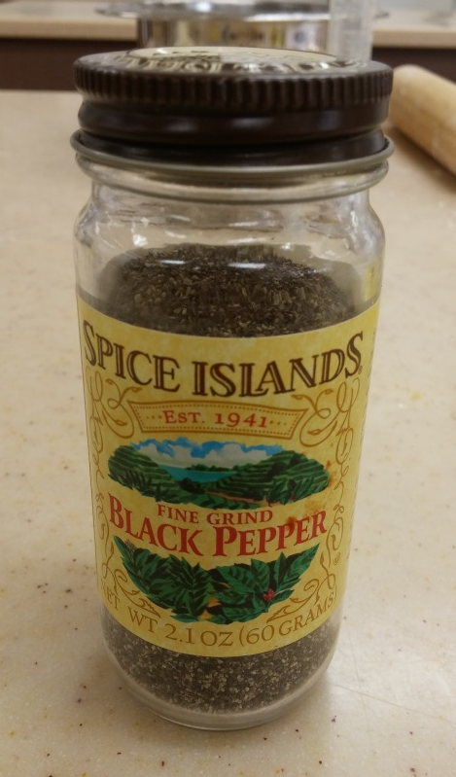
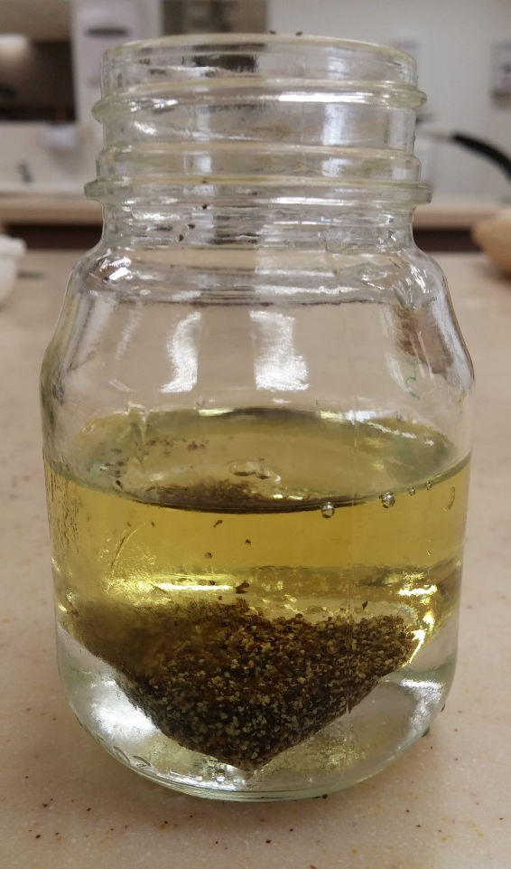
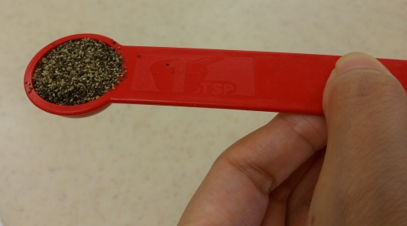
Sample 6:
Add 1tsp of pepper to 25ml vinegar and 50ml oil
Pepper added to oil-vinegar mixture
1 tsp of pepper

Slide 13
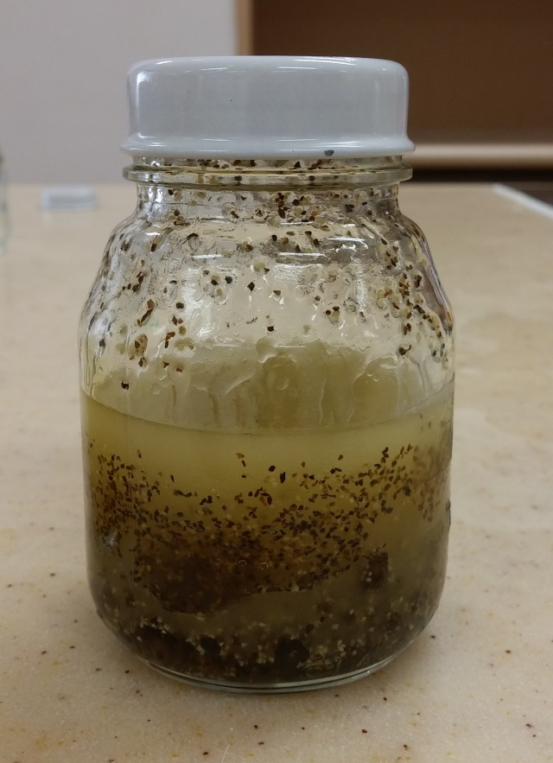
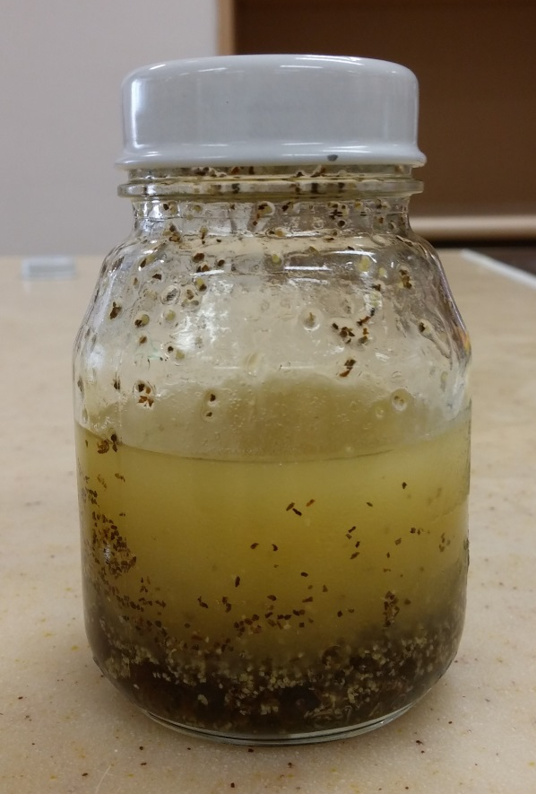
Sample 6:
2. Vigorous shaking for 30seconds
Before shaking
Immediately after shaking
1min after shaking

Slide 14
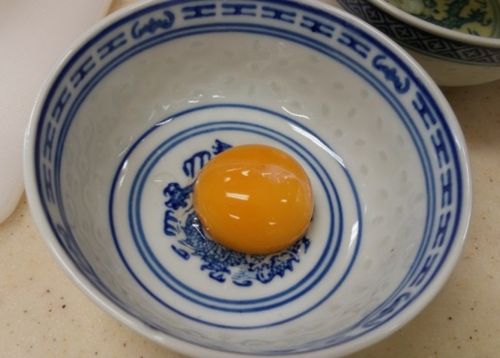
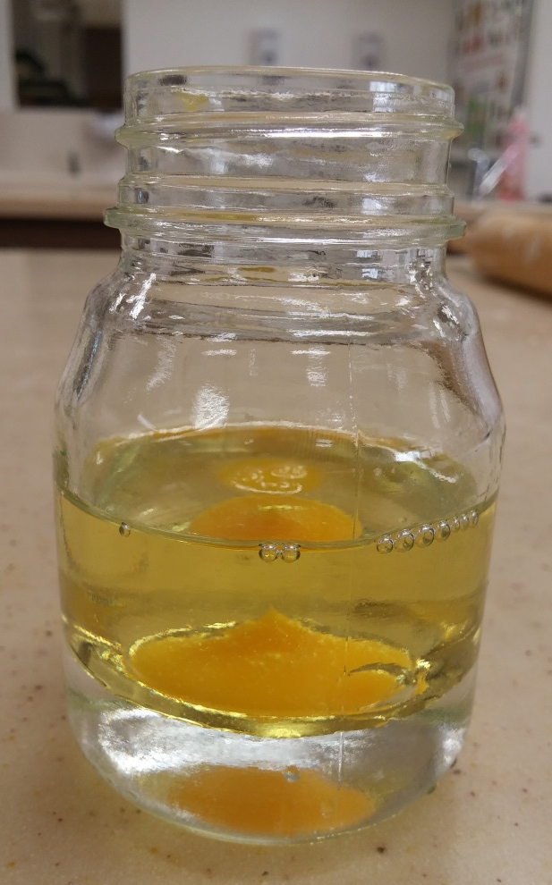

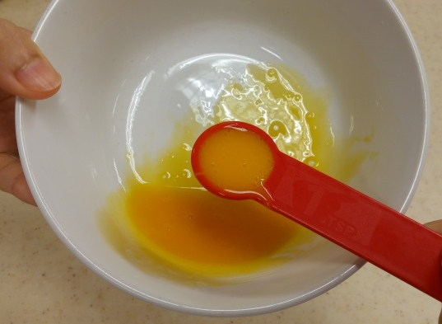
Sample 7:
Add 1tsp of egg yolk to 25ml vinegar and 50ml oil
Egg yolk added to oil-vinegar mixture
1 tsp of beaten egg yolk

Slide 15

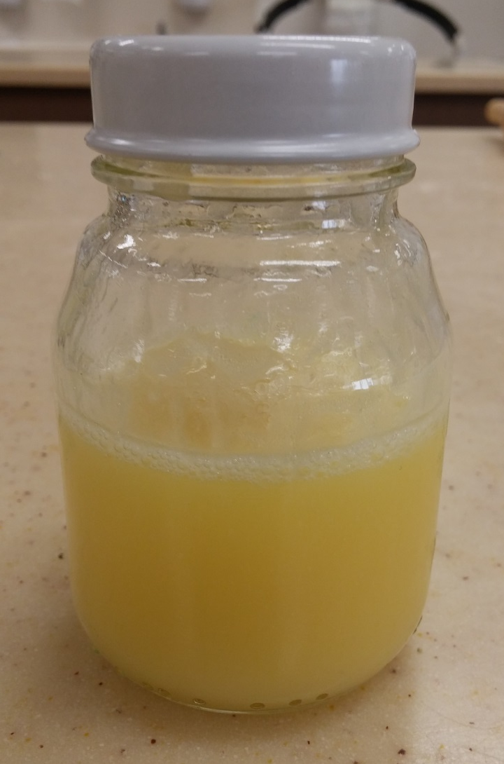
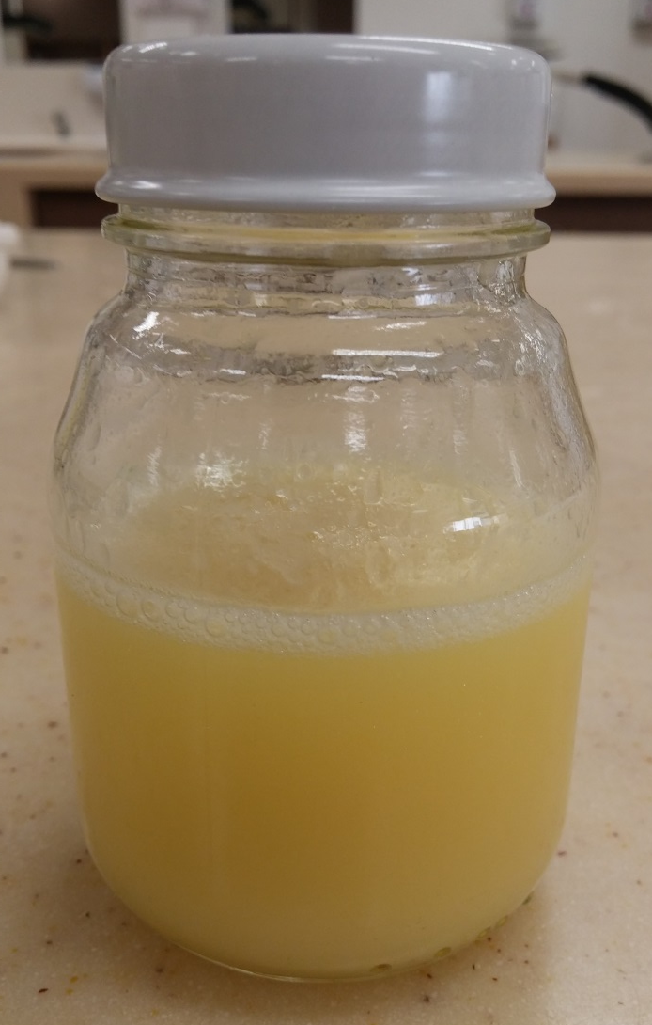
Sample 7:
2. Vigorous shaking for 30seconds
Before shaking
Immediately after shaking
1min after shaking

Slide 16
Conclusions

Slide 17




Vinegar-oil ratio
Sample 1 VS 2 VS 3
25ml vinegar and 50ml oil
50ml vinegar and 25ml oil
50ml vinegar and 50ml oil
Both Sample 2 and 3 separate into 2 layers immediately after vigorous shaking
25ml vinegar and 50ml oil produce the most stable emulsion

Slide 18
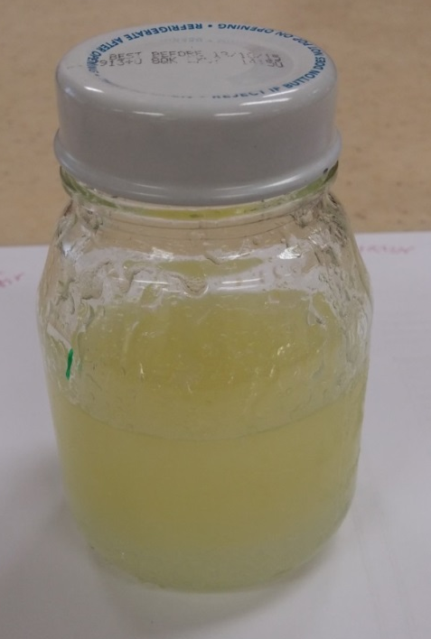




Emulsifiers
Sample 1 VS 4 VS 5 VS 6 VS 7
No emulsifier added
Sample 4:
Paprika
Sample 5:
Dry mustard
Sample 6:
Pepper
Sample 7:
Beaten egg yolk
One minute after vigorous shaking, only the vinegar-oil emulsions that are stabilised by egg yolk are not separated into 2 layers
Egg yolk is the most effective emulsifier to stabilise vinegar-oil emulsion

