Slide 1
Food test: Enzymatic browning

Slide 2
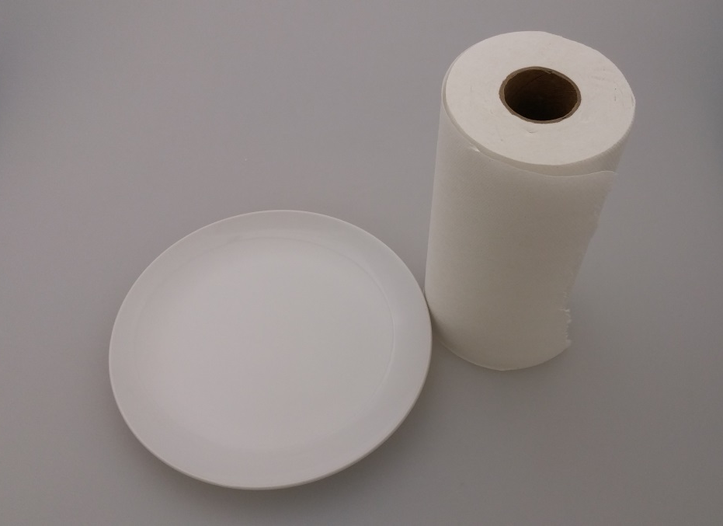
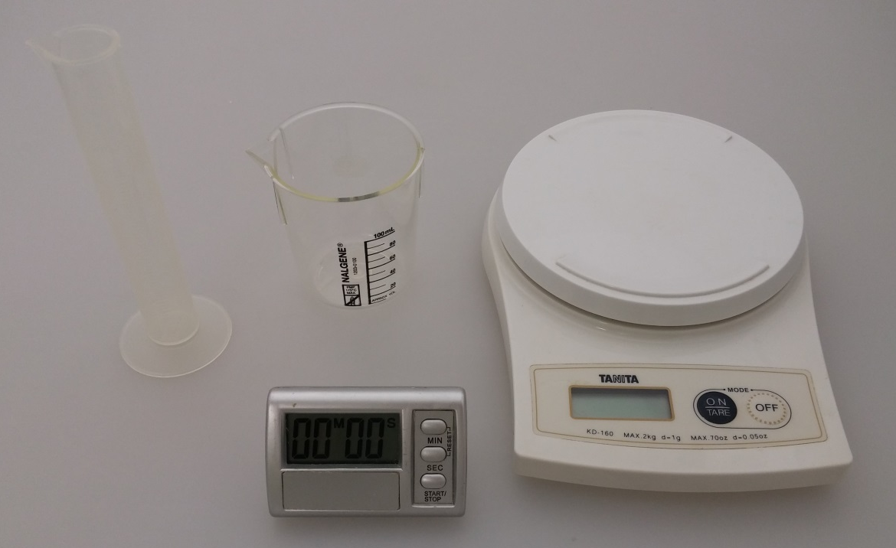
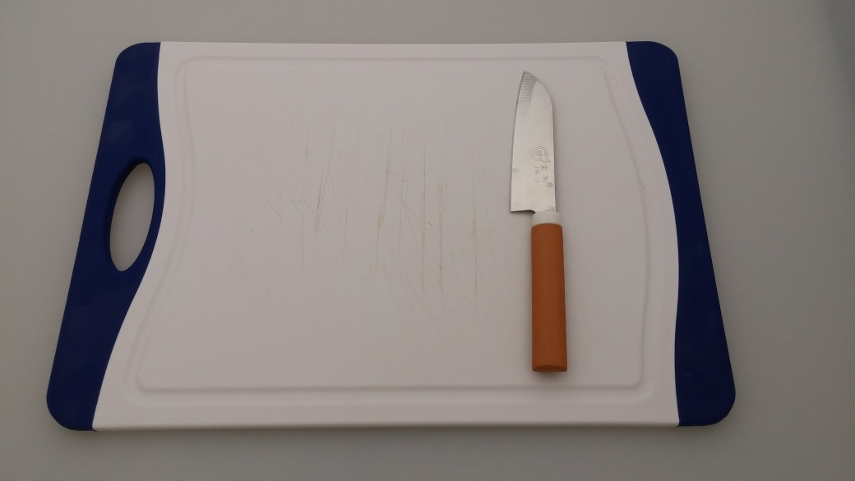
Equipment
Beakers
Plate
Paper towel
Measuring cylinder
Electronic weigh scale
Timer
Paring knife
Chopping board

Slide 3
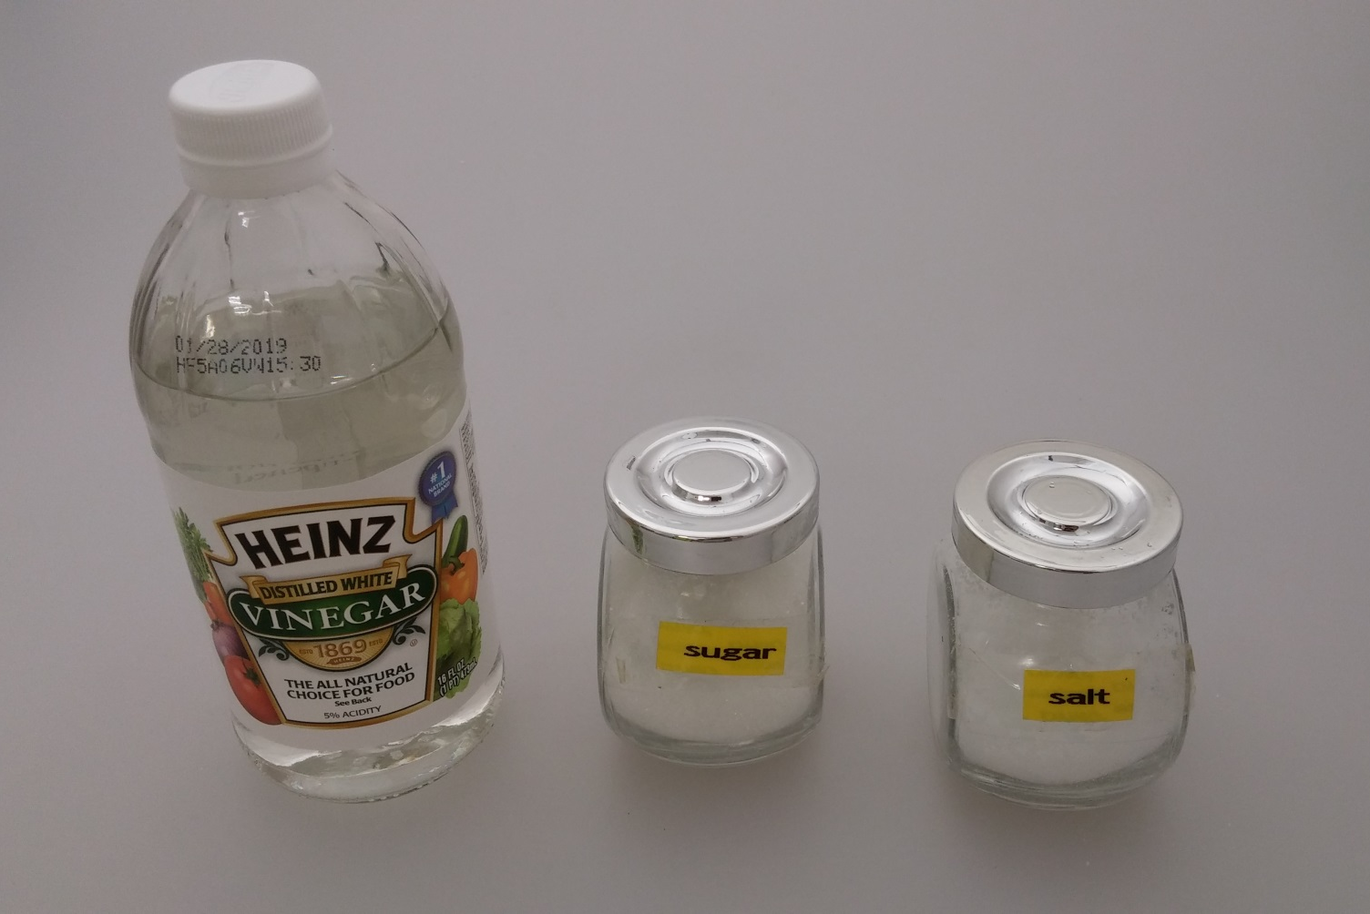
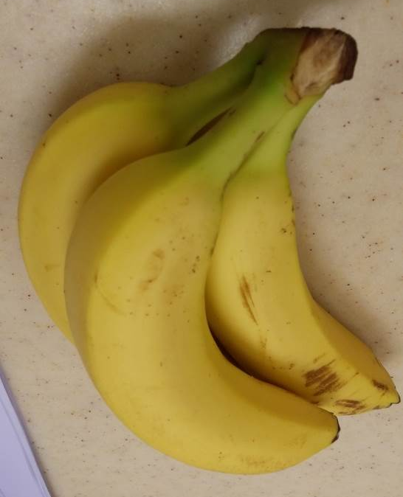
Materials
Lemon
Vinegar
Sugar
Salt
Banana

Slide 4
Procedures

Slide 5
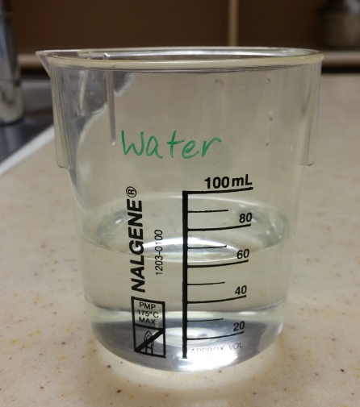
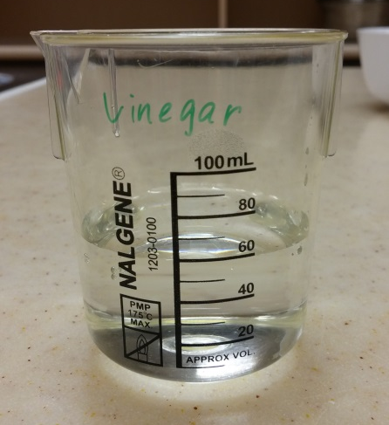
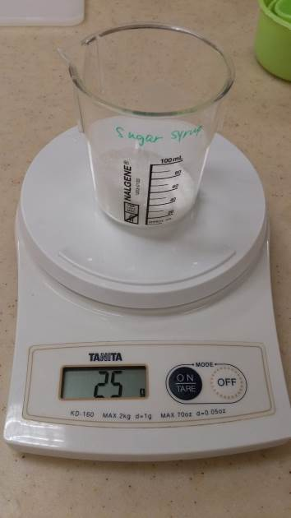
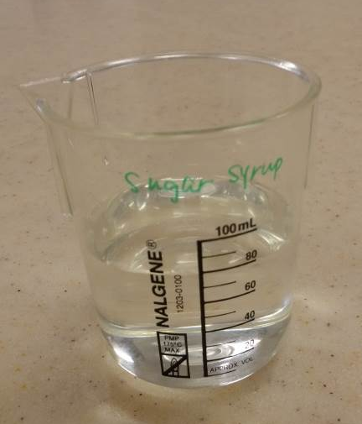
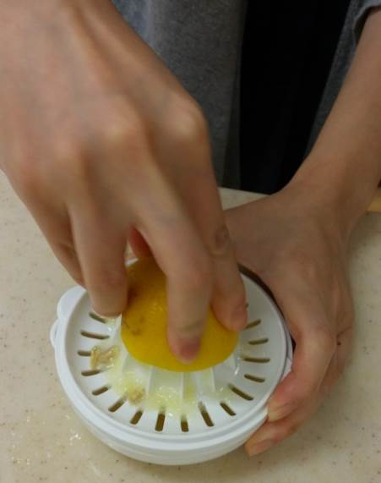
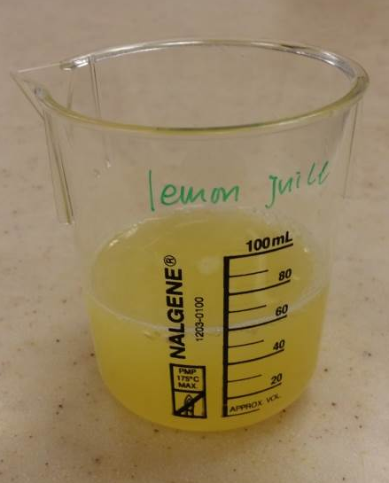
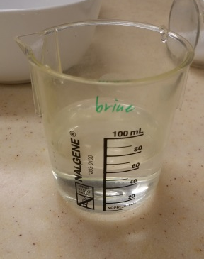
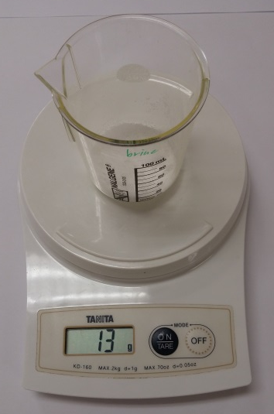
Prepare the solution
Dissolve 25g sugar in 60ml water
Sample 2:
60ml Water
Sample 4:
60ml Vinegar
Sample 5: 60ml Sugar syrup
Squeeze lemon to get lemon juice
Dissolve 13g salt in 60ml water
Sample 3: 60ml Lemon juice
Sample 6: 60ml Brine

Slide 6
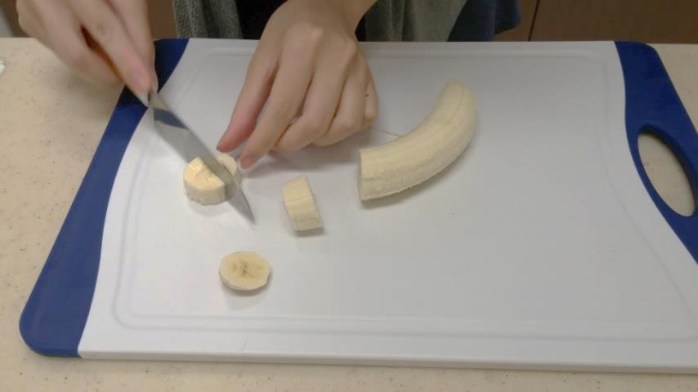
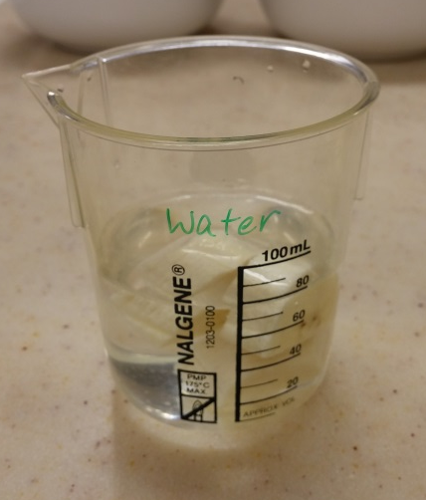
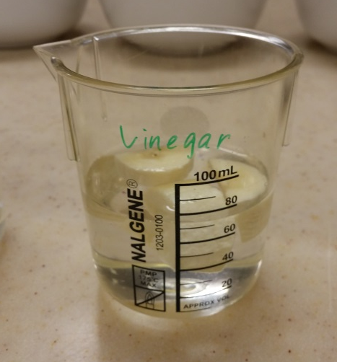
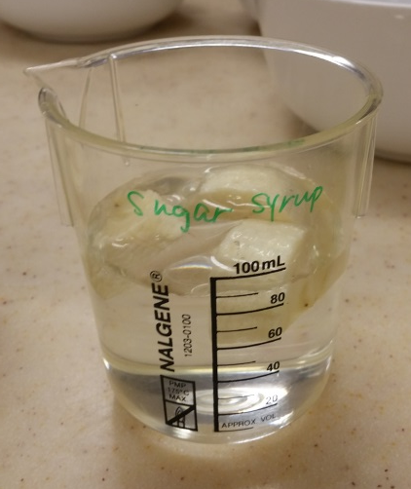
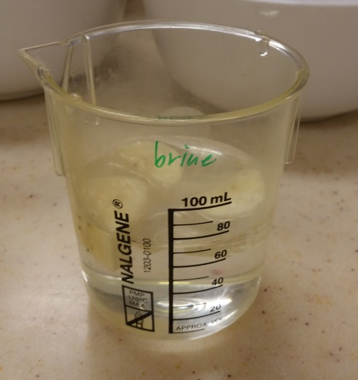
Procedures
Prepare the fruit samples
Cut banana into 12 pieces of equal size
Immerse the fruit slices into each sample so they are completely covered

Slide 7
Results

Slide 8
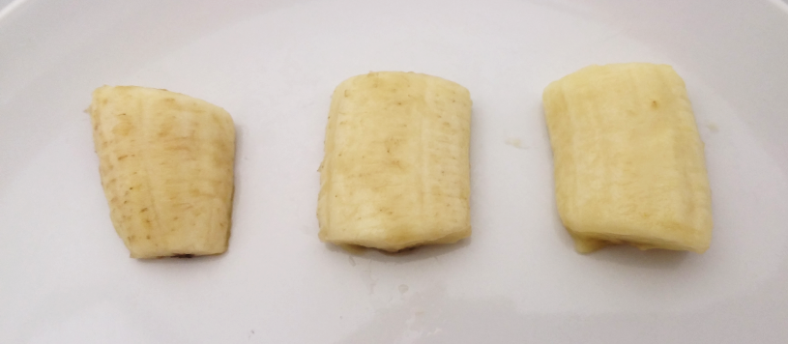
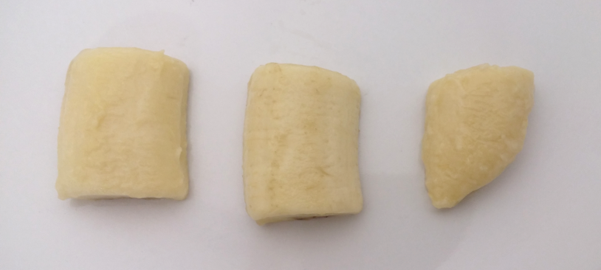
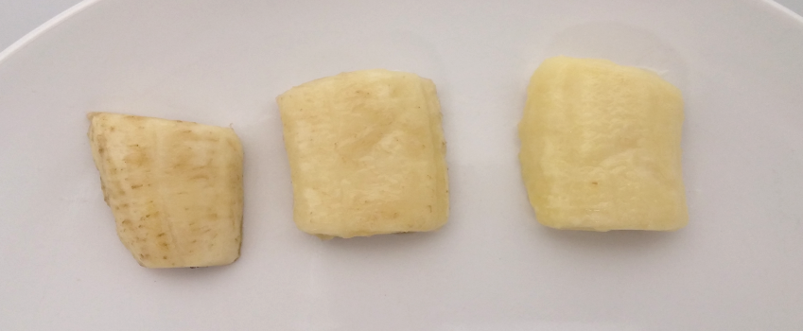
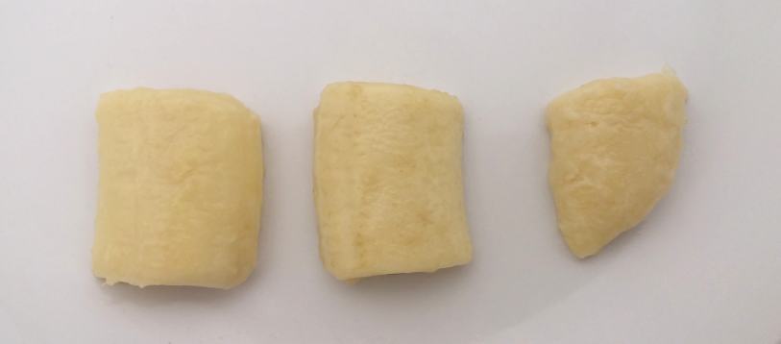
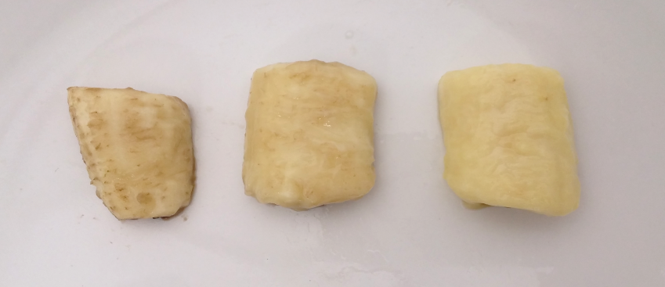
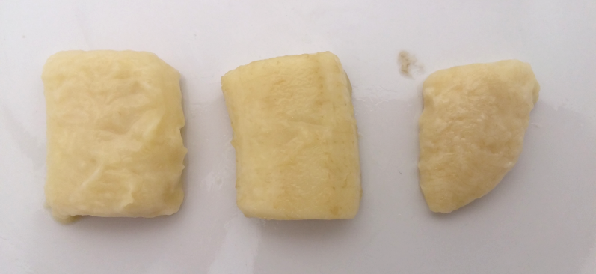
Sample | 1 | 2 | 3 | 4 | 5 | 6
Treatment | Nil | Water | Lemon juice | Vinegar | Sugar syrup | Brine
5 minutes
1
2
3
4
5
6
20 minutes
1
2
3
5
6
4
60 minutes
1
2
3
4
5
6

Slide 9
Cut fruit/ vegetables
Enzymatic browning
Enzymes
Oxygen
Browning takes place when the enzymes (polyphenol oxidase) in plant (cut fruits/vegetables) are exposed to oxygen in the air

Slide 10
Water
Immerse the cuts in water limits the enzyme ‘s access to oxygen and slows the browning reaction temporally
Brine
Chloride ions in salt inhibits the enzyme so that brine will retard enzymatic browning but at the cost of flavour
Lemon juice
The enzyme works very slowly in highly acidic conditions. Ascorbic acid in lemon juice inhibits enzymatic browning

