Slide 1
Food test:
Stability of foams-
Effect of added ingredients

Slide 2
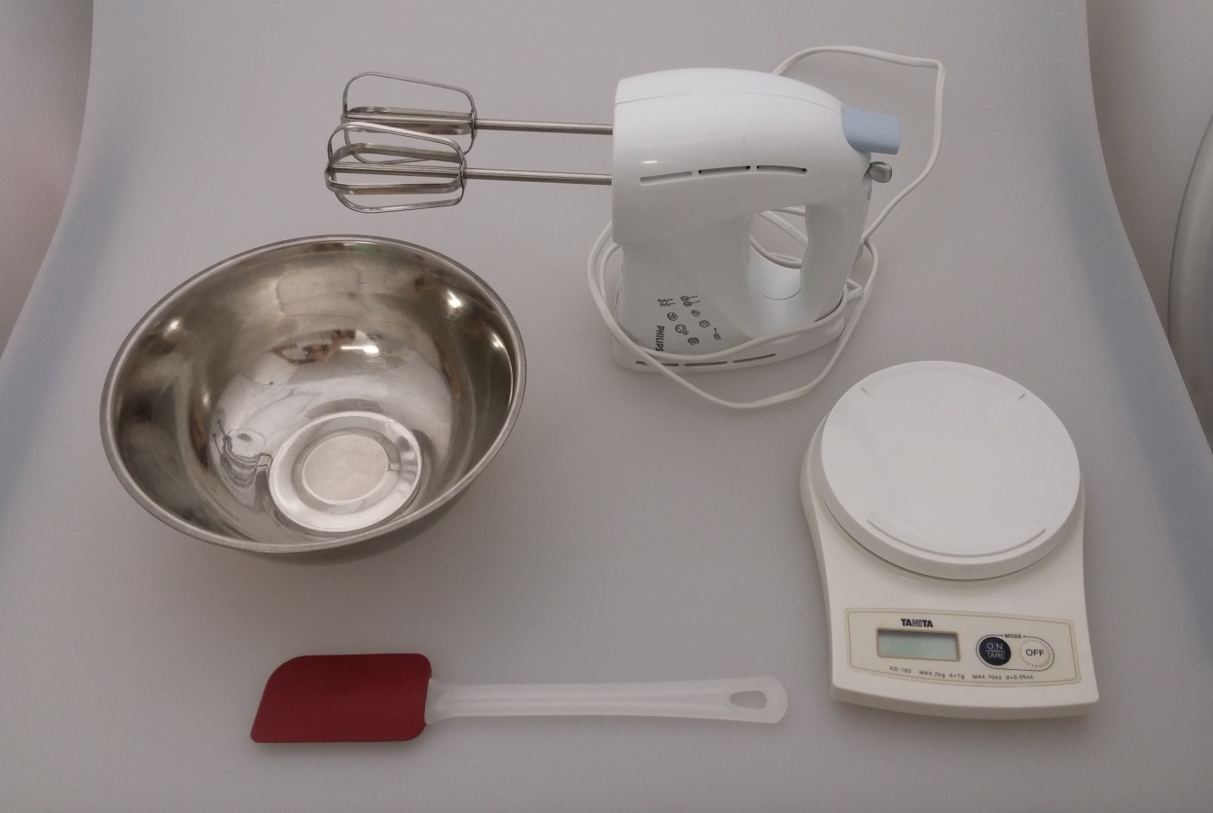
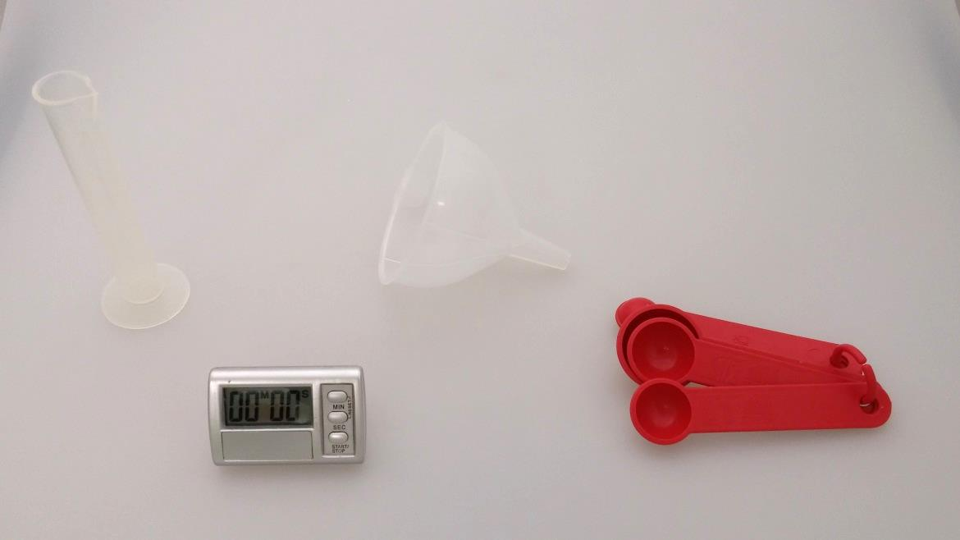
Equipment
Portable electric mixer
Weighing scale
Mixing bowl
Rubber scraper
Funnels
Measuring cylinder
Timer
Measuring spoons

Slide 3
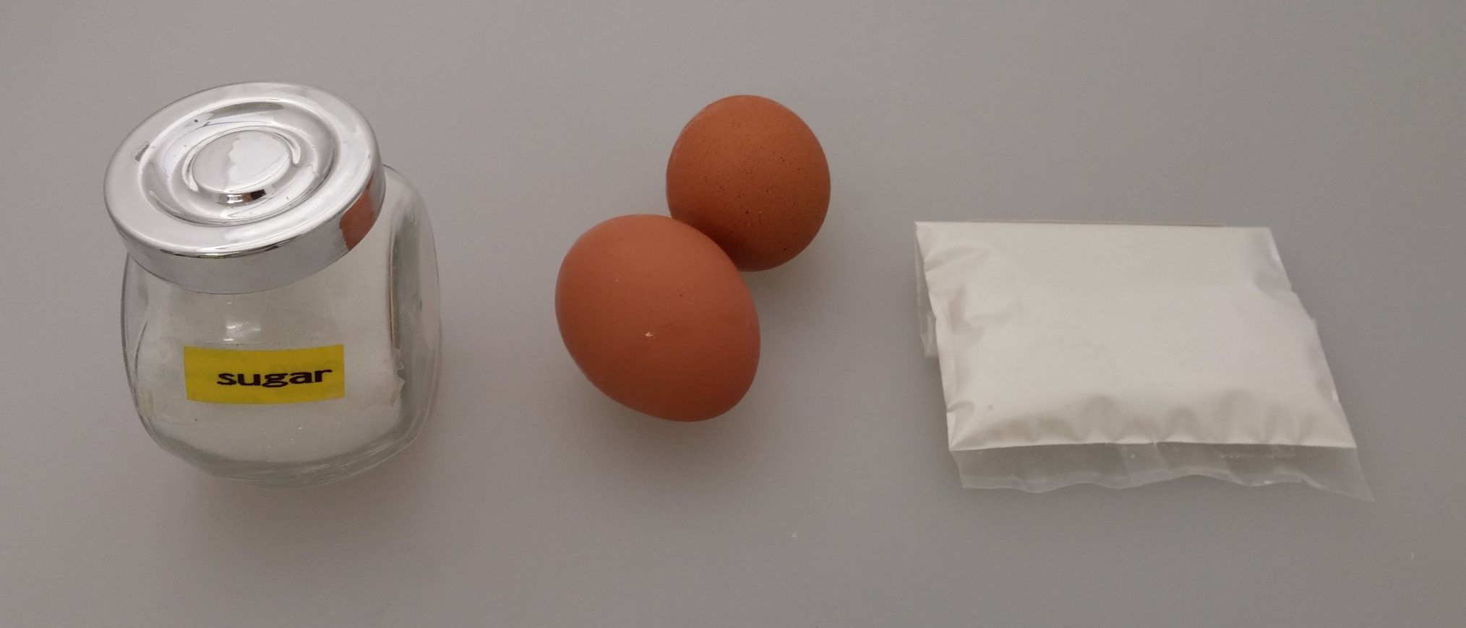
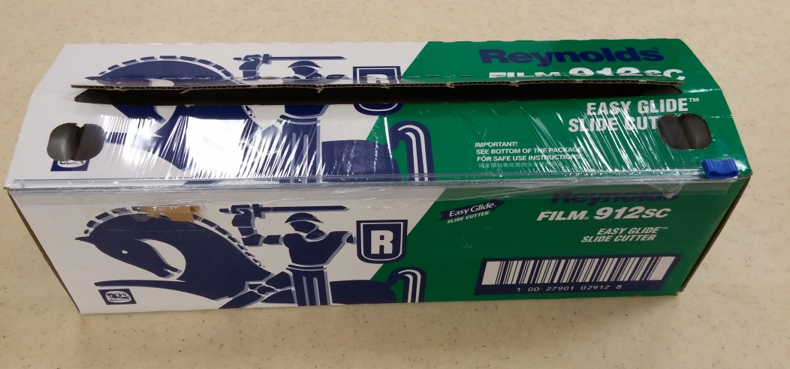
Materials
Sugar
Eggs
Cream of tartar
Plastic wrap

Slide 4
Procedures

Slide 5
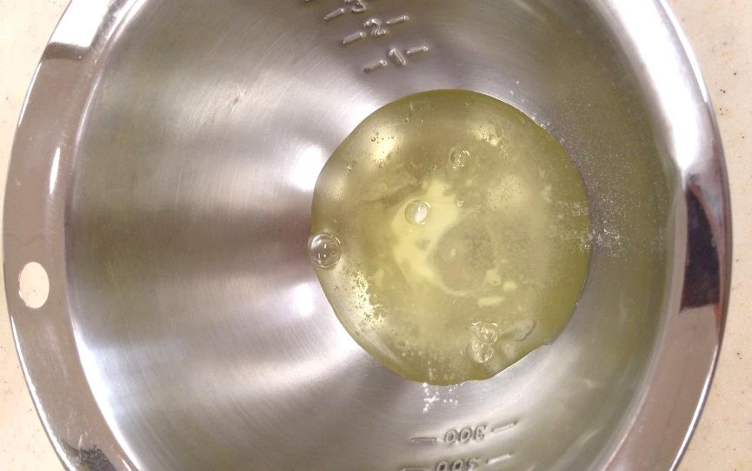
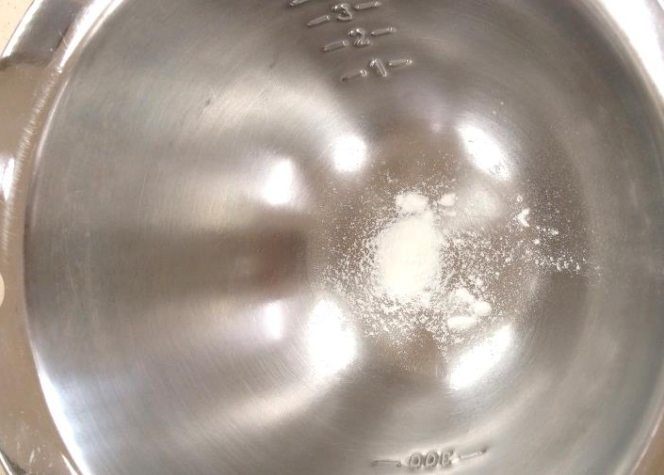
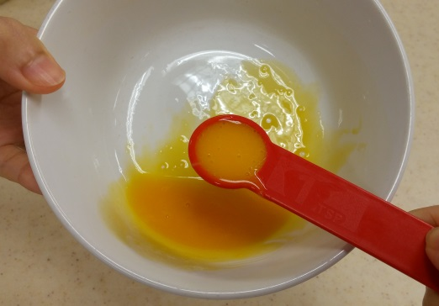
Prepare the samples…
Sample | Ingredients
 | Egg white | Cream of tartar | Sugar (add after beating for 1 minute) | Egg yolk
1 |  | ❒ | ❒ | ❒
2 |  | ❒ |  | ❒
3 |  |  | ❒ | ❒
4 |  |  |  | 
5 |  |  |  | ❒
Egg white
Cream of tartar
Sugar
Egg yolk

Slide 6
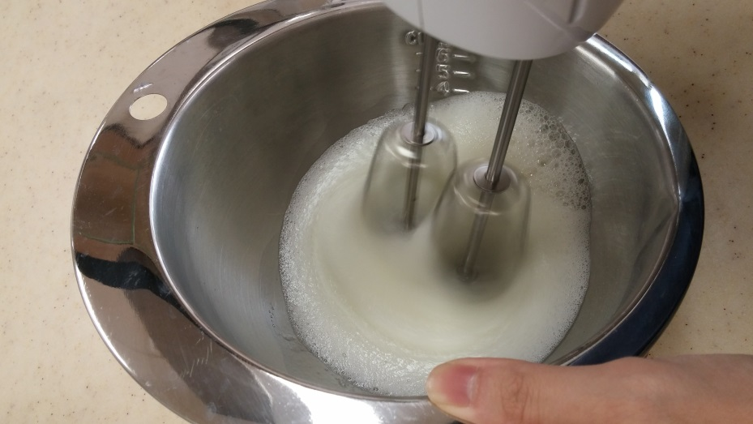
Use the electric mixer to beat the egg white samples

Slide 7
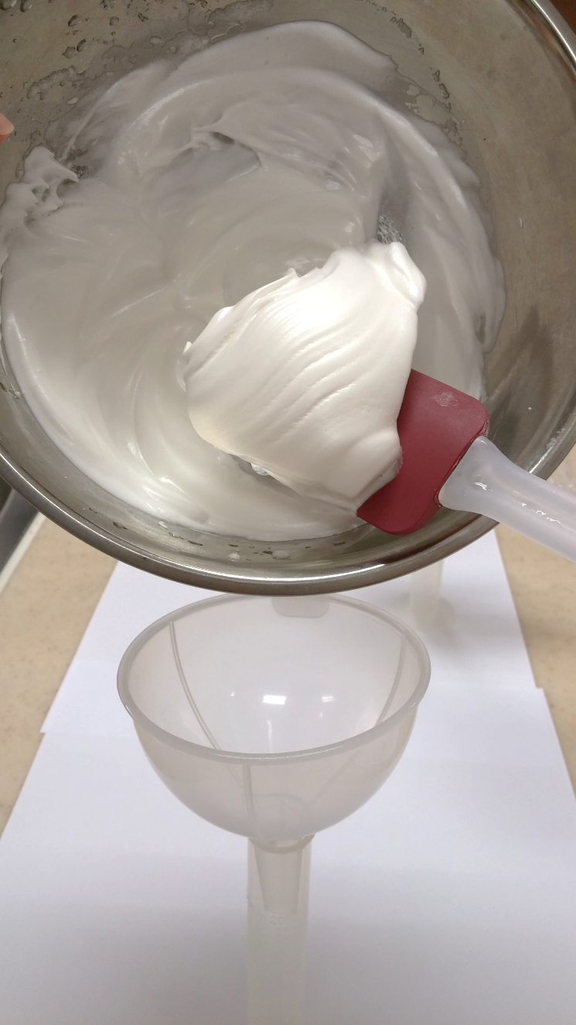
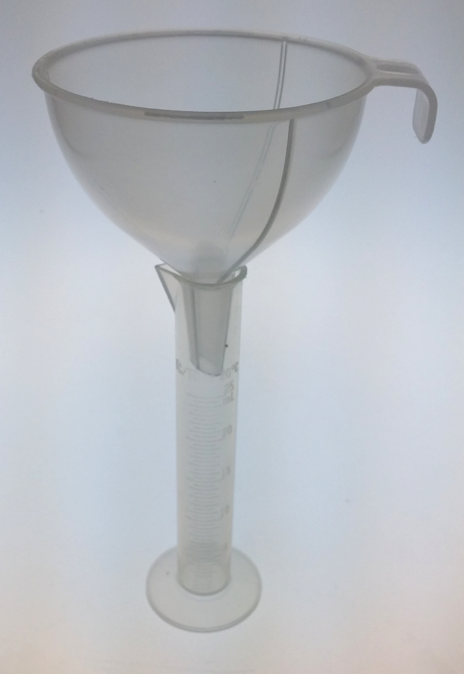
Place a funnel on top of a measuring cylinder
Use a rubber scraper to put the foam into the funnel

Slide 8
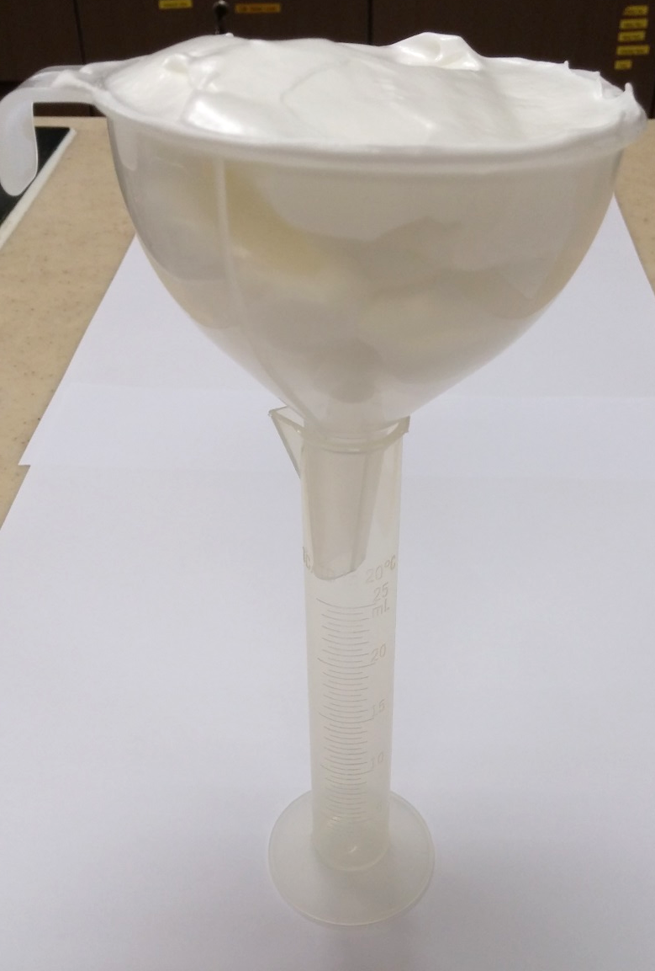
Level the foam and cover the top of the funnel with plastic wrap

Slide 9
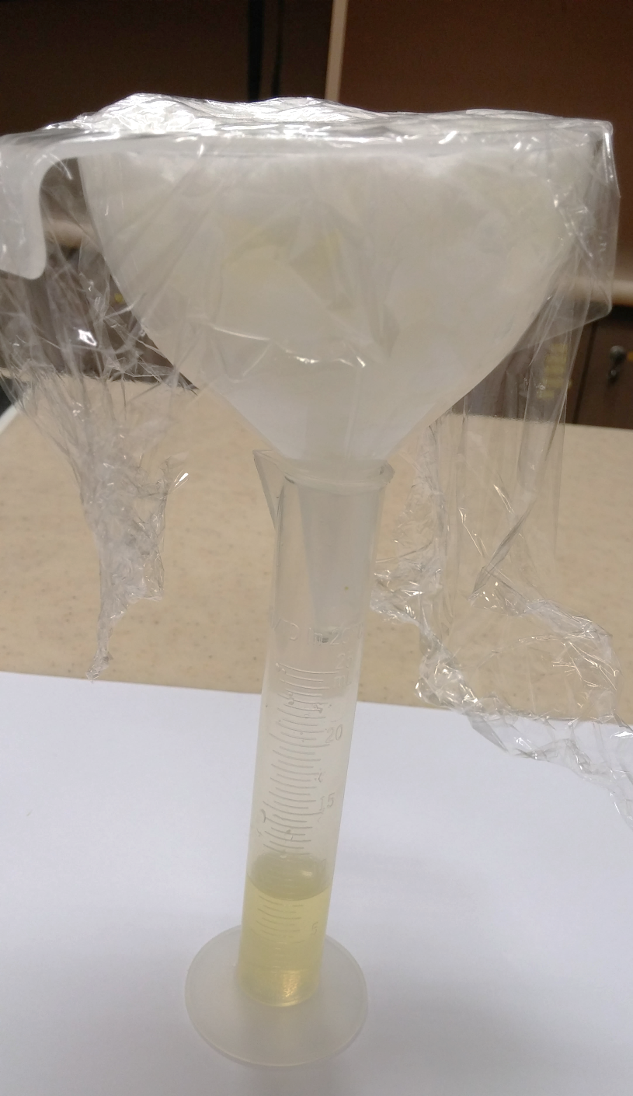
Record the volume of any leakage found in the measuring cylinder after 20 minutes

Slide 10
Results

Slide 11
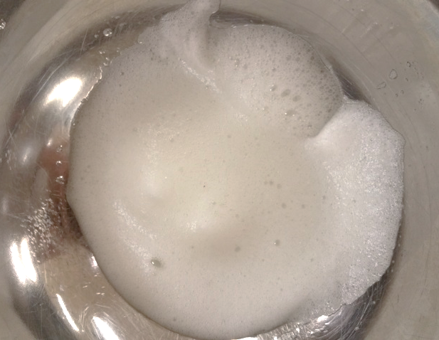
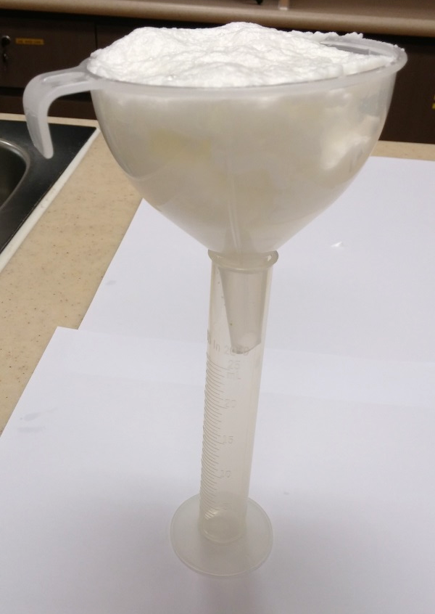
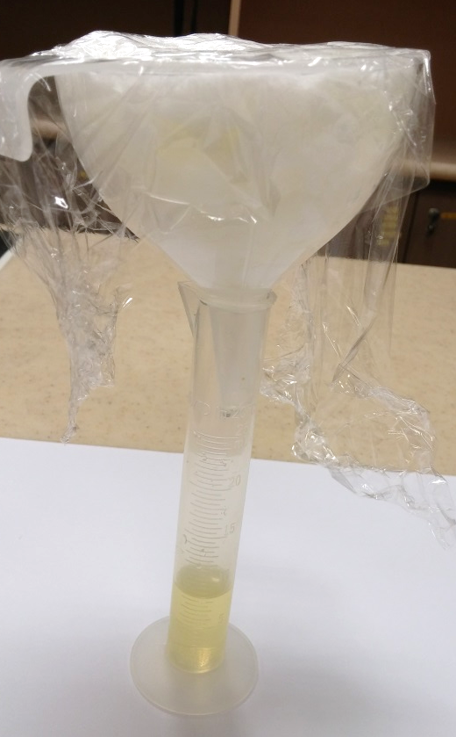
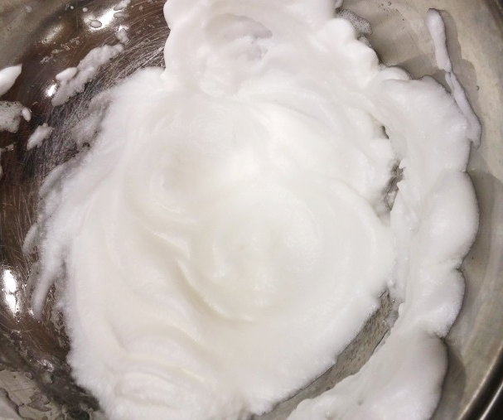
Sample 1:
egg white only
Beating for 1 minute
20mins
Beating for another 4 minutes

Slide 12
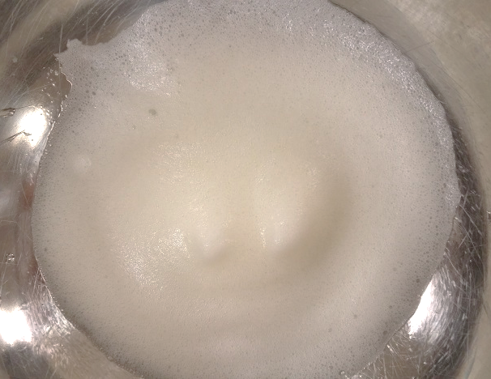
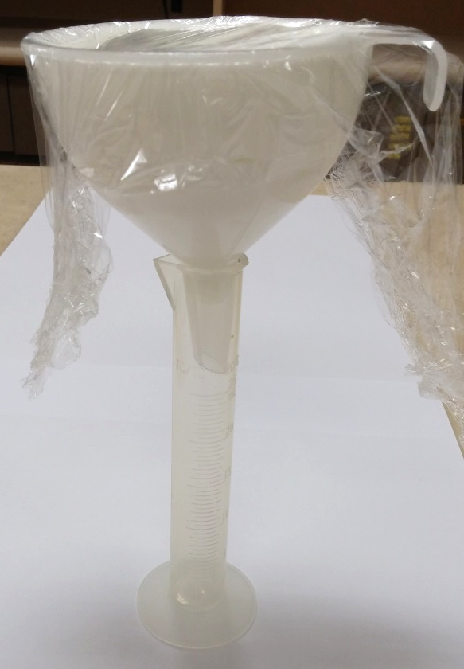
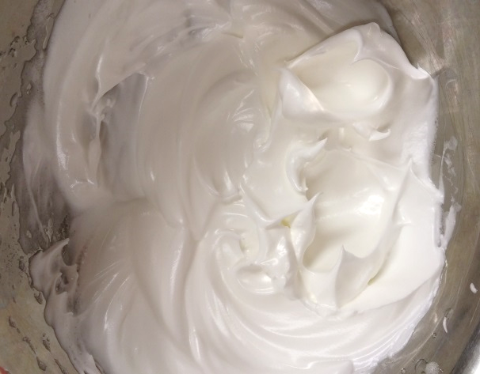
Sample 2:
egg white + sugar
Beating for 1 minute
20mins
Beating for another 4 minutes

Slide 13
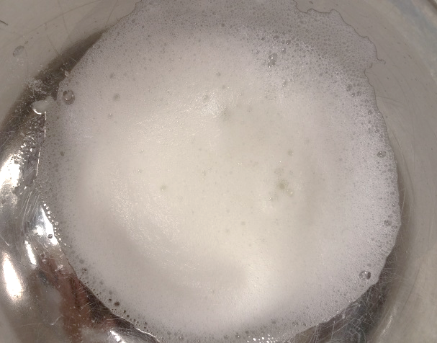
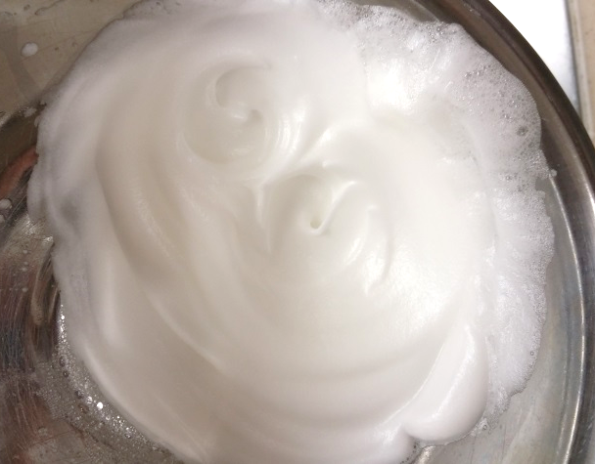
Sample 3:
egg white + cream of tartar
Beating for 1 minute
Beating for another 4 minutes
After standing for 20mins

Slide 14
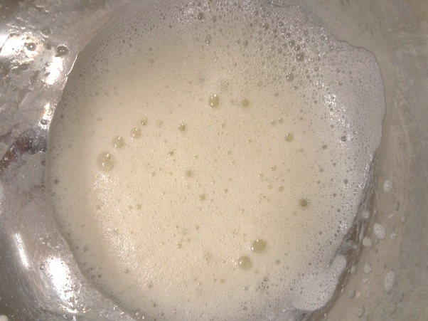
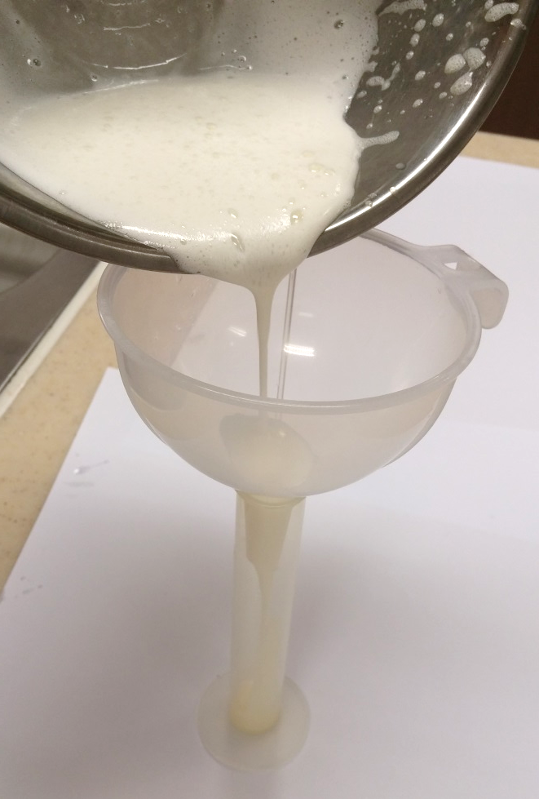
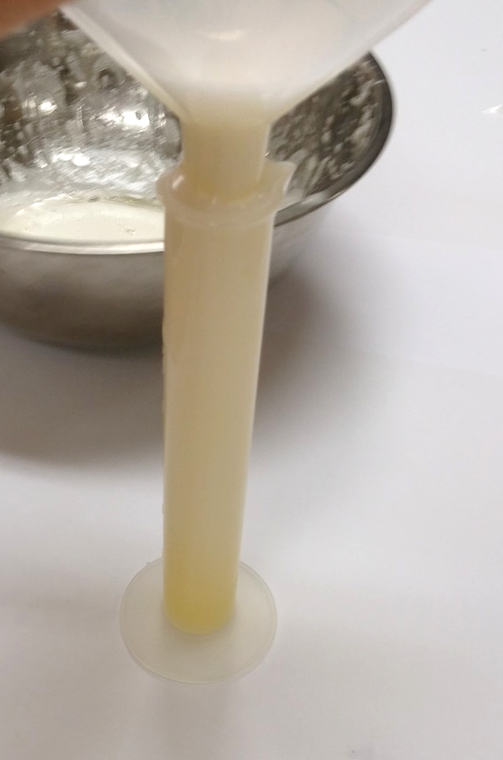
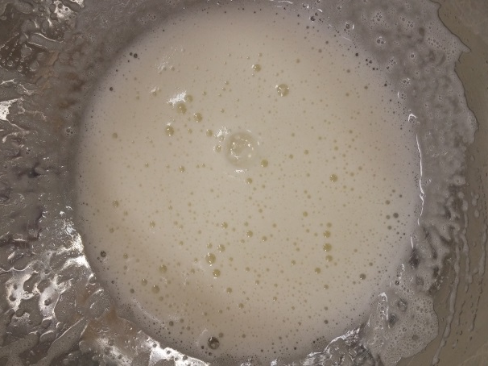
Sample 4:
egg white + cream of tartar+ sugar+ egg yolk
20mins
Beating for 1 minute
Beating for another 4 minutes

Slide 15
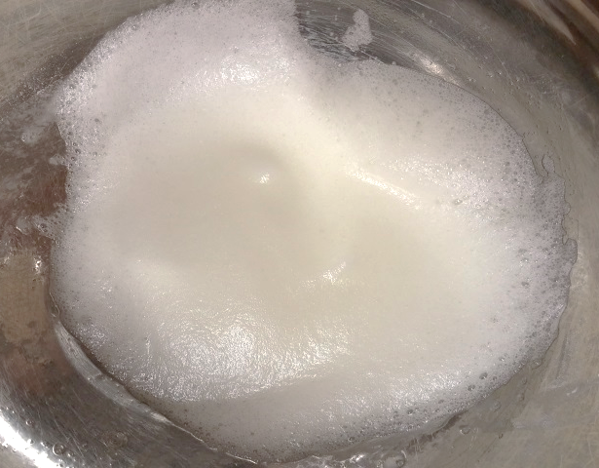
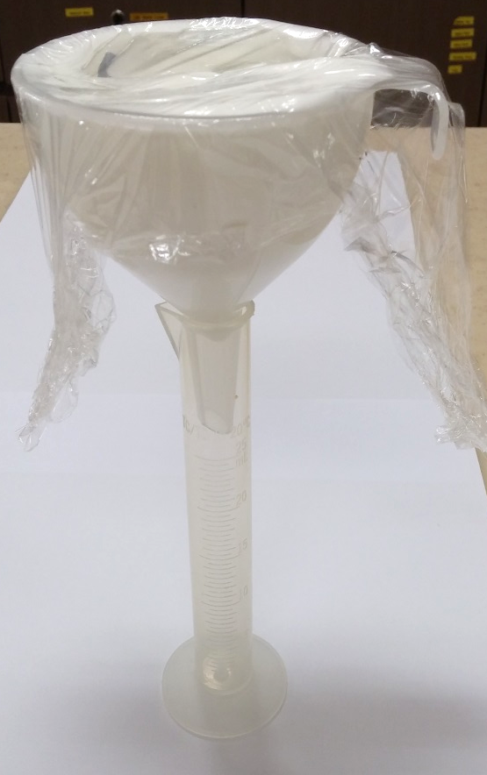
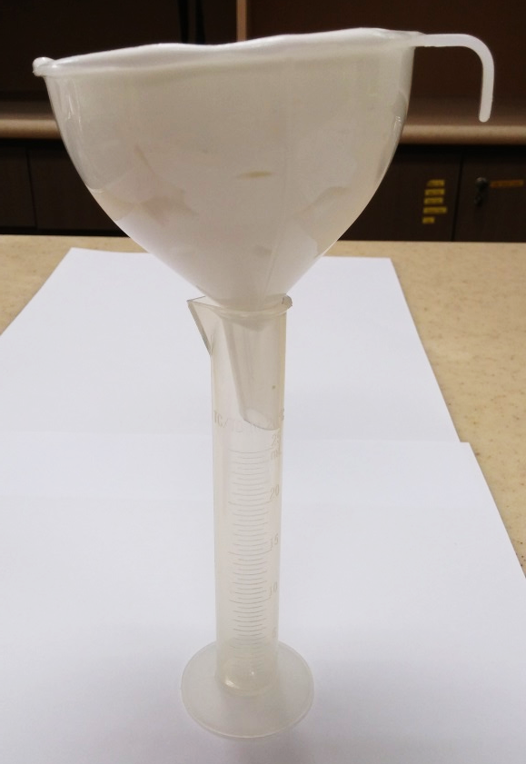
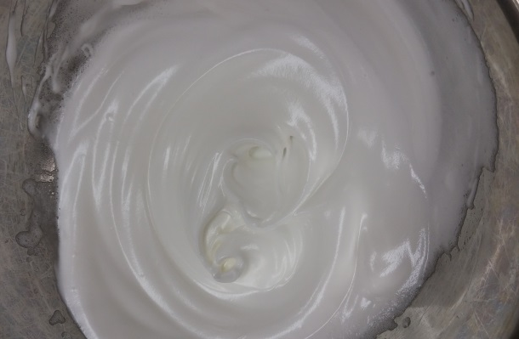
Sample 5:
egg white + cream of tartar + sugar
20mins
Beating for 1 minute
Beating for another 4 minutes

Slide 16
Summary

Slide 17
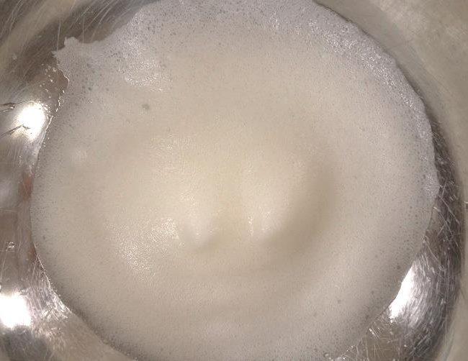
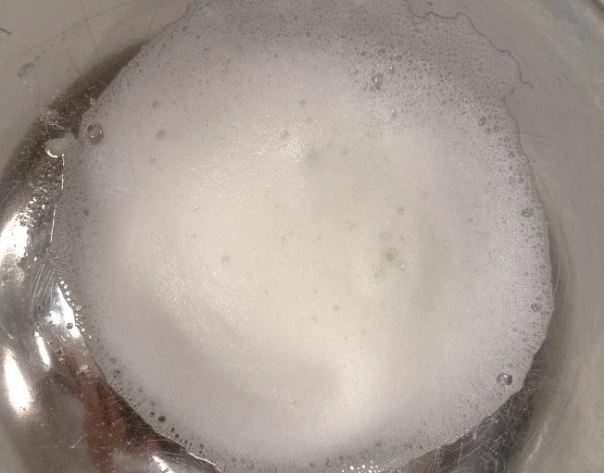
After beating for 1 min…
Sample 1
Sample 2
Sample 3
Sample 4
Sample 5

Slide 18
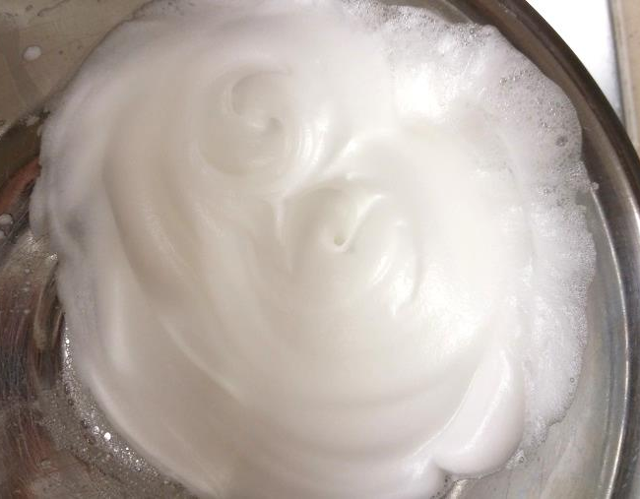
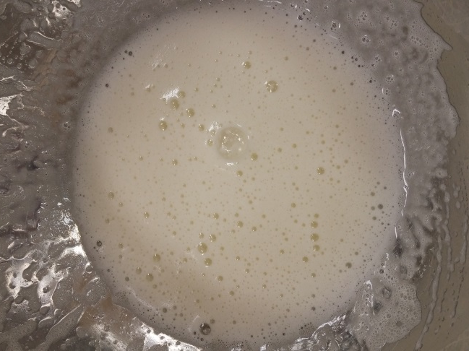
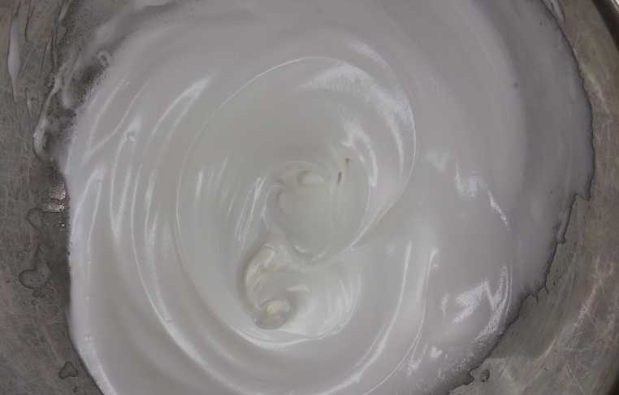
After beating for another 4mins…
Sample 1
Sample 2
Sample 3
Sample 4
Sample 5

Slide 19
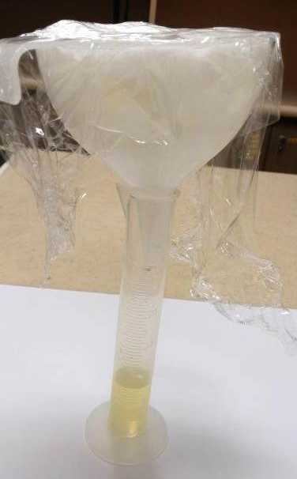
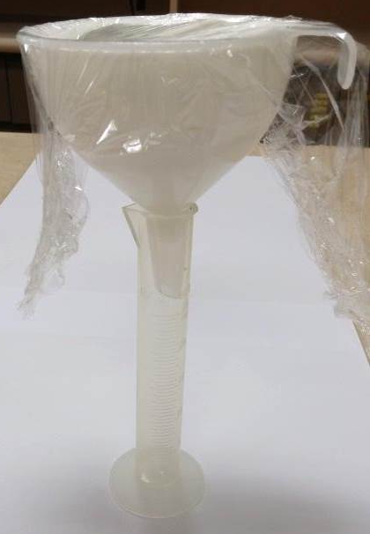
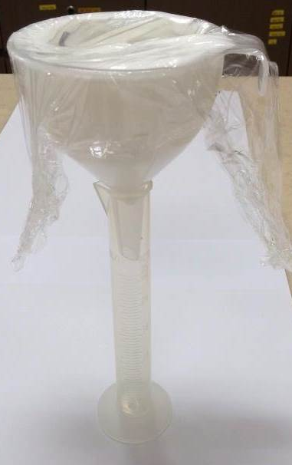
20mins after standing in funnel…
Sample 1
Sample 2
Sample 3
Sample 4
Sample 5
Egg foam cannot be formed in sample 4
No leakage in sample 2, 3 and 5
Significant leakage in sample 1

Slide 20
Why?
Egg foam cannot be formed in sample 4
Fat delays the formation of egg foams
The fat compounds in the yolk interfere with the alignment of protein around air cells
No leakage in sample 2, 3 and 5
Significant leakage in sample 1
Sugar and acidic ingredients, e.g. cream of tartar, are effective in stabilising egg foams

