Slide 1
Food test: Shortening power of fats

Slide 2
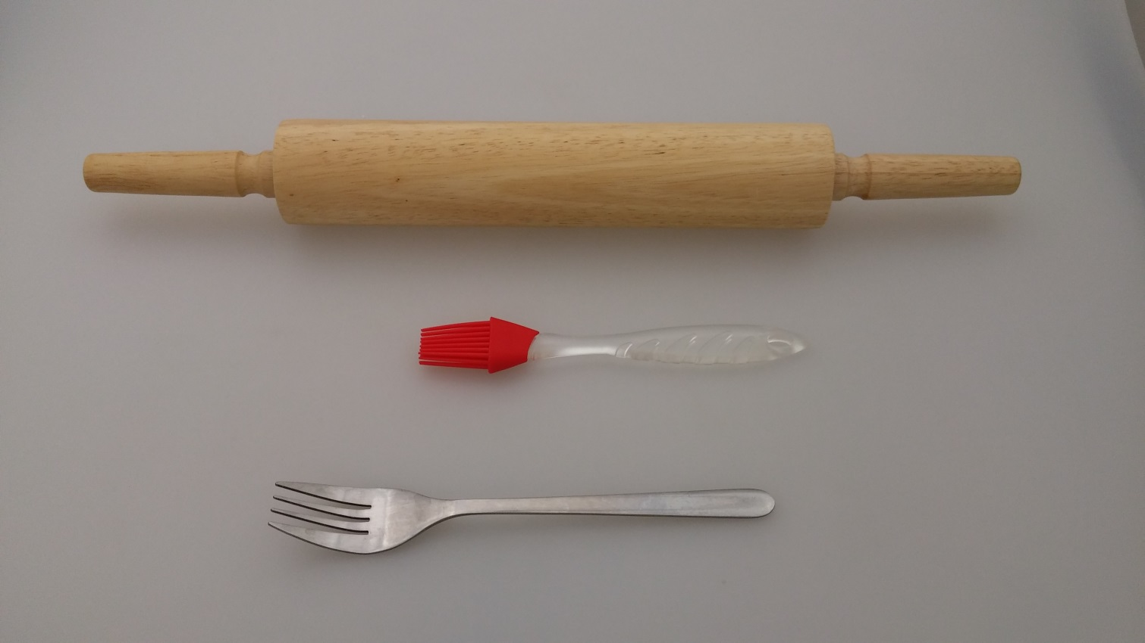
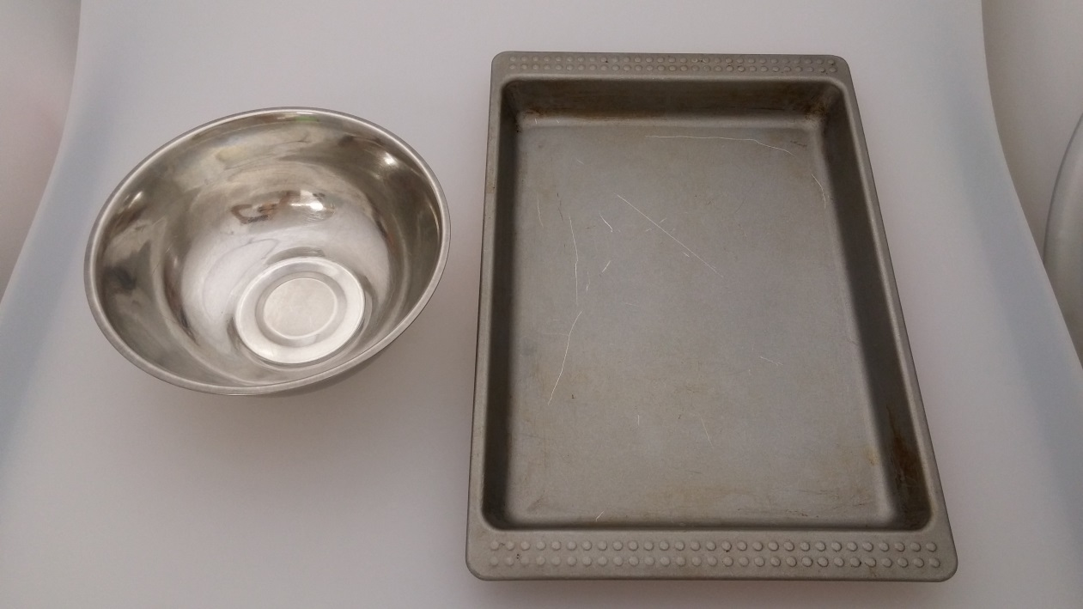
Equipment
Rolling pin
Pastry brush
Forks
Mixing bowl
Baking tray

Slide 3
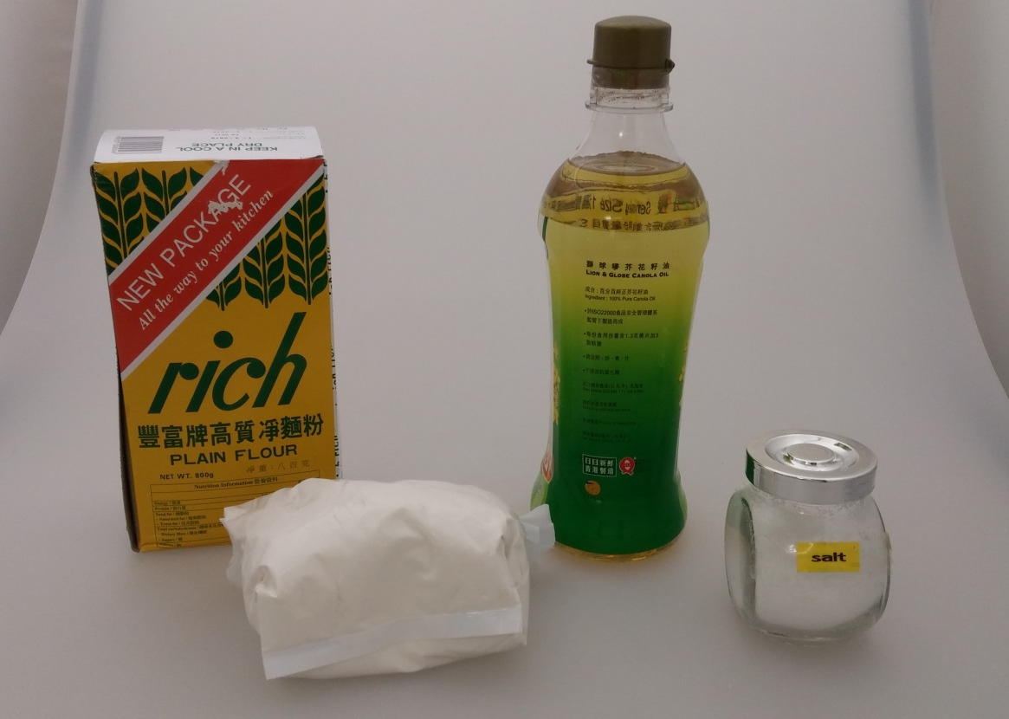
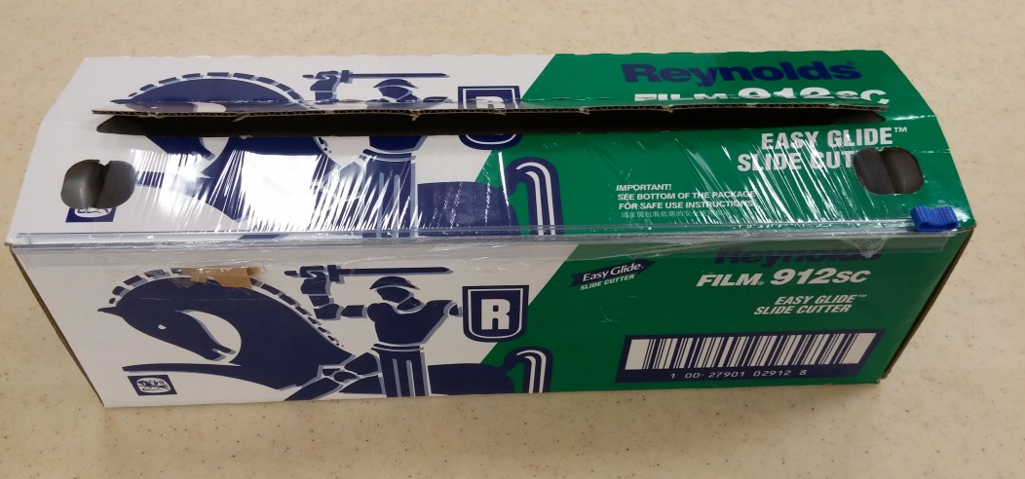
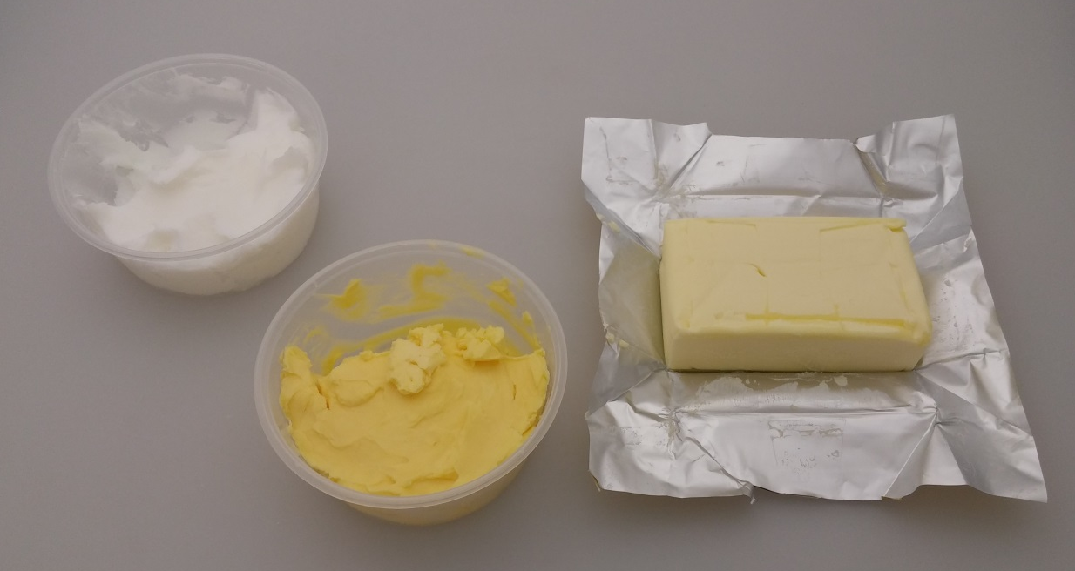
Materials
Canola oil
(Vegetable oil)
Plastic wrap
Salt
Pure lard
Plain flour
Butter
Margarine

Slide 4
Procedures

Slide 5
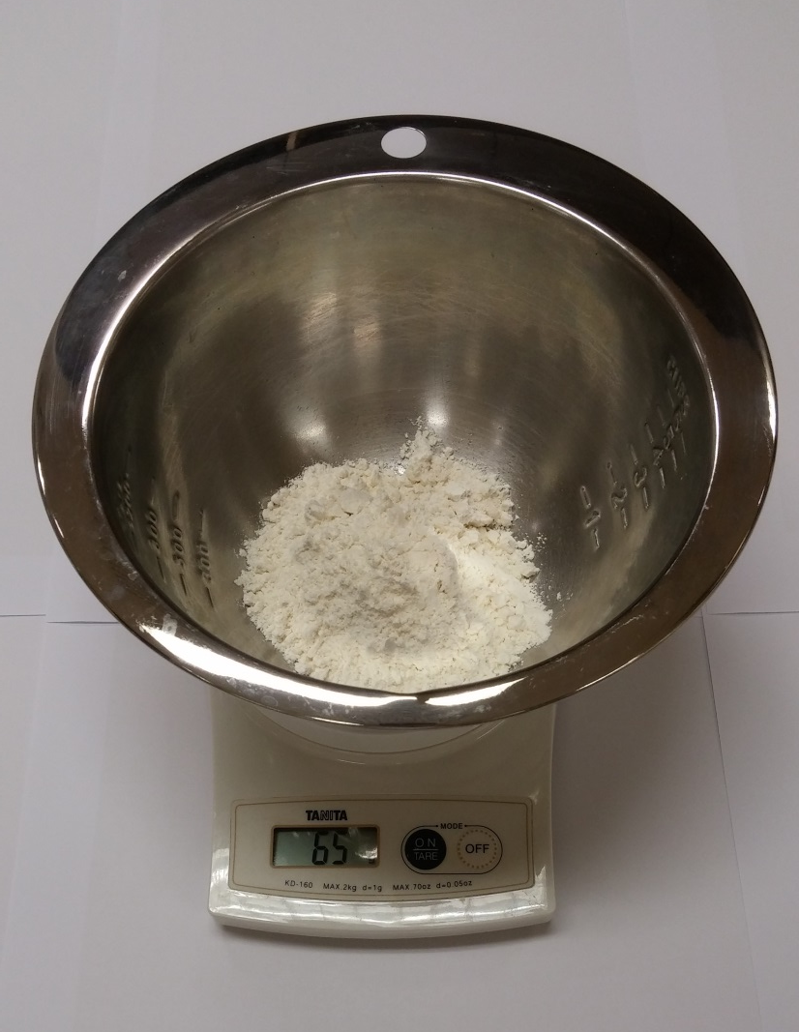
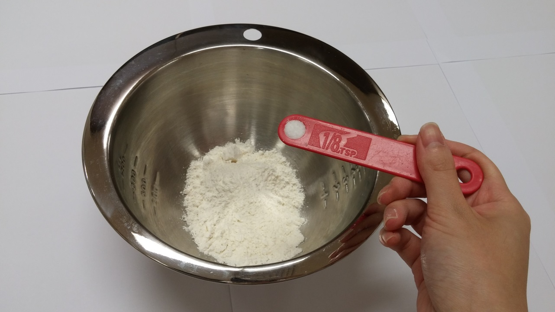
Prepare the samples…
Add 65g flour and 1/8 tsp salt in a mixing bowl

Slide 6
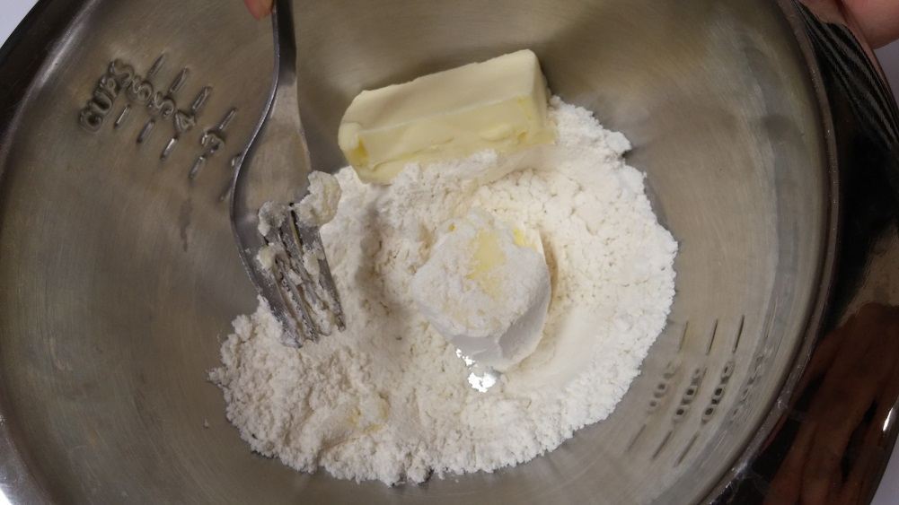
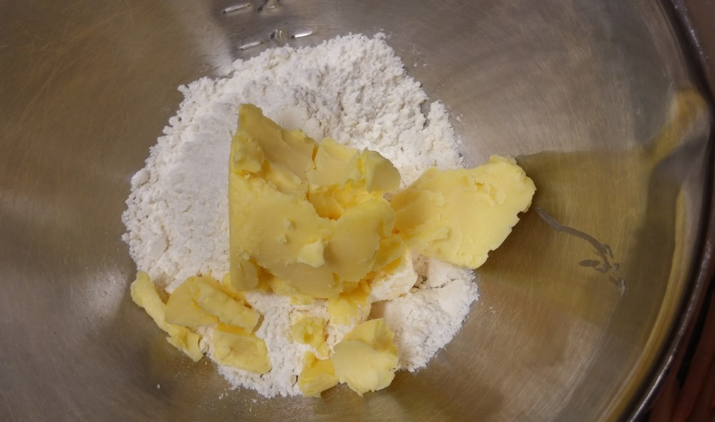
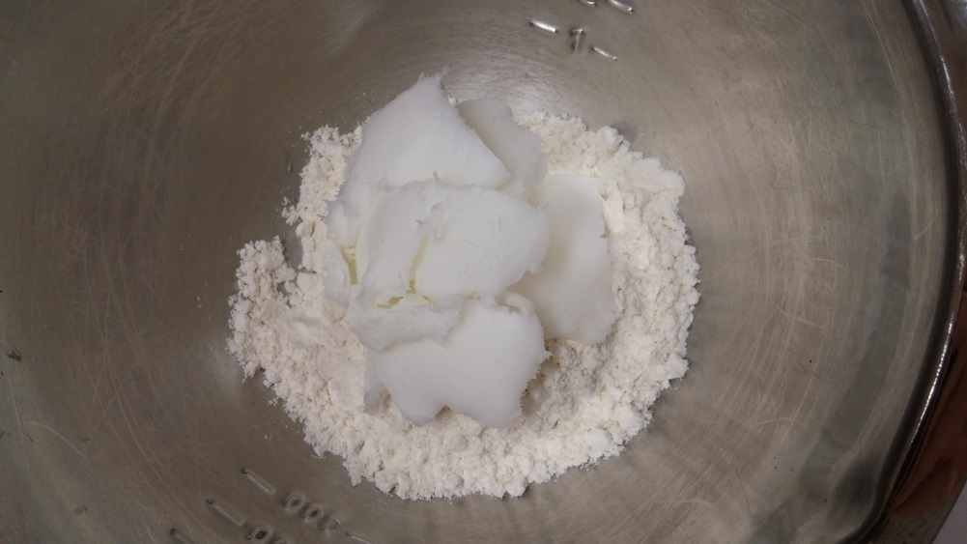
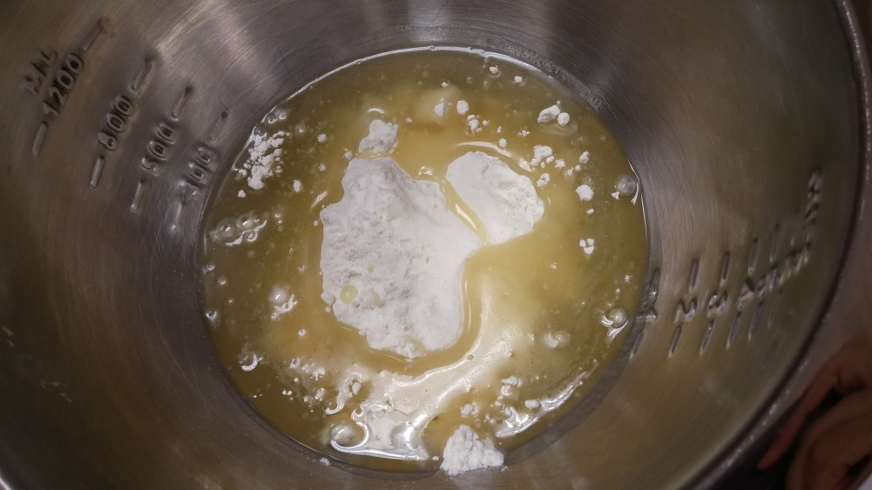
Cut the solid fats into the flour and mix with a fork
70g butter
70g margarine
70g lard
70ml oil

Slide 7
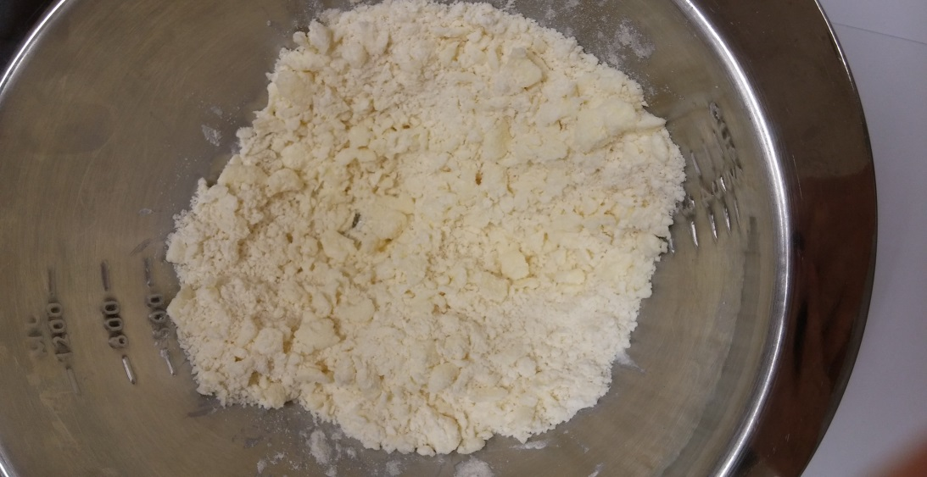
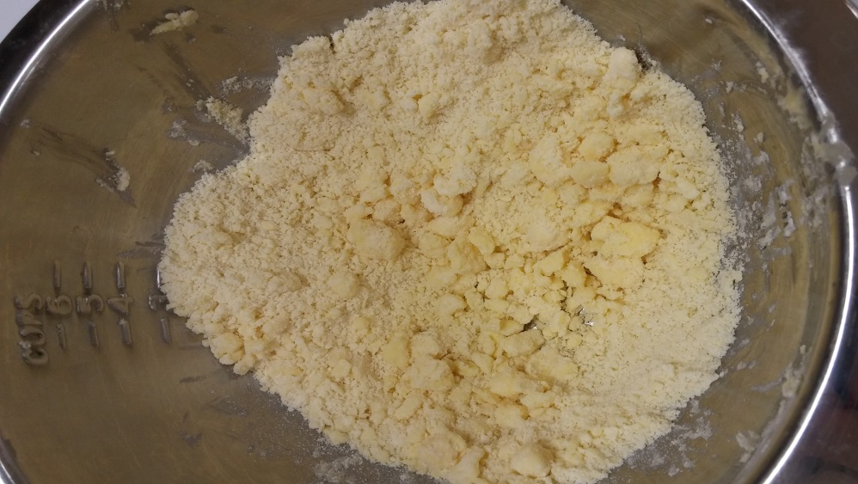
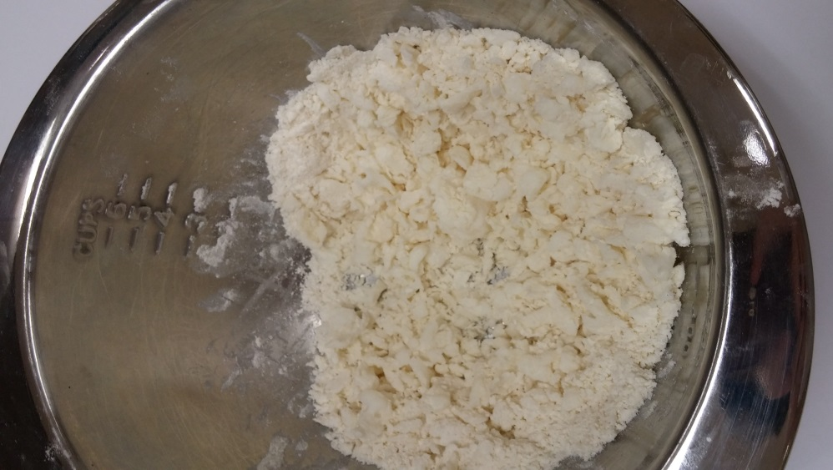
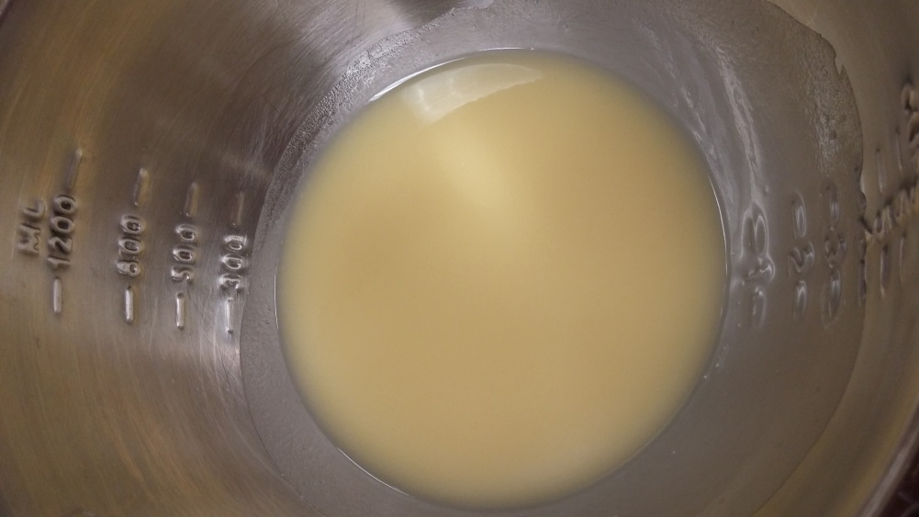
Mix until the average piece of fat about the size of a pea
Butter
Margarine
Lard
Oil

Slide 8
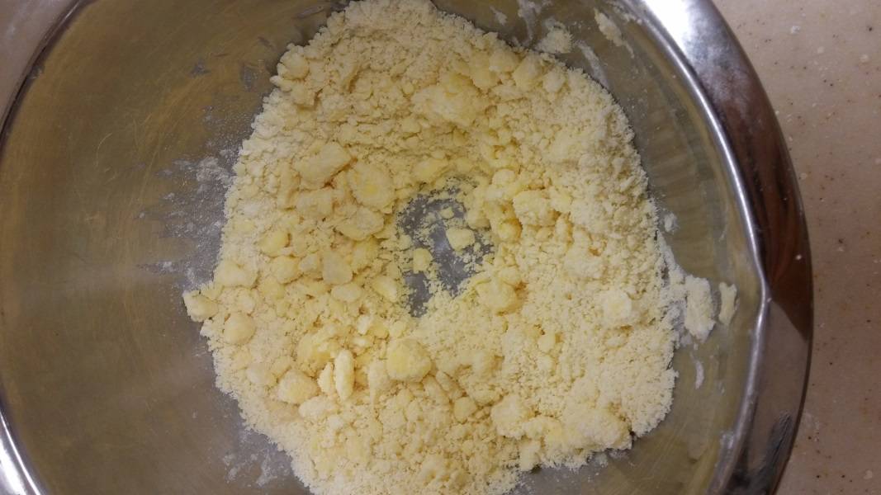
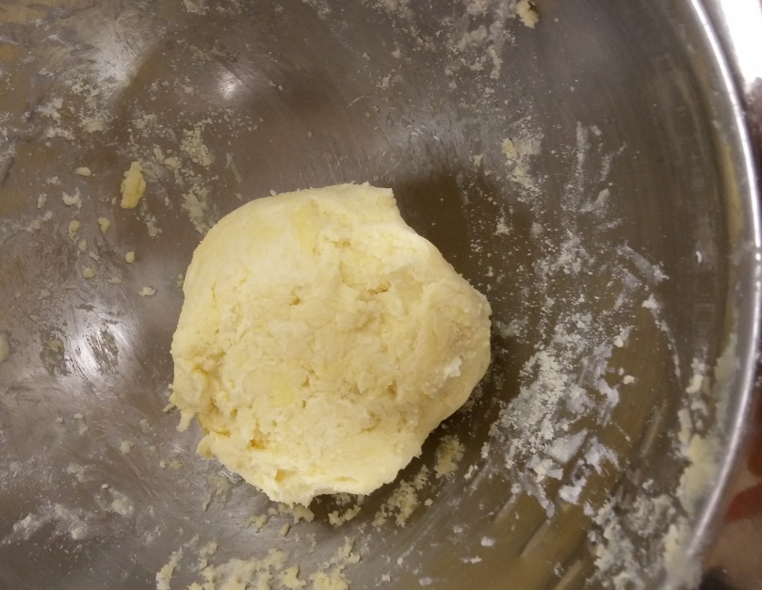
Form a well in the centre
Add cold water and
knead the mixture into a ball

Slide 9
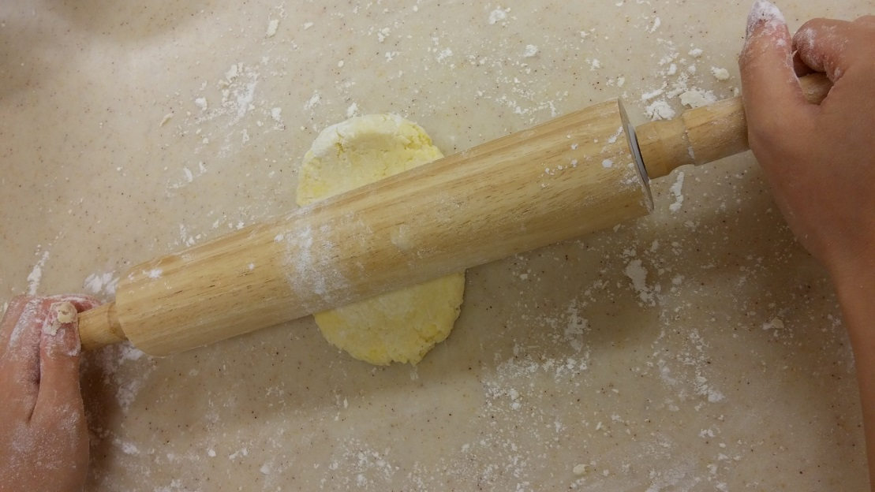
Flour the work surface and rolling pin
Roll out the dough into a long rectangle

Slide 10
Results

Slide 11
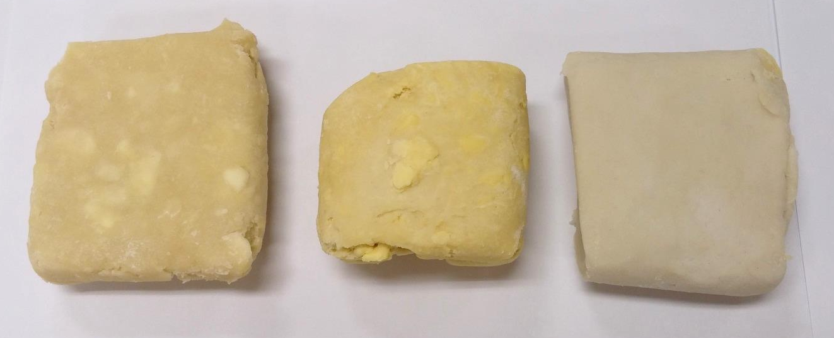
Before baking
Butter
Margarine
Lard
Oil
The vegetable oil sample is too watery to be baked

Slide 12
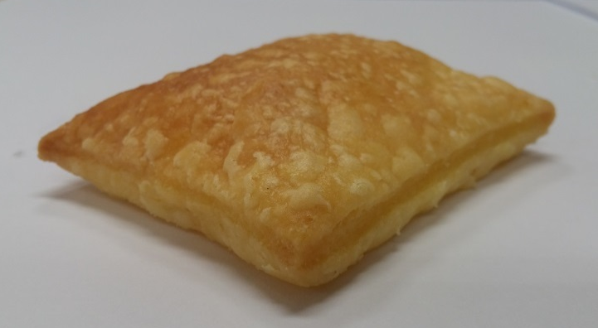
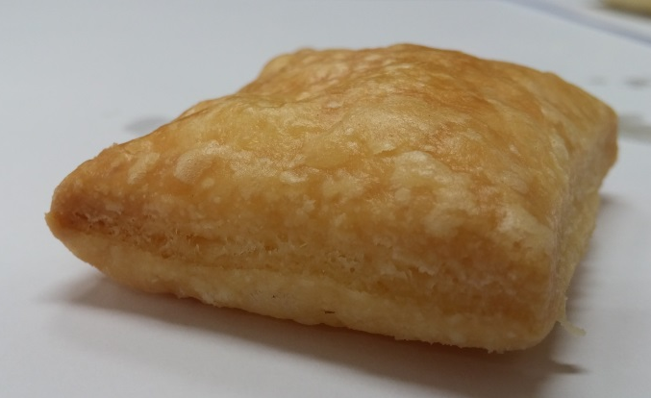
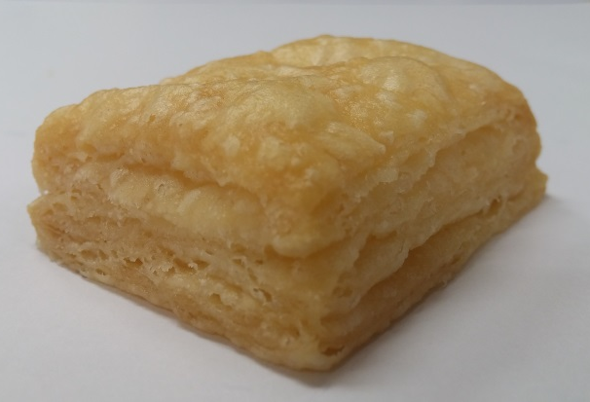
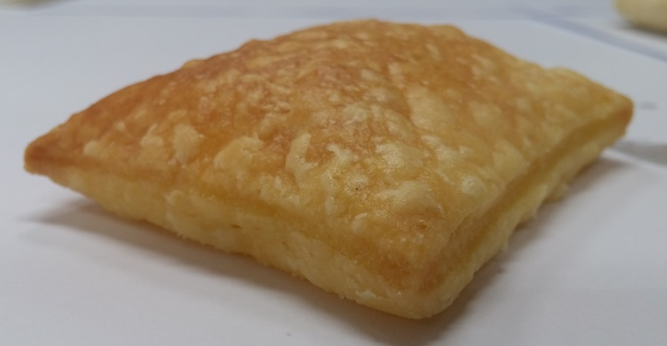
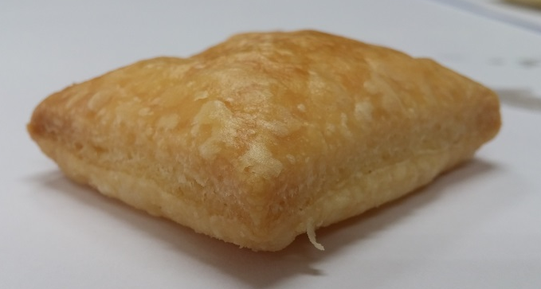
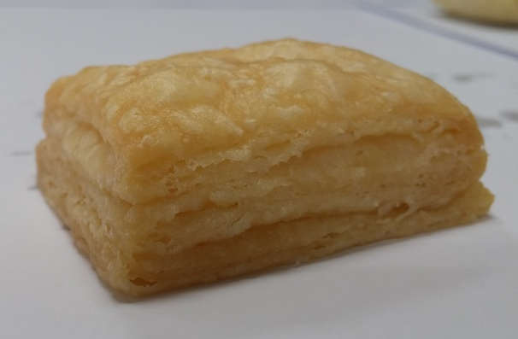
After baking
Butter
Margarine
Lard

Slide 13
After baking
Butter
Margarine
Lard
Butter and margarine have less shortening potential than lard
butter and margarine contain water and/or milk (20%) in addition to a variety of fat (80%)
water in butter and margarine hydrates the starch in flour
extra water also means extra toughness as a result of increased gluten development

Slide 14
After baking
Butter
Margarine
Lard
Lards form a desirable flaky product
The pea-sized chunks of lard melt within the gluten structure of flour, creating many layers (flakes) in baked products

