Slide 1
Importance of health to personal physical, mental and social well-being
According to World Health Organization, the definition of “health” is a state of complete physical, mental and social well-being and not merely the absence of disease or infirmity.
Health is important for us to adapt and manage different format of physical, emotional and social challenges. Foods provide nutrients, substances that provide energy, structural materials, and regulating agents to support the growth, maintenance, and repair of the body’s tissue.
Source: World Health Organization

Slide 2
The importance of nutrition
“Nutrition is an input to and foundation for health and development. Interaction of infection and malnutrition is well-documented. Better nutrition means stronger immune systems, less illness and better health. Healthy children learn better. Healthy people are stronger, are more productive and more able to create opportunities to gradually break the cycles of both poverty and hunger in a sustainable way. Better nutrition is a prime entry point to ending poverty and a milestone to achieving better quality of life.”
- WHO, 2008
Source: World Health Organization

Slide 3
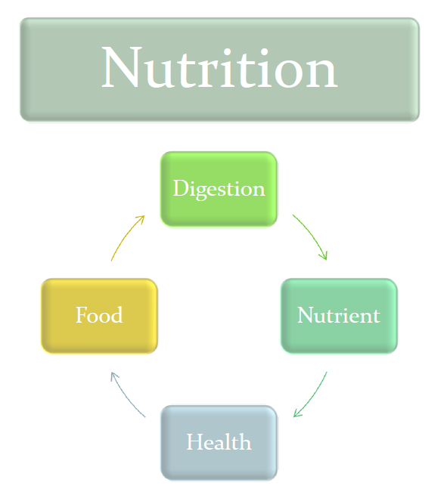
Relationship among food, nutrients & nutrition
What we choose to eat and drink – influences our health, well being and quality of life

Slide 4
Nutrients
Nutrients are the key players in nutrition, they are the substances that enrich the body and are essential to an organism (human). If it cannot be synthesised by the organism in sufficient quantities, it must be obtained from an external source (food).
Nutrients can be divided into two main groups:
1.Macronutrient
•‘Macro’ means large
•Body needs more of them for energy and growth, including carbohydrates, fats and protein
2.Micronutrient
•‘Micro’ means small
•Nutrients required in only small amounts, including vitamins and minerals

Slide 5

Six classes of nutrients
PROTEIN
CARBOHYDRATES
FATS
WATER
VITAMINS
MINERALS

Slide 6
Basic nutrition principles
Nutrients
Macronutrients
Micronutrients
carbohydrates
Vitamins
Foods
Protein
Minerals
Fats
Trace elements
Balanced diet
Energy
Dietary fibre
Water

Slide 7
Diet and disease
Choosing an inappropriate diet may affect health.
In the past, the most common diet-related disorders are those nutrient deficiency diseases caused by insufficient dietary intake of macro and micro nutrients.
Nowadays, under-nutrition and deficiency diseases has receded in both western and developing countries, while obesity and related ‘diseases of affluence’ such as coronary heart disease (CHD) and cancer have become common. Such modern diseases are believed to be associated with overeat and unhealthy diet.

Slide 8
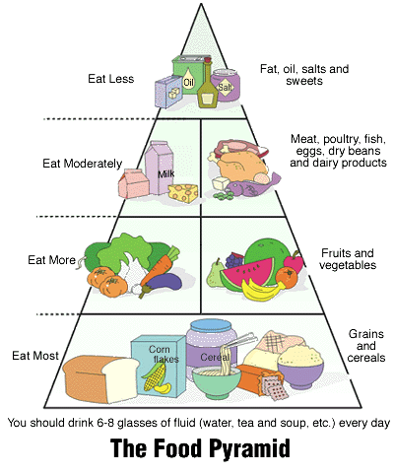
Dietary goals and food pyramid
A Guide to a Balanced Diet
Different foods have different nutritional values.
Eating too much or too little will certainly affect our health.
Source: Centre for Health Protection, Department of Health

Slide 9

Source: Hong Kong Nutrition Association

Slide 10
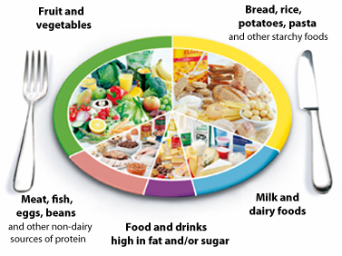
Dietary goals and food pyramid in different countries
The Eatwell Plate – UK
Plenty of fruit and vegetables
At least five portions of a variety of fruit and vegetable every day.
Plenty of potatoes, bread, rice, pasta and other starchy foods
Some milk and dairy foods
Some meat, fish, eggs, beans and other non-dairy sources of protein
Just a small amount of foods and drinks high in fats and/or sugar
Source: National Health Service, United Kingdom

Slide 11
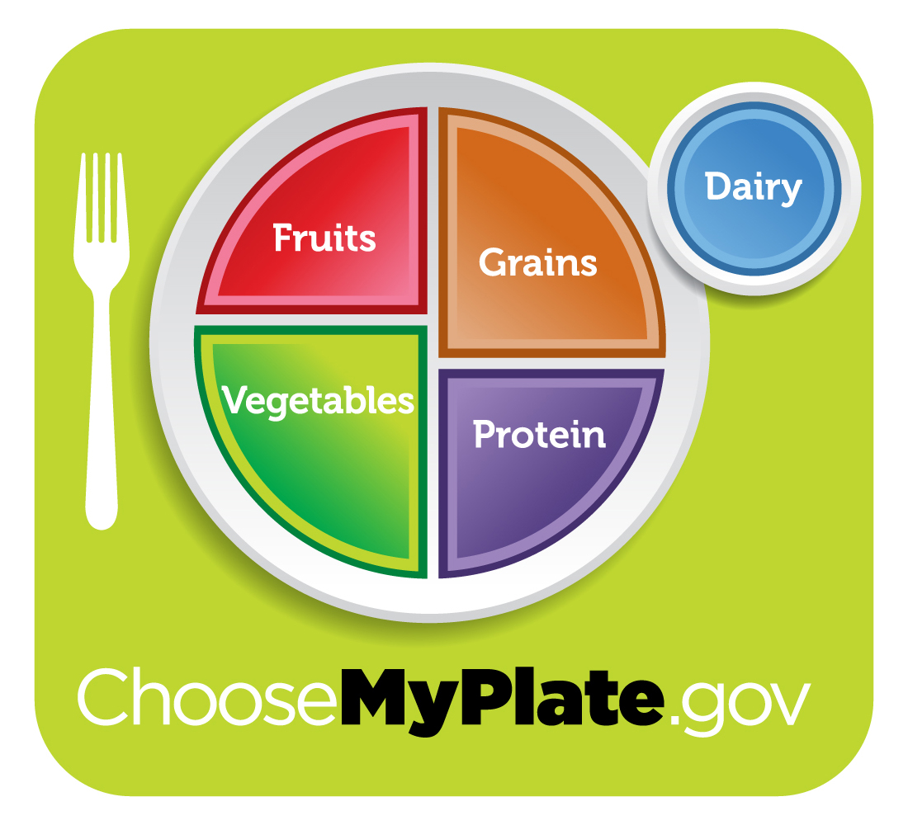
Dietary goals and food pyramid in different countries
MyPlate – US
Source: United States Department of Agriculture

Slide 12
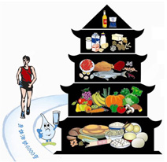
Dietary goals and food pyramid in different countries
Dietary Pagoda 膳食寶塔(中國營養學會)
Source: Chinese Nutrition Society

Slide 13
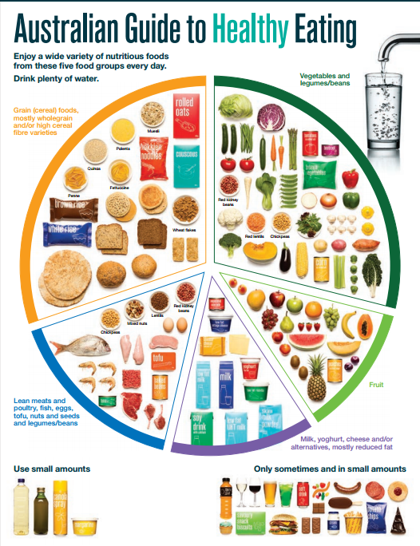
Dietary goals and food pyramid in different countries
The Australian Dietary Guidelines have information about the types and amounts of foods, food groups and dietary patterns.
Source: Eat For Health, Australia

Slide 14
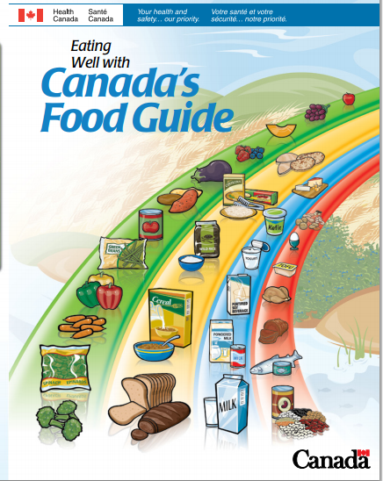
Dietary goals and food pyramid in different countries
Source: Health Canada

Slide 15
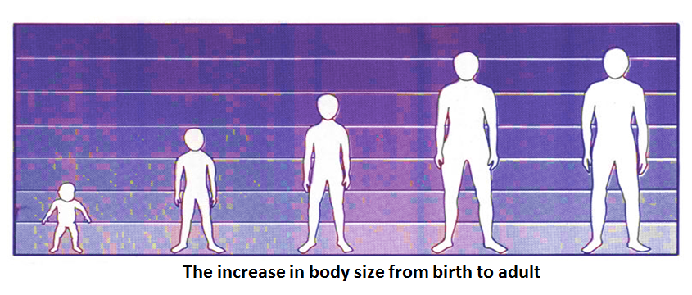
Adolescence is a period of rapid growth
Up to 45% of skeletal growth takes place and much of the adult height is achieved during adolescence.
As a result of the tremendous growth that occurs during adolescence, the requirements for protein and energy are greatly increased above childhood requirements.

Slide 16
Importance of a balanced diet
Different food groups serve different purposes in meeting our nutritional needs. We have to vary our food choices every day to get sufficient nutrients for maintaining a balanced diet to help keep the body and mind strong and healthy. Each food group provide specific set of nutrients.
List of food groups:
  Grains & Cereals
  Fruits
  Vegetables
  Meat, Poultry, Fish, Eggs & Beans
  Milk & Dairy Products
  Sweets & Oils
  Fluids

Slide 17
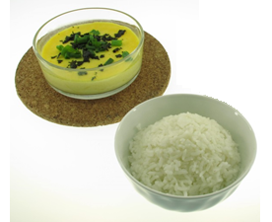

To translate nutritional knowledge into practical life
nutrients
foods
balanced diet
Grain
Vegetable
Fruits
Meat
Dairy
Oils
Salt
Sugar
Carbohydrates
Protein
Fats
Vitamins
Minerals
Trace elements
Dietary fibre

Slide 18
Macronutrients:
Carbohydrates
Protein
Fats
Macro means large, they are required in relatively large amounts by the body
Carbohydrates, Fats and Protein provide energy and thus are also referred to as energy-yielding nutrients

Slide 19
Micronutrients:
Vitamins:
Water Soluble:
  Vitamin C
  B Vitamins
    Thiamine
    Riboflavin
    Niacin
    Pantothenic acid
    Vitamin B6 (pyridoxine)
    Biotin
    Folic acid
    Vitamin B12 (cobalamin)
Fat Soluble:
  Vitamin A
  Vitamin D
  Vitamin E
  Vitamin K

Slide 20
Micronutrients:
Minerals:
Major minerals (macrominerals)
  Calcium
  Phosphorus
  Magnesium
  Sodium
  Potassium
  Chloride
  Sulfur
Trace elements (trace minerals)
  Iron
  Manganese
  Copper
  Iodine
  Zinc
  Cobalt
  Fluoride
  Selenium

Slide 21


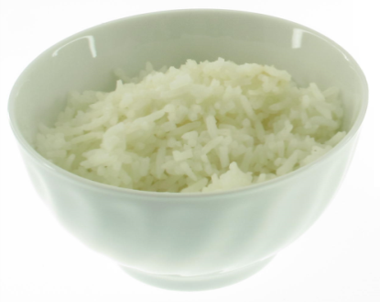
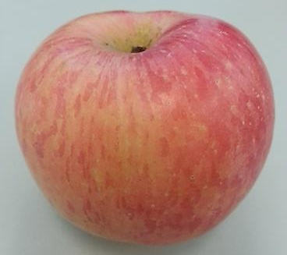

Basic idea and application of good eating habit and balanced diet in daily life
Good eating habit is to include several food groups in daily diet as one single food group cannot provide everything a human needs for good health.
The crucial part of healthy eating is a balanced diet. A balanced diet means consuming from all the different food groups in the right quantities.

Slide 22


Meal planning
A well planned diet delivers adequate nutrients, a balanced array of nutrients and an appropriate amount of energy.
It is based on nutrient-dense foods, moderation in substances that can affect health and varied in its selections.

Slide 23
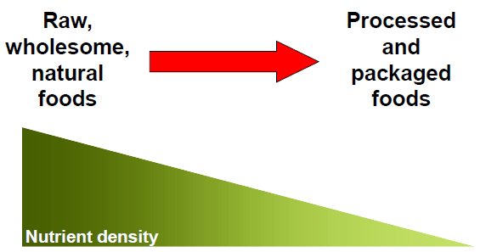
Nutrient density
•Foods low in calories and high in nutrients are nutrient-dense, while foods high in calories and low in nutrients are nutrient-poor (also called energy-dense or ‘empty calorie’ foods)

Slide 24
Changing food habit
Globalization:
Local to worldwide organisations
Consumerisation:
Indigenous to mass-produced foods
Migration:
Original to new settings
Acculturation:
Novel foods are introduced and accepted into a majority cuisine

Slide 25
Meal pattern
In general, people eat three meals a day- breakfast, lunch and dinner; sometimes with snacks in between meals.
Each meal should compose of food from each food group- grain/grain alternative, meat/meat alternative, vegetable/fruit, and milk/milk alternative.

Slide 26
Importance of breakfast
Breakfast is an important meal of a day. Skipping meals, especially breakfast, can make weight control difficult. Breakfast skippers tend to eat more food than usual at the next meal, or nibble on high-calorie snacks to stave off hunger.

Slide 27
Healthy breakfast tips
Breakfast should include a healthy source of protein and plenty of fibre; the combination will help satisfy hunger and will keep one feeling full longer.
The protein should come from low-fat meat, low-fat dairy products, eggs, pulses or nuts.
Cut back on sugary breakfast cereals, high-calorie pastries, and meats like bacon and sausage that are high in saturated fat and sodium.

Slide 28
Chinese breakfast
Examples :
  Congee with fish/meat slices and vegetables such as corn kernel and Chinese mushroom
  Rice roll (Cheung Fan) with meat and vegetables
  Stir-fried noodles / rice noodles
  Noodle in soup with meat slices and vegetables
  Steam bun with soya milk
  Dim sum + Chinese tea

Slide 29
Western breakfast
Examples :
  Breakfast cereal with low fat milk
  Toast or sandwich with baked beans / jam / butter (try whole wheat or whole-grain bread to increase dietary fibre)
  Hot cereal, such as oatmeal with dried fruit or nuts on top
  Yoghurt (best with low-fat option) with fruit or nuts
  Fruit smoothie, such as a strawberry smoothie
  Omelette with vegetables, button mushrooms and cheese (best with low-fat option)

Slide 30
One course meal for midday meal or lunch
Midday meal or lunch usually comes in one-dish or one course only, with drinks and fruits.
Examples :
  Fried rice with sliced meat and vegetables
  Wonton with noodles and vegetables
  Beans and minced pork with rice
  Spaghetti bolognaise
  Salad with croutons

Slide 31

Chinese Style Midday meal
  Fried Rice with Dried Scallop and Vegetables

Slide 32
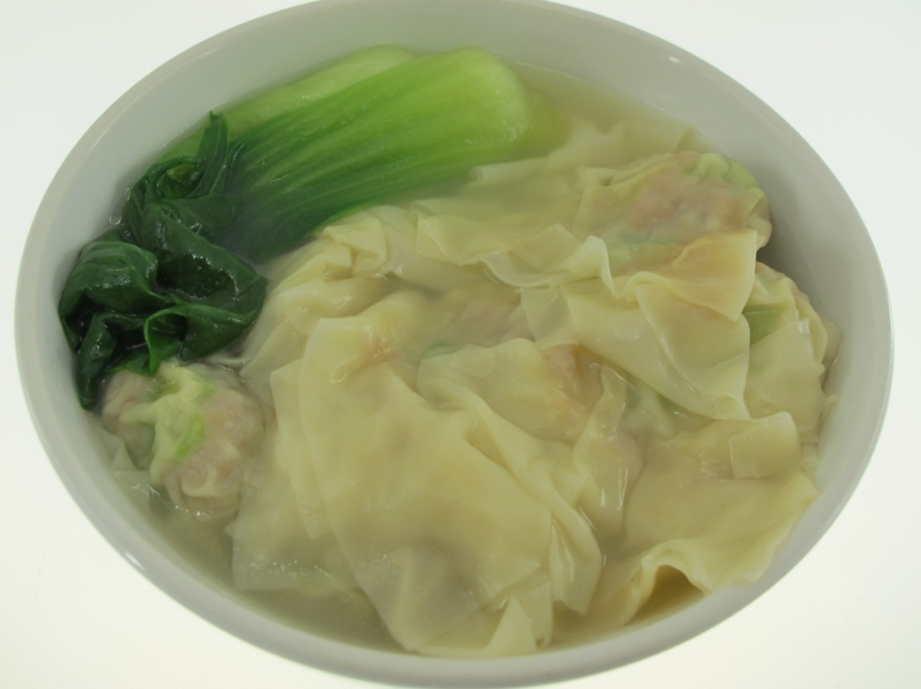
Chinese Style Midday meal
Pork Wonton with Vegetables

Slide 33
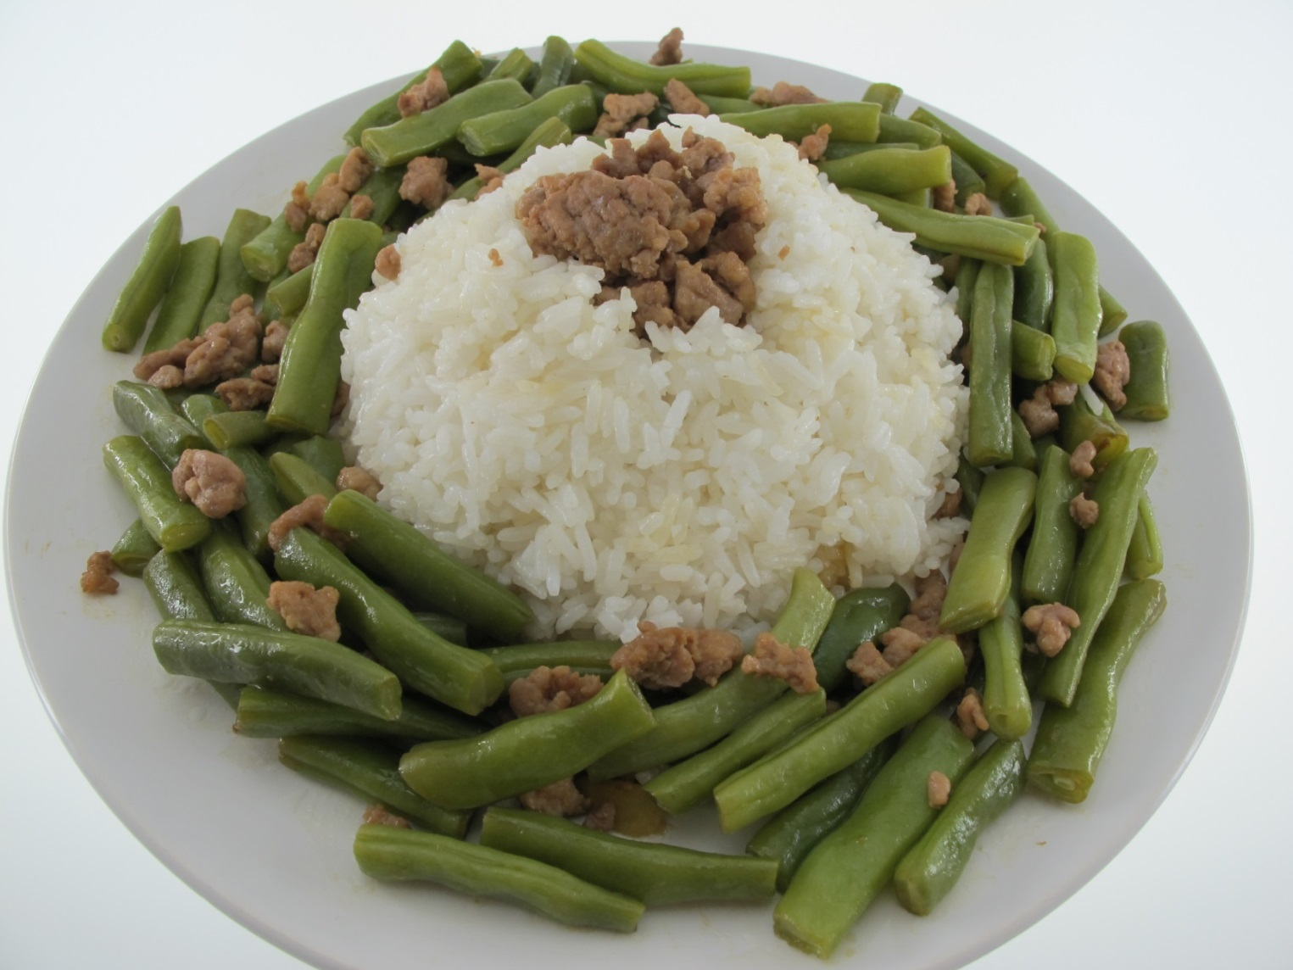
Chinese Style Midday meal
Beans and Minced Pork with Rice

Slide 34
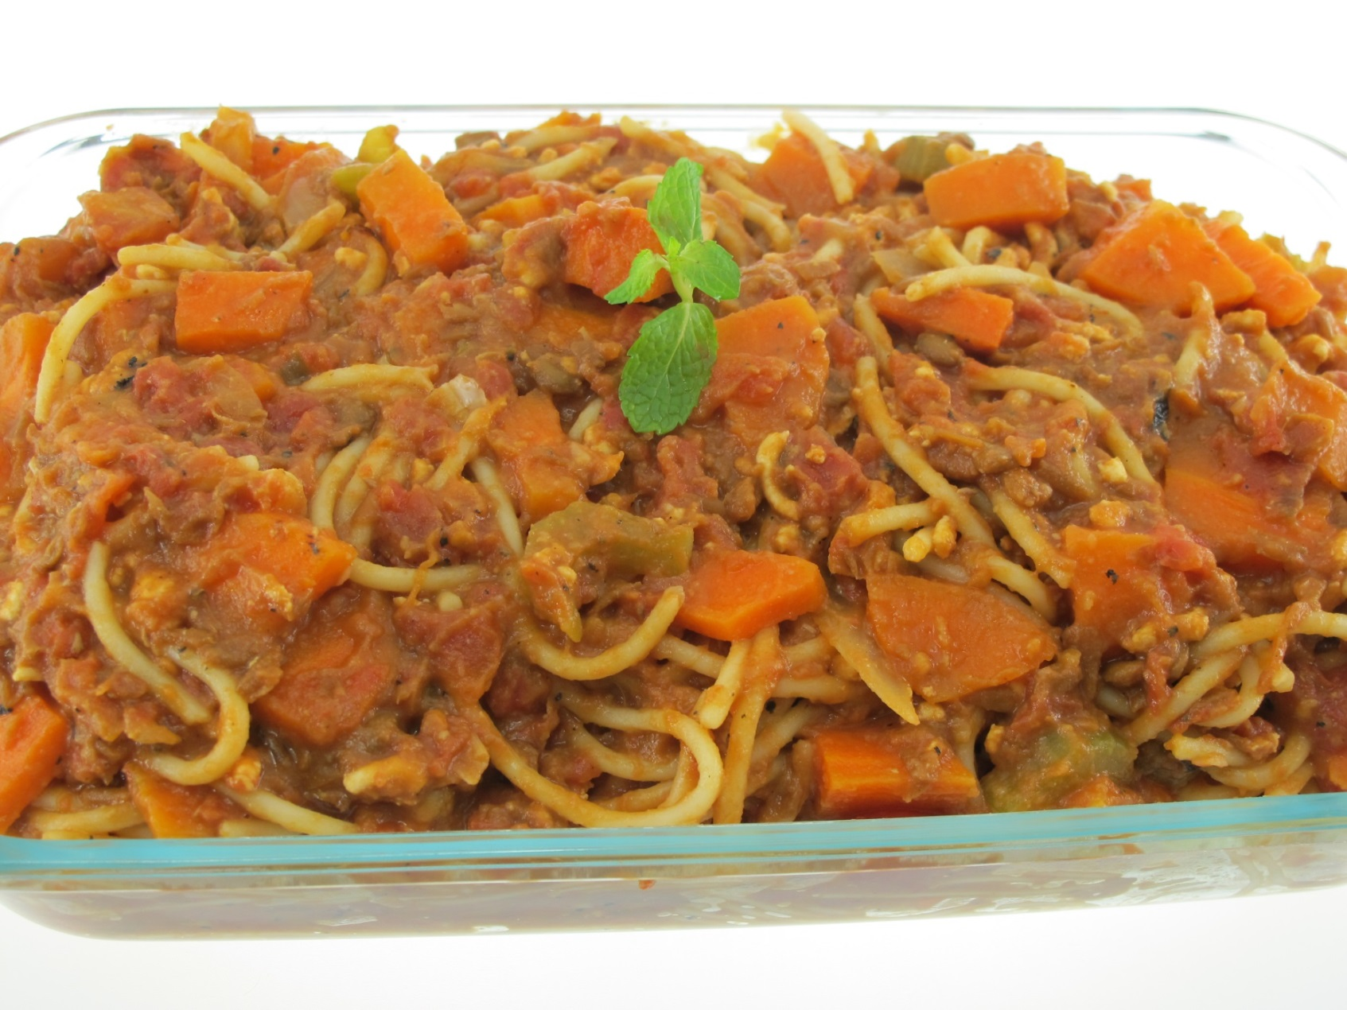
Western style midday meal
  Spaghetti Bolognaise

Slide 35
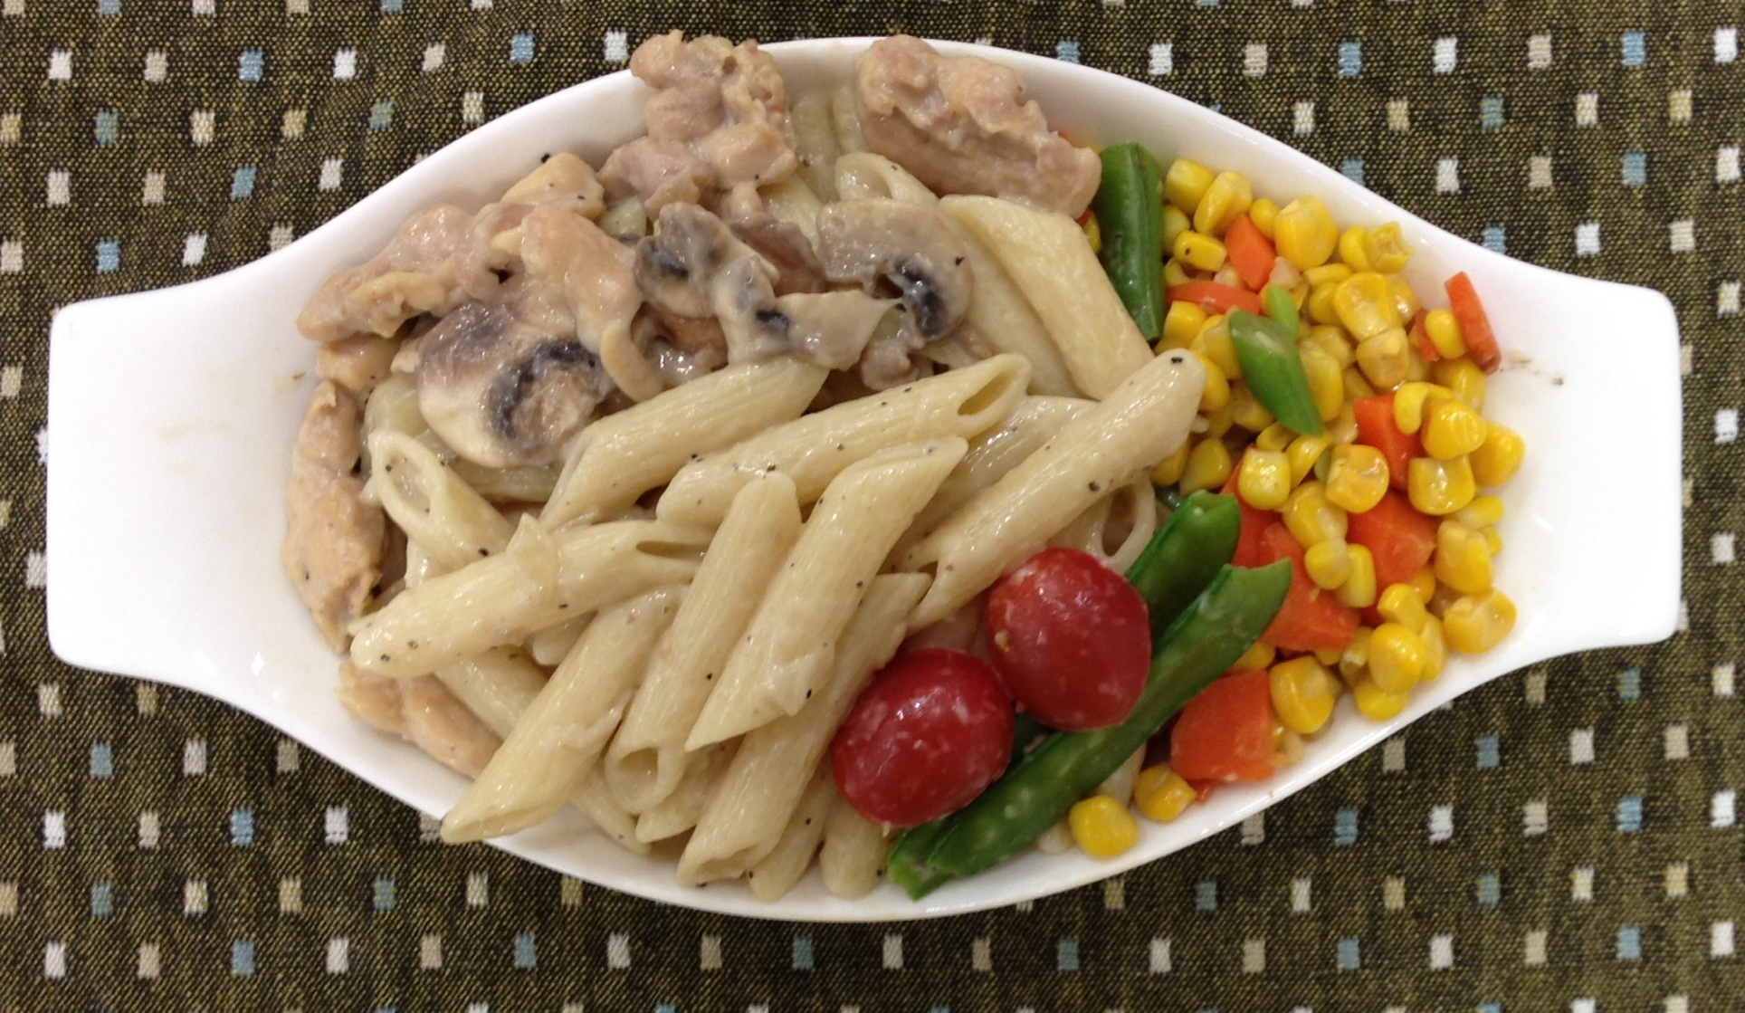
Western style midday meal
  Chicken and Mushroom Penne

Slide 36
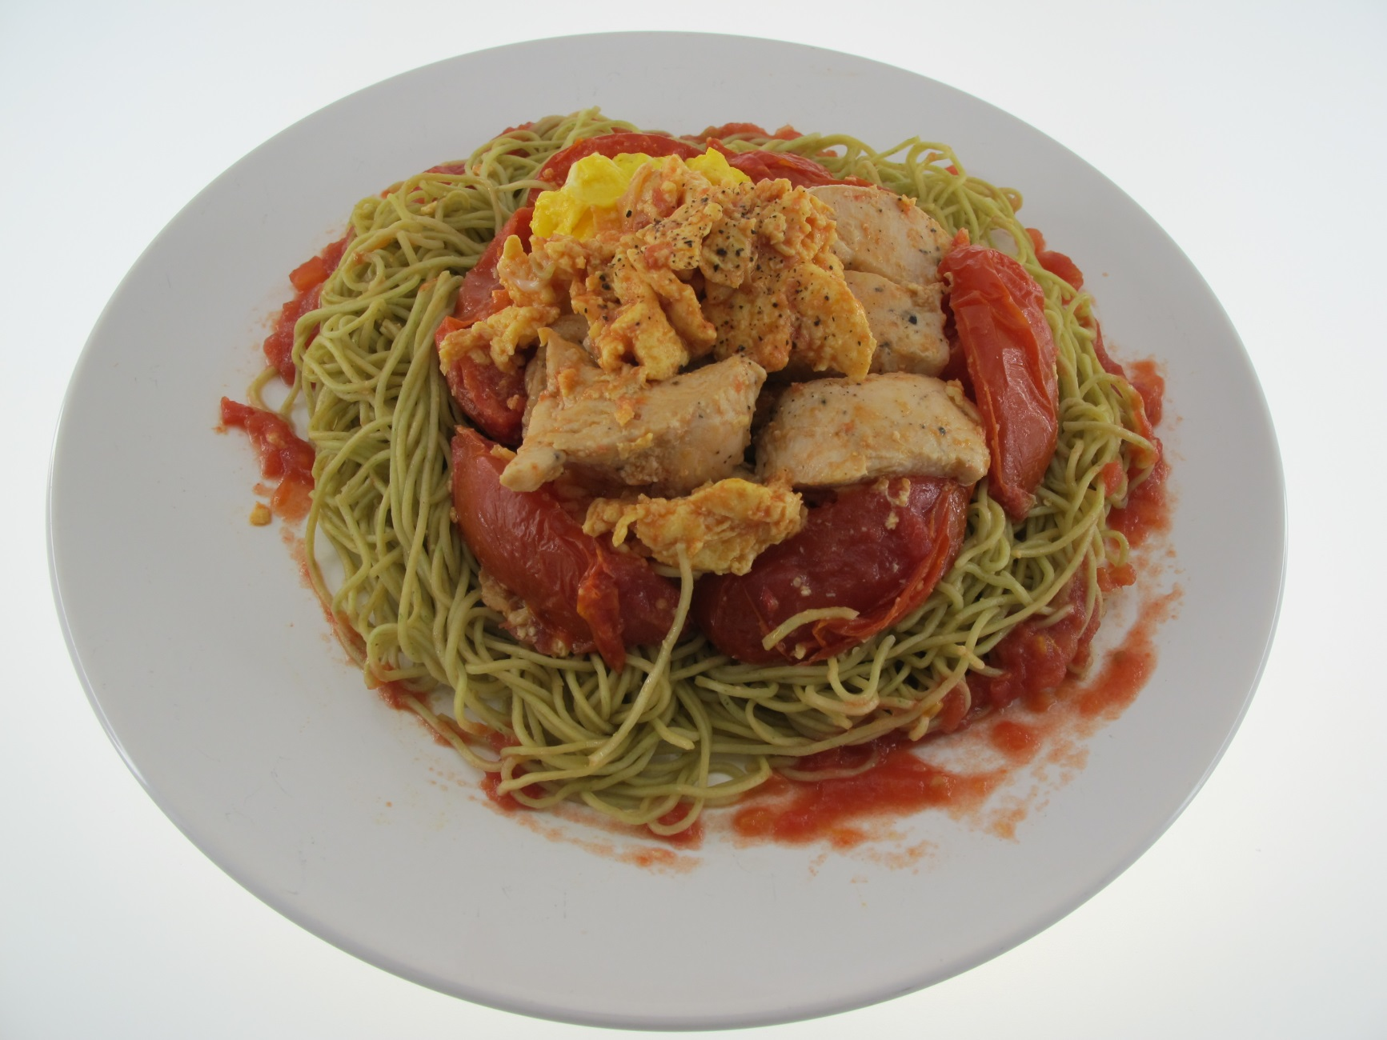
Western style midday meal
Spinach Noodles with Tomato, Egg and Chicken

Slide 37
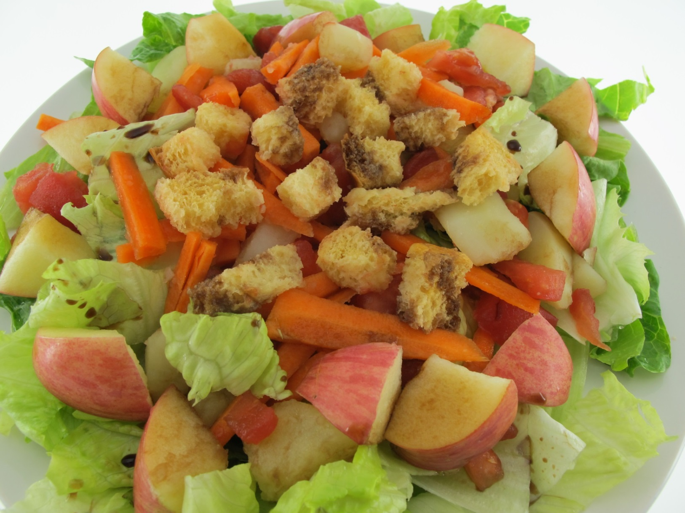
Western style midday meal
Salad with Croutons

Slide 38

Special midday meal
Seaweed Rice Burger

Slide 39
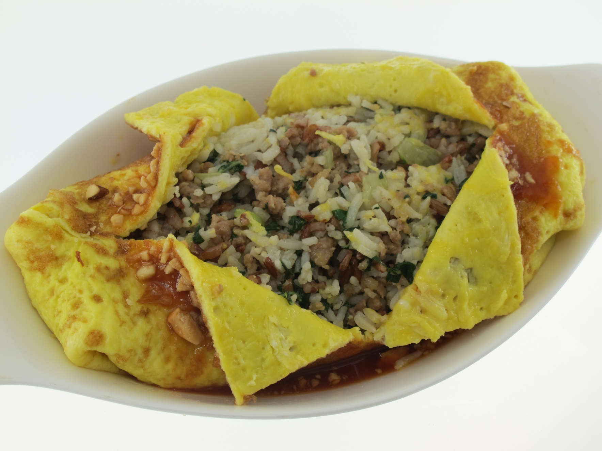
Special midday meal
Fried Rice Omelette

Slide 40
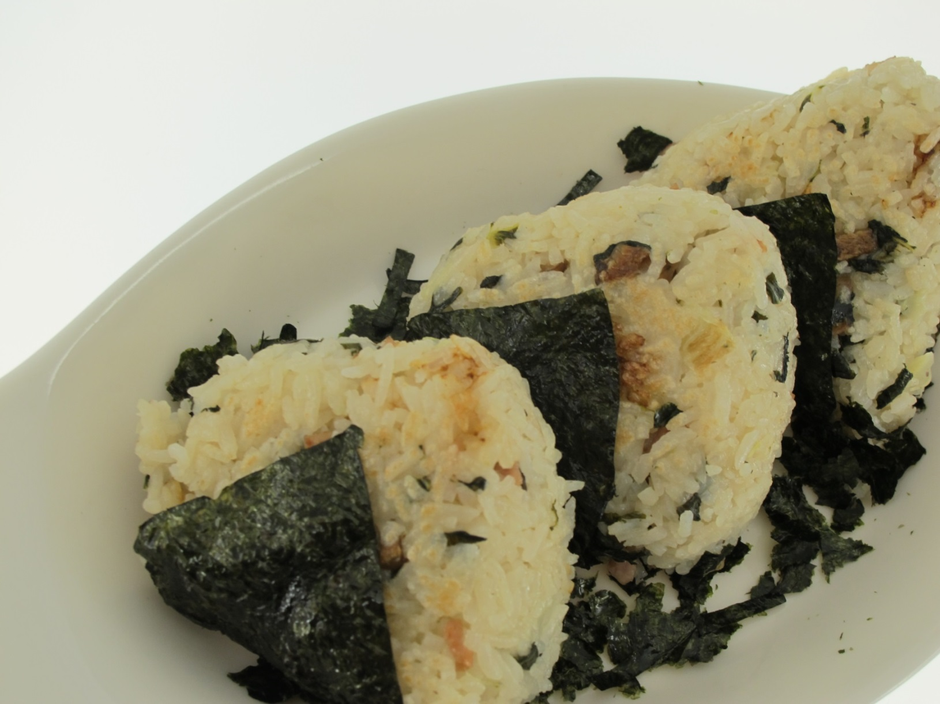
Special midday meal
Japanese Rice Rolls

Slide 41
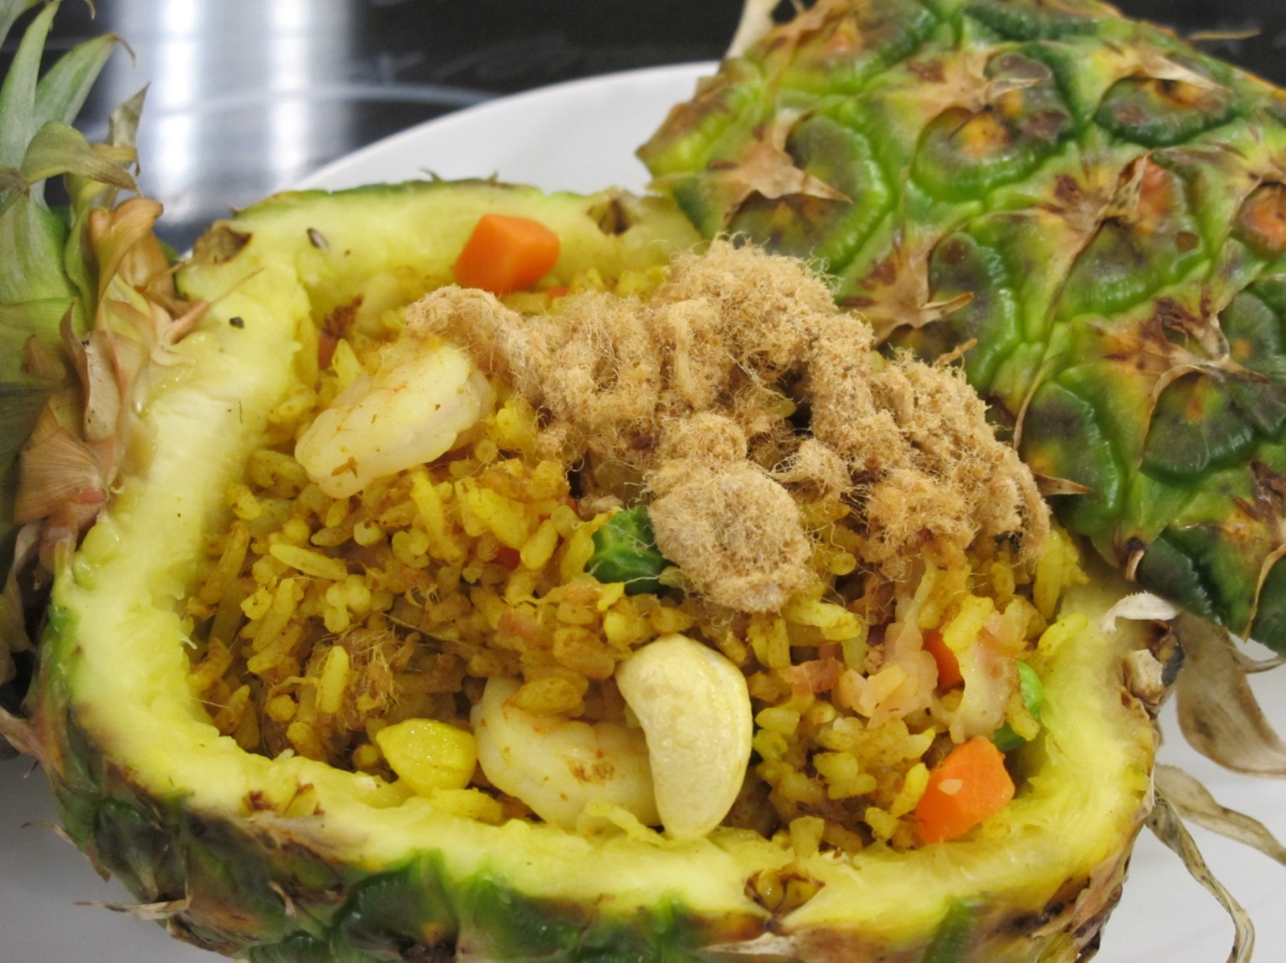
Special midday meal
Thai Style Fried Rice with Pineapple

Slide 42

Special midday meal
Korean Style Rice Rolls

Slide 43
Evening meal
Evening meal often includes two or more main dishes or courses.

Slide 44

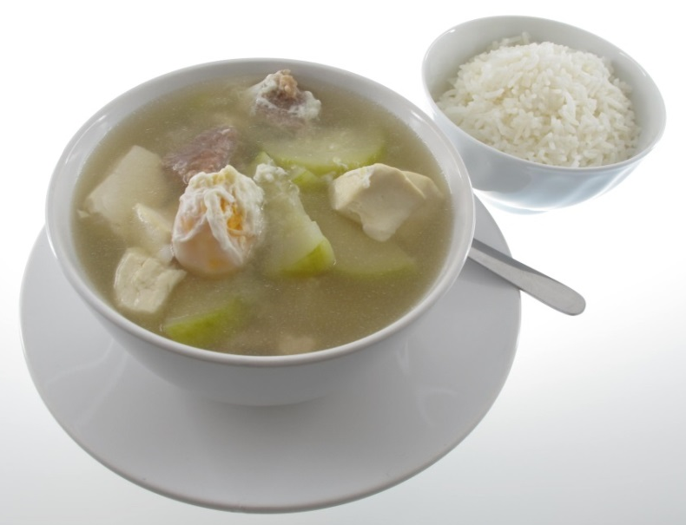
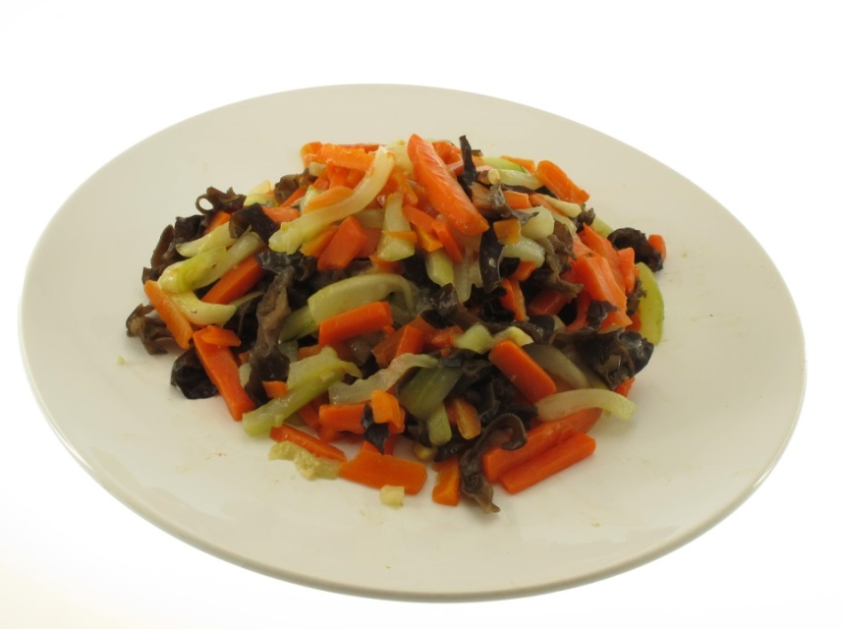
Chinese evening meal
Chinese style evening meal usually includes:
  Soup
  Two main dishes
  Rice
Steamed Bean Curd with Minced Fish
Rice
Assorted Vegetable Soup
Stir-fried Assorted Vegetables

Slide 45

Chinese style main dish
Fish Rolls with Enoki Mushroom and Carrot

Slide 46
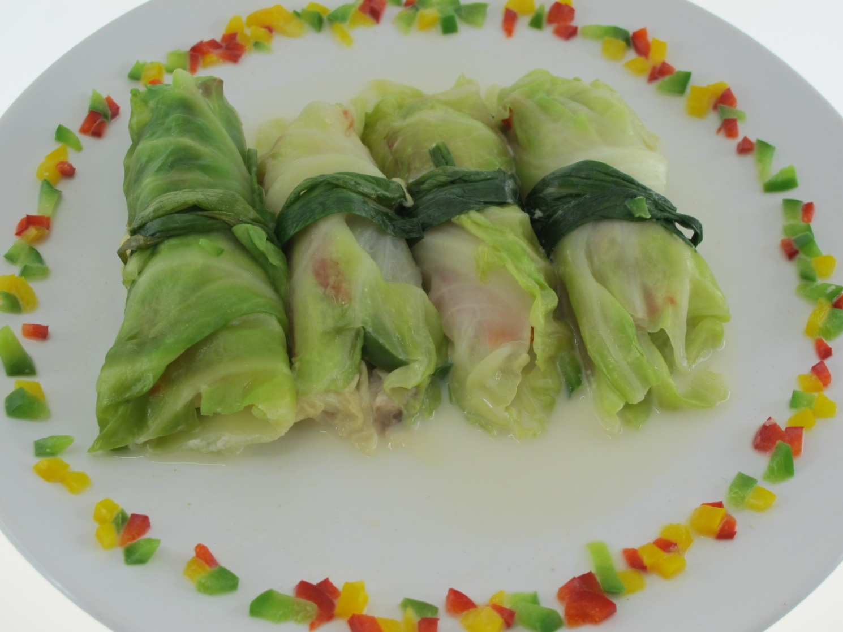
Chinese style main dish
Vegetable Rolls with Prawn and Pork

Slide 47

Chinese style main dish
Stuffed Cabbage with Minced Fish

Slide 48
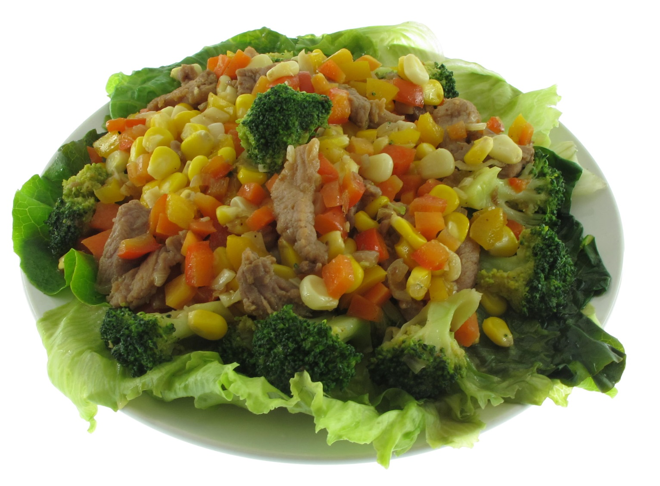
Chinese style main dish
Stir Fried Pork Slices with Assorted Vegetables

Slide 49

Chinese style main dish
Steamed Egg

Slide 50

Chinese style main dish
Sizzling Chicken Pot

Slide 51
Western evening meal
Western style evening meal usually includes:
  Soup
  Main course (protein food such as meat/ fish/ egg/ cheese/ beans and pulses, vegetables (for strict vegetarians) or pasta served with side vegetables)
  Dessert
  Tea / coffee / drink

Slide 52

Western style main course
Flatfish Rolls with Mango and Avocado

Slide 53

Western style main course
Vegetable Pancake

Slide 54
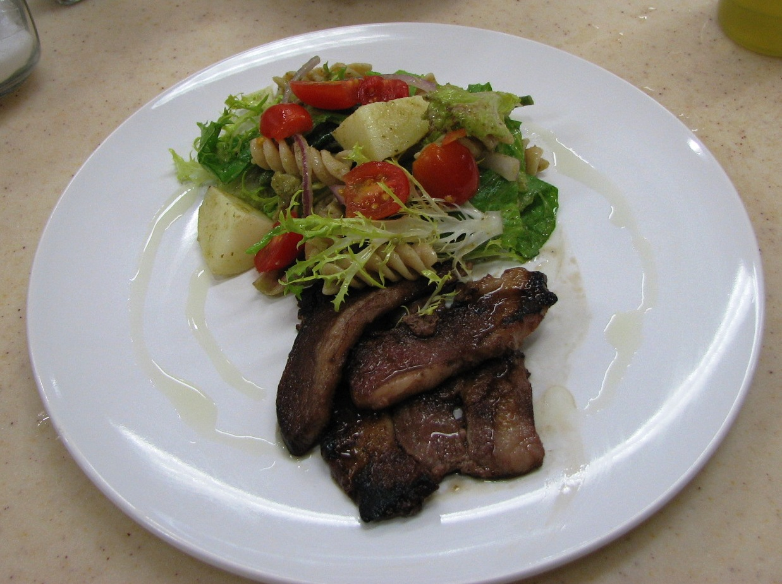
Western style main course
Beef with Potato Salad

Slide 55
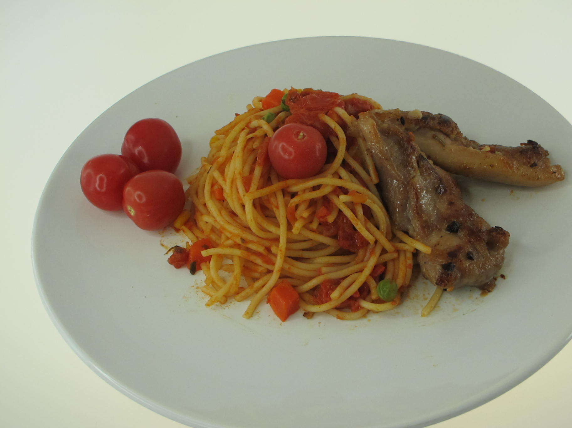
Western style main course
Pork Chop with Spaghetti

Slide 56

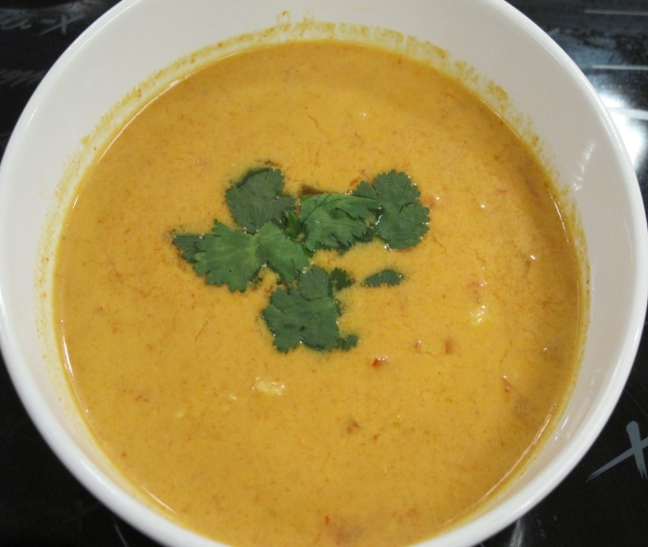
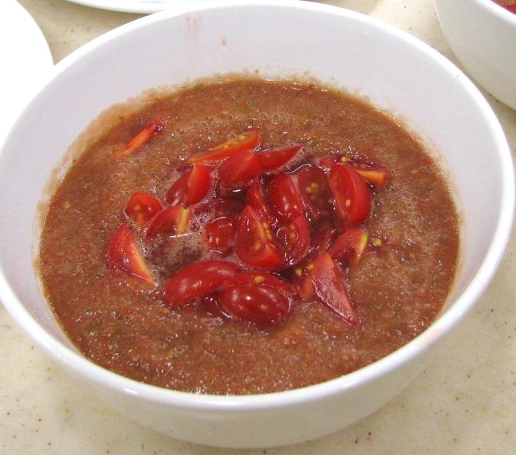
Soup
Soup is a liquid food derived from meat, poultry, fish or vegetables. It can be divided into three basic categories: clear or unthickened soups, thick soups and special soups.
Clear Soup
Thick Soup
Special Soup
Miso Soup
Cream of Pumpkin Soup
Cold Vegetables Soup

Slide 57
Dessert
Dessert is a sweet dish served at the end of a meal.
Examples of Chinese desserts
  Red/green bean soup
  Black sesame paste
  Sweet potato soup
  Tofu Jelly
Examples of western desserts
  Jelly and pudding
  Pies
  Cakes
  Candy
  Pastries
  Frozen Desserts

Slide 58


Snack
Snack is a light meal usually eaten in between the main meals. It can be sweet or savoury.
Savoury snack
Sweet snack
Hamburger
Yoghurt with Fruits

Slide 59

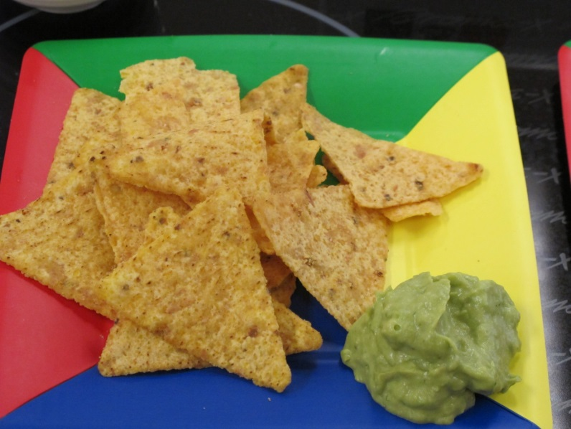
Snack
Choices of healthy snacks:
  Fresh fruits or dried fruits
  Fruit and vegetables salad
  Skimmed or low fat milk / low sugar soya milk
  Unsalted nuts
  Brown toast or sandwich
  Tacos and nacho
Tacos
Nacho

Slide 60
Beverages:
Water
Tea
Carbonated beverages
Fruit and vegetable beverages
Sports drinks
Dairy beverages
Alcoholic beverages
Coffee

Slide 61
Sugary beverages:
Frequent consumption of sugary drinks increase the risk of overweight and obesity
These include soft drinks, juice, lemon tea etc
It also contributes to tooth decay in children

Slide 62
Principles of Meal Planning
Nutrient recommendations, including correct serving size
Individual preferences and needs: factors including age, culture, religion
Costs: planning nutritive, flavourful and appealing meals within the available budget
Cooking methods (moist-heat cooking and dry-heat cooking): alternating different cooking methods like steaming, stir-frying, boiling to avoid monotony
Seasonal factors: availability of fresh food produce / products, methods of preparation and temperature at which food is served

Slide 63
Meal presentation using garnish
Garnishes come in a variety of shapes and sizes, depending on the meal being served and service required.
A common yet effective garnish used in many restaurants is a sprig of parsley (or other herb) on the side of a plate, or a wedge of lemon to be served with fish.
Garnish should be fresh, colourful, and edible.

Slide 64

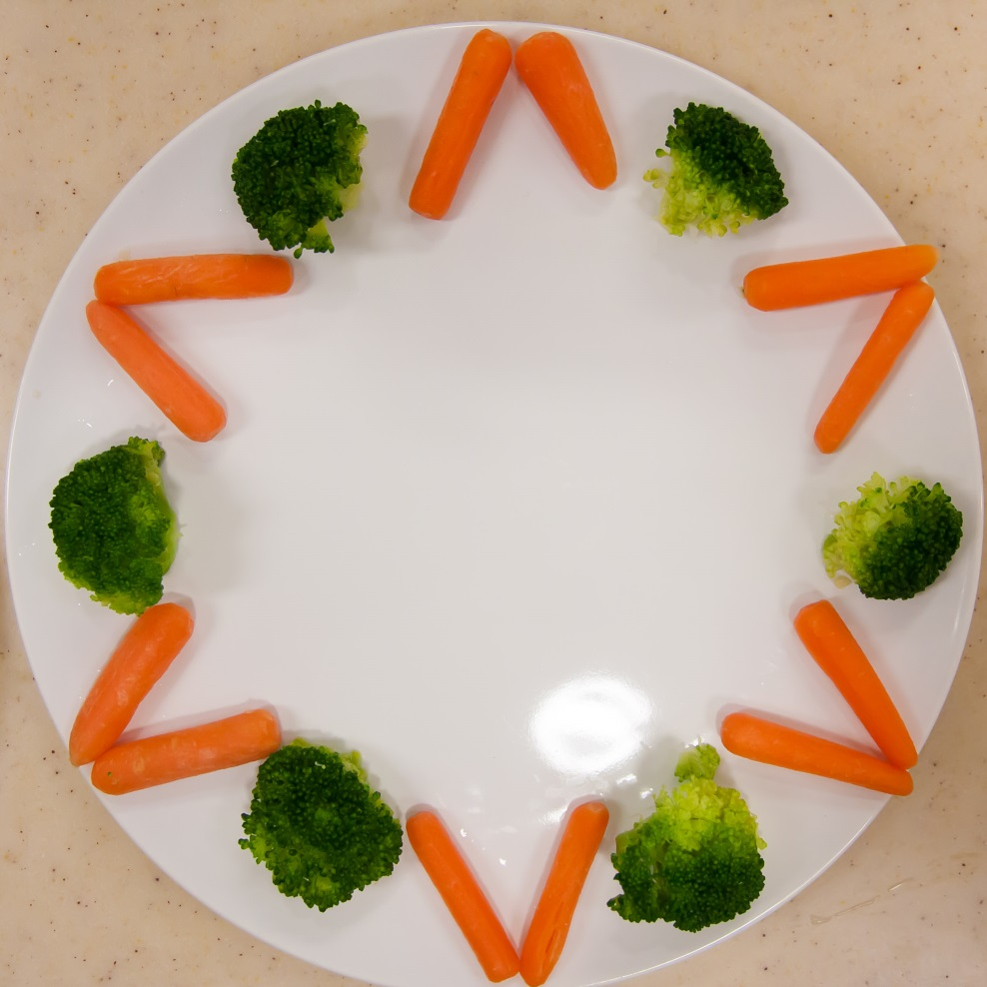
Meal presentation using garnish
Examples of garnish:

Slide 65
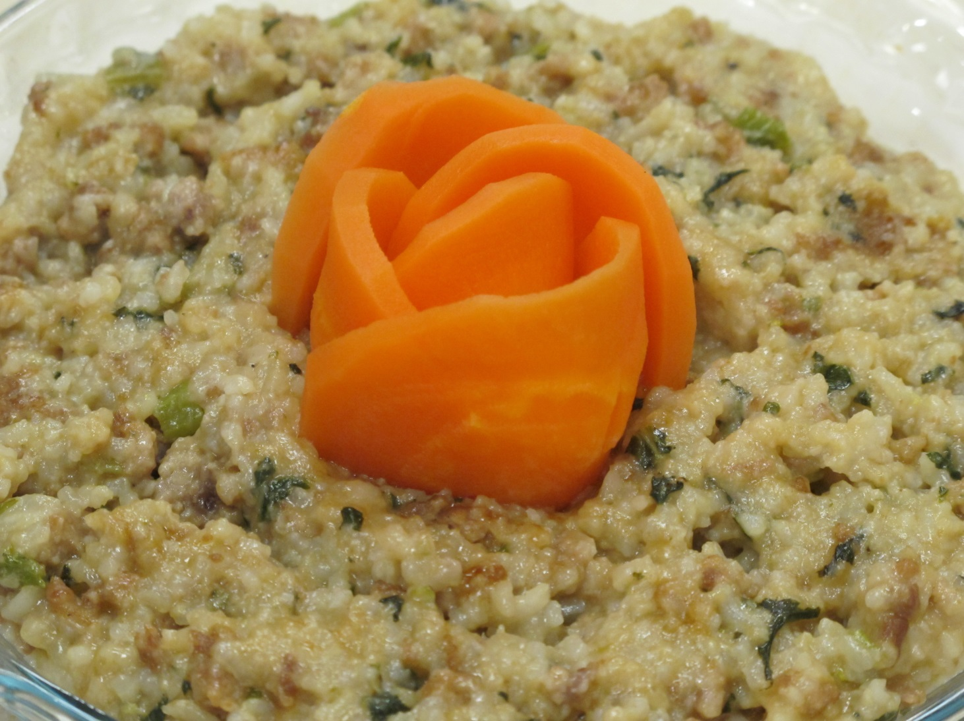
Meal presentation using garnish
Examples of garnish:

Slide 66
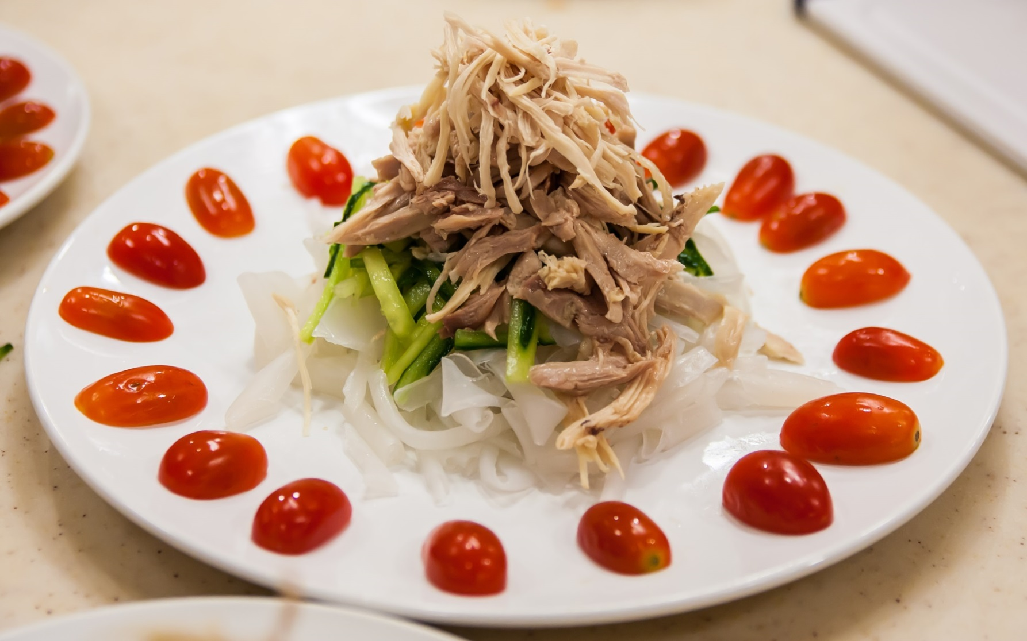
Meal presentation using garnish
Examples of garnish:

Slide 67



An example of table setting for Western meal
Bread plate
3 possible positions of the butter knife on the bread plate
Main plate

Slide 68

An example of table setting for Western meal
Bread plate
Main plate

Slide 69
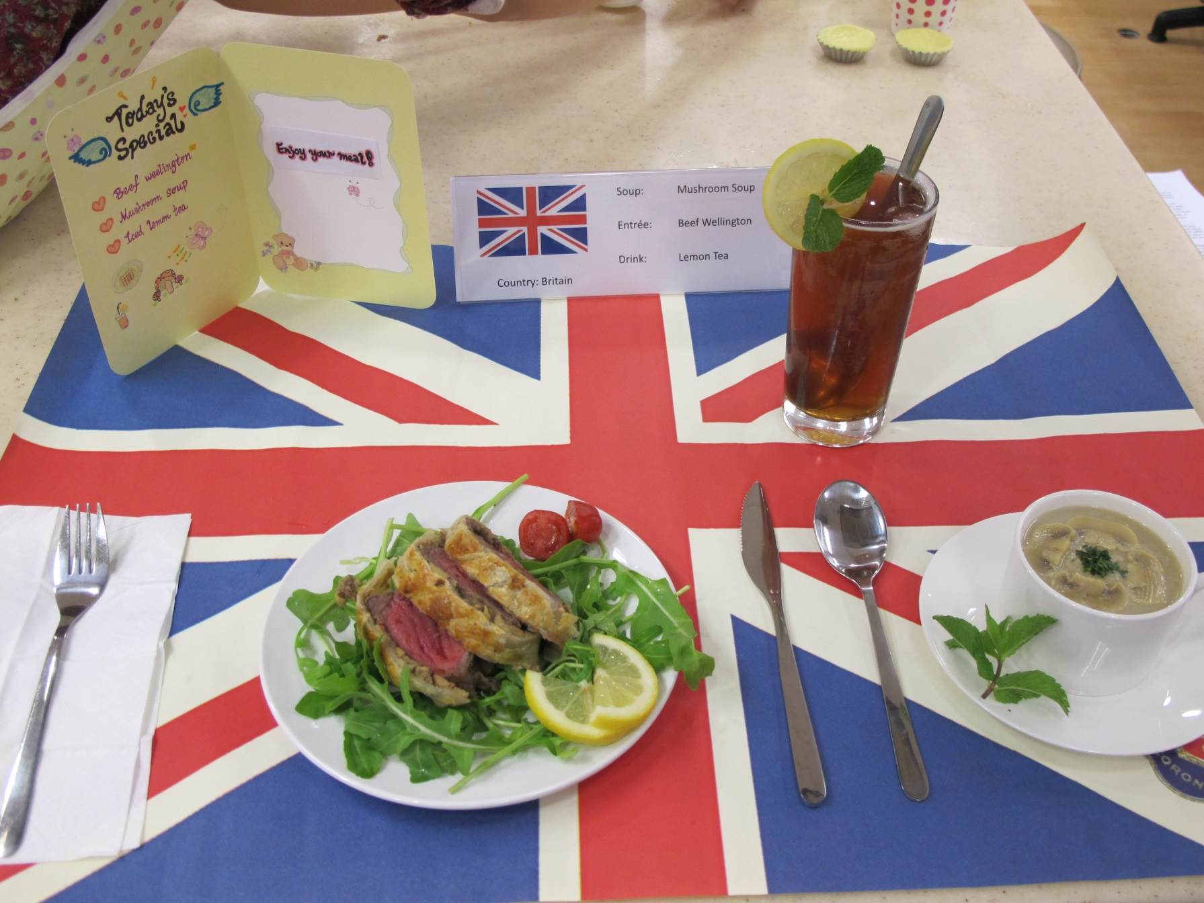
An example of table setting for Western meal

Slide 70

An example of table setting for Western meal

Slide 71
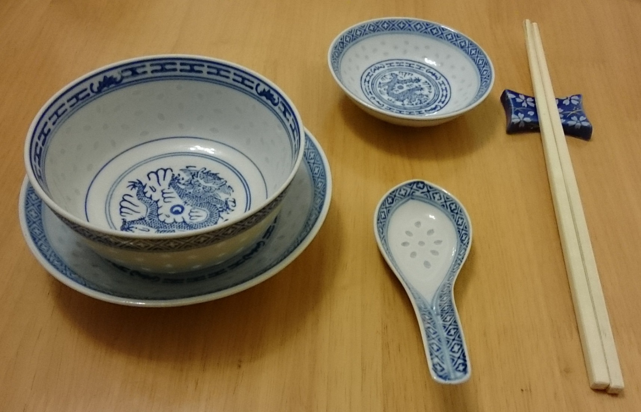
Table setting for Chinese meal
A typical place setting:

Slide 72
Glossary:
Tableware -Items used to serve and eat food
Flatware -Specific kind of tableware, for spoon, knives
Dinnerware -Specific kind of tableware, plates, bowls and cups
Glassware -Glasses used in a meal
Linens -Napkins, tablecloths, place mats
Place setting -The elements used by one person to eat a meal
A place setting describes the elements used by one person to eat a meal, while a cover is the arrangement of those elements.

Slide 73
Suggested activities

Slide 74
1) Suggested activity for Food Choice:
Think about it: How many meals have you eaten so far in your life?
Ans: age x 365 days x 3 meals/day. e.g. For age 15, i.e. 15x365x3=16425
Guiding principle for discussion:
Each day’s food choices may benefit or harm your health only a little, but when those choices are repeated over years and decades, the rewards or consequences become major. Many bodies’ activities are supported by the nutrients delivered by the foods people eat.
Without any conscious effort on your part, your body uses the nutrients from those foods to make all its components, fuel all its activities, and defend itself against diseases. How successfully your body handles these tasks depends, in part, on your food choices.
Carelessness about food choices can contribute to many chronic diseases, including heart disease, diabetes or even cancer.

Slide 75
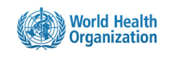
2) Suggested activity for Nutritional Deficiency:
Discuss in group the message below from World Health Organization.
“An estimated 250 000 to 500 000 vitamin A-deficient children become blind every year, half of them dying within 12 months of losing their sight.”
Source
WHO. Global prevalence of vitamin A deficiency in populations at risk 1995–2005. WHO Global Database on Vitamin A Deficiency. Geneva, World Health Organization, 2009.

Slide 76
Suggested activity for Nutritional Deficiency:
Hints for discussion:
Under-nutrition is a major public health problem
It can be caused by an inadequate amount of food or a deficiency of certain nutrients in the diet
Under-nutrition often associate with poverty
Rate of incidence is higher in developing countries
Vitamin A deficiency is a major public health problem and a leading cause of blindness

Slide 77
3) Suggested activity for Over-Nutrition:
Discuss in group the message below from World Health Organization.
Worldwide obesity has nearly doubled since 1980.
In 2008, more than 1.4 billion adults, 20 and older, were overweight.
35% of adults aged 20 and over were overweight in 2008, and 11% were obese.
65% of the world's population live in countries where overweight and obesity kills more people than underweight.
More than 40 million children under the age of 5 were overweight or obese in 2012.
Source: World Health Organization, 2014

Slide 78
Suggested activity for Over-Nutrition:
Hints for discussion:
Incidence of obesity is increasing worldwide
Obesity can lead to many chronic diseases such as diabetes, coronary heart disease and heart attacks
It may be due to sedentary lifestyles and change of eating habits

Slide 79
4) Suggested activity for Meal Planning:
Plot your actual intake (or your group) of each food group as compared to the recommended servings
 | Grains | Vegetables | Fruits | Milk | Meat and beans
Recom-mendation (e.g. Based on Dietary Guideline for Children aged 12 to 18) | 3 - 6 bowls | 6 - 8 taels (227 – 303 gram); 3 - 4 servings | 2 servings | approx. 2 servings | 5 – 6 taels (190 – 227 gram)
Name 1
Name 2
Name 3
Name 4

Slide 80
5) Suggested activity for Meal Planning:
Suggest the choices within each food group
Food group | Choice of food items
Grains
Vegetables
Fruits
Milk
Meat and beans

Slide 81
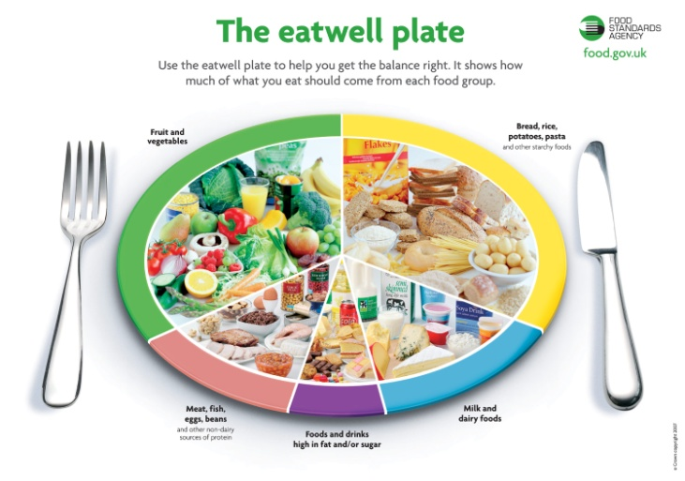
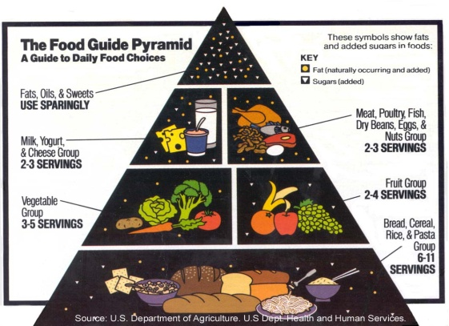
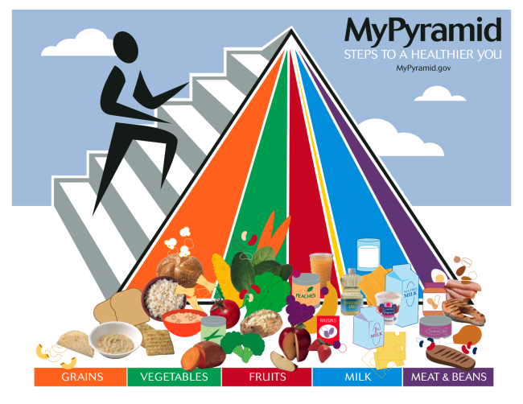

6) Suggested activity for Food Pyramid:
Discuss the similarity and differences of the food pyramids used in different countries

Slide 82
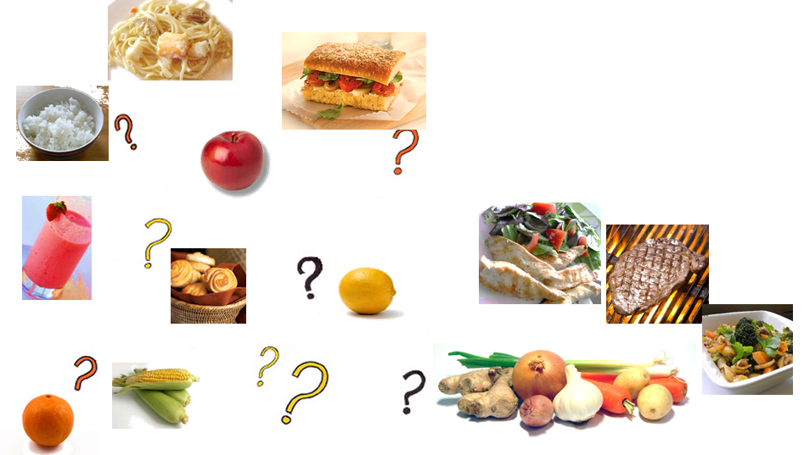
7) Suggested activity:
Discuss in class the different perceptions of “healthy food”.
What is your definition of perfect healthy food?

Slide 83
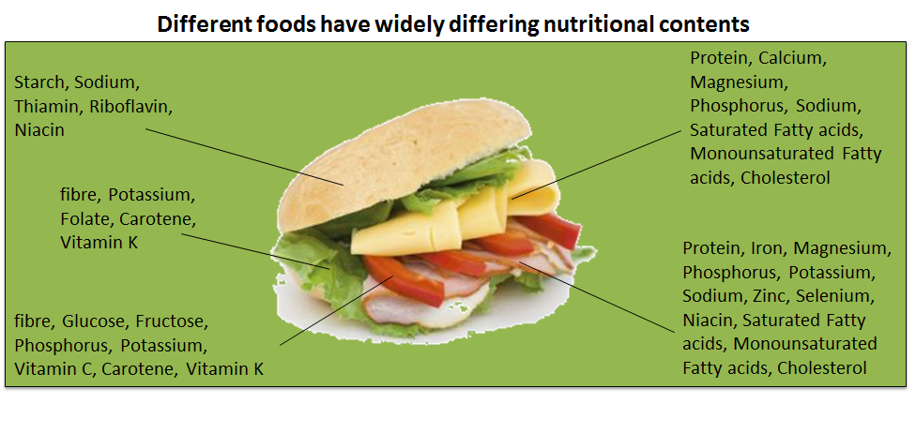
Perfect healthy food?
There is no single food that provides all the essential nutrients to keep us healthy, we need to eat a variety of foods to satisfy and nourish us.

Slide 84
Suggested assessment 1:
Select a news article with current food and nutrition issues and write a report to express your personal opinion on the selected article.

Slide 85
Suggested assessment 2:
Suggest some healthy snacks and explain how they suit your nutritional needs.
Examples:
Wheat bread roll spread with peanut butter and sprinkled with raisins: good source of fats and carbohydrates for providing energy; provide dietary fibre for gut health; raisins are also source of iron for adolescents’ growth
Cheese toast of whole grain bread with low-fat cheese: good source of carbohydrates for providing energy; provide dietary fibre for gut health; cheese is source of protein and calcium for adolescents’ growth
Low-fat yoghurt with a tablespoon of chopped almonds: good source of carbohydrates for providing energy; yoghurt and almonds are sources of calcium for bone development
Tuna salad on wheat pancake: good source of carbohydrates for providing energy; good source of protein for muscle growth; vegetables in salad provide dietary fibre for gut health

Slide 86
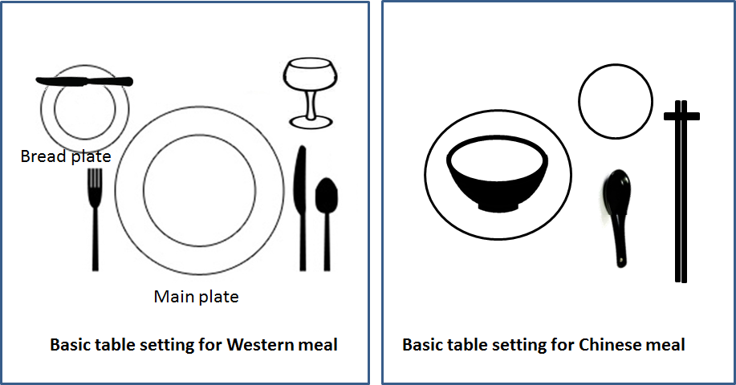
Suggested assessment 3:
Draw the basic table setting for Western and Chinese meal

