Slide 1
Hong Kong Dietary Guideline for adults
Food Group | Recommendation
Grains and Cereals | 3 – 6 bowls
Fruits | 2 – 3 servings
Vegetables | 6 - 8 taels (227 – 303 grams); 3 - 4 servings
Meat, poultry, fish, eggs & bean products | 5 – 6 taels (189 – 227 grams)
Milk & dairy products | 1 - 2 servings
Fluid: 6 - 8 cups
Source: Centre for Health Protection, Department of Health

Slide 2
Hong Kong Dietary Guideline for Children (aged 1 to 3)
Food Group | Recommendation
Grains and Cereals | 1 - 2 bowls
Fruits | 0.5 - 1 serving
Vegetables | 2 - 4 taels (76 – 151 grams); or 1 -2 servings
Meat, poultry, fish, eggs & bean products | 1 - 2 taels (38 – 76 grams)
Milk & dairy products | 2 servings
Fluid: 6 - 8 cups
Source: Centre for Health Protection, Department of Health

Slide 3
Hong Kong Dietary Guideline for Children
(aged 3 to 6)
Food Group | Recommendation
Grains and Cereals | 2 - 3 bowls
Fruits | 1 serving
Vegetables | 4 - 6 taels (151 – 227 grams); or 2 - 3 servings
Meat, poultry, fish, eggs & bean products | 2 – 3 taels (76 – 113 grams)
Milk & dairy products | approx. 2 servings
Fluid: 6 - 8 cups
Source: Centre for Health Protection, Department of Health

Slide 4
Hong Kong Dietary Guideline for Children (aged 6 to 12)
Food Group | Recommendation
Grains and Cereals | 3 - 4 bowls
Fruits | 1 – 2 servings
Vegetables | 4 - 6 taels (151 – 227 grams); or 2 - 3 servings
Meat, poultry, fish, eggs & bean products | 3 – 5 taels (113 – 189 grams)
Milk & dairy products | approx. 2 servings
Fluid: 6 - 8 cups
Source: Centre for Health Protection, Department of Health

Slide 5
Hong Kong Dietary Guideline for Children (aged 12 to 18)
Food Group | Recommendation
Grains and Cereals | 3 - 6 bowls
Fruits | 2 servings
Vegetables | 6 - 8 taels (227 – 303 grams); 3 - 4 servings
Meat, poultry, fish, eggs & bean products | 5 – 6 taels (189 – 227 grams)
Milk & dairy products | approx. 2 servings
Fluid: 6 - 8 cups
Source: Centre for Health Protection, Department of Health

Slide 6
Hong Kong Dietary Guideline for Elderly
Food Group | Recommendation
Grains and Cereals | 3 - 4 bowls
Fruits | 2 - 3 servings
Vegetables | 6 - 8 taels (227 – 303 grams); 3 - 4 servings
Meat, poultry, fish, eggs & bean products | 4 – 5 taels (151 – 189 grams)
Milk & dairy products | 1 - 2 servings
Fluid: 6 - 8 cups
Source: Centre for Health Protection, Department of Health

Slide 13
Dietary goals
Choose a variety of food and eat grains and cereals as the largest portion of food in every meal.
Eat a lot of vegetables and fruits.
Reduce the consumption of foodstuffs with high salt, fat and sugar content as well as those which are preserved.
A daily fluid intake of 6 to 8 glasses (including clear soup, fruit juice and tea).
Take meals regularly and in adequate amounts.

Slide 14
Nutrition
Nutrition is the intake of food, considered in relation to the body’s dietary needs.
Good nutrition refers to an adequate and well balanced diet combined with regular physical activity, it is the cornerstone of good health.
Poor nutrition can lead to reduced immunity, increased susceptibility to disease, impaired physical and mental development and reduced productivity.

Slide 15
Energy requirements of individuals
Daily energy needs vary among individuals, depending on their age, gender, job nature and physical activity level.
Children and adolescents in developmental stages and pregnant or breastfeeding women require higher calorie intake, while energy requirements of adults decline gradually with age.
Environmental temperature and activity level are also determining factors of our daily energy requirement. For example, we need more energy in cold weather; and people with high activity level or heavy workload have greater energy needs.

Slide 16
Energy requirements of individuals
People with low activity level should stay away from energy-dense food such as deep-fried food, candies and desserts to avoid becoming overweight.
Adolescents in their developmental stages and physically active people should maintain a balanced diet with sufficient calorie intake.
To maintain a healthy body weight, we should eat the right amount of different food groups as they contain different energy content.

Slide 17
Average daily energy requirements for individuals
Kilocalorie (kcal) is the unit for measuring energy. One kcal equals to the amount of energy needed to heat up one kilogram (one litre) of water by one degree Celsius.
 | Male (kcal) |  |  | Female (kcal)
Aged 7-10 | 1950 |  |  | 1850
Aged 11-14 | 2650 |  |  | 2300
Aged 15-18 | 2900 |  |  | 2400
Activity Level | Low | Medium | High | Low | Medium | High
Aged 18 above | 2400 | 2700 | 3200 | 2100 | 2300 | 2700
Aged 50 above | 2300 | 2600 | 3100 | 1900 | 2000 | 2200
Aged 60 above | 1900 | 2200 |  | 1800 | 2000
Aged 70 above | 1900 | 2100 |  | 1700 | 1900
Aged 80 above |  | 1900 |  |  | 1700
Extra daily energy requirements for female who are:
Pregnancy +200 kcal Breastfeeding +500 kcal
Source: The Chinese Dietary Reference Intakes, Chinese Nutrition Society 2000

Slide 18
Relationship between energy consumption and body weight
If we take in less energy than we use daily, our body growth will be hampered, leading to weight loss.
On the contrary, our body will gain weight if we take in more energy than we use daily, such as exercising less or eating too much.
It is important to maintain a good balance between energy input and output.
Energy consumption = Energy expenditure
→ body weight maintains
Energy consumption > Energy expenditure
→ body weight increases
Energy consumption < Energy expenditure
→ body weight decreases

Slide 19
Causes of nutritional disorders
There are many causes of nutritional disorders, including insufficient intake of food or of certain nutrients, inability to absorb and use nutrients, or overconsumption of certain foods.
Common nutritional disorders include anaemia caused by iron or vitamin B6 deficiency, protein-energy under-nutrition, obesity caused by excess energy intake and impaired sight caused by vitamin A deficiency.
For children, nutrition disorders can be particularly serious as it might interfere with growth and development. Under-nutrition may also predispose children to many health problems such as infection and chronic disease.
Source: World Health Organization, 2014

Slide 20
Malnutrition
Malnutrition refers to “bad nourishment”, it can be due to insufficient or excessive intake of food and nutrient. It can also be the results of the body's response to a wide range of infections that lead to malabsorption of nutrients or the inability to use nutrients properly.
Malnourishment remains a serious health problem all over the world, especially in the developing countries. Millions of children do not have access to a well-balanced diet with the nutrients they need to develop properly.
In developed countries, overeating and dietary excess have become more common. The primary consequence is obesity which may increase the risk of high blood pressure, high cholesterol levels and cardiovascular illness.
Source: World Health Organization, 2014

Slide 21
Relationship between diet and health
Food is essential for life as it is the source of energy and nutrients. Energy supports human activities whereas nutrients are vital for growth, repair, health maintenance and disease prevention.
Imbalanced or poor diet may lead to obesity or specific nutrient deficiency. These in turn may increase the risk of a variety of health problems, such as heart diseases, cerebrovascular disease, diabetes mellitus, hypertension and some cancers.
A balanced diet contributes to good health and protects against some forms of cancers.
Source: Centre for Health Protection, Department of Health

Slide 22
Dietary goals (WHO)
The recommendations include the following:
achieve energy balance and a healthy weight;
limit energy intake from fats and shift fat consumption away from saturated fats to unsaturated fats and towards the elimination of trans-fatty acids;
increase consumption of fruits and vegetables, and legumes, whole grains and nuts;
limit the intake of free sugars (e.g. sugar and syrup added to food, sugar naturally present in fruit juice and honey);
limit salt (sodium) consumption from all sources and ensure that salt is iodized.
Source: World Health Organization, 2014

Slide 23
Overweight and obesity
The prevalence of overweight and obesity is increasing at an alarming rate globally as a result of dietary changes and decreasing physical activity.
The risk of hypertension, coronary heart disease, stroke and type 2 diabetes grows progressively with increasing body weight, as do the risks of certain cancers such as breast and colon cancer.
Chronic overweight also contributes to osteoarthritis—a major cause of disability in later life.
Globally, 44% of diabetes, 23% of ischemic heart disease and between 7% and 41% of certain cancer burdens are attributable to overweight and obesity.
Source: World Health Organization, 2012

Slide 24
Tips for cutting fat and calories (1)
Buy fresh food whenever possible. Canned and processed products are often high in sodium and added with a lot of sugar or oil which is dense in calories but provide little nutritive value.
Choose lean cuts of meat and avoid meat with high fat content such as belly meat and short ribs.
Buy plenty and a variety of vegetables. Eating more vegetables can add bulk to diet and fill up the stomach so that it would be less likely to overeat as a whole. The recommendation is to eat at least 3 servings (about 240 grams or 6 taels) of vegetables each day.
Choose low-fat products of milk, dairy products, salad dressings, etc.

Slide 25
Tips for cutting fat and calories (2)
Trim all visible fat from meat before cooking and drain any fat accumulated after cooking meat. Remove fat and oil from soup as well.
Try to use steaming, stewing, braising or boiling instead of deep-frying.
Reduce the amount of oil used by adding sauces made from low-fat ingredients such as cornflour with water or light broth.
Choose vegetable oils and avoid animal fats such as butter and lard. Although both types of fats contain the same amount of calories, animal fats are rich in saturated fat which may cause elevated blood cholesterol level and increased risk of cardiovascular disease.

Slide 26
Tips for cutting fat and calories (3)
Use as little condiments as possible. Salad dressings, ketchup and chilli sauce can add fat as well as calories to food. Avoid sauces with significant amount of fat such as cream sauce and meat sauce.
Choose vegetable soup or broth instead of cream soup, because the latter is high in fat.
Avoid eating fat meat, poultry skins and offals which are high in animal fats and cholesterol.
Watch out the portion of meat which is sometimes served over-sized in restaurants. On average an adult only needs about 189 – 277 grams (5 to 6 taels) of meat each day including poultry, seafood and eggs.
Ask for a sugar-free drink.

Slide 27
Nutrition labelling
Provision of nutrition information on food labels is an important public health tool to promote a balanced diet. Nutrition labelling on food products has emerged as a prominent policy tool for promoting healthy eating.
Nutritional requirements and food preferences are different among individuals. By making use of nutrition labels, everyone can make informed choices on the types and amount of foods that meet their dietary needs.

Slide 28
Nutrition labelling scheme in Hong Kong
The Hong Kong Nutrition Labelling Scheme has come into force in 1st July 2010.
Under the Food and Drugs (Composition and Labelling) Regulations (Cap. 132W), nutrition labelling is required for all prepackaged food unless otherwise exempted.
On the nutrition label, information on energy and nutrients contents must be shown.
In addition, nutrition claims such as “low fat” or “no sugars” on pre-packaged foods are also regulated.
Source: Centre for Food Safety, Food and Environmental Hygiene Department

Slide 29
Use of nutrition information
Nutrition information is very useful for making healthy food choice.
One can use the nutrition label to:
compare nutritional content among different foods for a healthier choice, e.g. to choose food lower in fat, sodium (or salt) and sugars;
understand the nutritional content of food and estimate their contribution to the overall diet;
meet individual’s dietary needs.
Source: Centre for Food Safety, Food and Environmental Hygiene Department

Slide 30
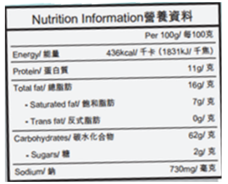
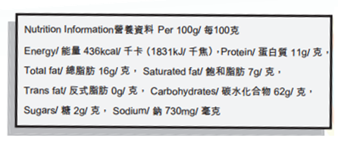
How to read nutrition label
Nutrition label is a systematic way of presenting nutrition information of food products. It is usually in a tabular format with a heading like “Nutrition Information”, “Nutrition Facts” or “Nutrition Label”.
Nutrition label is usually in a tabular format (Left side). For small packages, the nutrition label may show the energy and nutrients linearly (Right side).
Source: Centre for Food Safety, Food and Environmental Hygiene Department

Slide 31
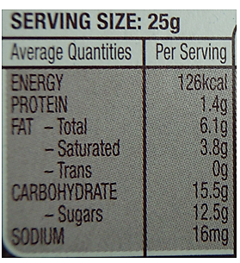
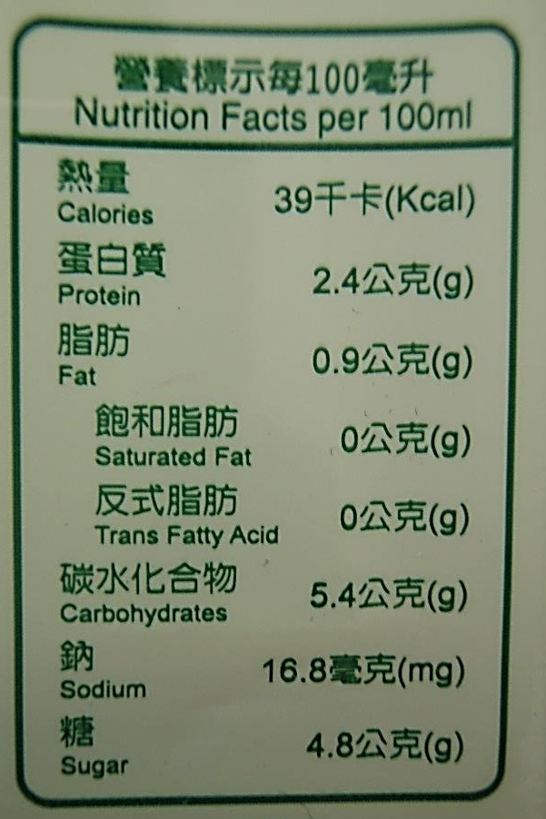
Reference amount of food
Energy and nutrient values can be expressed in different reference amounts such as per 100 g (100 mL for liquid), per serving or per package.

Slide 32
The energy and nutrient content
Nutrition label lists the energy content and values of 7 nutrients specified for labelling (“1+7”), namely, protein, total fat, saturated fat, trans fat, carbohydrates, sugars and sodium.

Slide 33
Tips to read the energy content
Read the energy content first because getting too much energy increases the risk of overweight and obesity, which then leads to increased risk of heart diseases, diabetes and certain types of cancer.
The energy content of food can be expressed in kilocalories (kcal) or kilojoules (kJ) (1 kcal ≈ 4.2 kJ) or in both.

Slide 34
Tips to read the energy content
In order to maintain health and a desirable body weight, try to limit total fat, saturated fat, trans fat and sugars by choosing food with lower amount.
For a 2000-kcal diet, the daily amount for each of the nutrients in the label should be:
Nutrient | Limit for a 2000 kcal diet
Protein | ~ 60 g
Total fat | ≤ 60 g
Saturated fat | ≤ 20 g
Trans fat | ≤ 2.2 g
Carbohydrates | ~ 300 g
Sugars | ≤ 50 g
Sodium | ≤ 2000 mg
Source: Centre for Food Safety, Food and Environmental Hygiene Department

Slide 35
Tips to read other nutrients content
In addition to the 7 nutrients specified for labelling, information of other nutrients may be found in the nutrition label.
For an average adult, recommendation of daily amount to these nutrients are:
Nutrient | Limit for a 2000 kcal diet
Dietary fibre | ≥ 25 g
Calcium | ≥ 800 mg
Vitamin C | ≥ 100 mg
Cholesterol | ≤ 300 mg
Source: Centre for Food Safety, Food and Environmental Hygiene Department

Slide 36
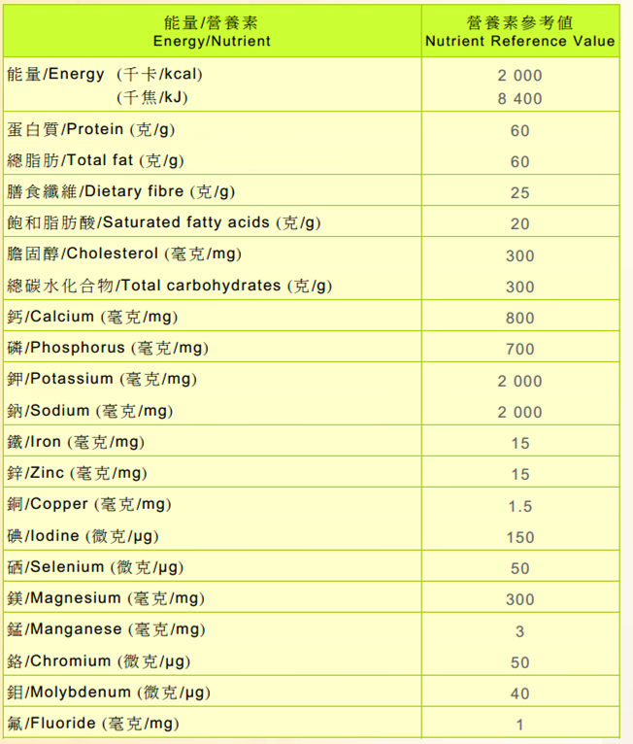
Source: Centre for Food Safety, Food and Environmental Hygiene Department

Slide 37
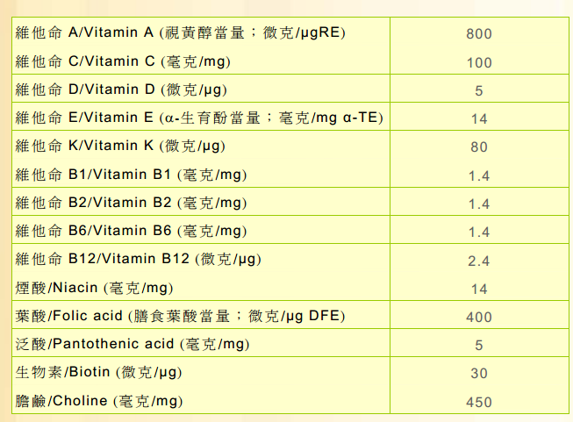
Source: Centre for Food Safety, Food and Environmental Hygiene Department

Slide 38
General meal planning principles
Nutrient recommendations: including correct serving size
Individual preferences and needs: consider factors including age, gender, occupation, health concern and special dietary needs, culture and religion
Cost/Budget: plan meals within the available budget
Cooking methods (moist-heat cooking and dry-heat cooking): alternating different cooking methods like steaming, stir-frying, boiling to avoid monotony
Seasonal factors: include fresh food produce / products which are in season and consider the climate of the season at which food is served
Occasions: prepare special dishes for different occasions, such as birthday and festivals

Slide 39
Differences between Chinese and Western meals
Chinese meal | Western meal
Cooking methods used are mainly stir frying or steaming. Ingredients and seasonings used, such as jelly fish, sea cucumber, fish maw, bird’s nest, thousand year eggs (century eggs), bean curd (tofu), oyster sauce, black bean sauce, shrimp paste, soya sauce, sesame oil. Herbs and spices used, such as ginger, spring onion, coriander (Chinese parsley), garlic, five spice powder, star anise, pepper. | Cooking methods used are mainly baking and frying. Ingredients and seasonings used, such as cheese, butter, cream or milk, salt and pepper. Herbs used, such as rosemary, dill, sage, oregano, thyme, tarragon.

Slide 40
Planning Chinese meals
A typical Chinese meal consists of soup and several main dishes, depending on the number of people to serve.
Dishes in the same meal will be of different tastes and texture, for example, serving one dish with crispy food and another dish with soft and light texture ingredients , or a bland dish with another spicy dish.
Rice or other starchy food like noodles and buns is served as the accompaniment.
Sometimes dessert or fresh fruits is served at the end of the meal.
Hot tea may be served after the meal.

Slide 41
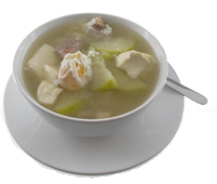
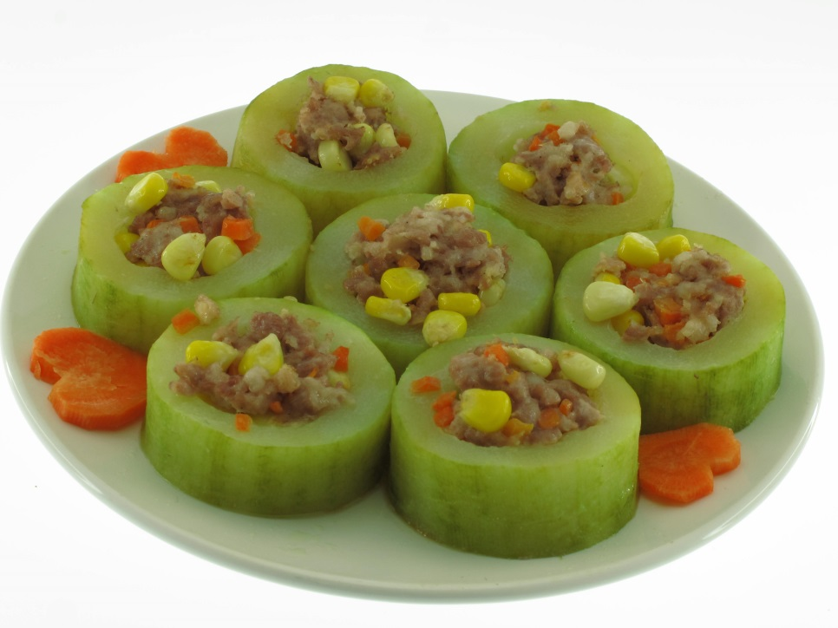
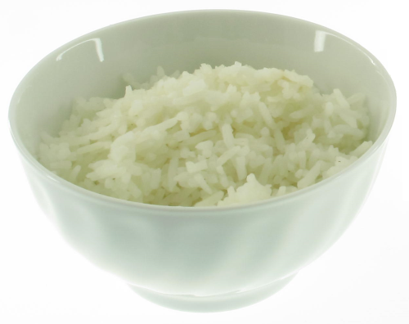
Meal pattern of a two-course Chinese meal (1)
Assorted Vegetable Soup
Starchy food, usually rice
Steamed Stuffed Hairy Melon
Soup
+ main dish (1) Steamed Stuffed Hairy Melon
+ Rice

Slide 42
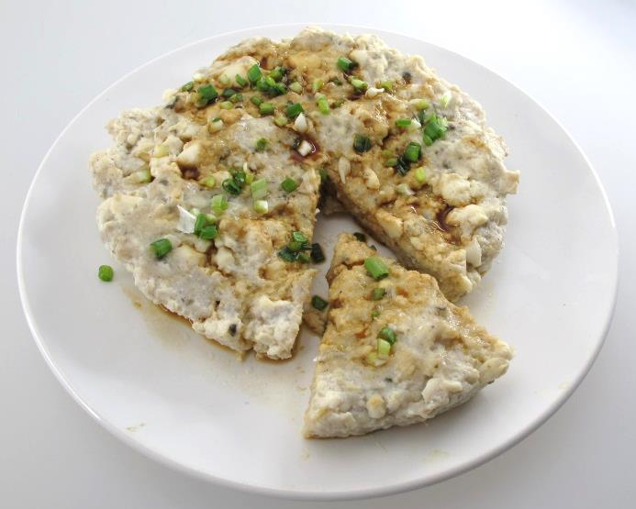
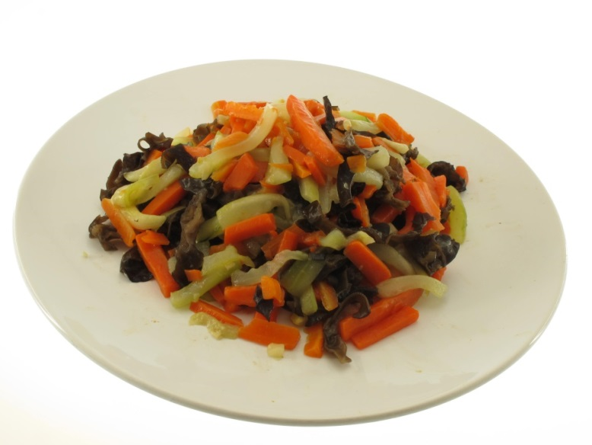
Meal pattern of a two-course Chinese meal (2)
Starchy food, usually rice
Steamed Bean Curd with Minced Fish (老少平安)
Stir-fried Assorted Vegetables
main dish (1) Steamed Bean Curd with Minced Fish
+ main dish (2) Stir-fried Assorted Vegetables
+ Rice

Slide 43
Planning Western meals
Western meal generally have three or four courses such as salad and/or soup, main dish (entrée) and dessert.
The main courses should be based on protein foods, or vegetables or pasta served with side vegetables and / or accompaniments and the meal is served together with starchy food (e.g. bread, rice) as accompaniment.
Meal pattern of a two-course Western meal usually consists of:
Soup with suitable accompaniment AND main course with suitable accompaniment OR
Main course with suitable accompaniment AND dessert

Slide 44
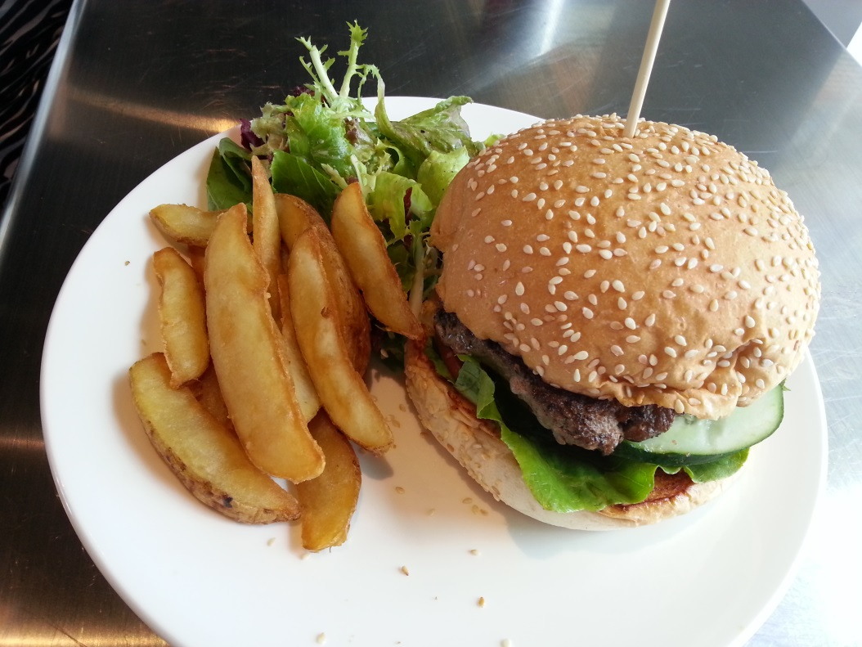
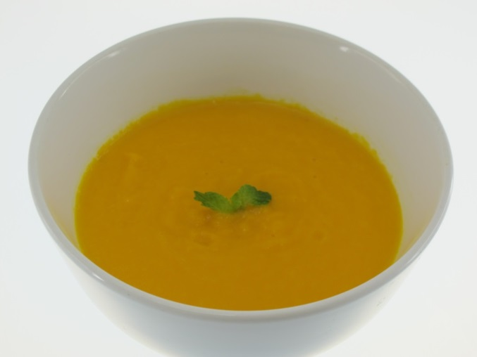
Meal pattern of a two-course Western meal
Soup: Cream of Pumpkin
Main Course: Angus Beef Burger with Chips
Soup + main course

Slide 45
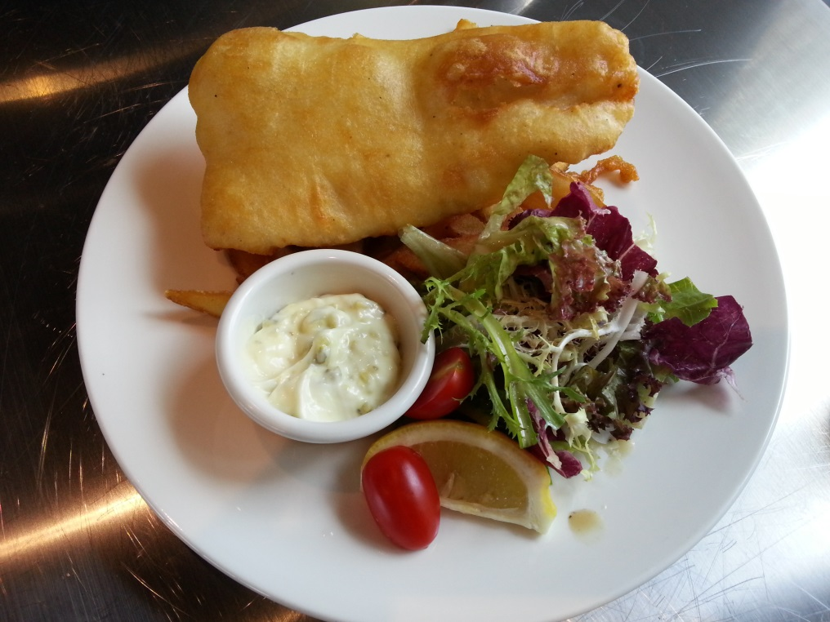
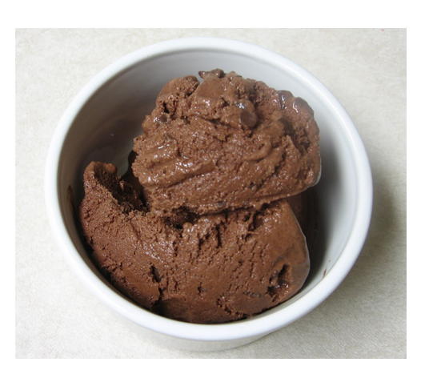
Meal pattern of a two-course Western meal
Dessert: Ice-cream
Main Course: Fried Fish with Green Salad
Main course + dessert

Slide 46
Accompaniments
Examples of accompaniments in Western meal
Dishes | Suggested accompaniments
Soup | Fried or toasted bread croutons, bread rolls, garlic bread, bread sticks
Salad | Salad dressing
Meat | Green salad, coleslaw, mixed vegetables, mustard or gravy
Fish | Tartar sauce, tomato sauce, lemon wedges
Seafood | Pepper mill, tabasco sauce, lemon wedge
Poultry | Bread sauce, roast gravy
Lamb chop | Mint sauce, apple sauce or redcurrant jelly
Spaghetti | Grated parmesan cheese

Slide 47
Planning meals for manual workers
As manual workers perform physically demanding work on a regular basis, their daily energy expenditure is high.
E.g. builders, farmers, engineers, road workers, landscape gardeners and all professions require a great deal of physical strength and energy.
Their working performance is directly affected by what and how much they eat.

Slide 48
Principles of planning meals for manual workers
Meet the high demands of food energy and fluid requirement.
The major source of energy is carbohydrate, such as rice, noodle and bread.
Include snacks in between meals, avoid fatty and sugary junk foods.
Vary food choices and offer plenty of water throughout the day, especially for those working outdoors and in the heat.
Avoid caffeine and alcohol or large amounts of sugar.

Slide 49
Example of a meal plan for manual workers
Meal | Foods
Breakfast | 3-4 slices of bread / toast + jam/peanut butter 250ml low fat milk
Morning tea | Sandwich (2 slices of bread) with chicken/ham/tuna 1 fresh fruit
Lunch | 2 bowls of rice 200g stir-fried sweet and sour pork 2 bowls of vegetables Low fat / low sugar yoghurt
Afternoon tea | 3 pancakes + cheese/peanut butter 1 fresh fruit Drink
Dinner | 2 bowls of rice or cooked pasta or 1 large potatoes 200g chicken breast or fish or lean meat 2 bowls of cooked vegetables or 1 large bowl of green salad Drink
Supper | 3-4 crackers + low fat soft cheese Large handful of nuts Low fat yoghurt

Slide 50
Comparison between plain water and sports beverages
 | Advantages | Disadvantages
Plain Water | Noncaloric Refreshing taste Widely available | Provides no carbohydrates Electrolytes content of unbottled water not known and variable
Sports Beverages (4% to 7% Carbohydrates) | Provide carbohydrates Sweet taste Contain electrolytes in known quantities Rapid rate of absorption due to sugar and sodium content Convenient | Could provide unwanted calories if overconsumed

Slide 51
Planning meals for sedentary worker
Sedentary workers are always sitting at a desk with minimal physical activity. Nowadays many people live a sedentary lifestyle owing to the nature of the work, e.g. working either in office or at home.
The energy requirement for an individual depends on many factors such as age, gender, weight and lifestyle. People having sedentary lifestyle do not require energy similar to active people. A sedentary lifestyle and poor eating habits are the main causes of weight gain, therefore a well balanced diet is necessary for weight management.

Slide 52
Principles of planning meals for sedentary workers
Include all food groups daily to get sufficient vitamins and minerals in the diet.
Consume more complex carbohydrates (instead of simple and refined carbohydrates) as the main base of the meals. Such complex carbohydrates include whole grain, whole wheat products, whole cereals, fruits and vegetables.
The protein should come from good quality sources such as poultry without skin, lean meat, fish, eggs and low fat dairy products.
If possible choose low fat alternatives such as skimmed milk, low fat cheese and yoghurt. Seeds, olive oil, and nuts are good sources of healthy fat forms.
Fresh fruits and salads will be a great alternative to salty and fatty snacks.

Slide 53
Example of a meal plan for sedentary workers
Meal | Foods
Breakfast | 2 slices of bread / toast + jam/peanut butter OR 1 cup of high-fibre cereal OR 1 cup of cooked oatmeal 200ml skimmed milk
Morning tea | 1 fresh fruit or fruit salad
Lunch | 1 bowl of rice 100g steamed fish 1 bowl of vegetables Low fat / low sugar yoghurt
Afternoon tea | Small handful of nuts
Dinner | 1 bowl of rice or cooked pasta 100g lean meat 2 bowls of cooked vegetables or 1 large bowl of green salad
Supper | 1 fresh fruit

Slide 54
Planning meals for vegetarian
Vegetarian is a general term used to describe people who exclude meat, poultry, fish, or other animal-derived foods from their diets.
Vegetarian diet has become more popular in recent years for the following reasons:
some people believe that vegetarian diet is healthier;
some have religious reasons and refrain from eating meat;
some have special beliefs such as environmental protection and animal rights protection;
some people simply want to control their weight and therefore cut down on meat consumption.

Slide 55
Planning meals for vegetarian
In general, vegetarians can be categorised into two main groups:
Strict vegetarians (Vegan) who only eat plant foods and products.
Half vegetarians who eat egg, milk or milk products:
Lacto-vegetarian: Consumes only milk and dairy products, fruits, vegetables and cereals, but exclude eggs, meat, poultry, fish and seafood.
Ovo-vegetarian: Consumes only eggs, fruits, vegetables and cereals, but exclude milk and dairy products, and meat, poultry, fish and seafood.
Lacto-ovo-vegetarian: Consumes only milk and dairy products, eggs, fruits, vegetables and cereals , but exclude meat, poultry, fish and seafood.

Slide 56
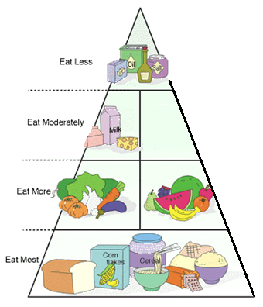
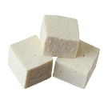
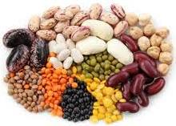
Planning meals for vegetarian
Vegetarian diets should be well-planned to meet nutritional requirements and to be regarded as a healthy diet.
To ensure a nutritionally balanced diet, a variety of foods should be selected from each of the food groups.
Fat, oil, salts and sweets
Beans, legumes, nuts, seeds, their alternatives and/or egg, dairy products (for lacto-, ovo- and lacto-ovo-vegetarians)
Fruits and vegetables
Grains and cereals
Modified from the Central Health Education Unit of the Department of Health, HKSAR

Slide 57
Principles in planning vegetarian meals
Vegan tends to be lack in protein. A good supply of protein from plant source is necessary such as nuts, pulses, soya bean products (e.g. bean curd / tofu), textured vegetable protein and commercially prepared meat analogues.
Vegetable fat and oils should be used for cooking instead of butter and lard.
As strict vegans do not consume milk and dairy products, good supply of calcium from plant source is needed, such as dark green leafy vegetables, bean curd / tofu made with calcium sulfate, calcium-fortified soya milk and orange juice.

Slide 58
Example of a meal plan for vegans
Meal | Foods
Breakfast | 2 slices of bread / toast + jam/peanut butter/avocado OR 1 cup of high-fibre cereal with 1 tablespoon raisins or nuts OR 1 cup of cooked oatmeal with 1 tablespoon raisins or nuts 200ml soya milk
Morning tea | 1 fresh fruit or fruit salad Small handful of nuts
Lunch | 1 bowl of rice 100g braised Chinese mushrooms and bean curd / tofu OR 100g Chinese peas and cabbages in curry sauce OR 100g Stewed assorted beans, eggplant and cauliflower
Afternoon tea | 1 small wheat bread roll with 60g beancurd burger
Dinner | 1 bowl of rice or cooked pasta 100g stir-fried assorted vegetables with seitan (meat analog made with wheat gluten) 2 bowls of cooked vegetables or 1 large bowl of green salad with sesame dressing 1 slice of apple pie / carrot cake
Supper | 1 fresh fruit / 1 cup fruit smoothie

Slide 59
Planning packed meal
Packed meals are meals which are packed at home, then taken to eat at school, office or outdoor.
The reasons for taking packed meal includes money saving and eating healthier.
Packed meals can be prepared from leftovers from the dinner in the previous evening. Plan the evening meal with the next day’s packed lunch in mind.

Slide 60
Principles in planning packed meals
Maintain the taste and appearance of packed meals as compared to freshly made meals as much as possible.
Follow safety rules such as proper packaging and sufficient heating to avoid foodborne illnesses.
The characteristics of packed meal are:
Easy to pack and carry such that foods will not be damaged or crushed during transportation.
Convenient to eat so only simple cutlery is needed.
Cold dish is also suitable as packed meals such as salad and bread.
A drink should be included such as soup, milk, juice, cold tea or water.

Slide 61
Examples of packed meals
Main | Drink
Ham, cheese, tomato and lettuce sandwich | Soya milk
Garden green salad with sesame dressing | Soup
Beef curry and bell peppers with rice | Tea
Chicken breast, corn and carrot with macaroni | Low fat milk
Pan Bagnat with tuna, hard-boiled egg, tomato and olive | Low-fat yoghurt drink

Slide 62
Convenience foods
Convenience food is any product that has been partially or completely prepared or processed by the manufacturer.
Most people use convenience foods to save time, eat conveniently during travel and be able to store food for a longer period of time.
Their environmental effects are also a concern because they come with a package such as plastic, metal or cardboard containers. It is highly encouraged that these materials be recycled and re-used.

Slide 63
Types of convenience foods
There are different types of convenience food and could generally be classified as follows:
(1) Usage – convenience foods can use as a meal / dish or part of a meal / dish
(2) Preservation method
Ready-to-eat (e.g. cakes, snacks, pasties, salads, sandwiches)
Cook-chill
Chilled or frozen
Dehydrated
Bottled
Canned or tinned

Slide 64
Usage of convenience foods
Used as a meal / dish (ready-to-eat, cook-chill, chilled or frozen, ready-to-cook) e.g.
One dish meal such as pies, curries (to be served with starchy food), stewed food (to be served with starchy food), fried rice / noodles, main dish with rice / noodles, pasta, pizzas, burgers, sandwiches, fish and chips
Baby food
Used as part of a meal / dish (ready-to-eat, cook-chill, chilled or frozen, dehydrated, canned, tinned, bottled) e.g.
Soups, desserts, salads, sauces, canned meat balls, processed sliced meat, canned chicken in white sauces, shaped and breaded chicken pieces for frying and baking, filleted fish coated with breadcrumbs

Slide 65
Usage of convenience foods
Used as snacks, e.g.
Canned corn, drink mixes, potato chips, individually wrapped bread roll, cup cakes, crackers
Used as ingredients, e.g.
Sauces and seasonings (e.g. packet mixes, stocks cubes, liquid stock, sauces in cans / tins / bottles, soya bean paste)
Dried / preserved ingredients (e.g. dried noodles, dried pasta, dried / preserved vegetables)

Slide 66
Nutrition issues of convenience foods
As long as fresh food products undergo minimal storage and are handled at proper temperatures, they are better than processed products.
The nutritive value of food is often altered by the kind of processing it undergoes. The water-soluble vitamins such as vitamin C are the most vulnerable to processing and cooking.

Slide 67
Nutrition issues of convenience foods
Some convenience foods such as syrup-free canned fruit can be excellent choices to include in a well-balanced diet as they are rich in nutrients but relatively low in calories.
However, some prepackaged types are loaded with additives, excessive sugar or salt in order to extend the product’s shelf life. It is recommended that convenience foods shall be used occasionally and not to replace freshly made diets.

Slide 68
Left-over foods
Using left-over foods helps to cut down the cost of meals and reduce food waste.
Improper handling or storing cooked food is one of the most common causes of food poisoning in the home.
Left-over foods should be cooled as quickly as possible and stored in covered containers in the refrigerator or freezer and consumed within 2 days.
Before consumption of the left-over foods, they should be reheated to a temperature over 75°C to kill the bacteria. During the reheating process the food must be bubbling throughout and stirred sufficiently so as to distribute heat evenly.
The left-over foods should be reheated only once. Reheating more than once increase the chance for the growth of bacteria.

Slide 69
Tips of using left-over foods
Cut the left-over foods into smaller pieces so they can be mixed and cooked with fresh ingredients together.
Add other ingredients such as fresh vegetables with the left-over foods to make it different
Add sauce to replace the loss of water of left-over foods
Add flavouring to improve or change the original taste

Slide 70
Examples of using left-over foods
Cooked rice may be made into:
fried rice and mixed with new ingredients
toss into vegetable soup or chicken broth to become rice in soup
Bread can be made into:
croutons to serve with green salad
bread pudding, a sweet dessert
Carcass of chicken can be used to make soup base
Cooked chicken meat can be diced / sliced / shredded and mixed with other ingredients such as Fried Broccoli and Shredded Chicken with Egg Noodles
Vegetables can be diced and sauté with eggs to make veggie omelette

Slide 71
1) Suggested activity for fat intake:
Discuss in class “How to avoid excessive intake of fat?”
Points to consider:
remove skin before eating meat
avoid eating deep fried food
portion control in every meal is important
use a minimum amount of oil to cook
check the nutrition information before choosing food
use steaming or boiling as methods of cooking
use lean meat to replace fatty meat
take less fatty food, such as pork, oily fish etc.
reduce eating processed foods such as luncheon meat, instant noodles and sausages
eat less greasy and energy dense foods such as potato crisps, soft drinks and ice-cream

Slide 72
2) Understanding beans:
Play a game of “BeanGo” (modified BINGO)
Each student receives a card with 4x4 matrices printed with different bean names in each space. Teacher will randomly call out a name of bean each time. Anyone who gets a roll will win. The winners need to call out the word "BeanGo“ to alert the other students of a possible win.
BEANGO

Slide 73
2) Understanding beans:
Play a game of “BeanGo” (modified BINGO)
Example:
Bean list:
Red Bean (Adzuki)
Black-eyed pea
Pinto bean
Broad bean
Chickpea
Edamame (Mao Dou)
Green pea
Black bean
Kidney bean
Butter bean
Hyacinth bean
Chinese Long Bean
String bean
Snow pea
Mung Bean
soya bean
BEANGO
Red bean (Adzuki) | Black-eyed pea | Broad bean | Chickpea
Edamame (Mao Dou) | Green pea | Black bean | Kidney bean
Butter bean | Hyacinth bean | Pinto bean | Chinese long bean
String bean | Snow pea | Mung Bean | soya bean

Slide 74
3) Eating varieties
Rainbow food tracker
Food natural colours are health protectors with antioxidants. Track your food colours and aim for at least 5 colors everyday.
Examples of foods in different colour:
Tomato | Orange | Mango | Broccoli | Cabbage | Eggplant | Walnuts | White bean
Straw-berry | Carrot | Lemon | Kale | Avocado | Purple sweet potato | Whole grain bread | Garlic
Red bean | Sweet potato | Corn | Choi sum | Kiwi | Plums | Mush-room | Onion
Water-melon | Pumpkin | Pepper | Pea | Spring onion | Blue-berry | Peanut butter | Cauli-flower

Slide 75
3) Eating varieties
Rainbow food tracker
Track your food colours and aim for at least 5 colours everyday. Colour the circle with the colours of food that are included each day.
Monday | Tuesday | Wednesday | Thursday | Friday | Saturday | Sunday

Slide 76
4) Understanding food label
Grocery Store Race
Search for the best snack for you. Fill in the table below and compare the fat level of your favourite snack in the grocery store.
Snack item | Total fats per 100 gram | Sugars per 100 gram

Slide 77
4) Understanding food label
Grocery Store Race
Search for the best snack for you. Fill in the table below and compare the fat level of your favourite snack in the grocery store.
Example:
Snack item | Total fats per 100 gram | Sugars per 100 gram
Cream sandwich crackers | 29 gram | 9.5 gram
Five Spices Pork Slices | 8.2 gram | 20.6 gram

Slide 78
Suggested assessment 1:
By using the food pyramid, design a one day meal to meet your nutritional needs
Meal | Food group | Food items
Breakfast
Morning tea
Lunch
Afternoon Tea
Dinner
Supper

Slide 79
Suggested assessment 1:
Sample answer.
Meal | Food group | Food items
Breakfast | Cereals and dairy Fruit Meat | 1 cup of oatmeal with 200 ml skimmed milk 1 banana ¼ cup almonds
Morning tea | Cereals Dairy | 4 x Plain soda crackers 1 slice of low-fat cheese
Lunch | Grains Meat Vegetables | 1 bowl of rice 2 medium sized pork chops 1 bowl of mixed green cabbages
Afternoon tea | Dairy Grains and fats | 1 cup of low-fat yoghurt 1 small bread roll with peanut butter
Dinner | Grains Meat Vegetables | 1 small plate of spaghetti 80 gram minced beef 2 tomatoes ½ bowl of carrot and onion
Supper | Fruit | 1 orange

Slide 80
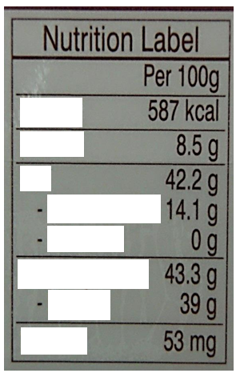
Suggested assessment 2:
Understanding nutrition label
Fill in the blanks below for the components of a nutrition label in Hong Kong
Word bank:
Sodium
Saturated fat
Protein
Total fat
Carbohydrates
Energy
Trans fat
Sugars

Slide 81
Suggested assessment 2:
Understanding nutrition label
Fill in the blanks below for the components of a nutrition label in Hong Kong
Answer:
Word bank:
Sodium
Saturated fat
Protein
Total fat
Carbohydrates
Energy
Trans fat
Sugars

Slide 82
Suggested assessment 3:
Choose healthier alternatives
Suggest alternatives to the snacks stated below.
Instead of | Replace with
Sugary beverages
Cookies
Potato crisps
Ice cream
Sweet bun / egg tart

Slide 83
Suggested assessment 3:
Choose healthier alternatives
Suggest alternatives to the snacks stated below.
Suggested answers:
Instead of | Replace with
Sugary beverages | Tea, diluted 100% juice, low-fat yoghurt drink
Cookies | Soda crackers or rice crackers
Potato crisps | Baked vegetable crisps, apple crisps
Ice cream | Low-fat yoghurt, low-fat frozen yoghurt
Sweet bun / egg tart | Whole wheat bread roll

Slide 84
Glossary:
Adequate diet: a diet that provides enough energy, essential nutrients and dietary fibre to keep a person healthy
Balanced diet: a diet in which foods are chosen to provide energy essential nutrients and dietary fibre in the right proportions
Cancer: a group of diseases characterised by unrestrained cell division and growth that can disrupt the normal functioning of an organ and also spread beyond the tissue in which it started.
Cardiovascular disease: a disease of the heart and blood vessels such as coronary artery disease, stroke and high blood pressure.

Slide 85
Glossary:
Visible fat: fats in foods that are purchased and used as fats, such as butter or margarine
Invisible Fats: fats that are not immediately noticeable such as those in egg yolk, cheese, cream, and salad dressings
Body Mass Index (BMI): a simple index of weight-for-height that is commonly used to classify underweight, overweight and obesity in adults. It is defined as the weight in kilograms divided by the square of the height in metres (kg/m²).
Overweight: Body mass index (BMI) of 25.1 to 30 kg/m² or weight 10-20% above normal range
Obesity: Body mass index (BMI) > 30 kg/m² or excessive body fat of 20% above normal range

Slide 86
Glossary:
Vegans: individuals eating a type of vegetarian diet in which no eggs or dairy products are eaten; their diet relies exclusively on plant foods
Lacto-Ovo Vegetarian: vegetarians who will eat dairy products and eggs but no meat, fish or poultry
Ovo-Vegetarian: vegetarians who will eat eggs but no meat, fish or poultry
Lacto-Vegetarian: vegetarians who will eat dairy product but no meat, fish or poultry

