Slide 1
TECHNOLOGY & LIVING
Textile Technology
S1.1 Basic Design Process &
Textile Development Process

Slide 2
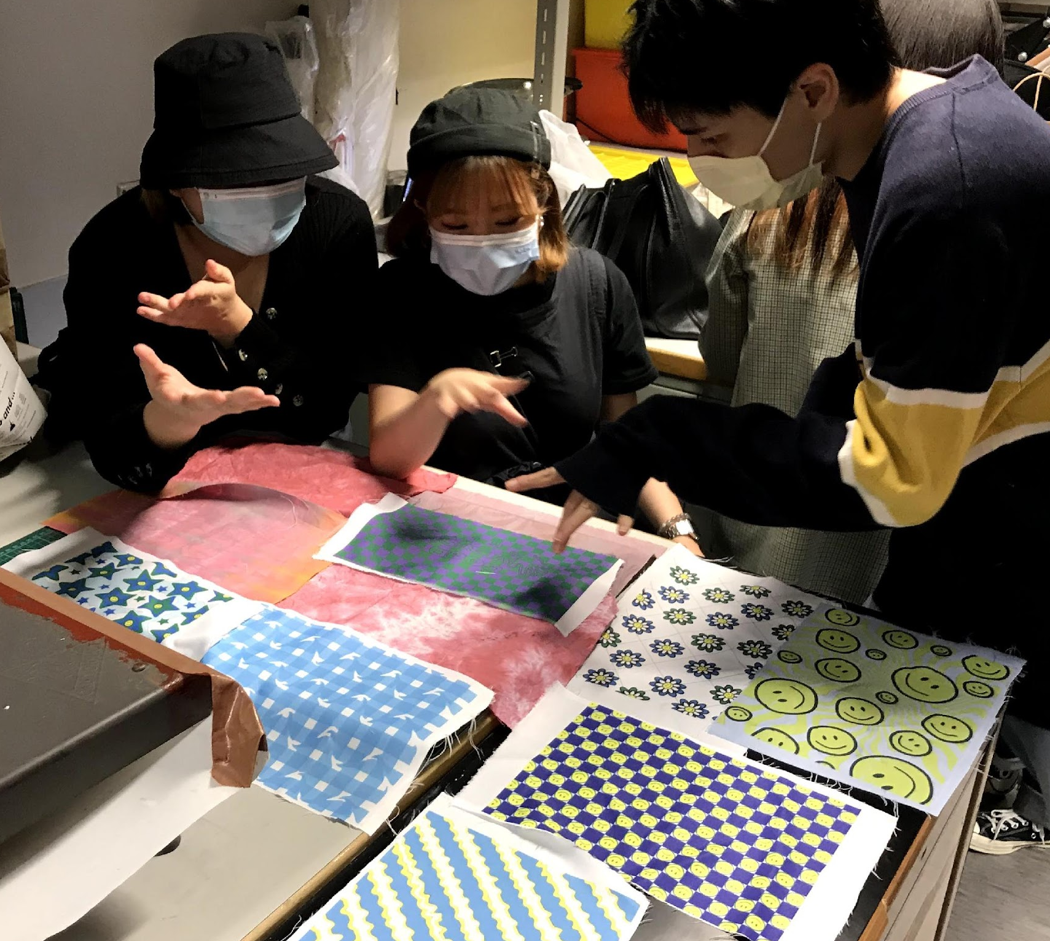
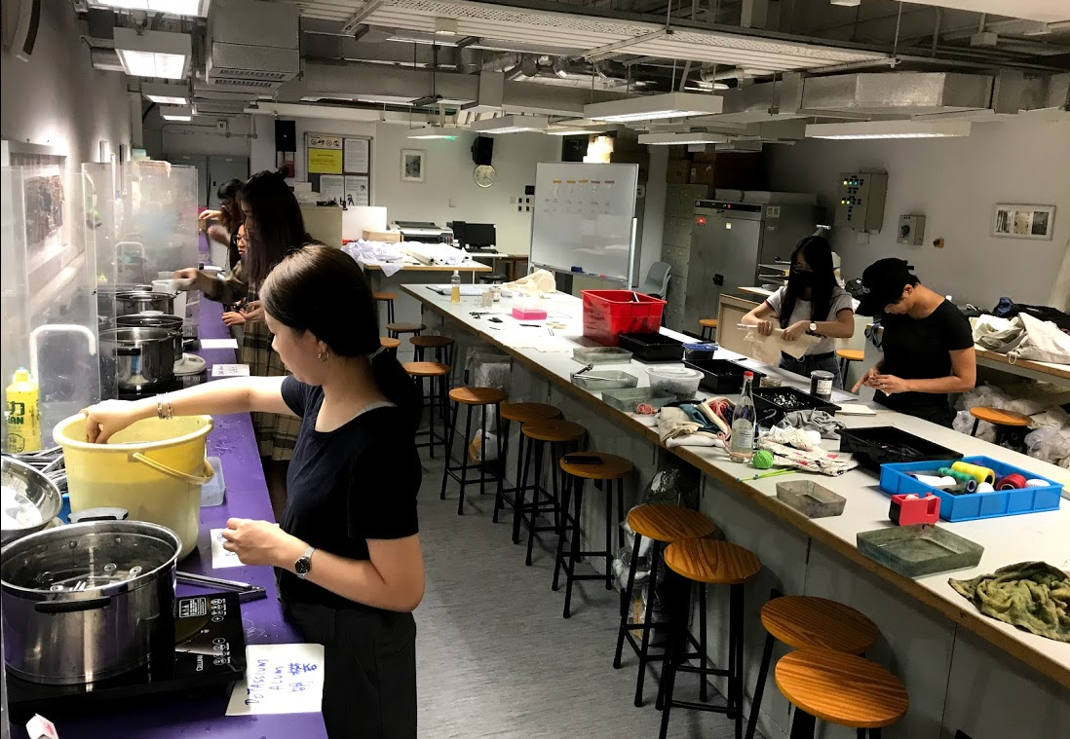
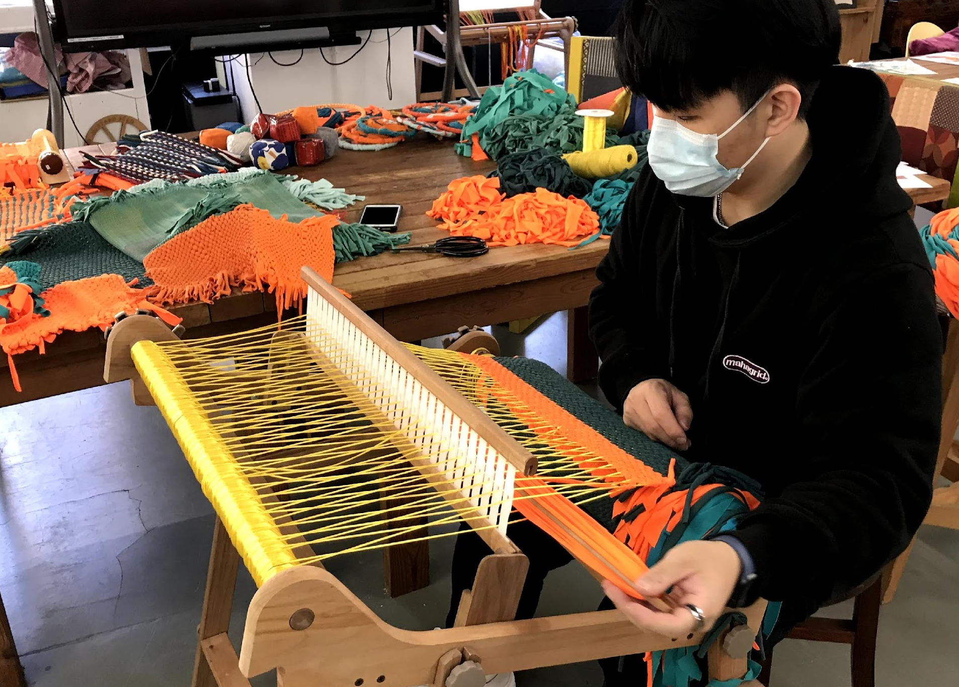
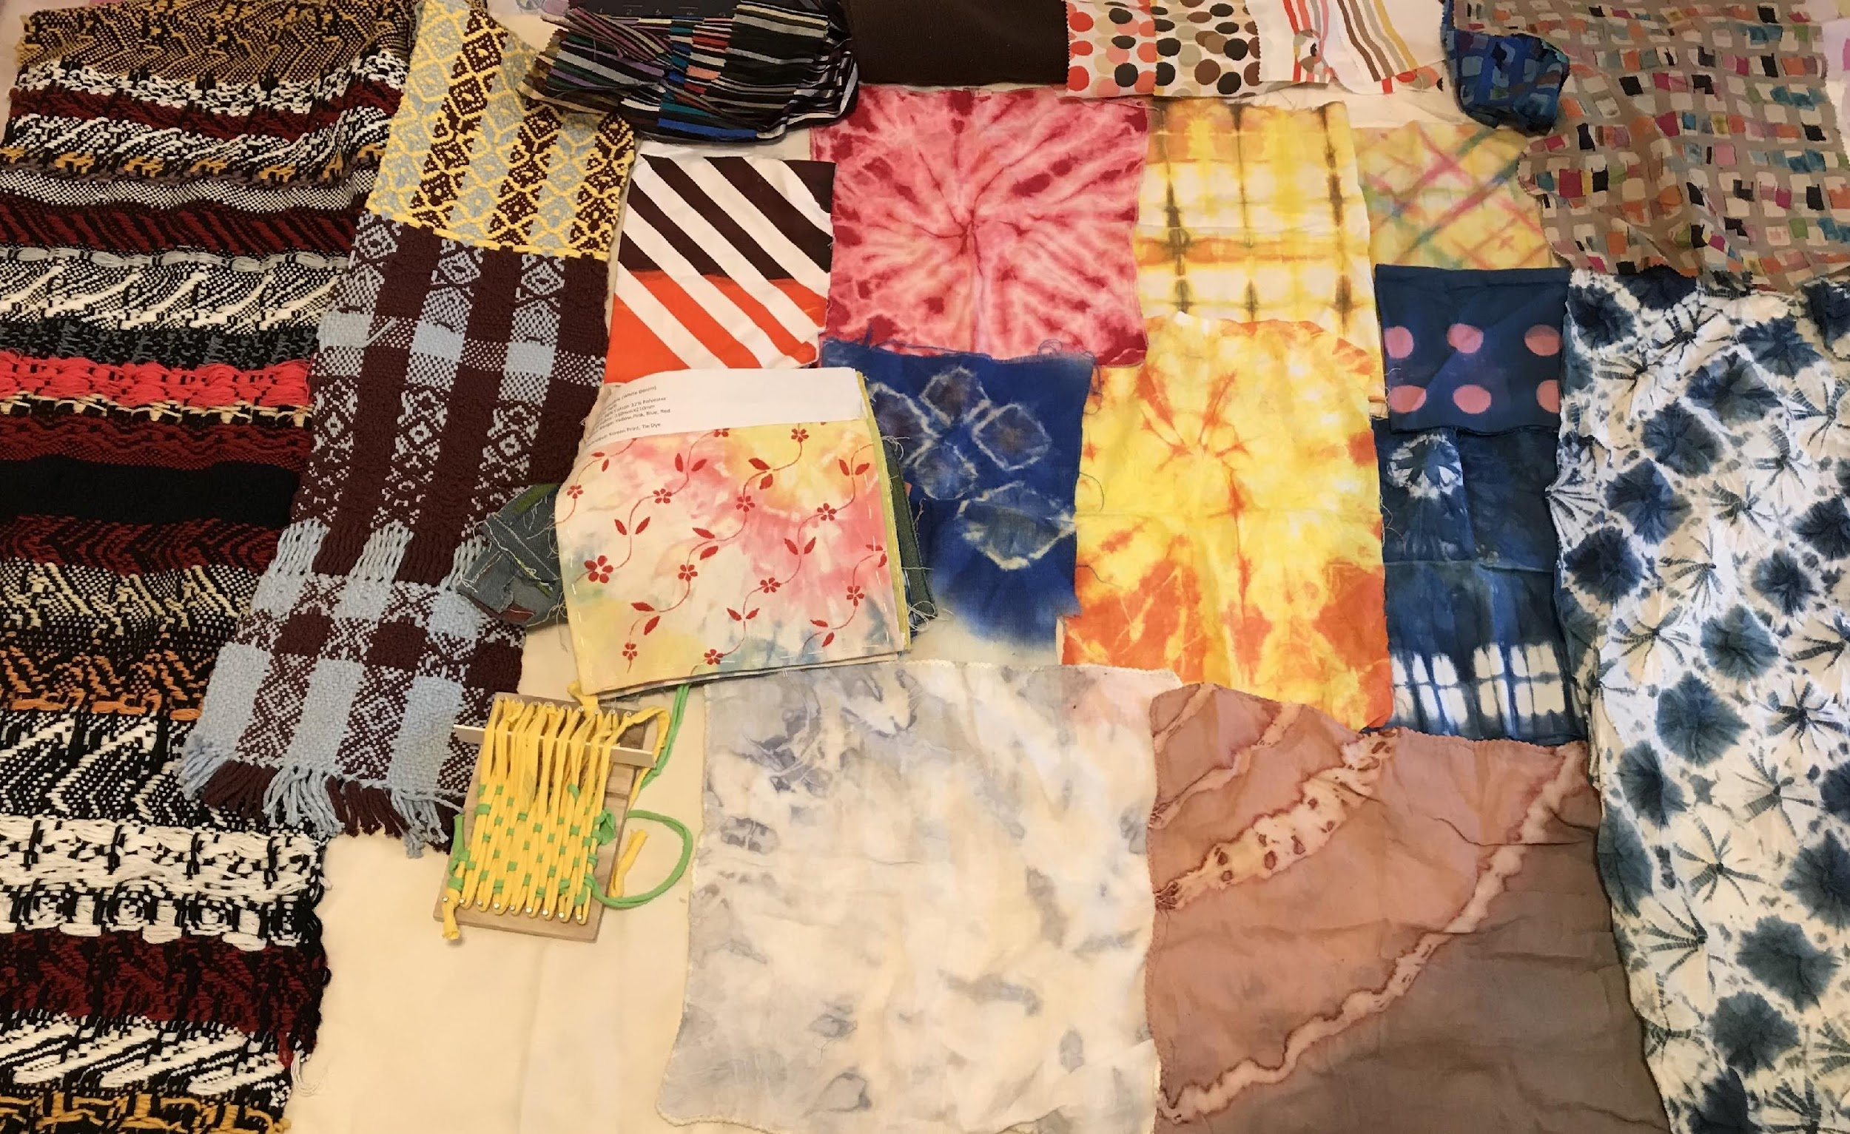
Basic Design & Textile Development Process
Fashion materials in class activities of HD in Fashion Branding and Buying, Hong Kong Design Institute
Photo(s) is/are owned and provided by HKDI

Slide 3
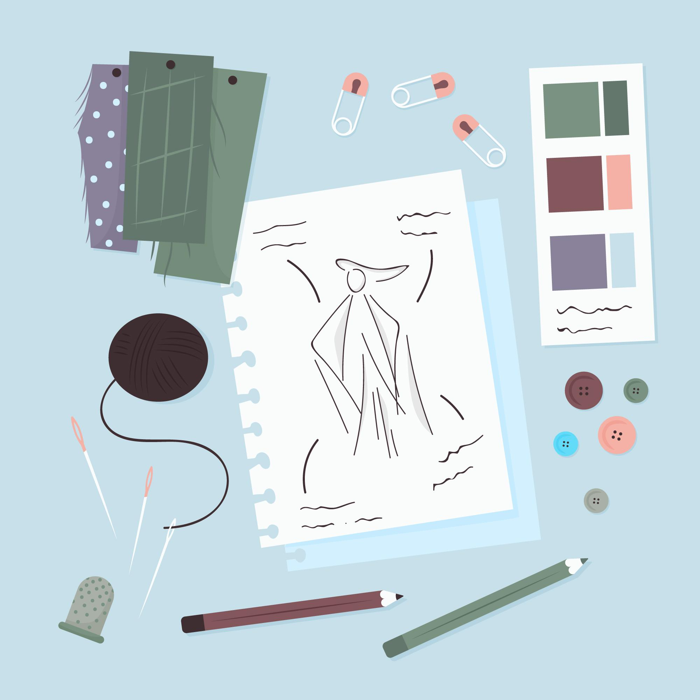
The Design & Production Process
1.Design & Production Planning
2.Fribre Cultivation & Processing
3 . Yarn and Fabric Manufacturing
4 . Apparel Manufacturing
Source: freepik.com

Slide 4
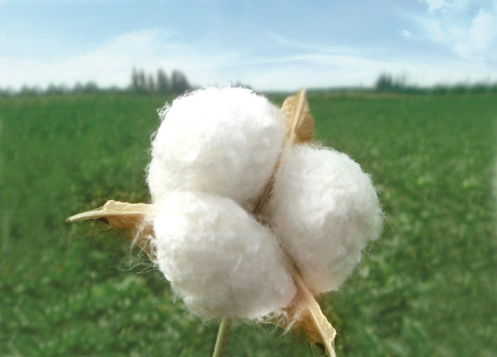
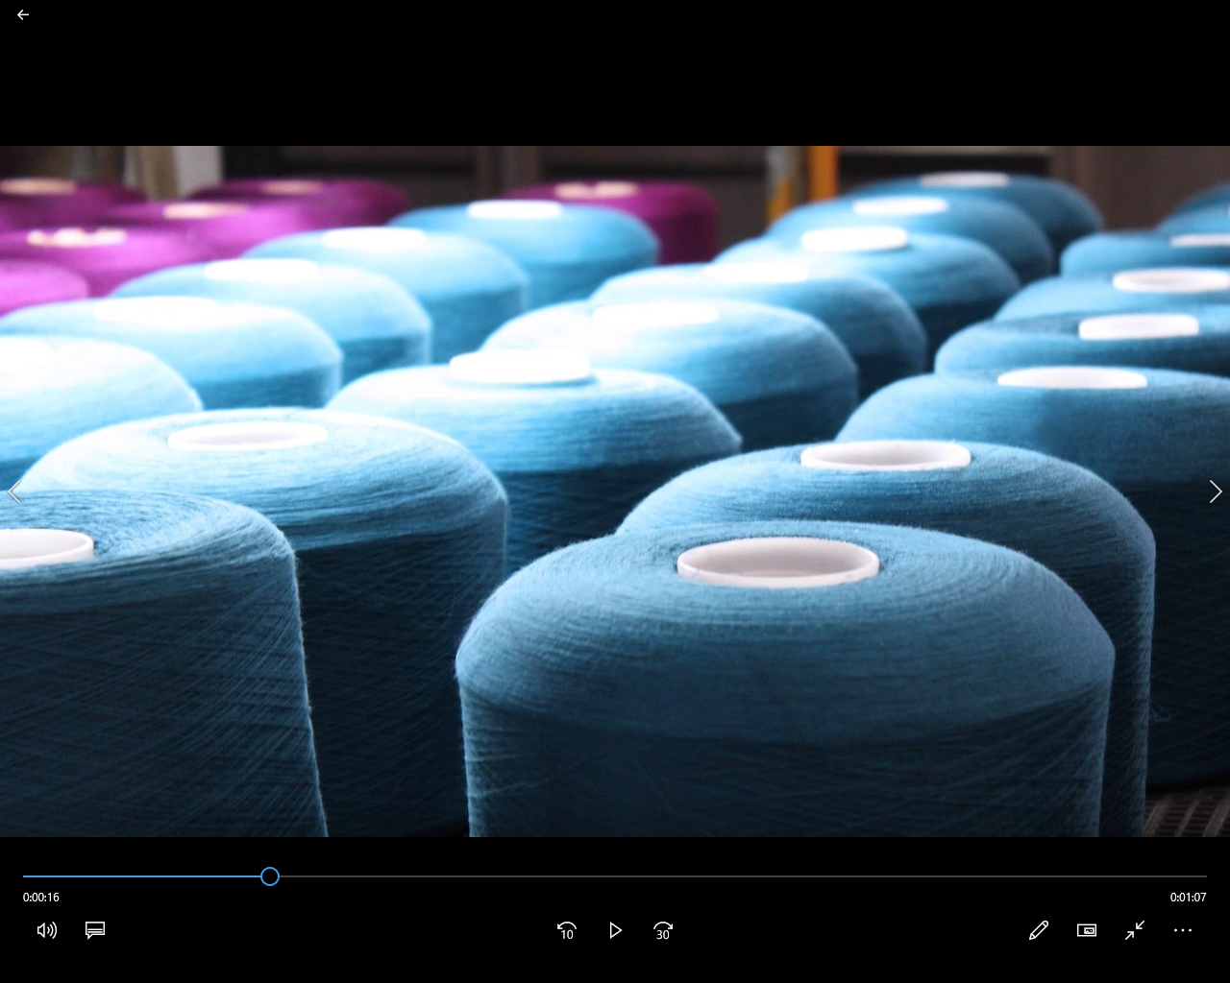
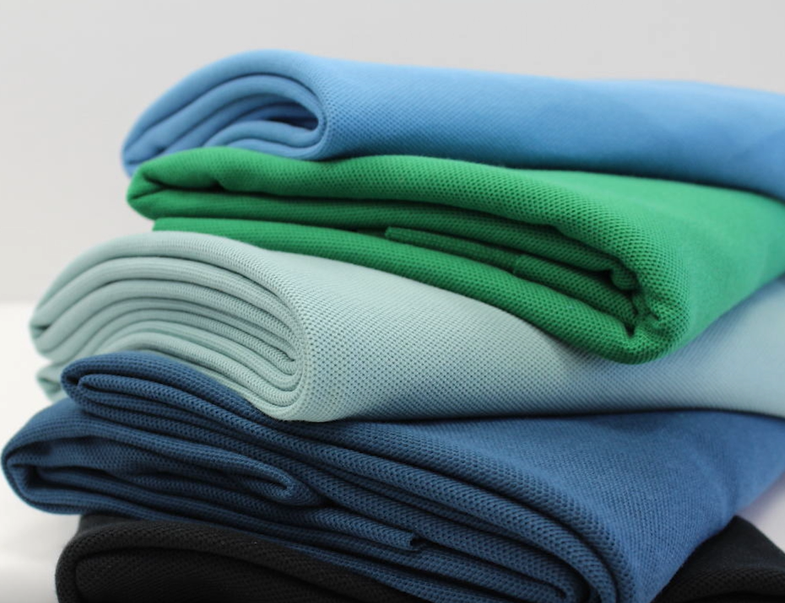
Fibre is a material with continuous or discrete lengthy substance.
Fabrics are made fundamentally from fibres.
Fibre
Yarn
Fabric
Photo(s) is/are owned and provided by Esquel Group & HKDI.

Slide 5
Fibre
Yarn
Fabric
Spinning
Knitting or Weaving
Photo(s) is/are owned and provided by Esquel Group & HKDI.

Slide 6
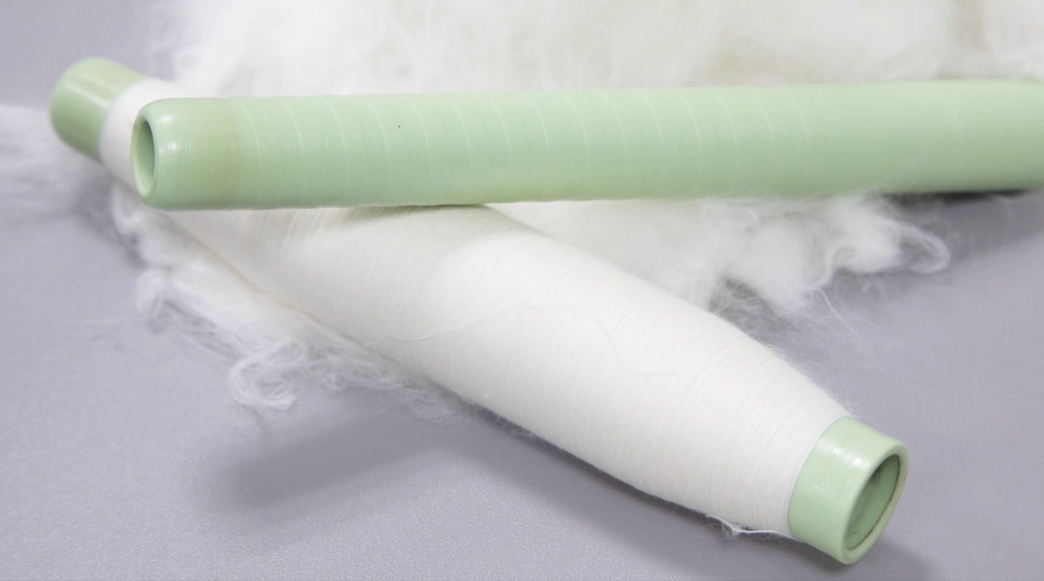
From Fibre to Yarn
The way in which a yarn is produced is related to the texture, functional properties, thickness and weight of the final fabric
Yarn producers also look into trend and colour predictions when producing and developing yarns
Photo(s) is/are owned and provided by Esquel Group & HKDI.

Slide 7
Basic Cotton Yarn Spinning Process
Blowing
Carding
Drawing
Spinning Process
Roving
Ring Spinning
Photo(s) is/are owned and provided by Esquel Group & HKDI.

Slide 8
From Yarn to Fabric
Yarn
Fabric
Knitting
Weaving
or
Photo(s) is/are owned and provided by Esquel Group & HKDI.

