Slide 1
Consumer choice for value I
CHAPTER 10

Slide 2
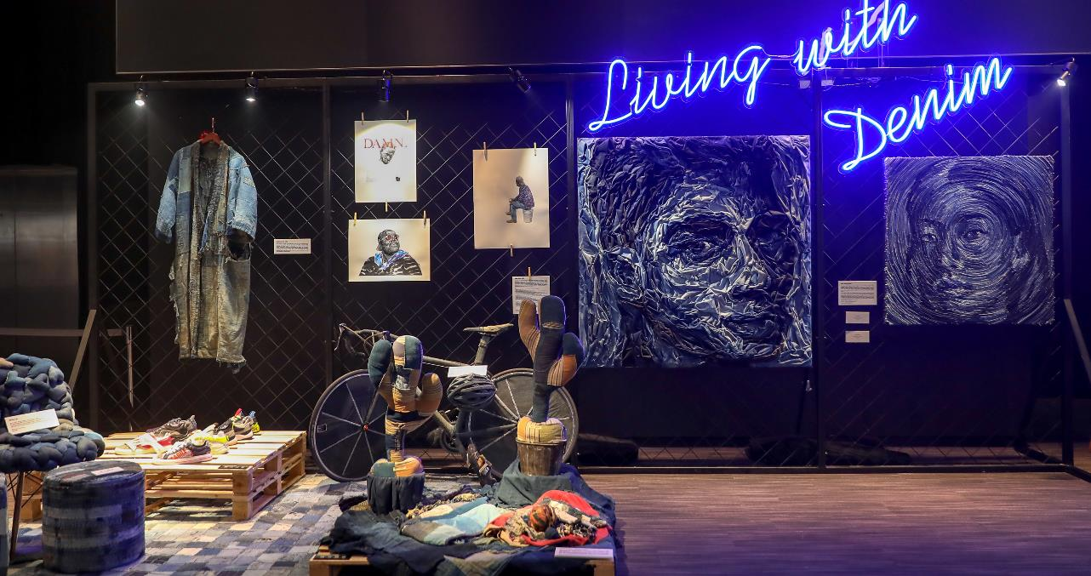
4. CULTURAL VALUES
CELEBRATE TRADITIONAL CRAFTMANSHIP
^{Denim Painting by Deniz Sagnic}
Denim Festival held by Hong Kong Design Institute Of Vocational Training Council
Photo(s) is/are owned and provided by HKDI

Slide 3
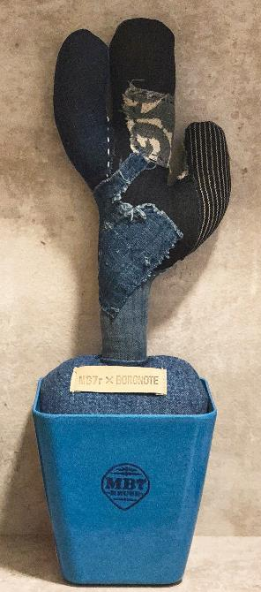
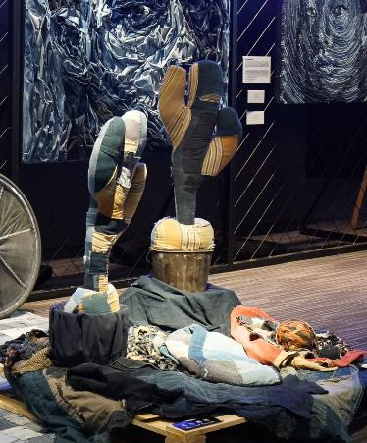
CULTURAL SUSTAINABILITY
CASE STUDY OF BORO
Boro cactus art piece by Yumiko Fukayama
Boro piece ⁽¹²⁾
Traditional Japanese craftmanship of stitch repair, now is regarded as a heritage and art technique that people appreciate and willing to pay for it
Boro piece ⁽⁸⁾
Photo provided by HKDI

Slide 4
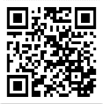

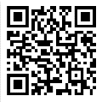
Centre of Innovative Material and Technology
Scan to Check:
CIMT Facebook Fanpage
Scan to Check:
CIMT Website
Photo(s) is/are owned and provided by HKDI

Slide 5


ABOUT CIMT
Centre of innovative material and technology (CIMT) is established to share diverse and dynamic material collection with the academic and industry fields, offer them an opportunity to first-hand experience a wide range of cutting-edge materials and experimental techniques and bring new insights into the latest innovative materials, their processing and applications.
Photo(s) is/are owned and provided by HKDI

Slide 6

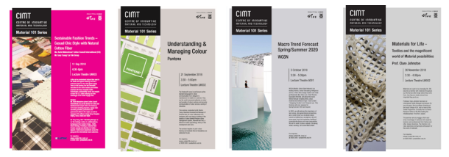
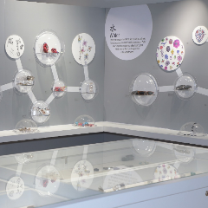
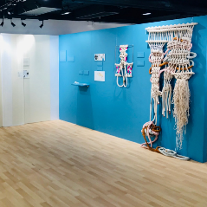
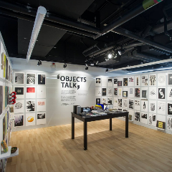
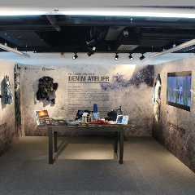
Material 101
Series seminar
HKDI Centre of Innovative Material and Technology (CIMT), serves as a platform for knowledge exchange for design, innovative processes and materials. CIMT holds exhibitions and seminars regularly to showcase innovative material technology and application in different contexts, e.g. sustainability and cultural appreciation.
Exhibitions
Photo(s) is/are owned and provided by HKDI

Slide 7
UpcyCLing weaving workshopS
One of the core missions of CIMT is to promote sustainability, innovativeness and environmental friendliness of materials. Regularly, CIMT holds series of upcycling weaving workshops to community, such as secondary and primary school students, elderly etc. For example, wood board waste material is used as weaving loom and fabric wastes as yarns for workshop. Participants were taught the basic concept and knowledge of sustainable weaving and textile design. Participants enjoyed the workshops a lot, and were inspired and encouraged to design their own weaving artworks with both ethical and creative design thinking, and create a unique piece of textile art.
Photo(s) is/are owned and provided by HKDI

Slide 8
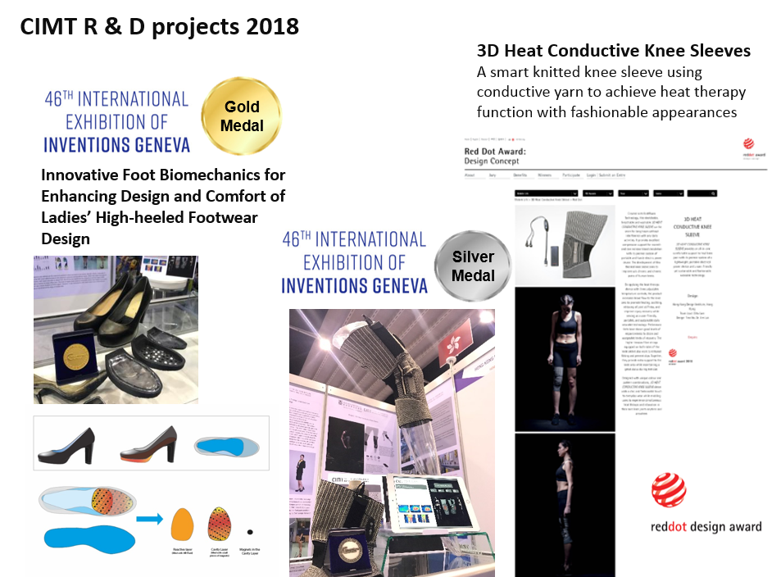
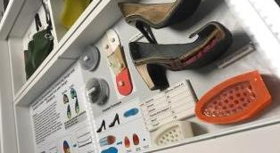
CIMT
Research
Projects
Photo(s) is/are owned and provided by HKDI

Slide 9
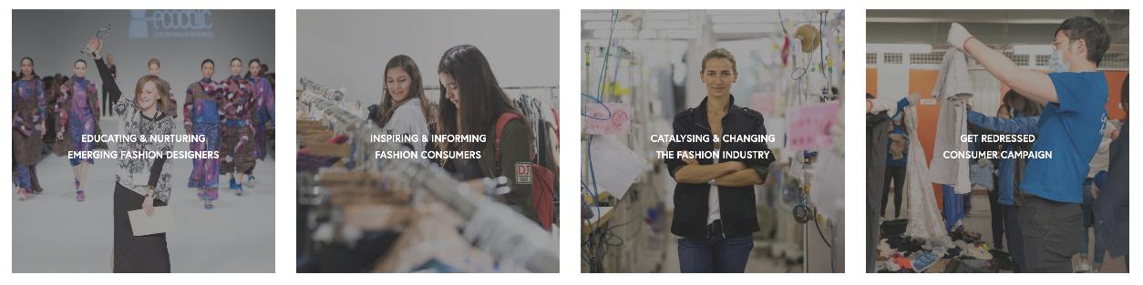

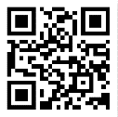
Scan to Check:
REDRESS Website
Redress is an environmental NGO working to reduce waste in the fashion industry, based in Hong Kong
Redress is an environmental charity with a mission to transform textile waste to catalyse a circular economy and reduce fashion's water, chemical and carbon footprints. The programmes work to change mindsets and practices to stop the creation of textile waste now and in the future, as well as creating systems and partnerships that generate and showcase value in existing waste.

Slide 10
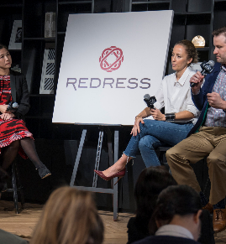
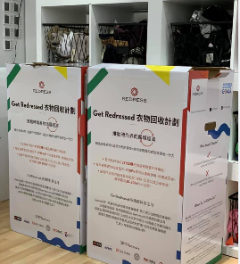
REDRESS DESIGN
AWARD
Second hand popup
stores
Seminars & Talks
Consumer Recycled
campaign
CIMT
Research
Projects

