Slide 1
Research & idea generation
Chapter 3

Slide 2
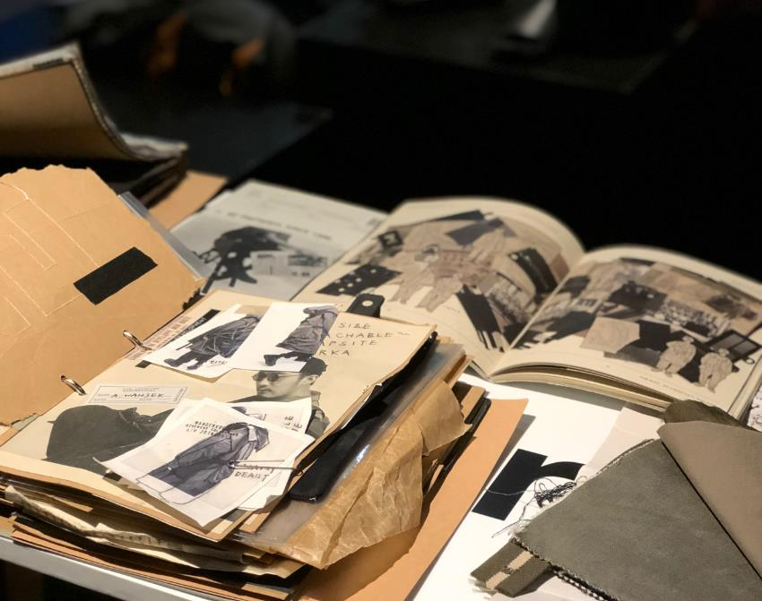
Introduction
Sketchbook and research log by HKDI fashion design graduate CHAN Leo recording his initial idea and concept during his research and development stage.
Inspiration can be found through planned or serendipitous research.
Collating research and presenting it in an inspiration book / research log is essential when it comes to generate fresh ideas.
Photo(s) is/are owned and provided by HKDI

Slide 3
Types of research
Primary research
Original materials that are collected and synthesised by the designer. It might be collected from seeing original artwork in a museum, sketching historical garments. Designers might also look at historical pictures, furniture designs, or scientific images of plants and animals to gather information about details, ideas, forms, colours or textures.
Secondary research
Information that has been accumulated and synthesised for the designer. It may be through trend forecasting report provided by fashion magazine. Interpretations of important design elements maybe highlighted from several designers to show a common idea.

Slide 4
Fashion inspiration
Fashion inspiration is the outcome of creative research, which in turn is an essential part of the design process.
It is the sourcing of and collection of ideas prior to design.
An idea is rarely completely new, and it is all about reinventing the world around us through observation and exploration.
Royalty-free photo sourced from Pexels.

Slide 5
Sources of common fashion inspiration

Slide 6
01. Historical fashion
One of the most common themes used for designer’s inspiration.
Period silhouettes, details, fabrics, and even cultural attitude associated with a particular era can all be materials from which a collection is conceived.
Royalty-free photo sourced from Pexels.

Slide 7
02. Art
Fashion and art have always had a close relationship, and designers often look to paintings for creative inspiration.
Royalty-free photo sourced from Pexels.

Slide 8
03. Culture
Cultural influences can be everything from the appreciation of literature, art and music from your own country to the appreciation of the customs and civilisation of another.
Looking at another country for ideas can provide designers with a wealth of inspiration that may translate itself into colour, fabric, print and garment shapes.
Royalty-free photo sourced from Pexels.

Slide 9
04. Ethnic and Tribal costume
Ethnic and tribal costume offers rich and diverse inspirations for design, because of the histories of regional dress and particularity to the respective society, often provide interesting symbolic meaning behind the design.
Royalty-free photo sourced from Pexels.

Slide 10
05. Architecture
Architectural inspirations provide designers with limitless styles, periods, colours, forms, textures and purposes.
Iconic architecture offers unique aesthetic view of the architect, which can be translated into fashion, both physically and conceptually.
Royalty-free photo sourced from Pexels

Slide 11
06. Nature
Nature is a perfect way to recharge one's soul and ease the mind. It gives a fresh perspective on design.
The most important part of getting inspiration from nature is not just to view it, but to incorporate the elements into the design.
Royalty-free photo sourced from Pexels

