Slide 1
Research & idea generation
Chapter 3

Slide 2
Sources of Information for fashion inspiration

Slide 3
01.
Online Fashion Resources
Easiest place and most accessible way of gathering information and it’s often the fastest way to find inspirations by using search engines.
(e.g. trend forecasting website, social media, fashion blogs)
Royalty-free photo sourced from Pexels.

Slide 4



PINTEREST
Pinterest is an American image sharing and social media service designed to enable saving and discovery of information on the World Wide Web using images and, on a smaller scale, GIFs and videos, in the form of pinboards.
WGSN
WGSN is the global authority on consumer and design trends, helping brands around the world create the right products at the right time for tomorrow's consumer. 'WGSN services cover consumer insights, fashion, beauty, interiors, lifestyle, food and drink forecasting, data analytics and expert advisory.
Vogue Runway
Vogue Runway provides access to fashion shows around the world from the global authority in fashion media within minutes after the models walk down the runway. It includes the latest ready-to-wear, couture, resort, pre-fall, and menswear collections from around the globe - including New York, London, Milan, Paris, and beyond.

Slide 5
02.
Magazines and
Online Magazines
Fashion blogs and online magazines are a huge growth area in current fashion media industry, and it enables people to review and follow trends from all around the world.
(e.g. trend forecasting books, fashion magazines)
Royalty-free photo sourced from Pexels.

Slide 6
renowned
Fashion magazines:
Harper's Bazaar is an American monthly women's fashion magazine and considers itself to be the style resource for "women who are the first to buy the best, from casual to couture".
Vogue is an American fashion and lifestyle magazine covering many topics including fashion, beauty, culture, living, and runway based in New York City.

Slide 7
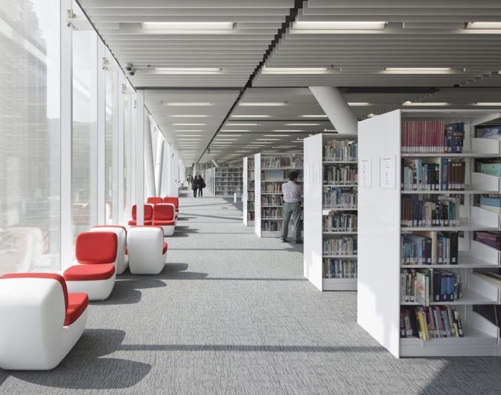
03. Libraries
Libraries contain books which can offer immediate references for images and text. They also allow designers to explore aisles of books on different subjects or areas that may not have initially considered before the research.
Hong Kong Design Institute Library ⁽²⁾

Slide 8
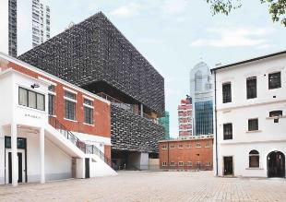
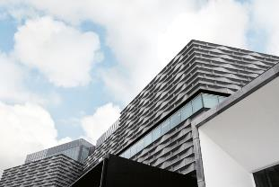
List of major museums in
Hong Kong:
04.
Museums and Galleries
Hong Kong Museum of History
Hong Kong Heritage Museum
Tai Kwun Centre for Heritage and Art
University Museum and Art Gallery
Hong Kong Museum of Art
Museums and galleries are perfect sources of primary research as they contain huge and diverse array of objects, artefacts and historical treasures.
(Above) Tai Kwun Centre for Heritage and Art.
(Bottom) Hong Kong Museum of Art.

Slide 9
05.
Movie
The film industry has always had very close links to dress and fashion. Using film as the starting point for primary research is something designers have been doing for years.
Royalty-free photo sourced from Pexels.com

Slide 10
06.
Travel
Travelling around different places provide opportunities for designers to explore and discover inspirations from other cultures and countries that can be translated into contemporary fashion design ideas.
Royalty-free photo sourced from Pexels.

