Slide 1
Design Presentation: Fashion Design Realisation
CHAPTER 4

Slide 2
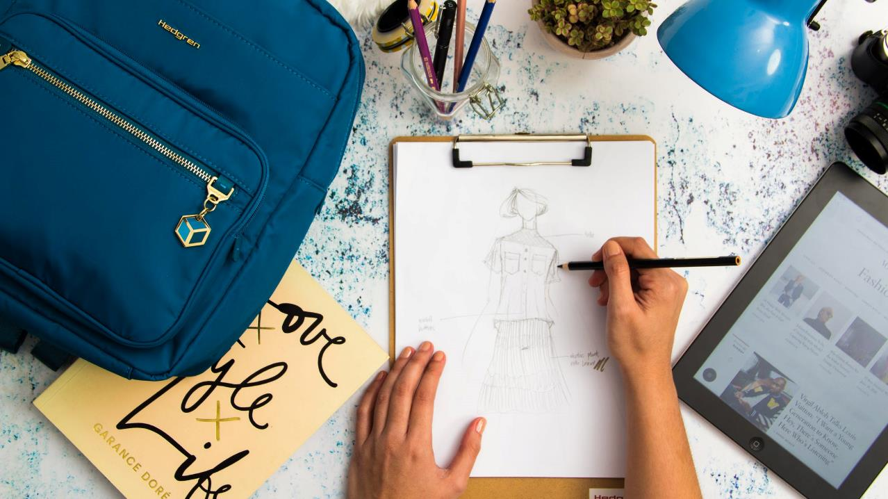
WHAT IS FASHION ILLUSTRATION?
Royalty-free photo sourced from www.pexels.com

Slide 3
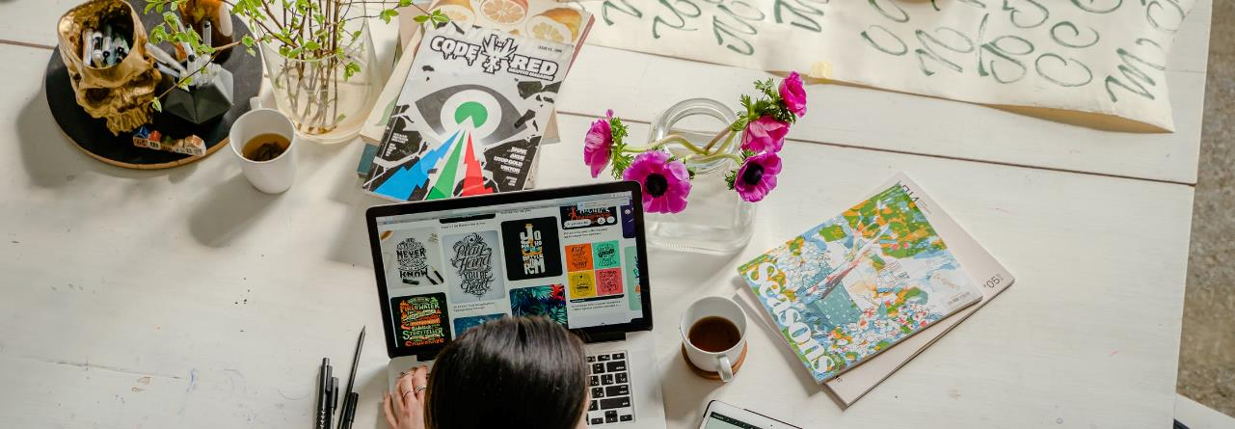
Traditional Definition
Fashion illustration is the art of communicating fashion ideas in a visual form that originates with illustration, drawing and painting, which is also known as fashion sketching. It is mainly used by fashion designers to brainstorm their ideas on paper or digitally. Fashion sketching plays a major role in designing to preview and visualise designs before sewing actual clothing (Nicolas, 1994).
Reference: Drake, Nicolas., 1994. Fashion Illustration Today (Revised Edition). Thames & Hudson Ltd. London. (p 7)

Slide 4
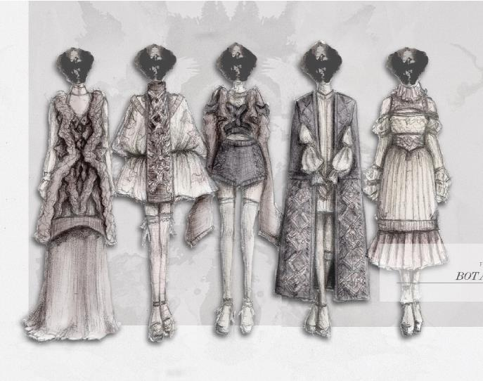
More About Fashion Illustration
Fashion illustration is about communicating designers’ ideas
Not aim for realism
Hand drawn or computer aided drawing
Often uses notes to indicate technical details
Good fashion illustrators require understanding the current ideal of beauty
Collection Illustration by Maness Ko, year 2 students of HD in Fashion Design in Hong Kong Design Institute
Photo provided by HKDI

Slide 5
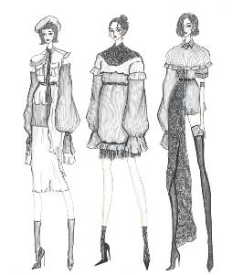
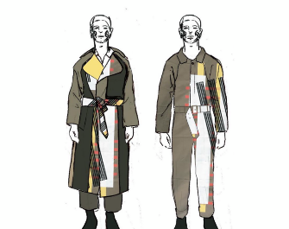
Functions of Fashion Illustrations
For production of garment, advertisement and presentation of design ideas
Illustrations by Foxla Chu, year 1 students of HD in Fashion Design in Hong Kong Design Institute
Sketches of Graduation Collection in Westminster University by Haylee Wong, alumni of Vocational Training Council)
Photo provided by the alumni of HKDI and the Vocational Training Council

Slide 6
100 YEARS AGO
When there was no colour photography
for magazine features.

Slide 7
50 YEARS AGO
Fashion illustrators started to use a variety of materials including pencil, pen and ink, charcoal, watercolour for creating fashion illustration.
Anotonio Lopez (1943-1987), was a major fashion illustrator whose drawings appeared frequently in fashion magazines.

Slide 8
AND NOW ……
MODERN ILLUSTRATIONS
Frequent application of computer drawing
Mixed media presentation
Unique styles in artists’ techniques and art direction

Slide 9
MODERN ILLUSTRATION
Paper Fashion
Fancy application of clothing trims to create unique presentation styles.

Slide 10
MODERN ILLUSTRATION
Laura Laine
Characterised face drawing
Interesting figure and gestures
Iconic hair drawings

Slide 11
MODERN ILLUSTRATION
Vera Wang & Riccardo Tisci for Givenchy
More Realistic
Less gimmick and dramatic
Practical for communication

Slide 12
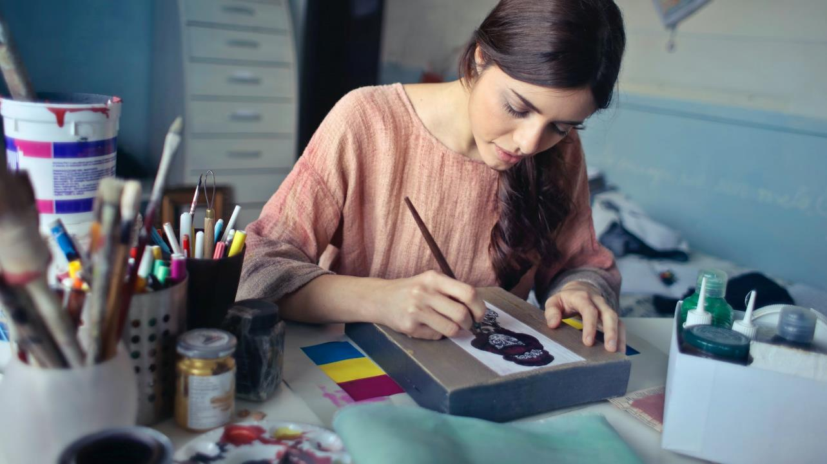
HOW TO MAKE FASHION illustration?
Royalty-free photo sourced from Pexels

Slide 13
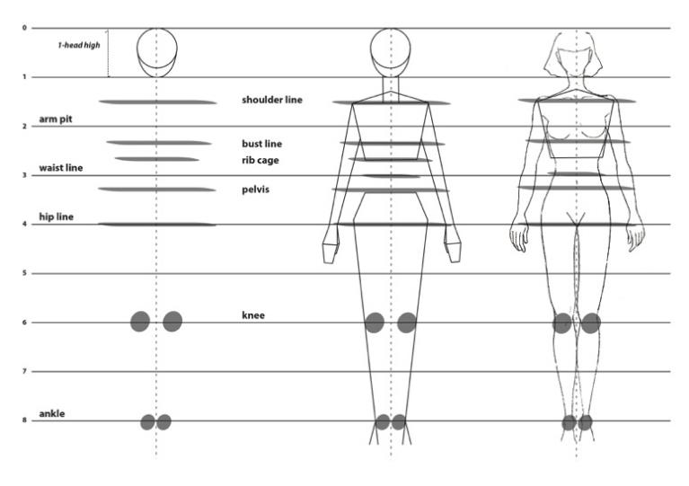
Practice of Figure drawing
(8.5 heads figure)
1st line: from the top of the head to the chin
2nd line: armpit (between line 1 and 2 is shoulder line)
3rd line: this section is divided into 3 equal parts: 1: bust line, 2: ribcage, 3: waistline
4th line: crotch: consists of the pelvis top and low pelvis
5th line: consists of the buttock and the tips of the fingers)
6th line: kneecaps
8th line: ankle
Practice materials is/are owned and provided by HKDI

Slide 14
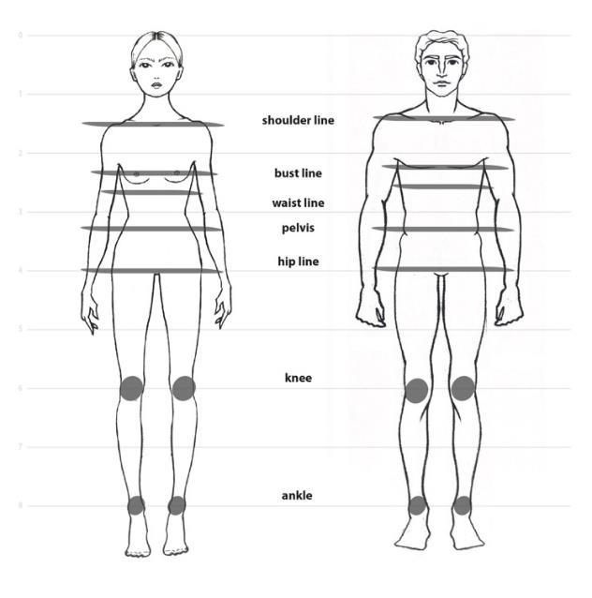
Differences between female
& male figure
Female figure is generally thin,
slender and narrower shoulder,
obvious line of waist
Male figure is generally thicker, muscular, i.e. thick shoulder, rounder arms, stronger thigh
Practice materials is/are owned and provided by HKDI

Slide 15
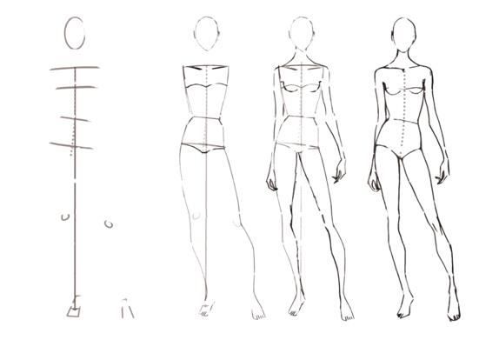
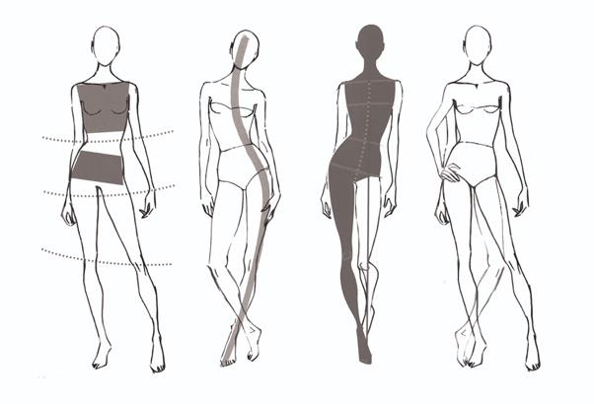
Practice of Figure changing pose & Balance
balance line
Shoulder
Bust
waist
hip
Try to draw figures in different pose, by adjusting the balance line, shoulder line, waist line and hip line
Practice materials is/are owned and provided by HKDI

Slide 16
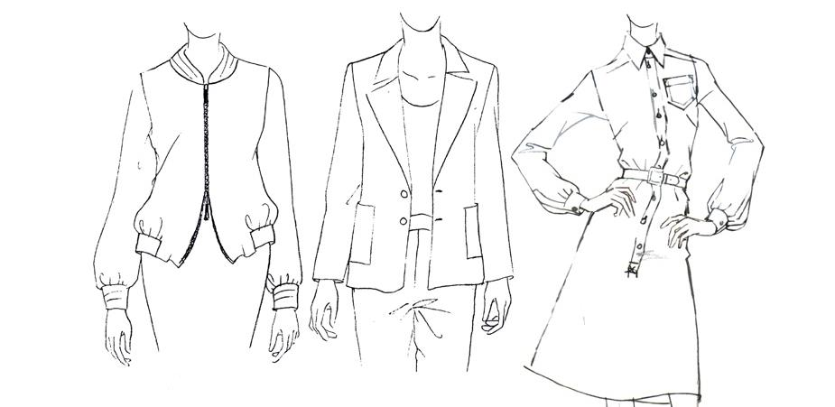
Practice materials is/are owned and provided by HKDI
GARMENT DETAILS I
BOMBER JACKET
Casual type of jacket, usually provides loose fit cutting to figure, shows the details of the zipped opening
TAILORED JACKET
To draw a tailored jacket, lines should be clean and straight, while have a fit or semi-fitted worn by figure
SHIRT DRESS
A shirt dress looks like an elongated shirt, which has a A-line shape at the dress bottom. Lines should be clean and fine to illustrate all details such as the volume on sleeve hem and gathers formed around the belt

Slide 17
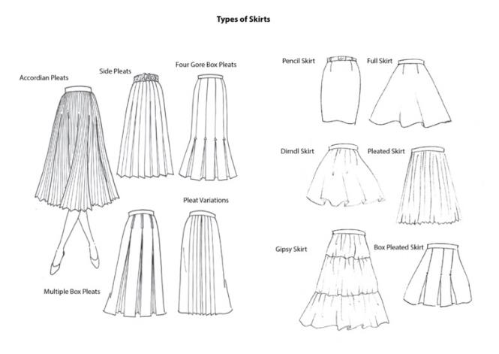
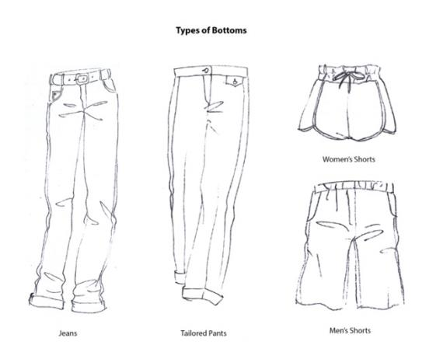
GARMENT DETAILS II
SKIRTS & BOTTOMS
Practice materials is/are owned and provided by HKDI

Slide 18
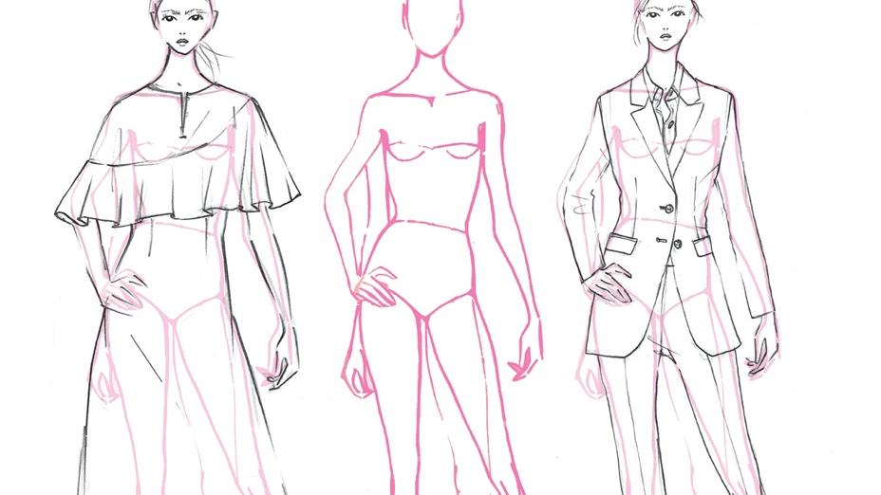
BASICS IN DESIGN SKETCH
HOW TO DRAW SIMPLE FASHION SKETCH ON FIGURE
Practice materials is/are owned and provided by HKDI

Slide 19
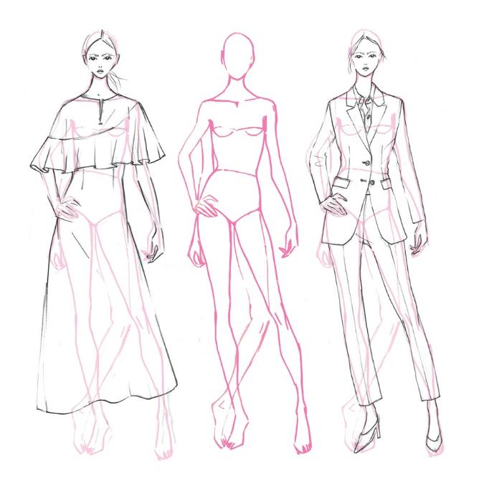




PRACTICE
DEMO
Scan to check:
Scan to check:
Part 1
Part 1
Part 2
Part 2
Tailor Jacket
Demonstration
Dress
Demonstration
Practice materials is/are owned and provided by HKDI

