Slide 1
Fundamental Knowledge of
Fashion Trend
Chapter 6

Slide 2
What is Fashion Trend?
A fashion trend is a particular style, or clothing popular at a certain point of time or a particular period of time.

Slide 3
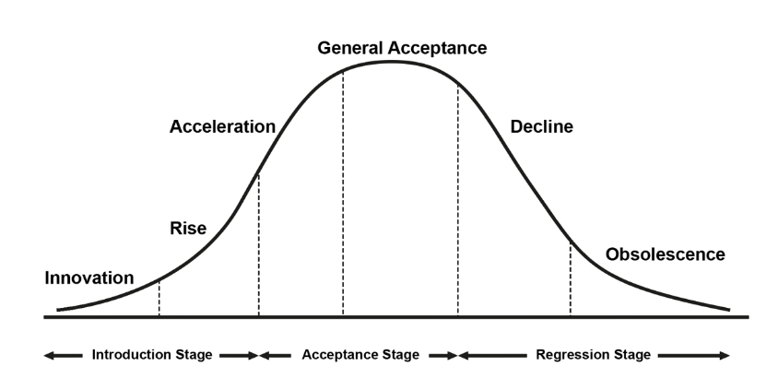
What is Fashion Cycle?
Fashion cycle is a period of time or life span during which the fashion exists, moving through the stages from introduction through obsolescence.
When a customer purchases and wears a certain style, that style is considered accepted and the acceptance leads to the style becoming a fashion.

Slide 4
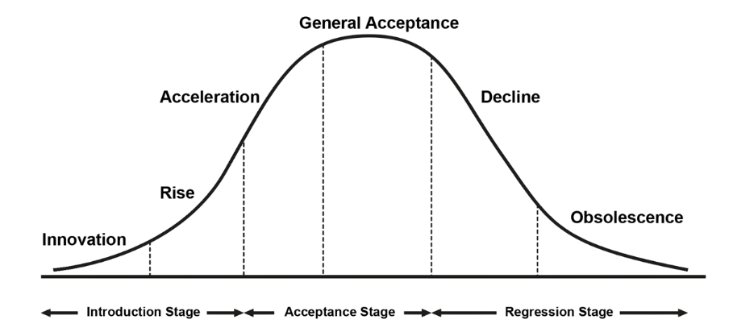
Stage: Introduction
New trends are introduced on runways or put together by influential fashion innovators.
Worn by fashion innovators who have the means to buy designer fashion or who take the lead in putting together innovative street looks.

Slide 5
Stage: growth
Fashion leaders or early adopters purchase fashion as it becomes widely available at contemporary designer.

Slide 6
Stage: Acceleration
Trend is interpreted and widely available at a mass market level and worn by fashion followers.

Slide 7
Stage: Saturation
At its height of popularity and is widely available to mass market at all price points.

Slide 8
Stage:
DECLINE
Consumers may continue to wear the fashion, but no longer in purchasing additional items unless it is at greatly reduced prices.
Eventually the fashion item looks dated and is impossible to sell.

Slide 9
factors that influence fashion trend
Fashion trends are influenced by several factors, including political, technology, social and economic.
Fashion forecasters can use this information to help determine the growth or decline of a particular trend.
It helps to know more about the fashion arena and lifestyle in the modern world.
Royalty-free photo sourced from Pexels.

Slide 10
Sources of trend information
Trend forecasting websites
Trend books
Trade shows
Fashion magazines
Window shopping

