Slide 1
CHAPTER 7
DRESS CODE
& STYLES

Slide 2
Royalty-free photo sourced from www.pexels.com
WHAT IS a DRESS CODE?
Understanding the rules of dress code based on purposes and occasions

Slide 3
FORMAL VS CASUAL
Royalty-free photo sourced from Pexels.

Slide 4
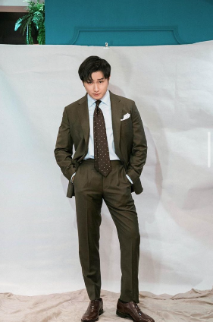
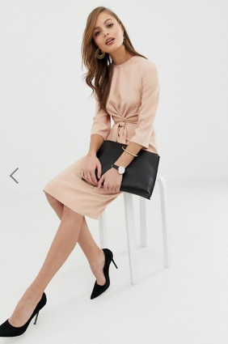
FORMAL
Suit design by brand Suit Artisan
Formal dress with heeled shoes from ASOS ⁽¹⁾
Formal occasions include ceremonies, parties, banquets etc.
Girls usually wear party dresses or evening gown in formal occasions, matching with small handbags and heeled shoes.
Boys usually wear shirt and long trousers. In more formal occasions, wearing two-piece suit (blazer and trousers) with a tie would be the best choice to make them look smart.
TIPS!
To attend an interview : formal or smart casual are ideal dress code for interviews, a decent and tidy look could demonstrate a sense of respect and credibility.
Photo provided by the copyright holder, Suit Artisan

Slide 5
CASUAL
Royalty-free photo sourced from www.pexels.com
What is casualwear style?
There are several kinds of casual styles: casual, smart casual, leisure, sports.

Slide 6
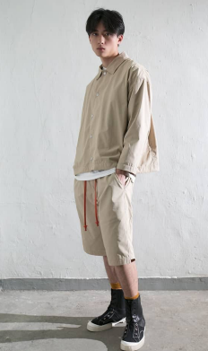
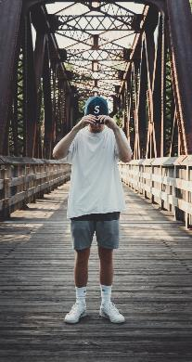
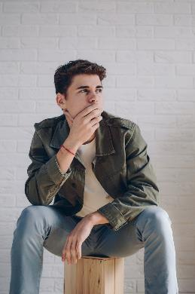
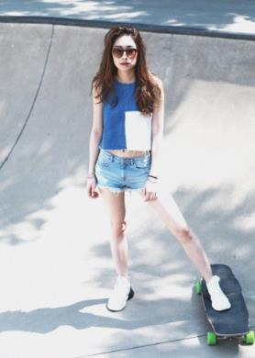
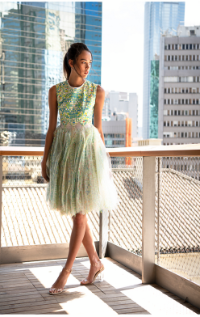
TO LOOK ‘CASUAL’
Jeans, shorts, vest, t-shirt and sweaters are common items that may be worn to match with sneakers and other casual shoes, such as boat shoes for boys and sandals for girls.
For boys, they could wear printed shirt, cargo pants, denim shirt, printed T-shirt. For girls, sleeveless tops, printed midi dress, shirt dress, denim shirt are usual choices.
Royalty-free photo sourced from www.pexels.com
Photo provided by the copyright holder, YMDH STUDIOS
Royalty-free photo sourced from Pexels.
Royalty-free photo sourced from Pexels.
Photo provided by the copyright holder, Travis Li
Photo provided by the copyright holder, Mountain Yam

Slide 7
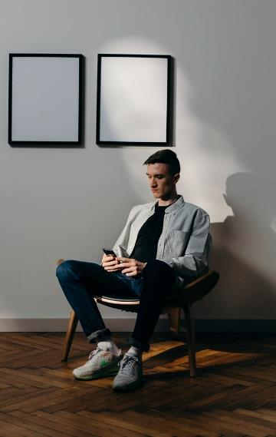
ABOUT SMART CASUAL
Royalty-free photo sourced from www.pexels.com
Smart casual: A flexible version of formal wear that offers more choices than suits for male and set for females, showing stronger personality and characters.
Boys could wear jeans, sneakers, boots, informal shirt, matching t-shirt with blazer. Girls could wear fitted jeans with blouse, T-shirt, flat shoes or sneakers.

Slide 8
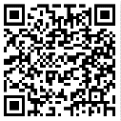
IS THIS SMART CASUAL?
OVERDRESSED
OR
UNDERDRESSED?
A singer artist misunderstood the definition of “Smart Casual”, and wore a neon yellow T-shirt and jeans, which presented an “underdressed” look in a formal evening occasion on TV show.
Scan to Check:
Related news

Slide 9
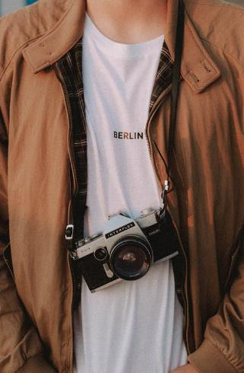
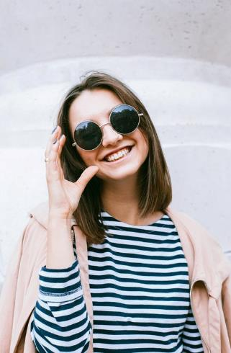
FOR LEISURE
To show the wearer’s personal appearance, which reflects a personal lifestyle or image engaging in leisure activities.
Like lifestyle, leisure clothing has a great variety that fits a range of situations, time, place, activities and age.
In general, it should provide ease of wearing while make the wearer feel relaxed and comfortable.
Source from royalty free photo from Pexels

Slide 10
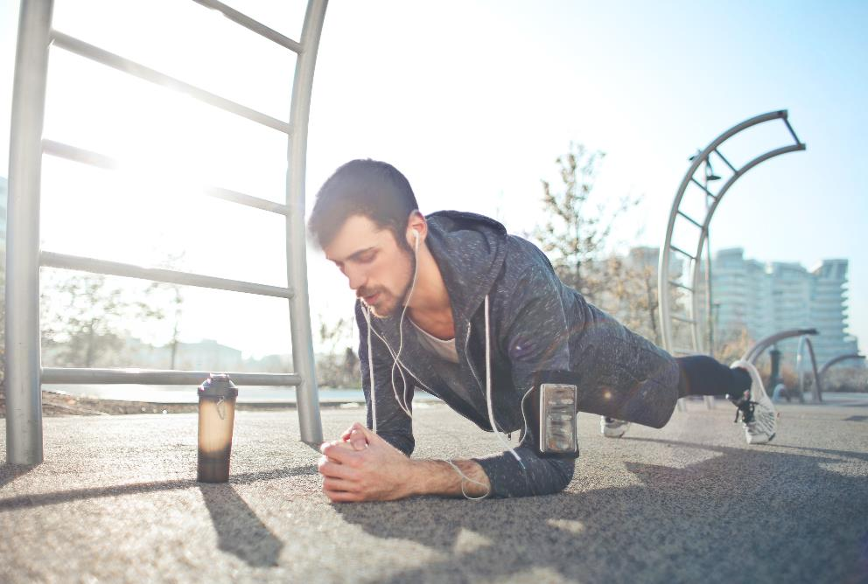
FOR SPORTS
Performance wear and functional wear provide ease of movement and breathability
Royalty-free photo sourced from Pexels

