Slide 1
Between garment and body
Chapter 8

Slide 2
Garment fitting
The garment fitting refers to how well a garment confirms to the three-dimensional human body figure.
Royalty-free photo sourced from Pexels.

Slide 3
Common types of apparel silhouette

Slide 4
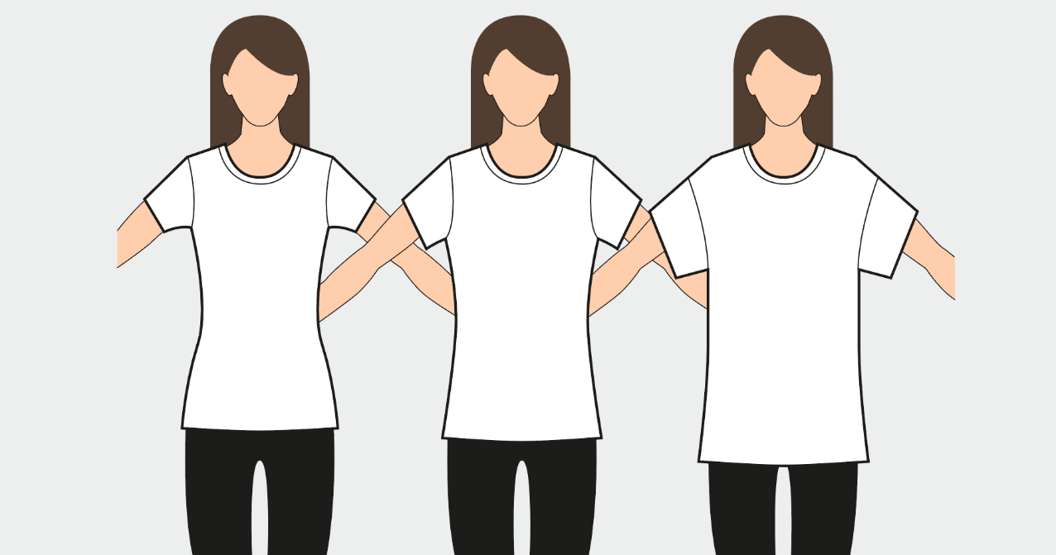
Regular fit
Slim
fit
loose
fit
tops

Slide 5
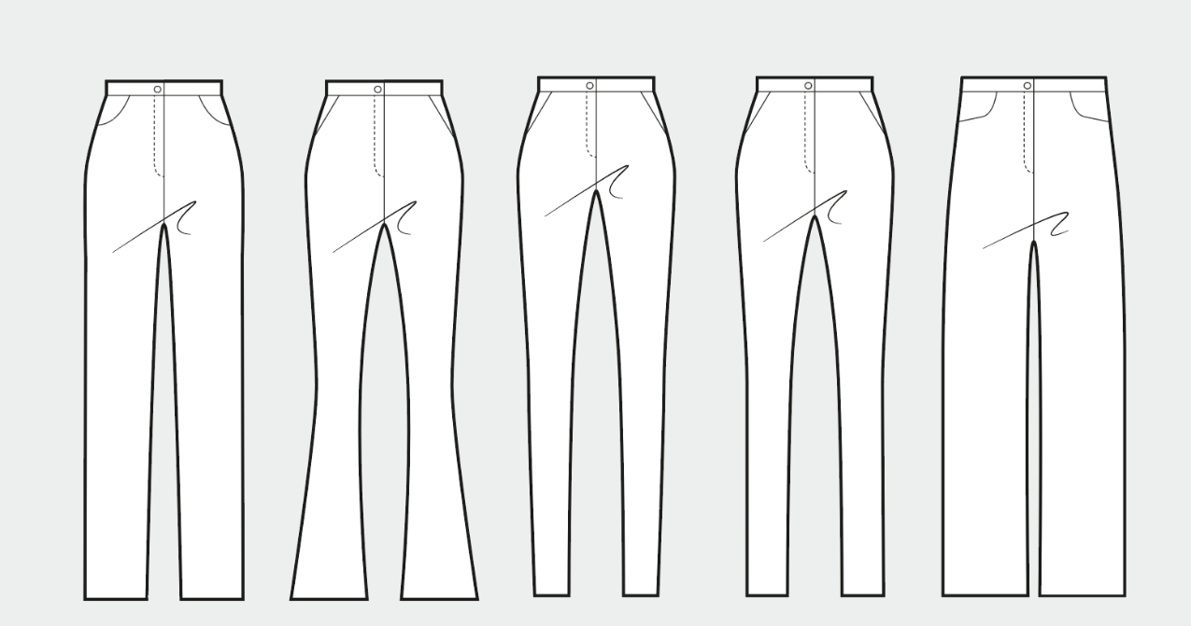
Regular fit
Flared
leg
skinny
fit
slim
fit
loose
fit
pants

Slide 6
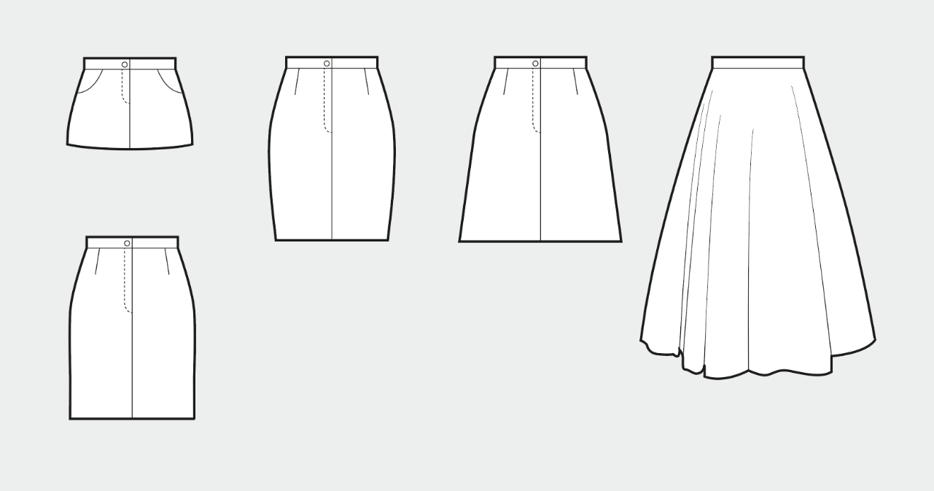
Mini
pencil
A-line
circle
straight
skirts

Slide 7
Body shape
Knowing your body type can be helpful for choosing clothing that will accent your best features.
Royalty-free photo sourced from Pexels.

Slide 8
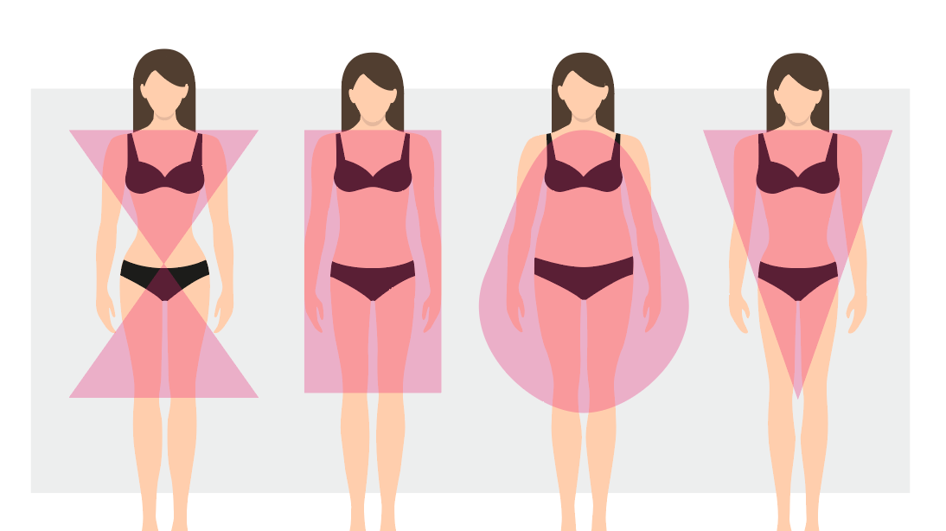
Women’s body shapes

Slide 9
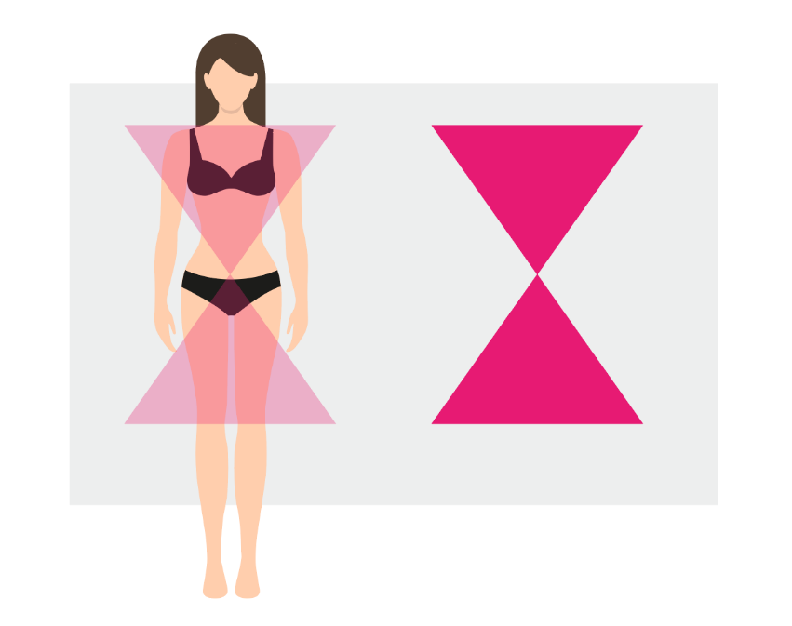
Women’s body shape
01.
Hourglass
The most balanced of all with a proportionate top and bottom part of the body with a well-defined waistline.

Slide 10
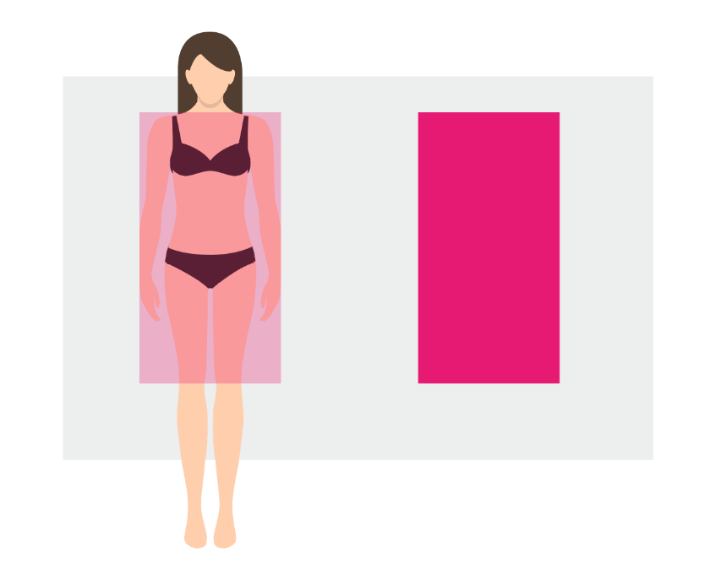
Women’s body shape 02.
Rectangle
Equal bust, waist and hip measurements.
Rectangles tend to be tall and lean. The waist is not well-defined, and the bottom is rather flat.

Slide 11
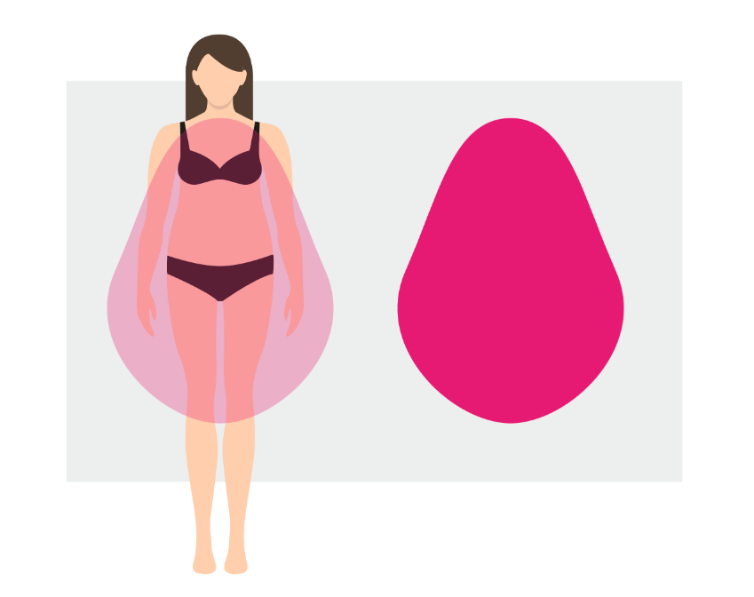
Women’s body shape 03.
Pear
Fully around the hips, have a wide pelvis and are small around the chest and shoulders.

Slide 12
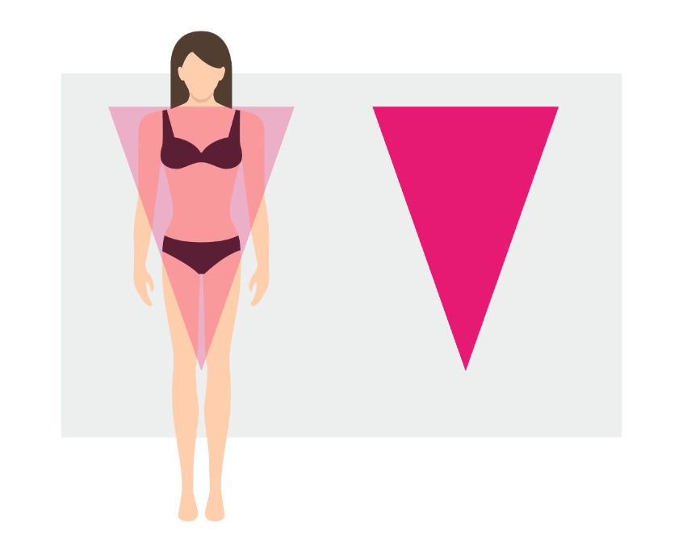
Women’s body shape 04.
Inverted triangle
Broad shoulders and / or bust that narrow down to the hips.
The strong shoulders often lend this body shape an athletic-looking physique.

Slide 13
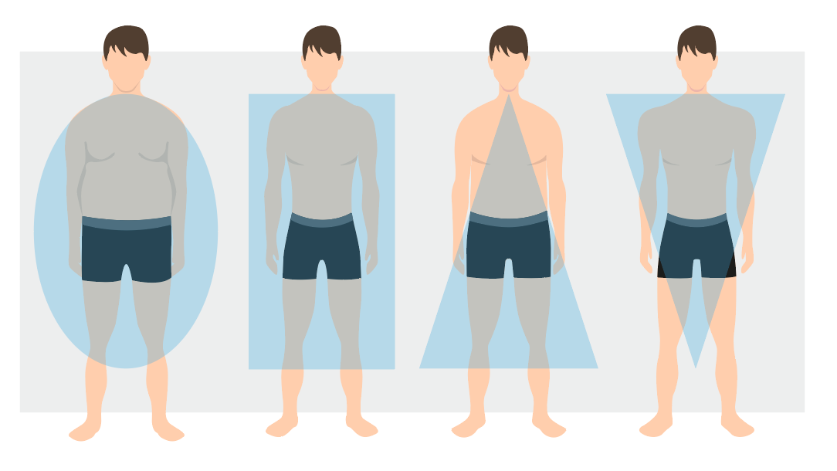
men’s body shapes

Slide 14
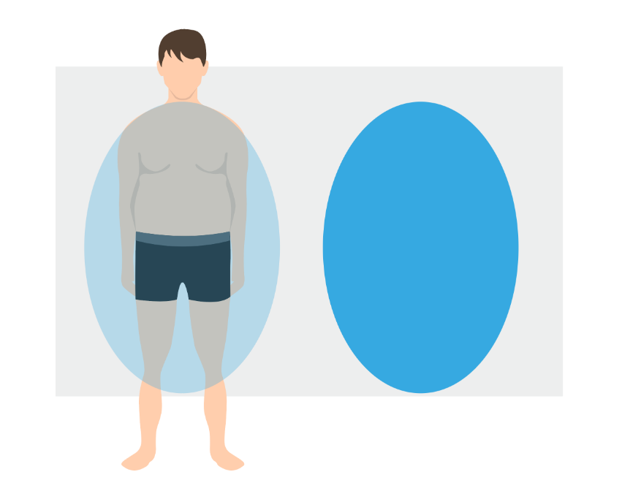
Men’s body shape
01.
Rounded
Body carrying a little extra weight on the body.
Torso is wider than the shoulders and hips.
Have a more rounded stomach, fuller face, and short neck.

Slide 15
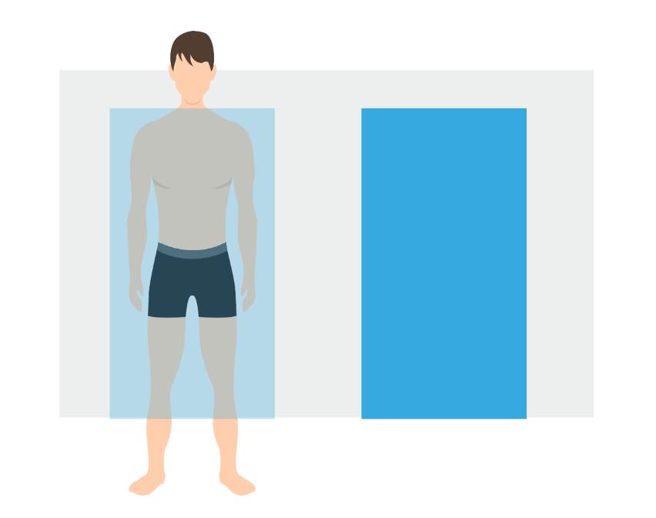
Men’s body shape
02.
Rectangle
Shoulders are roughly the same width as the waist and hips.

Slide 16
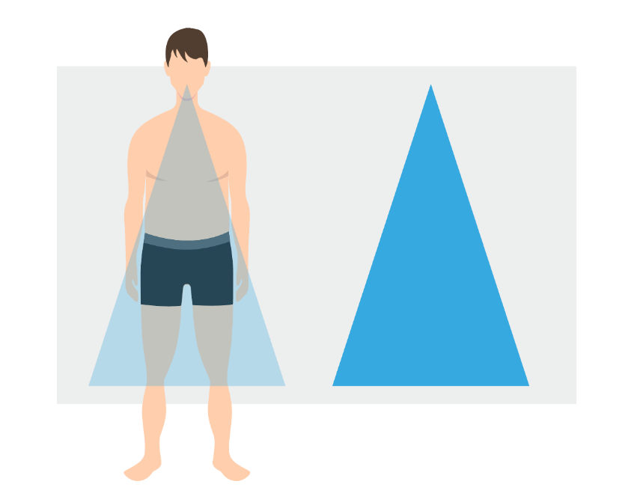
Men’s body shape
03.
Triangle
Larger around the waist and hips in relation to the chest.
The lower body is heavier than the upper body and have narrow or sloped shoulders.

Slide 17
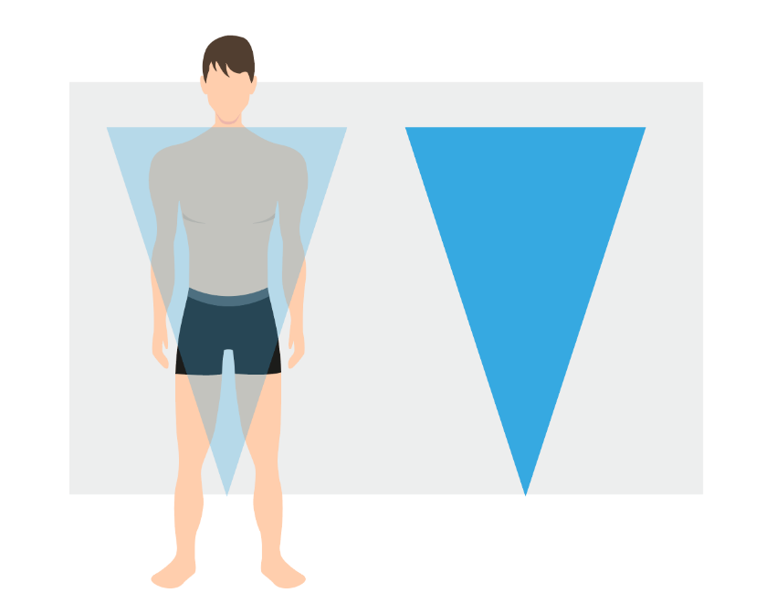
04.
Inverted triangle
Well-developed chest and shoulders that are significantly broader than the waist and hips.
Overall, the upper half of the body is wider than the lower half. Shoulder, arm and chest muscles may be fairly bulky.

Slide 18
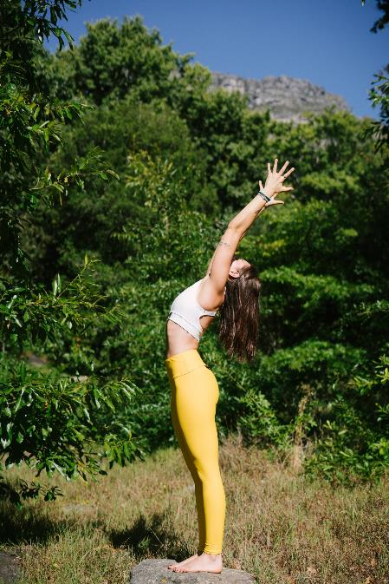
chapter activity
WHICH BODY FIGURE TYPE ARE YOU?
With the different body figure types suggested in this chapter, discuss with your classmates and identify which body figure type you belong to?
Royalty-free photo sourced from Pexels.

