Slide 1
CHAPTER 9
WARDROBE PLANNING
For
Daily activities

Slide 2
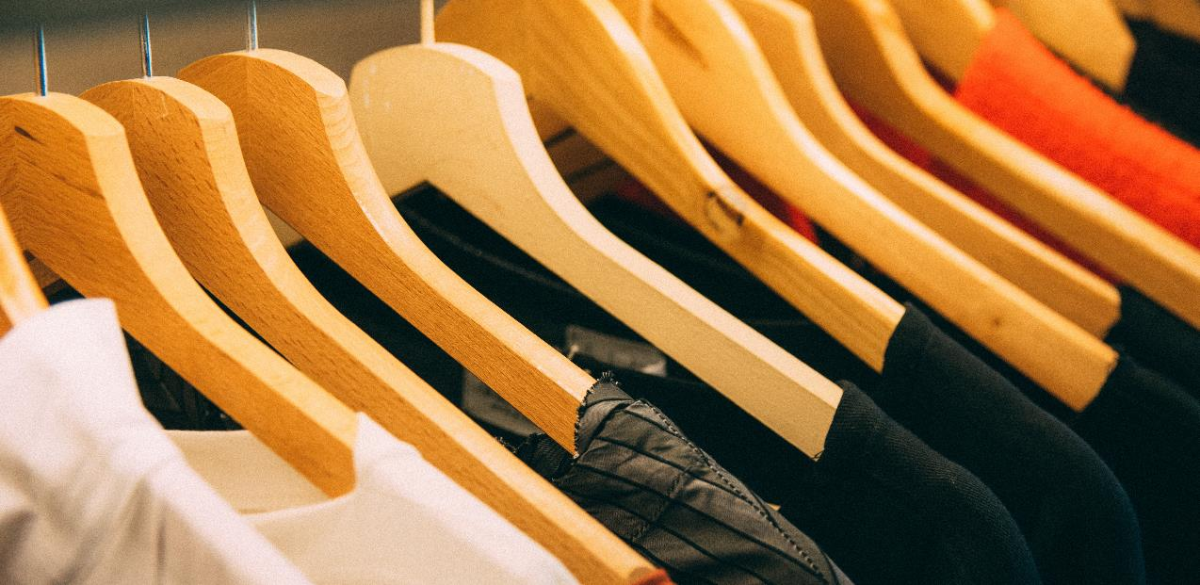
Planning for daily activities
The more understanding you have about yourself, the better wardrobe planning you could make, in order to look better.
Royalty-free photo sourced from Pexels.

Slide 3
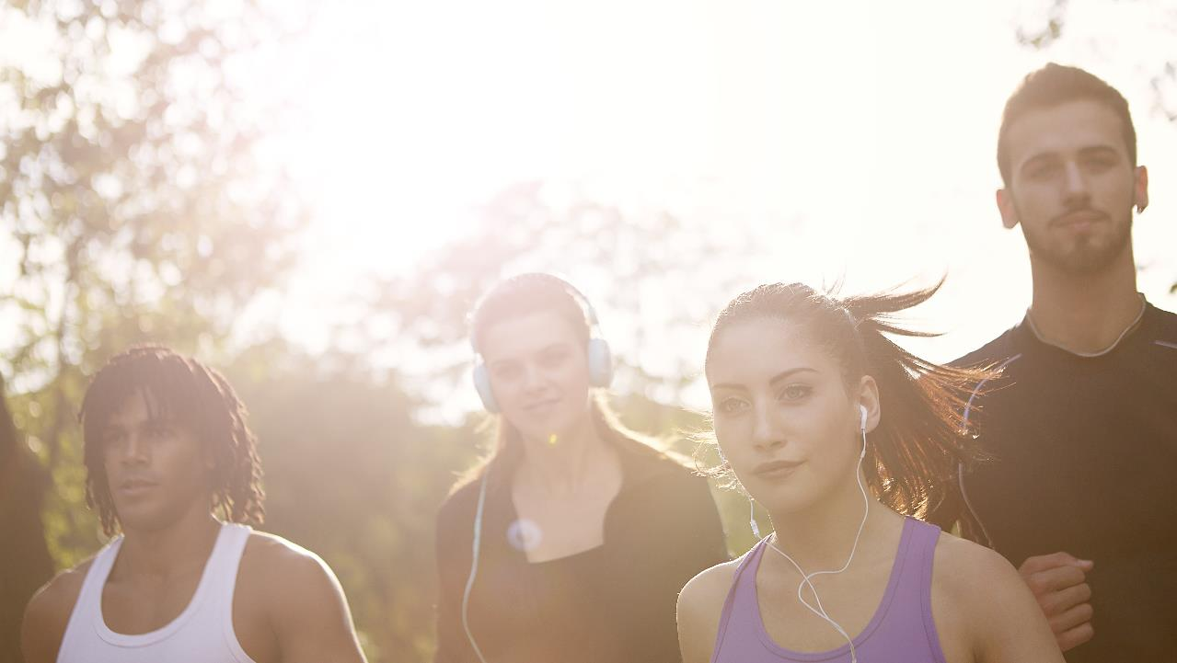
Planning for daily activities
Budget
age
personality figure occupation occasion
Royalty-free photo sourced from Pexels

Slide 4
OBSERVE!!!
HOW PEOPLE DRESS IN YOUR FAVOuRITE PLACE, ANY IDEA?
Royalty-free photo sourced from Pexels

Slide 5
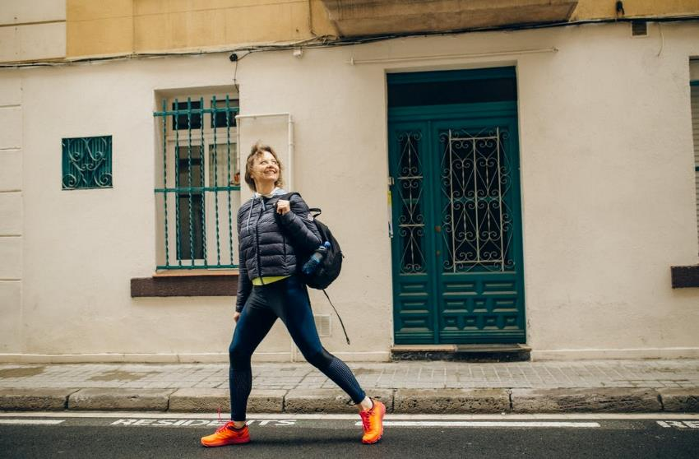
ATHLEISURE
It is one of the most fashionable, hip, comfortable, flexible sportswear styles, which is considered as a kind of hybrid style combining athletics (sportswear) and leisure. It refers to styles and items which are suitable for occasions including workplace, school, or casual and social places.
Source from royalty free photo from Pexels

Slide 6
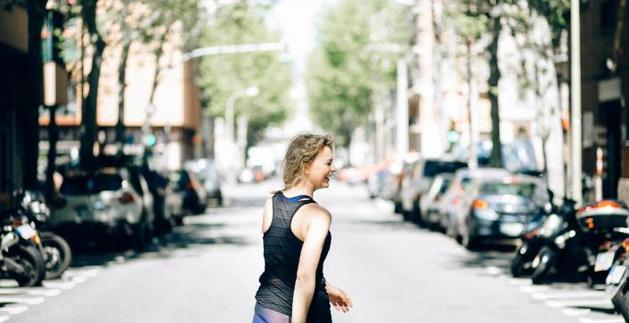
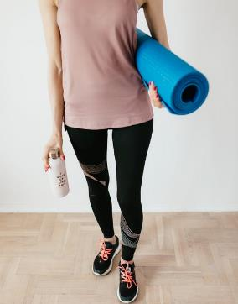
ATHLEISURE For girls
Athleisure outfits include yoga pants, tights, lounge pants, sneakers, windbreaker, shorts, sporty tops such as t-shirt, bra-top.
Source from royalty free photo from Pexels

Slide 7
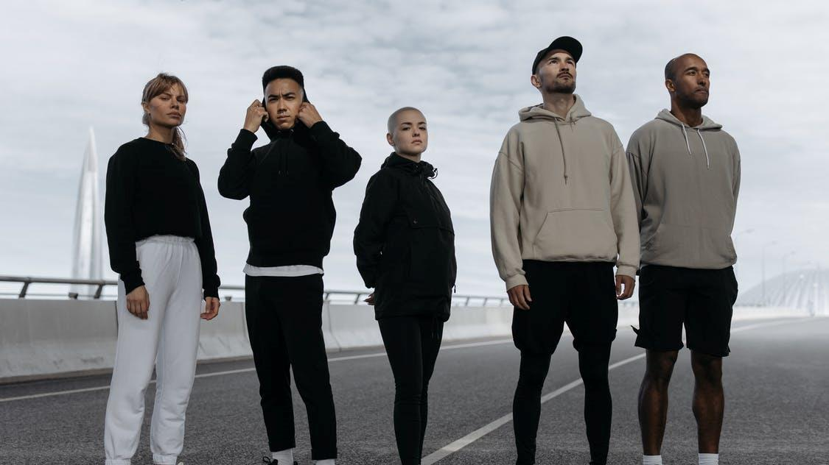
ATHLEISURE For boys
For boys, athleisure clothing items include jogger pants, shorts, functional jacket and pants, track pants / sweatpants, hoodies, sweatshirt etc.
Source from royalty free photo from Pexels

Slide 8
WHAT IS OOTD?
OOTD is the abbreviation of “Outfit of Today”, it is a popular term, used in fashion blog or social network, such as Instagram.
It refers to what someone’s wearing on a particular day, usually in the context of fashion blogging. It can also mean a particularly fashionable outfit, or the photoshoot involved in taking an ootd photo for a social network.
Usually, when someone hashtags “OOTD” in his/her post in social network, he/she will feature his/her style which share his/her taste and fashion sense to friends over the internet.
Screencap of Instagram searching hashtag “OOTDHK”
Source from royalty free photo from Pexels

Slide 9
Royalty-free photo sourced from www.pexels.com
Chapter Activity
SHOW
YOUR
OOTD!
Create your best look for a weekend hangout with friends
Take a OOTD shot to post on social medium platforms
Don’t forget to make 3 hashtags in the post:
#1 OOTD
#2 an adjective describing your look
#3 any item you are wearing
Royalty-free photo sourced from Pexels.

