Slide 1
Material inspirations for fashion design
Chapter 1

Slide 2
FABRICS
& FIBreS
What is the composition of fabrics?
What are the sources of fibres, natural or man-made?
How are fabrics constructed?
Royalty-free photo sourced from Pexels.

Slide 3
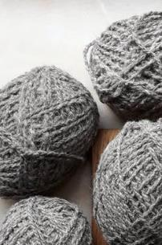
YARN
FIBRE
FABRIC
Spinning
Constructing
Royalty-free photo sourced from Pexels.

Slide 4
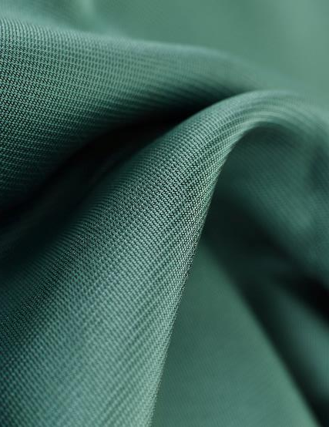
Types of FIBRES
NATURAL FIBRES
MAN-MADE FIBRES
Cellulose / PLANT
Protein /animal
Regenerated and Synthetic
Royalty-free photo sourced from Pexels.

Slide 5
CELLULOSE/PLANT FIBRES
FABRICS & FIBERS
Cellulose is made of carbohydrates and forms the main part of plant cell walls
Cellulose can be extracted from a variety of plant
Cotton is a great example of a plant fibre
Soft, but strong to be spun into yarn
Contributes to 40% of worlds’ textiles
Can be woven or knitted
Durable and breathable
Linen has similar properties to cotton, but it tends to form crease easily
What is the
Difference?
Royalty-free photo sourced from Pexels.

Slide 6
PROTEIN FIBRES
FABRICS & FIBERS
From animal hair such as wool fleece from sheep
Shorn and spun into wool yarn
Warm, with little elasticity
Shrinks when washes in hot water
Goats, alpaca, camel, rabbit hair are also protein fibres which produce fabrics with a warm and luxurious quality
Silk is a protein fibre that is harvested from cocoon of silkworm
Fine and luxurious material
What is the
Difference?
Royalty-free photo sourced from Pexels.

Slide 7
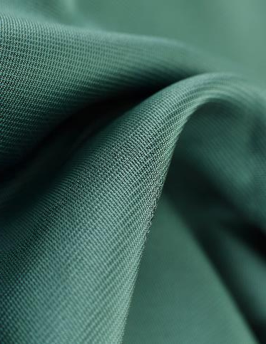
MAN-MADE Fibres (Regenerated and Synthetic)
FABRICS & FIBERS
Invented in the 20th century
For better performance over natural fibres
Regenerated fibres are made from cellulose such as wood pulp through chemical methods
Rayon is the first man-made fabric developed, used as a substitute of silk, while giving a strong and absorbing properties, as well as drapes well with a soft handle
Other synthetic fibres includes: Tencel, acetate, viscose etc.
Synthetic fibres are from chemicals
Nylon is strong, smooth and lightweight
Acrylic has the look and handle of wool with easier care
Polyester is strong and crease resistant
What is the
Difference?
Royalty-free photo sourced from Pexels.

Slide 8
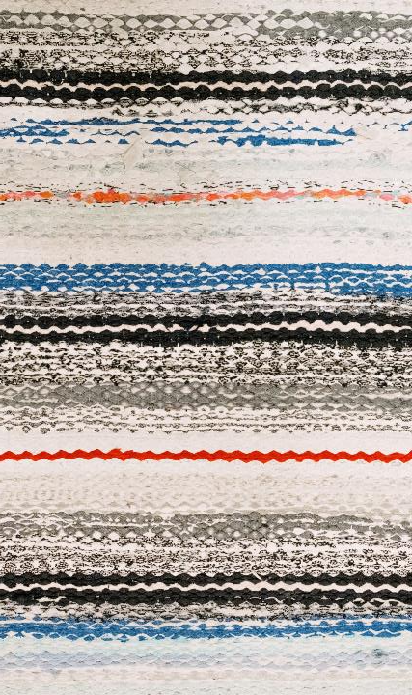
WOVEN
FABRICS
FABRIC
contruc-tions
KNITTED
FABRICs
What is the
Difference?
Royalty-free photo sourced from Pexels.

Slide 9
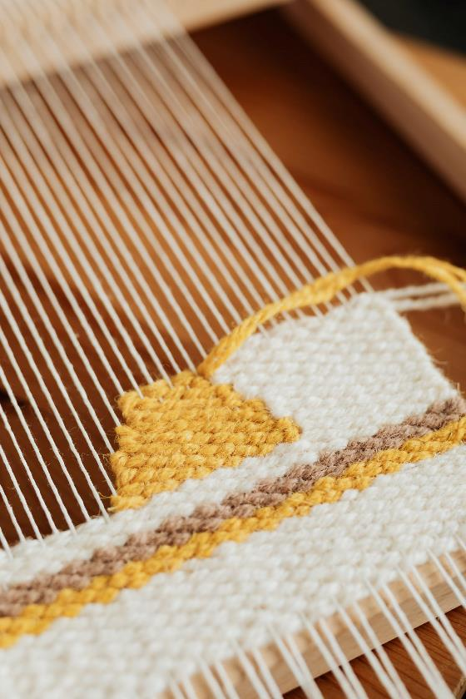
WOVEN FABRICS
FABRICS & FIBERS
A woven fabric is made from a warp yarn
goes down the length of a fabric and
a weft weave across the breadth of the fabrics
What is the
Difference?
Royalty-free photo sourced from Pexels.

Slide 10
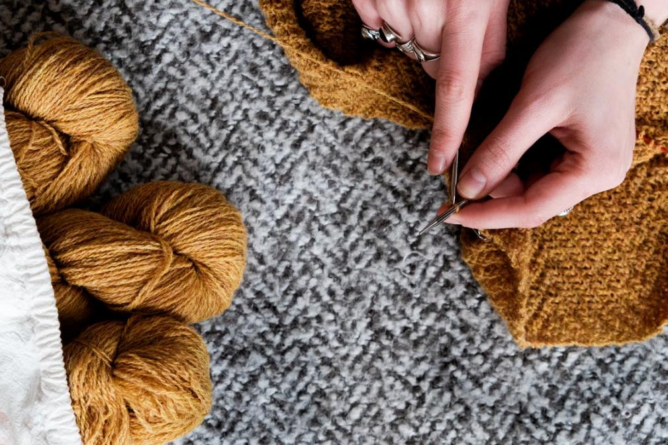
knitted FABRICS
FABRICS & FIBERS
A knitted fabric is constructed from interlocking
action of loops made from yarn, giving the fabric itself stretch ability
What is the
Difference?
Royalty-free photo sourced from Pexels.

