Slide 1
Material inspirations for fashion design
Chapter 1

Slide 2
WOVEN FABRICS
FABRICS & FIBERS
っっっっっx
Cotton
Canvas
Gabardine
Silk
Chiffon
Satin
Wool
Herringbone
What is the
Difference?
Cotton Denim
Cotton
Corduroy
Polyester
Laminated
Royalty-free photo sourced from Pexels.

Slide 3
KNITTED FABRICS
FABRICS & FIBERS
Cotton Jersey
Cotton Fleece
Polyester Fleece
Sports
Jersey
Polyester
Tracksuit
Wool Knit
Crochet
Royalty-free photo sourced from Pexels

Slide 4
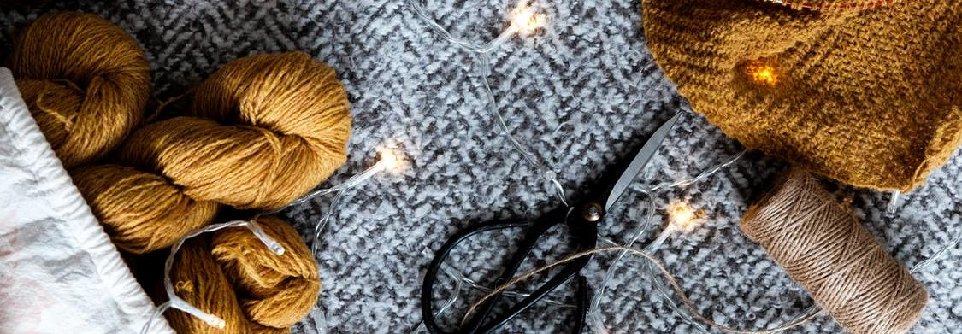
Material inspirations
Royalty-free photo sourced from Pexels.
Fashion designers has been using ordinary textile materials to create their garments for the past centuries. However, with the unlimited creativity and technological development advocated by contemporary designers in the 21st Century, designers have been expanding and pushing the boundaries of fashion material inspirations and choices.

Slide 5
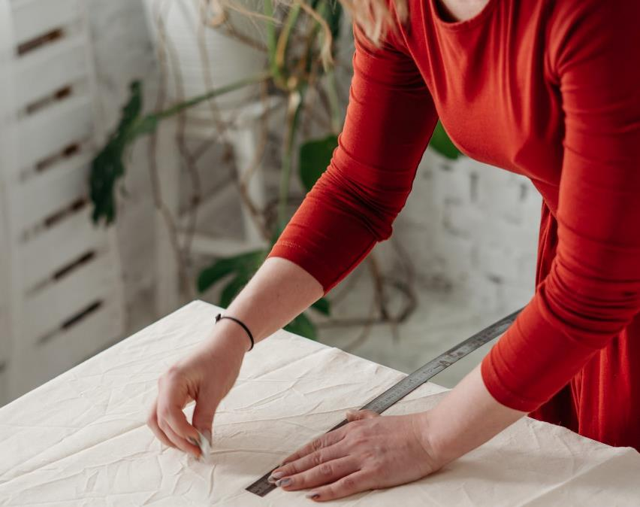
Dressing materials on human body
Material categories:
Fabric
Paper
Wood
Plastic
Metal
Sustainable material (recycled/upcycled materials)
Royalty-free photo sourced from Pexels.

Slide 6
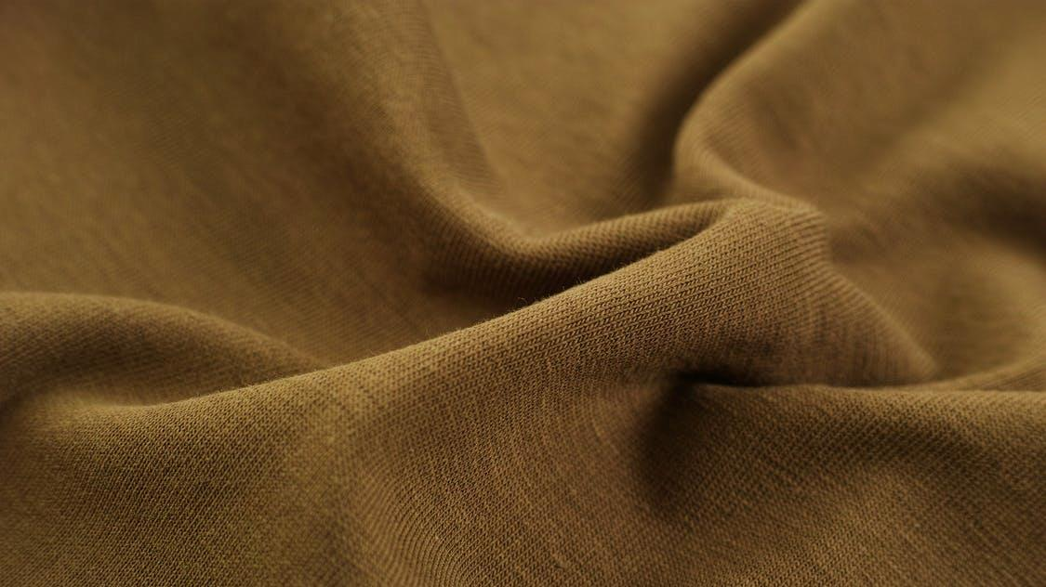
fabrics
Royalty-free photo sourced from Pexels

Slide 7
fabrics
Canvas
Linen
Chiffon
Denim
Leather
Twill
Satin
  Plain weave cloth made from cotton yarn with heavy weight.
  Strong and tough.
  Made from flax.
  High natural luster with natural colour.
  A lightweight sheer and semi- transparency material.
  Commonly used in evening wear.
  Traditionally coloured blue with indigo dye to make blue "jeans”.
  Leather is a material created through the tanning of hides, and skins of animals, primarily cows.
  Woven fabric with a pattern of diagonal parallel ribs.
  Durable and tough.
  Has a glossy surface and a dull back.
  Commonly used in nightgowns, lingerie.

Slide 8
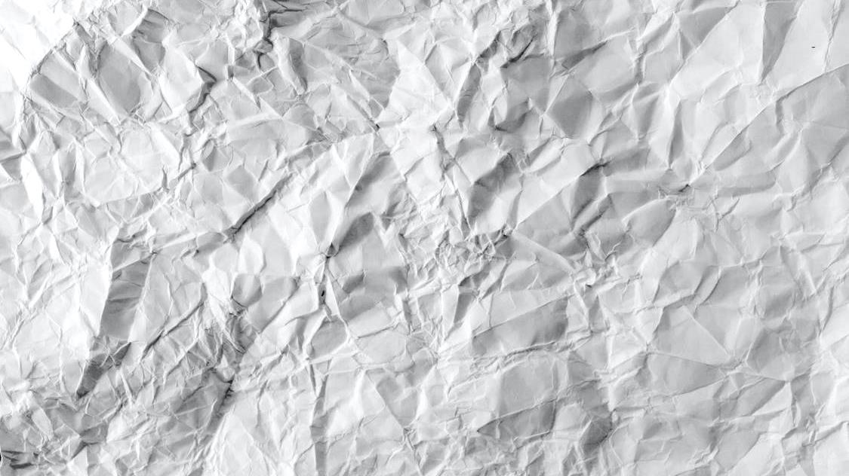
paper
Royalty-free photo sourced from Pexels.

Slide 9
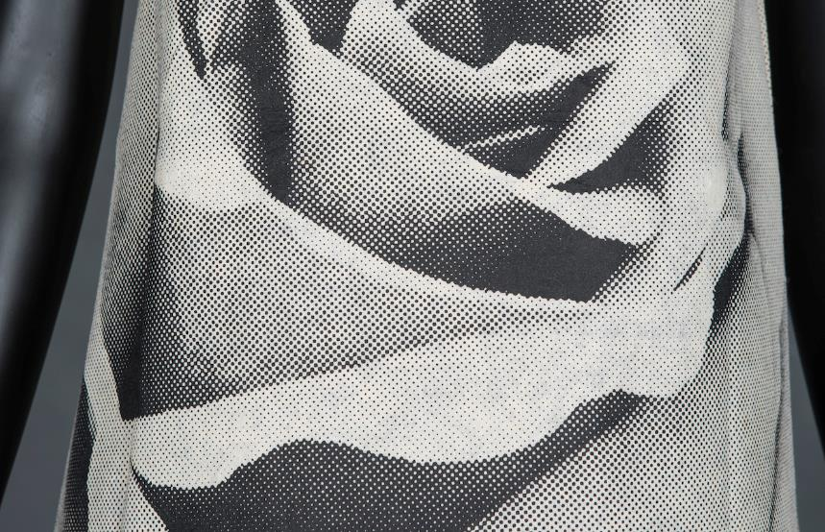
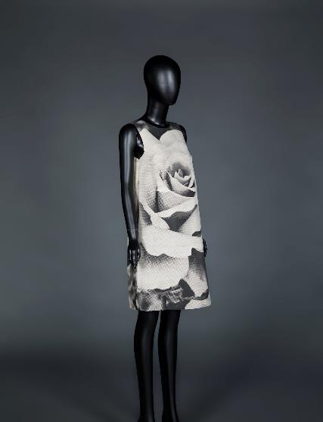
Paper in fashion
Poster dress from HKDI Fashion Archive
In 1968, American graphic artist Harry Gordon fabricated mod-pop “poster dresses” in a series of five different designs.

Slide 10
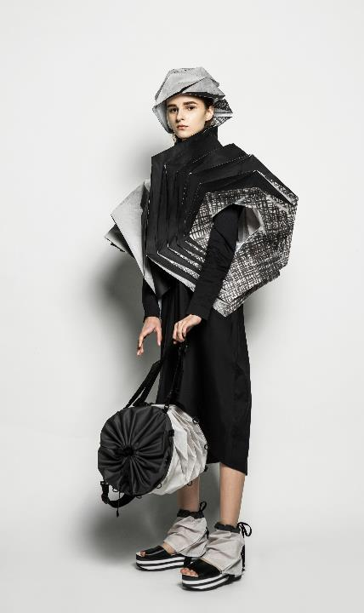
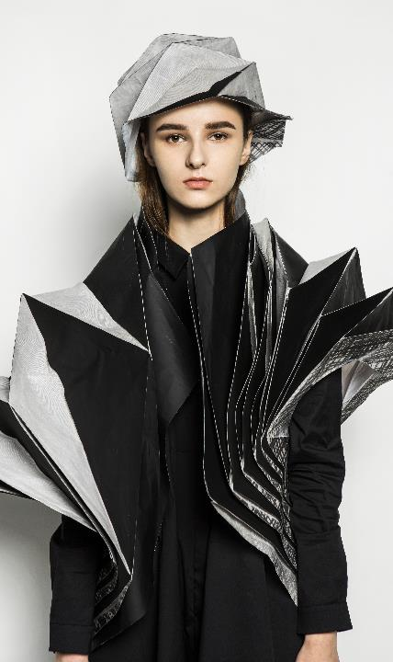
Paper in fashion
Garment and accessory design inspired by traditional paper origami.
Collection by YU Chi Yan, Suzanna 2017 graduate of HD in Fashion Design in Hong Kong Design Institute

Slide 11
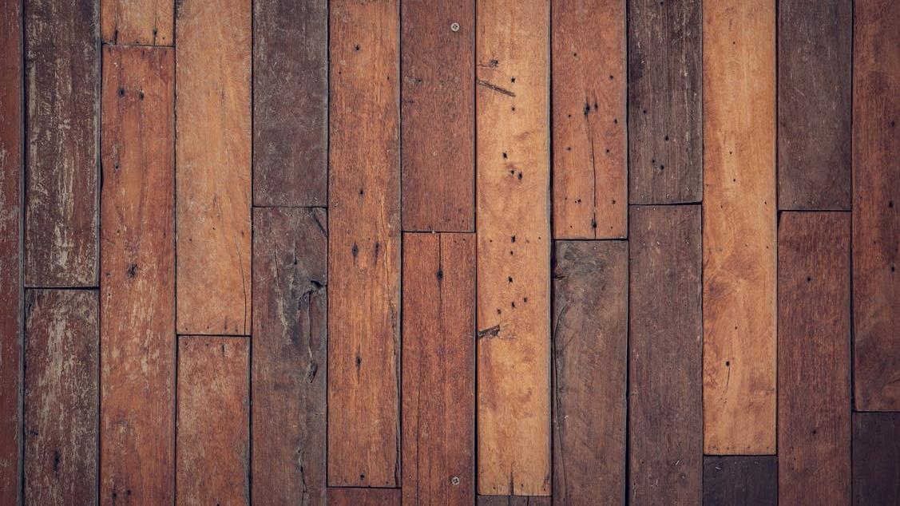
wood
Royalty-free photo sourced from Pexels

Slide 12
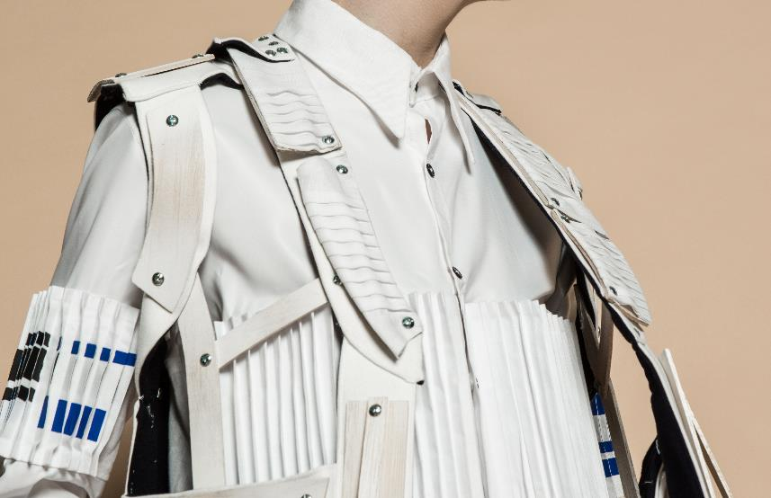
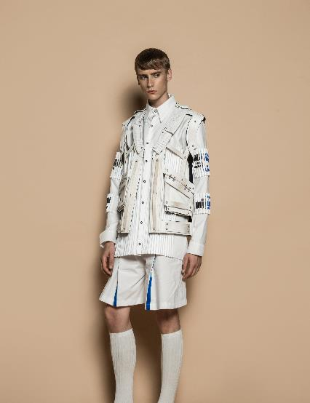
Wood in fashion
Collection by YU Sze Ki, Yusky 2017 graduate of HD in Fashion Design in Hong Kong Design Institute

Slide 13
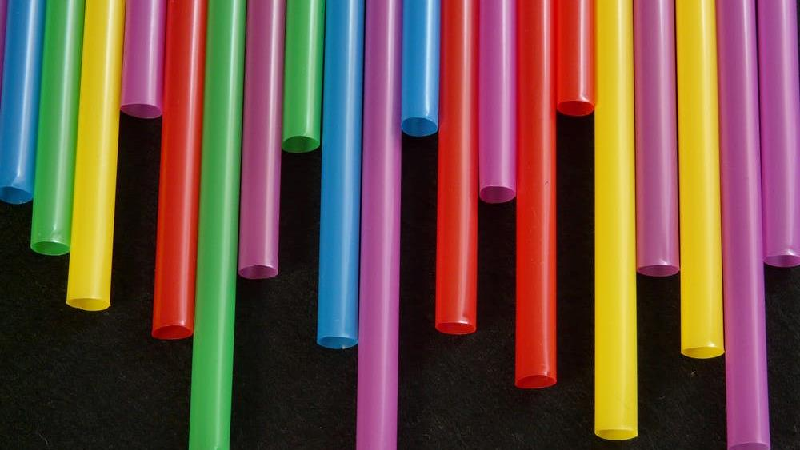
plastic
Royalty-free photo sourced from Pexels

Slide 14
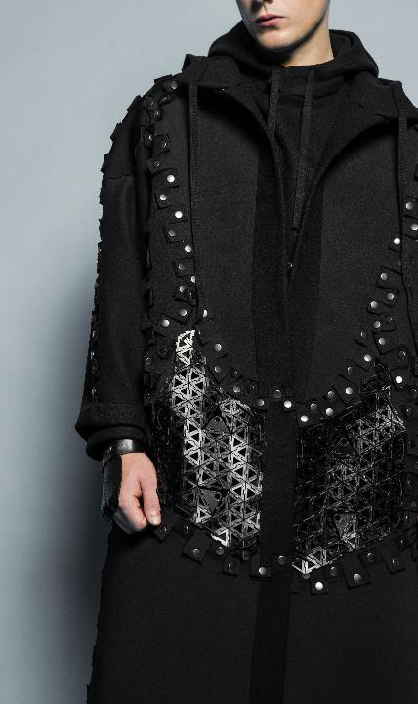
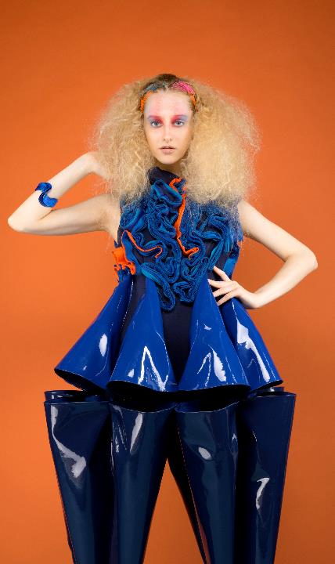
Plastic in fashion
The 3D printed panels provide extra flexibility for the garment.
The stiffness of PVC materials also allow designers to create and mould 3-dimentional shapes.
Left: Collection by CHU Hoi Lam, Daniel 2016 graduate of HD in Fashion Design in Hong Kong Design Institute
Right: Collection by CHU Chun Yee, Daniel 2016 graduate of HD in Fashion Image Design in Hong Kong Design Institute

Slide 15
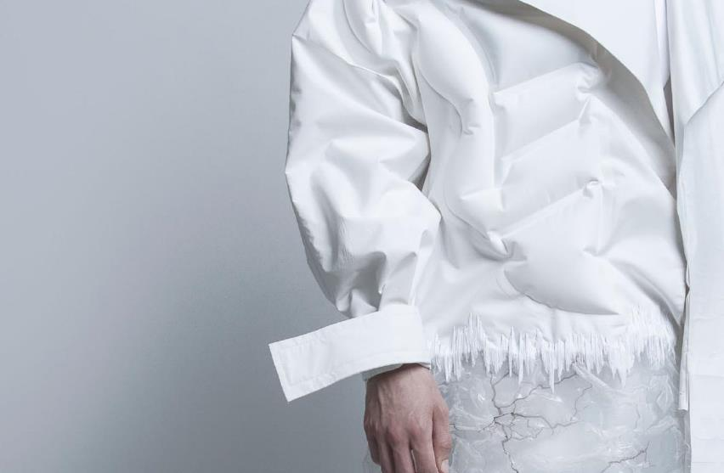
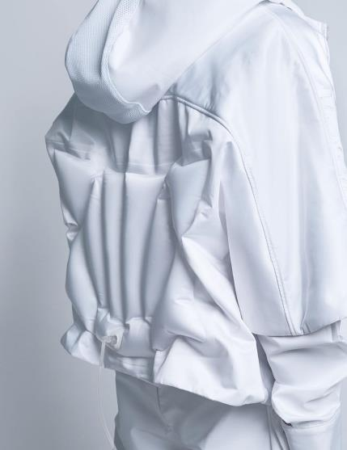
Plastic in fashion
The PVC materials were bonded with inflatable feature, this design provides an extra protection for the wearer while the garment is worn on the body.
Collection by Wilson CHOI 2016 graduate of HD in Fashion Design in Hong Kong Design Institute

Slide 16
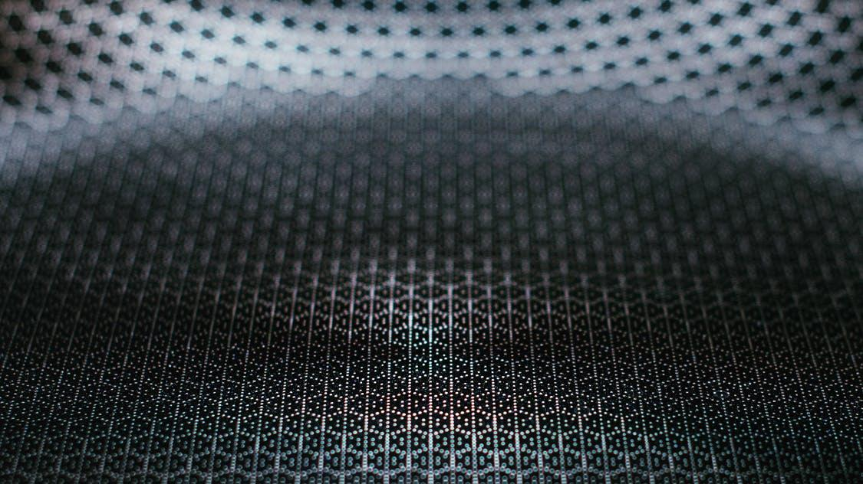
metal
Royalty-free photo sourced from Pexels

Slide 17
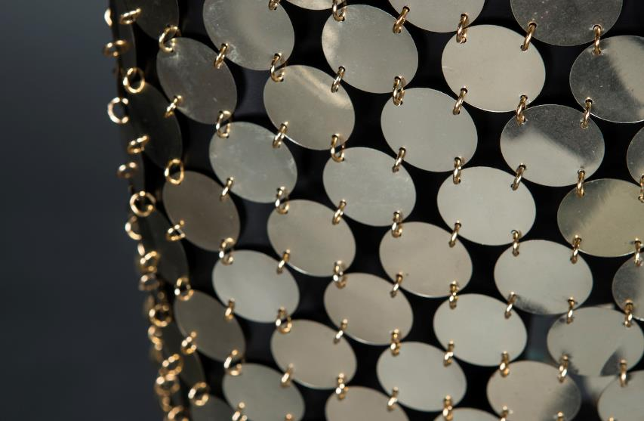
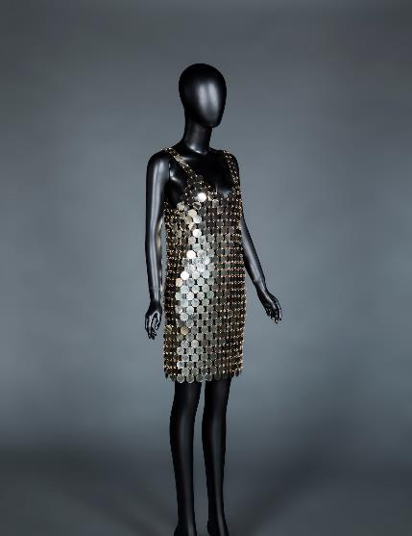
Metal in fashion
Paco Rabanne’s iconic rhodoid disc dress.
Paco Rabanne dress from HKDI Fashion Archive

Slide 18
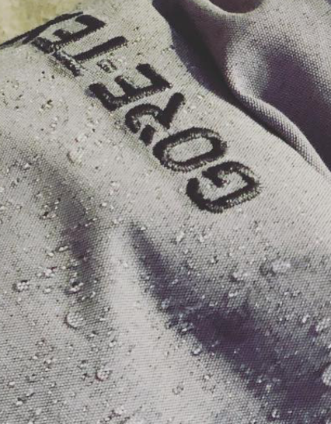

WHAT ARE NEW FABRICS
PERFORMANCE
ECO
RECYCLED
GORE-TEX fabric engineered with patent technology that is water repellent, wind-proof, yet breathable.
Organic cotton is grown without toxic, synthetic chemical inputs. It is more expensive than normal cotton, but has low impact on the environment
Renowned fashion brands began to design products (i.e. sneaker and soccer jersey) with material recycled from plastic bottle
Royalty-free photo sourced from Pexels.

Slide 19
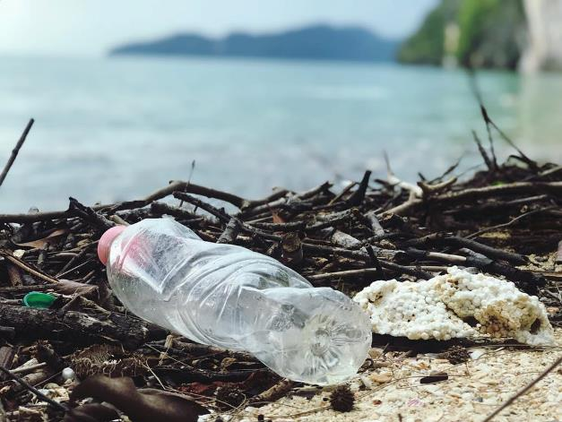

sustainable materials
(recycled)
An American sportswear company introduced a national team kits made using an average of 13 recycled plastic bottles per kit in 2012.
The fabric for the shorts is made with 100 percent recycled polyester, and the jersey fabric for the top is made with approximately 96 percent recycled polyester.
Scan to check:
Company news
Royalty-free photo sourced from Pexels.

Slide 20
Creative materials
A fashion designer known for her 3D printed fashion work, her 3D printed graduate collection made waves in the fashion and tech worlds.
Approach #1
Printing with a known pattern
Approach #2
Printing textiles for draping
Approach #3
Printing parts that can be linked together
3D Printed Textile
Scan to check:
Designer Website

Slide 21

Creative materials
A Dutch fashion designer who is widely recognised as one of fashion’s most talented and forward-thinking creators continuously pushes the boundaries of fashion design.
Since her first show in 2007, she has been preoccupied with inventing new forms and methods of sartorial expression by combining the most traditional and the most radical materials and garment construction methods into her unique aesthetic vision.
Scan to check:
Process film

Slide 22
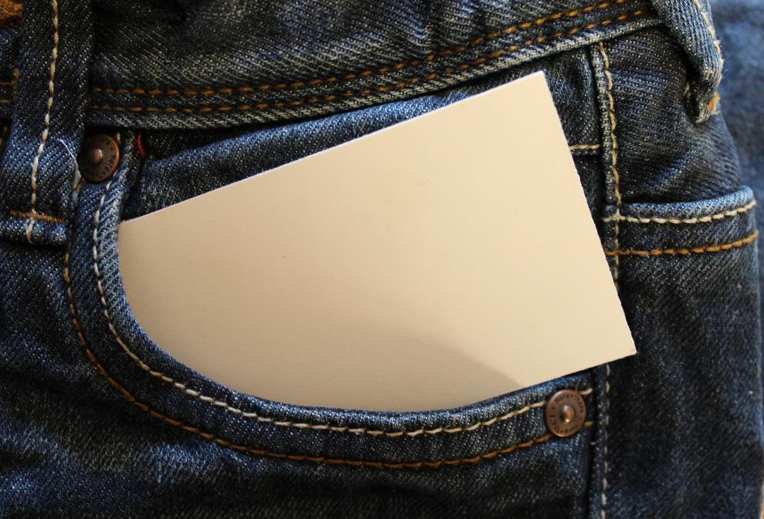
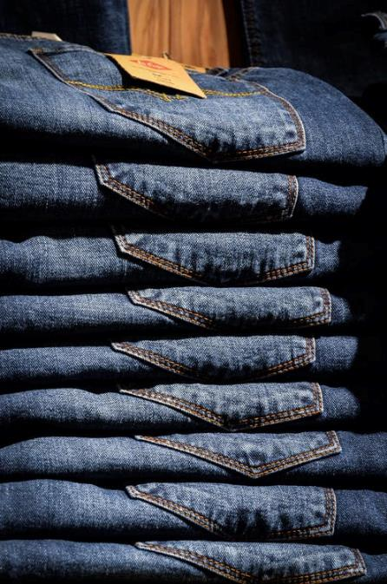
chapter activity
How many types of materials can you identify from a pair of denim jeans?
Royalty-free photo sourced from Pexels.

