Slide 1
fashion design applications
Chapter 2

Slide 2
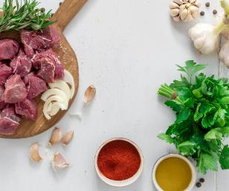
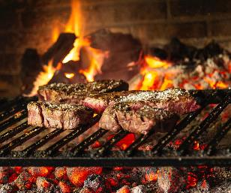
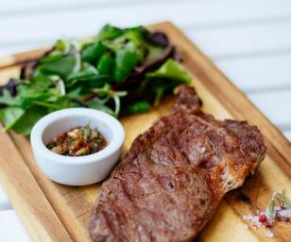
Relationships between
Design Elements & Principles
Elements
Principles
Elements of design are the ingredients used in a cooking recipe while principles are the manner in which the elements combine.
In this chapter, samples of designer collection will be analysed to demonstrate how fashion designers combine design elements and principles together to create an unified design outcome.
Royalty-free photos sourced from Pexels.

Slide 3
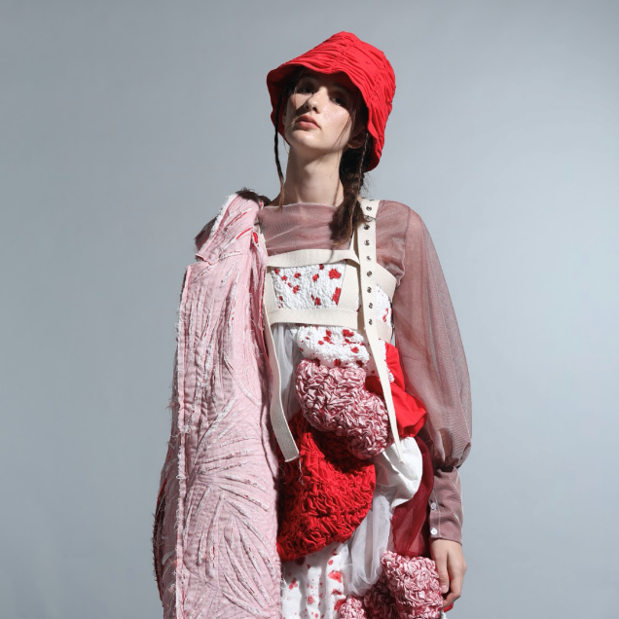
VIOLENCE
Collection by LAI Xiao Ling

Slide 4
Design rationale:
Design inspiration comes from the word ‘Violence’. Design elements of the outfit such as slashing, pleating, blood stains and bondage representing the feelings of the victims who suffered from domestic violence. Through this design, let’s say no to domestic violence.
Design elements | Line | Random curve lines
 | Shape | Irregular
 | Form | Drapey
 | Texture | Textured surface finishing
 | Colour | Warm colour palette
Design principles | Balance | Asymmetrical design
 | Emphasis | Contrasted colours (red and white) & textures
 | Rhythm | Coloured gradation
 | Proportion | Oversized
 | Unity | Monochromatic colour scheme
Collection by LAI Xiao Ling, year 2 student of HD in Fashion Design in Hong Kong Design Institute

Slide 5
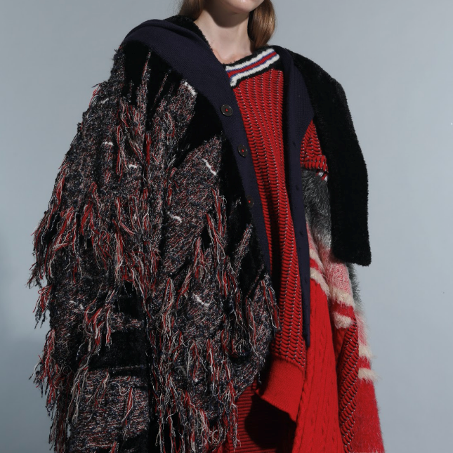
TAN: Fisherman’s ballads
Collection by WONG Hin Yeung

Slide 6
Design rationale:
The ballads of fishermen are one of the forgotten traditional cultures in Hong Kong. Attracted by the application of sustainable aspects and their characteristics, designer used asymmetrical design to express the feeling of freedom, vividness with flexibility. Through the contrast between warm and cool colours, the collection reflects the fishermen’s values and their somewhat sad take on life, death and religious beliefs.
Design elements | Line | Horizontal stripes
 | Shape | Colour blocking
 | Form | Boxy
 | Texture | Knitted and fur
 | Colour | Warm & cool colour palette mixed
Design principles | Balance | Asymmetrical balance of materials
 | Emphasis | Contrasted colours & textures
 | Rhythm | Coloured gradation
 | Proportion | Elongated silhouette
 | Unity | Unified colour and texture palettes
Collection by WONG Hin Yeung, year 2 student of HD in Fashion Design in Hong Kong Design Institute

Slide 7
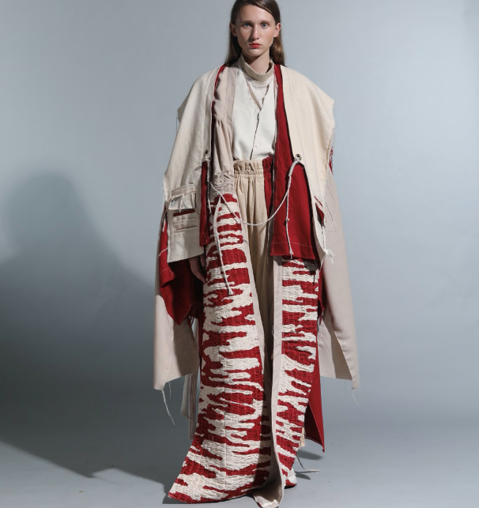
musubi
Collection by CHAN Pui Yi

Slide 8
Design rationale:
Musubi, the Japanese pronunciation of knot has the meaning of connection. This design collection is about the integration of culture into fashion, with emphasis on traditional handicraft details that connect people with the society. Traditional handicrafts and tied techniques such as bundling, weaving and tangling are materialised in this collection. Designer wishes to convey a message of bonding between people of different cultures and to preserve traditional handicraft culture. The silhouette combines ancient and modern styles. Ropes are used to connect different garment parts that change the form of the clothing, drawing people's attention to focus on the details.
Design elements | Line | Grid lines
 | Shape | Rectangular
 | Form | Boxy and layering
 | Texture | Crafted surface finishing
 | Colour | Warm colour palette
Design principles | Balance | Visually balanced design
 | Emphasis | Contrasted colours (red and white) & textures
 | Rhythm | Repetition (lines)
 | Proportion | Loose fitted
 | Unity | Unified texture and finishes
Collection by CHAN Pui Yi, year 2 student of HD in Fashion Design in Hong Kong Design Institute

