Slide 1
Prototype development
Chapter 3

Slide 2
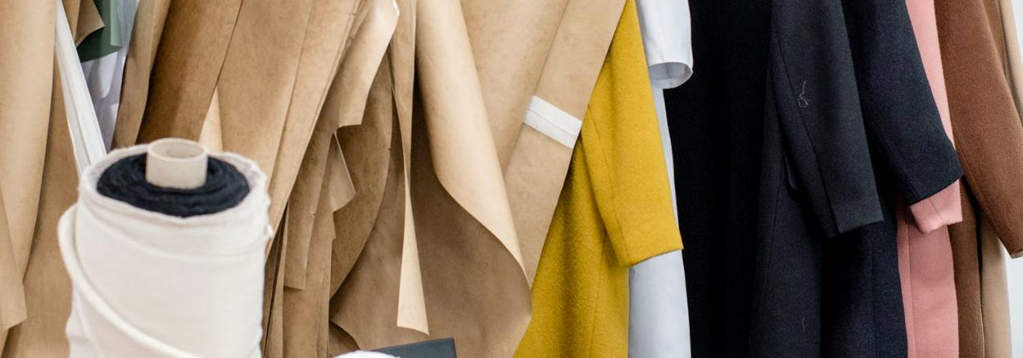
What is a prototype?
Royalty-free photo sourced from Pexels
A prototype is an example of a design style..
The construction should be identical to the specifications intended for the final product.

Slide 3
From Concept(2D) to prototype (3D)
Sizing & measurement
Pattern making
Draping
Sewing
The toile
Fitting & finishing
The prototype sample

Slide 4
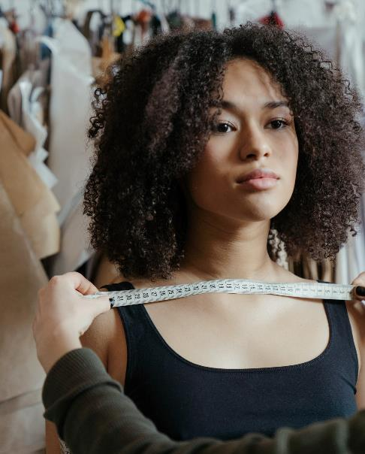
Sizing and measurement
Royalty-free photo sourced from www.pexels.com
Listed below are the main body measurements that are applied to fashion design:
  Bust size
  Waist size
  Hip size
  Nape of neck to waist or hip
  Waist to hip or knee
  Shoulder from the neck point
  Neck to wrist length
  Wrist
  Front and back rise (for trousers/ pants)
  Inside leg measurement
Taking measurement is an important step for creating a prototype sample.
Royalty-free photo sourced from Pexels.

Slide 5
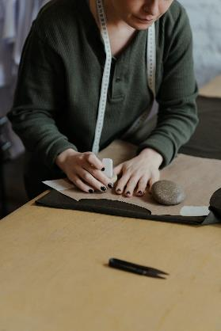
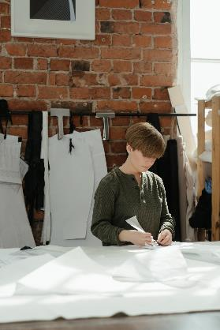
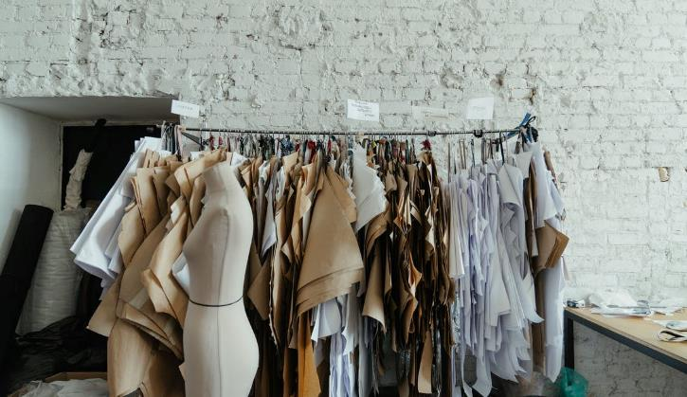
Pattern making
Royalty-free photo sourced from Pexels
Pattern making is the process to translate a 2-dimensional design into a 3-dimensional form.
“Basic Block” is a set of generic flat patterns based on a standard measuring system.
Styled design can be drafted and developed from the basic blocks into a prototype sample.

Slide 6
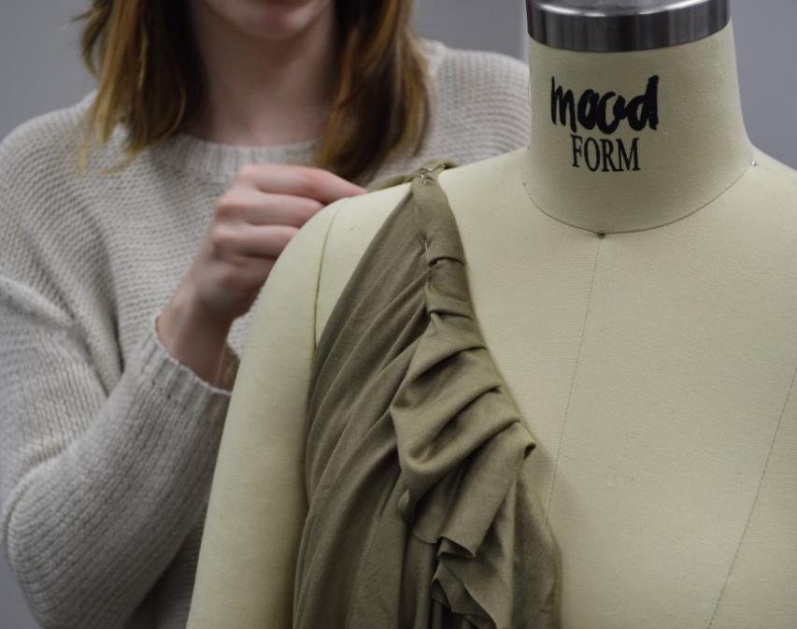
draping
Draping offers an alternative method of creating a pattern by working directly on the dummy with fabric.
It offers a designer the creative experience of exploring the relationship between shape and fit.
Royalty-free photo sourced from Pexels.

Slide 7
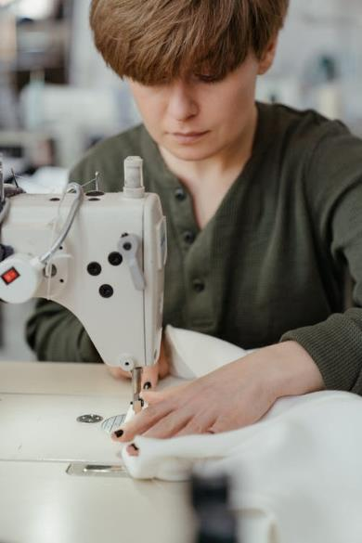
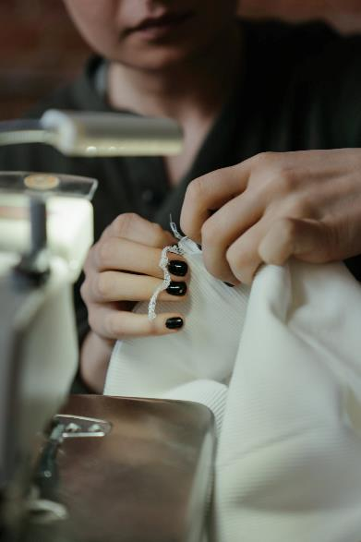
sewing
Sewing involves joining, assembling and stitching fabrics.
Hand sewing covers basting, tacking, hemming and decorative stitch work such as embroidery.
Machine sewing involves operating an industrial or domestic sewing machine.
Royalty-free photo sourced from Pexels

Slide 8
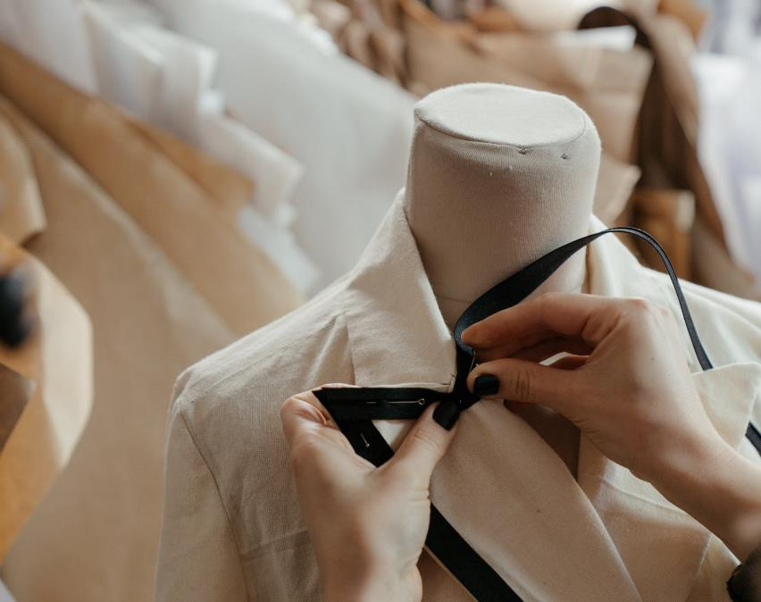
The toile
A toile represents the first version of a design transferred into a fabric.
It helps designer to evaluate the design and to make alterations or modifications before the first sample.
Calico and cotton muslin are the most common materials used for producing toile.
Royalty-free photo sourced from Pexels

Slide 9
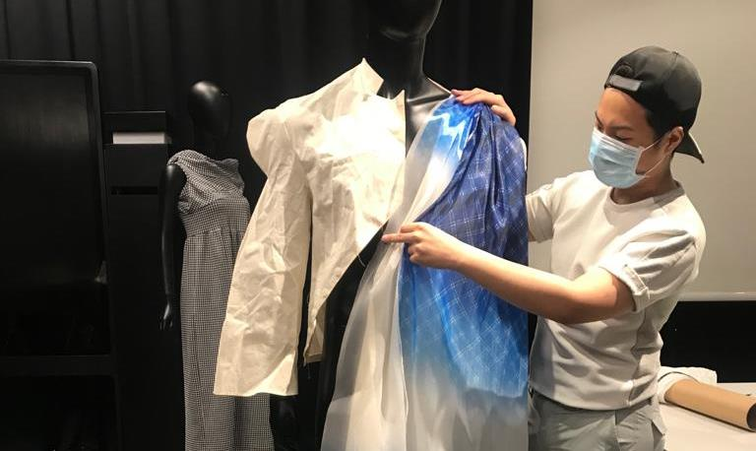
Fitting
Fit refers to how a garment looks and feels..
Photo(s) is/are owned and provided by HKDI

Slide 10
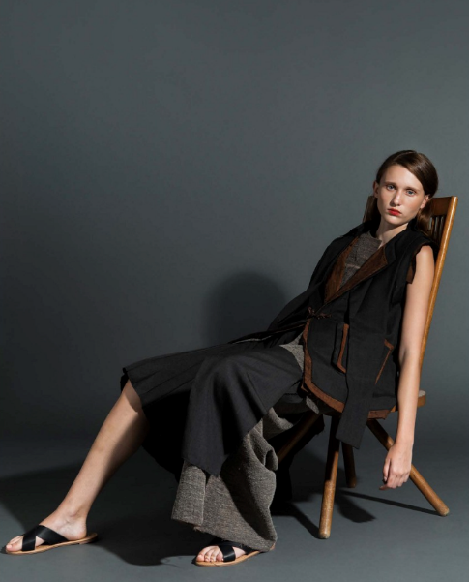
The prototype sample
The prototype sample is the design process presented in garment form.
Collection by CHEN Jaihao, year 2 student of HD in Fashion Design in Hong Kong Design Institute

